Slide 1

An exact method and Heuristic algorithms for single source capacitated facility location problems
Simulação e Otimização | MEI | 2022/2023
João Silva | Olavo Alves | Luís Silva

Slide 2
Introduction
In this presentation, we will approach the SSCFLP with an Exact Method Algorithm, Heuristics and Metaheuristic approach.
Firstly, we will discuss the SSCFLP with some approaches from literature. Our approach is then presented with computational results. Lastly, we compare our results (Optimal Solution and Gap) with the literature.
Óscar Oliveira / Simulação e Otimização (2022/23)
João Silva | Olavo Alves | Luís Silva

Slide 3
The SSCFLP
The SSCFLP is a problem where the goal is to minimize the total cost of opening and assigning customers to facilities from a set of potential locations and a set of customers, while determining which facilities should be opened and which customers should be assigned to each facility.
PN-Hard
Óscar Oliveira / Simulação e Otimização (2022/23)
João Silva | Olavo Alves | Luís Silva

Slide 4
Approaches from literature
Repeated Matching Algorithm (Rönnqvist, M.)
Kernel Search (Guastaroba, G.)
Corridor Method (Caserta, M.)
Dual RAMP (Oliveira, Ó)
Ant Colony Optimization (Kumweang, K.)
Scatter Search (Contreras et. Al)
Óscar Oliveira / Simulação e Otimização (2022/23)
João Silva | Olavo Alves | Luís Silva

Slide 5
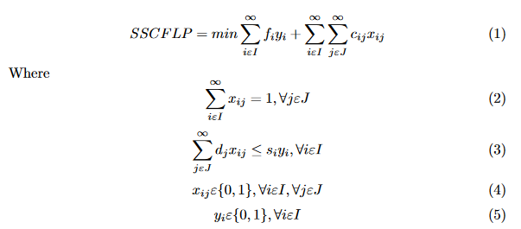
Equation of the problem
It contains the objective function, constraints and decision variables.
Óscar Oliveira / Simulação e Otimização (2022/23)
João Silva | Olavo Alves | Luís Silva

Slide 6
Optimization Problems
Methods for solving combinatorial optimization problems can be divided into two categories: exact methods and approximate methods.
Exact methods guarantee to obtain the optimal solution, only if there is no limit time for its execution and if the computational resources are assured necessary, which for large instances can be totally impractical.
From these conditions, there is a need for methods that can, with less demanding computational tasks and in acceptable times, obtain quality solutions.
Exact Methods
Approximate methods
Óscar Oliveira / Simulação e Otimização (2022/23)
João Silva | Olavo Alves | Luís Silva

Slide 7
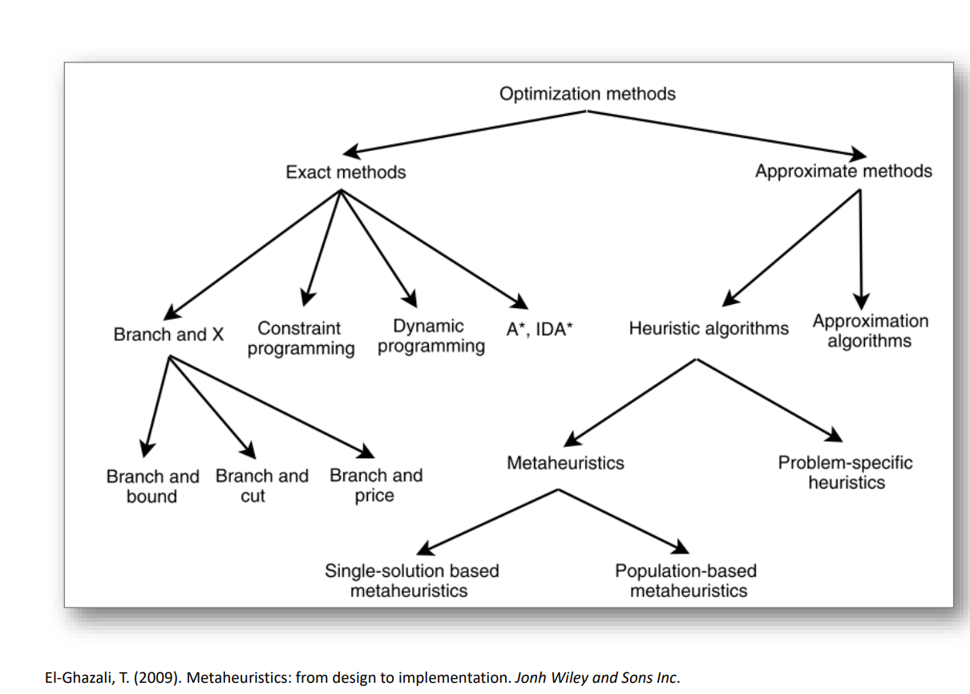
Optimization Methods

Slide 8
Exact Method Algorithm
We decided to approach this problem using an exact method algorithm.
In order to reproduce the equations, we used the OR-Tools Library in Python.
OR-Tools is an open-source software for combinatorial optimization, which seeks to find the best solution to a problem from a very large number of possible solutions.
The solver was used in 5 instances of datasets (Delmaire, Holmberg, OR-library, Yang, TBED1).
Óscar Oliveira / Simulação e Otimização (2022/23)
João Silva | Olavo Alves | Luís Silva

Slide 9
Heuristic
Heuristics are generally less demanding on computational resources than approximation algorithms, but they do not guarantee that the solution obtained is within a range of quality or computational resources needed. Heuristics are also useful for accelerating the convergence of algorithms. Exact optimization typically providing you with a good initial solution.
Heuristic
Constructive
Local Search (Improvement)
Metaheuristic

Slide 10
Constructive Heuristic
Constructive heuristics generate a solution by iteratively adding an element to the solution until an admissible solution is generated.
In the case of the Constructive Heuristic, it was decided to allocate customers to facilities, promoting an allocation criterion based on the lowest ratio between the cost of opening a Facility and the Facility’s initial capacity.
In the case of greedy heuristics, the choice of the next element to be inserted in the solution is done by what most favors the objective of the problem in the time.

Slide 11
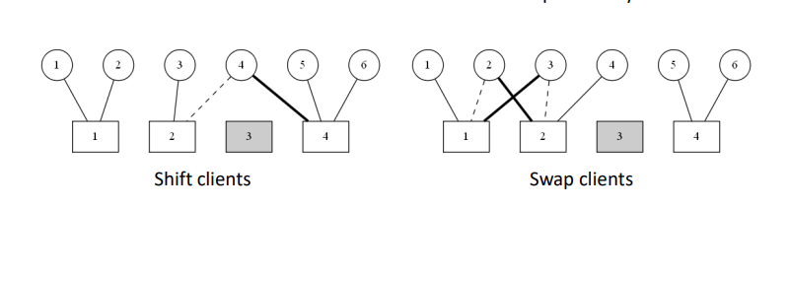
Local Search
Local search (or improvement) heuristics start from a solution and, in each iteration, by exploring the space of neighboring solutions , try to find a solution that is better than the current one.

Slide 12
Grasp
GRASP is a method that works with local improvement procedures and other higher level strategies to create processes capable of escaping from local optima, and performing a robust search of a solution space.
Repeat until element list is empty
Initialize elements
Build RCL
Update Candidate List
Contructed Solution
Randomly choose an element
Update Solution
Óscar Oliveira / Simulação e Otimização (2022/23)
João Silva | Olavo Alves | Luís Silva

Slide 13
Results of the Exact Method
Delmaire (52 OS out of 57)
Holmberg (71 OS out of 71)
OR-Library (9 OS out of 36)
Yang (9 OS out of 20)
TBED1 (0 OS out of 60)
*OS – Optimal Solutions
** Optimal Solutions considered when Z-Z* was 0 or ≈0
Óscar Oliveira / Simulação e Otimização (2022/23)
João Silva | Olavo Alves | Luís Silva

Slide 14
Results of the Heuristic Constructive
Delmaire:
Gap between 6.853 and 69.391 – Mean 29.442
Time(ms) between 0.147 and 0.962 – Mean 0.433
Holmberg:
Gap between 40.570 and 967.445 – Mean 275.177
Time(ms) between 0.386 and 2.273 – Mean 0.857
OR-Library (9 OS out of 36)
Gap between 20.596 and 197.881 – Mean 98.012
Time(ms) between 0.151 and 38.465 – Mean 7.848
Yang (9 OS out of 20)
Gap between 47.066 and 87.332 – Mean 63.852
Time(ms) between 1.459 and 6.131 – Mean 2.978
TBED1 (0 OS out of 60)
Gap between 138.103 and 935.264 – Mean 394.944
Time(ms) between 3.461 and 335.711 – Mean 81.912

Slide 15
Results of the Local Search Shift
Delmaire:
Gap between 5.949 and 49.677 – Mean 20.852
Time(ms) between 0.049 and 0.427 – Mean 0.195
Holmberg:
Gap between 38.231 and 967.445 – Mean 215.618
Time(ms) between 0.070 and 1.045 – Mean 0.376
OR-Library (9 OS out of 36)
Gap between 20.596 and 181.168 – Mean 77.976
Time(ms) between 0.071 and 11.022 – Mean 2.889
Yang (9 OS out of 20)
Gap between 32.868 and 70.159 – Mean 48.246
Time(ms) between 0.571 and 2.791 – Mean 1.300
TBED1 (0 OS out of 60)
Gap between 103.657 and 891.159 – Mean 307.471
Time(ms) between 4.188 and 103.051 – Mean 33.445

Slide 16
Results of the Local Search Swap
Delmaire:
Gap(ms) between 2.165 and 32.991 – Mean 13.307
Time - between 0.113 and 17.235 – Mean 3.505
Holmberg:
Gap - between 22.246 and 796.071 – Mean 139.359
Time - between 1.184 and 164.174 – Mean 32.331
OR-Library (9 OS out of 36)
Gap - between 20.596 and 90.992 – Mean 47.222
Time - between 0.019 and 22156.194 – Mean 3720.548
Yang (9 OS out of 20)
Gap - between 10.054 and 29.627 - Mean 19.652
Time - between 84.428 and 1029.903 – Mean 332.113
TBED1 (0 OS out of 60)
Gap - between 21.465 and 486.662 – Mean 111.792
Time - between 289.036 and 132175.172 – Mean 25223.940

Slide 17
Results of the GRASP – Local Search Shift
Delmaire:
Gap between 1.398 and 34.360 – Mean 14.197
Time between 0.636 and 2.566 – Mean 0.653
Holmberg:
Gap between 2.363 and 113.402 – Mean 34.209
Time between 0.802 and 4.753 – Mean 1.185
OR-Library (9 OS out of 36)
Gap between 3.300 and 57.308 – Mean 24.928
Time between 0.890 and 45.524 – Mean 5.586
Yang (9 OS out of 20)
Gap between 12.349 and 25.308 – Mean 18.722
Time between 3.587 and 21.335 – Mean 10.263
TBED1 (0 OS out of 60)
Gap between 24.413 and 203.048 – Mean 77.911
Time between 152.889 and 27589.182 – Mean 3704.759

Slide 18
Results of the GRASP – Local Search Swap
Delmaire:
Gap - between 0.397 and 36.852 – Mean 13.552
Time - between 0.930 and 5.553 – Mean 1.633
Holmberg:
Gap - between 4.599 and 125.677 – Mean 34.710
Time - between 1.719 and 35.11 – Mean 9.784
OR-Library (9 OS out of 36)
Gap - between 9.029 and 57.308 – Mean 27.207
Time - between 1.810 and 8493.712 – Mean 655.852
Yang (9 OS out of 20)
Gap - between 11.289 and 23.885 – Mean 17.986
Time - between 35.606 and 363.472 – Mean 25.580
TBED1 (0 OS out of 60)
Gap - between 33.776 and 210.352 – Mean 75.948
Time - between 143.401 and 24081.043 – Mean 3501.798

Slide 19
Conclusion
The results were pleasant, some algorithms could only be solved by changing the time limit for the Solver.
Exact Method algorithm uses a ton of resources. Works well in small instances.
Óscar Oliveira / Simulação e Otimização (2022/23)
João Silva | Olavo Alves | Luís Silva

Slide 20
An exact method algorithm for single source capacitated facility location problems
Simulação e Otimização | MEI | 2022/2023
João Silva | Olavo Alves | Luís Silva

