Slide 1

An exact method and Heuristic algorithms for single source capacitated facility location problems
Simulação e Otimização | MEI | 2022/2023
João Silva | Olavo Alves | Luís Silva

Slide 2
Introduction
In this presentation, we will approach the SSCFLP with an Exact Method Algorithm, Heuristics and Metaheuristic approach.
Firstly, we will discuss the SSCFLP with some approaches from literature. Our approach is then presented with computational results. Lastly, we compare our results (Optimal Solution and Gap) with the literature.
Óscar Oliveira / Simulação e Otimização (2022/23)
João Silva | Olavo Alves | Luís Silva

Slide 3
The SSCFLP
The SSCFLP is a problem where the goal is to minimize the total cost of opening and assigning customers to facilities from a set of potential locations and a set of customers, while determining which facilities should be opened and which customers should be assigned to each facility.
Óscar Oliveira / Simulação e Otimização (2022/23)
João Silva | Olavo Alves | Luís Silva

Slide 4
Approaches from literature
Repeated Matching Algorithm (Rönnqvist, M.)
Kernel Search (Guastaroba, G.)
Corridor Method (Caserta, M.)
Dual RAMP (Oliveira, Ó)
Ant Colony Optimization (Kumweang, K.)
Scatter Search (Contreras et. Al)
Óscar Oliveira / Simulação e Otimização (2022/23)
João Silva | Olavo Alves | Luís Silva

Slide 5
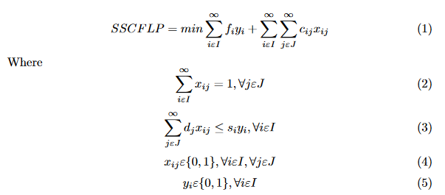
Equation of the problem
It contains the objective function, constraints and decision variables.
Óscar Oliveira / Simulação e Otimização (2022/23)
João Silva | Olavo Alves | Luís Silva

Slide 6
Optimization Problems
Methods for solving combinatorial optimization problems can be divided into two categories: exact methods and approximate methods.
Exact methods guarantee to obtain the optimal solution, only if there is no limit time for its execution and if the computational resources are assured necessary, which for large instances can be totally impractical.
From these conditions, there is a need for methods that can, with less demanding computational tasks and in acceptable times, obtain quality solutions.
Exact Methods
Approximate methods
Óscar Oliveira / Simulação e Otimização (2022/23)
João Silva | Olavo Alves | Luís Silva

Slide 7
Exact Method Algorithm
We decided to approach this problem using an exact method algorithm.
In order to reproduce the equations, we used the OR-Tools Library in Python.
OR-Tools is an open-source software for combinatorial optimization, which seeks to find the best solution to a problem from a very large number of possible solutions.
The solver was used in 5 instances of datasets (Delmaire, Holmberg, OR-library, Yang, TBED1).
Óscar Oliveira / Simulação e Otimização (2022/23)
João Silva | Olavo Alves | Luís Silva

Slide 8
Heuristic
Heuristics are generally less demanding on computational resources than approximation algorithms, but they do not guarantee that the solution obtained is within a range of quality or computational resources needed. Heuristics are also useful for accelerating the convergence of algorithms. Exact optimization typically providing you with a good initial solution.
Heuristic
Constructive
Local Search (Improvement)
Metaheuristic

Slide 9
Constructive Heuristic
Constructive heuristics generate a solution by iteratively adding an element to the solution until an admissible solution is generated.
In the case of the Constructive Heuristic, it was decided to allocate customers to facilities, promoting an allocation criterion based on the lowest ratio between the cost of opening a Facility and the Facility’s initial capacity.
In the case of greedy heuristics, the choice of the next element to be inserted in the solution is done by what most favors the objective of the problem in the time.

Slide 10
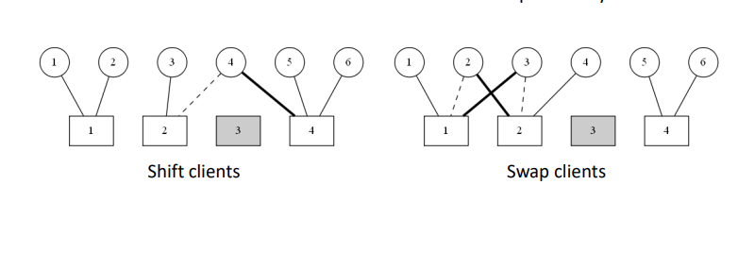
Local Search
Local search (or improvement) heuristics start from a solution and, in each iteration, by exploring the space of neighboring solutions , try to find a solution that is better than the current one.

Slide 11
Grasp
GRASP is a method that works with local improvement procedures and other higher level strategies to create processes capable of escaping from local optima, and performing a robust search of a solution space.
Repeat until element list is empty
Initialize elements
Build RCL
Update Candidate List
Contructed Solution
Randomly choose an element
Update Solution
Óscar Oliveira / Simulação e Otimização (2022/23)
João Silva | Olavo Alves | Luís Silva

Slide 12
Results of the Exact Method
Delmaire (52 OS out of 57)
Holmberg (71 OS out of 71)
OR-Library (9 OS out of 36)
Yang (9 OS out of 20)
TBED1 (0 OS out of 60)
*OS – Optimal Solutions
** Optimal Solutions considered when Z-Z* was 0 or ≈0
Óscar Oliveira / Simulação e Otimização (2022/23)
João Silva | Olavo Alves | Luís Silva

Slide 13
Results of the Heuristic Constructive

Slide 14
Results of the GRASP

Slide 15
Conclusion
The results were pleasant, some algorithms could only be solved by changing the time limit for the Solver.
Exact Method algorithm uses a ton of resources. Works well in small instances.
Óscar Oliveira / Simulação e Otimização (2022/23)
João Silva | Olavo Alves | Luís Silva

Slide 16
An exact method algorithm for single source capacitated facility location problems
Simulação e Otimização | MEI | 2022/2023
João Silva | Olavo Alves | Luís Silva

