Slide 1

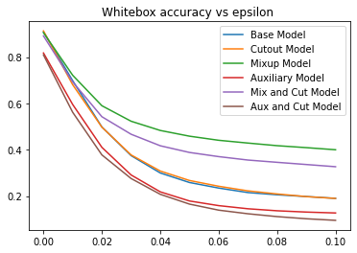
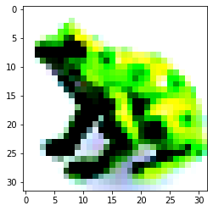
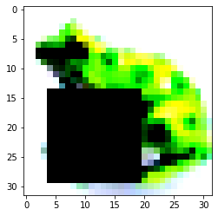
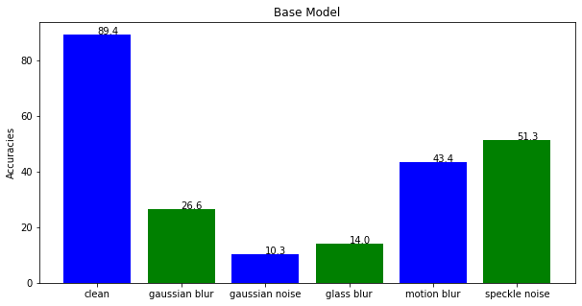
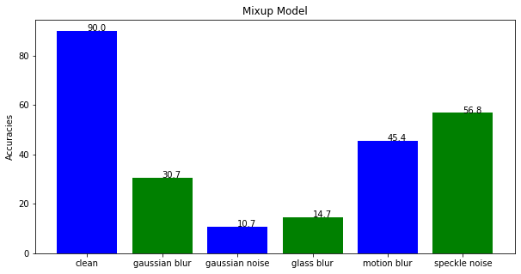

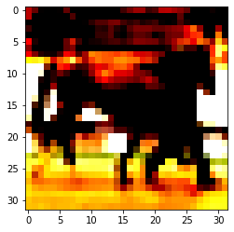
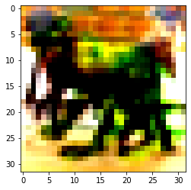

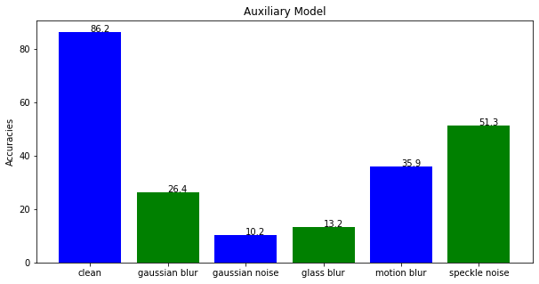
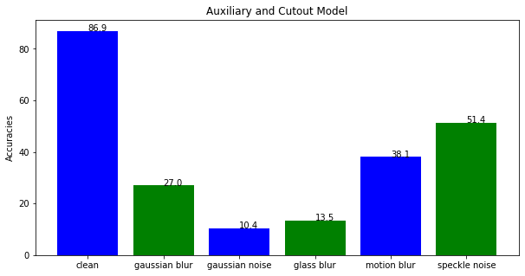

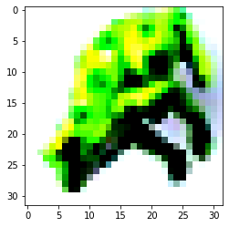
Improved Regularization of CNNs
Luis Pereda Amaya and Julian Stebbins-Sharpless
Motivation
Experimental Results
Convolutional Neural Networks (CNNs) are prone to overfitting to data they are trained on, which leads to a loss in accuracy when classifying unseen data. This can be mitigated by the regularization of your training data, what we examined in this project. We explored three techniques, cut-out, mixup, and self-supervised auxiliary head rotation, and their applicable combinations, on our ResNet-20 architecture to reduce overfitting. Additionally, we considered the applicable combinations of these techniques.
Regularization technique accuracies on clean data
FGSM Whitebox Adversarial Attack
Regularization Technique | Testing Accuracy | Regularization Technique | Testing Accuracy | Regularization Technique | Testing Accuracy
Base | 0.8942 | Mixup | 0.9002 | Mixup + Cutout | 0.8901
Cutout | 0.8944 | Aux. Rotation | 0.8942 | Aux. Rot + Cutout | 0.8695
Methodology
The different models used the same ResNet-20 architecture, and were trained, validated and tested on the same split of the CIFAR-10 dataset. The approach taken was broken into 4 parts: 1) Training
2) Testing on clean data 3) Testing on 5 types of corrupted data
4) Testing against a whitebox FGSM attack.
This table documents the highest accuracies the models produced with the considered regularization techniques, and their applicable combinations. Many of these models used additional data augmentation techniques to improve generalization. Thus hyper parameter sweeps with these techniques had a muted effect on the accuracy as the supplementary techniques result in similar experimental accuracies. Hyper parameter sweeps are explored further in the paper.
Cutout
The cutout technique regularizes a CNN by removing contiguous squares from the training images, causing the CNN to learn underlying abstractions present in images rather than specific elements in the training set.
These regularization techniques provide the models with a relative degree of robustness against whitebox FGSM attacks, despite the model not being adversarially trained. This is a promising result, as the combination of mixup with adversarial training should be expected to perform relatively robustly. In conclusion, these techniques help us to avoid overfitting, and improve the robustness of our model to potential attacks. Looking forward, the intersection of mixup and adversarial training seems promising to address potential attacks.
Robustness against varied image corruptions
The models were tested with 5 kinds of image corruptions:
1) Gaussian Blur 2) Gaussian Noise 3) Glass Blur 4) Motion Blur 5) Speckle Noise
Mixup
Mixup considers the weighted linear combination of two images in training incentivizing the neural network to favor linear behavior in-between training examples
References and Acknowledgments
We would like to say thank you to Dr. Chen and all the TAs who have helped us along the way, and in particular, we would like to say a special thank you to Matt And Xueying for taking time to help us out with difficult questions and debugging.
DeVries, T., & Taylor, G. W. (2017). Improved regularization of convolutional neural networks with cutout. arXiv preprint arXiv:1708.04552.
Hongyi Zhang, Moustapha Cissé, Yann N. Dauphin, David Lopez-Paz:
mixup: Beyond Empirical Risk Minimization. ICLR (Poster) 2018
Dan Hendrycks, Mantas Mazeika, Saurav Kadavath, Dawn Song:
Using Self-Supervised Learning Can Improve Model Robustness and Uncertainty. NeurIPS 2019
He, K., Zhang, X., Ren, S., & Sun, J. (2016). Deep residual learning for image recognition.
In Proceedings of the IEEE conference on computer vision and pattern recognition (pp. 770-778).
https://github.com/bethgelab/imagecorruptions
Goodfellow, I. J., Shlens, J., & Szegedy, C. (2014). Explaining and harnessing adversarial examples. arXiv preprint arXiv:1412.6572.
This utilizes a rotation head in the neural network, and whose loss is considered when optimizing the weights. Thus the loss is the weighted sum of the classification and rotation head losses.
Self-supervised learning with auxiliary head rotation

