Slide 1

Apresentação INTERMÉDIA
Picand Go
Desenvolvimento Web Multimédia
18458 João Antunes - 18446 Luís Pereira - 18450 Rui Pinto

Slide 2
TÓPICOS ABORDADOS
Product Backlog
Sprint Backlog
Labels
Milestones
Issues
GitHub Projects
GitHub Pages
GitHub Actions
Back-end
Front-end

Slide 3
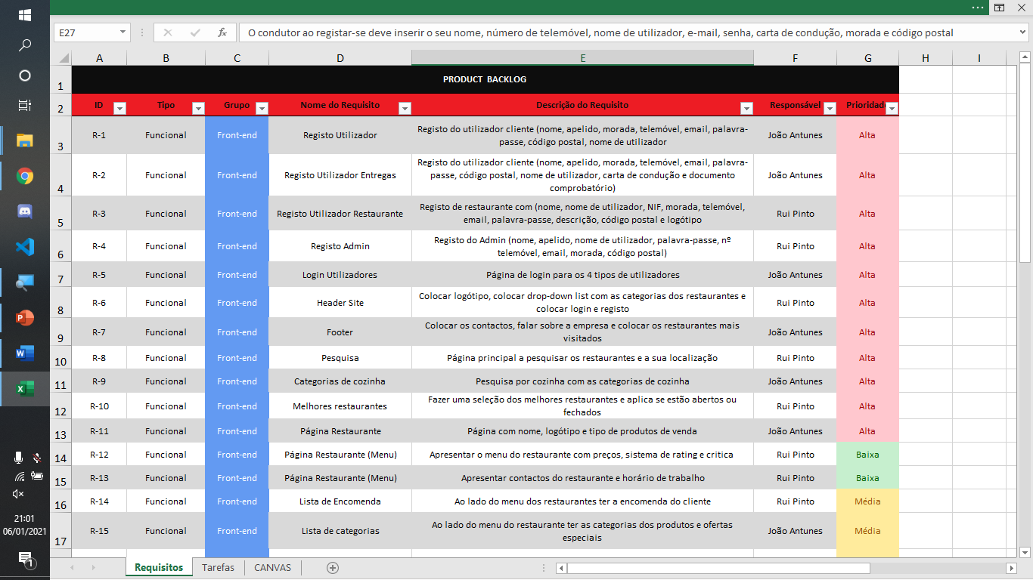
Product Backlog

Slide 4
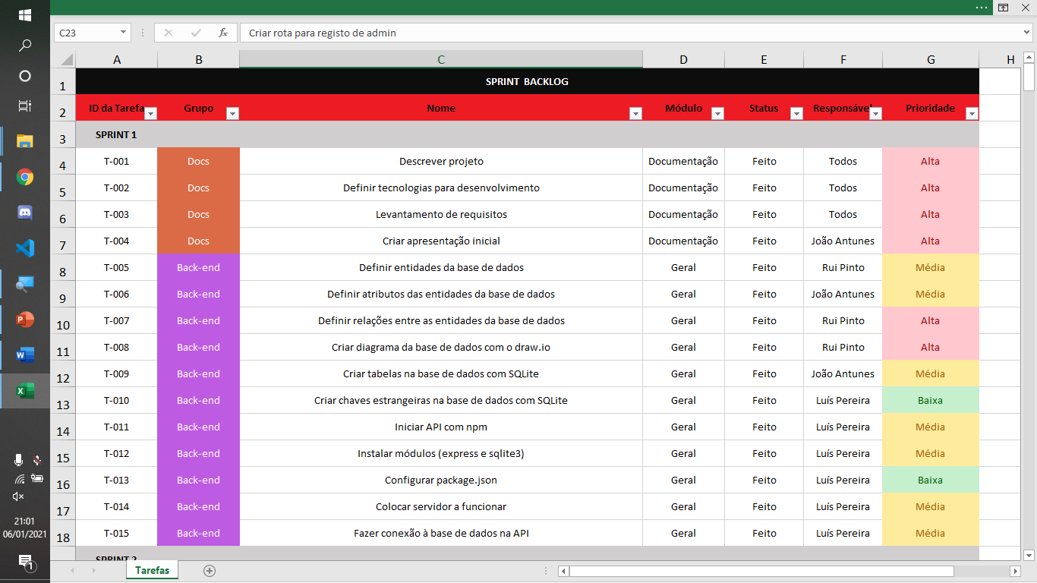
SPRINT Backlog

Slide 5
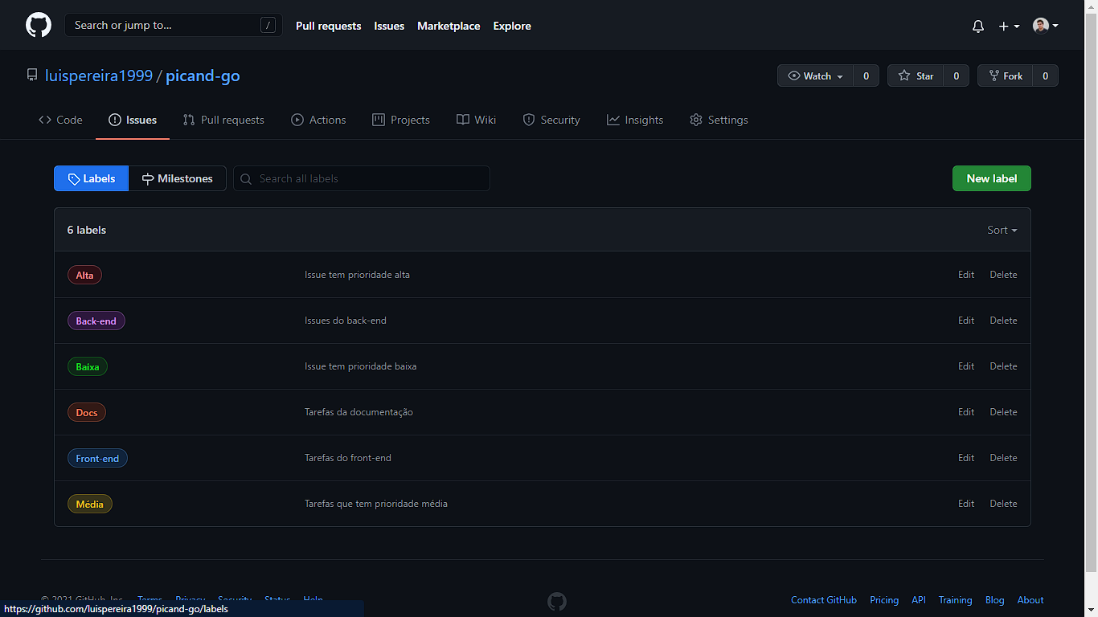
LABELS

Slide 6
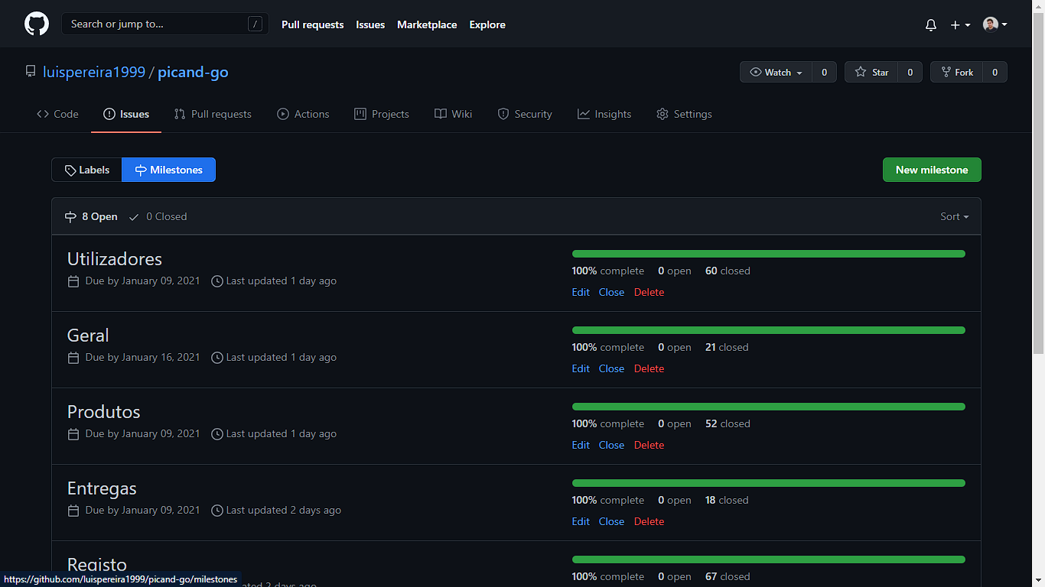
Milestones

Slide 7
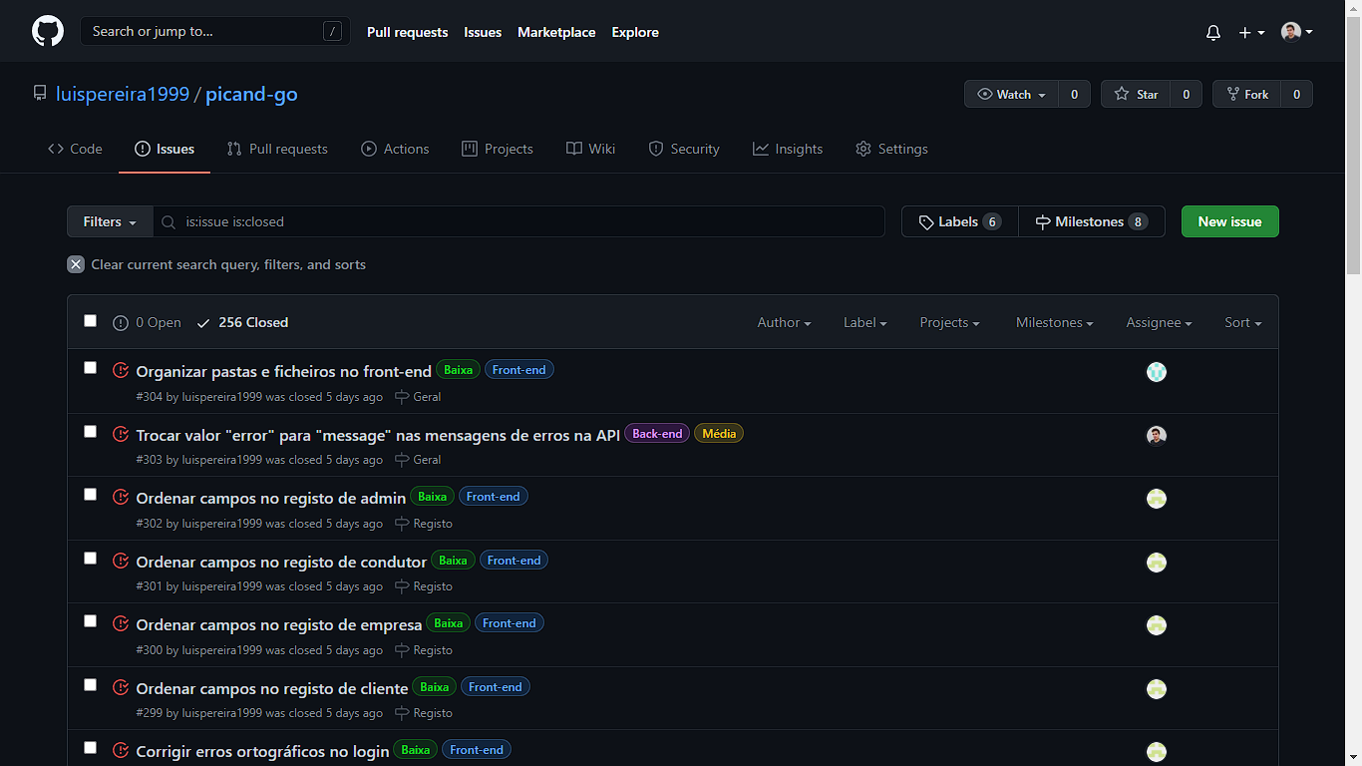
ISSUES

Slide 8
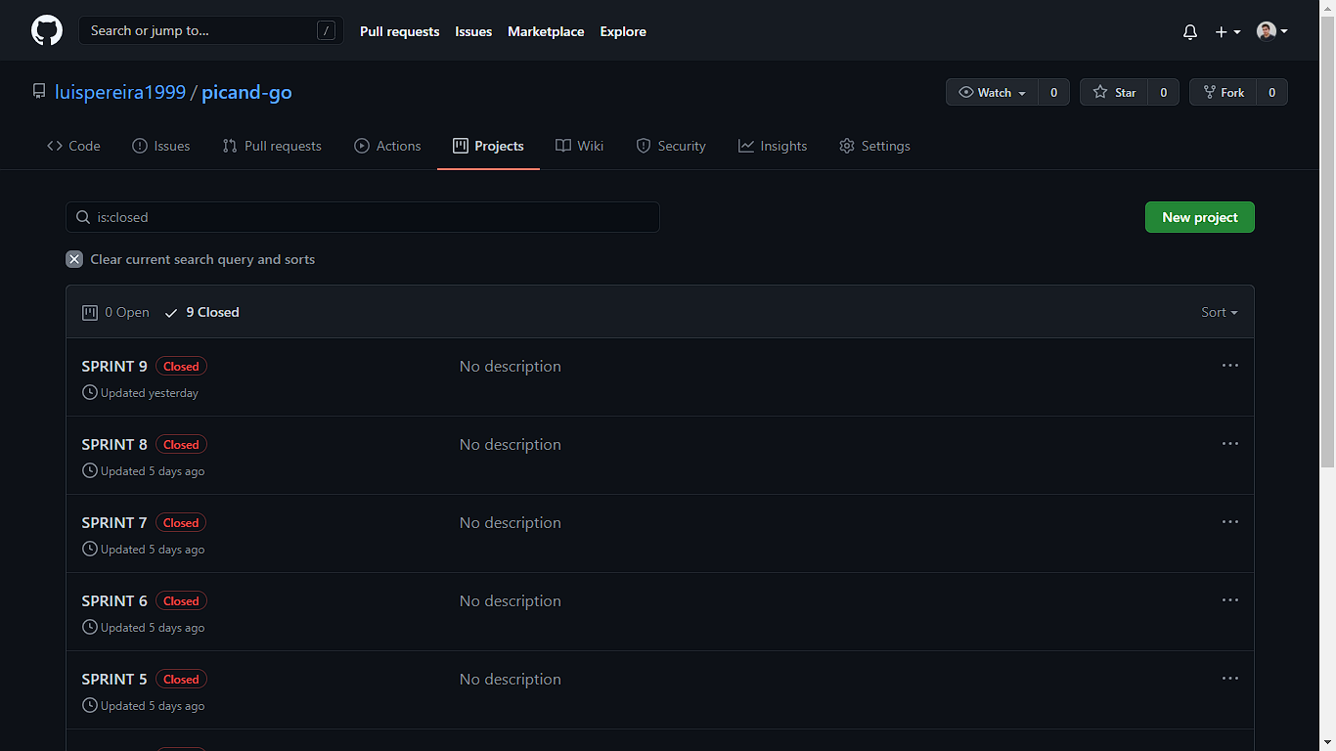
GITHUB PROJECTS

Slide 9
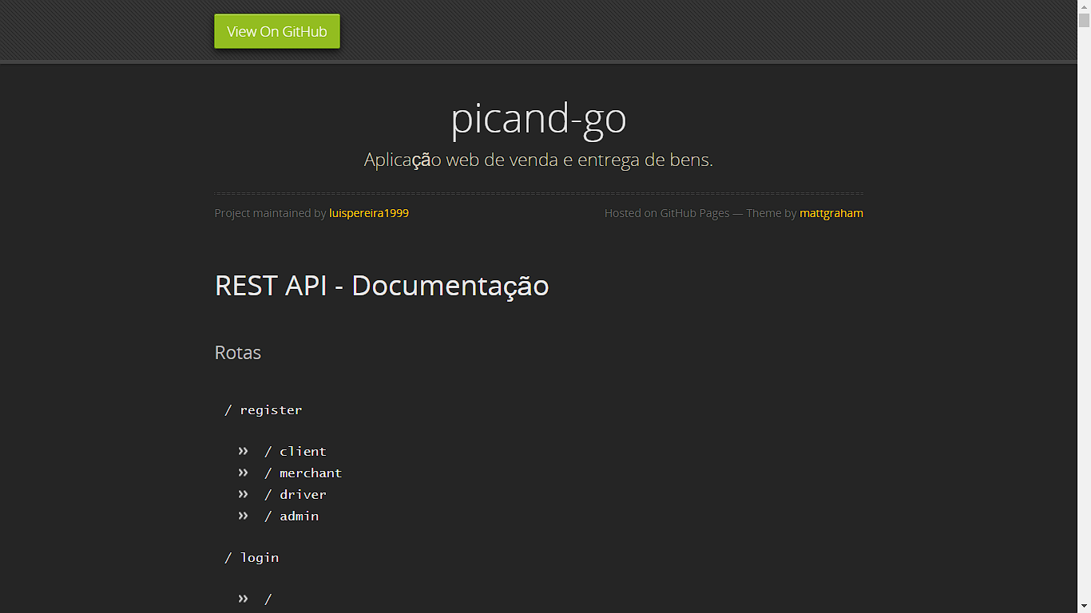
GitHub Pages

Slide 10
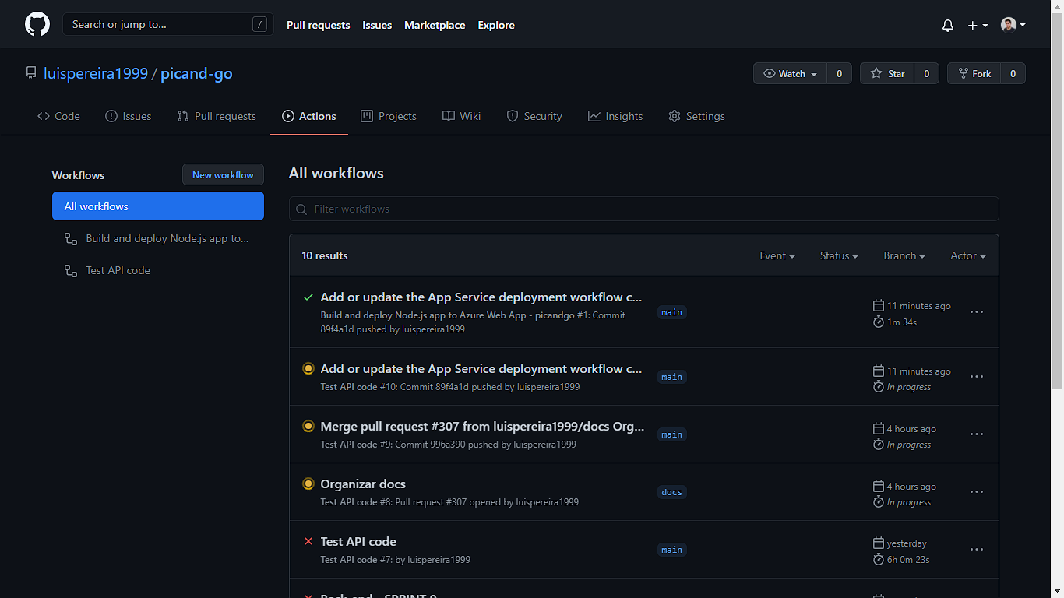
GitHub Actions

Slide 11
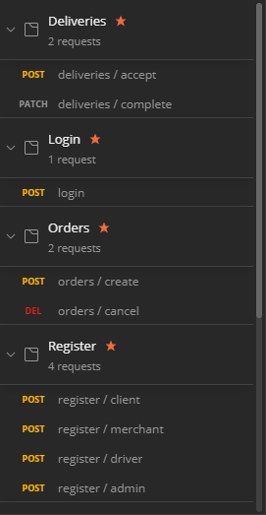
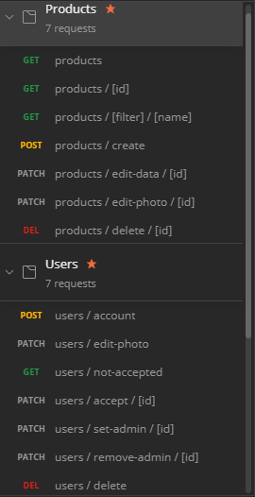
BACK-END

Slide 12
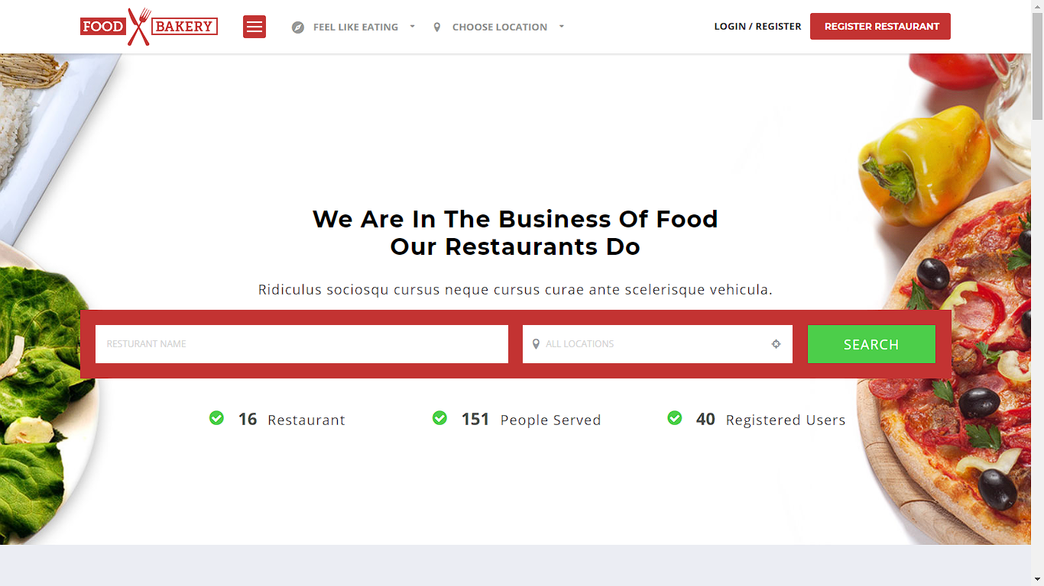
FRONT-END

Slide 13
REFERÊNCIAS
https://github.com/luispereira1999/picand-go
https://luispereira1999.github.io/picand-go
https://picandgo.azurewebsites.net

