Slide 1
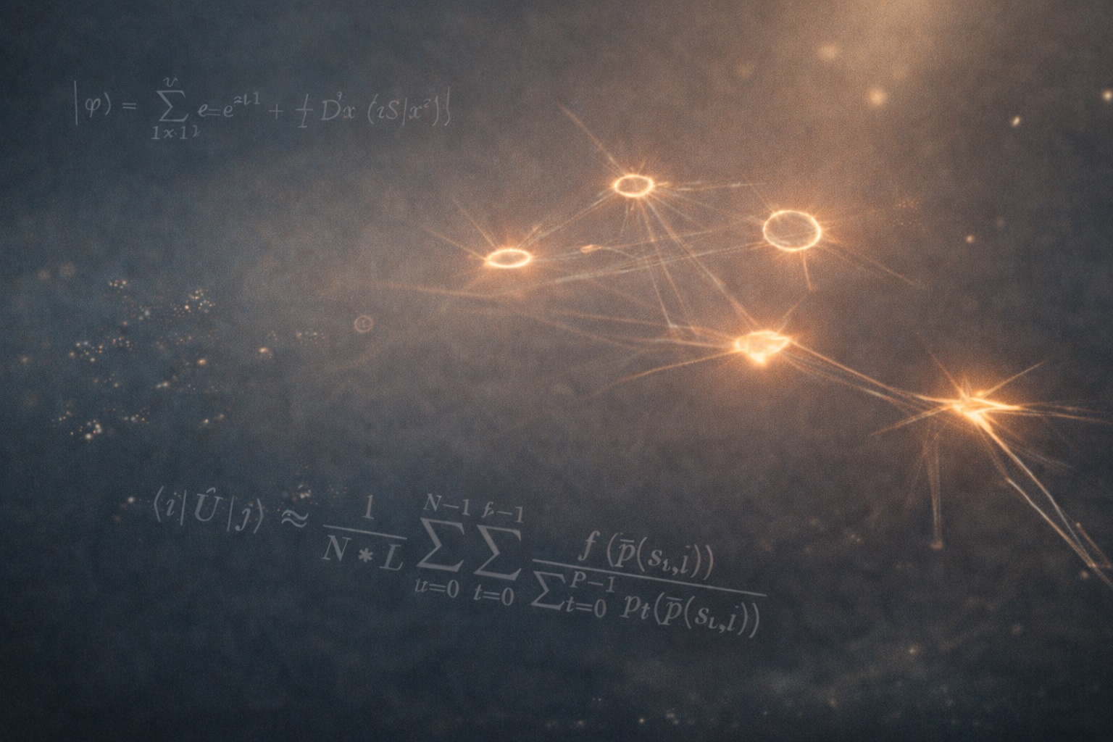


From Light Paths
to
Feynman Paths
Luís Paulo Peixoto dos Santos
March, 2026
Habilitation in Informatics

Slide 2
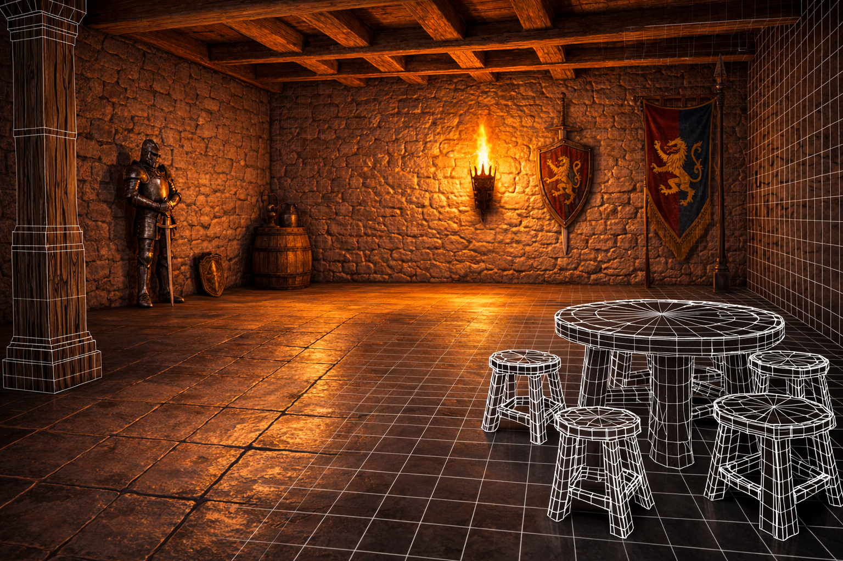
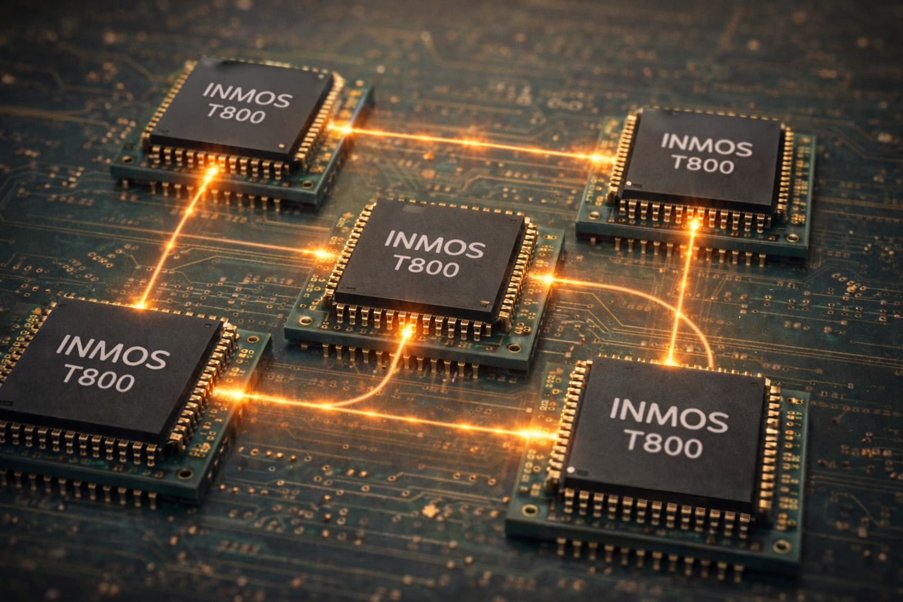
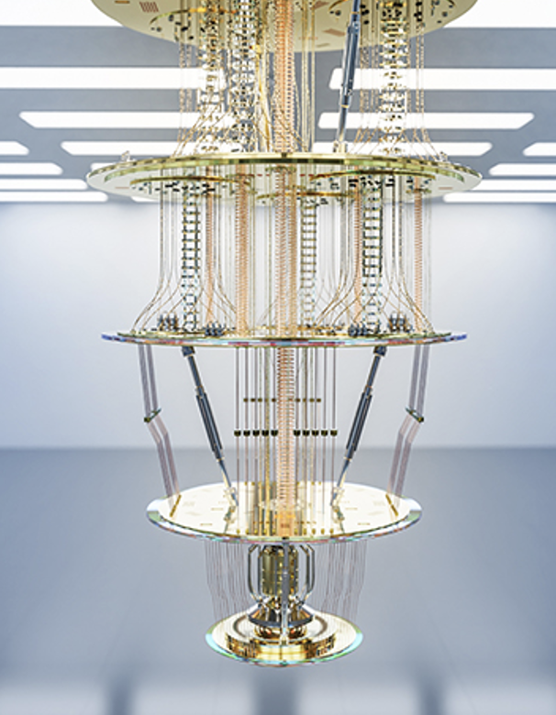
Through the years
Parallel Processing
Global Illumination
1990
2001
Quantum Computing
2016

Slide 3
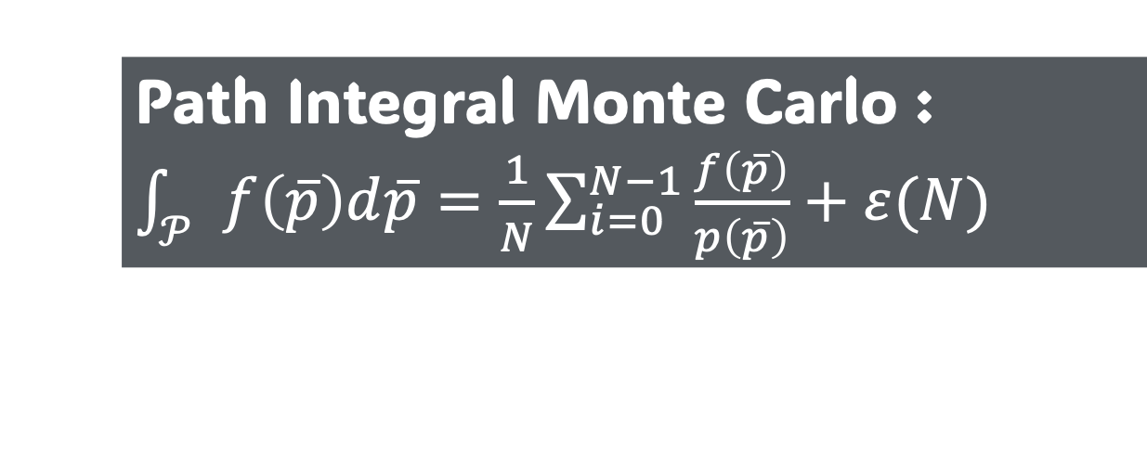
Lesson object
Early quest to understand
Physically Based Global Illumination
possible connections between
light paths to
existing paths from
and
Path Integral Monte Carlo : $\int_{𝒫}{f\left(\overline{p}\right)d\overline{p}}=\frac{1}{N}\sum_{i=0}^{N−1}{\frac{f\left(\overline{p}\right)}{p\left(\overline{p}\right)}}+ε(N)$
Quantum Computing
Feynman paths

Slide 4
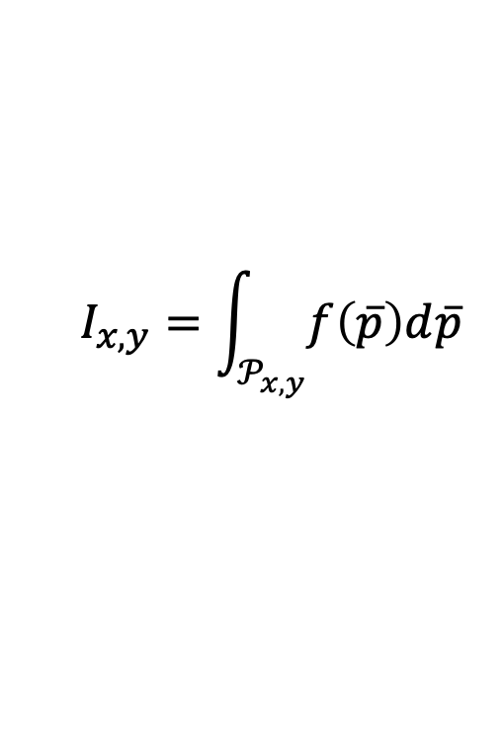
Global Illumination
🎥
$$I_{x,y}=\int_{𝒫_{x,y}}{f\left(\overline{p}\right)d\overline{p}}$$

Slide 5

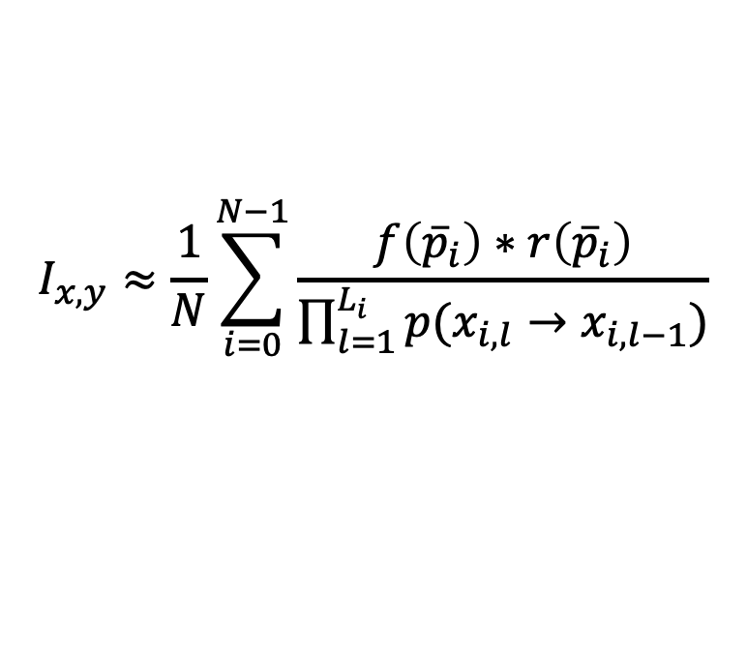





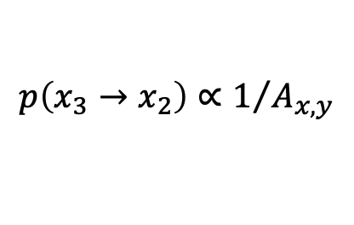
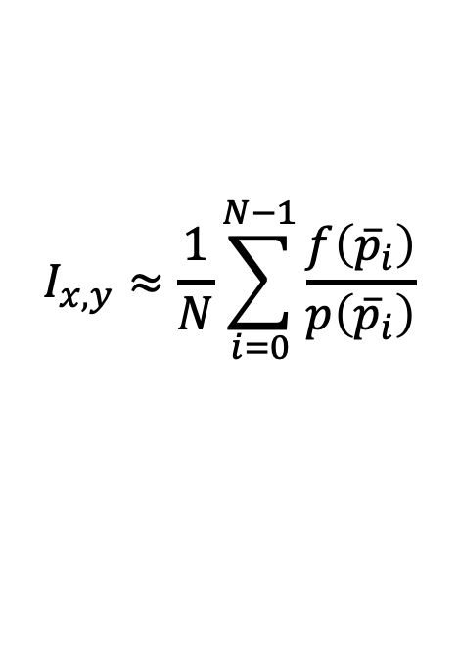
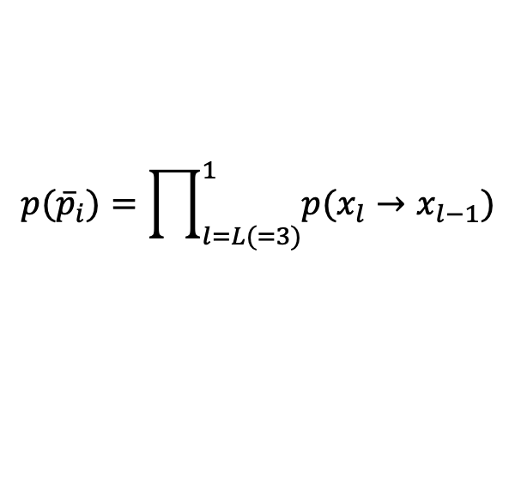

Monte Carlo
$$x_{0}$$
🎥
$$x_{1}$$
$$x_{3}$$
$$x_{2}$$
$$I_{x,y}≈\frac{1}{N}\sum_{i=0}^{N−1}{\frac{f\left({\overline{p}}_{i}\right)}{p\left({\overline{p}}_{i}\right)}}$$
$${\overline{p}}_{i}=\left(x_{3},x_{2},x_{1},x_{0}\right)$$
$$p\left(x_{3}→x_{2}\right)∝1/{A_{x,y}}$$
$$I_{x,y}≈\frac{1}{N}\sum_{i=0}^{N−1}{\frac{f\left({\overline{p}}_{i}\right)∗r\left({\overline{p}}_{i}\right)}{\prod_{l=1}^{L_{i}}{p(x_{i,l}→x_{i,l−1})}}}$$
$$p({\overline{p}}_{i})=\prod_{l=L(=3)}^{1}{p(x_{l}→x_{l−1})}$$
$$p\left(x_{2}→x_{1}\right)∝BRDF(x_{2})$$
$$p\left(x_{!}→x_{0}\right)∝1$$

Slide 6


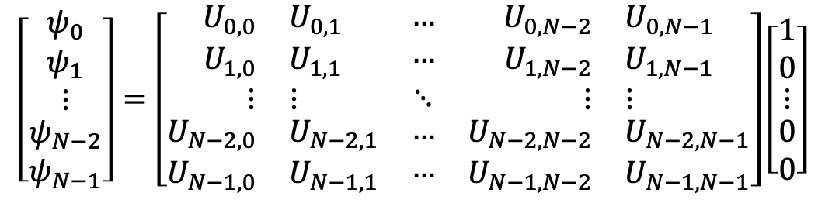
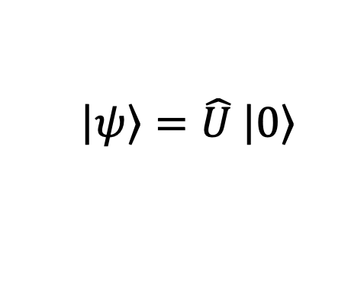
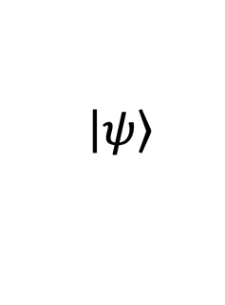
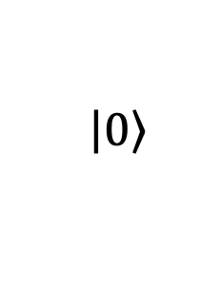
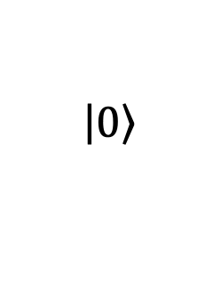

Classical Simulation of Quantum Circuits
$$\left.\left|ψ\right.\right\rangle =\hat{U} \left.\left|0\right.\right\rangle$$
$$\left.\left|0\right.\right\rangle$$
$$\hat{U}$$
$$\left[\begin{matrix}\begin{matrix}ψ_{0} \\ ψ_{1}\end{matrix} \\ ⋮ \\ \begin{matrix}ψ_{N−2} \\ ψ_{N−1}\end{matrix}\end{matrix}\right]=\left[\begin{matrix}\begin{matrix}\begin{matrix}U_{0,0} & U_{0,1}\end{matrix} \\ \begin{matrix}U_{1,0} & U_{1,1}\end{matrix}\end{matrix} & \begin{matrix}… \\ …\end{matrix} & \begin{matrix}\begin{matrix}U_{0,N−2} & U_{0,N−1}\end{matrix} \\ \begin{matrix}U_{1,N−2} & U_{1,N−1}\end{matrix}\end{matrix} \\ \begin{matrix}⋮ & ⋮\end{matrix} & ⋱ & \begin{matrix}⋮ & ⋮\end{matrix} \\ \begin{matrix}\begin{matrix}U_{N−2,0} & U_{N−2,1}\end{matrix} \\ \begin{matrix}U_{N−1,0} & U_{N−1,1}\end{matrix}\end{matrix} & \begin{matrix}… \\ …\end{matrix} & \begin{matrix}\begin{matrix}U_{N−2,N−2} & U_{N−2,N−1}\end{matrix} \\ \begin{matrix}U_{N−1,N−2} & U_{N−1,N−1}\end{matrix}\end{matrix}\end{matrix}\right]\left[\begin{matrix}\begin{matrix}1 \\ 0\end{matrix} \\ ⋮ \\ \begin{matrix}0 \\ 0\end{matrix}\end{matrix}\right]$$
n qubits
$$\left.\left|0\right.\right\rangle$$
$$\left.\left|ψ\right.\right\rangle$$
$N=2^{n}$ rows
$$\left.\left|0\right.\right\rangle$$
$N=2^{n}$ columns
Schrödinger picture: $𝒪\left(2^{n}\right)$ time and space exponential complexity

Slide 7

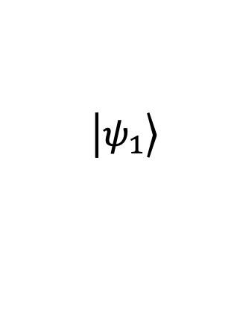
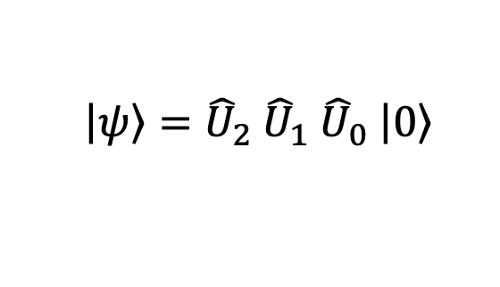
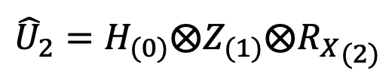



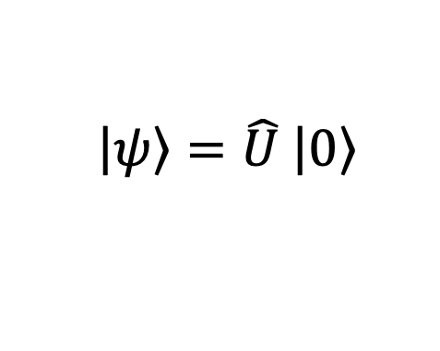

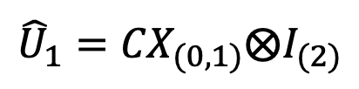

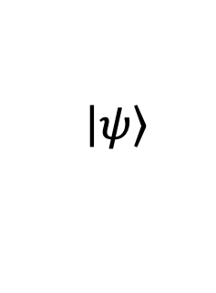


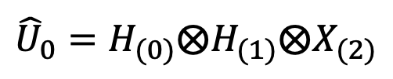

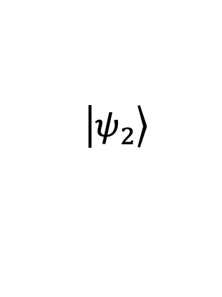
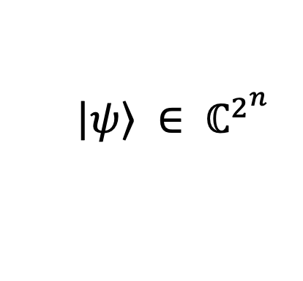
Classical Simulation of Quantum Circuits
$${\hat{U}}_{0}$$
$${\hat{U}}_{1}$$
$${\hat{U}}_{2}$$
$$\left.\left|ψ\right.\right\rangle =\hat{U} \left.\left|0\right.\right\rangle$$
$$\left.\left|ψ\right.\right\rangle ={\hat{U}}_{2} {\hat{U}}_{1} {\hat{U}}_{0} \left.\left|0\right.\right\rangle$$
$$\left.\left|0\right.\right\rangle$$
$$H$$
$$H$$
$${\hat{U}}_{0}=H_{(0)}⨂H_{(1)}⨂X_{(2)}$$
$${\hat{U}}_{1}={CX}_{(0,1)}⨂I_{(2)}$$
n qubits
$$\left.\left|0\right.\right\rangle$$
$$H$$
$$Z$$
$$\left.\left|ψ\right.\right\rangle$$
$${\hat{U}}_{2}=H_{(0)}⨂Z_{(1)}⨂{R_{X}}_{(2)}$$
$$\left.\left|0\right.\right\rangle$$
$$X$$
$$R_{X}$$
$$\left.\left|ψ_{1}\right.\right\rangle$$
$$\left.\left|ψ_{2}\right.\right\rangle$$
$$\left.\left|ψ\right.\right\rangle ∈ ℂ^{2^{n}}$$
Schrödinger picture: $𝒪\left(2^{n}\right)$ time and space exponential complexity

Slide 8

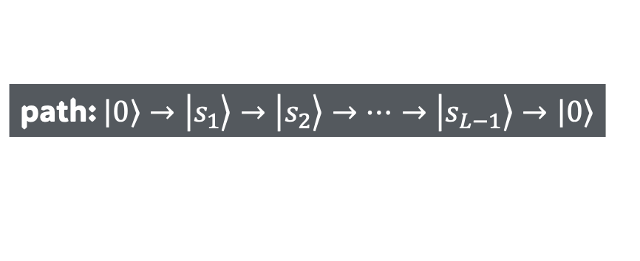
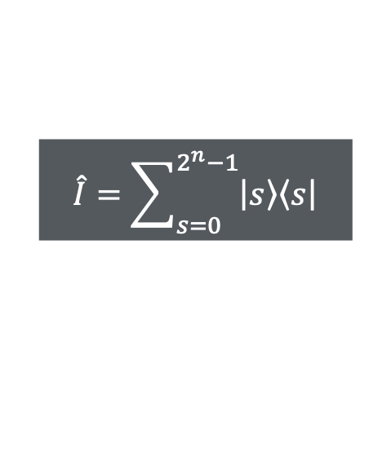


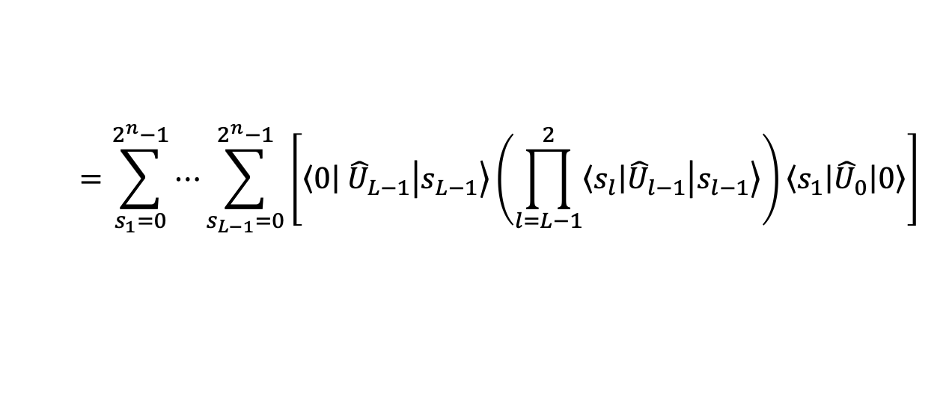
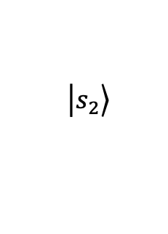

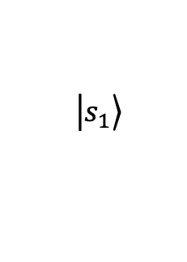

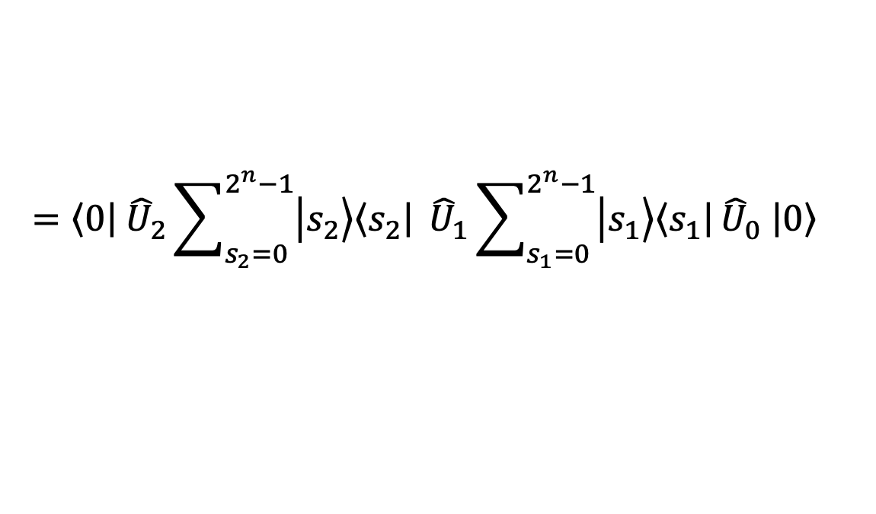
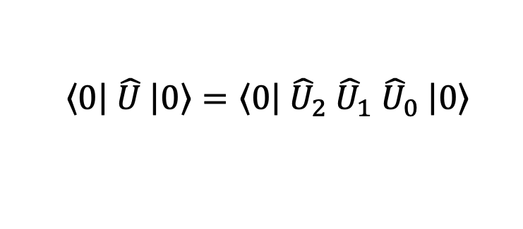



Classical Simulation of Quantum Circuits
$${\hat{U}}_{0}$$
$$\left.\left|s_{1}\right.\right\rangle$$
$${\hat{U}}_{1}$$
$$\left.\left|s_{2}\right.\right\rangle$$
$${\hat{U}}_{2}$$
$$\left\langle \left.0\right|\right. \hat{U} \left.\left|0\right.\right\rangle =\left\langle \left.0\right|\right. {\hat{U}}_{2} {\hat{U}}_{1} {\hat{U}}_{0} \left.\left|0\right.\right\rangle$$
000
000
000
000
$$\hat{I}=\sum_{s=0}^{2^{n}−1}{\left.\left|s\right.\right\rangle \left\langle \left.s\right|\right.}$$
001
001
010
010
011
011
$$=\left\langle \left.0\right|\right. {\hat{U}}_{2}\sum_{s_{2}=0}^{2^{n}−1}{\left.\left|s_{2}\right.\right\rangle \left\langle \left.s_{2}\right|\right.} {\hat{U}}_{1}\sum_{s_{1}=0}^{2^{n}−1}{\left.\left|s_{1}\right.\right\rangle \left\langle \left.s_{1}\right|\right.}{\hat{U}}_{0} \left.\left|0\right.\right\rangle$$
100
100
101
101
110
110
111
111
$$=\sum_{s_{1}=0}^{2^{n}−1}{⋯\sum_{s_{L−1}=0}^{2^{n}−1}{\left[\left\langle \left.0\right|\right. {\hat{U}}_{L−1}\left.\left|s_{L−1}\right.\right\rangle \left(\prod_{l=L−1}^{2}{\left\langle \left.s_{l}\right|\right.{\hat{U}}_{l−1}\left.\left|s_{l−1}\right.\right\rangle }\right)\left\langle \left.s_{1}\right|\right.{\hat{U}}_{0}\left.\left|0\right.\right\rangle \right]}}$$
$$H$$
$$H$$
$$H$$
$$Z$$
$$X$$
$$R_{X}$$
path: $\left.\left|0\right.\right\rangle →\left.\left|s_{1}\right.\right\rangle →\left.\left|s_{2}\right.\right\rangle →⋯→\left.\left|s_{L−1}\right.\right\rangle →\left.\left|0\right.\right\rangle$

Slide 9
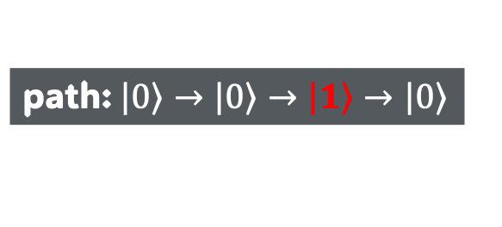
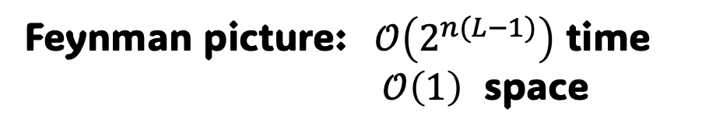
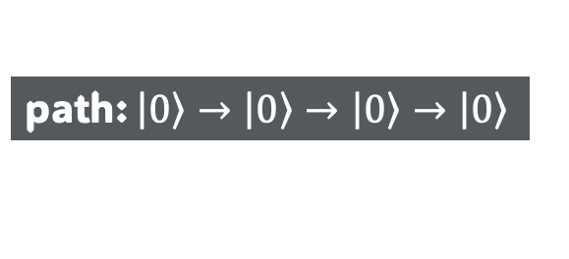


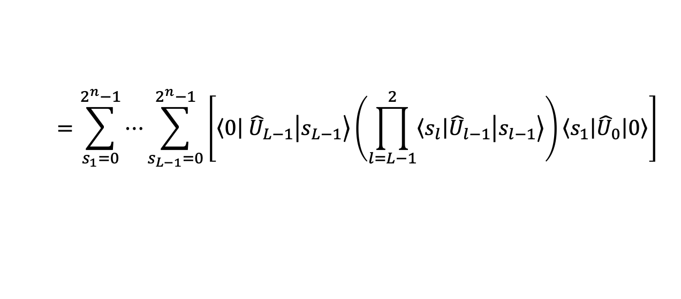
Classical Simulation of Quantum Circuits
$${\hat{U}}_{0}$$
$$\left.\left|s_{1}\right.\right\rangle$$
$${\hat{U}}_{1}$$
$$\left.\left|s_{2}\right.\right\rangle$$
$${\hat{U}}_{2}$$
$$\left\langle \left.0\right|\right. \hat{U} \left.\left|0\right.\right\rangle =\left\langle \left.0\right|\right. {\hat{U}}_{2} {\hat{U}}_{1} {\hat{U}}_{0} \left.\left|0\right.\right\rangle$$
000
000
000
000
$$=\sum_{s_{1}=0}^{2^{n}−1}{⋯\sum_{s_{L−1}=0}^{2^{n}−1}{\left[\left\langle \left.0\right|\right. {\hat{U}}_{L−1}\left.\left|s_{L−1}\right.\right\rangle \left(\prod_{l=L−1}^{2}{\left\langle \left.s_{l}\right|\right.{\hat{U}}_{l−1}\left.\left|s_{l−1}\right.\right\rangle }\right)\left\langle \left.s_{1}\right|\right.{\hat{U}}_{0}\left.\left|0\right.\right\rangle \right]}}$$
001
001
010
010
011
011
100
100
path: $\left.\left|0\right.\right\rangle →\left.\left|0\right.\right\rangle →\left.\left|0\right.\right\rangle →\left.\left|0\right.\right\rangle$
path: $\left.\left|0\right.\right\rangle →\left.\left|0\right.\right\rangle →\left.\left|1\right.\right\rangle →\left.\left|0\right.\right\rangle$
101
101
110
110
$$\left\langle \left.0\right|\right. \hat{U} \left.\left|0\right.\right\rangle =\sum_{{\overline{p}}_{i}∈𝒫}{ω\left({\overline{p}}_{i}\right)}$$
111
111
$$\left|𝒫\right|=2^{n(L−1)}$$
$$H$$
$$H$$
$$H$$
$$Z$$
Feynman picture: $𝒪\left(2^{n(L−1)}\right)$ time
$𝒪\left(1\right)$ space
$$X$$
$$R_{X}$$

Slide 10

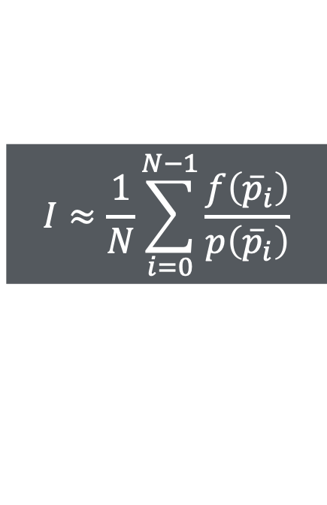




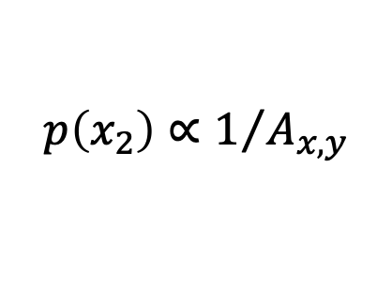
Path Integral Monte Carlo - forward
$$I≈\frac{1}{N}\sum_{i=0}^{N−1}{\frac{f\left({\overline{p}}_{i}\right)}{p\left({\overline{p}}_{i}\right)}}$$
🎥
$$x_{3}$$
$$x_{1}$$
$$x_{0}$$
$$p\left(x_{2}\right)∝1/{A_{x,y}}$$
$$p\left(x_{1}\right)∝BRDF(x_{2})$$
$$x_{2}$$
$$p\left(x_{0}\right)∝1$$

Slide 11






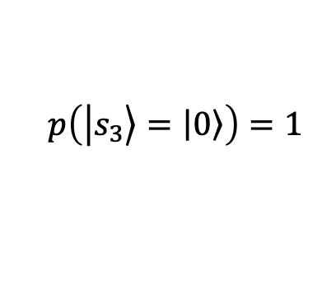



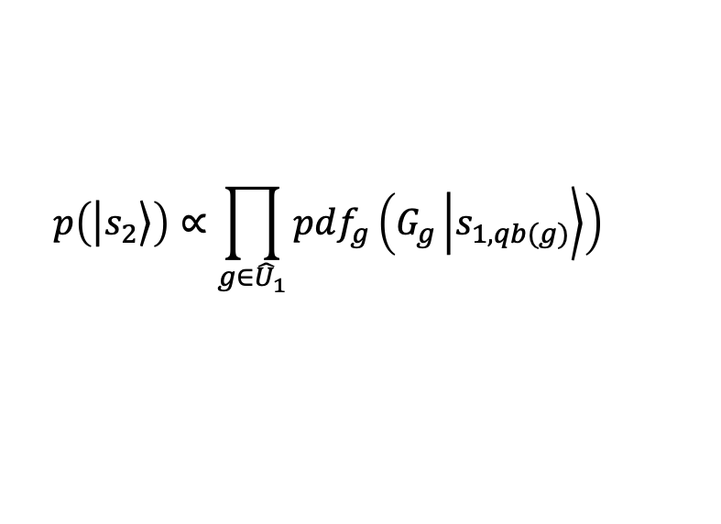

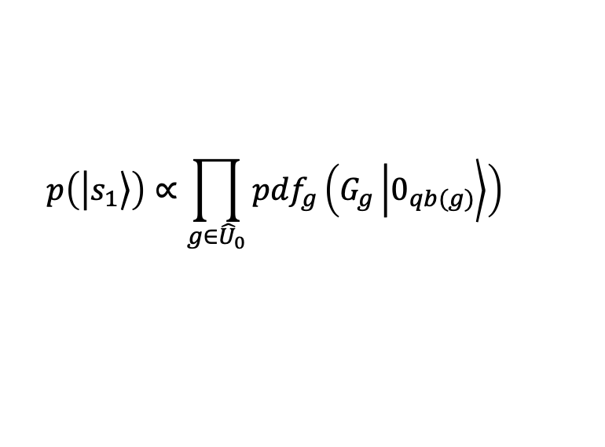
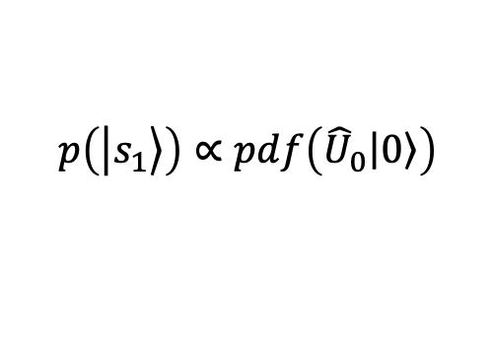



Path Integral Monte Carlo - forward
$$I≈\frac{1}{N}\sum_{i=0}^{N−1}{\frac{f\left({\overline{p}}_{i}\right)}{p\left({\overline{p}}_{i}\right)}}$$
$${\hat{U}}_{0}$$
$${\hat{U}}_{1}$$
$${\hat{U}}_{2}$$
000
000
000
000
001
001
010
010
011
011
100
100
$$p\left(\left.\left|s_{1}\right.\right\rangle \right)∝\prod_{g∈{\hat{U}}_{0}}{{pdf}_{g}\left(G_{g}\left.\left|0_{qb(g)}\right.\right\rangle \right)}$$
101
101
$$p\left(\left.\left|s_{1}\right.\right\rangle \right)∝pdf\left({\hat{U}}_{0}\left.\left|0\right.\right\rangle \right)$$
110
110
$$p\left(\left.\left|s_{1,(2)}\right.\right\rangle \right)∝pdf\left(H\left.\left|0\right.\right\rangle \right)$$
111
111
$$p\left(\left.\left|s_{2}\right.\right\rangle \right)∝\prod_{g∈{\hat{U}}_{1}}{{pdf}_{g}\left(G_{g}\left.\left|s_{1,qb(g)}\right.\right\rangle \right)}$$
$$p\left(\left.\left|s_{1,(1)}\right.\right\rangle \right)∝pdf\left(H\left.\left|0\right.\right\rangle \right)$$
$$H$$
$$H$$
0
0
0
0
$$p\left(\left.\left|s_{1,(0)}\right.\right\rangle \right)∝pdf\left(X\left.\left|0\right.\right\rangle \right)$$
🎥
$$p\left(\left.\left|s_{3}\right.\right\rangle =\left.\left|0\right.\right\rangle \right)=1$$
0
$$H$$
0
0
$$Z$$
0
0
$$X$$
1
1
$$R_{X}$$
0

Slide 12
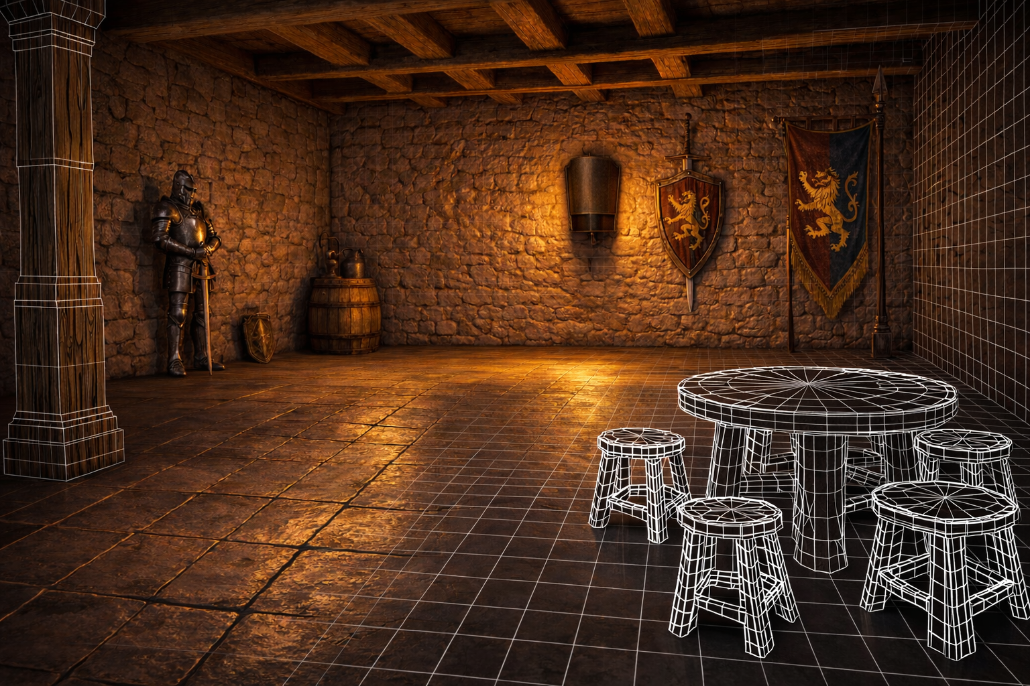

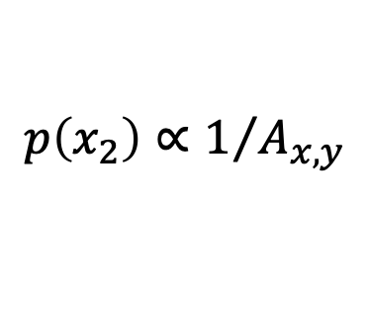


Path Integral Monte Carlo - forward
$$I≈\frac{1}{N}\sum_{i=0}^{N−1}{\frac{f\left({\overline{p}}_{i}\right)}{p\left({\overline{p}}_{i}\right)}}$$
🎥
$$x_{3}$$
$$x_{1}$$
$$x_{0}$$
$$p\left(x_{2}\right)∝1/{A_{x,y}}$$
$$p\left(x_{1}\right)∝BRDF(x_{2})$$
$$p\left(x_{0}\right)∝1$$
$$x_{2}$$
$$f\left(x_{1}→x_{0}\right)=0⇒f\left(\overline{p}\right)=0$$

Slide 13
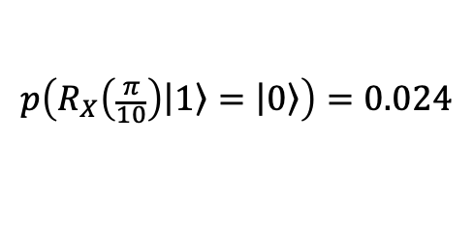


Path Integral Monte Carlo - forward
$$I≈\frac{1}{N}\sum_{i=0}^{N−1}{\frac{f\left({\overline{p}}_{i}\right)}{p\left({\overline{p}}_{i}\right)}}$$
$${\hat{U}}_{0}$$
$${\hat{U}}_{1}$$
$${\hat{U}}_{2}$$
000
000
000
000
001
001
?
010
010
$$p\left(R_{X}\left(\frac{π}{10}\right)\left.\left|1\right.\right\rangle =\left.\left|0\right.\right\rangle \right)=0.024$$
011
011
100
100
$$p\left(\left.\left|s_{1}\right.\right\rangle \right)∝\prod_{g∈{\hat{U}}_{0}}{{pdf}_{g}\left(G_{g}\left.\left|0_{qb(g)}\right.\right\rangle \right)}$$
101
101
110
110
111
111
$$p\left(\left.\left|s_{2}\right.\right\rangle \right)∝\prod_{g∈{\hat{U}}_{1}}{{pdf}_{g}\left(G_{g}\left.\left|s_{1,qb(g)}\right.\right\rangle \right)}$$
0
$$H$$
0
0
$$H$$
0
$$p\left(\left.\left|s_{3}\right.\right\rangle =\left.\left|0\right.\right\rangle \right)=1$$
🎥
$$H$$
$$Z$$
0
0
0
0
0
$$X$$
1
1
$$R_{X}$$
0

Slide 14





Path Integral Monte Carlo - bidirectional
$$y_{1}$$
🎥
$$x_{3}$$
$$y_{0}$$
$$x_{1}$$
$$y_{2}$$
$$x_{2}$$

Slide 15
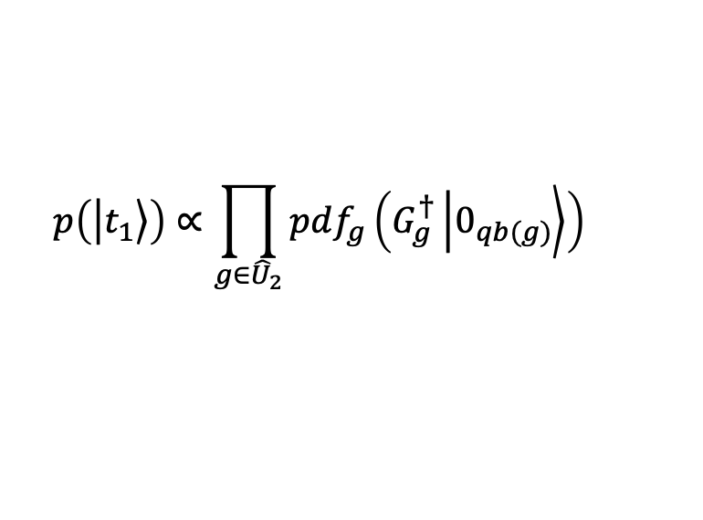

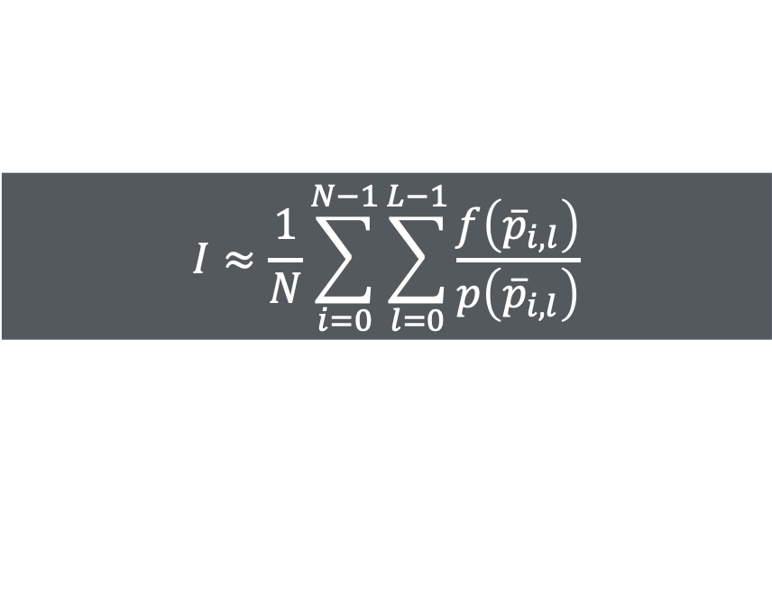

Path Integral Monte Carlo - bidirectional
$$I≈\frac{1}{N}\sum_{i=0}^{N−1}{\sum_{l=0}^{L−1}{\frac{f\left({\overline{p}}_{i,l}\right)}{p\left({\overline{p}}_{i,l}\right)}}}$$
$${\hat{U}}_{0}$$
$${\hat{U}}_{1}$$
$${\hat{U}}_{2}$$
000
000
000
000
001
001
$${\overline{p}}_{.,l}=(0,…,s_{l},t_{L−1−l},…,0)$$
010
010
011
011
$$p\left(\left.\left|t_{1}\right.\right\rangle \right)∝\prod_{g∈{\hat{U}}_{2}}{{pdf}_{g}\left(G_{g}^{†}\left.\left|0_{qb(g)}\right.\right\rangle \right)}$$
100
100
101
101
$$p\left(\left.\left|t_{2}\right.\right\rangle \right)∝\prod_{g∈{\hat{U}}_{1}}{{pdf}_{g}\left(G_{g}^{†}\left.\left|t_{1,qb(g)}\right.\right\rangle \right)}$$
110
110
111
111
$$p\left(0→s_{1}→s_{2}→0\right)=p\left(s_{1}\right)∗p\left(s_{2}\right)∗1$$
$$H$$
$$H$$
0
0
$$p\left(0→s_{1}→t_{1}→0\right)=p\left(s_{1}\right)∗1∗p\left(t_{1}\right)$$
🎥
$$H$$
$$Z$$
0
0
$$p\left(0→t_{2}→t_{1}→0\right)=1∗p\left(t_{2}\right)∗p\left(t_{1}\right)$$
0
$$X$$
$$R_{X}$$
0

Slide 16



Path Integral Monte Carlo - bidirectional
$$I≈\frac{1}{N}\sum_{i=0}^{N−1}{\sum_{l=0}^{L−1}{\frac{f\left({\overline{p}}_{i,l}\right)}{p\left({\overline{p}}_{i,l}\right)}}}$$
$${\hat{U}}_{0}$$
$${\hat{U}}_{1}$$
$${\hat{U}}_{2}$$
000
000
000
000
001
001
$${\overline{p}}_{.,l}=(0,…,s_{l},t_{L−1−l},…,0)$$
010
010
011
011
$p\left(\left.\left|t_{1}\right.\right\rangle =\left.\left|101\right.\right\rangle \right)$ very small
$⇒p\left(\overline{p}\right)$ very small
$⇒{f\left(\overline{p}\right)}/{p\left(\overline{p}\right)}$ very large
100
100
$$p\left(R_{X}^{†}\left(\frac{π}{10}\right)\left.\left|0\right.\right\rangle =\left.\left|1\right.\right\rangle \right)=0.024$$
101
101
110
110
111
111
$\overline{p}⊃\left.\left|101\right.\right\rangle$ has low probability,
thus it overshoots the estimator.
$Var\left(\left\langle I\right\rangle \right)$ increases
0
$$H$$
$$H$$
0
🎥
$$H$$
$$Z$$
0
0
0
$$X$$
$$R_{X}$$
0

Slide 17








Path Integral Monte Carlo – Multiple Importance Sampling
$${\hat{U}}_{0}$$
$${\hat{U}}_{0}$$
$${\hat{U}}_{0}$$
$${\hat{U}}_{1}$$
$${\hat{U}}_{1}$$
$${\hat{U}}_{1}$$
$${\hat{U}}_{2}$$
$${\hat{U}}_{2}$$
$${\hat{U}}_{2}$$
000
000
000
000
000
000
000
000
000
000
000
000
001
001
001
001
001
001
010
010
010
010
010
010
011
011
011
011
011
011
100
100
100
100
100
100
101
101
101
101
101
101
$$p\left(R_{X}^{†}\left(\frac{π}{10}\right)\left.\left|0\right.\right\rangle =\left.\left|1\right.\right\rangle \right)$$
$$=0.024$$
$$p\left(\left.\left|101\right.\right\rangle →\left.\left|000\right.\right\rangle \right)=1$$
110
110
110
110
110
110
111
111
111
111
111
111
$$p_{2}\left(\overline{p}\right)=p\left(0→7\right) ∗ p(7→5)∗ 1$$
$$p_{1}\left(\overline{p}\right)=p\left(0→7\right)∗ 1 ∗ p(5←0)$$
$$p_{0}\left(\overline{p}\right)=1 ∗ p(7←5)∗ p(5←0)$$

Slide 18






Path Integral Monte Carlo – Multiple Importance Sampling
Bidirectional – no MIS
Bidirectional –MIS
Bidirectional –MIS
$$I≈\frac{1}{N}\sum_{i=0}^{N−1}{\sum_{l=0}^{L−1}{\frac{f\left({\overline{p}}_{i,l}\right)}{p\left({\overline{p}}_{i,l}\right)}}}$$
$$I≈\frac{1}{N}\sum_{i=0}^{N−1}{\sum_{l=0}^{L−1}{\frac{f\left({\overline{p}}_{i,l}\right)}{\sum_{t=0}^{L−1}{p_{t}\left({\overline{p}}_{i,l}\right)}}}}$$
$$I≈\frac{1}{N}\sum_{i=0}^{N−1}{\sum_{l=0}^{L−1}{\left\langle I_{MIS}\left({\overline{p}}_{i,l}\right)\right\rangle }}$$
$$\left\langle I_{MIS}\left({\overline{p}}_{i,l}\right)\right\rangle =w\left({\overline{p}}_{i,l}\right)\frac{f\left({\overline{p}}_{i,l}\right)}{p\left({\overline{p}}_{i,l}\right)}$$
$$\left\langle I_{MIS}\left({\overline{p}}_{i,l}\right)\right\rangle =\frac{f\left({\overline{p}}_{i,l}\right)}{\sum_{t=0}^{L−1}{p_{t}\left({\overline{p}}_{i,l}\right)}}$$
Balance Heuristic
$$w\left({\overline{p}}_{i,l}\right)=\frac{p\left({\overline{p}}_{i,l}\right)}{\sum_{t=0}^{L−1}{p_{t}\left({\overline{p}}_{i,l}\right)}}$$

Slide 19


Path Integral Monte Carlo – BD Multiple Importance Sampling
Bidirectional – MIS
$$I≈\left\langle I_{BD}\right\rangle =\frac{1}{N}\sum_{i=0}^{N−1}{\sum_{l=0}^{L−1}{\frac{f\left({\overline{p}}_{i,l}\right)}{\sum_{t=0}^{L−1}{p_{t}\left({\overline{p}}_{i,l}\right)}}}}$$
$\sum_{t=0}^{L−1}{p_{t}\left({\overline{p}}_{i,l}\right)}>0$
$\sum_{t=0}^{L−1}{p_{t}\left({\overline{p}}_{i,l}\right)}≥p_{t}\left({\overline{p}}_{i,l}\right), ∀_{t∈\left\{0,…,L−1\right\}}$
$Var\left(\left\langle I_{BD}\right\rangle \right)≤Var\left(\left\langle I_{FWD}\right\rangle \right)$

Slide 20
Experimental Results
Simulator
Forward and Bidirectional Monte Carlo sum of Feynman paths
Deterministic exact sum of Feynman paths
C++
Parallel resources exploitation:
vectorized
multi-threaded
multiple-nodes (MPI)
Executed on Deucalion (https://docs.macc.fccn.pt/)
x86 partition: 128 physical cores / node

Slide 21

Experimental Results
Metrics
Variance as a function of the number of samples
Variance as a function of execution time
Efficiency as a function of the number of samples: $\text{Eff}={\left(Var∗time\right)}^{−1}$
Circuits
Efficient SU2: 5, 15 and 25 qubits
IQP: 5, 15 and 25 qubits
RND: 8, 10 and 12 qubits
HSC: 256, 1024 and 4096 qubits

Slide 22


Variance: number of samples (N)
Efficient SU2
RND

Slide 23


Variance: execution time
IQP
RND

Slide 24


Efficiency: number of samples
IQP
RND

Slide 25

Large Hidden Shift Circuits

Slide 26


Path Space Sparseness

Slide 27

Path Space Sparseness – FWD versus BD

Slide 28

Hardness of Classical Simulation
Context | Metric | Easy | Hard
Magic (stabilizer theory) | stabilizer extent | $$ξ\left(\hat{U}\right)=1$$ | $$ξ\left(\hat{U}\right)≫1$$
 | $$ξ\left(\hat{U}\right)={\left(\sum_{k}{\left|c_{k}\right| }\right)}^{2}$$
Redundancy (decision diagrams) | redundancy | $$R=2^{n}$$ | $$R=1$$
 | $$R=\frac{2^{n}}{N_{DD}}$$
Monte Carlo (numerical sign) | average phase | $$\left|\left\langle e^{iφ}\right\rangle \right|=1$$ | $$\left|\left\langle e^{iφ}\right\rangle \right|≪1$$
 | $$χ=\left|\left\langle e^{iφ}\right\rangle \right|=\frac{\left|\sum{f\left(\overline{p}\right)}\right|}{\sum{\left|f\left(\overline{p}\right)\right|}}$$

Slide 29


Hardness of Classical Simulation – SU5

Slide 30


Hardness of Classical Simulation – IQP5

Slide 31


Hardness of Classical Simulation – RND8

Slide 32


Average phase scalability
The numerical sign problem grows with circuit size
${VAR}_{MC}≈𝒪\left(\frac{1}{Nχ^{2}}\right)$
for constant variance $N≈𝒪\left(\frac{1}{χ^{2}}\right)$
Easy circuits $χ≈1$
Stabilizer circuits
$χ=1$
$χ≈𝒪(2^{−t})$, $t=$ #T gates

Slide 33
The Future
Noisy circuits simulation
Pauli paths Monte Carlo
Hybrid Schrödinger + Path Integration Monte Carlo
Metropolis Monte Carlo
Numerical sign problem mitigation
Learning the estimator

Slide 34
From Light Paths to Feynman Paths
Caminante, no hay camino, se hace camino al andar
(Seeker, there is no path; the path is traced as you walk it.)
Antonio Machado Ruiz, 1912
March, 2026
Habilitation in Informatics

