Slide 1
Ciência de Dados Quântica Data Encoding
Luís Paulo santos

Slide 2
Material de Consulta
[Schuld2021] – Sec 3.4 (3.4.1 ; 3.4.2) Chap. 4 (4.1 ; 4.2)

Slide 3

Data Encoding
Consider a dataset $𝒟$ with $M$ data points, each a vector of $N$ features
$𝒟=\left\{x^{1},⋯,x^{M}\right\}$, with $x^{m}∈ℝ^{N}$, i.e. $x^{m}={\left\{x_{1}^{m},⋯,x_{N}^{m}\right\}}^{T}$
Data encoding (or state preparation) is the process of representing either a single data point or the entire dataset as a quantum state.

Slide 4
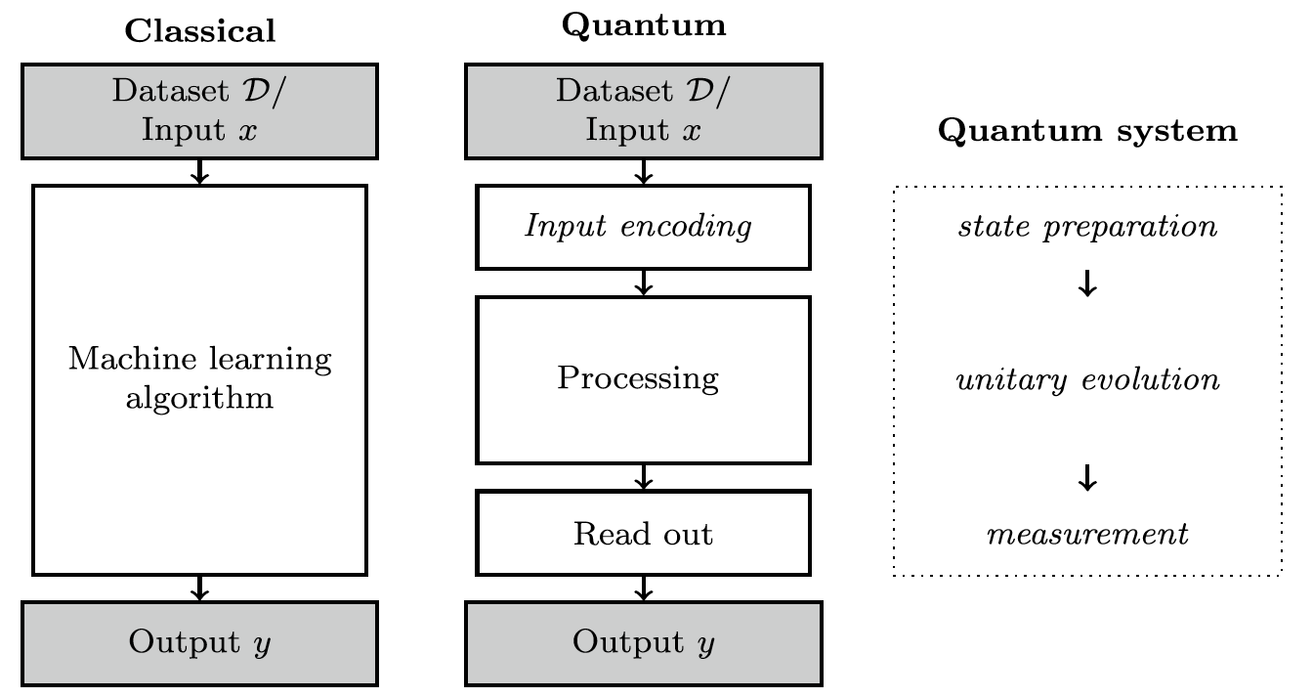
Data Encoding
[Schuld2021]

Slide 5
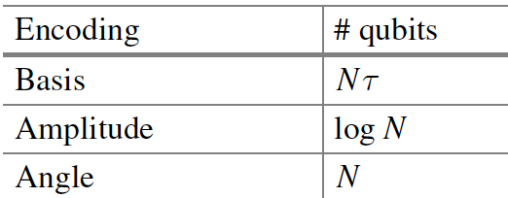

Data encoding and algorithm complexity
In classical ML an efficient algorithm is $𝒪\left(poly(M)poly(N)\right)$
In quantum computing an efficient algorithm is $𝒪\left(poly(n) \right)$, $n$ the nbr qubits
State preparation is often the bottleneck of the quantum algorithm
Theoretical frameworks, software and hardware that address the interface between the classical memory and the quantum device are central for runtime evaluations.
where N is the number features

Slide 6













Basis encoding
Basis encoding associates a computational basis state of an n-qubit system with a classical n-bit string
Exemplo: $\left.\left|3\right.\right\rangle =\left.\left|0011\right.\right\rangle$
Encoding a single data point with a single feature and $τ$ qubits per feature:
$\left.\left|3\right.\right\rangle =\left.\left|0011\right.\right\rangle$
$$b_{0}$$
$$\left.\left|0\right.\right\rangle$$
X
$$\left.\left|1\right.\right\rangle$$
$$b_{1}$$
$$\left.\left|0\right.\right\rangle$$
X
$$\left.\left|1\right.\right\rangle$$
$$b_{2}$$
$$\left.\left|0\right.\right\rangle$$
$$\left.\left|0\right.\right\rangle$$
$$b_{3}$$
$$\left.\left|0\right.\right\rangle$$
$$\left.\left|0\right.\right\rangle$$

Slide 7

Binary: signal + fixed point amplitude
$b=b_{s}b_{τ_{l−1}}⋯b_{1}$ $b_{0} .b_{−1}b_{−2} ⋯b_{−τ_{r}}$
$x={\left(−1\right)}^{b_{s}} (b_{τ_{l−1}}∗2^{τ_{l−1}}+⋯b_{1}∗2^{1}+b_{0}∗2^{0}+b_{−1}∗2^{−1}+ ⋯+b_{−τ_{r}}∗2^{{−τ}_{r}}$)

Slide 8

Basis encoding in superposition
$𝒟=\left\{x^{1},⋯,x^{M}\right\}$, where $x^{m}∈𝒟$ is given by $x^{m}=b^{m}={\left\{b_{1}^{m},⋯,b_{n}^{m}\right\}}^{T}$
then a superposition of basis states can be prepared:
$$\left.\left|𝒟\right.\right\rangle =\frac{1}{\sqrt{M}}\sum_{m=1}^{M}{\left.\left|x^{m}\right.\right\rangle }$$
Example: $𝒟=\left\{(1,2),\left(0,3\right),\left(2,3\right)\right\}$ $⇔$ $𝒟=\left\{(01,10),\left(00,11\right),\left(10,11\right)\right\}$
$$\left.\left|𝒟\right.\right\rangle =\frac{1}{\sqrt{3}}\left(\left.\left|0110\right.\right\rangle +\left.\left|0011\right.\right\rangle +\left.\left|1011\right.\right\rangle \right)$$
$\left.\left|𝒟\right.\right\rangle = \left(0, 0, 0,\frac{1}{\sqrt{3}}, 0, 0,\frac{1}{\sqrt{3}}, 0, 0, 0, 0,\frac{1}{\sqrt{3}}, 0, 0, 0, 0\right)$

Slide 9













Basis encoding in superposition
Example: $𝒟=\left\{3,6,2\right\}$
$𝒟=\left\{0,2,3,6\right\}$
$$q_{0}$$
$$\left.\left|0\right.\right\rangle$$
H
$$q_{1}$$
$$\left.\left|0\right.\right\rangle$$
H
$$b_{0}$$
$$\left.\left|0\right.\right\rangle$$
X
$$b_{1}$$
$$\left.\left|0\right.\right\rangle$$
X
X
X
$$b_{2}$$
$$\left.\left|0\right.\right\rangle$$
X
$$\frac{1}{2}\left(\left.\left|000\right.\right\rangle +\left.\left|010\right.\right\rangle +\left.\left|011\right.\right\rangle +\left.\left|110\right.\right\rangle \right)$$

Slide 10

Basis encoding: conclusion
Is expensive in terms of qubits: $log(NM)τ$
The complexity of the state preparation circuit depends on the superposition, but in general can be $𝒪(2^{n})$
Simplest case: uniform superposition
$\left.\left|𝒟\right.\right\rangle =\frac{1}{\sqrt{2^{n}}}\sum_{i=0}^{2^{n}−1}{\left.\left|i\right.\right\rangle }$ $\left.\left|𝒟\right.\right\rangle = H^{⊗n}{\left.\left|0\right.\right\rangle }^{⊗n}$

Slide 11

QRAM
Theoretical device that loads data patterns from memory to a quantum state: given an address $\left.\left|m\right.\right\rangle$ in a quantum register loads the corresponding data bit pattern to a second register :
$$\left.\left|m\right.\right\rangle \left.\left|0⋯0\right.\right\rangle ⟶\left.\left|m\right.\right\rangle \left.\left|x^{m}\right.\right\rangle$$
More importantly, given a superposition of the address register, loads the corresponding data patterns to the superposition:
$$\frac{1}{\sqrt{M}}\sum_{m=0}^{M−1}{\left.\left|m\right.\right\rangle \left.\left|0⋯0\right.\right\rangle } ⟶\frac{1}{\sqrt{M}}\sum_{m=0}^{M−1}{\left.\left|m\right.\right\rangle \left.\left|x^{m}\right.\right\rangle }$$

Slide 12
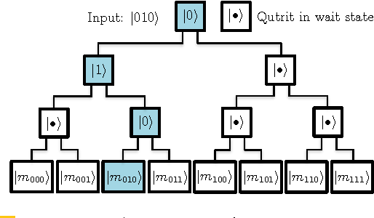
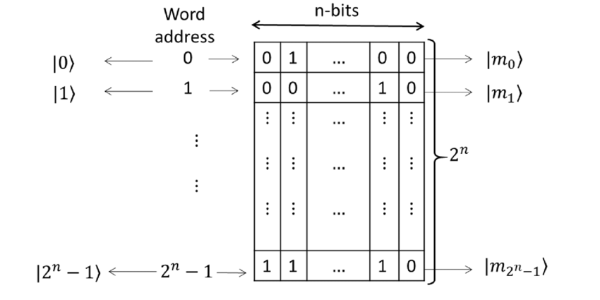
QRAM
Architectures have been proposed to realize this query in $𝒪(n)$ time, but its physical realisation remains an open challenge
Quantum Random Access Memory
Vittorio Giovannetti, Seth Lloyd, and Lorenzo Maccone
Phys. Rev. Lett. 100, 160501 – Published 21 April 2008

Slide 13

Angle Encoding
Each feature of a data point is encoded as a rotation of a qubit. For $x=\left\{x_{1}, ⋯x_{N}\right\}$ and angle encoding $N$ qubits and $N$ rotation gates are required
$$\left.\left|x\right.\right\rangle = ⊗_{i=1}^{N}R_{y}\left(x_{i}\right){\left.\left|0\right.\right\rangle }_{i}$$
$$\left.\left|q_{i}\right.\right\rangle = \cos\left(\frac{x_{i}}{2}\right)\left.\left|0\right.\right\rangle + \sin\left(\frac{x_{i}}{2}\right)\left.\left|1\right.\right\rangle$$
Each feature has to be normalized in the interval $\left[−π , π\right]$
$$\tilde{x_{i}}= \frac{x_{i}}{\max_{x_{j}}\left(abs(x_{j})\right)} ∗ π$$

Slide 14
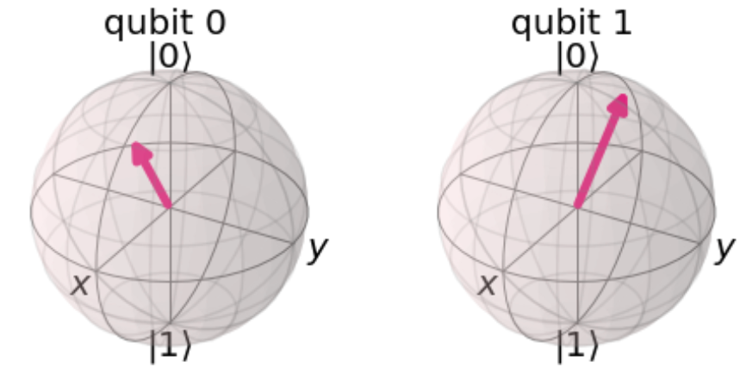
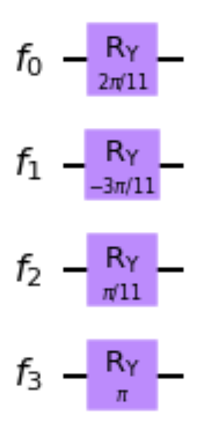
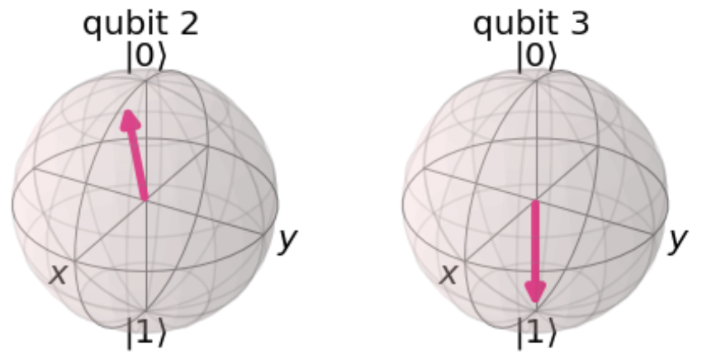

Angle Encoding: example
$x=\left(2, −3, 1, 11\right)$
$\max_{}\left(abs(x)\right)=11$
$\tilde{x}= \left(\frac{2}{11}π,−\frac{3}{11}π,\frac{1}{11}π, π\right)$

Slide 15

Amplitude Encoding
A real or complex valued vector $x∈ ℂ^{N}$ is encoded into the amplitudes of a quantum state:
$$\left.\left|ψ_{x}\right.\right\rangle = \sum_{i=0}^{N−1}{x_{i }\left.\left|i\right.\right\rangle }$$
$x$ has to be normalised such that $\sum_{i=0}^{N−1}{{\left|x_{i }\right|}^{2}}=1$ and padded with zeros such that N is a power of 2
An entire dataset can be encoded
$$\left.\left|ψ_{𝒟}\right.\right\rangle = \frac{1}{\sqrt{M}}\sum_{m=0}^{M−1}{\sum_{i=0}^{N−1}{x_{i }\left.\left|i\right.\right\rangle \left.\left|m\right.\right\rangle }}=\frac{1}{\sqrt{M}}\sum_{m=0}^{M−1}{\left.\left|ψ_{x^{m}}\right.\right\rangle \left.\left|m\right.\right\rangle }$$

Slide 16

Amplitude Encoding: example
$x=\left(0.1, −0.6, 1.0\right)$
norm = $\sum{\left|x_{i}\right|}$
$\tilde{x}= \frac{x}{norm}= \left(0.073, −0.438, 0.730, 0.000\right)$
$\left.\left|ψ_{x}\right.\right\rangle =0.073\left.\left|00\right.\right\rangle$ - 0.438 $\left.\left|01\right.\right\rangle +0.730\left.\left|10\right.\right\rangle +0.000\left.\left|11\right.\right\rangle$
Amplitude encoding requires only $\log\left(MN\right)$ qubits
The theoretical lower bound of the depth of an arbitrary state preparation circuit is known to be $\frac{1}{n}2^{n}$ but currently known algorithms perform slightly worse

Slide 17
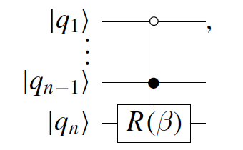



Amplitude Encoding: Mottonen et al.
The inverse circuit is designed by considering the reverse problem of mapping the arbitrary state $\left.\left|ψ\right.\right\rangle$ to the ground state $\left.\left|0⋯0\right.\right\rangle$
The basic idea is to control a rotation on qubit $q_{s}$ by all possible states of the previous qubits ${q_{1} ⋯ q}_{s−1}$, using sequences of so-called multi-controlled rotations.
A controlled rotation is depicted by:
if $q_{1}==0$
if $q_{n−1}==1$

Slide 18
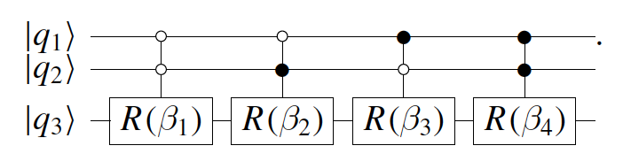
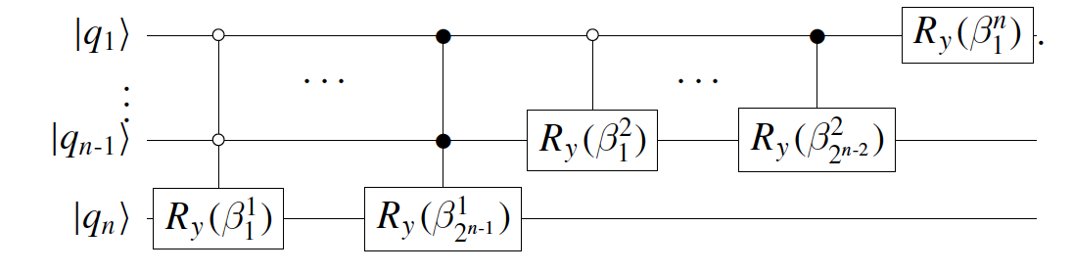
Amplitude Encoding: Mottonen et al.
Representing conditional rotations on all possible states of the previous qubits:
The final cascade:
[Schuld2021]

Slide 19
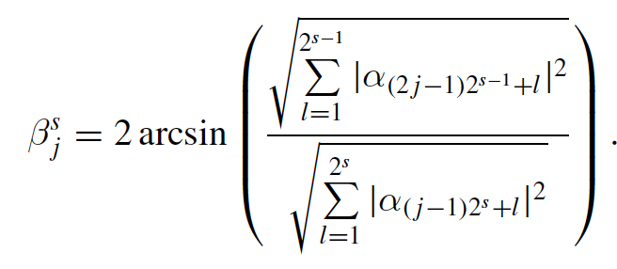

Amplitude Encoding: Mottonen et al.
The rotation angles $β$ are given by
This algorithm is still $𝒪\left(2^{n}\right)$
It is the algorithm used by Qiskit initialize():
qc = QuantumCircuit (1)
state = [1/sqrt(2), 1j/sqrt(2)]
qc.initialize(state, 0)

Slide 20
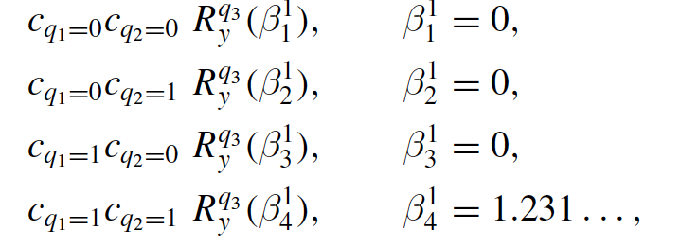
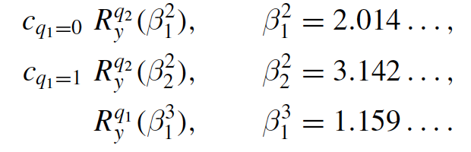











Amplitude Encoding: example
$\left.\left|ψ\right.\right\rangle = \sqrt{0.2}\left.\left|000\right.\right\rangle +\sqrt{0.5}\left.\left|010\right.\right\rangle +$ $\sqrt{0.2} \left.\left|110\right.\right\rangle + \sqrt{0.1} \left.\left|111\right.\right\rangle$
Invertendo o circuito:
$$q_{1}$$
$$\left.\left|0\right.\right\rangle$$
$$R_{y}\left(−1.159\right)$$
$$q_{2}$$
$$\left.\left|0\right.\right\rangle$$
$$R_{y}\left(−2.014\right)$$
$$R_{y}\left(−3.142\right)$$
$$q_{3}$$
$$\left.\left|0\right.\right\rangle$$
$$R_{y}\left(−1.231\right)$$

Slide 21
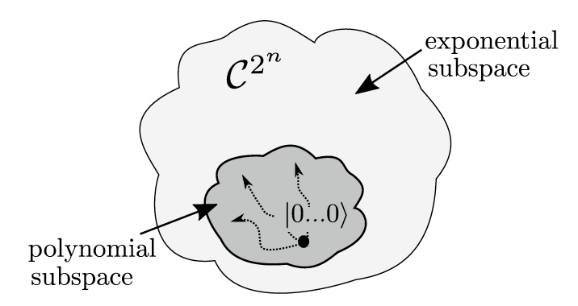
Amplitude encoding: conclusions
It is an exponentially compact representation: requires only n = log N qubits to encode an input of N features, and n = log(NM) qubits for an M points dataset
But is there an algorithm that only uses log(NM) gates to prepare amplitude-encoded states?
it is a strange concept since loading the N features from the memory hardware takes time that is linear in N
It is possible only when the dataset exhibits structure:
uniform superposition,
very sparse data sets
[Schuld2021]

Slide 22
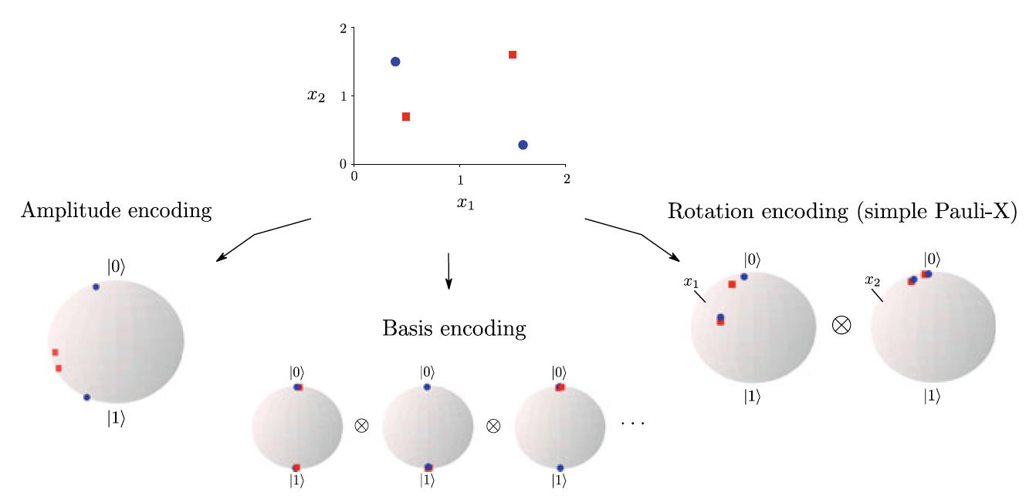
Data encoding: Bloch visualization
[Schuld2021]

Slide 23

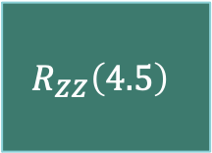


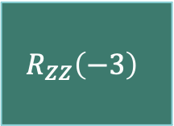








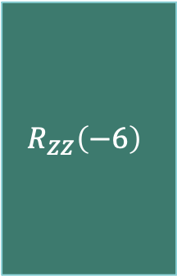
Instantaneous quantum polynomial: IQP
$$\left.\left|x\right.\right\rangle ={\left({U_{Z}\left(x\right)H}^{⨂n}\right)}^{r}{\left.\left|0\right.\right\rangle }^{⨂n}$$
$$U_{Z}\left(x\right)=\prod_{\left(i,j\right)∈S}{R_{Z_{i}Z_{j}}\left(x_{i}∗x_{j}\right)}\underset{k=1…n}{⊗}{R_{z}}\left(x_{k}\right)$$
diagonal in the Z-basis
$$𝒟=\left\{−2, 1.5, 3\right\}$$
$r=1$ (known to be classically hard for $r>1$)
$$q_{1}$$
$$\left.\left|0\right.\right\rangle$$
H
$$R_{z}\left(−2\right)$$
$$R_{ZZ}\left(−6\right)$$
$$R_{ZZ}\left(−3\right)$$
$$q_{2}$$
$$\left.\left|0\right.\right\rangle$$
H
$$R_{z}\left(1.5\right)$$
$$R_{ZZ}\left(4.5\right)$$
$$q_{3}$$
$$\left.\left|0\right.\right\rangle$$
H
$$R_{z}\left(3\right)$$
[“Supervised learning with quantum-enhanced feature spaces”, Havlíček, V. et al., Nature 567(7747), 2019 DOI={10.1038/s41586-019-0980-2}]

Slide 24
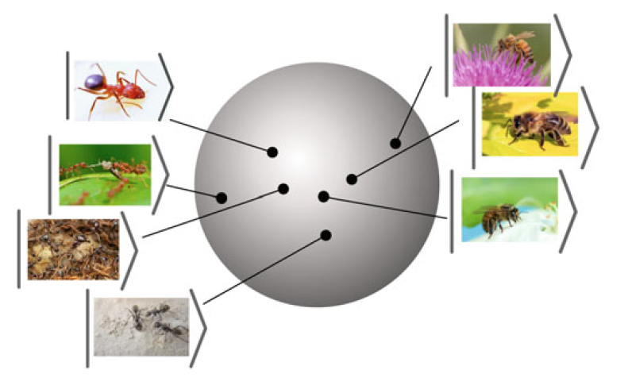

Data encoding as a feature map
Data encoding maps data points from the input space $𝒳$ into the quantum Hilbert space $ℂ^{2^{n}}$
The data encoding feature map can change the structure of the data in non-trivial (and non linear) manners eventually determining the success of the learning algorithm
[Schuld2021]

Slide 25
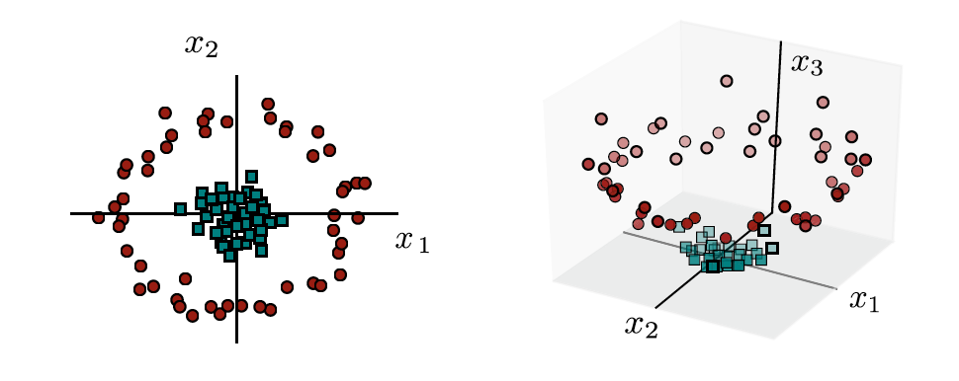


Data encoding as a feature map
Feature maps, more often than not, increase the dimensionality of the data
$∅\left((x_{1},x_{2})\right)=(x_{1},x_{2}$, $0.5 ({x_{1}}^{2}+{x_{2}}^{2}))$
“Hilbert space is a big space” [Carlton Caves]
Quantum computation accesses an exponential Hilbert state space: $ℂ^{2^{n}}$
Data encoding allows mapping classical data (eventually non-linearly) into this hyperdimensional state space
Quantum advantage depends on the inability to efficiently simulate the data encoding classical resources

