Slide 1
Ciência de Dados Quântica Variational Quantum Classification: an overview
Luís Paulo santos

Slide 2
Material de Consulta
[Schuld2021] – Chap. 5
[Abbas2021] – 2021 Qiskit Global Summer School on Quantum Machine Learning: Building a Quantum Classifier https://learn.qiskit.org/summer-school/2021/lec5-1-building-quantum-classifier

Slide 3
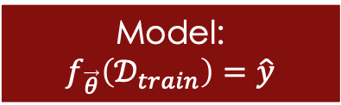

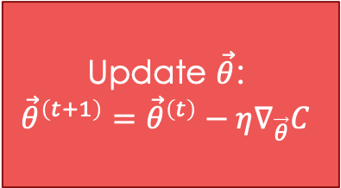
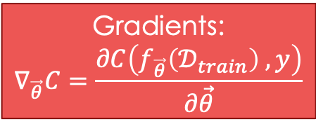
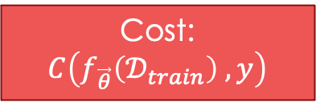
General framework
Training data:
$$𝒟_{train}=\left\{\left(x^{1},y^{1}\right),⋯\right\}$$
Model:
$$f_{\vec{θ}}\left(𝒟_{train}\right)=\hat{y}$$
Cost:
$$C\left(f_{\vec{θ}}\left(𝒟_{train}\right) , y\right)$$
Can we use a quantum device as a quantum model?
Update $\vec{θ}$:
$${\vec{θ}}^{\left(t+1\right)}={\vec{θ}}^{\left(t\right)}−η∇_{\vec{θ}}C$$
Gradients:
$$∇_{\vec{θ}}C=\frac{∂C\left(f_{\vec{θ}}\left(𝒟_{train}\right) , y\right)}{∂\vec{θ}}$$

Slide 4

Near Term versus Fault Tolerant
Fault Tolerant :
Large number of qubits, error corrected, noise resilient
Large and long programs, deep circuits
NISQ : Noisy Intermediate Scale Quantum systems
Limited number of qubits, noise sensitive, decoherence
Short lived programs, shallow circuits
NOISE
[Abbas2021]

Slide 5





Variational Models
Ansatz
Variational circuit
The output is stochastic
Multiple measurements
Expectation value
Probability distribution over basis states
$$U\left(θ\right)$$
$$\left.\left|φ\right.\right\rangle$$
$$U$$
$$M$$
$$\left\langle z\right\rangle$$
Parameterized quantum circuit / model

Slide 6
Variational circuit as a classifier
Task: Train a parameterized quantum circuit on labelled samples for a set of classical data in order to predict label for new, unseen, data
Encode the classical data into a quantum state
Apply a parameterized model
Measure the circuit to extract labels
Use optimization to update the model’s parameters

Slide 7







Data encoding
$\left.\left|φ\right.\right\rangle$ is the quantum state encoding some classical data point, $x^{i}$, which is eventually a vector of multiple features: $x^{i}=\left(x_{1}^{i}, ⋯,x_{N}^{i}\right)$
This encoding should be made explicit : $U\left(θ\right)\left.\left|φ\right.\right\rangle = U^{′}\left(x,θ\right)\left.\left|0\right.\right\rangle =W\left(θ\right)S\left(x\right)\left.\left|0\right.\right\rangle$
$$\left.\left|0\right.\right\rangle$$
S$\left(x\right)$
$$U\left(θ\right)$$
W$\left(θ\right)$
$$M$$
$$\left.\left|φ\right.\right\rangle$$
State Preparation
Basis / Amplitude / Angle encoding
IQP
Higher order encoding
…

Slide 8














Data encoding: example
$x^{i}=\left(x_{1}^{i} ,x_{2}^{i}\right)$ represents a student:
$x_{1}$ - university access grade $∈ \left[10 , 20\right]$
$x_{2}$ - hours of independent work per week $∈ \left[0 , 20\right]$
Angle encoding. Normalize to $\left[−π , π\right]$:
$\tilde{x_{1}}= \frac{x_{1}−10}{10} ∗2π −π$ ; $\tilde{x_{2}}= \frac{x_{2}}{20} ∗2π −π$
Higher order encoding. Normalize $\tilde{x_{1}}∗\tilde{x_{2}}$ to $\left[−π , π\right]$:
$\tilde{{x_{1}x}_{2}}= \frac{\tilde{x_{1}} ∗\tilde{x_{2}}}{π}$
$$S\left(x\right)$$
$$\left.\left|0\right.\right\rangle$$
$$ℛ_{y}\left(\tilde{x_{1}}\right)$$
$$\left.\left|0\right.\right\rangle$$
$$ℛ_{y}\left(\tilde{x_{2}}\right)$$
$$\left.\left|0\right.\right\rangle$$
$$H$$
$$ℛ_{y}\left(\tilde{x_{1}}\right)$$
$$\left.\left|0\right.\right\rangle$$
$$H$$
$$ℛ_{y}\left(\tilde{x_{2}}\right)$$
$$ℛ_{y}\left(\tilde{x_{1}x_{2}}\right)$$
$$S\left(x\right)$$

Slide 9
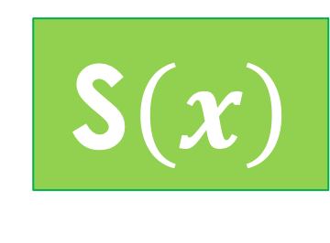



Parameterized model
What should be the parameterized model (ansatz) ?
$$\left.\left|0\right.\right\rangle$$
S$\left(x\right)$
W$\left(θ\right)$
$$M$$
Problem dependent …
Open research question …

Slide 10
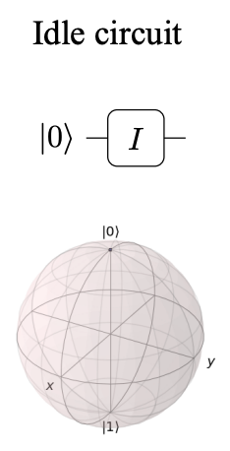
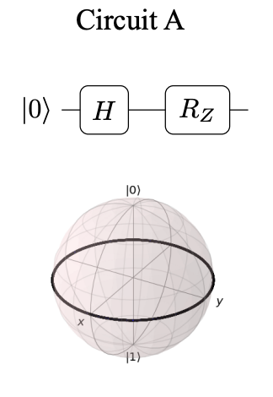
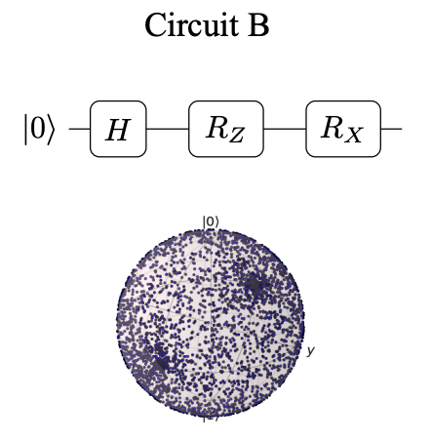
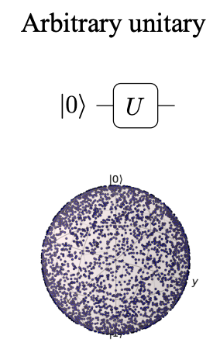
Parameterized model: expressibility
What is the reachable subset $ℋ_{U}⊂{ℂ^{2}}^{n}$ and does $ℋ_{U}$ contain the sought solution?
Expressibility depends on the data encoding and the ansatz
High expressibility might not always be desirable
[Expressibility and entangling capability of parameterized quantum circuits for hybrid quantum-classical algorithms
Sukin Sim, Peter D. Johnson, Alan Aspuru-Guzik; Adv. Quantum Technol. 2 (2019) 1900070]

Slide 11













Parameterized model
Problem dependent versus problem independent
Hardware dependent versus hardware independent
Hardware and problem independent common template:
Layer 1
Layer 2
$$\left.\left|0\right.\right\rangle$$
$$S\left(x\right)$$
$$ℛ_{\left[x,y,z\right]}\left(θ_{1}\right)$$
$$ℛ_{\left[x,y,z\right]}\left(θ_{5}\right)$$
$$\left.\left|0\right.\right\rangle$$
$$ℛ_{\left[x,y,z\right]}\left(θ_{2}\right)$$
$$ℛ_{\left[x,y,z\right]}\left(θ_{6}\right)$$
$$\left.\left|0\right.\right\rangle$$
$$ℛ_{\left[x,y,z\right]}\left(θ_{3}\right)$$
$$ℛ_{\left[x,y,z\right]}\left(θ_{7}\right)$$
$$\left.\left|0\right.\right\rangle$$
$$ℛ_{\left[x,y,z\right]}\left(θ_{4}\right)$$
$$ℛ_{\left[x,y,z\right]}\left(θ_{8}\right)$$

Slide 12













Extracting labels: binary example
Binary classification requires distinguishing between 2 labels: $y_{F}$ and $y_{P}$
On our students example (slide 8): $y_{F}$= FAIL ; $y_{P}$= PASS
Two qubit measurement example:
$$S\left(x\right)$$
W$\left(θ\right)$
$${\hat{y}}_{F}=\frac{e^{\left\langle z_{F}\right\rangle }}{e^{\left\langle z_{F}\right\rangle }+e^{\left\langle z_{P}\right\rangle }}$$
$$\left.\left|0\right.\right\rangle$$
$$M$$
$$\left\langle z_{F}\right\rangle$$
$$∈ \left[−1 , +1\right]$$
$$\left.\left|0\right.\right\rangle$$
$$M$$
$$\left\langle z_{P}\right\rangle$$
$$∈ \left[−1 , +1\right]$$
$${\hat{y}}_{P}=\frac{e^{\left\langle z_{P}\right\rangle }}{e^{\left\langle z_{F}\right\rangle }+e^{\left\langle z_{P}\right\rangle }}$$

Slide 13
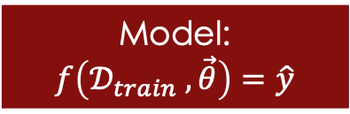

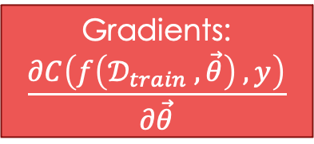
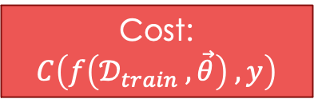
Cost Function
Training data:
$$𝒟_{train}=\left\{\left(x^{1},y^{1}\right),⋯\right\}$$
Model:
$$f\left(𝒟_{train} , \vec{θ}\right)=\hat{y}$$
Cost:
$$C\left(f\left(𝒟_{train} , \vec{θ}\right) , y\right)$$
Update $\vec{θ}$
Gradients:
$$\frac{∂C\left(f\left(𝒟_{train} , \vec{θ}\right) , y\right)}{∂\vec{θ}}$$

Slide 14

Loss function: cross entropy
The loss function : measurement of the dissimilarity between the true class $y^{i}$ and the estimated distribution over the C classes ${\hat{y}}^{i}$, for data point $x^{i}$
Cross entropy is based on the notion of entropy and compares two probability distributions
let $y^{i}$ be a one-hot encoded vector (all 0s, except in the position corresponding to $x^{i}$ true class): $ce\left(y^{i},{\hat{y}}^{i}\right)=−\sum_{c=1}^{C}{\left(y_{c}^{i} ∗\ln\left({\hat{y}}_{c}^{i}\right)\right)}$

Slide 15

Cost function
The cost is the average of cross entropy across all M data points:
$$C\left(θ^{t}\right)= \frac{1}{M} \sum_{i=1}^{M}{\text{ce}\text{ (}y^{i}\text{ , }{\hat{y}}^{i}\text{)}}=−\frac{1}{M} \sum_{i=1}^{M}{\sum_{c=1}^{C}{y_{c}^{i} ∗\ln\left({\hat{y}}_{c}^{i}\right) }}$$

Slide 16
Optimization
Training data:
$$𝒟_{train}=\left\{\left(x^{1},y^{1}\right),⋯\right\}$$
Model:
$$f\left(𝒟_{train} , \vec{θ}\right)=\hat{y}$$
Cost:
$$C\left(f\left(𝒟_{train} , \vec{θ}\right) , y\right)$$
Update $\vec{θ}$
Gradients:
$$\frac{∂C\left(f\left(𝒟_{train} , \vec{θ}\right) , y\right)}{∂\vec{θ}}$$

Slide 17
















Optimization: parameters shift rule
$$θ^{t+1}=θ^{t}−η {\vec{∇}}_{θ}C\left(θ^{t}\right)$$
$${\vec{∇}}_{θ}{\left\langle O\right\rangle }_{θ}=$$
S$\left(x\right)$
W$\left(θ+\frac{π}{s}\right)$
$$M$$
$${\left\langle M\right\rangle }_{θ+\frac{π}{s}}$$
$$−$$
$$\left.\left|0\right.\right\rangle$$
S$\left(x\right)$
W$\left(θ−\frac{π}{s}\right)$
$$M$$
$${\left\langle M\right\rangle }_{θ−\frac{π}{s}}$$
$$\left.\left|0\right.\right\rangle$$
$${\vec{∇}}_{θ}{\left\langle O\right\rangle }_{θ} =\frac{1}{s}\left[{\left\langle O\right\rangle }_{θ+\frac{π}{s}} −{\left\langle O\right\rangle }_{θ−\frac{π}{s}}\right]$$
For single qubit Pauli gates $s=2$
$${\vec{∇}}_{θ}{\left\langle O\right\rangle }_{θ} =\frac{1}{2}\left[{\left\langle O\right\rangle }_{θ+\frac{π}{2}} −{\left\langle O\right\rangle }_{θ−\frac{π}{2}}\right]$$

Slide 18

Optimization: parameters shift rule
The gradient has to be evaluated:
for each parameter $θ_{k}$ in $\vec{θ}$
for each data point $x^{m}$ in the data set
if there are different measurements per class, for each class $c$
$$∇_{θ_{k}}{\left\langle σ_{z}\right\rangle }_{c, θ_{∂k}^{t}}^{m}= \frac{1}{2}\left[{\left\langle σ_{z}\right\rangle }_{c, θ_{k}+\frac{π}{2}}^{m} −{\left\langle σ_{z}\right\rangle }_{c, θ_{k}− \frac{π}{2}}^{m}\right]$$
The evaluation of each $\left\langle σ_{z}\right\rangle$ requires multiple shots

Slide 19
Iterate
Training data:
$$𝒟_{train}=\left\{\left(x^{1},y^{1}\right),⋯\right\}$$
Model:
$$f\left(𝒟_{train} , \vec{θ}\right)=\hat{y}$$
Cost:
$$C\left(f\left(𝒟_{train} , \vec{θ}\right) , y\right)$$
Update $\vec{θ}$
Gradients:
$$\frac{∂C\left(f\left(𝒟_{train} , \vec{θ}\right) , y\right)}{∂\vec{θ}}$$

Slide 20



Update $θ$
$${\vec{θ}}^{t+1}=\left(\begin{matrix}θ_{1}^{t}−η ∇_{θ_{1}}C\left({\vec{θ}}^{t}\right) \\ ⋮ \\ θ_{K}^{t}−η ∇_{θ_{K}}C\left({\vec{θ}}^{t}\right)\end{matrix}\right)$$
$${\vec{θ}}^{t+1}={\vec{θ}}^{t}−η {\vec{∇}}_{θ}C\left({\vec{θ}}^{t}\right)$$

Slide 21
Variational Quantum Algorithms
Training data:
$$𝒟_{train}=\left\{\left(x^{1},y^{1}\right),⋯\right\}$$
Model:
$$f\left(𝒟_{train} , \vec{θ}\right)=\hat{y}$$
Cost:
$$C\left(f\left(𝒟_{train} , \vec{θ}\right) , y\right)$$
Update $\vec{θ}$
Gradients:
$$\frac{∂C\left(f\left(𝒟_{train} , \vec{θ}\right) , y\right)}{∂\vec{θ}}$$

