Slide 1
Ciência de Dados Quântica QAOA: Quantum Approximate Optimization Algorithm
Luís Paulo santos

Slide 2
Material de Consulta
[Schuld2021] – Sec. 3.6.5.2; Chap. 5
Qiskit Textbook: Solving combinatorial optimization problems using QAOA https://qiskit.org/textbook/ch-applications/qaoa.html
Theory and Implementation of the Quantum Approximate Optimization Algorithm: A Comprehensible Introduction and Case Study Using Qiskit and IBM Quantum Computers https://arxiv.org/abs/2301.09535
Quantum Approximate Optimization Algorithm explained https://www.mustythoughts.com/quantum-approximate-optimization-algorithm-explained
Quantum TSP tutorial https://github.com/mstechly/quantum_tsp_tutorials

Slide 3

Combinatorial Optimization
Combinatorial optimization problems: finding an optimal object out of a finite set of objects.
Our formulation: finding optimal bit strings, $z={\left\{0,1\right\}}^{⨂n }$, out of a set of finite bitstrings

Slide 4
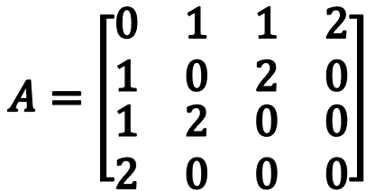
Combinatorial Optimization: MaxCut
z=z₀z₁z₂z₃ | Cut
0000 | 0
0001 | 2
0010 | 3
0011 | 5
0100 | 3
0101 | 5
0110 | 2
0111 | 4
1000 | 4
1001 | 2
1010 | 5
1011 | 3
1100 | 5
1101 | 3
1110 | 2
1111 | 0
Given a graph G=(V,E) find the cut with maximum cost A cut is a partitioning of the graph’s nodes into 2 sets
2
0
1
$$A=\left[\begin{matrix}\begin{matrix}0 & 1 \\ 1 & 0\end{matrix} & \begin{matrix}1 & 2 \\ 2 & 0\end{matrix} \\ \begin{matrix}1 & 2 \\ 2 & 0\end{matrix} & \begin{matrix}0 & 0 \\ 0 & 0\end{matrix}\end{matrix}\right]$$
3
1
1
2
2

Slide 5

Combinatorial Optimization: MaxSAT
Given Boolean statements on the bits $z_{i}$ identify the bit strings which satisfy more statements
$z=z_{0}z_{1}z_{2}$ $C_{1}(z)=z_{0}z_{1}$ $C_{2}(z)=z_{0}\overline{z_{2}}$
$$C(z)=\sum_{z=1}^{K}{C_{k}\left(z\right)}$$
z=z₀z₁z₂ | C₁(z) | C₂(z) | C(z)
000 | 0 | 0 | 0
001 | 0 | 0 | 0
010 | 0 | 0 | 0
011 | 0 | 0 | 0
100 | 0 | 1 | 1
101 | 0 | 0 | 0
110 | 1 | 1 | 2
111 | 1 | 0 | 1

Slide 6

Time Evolution
Let $H$ be the Hamiltonian of a quantum system. Then the system time evolution, according to Schrodinger equation is:
$iℏ\frac{d}{dt}\left.\left|ψ\left(t\right)\right.\right\rangle =H$ $\left.\left|ψ\left(t\right)\right.\right\rangle$
$$\left.\left|ψ\left(t\right)\right.\right\rangle =e^{\frac{−iHt}{ℏ}}\left.\left|ψ\left(0\right)\right.\right\rangle$$
The Hamiltonian is Hermitian ($H=H^{†}$),
therefore $U_{H}\left(t\right)=e^{\frac{−iHt}{ℏ}}$ is unitary ($U_{H}^{−1}\left(t\right)=U_{H}^{†}\left(t\right)$)
$$\left.\left|ψ\left(t\right)\right.\right\rangle =e^{\frac{−iHt}{ℏ}}\left.\left|ψ\left(0\right)\right.\right\rangle =U_{H}\left(t\right)\left.\left|ψ\left(0\right)\right.\right\rangle$$

Slide 7

Adiabatic Quantum Computing
“A physical system remains in its instantaneous eigenstate if a given perturbation is acting on it slowly enough ...” ^{[1]}
Start from the ground state $\left.\left|s\right.\right\rangle$ of a quantum system with an easily realisable Hamiltonian $H_{0}$, which corresponds to a smooth landscape
Aim towards the ground state of the Hamiltonian $H_{p}$, which describes the quantum system of interest
Then the Hamiltonian used by the adiabatic approach is:
$$H\left(t\right)=\left(1−t\right) H_{0}+t H_{p}$$
[1] - M. Born and V. A. Fock (1928). "Beweis des Adiabatensatzes". Zeitschrift für Physik A. 51 (3–4): 165–180. doi:10.1007/BF01343193

Slide 8

Adiabatic Quantum Computing
t=t₀
t=t₂
t=t₁
$$\left.\left|ψ\right.\right\rangle$$
Slow time evolution from the ground state of $H_{0}$ to the ground state of $H_{p}$

Slide 9

QAOA operator
Up to now:
$\left.\left|ψ\left(t\right)\right.\right\rangle =e^{\frac{−iHt}{ℏ}}\left.\left|ψ\left(0\right)\right.\right\rangle$
$H\left(t\right)=\left(1−t\right) H_{0}+t H_{p}$
The circuit based QAOA substitutes $(1−t)$ and $t$ by parameters $β$and $α$, which are variationally optimized:
$\left.\left|ψ\left(t\right)\right.\right\rangle =e^{\left(\frac{−iβH_{0}}{ℏ}+\frac{−iαH_{p}}{ℏ}\right)}\left.\left|ψ\left(0\right)\right.\right\rangle$

Slide 10

QAOA operator: trotterization
if $H_{0}$ and $H_{p}$ do not commute (and they can’t commute for QAOA to converge^{[2]}), then:
$$e^{(−iβH_{0})+(−i∝H_{p}) } ≠e^{−iβH_{0}} ∗e^{−i∝H_{p}}$$
Lie product formula states that: $e^{A+B}=\lim_{p→∞}{{\left(e^{A/p}∗e^{B/p}\right)}^{p}}$
The Trotter Suzuki formula allows truncation (trotterization) of the above product:
$e^{A+B}={\left(e^{A/p}∗e^{B/p}\right)}^{p}+𝒪\left(p^{−1}\right)$, for finite $p∈ℕ$
[2] – for an explanation of the implications of commutation see: https://physics.stackexchange.com/questions/9194/what-is-the-physical-meaning-of-commutation-of-two-operators

Slide 11

QAOA operator: trotterization
$e^{(−iβH_{0})+(−iH_{p}) }={\left(e^{{−iβH_{0}}/p}∗e^{{−i∝H_{p}}/p}\right)}^{p}+𝒪\left(p^{−1}\right)$, for finite $p∈ℕ$
Let $U\left(β,H_{0}\right)=e^{−iβH_{0}}$ and $U\left(α,H_{p}\right)=e^{−i∝H_{p}}$, where $\frac{1}{p}$ has been absorbed into the parameters $α$ and $β$
Furthermore, allow $α$ and $β$ to be different for each term of the product:
$$e^{(−iβH_{0})+(−i∝H_{p}) }≈\prod_{j=1}^{p}{\left(U\left(β_{j},H_{0}\right)U\left(α_{j},H_{p}\right)\right)}$$
Finally we get:
$$\left.\left|ψ\left(α,β\right)\right.\right\rangle =U\left(β_{p},H_{0}\right)U\left(α_{p},H_{p}\right)⋯U\left(β_{1},H_{0}\right)U\left(α_{1},H_{p}\right)\left.\left|ψ\left(0\right)\right.\right\rangle$$

Slide 12
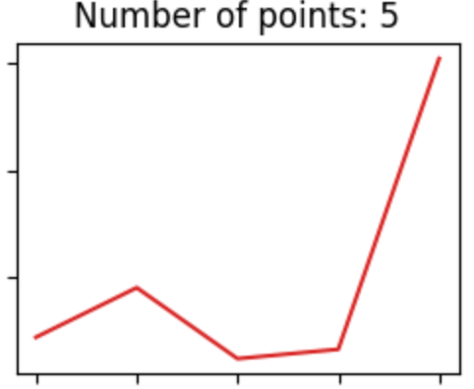
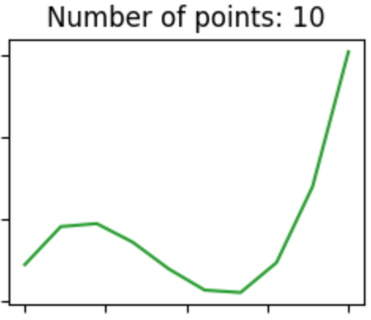
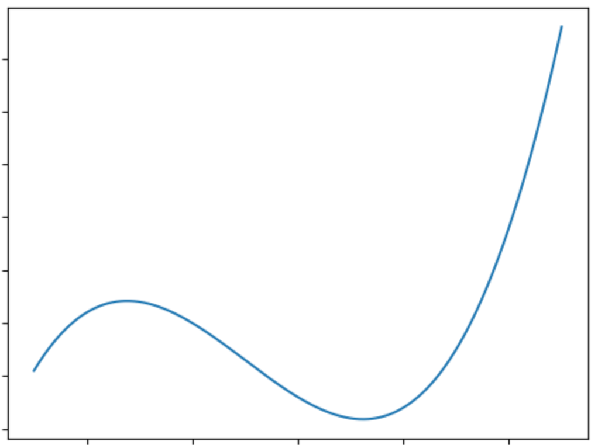
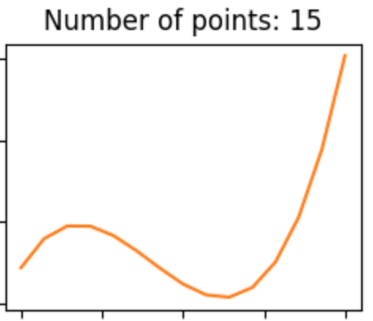
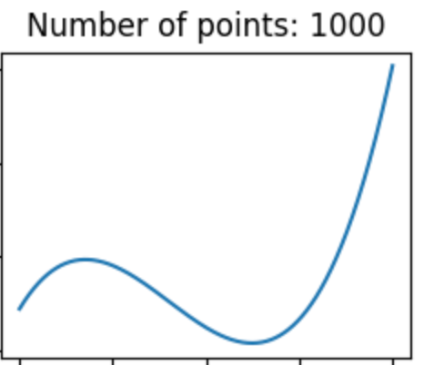
QAOA operator: trotterization
trotterization:
discretization of the time evolution

Slide 13
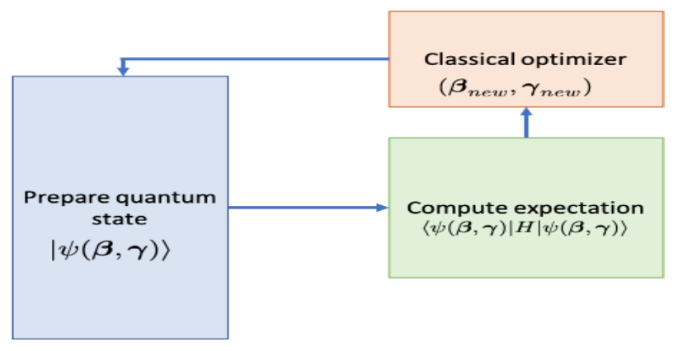


QAOA: overall
find $\left(α^{∗}, β^{∗}\right)$ such that the expectation of $H_{p}$ is minimized:
$$\left.\left|ψ\left(α^{∗}, β^{∗}\right)\right.\right\rangle =\underset{α,β}{argmin}\left\langle \left.\left|ψ\left(α,β\right)\right.\right|\right.H_{p} \left.\left|ψ\left(α,β\right)\right.\right\rangle$$
sample basis states $\left.\left|z\right.\right\rangle$ from $\left.\left|ψ\left(α^{∗}, β^{∗}\right)\right.\right\rangle$ to find a solution

Slide 14


The mixer Hamiltonian: $H_{0}$
$H_{0}$ must:
have a smooth landscape
be easy to implement
have a ground state easy to prepare
not commute with $H_{p}$
A good option is using a Pauli-X ($σ_{j}^{x}$) based Hamiltonian:
$H_{0}=\sum_{j}^{n}{σ_{j}^{x}}$; $U\left(β,H_{0}\right)=e^{−iβH_{0}}=R_{X}^{⨂n}\left(β\right)$, i.e, a X-rotation for all $n$ qubits
The ground state of $H_{0}$ is ${\left.\left|+\right.\right\rangle }^{⨂n}=H^{⨂n}\left.\left|0\right.\right\rangle$, where $H$ is an Hadarmard gate
$H_{p}$ will be based on Pauli-Z operators ($σ_{}^{z}$), which do not commute with $σ_{}^{x}$

Slide 15
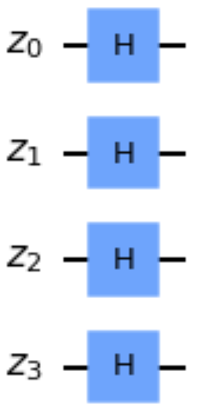
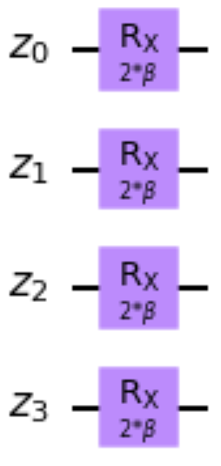

The mixer Hamiltonian: $H_{0}$
$\left.\left|ψ(0)\right.\right\rangle =\left.\left|s\right.\right\rangle ={\left.\left|+\right.\right\rangle }^{⨂n}=H^{⨂n}\left.\left|0\right.\right\rangle$ ; $H_{0}=\sum_{j}^{n}{σ_{j}^{x}}$; $U\left(β,H_{0}\right)=e^{−iβH_{0}}=R_{X}^{⨂n}\left(β\right)$;

Slide 16

The mixer Hamiltonian: $H_{0}$
What is the role of $H_{0}$?
Suppose there is no $H_{0}$. Then the circuit would repetitively apply $U\left(α_{j},H_{p}\right)$
Once an eigenstate of $H_{p}$ is reached the state won’t evolve any further. Applying an operator to its eigenvector can change its length, but not direction. The same would apply if $H_{0}$ would commute with $H_{p}$ .
$H_{0}$allows the quantum system to escape from local minima and search for the ground state;

Slide 17


The problem Hamiltonian: $H_{p}$
$H_{p}$ is built from the problem cost function $C\left(z\right)$, where $z∈{\left\{0,1\right\}}^{n}$ is a bit string
Let $z=z_{0}z_{1}⋯z_{n}$, where $z_{i}=\left\{0,1\right\}$ refers to the i^{th} bit in the string
Using Pauli-Z ($σ^{z}$) operators to develop $H_{p}$ ($σ^{z}$ does not commute with $σ^{x}$) we can map:
$z_{i}→\frac{1−σ_{i}^{z}}{2}$, $σ_{i}^{z} =1⟹z_{i}=0$ ; $σ_{i}^{z}=−1⟹z_{i}=1$

Slide 18


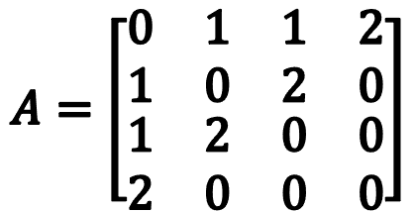
$H_{p}$: MaxCUT
2
0
1
$$A=\left[\begin{matrix}\begin{matrix}0 & 1 \\ 1 & 0\end{matrix} & \begin{matrix}1 & 2 \\ 2 & 0\end{matrix} \\ \begin{matrix}1 & 2 \\ 2 & 0\end{matrix} & \begin{matrix}0 & 0 \\ 0 & 0\end{matrix}\end{matrix}\right]$$
3
1
1
G=(V,E)
2
2
$C\left(z\right)=\sum_{(i,j)εE}{\left[w_{i,j}\left(z_{i}\left(1−z_{j}\right)+z_{j}\left(1−z_{i}\right)\right)\right]}$ $z_{i}→\frac{1−σ_{i}^{z}}{2}$
$H_{p}=\frac{1}{2}\sum_{(i,j)εE}{\left[w_{i,j}\left(1−σ_{i}^{z}σ_{j}^{z}\right)\right]}$
$H_{p}=\frac{1}{2} \left[\left(1−σ_{0}^{z}σ_{1}^{z}\right)+\left(1−σ_{0}^{z}σ_{2}^{z}\right)+2\left(1−σ_{1}^{z}σ_{2}^{z}\right)+2\left(1−σ_{0}^{z}σ_{3}^{z}\right)\right]$
$H_{p}=\left(σ_{0}^{z}⨂σ_{1}^{z}⨂𝕀_{2}⨂𝕀_{3}\right)+\left(σ_{0}^{z}⨂𝕀_{1}⨂σ_{2}^{z}⨂𝕀_{3}\right)+2\left(𝕀_{0}⨂σ_{1}^{z}⨂σ_{2}^{z}⨂𝕀_{3}\right)+2\left(σ_{0}^{z}⨂𝕀_{1}⨂𝕀_{2}⨂σ_{3}^{z}\right)$
$U\left(α,H_{p}\right)=e^{−iα\left(σ_{0}^{z}⨂σ_{1}^{z}⨂𝕀_{2}⨂𝕀_{3}\right)}e^{−iα\left(σ_{0}^{z}⨂𝕀_{1}⨂σ_{2}^{z}⨂𝕀_{3}\right)}e^{−i2α\left(𝕀_{0}⨂σ_{1}^{z}⨂σ_{2}^{z}⨂𝕀_{3}\right)}e^{−i2α\left(σ_{0}^{z}⨂𝕀_{1}⨂𝕀_{2}⨂σ_{3}^{z}\right)}$
See section 4 of https://arxiv.org/pdf/1001.3855.pdf for details on how to develop the Hamiltonian and the respective circuit

Slide 19
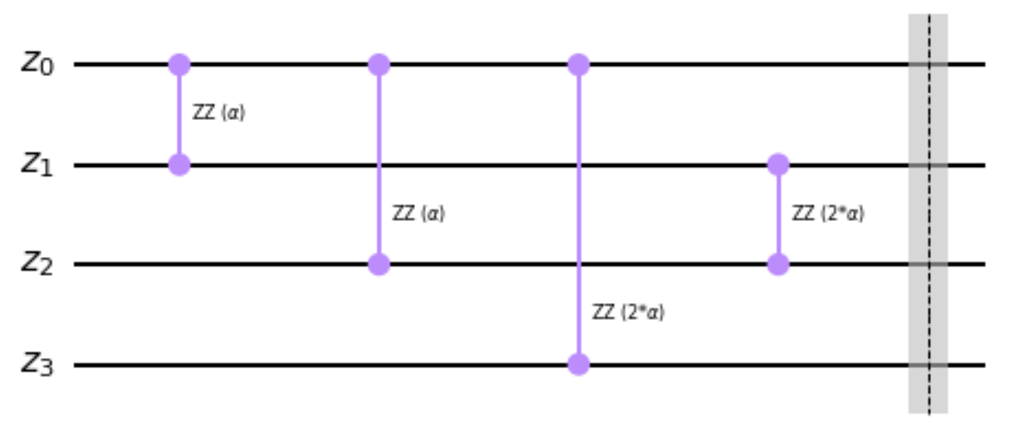

$H_{p}$: MaxCUT
$$U\left(α,H_{p}\right)=e^{−iα\left(σ_{0}^{z}⨂σ_{1}^{z}⨂𝕀_{2}⨂𝕀_{3}\right)}e^{−iα\left(σ_{0}^{z}⨂𝕀_{1}⨂σ_{2}^{z}⨂𝕀_{3}\right)}e^{−i2α\left(𝕀_{0}⨂σ_{1}^{z}⨂σ_{2}^{z}⨂𝕀_{3}\right)}e^{−i2α\left(σ_{0}^{z}⨂𝕀_{1}⨂𝕀_{2}⨂σ_{3}^{z}\right)}$$
$$U\left(α,H_{p}\right)=R_{0,1}^{z}\left(2α\right)R_{0,2}^{z}\left(2α\right)R_{1,2}^{z}\left(4α\right)R_{0,3}^{z}\left(4α\right)$$

Slide 20
MaxCUT: cost and loss functions
def loss_function(z,counts):
loss=0
for i in range(n_qubits):
for j in range(i+1,n_qubits):
if z[i] != z[j] and A[i,j]:
loss -= A[i,j]
loss *= counts
return loss
def cost_function():
counts = execute_circuit(full_qaoa_circuit, shots=2048)
cost = 0
for (z,c) in counts.items():
cost+=loss_function(z, c)
cost /= shots
return cost

Slide 21
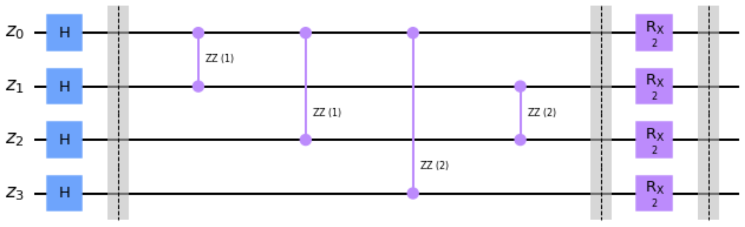
MaxCUT: p=1

Slide 22
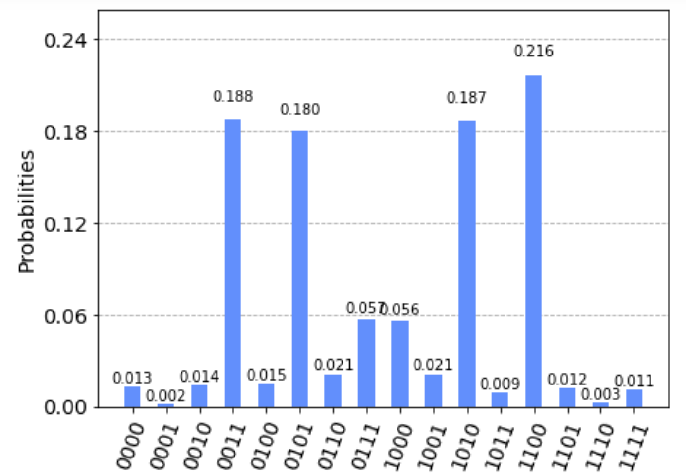
MaxCUT: p=1
z=z₀z₁z₂z₃ | Cut
0000 | 0
0001 | 2
0010 | 3
0011 | 5
0100 | 3
0101 | 5
0110 | 2
0111 | 4
1000 | 4
1001 | 2
1010 | 5
1011 | 3
1100 | 5
1101 | 3
1110 | 2
1111 | 0
2
0
1
3
1
1
2
2

Slide 23
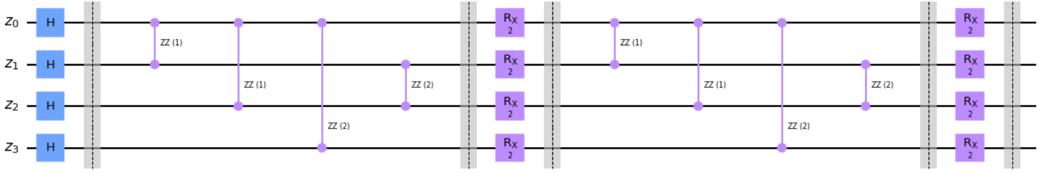
MaxCUT: p=2

Slide 24
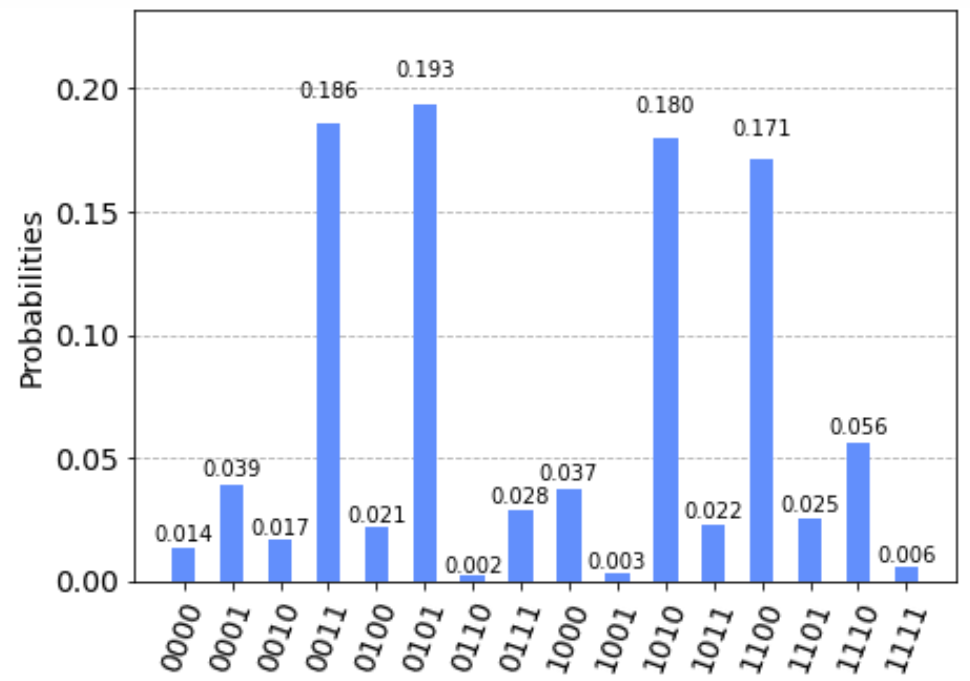
MaxCUT: p=2
z=z₀z₁z₂z₃ | Cut
0000 | 0
0001 | 2
0010 | 3
0011 | 5
0100 | 3
0101 | 5
0110 | 2
0111 | 4
1000 | 4
1001 | 2
1010 | 5
1011 | 3
1100 | 5
1101 | 3
1110 | 2
1111 | 0
2
0
1
3
1
1
2
2

Slide 25
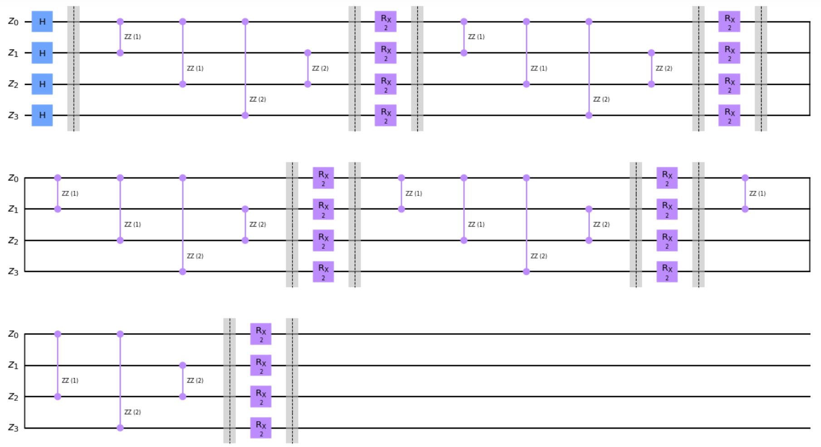
MaxCUT: p=5

Slide 26
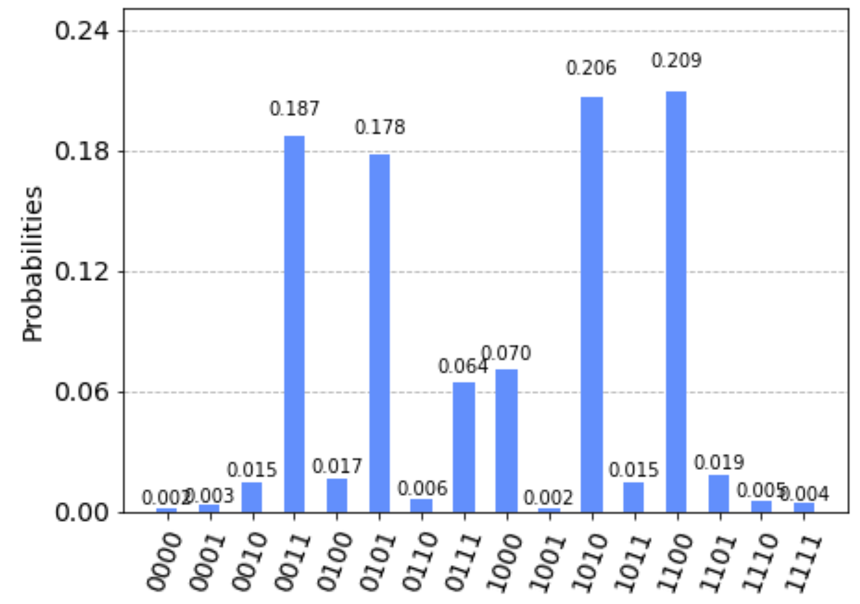
MaxCUT: p=5
z=z₀z₁z₂z₃ | Cut
0000 | 0
0001 | 2
0010 | 3
0011 | 5
0100 | 3
0101 | 5
0110 | 2
0111 | 4
1000 | 4
1001 | 2
1010 | 5
1011 | 3
1100 | 5
1101 | 3
1110 | 2
1111 | 0
2
0
1
3
1
1
2
2

