Slide 1
Ciência de Dados Quântica QUBO 4 QAOA: Quantum Approximate Optimization Algorithm
Luís Paulo santos

Slide 2
Material de Consulta
Fred Glover, Gary Kochenberger, Yu Du; Quantum Bridge Analytics I: A Tutorial on Formulating and Using QUBO Models https://arxiv.org/pdf/1811.11538.pdf
Qiskit Summer School 2021: 5.2 – Introduction to QAOA and Applications
Qiskit Summer School 2021: Lab2 – Introduction to Variational Algorithms

Slide 3

Combinatorial Optimization
Combinatorial optimization problems: finding an optimal object out of a finite set of objects.
Our formulation: finding optimal bit strings, $z={\left\{0,1\right\}}^{⨂n }$, out of a set of finite bitstrings
These problems are NP-hard

Slide 4
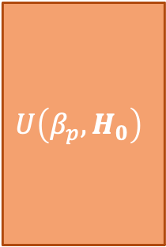
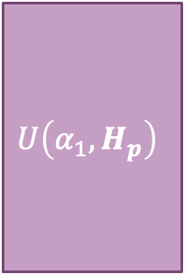
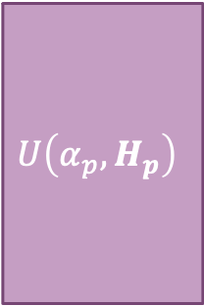



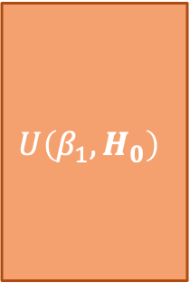

QAOA operator
Let $H_{0}$ be the mixer Hamiltonian and $H_{p}$be the problem Hamiltonian
Then $U\left(β,H_{0}\right)=e^{−iβH_{0}}$ and $U\left(α,H_{p}\right)=e^{−i∝H_{p}}$ are the unitaries, with $α$ and $β$ capturing both time evolution and the $\frac{1}{p}$ term associated with trotterization
Finally we get:
$$\left.\left|ψ\left(α,β\right)\right.\right\rangle =U\left(β_{p},H_{0}\right)U\left(α_{p},H_{p}\right)⋯U\left(β_{1},H_{0}\right)U\left(α_{1},H_{p}\right)H\left.\left|0\right.\right\rangle$$
$$\left.\left|0\right.\right\rangle$$
H
$$U\left(α_{1},H_{p}\right)$$
$$U\left(β_{1},H_{0}\right)$$
$$U\left(α_{p},H_{p}\right)$$
$$U\left(β_{p},H_{0}\right)$$
$$\left.\left|ψ\left(α,β\right)\right.\right\rangle$$
$$\left.\left|0\right.\right\rangle$$
H

Slide 5
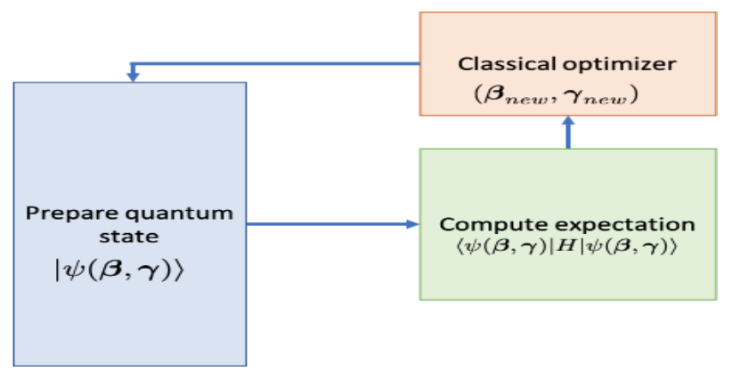


QAOA: overall
find $\left(α^{∗}, β^{∗}\right)$ such that the expectation of $H_{p}$ is minimized:
$$\left.\left|ψ\left(α^{∗}, β^{∗}\right)\right.\right\rangle =\underset{α,β}{argmin}\left\langle \left.\left|ψ\left(α,β\right)\right.\right|\right.H_{p} \left.\left|ψ\left(α,β\right)\right.\right\rangle$$
sample basis states $\left.\left|z\right.\right\rangle$ from $\left.\left|ψ\left(α^{∗}, β^{∗}\right)\right.\right\rangle$ to find a solution

Slide 6
Problem Statement
We want to use near term quantum hardware to solve classical combinatorial optimization problems
Adiabatic Computing (in general) and QAOA (in particular) seem like good candidates to investigate whether a quantum advantage can be unleashed
But how do we transform a classical combinatorial problem into the specification of an Hamiltonian suitable for the QAOA framework?

Slide 7
Problem Statement
It has been found that the framework of Quadratic Unconstrained Binary Optimization (QUBO) can embrace a wide set of important combinatorial optimization problems
Once formulated as a QUBO these problems can be efficiently solved using QUBO solvers, including QAOA within the quantum context
QUBO is a special case of Quadratic Programming

Slide 8

Quadratic Programming
$\min_{x}\left(x^{T}Qx+c^{T}x\right)$, $x∈R^{N}$, $c∈R^{N}$, $Q∈R^{N∗N}$
subject to
$Ax≤b$ linear constraints
$x^{T}Qx+c^{T}x≤r_{i}$ quadratic constraints
$l_{j}≤x_{j}≤u_{j}$ range constraints

Slide 9

QUBO – Quadratic Unconstrained Binary Optimization
$\min_{z}\left(z^{T}Qz+c^{T}z\right)$, $z∈{\left\{0,1\right\}}^{n}$, $c∈R^{N}$, $Q∈R^{N∗N}$
subject to
$Ax≤b$ linear constraints
$x^{T}Qx+c^{T}x≤r_{i}$ quadratic constraints
$l_{j}≤x_{j}≤u_{j}$ range constraints
Binary variables
no variable constraints
although linear constraints $Az=b$ can be supported

Slide 10

QUBO – Basic definitions
$\min_{z}\left(z^{T}Qz+c^{T}z\right)$, $z∈{\left\{0,1\right\}}^{n}$, $c∈R^{N}$, $Q∈R^{N∗N}$
$c$ $∈R^{N}$, is a vector containing the coefficients of the linear terms of the objective function, i.e. $c_{i}$ is the coefficient of the term $z_{i}$
$Q∈R^{N∗N}$, is a square symmetric matrix containing the coefficients of the quadratic terms of the objective function, i.e. $q_{ij}$ is the coefficient of the term $z_{i}z_{j}$
$Q$ is symmetric since $z_{i}z_{j}=z_{j}z_{i}$, for binary variables $z_{t}$
If $Q$ is not given on a symmetric form it can always be made symmetric by redefining it:
$$q_{ij}={\left(q_{ij}+q_{ji}\right)}/2, ∀i,j;j≠i$$

Slide 11
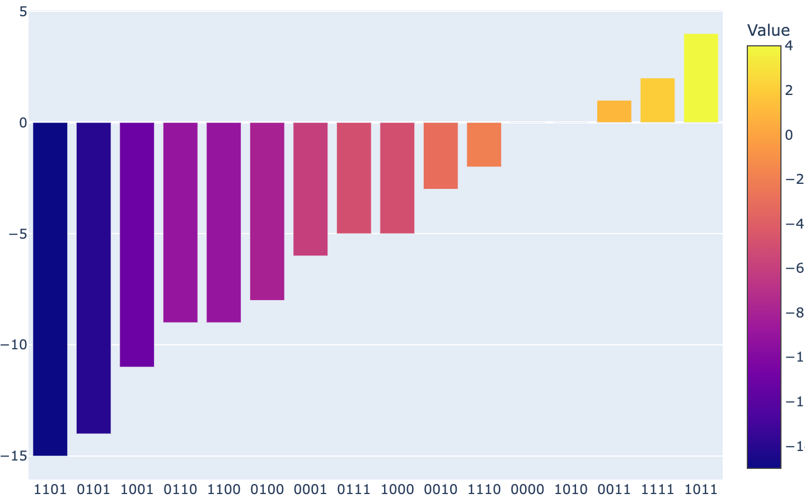


QUBO – Basic example I
$$\min_{z}\left(−5z_{1}−8z_{2}−3z_{3}−6z_{4}+4z_{1}z_{2}+8z_{1}z_{3}+2z_{2}z_{3}+10z_{3}z_{4}\right)$$
linear
quadratic
We can evaluate $f(z)$ for $∀z$, obtaining
$$\min_{z}\left(\left\{\begin{matrix}\begin{matrix}z_{1} & z_{2}\end{matrix} & \begin{matrix}z_{3} & z_{4}\end{matrix}\end{matrix}\right\}\left[\begin{matrix}\begin{matrix}0 & 2 \\ 2 & 0\end{matrix} & \begin{matrix}4 & 0 \\ 1 & 0\end{matrix} \\ \begin{matrix}4 & 1 \\ 0 & 0\end{matrix} & \begin{matrix}0 & 5 \\ 5 & 0\end{matrix}\end{matrix}\right]\left\{\begin{matrix}\begin{matrix}z_{1} \\ z_{2}\end{matrix} \\ \begin{matrix}z_{3} \\ z_{4}\end{matrix}\end{matrix}\right\}+\left\{\begin{matrix}\begin{matrix}−5 & −8\end{matrix} & \begin{matrix}−3 & −6\end{matrix}\end{matrix}\right\}\left\{\begin{matrix}\begin{matrix}z_{1} \\ z_{2}\end{matrix} \\ \begin{matrix}z_{3} \\ z_{4}\end{matrix}\end{matrix}\right\}\right)$$

Slide 12


From QUBO to QAOA
$$C\left(z\right)=\sum_{i=1,j=1,i≠j}^{n}{z_{i} q_{ij}z_{j}}+\sum_{i=1}^{n}{c_{i}z_{i}}$$
$$H_{p}=\sum_{i=1,j=1,i≠j}^{n}{\frac{1}{4}q_{ij} Z_{i} Z_{j}}−\sum_{i=1}^{n}{\frac{1}{2}\left(c_{i}+\sum_{j=1}^{n}{q_{ij}}\right)Z_{i}}+\left(\sum_{i=1,j=1,i≠j}^{n}{\frac{q_{ij}}{4} }+\sum_{i=1}^{n}{\frac{c_{i}}{2}}\right)$$
The Hamiltonian is given by a sum of Pauli Z’s, as expected
Drop
To automatically generate the Hamiltonian from a QUBO using Qiskit see:
https://qiskit-community.github.io/qiskit-optimization/tutorials/10_warm_start_qaoa.html#
Simple demonstration minutes 14:00 to 18:30 in: 5.2 – Introduction to QAOA and Applications

Slide 13


QUBO – Basic example I
$$\min_{z}\left(\left\{\begin{matrix}\begin{matrix}z_{1} & z_{2}\end{matrix} & \begin{matrix}z_{3} & z_{4}\end{matrix}\end{matrix}\right\}\left[\begin{matrix}\begin{matrix}0 & 2 \\ 2 & 0\end{matrix} & \begin{matrix}4 & 0 \\ 1 & 0\end{matrix} \\ \begin{matrix}4 & 1 \\ 0 & 0\end{matrix} & \begin{matrix}0 & 5 \\ 5 & 0\end{matrix}\end{matrix}\right]\left\{\begin{matrix}\begin{matrix}z_{1} \\ z_{2}\end{matrix} \\ \begin{matrix}z_{3} \\ z_{4}\end{matrix}\end{matrix}\right\}+\left\{\begin{matrix}\begin{matrix}−5 & −8\end{matrix} & \begin{matrix}−3 & −6\end{matrix}\end{matrix}\right\}\left\{\begin{matrix}\begin{matrix}z_{1} \\ z_{2}\end{matrix} \\ \begin{matrix}z_{3} \\ z_{4}\end{matrix}\end{matrix}\right\}\right)$$
$$H_{p}=\sum_{i=1,j=1,i≠j}^{n}{\frac{1}{4}q_{ij} Z_{i} Z_{j}}−\sum_{i=1}^{n}{\frac{1}{2}\left(c_{i}+\sum_{j=1}^{n}{q_{ij}}\right)Z_{i}}$$
$$H_{p}=Z_{1} Z_{2}+2 Z_{1} Z_{3}+0.5 Z_{2} Z_{3}+2.5 Z_{3} Z_{4}+0.5 Z_{1}−2.5 Z_{2}+3.5 Z_{3}−0.5 Z_{4}$$

Slide 14
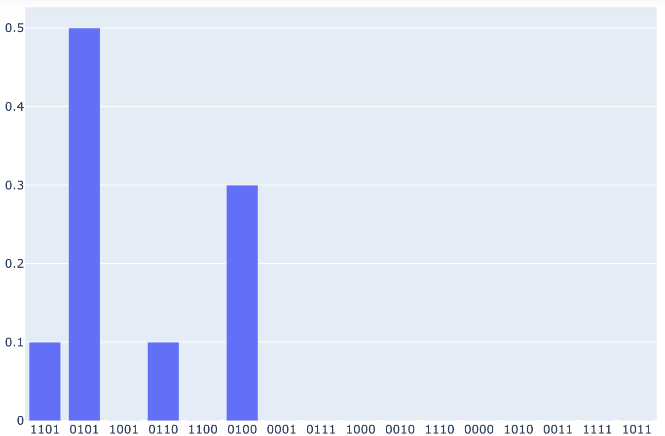
QUBO – Basic example I
$$H_{p}=Z_{1} Z_{2}+2 Z_{1} Z_{3}+0.5 Z_{2} Z_{3}+2.5 Z_{3} Z_{4}+0.5 Z_{1}−2.5 Z_{2}+3.5 Z_{3}−0.5 Z_{4}$$
$$U\left(∝_{t},H_{p}\right)=e^{−i∝_{t}H_{p}}=R_{Z_{1} Z_{2}}\left(∝_{t}\right)∗R_{Z_{1} Z_{3}}\left(2∝_{t}\right)∗R_{Z_{2} Z_{3}}\left(0.5∝_{t}\right)∗R_{Z_{3} Z_{4}}\left(2.5∝_{t}\right)∗$$
$$∗R_{Z_{1} }\left(0.5∝_{t}\right)∗R_{Z_{2} }\left(−2.5∝_{t}\right)∗R_{Z_{3} }\left(3.5∝_{t}\right)∗R_{Z_{4} }\left(−0.5∝_{t}\right)$$
p=2

Slide 15
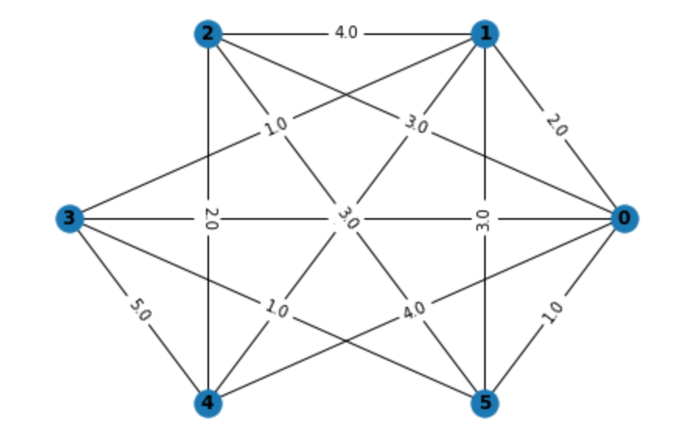
QUBO – MaxCut
Given the weighted adjacency matrix of a graph cut it onto two subgraphs, such that the cut is maximal
w =np.array([[0., 2., 3., 2., 4., 1.],
[2., 0., 4., 1., 1., 3.],
[3., 4., 0., 0., 2., 3.],
[2., 1., 0., 0., 5., 1.],
[4., 1., 2., 5., 0., 0.],
[1., 3., 3., 1., 0., 0.]])

Slide 16

QUBO – MaxCut
The cost function is given by :
$$C\left(z\right)=\sum_{i,j,i≠j}^{n}{w_{ij}∗z_{i}\left({1−z}_{j}\right)} ⟺ C\left(z\right)=\sum_{i,j,i≠j}^{n}{w_{ij}∗z_{i}}−\sum_{i,j,i≠j}^{n}{w_{ij}∗z_{i}z_{j}}$$
spinning the sign to convert to a minimization problem
$$C\left(z\right)=\sum_{i,j,i≠j}^{n}{{−w}_{ij}∗z_{i}}+\sum_{i,j,i≠j}^{n}{w_{ij}∗z_{i}z}$$
write in the QUBO representation
$c_{i}=\sum_{j=1}^{n}{−w_{ij}}$ $q_{ij}=w_{ij}, i≠j$

Slide 17
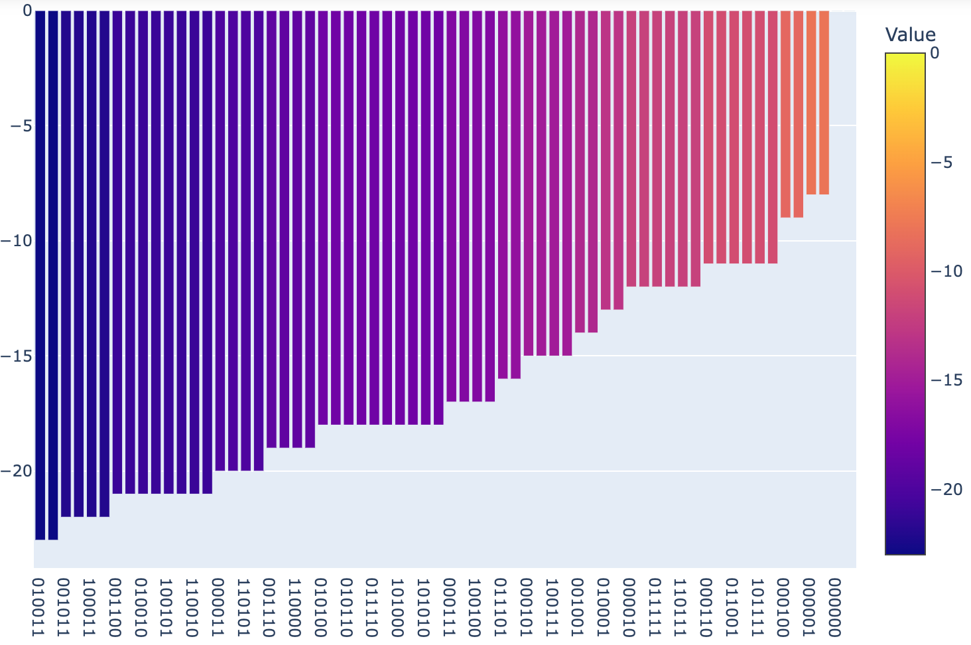
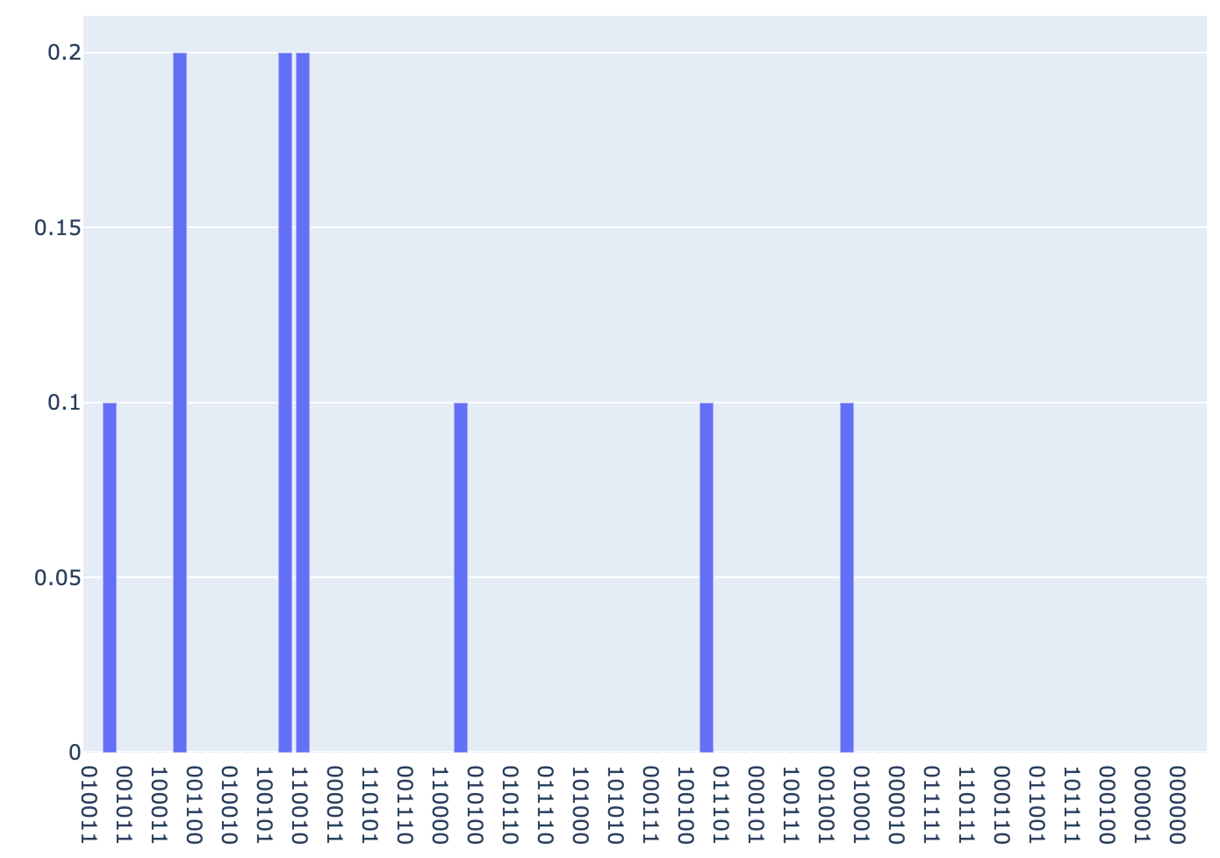
QUBO – MaxCut
p=2

Slide 18

QUBO – Number Partitioning
Given a set $𝒮$ of numbers partition to into two disjoint subsets, $𝒮_{0}$ and $𝒮_{1}$, such that the sum of their elements is minimal:
$$\min\left|\sum_{s∈𝒮_{0}}{s}−\sum_{s∈𝒮_{1}}{s}\right|$$
Let $𝒮=\left\{s_{1},…,s_{n}\right\}$ and $z_{i}∈\left\{0,1\right\}, i=1…n$ indicate to which subset $s_{i}$ belongs to
$sum 𝒮_{1}=\sum_{i=1}^{n}{s_{i}∗z_{i}}$ ; $sum 𝒮_{0}=\sum_{i=1}^{n}{s_{i}}−\sum_{i=1}^{n}{s_{i}∗z_{i}}$
Let $S=\sum_{i=1}^{n}{s_{i}}$ then $sum 𝒮_{0}−sum 𝒮_{1}=S−\sum_{i=1}^{n}{s_{i}∗z_{i}}$
Let our objective function be
$$C\left(z\right)={\left(S−\sum_{i=1}^{n}{s_{i}∗z_{i}}\right)}^{2}$$

Slide 19


QUBO – Number Partitioning
$$C\left(z\right)={\left(S−\sum_{i=1}^{n}{s_{i}∗z_{i}}\right)}^{2}$$
$$C\left(z\right)= S^{2}−2S\sum_{i=1}^{n}{s_{i}∗z_{i}}+{\left(\sum_{i=1}^{n}{s_{i}∗z_{i}}\right)}^{2}$$
$${\left(\sum_{i=1}^{n}{s_{i}∗z_{i}}\right)}^{2}=\sum_{i=1}^{n}{{s_{i}}^{2}∗z_{i}}+\sum_{i,j=1, i≠j}^{n}{2s_{i}s_{j}∗z_{i}z_{j}}$$
$$C\left(z\right)= S^{2}−2S\sum_{i=1}^{n}{s_{i}∗z_{i}}+\sum_{i=1}^{n}{{s_{i}}^{2}∗z_{i}}+\sum_{i,j=1, i≠j}^{n}{2s_{i}s_{j}∗z_{i}z_{j}}$$
$$C\left(z\right)= S^{2}+4\sum_{i=1}^{n}{s_{i}\left(s_{i}−S\right)∗z_{i}}+8\sum_{i,j=1, i≠j}^{n}{s_{i}s_{j}∗z_{i}z_{j}}$$
$${z_{i}}^{2}=z_{i},z_{i}∈\left\{0,1\right\}$$

Slide 20

QUBO – Number Partitioning
$$\min_{z}{C\left(z\right)}=\min_{z}\left(\sum_{i=1}^{n}{s_{i}\left(s_{i}−S\right)∗z_{i}}+2\sum_{i,j=1, i≠j}^{n}{s_{i}s_{j}∗z_{i}z_{j}}\right)$$
$c_{i}=s_{i}\left(s_{i}−S\right)$ $q_{ij}=s_{i}s_{j}$
Let $𝒮=\left\{25, 7, 13, 31, 42, 17, 21, 10\right\}$
One optimal solution:
$z=\left\{0, 0, 0, 1, 1, 0, 0, 1\right\}$
$𝒮_{0}=\left\{25, 7, 13, 17, 21\right\}$; $sum=80$
$𝒮_{1}=\left\{31, 41, 10\right\}$; $sum=81$

Slide 21
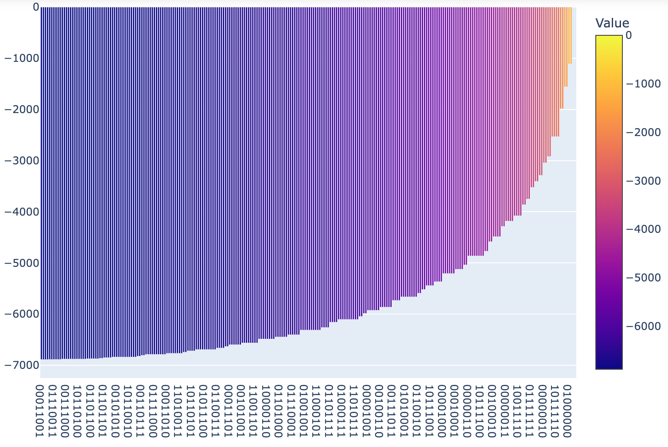
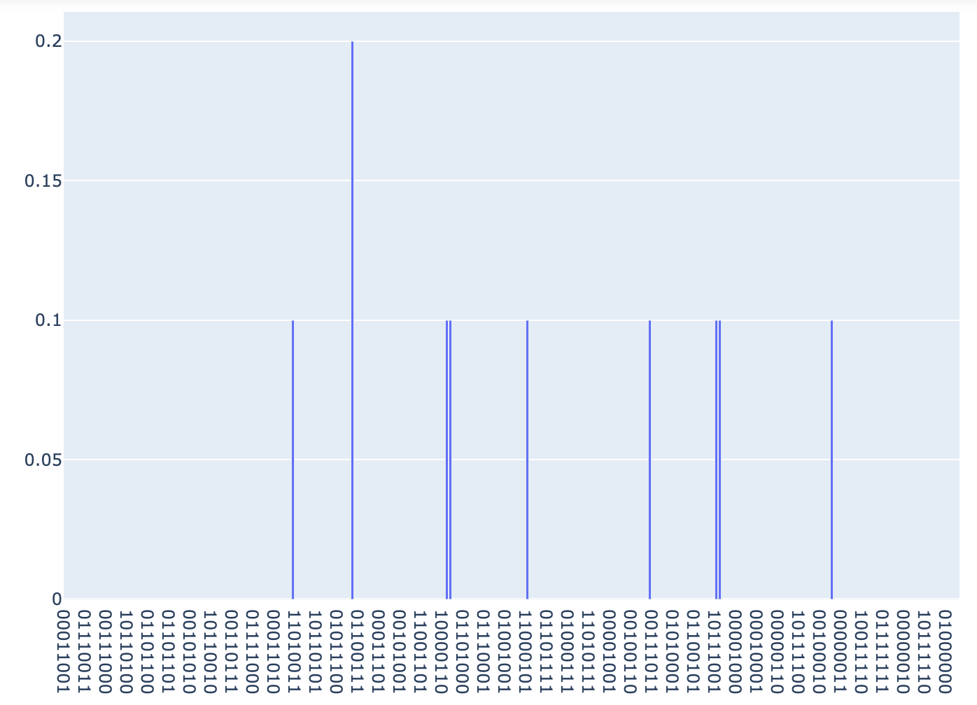
QUBO – Number Partitioning
p=2

Slide 22
Linear Constraints
For reference only

Slide 23

QUBO with linear equality constraints
Consider a QUBO $z^{T}Q^{′}z+{c′}^{T}z$
subject to $M$ constraints of the form $A_{m}z=b_{m}$
Each constraint $m$ can be converted into a quadratic constraint with weight P:
$$P{\left(\sum_{i=1}^{n}{\left(a_{mi}z_{i}\right)−b_{m}}\right)}^{2}=P\left[\sum_{i=1}^{n}{\left(a_{mi}^{2}−2a_{mi}b_{m}\right)z_{i}}+\sum_{i,j=1, j≠i}^{n}{\left(2a_{mi}a_{mj}\right)z_{i}z_{j}}+b_{m}^{2}\right]$$
The quadratic constraints are added to the original QUBO to build a “constrained” QUBO
Fred Glover, Gary Kochenberger, Yu Du; Quantum Bridge Analytics I: A Tutorial on Formulating and Using QUBO Models https://arxiv.org/pdf/1811.11538.pdf

Slide 24

QUBO with linear equality constraints
$$\min_{z}\left(20z_{1}+5z_{2}+7z_{3}+10z_{4}\right)$$
s.t.
$$10z_{1}+5z_{2}+5z_{3}+5z_{4}=10$$
P=1
$\min_{z}\left(\begin{aligned}20z_{1}+5z_{2}+7z_{3}+10z_{4}−100z_{1}−75z_{2}−75z_{3}−75z_{4}+ \\ 100z_{1}z_{2}+100z_{1}z_{3}+100z_{1}z_{4}+ \\ 50z_{2}z_{3}+50z_{2}z_{4}+50z_{3}z_{4}\end{aligned}\right)$
$$\min_{z}\left(\begin{aligned}−90z_{1}−70z_{2}−68z_{3}−65z_{4}+ \\ 100z_{1}z_{2}+100z_{1}z_{3}+100z_{1}z_{4}+ \\ 50z_{2}z_{3}+50z_{2}z_{4}+50z_{3}z_{4}\end{aligned}\right)$$

Slide 25
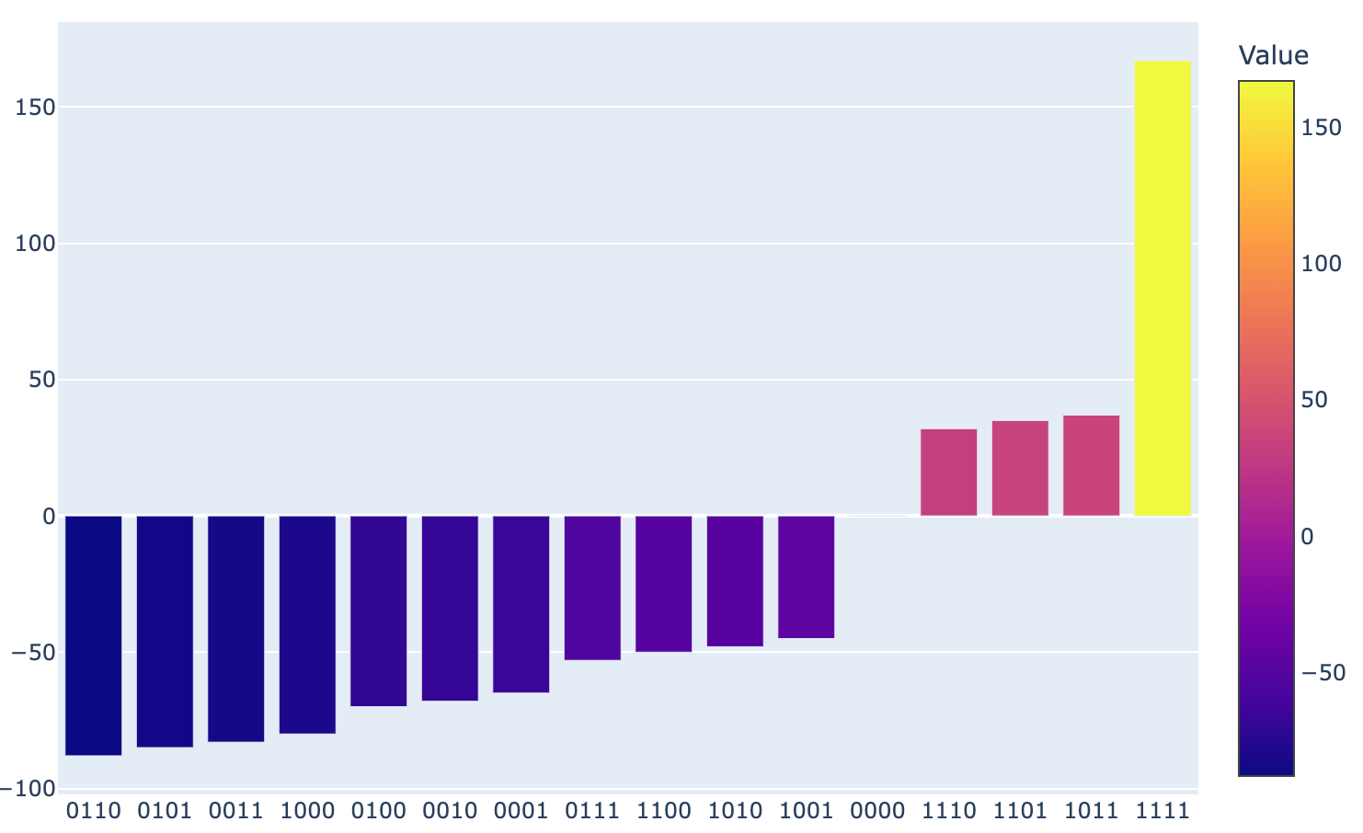
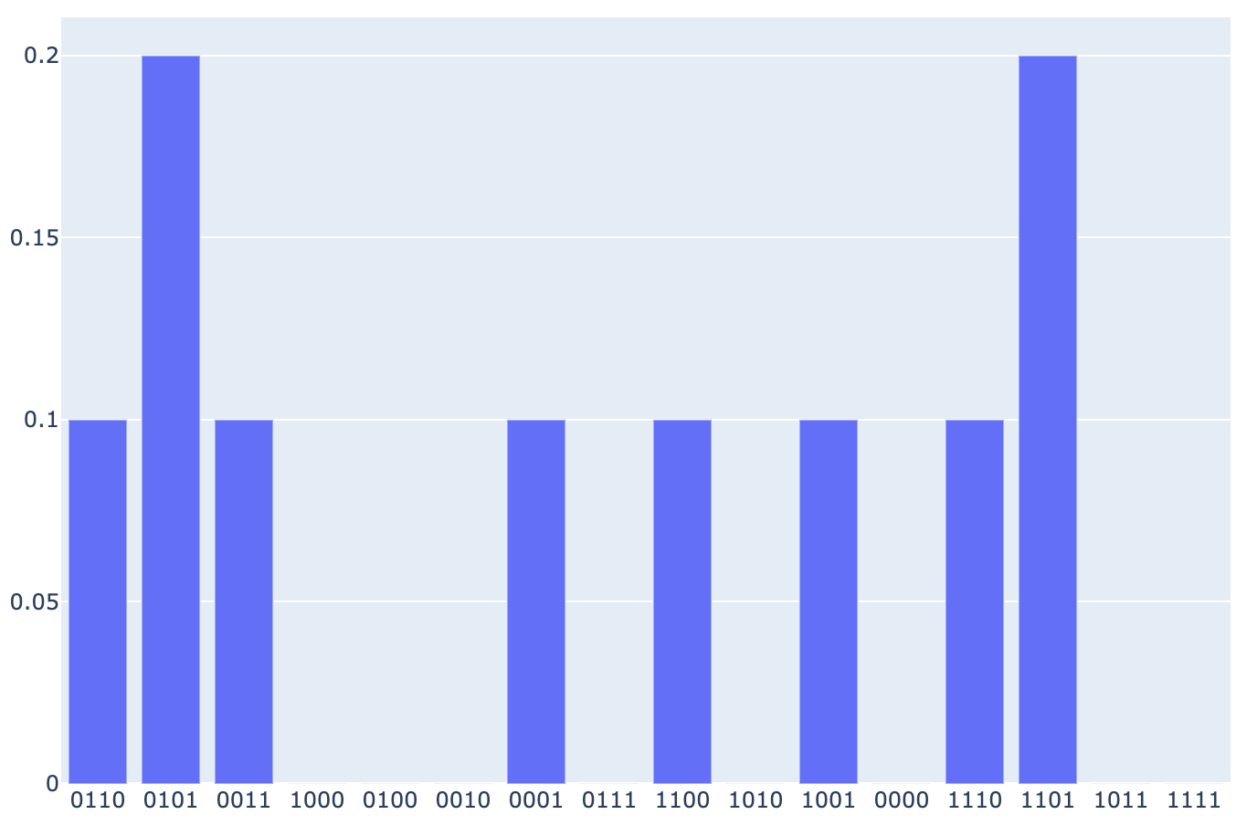

QUBO with linear equality constraints
$$\min_{z}\left(20z_{1}+5z_{2}+7z_{3}+10z_{4}\right)$$
s.t. $10z_{1}+5z_{2}+5z_{3}+5z_{4}=10$
p=2 ; P = 1
0110: min = 12 ; constraint 10=10
0101: min = 15 ; constraint 10=10

