Slide 1
Ciência de Dados Quântica 22/23 Classical Machine Learning: Regression & Classification
Luís Paulo santos
andré sequeira

Slide 2
Material de Consulta
Maria Schuld, Francesco Petruccione “Machine Learning with Quantum Computers” Cap. 2
Luís G. Serrano “grokking Machine Learning” Caps. 2, 3, 4, 5, 6, 7 e apêndice B

Slide 3
An attempt on definition
“Machine learning can be seen as one particular flavour of AI, which designs computer algorithms that generalise from patterns found in data to make predictions in unknown situations.”
“The attraction of machine learning, therefore, lies in its capability to learn from extremely large data sets that only computers can process.”
[Schuld2021 – chapter 2]

Slide 4
An attempt on definition
“Machine learning starts with a very general, agnostic mathematical model, and uses data to adapt it to the case, a process called “training”.
When looking at the final model, we do not necessarily gain information on the physical mechanism or statistical relationships behind the data, but consider it as a black box that has learned to produce reliable outputs.
[Schuld2021 – chapter 2]
Contrast this with Explainable AI (XAI): https://en.wikipedia.org/wiki/Explainable_artificial_intelligence

Slide 5

Fundamental concepts
Problem: defined by an unknown function $f^{∗}$ that relates every point $x$ in the domain $𝒳$ to a value $y$ in the codomain $𝒴$: $f^{∗}:𝒳⟶𝒴$
Regression: $𝒴$ is continuous
Classification: $𝒴$ is discrete

Slide 6

Fundamental concepts
Data set: set of points $𝒟$ in either $𝒳$ or $𝒳⨂𝒴$ available to the machine learning algorithm
$𝒟 ∈𝒳= \left\{x^{1}, ⋯,x^{M}\right\}$ : unlabelled data
$𝒟 ∈𝒳⨂𝒴= \left\{\left(x^{1},y^{1}\right), ⋯,\left(x^{M},y^{M}\right)\right\}$ : labelled data
Features: $𝒳$ is $n$-dimensional, meaning that $x∈𝒳$is a vector with $n$ elements
$$x=\left(x_{1},x_{2},⋯,x_{n}\right)∈𝒳$$

Slide 7

Fundamental concepts
Model: $f:𝒳⟶𝒴$, which “approximates” $f^{∗}$
Model Family: $ℱ=\left\{f_{θ}\right\}$, with $f_{θ}:𝒳⟶𝒴$ and $θ= \left\{θ_{0},θ_{1}, ⋯,θ_{T}\right\}$ is a $T$-dimensional vector that parameterizes $f_{θ}$
Loss: $L(f_{θ}\left(x\right), f^{∗}\left(x\right)=y)$ quantifies the disparity between the model prediction $f_{θ}\left(x\right)$and the true value $y=f^{∗}\left(x\right)$

Slide 8

Fundamental concepts
Risk (aka generalization error): The risk of a model $f_{θ}$ is the expected value of the loss over the whole domain $𝒳$: $R_{f_{θ}}=\int_{𝒳}{L\left(f_{θ}\left(x\right),f^{∗}\left(x\right)\right)dx}$
ML goal: find the model $f_{θ^{∗}}$ which minimizes the generalization error over $𝒳$: $f_{θ^{∗}}=\underset{f_{θ}εℱ}{argmin}{\int_{𝒳}{L\left(f_{θ}\left(x\right),f^{∗}\left(x\right)\right)dx}}$

Slide 9

Fundamental concepts
Empirical Risk : the expected value of $f_{θ}$’s loss over $𝒟$: ${\hat{R}}_{f_{θ}}\left(𝒟\right)=\frac{1}{M}\sum_{i=1}^{M}{L\left(f_{θ}\left(x^{i}\right),y^{i}\right)}$
ML’s practical goal: find the model ${\hat{f}}_{θ}$ which minimizes the empirical risk ${\hat{R}}_{f_{θ}}\left(𝒟\right)$: ${\hat{f}}_{θ}=\underset{f_{θ}εℱ}{argmin}{\sum_{i=1}^{M}{L\left(f_{θ}\left(x^{i}\right),y^{i}\right)}}$

Slide 10
Classification of ML
Supervised Learning : labelled data set
Unsupervised Learning: unlabelled data set
Reinforcement Learning: interactive based on feedback

Slide 11

Types of ML - Supervised Learning
Definition: Given a labelled data set $𝒟 ∈𝒳⨂𝒴= \left\{\left(x^{1},y^{1}\right), ⋯,\left(x^{M},y^{M}\right)\right\}$ as well as a new unclassified point $x ∈𝒳$, predict the corresponding output $y∈𝒴$.

Slide 12
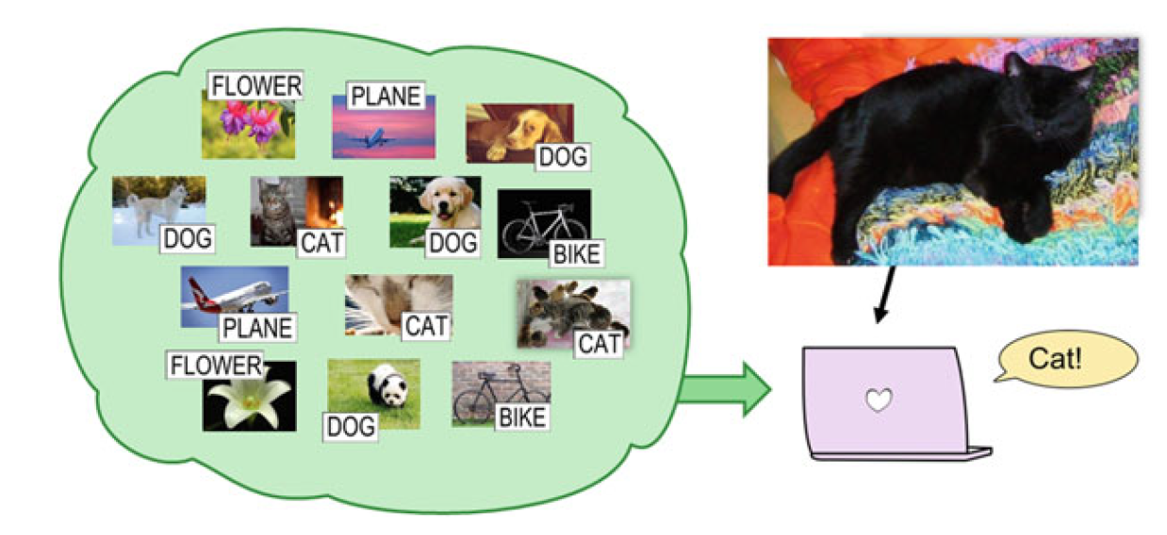
Supervised Learning Examples
[Schuld2021 – chapter 2]

Slide 13
Supervised Learning Examples
Time Series
What will be the value of C
for time=20, given A and B ?

Slide 14


Supervised Learning
Learns a model from the training data set which is used to predict unseen data points
$$𝒴$$
Dog
Regression
Bat
Classification
Cat
$$𝒳$$

Slide 15
Supervised Learning Algorithms
Support-vector machines.
Linear regression.
Random forest.
Naive Bayes.
Linear discriminant analysis.
Decision trees.
K-nearest neighbor algorithm.
Artificial Neural Networks

Slide 16

Types of ML - Unsupervised Learning
Definition: Given an unlabelled data set $𝒟 ∈𝒳= \left\{x^{1}, ⋯,x^{M}\right\}$ drawn from a probability distribution $p(x)$:
group the points according to some similarity measure – clustering
eliminate/combine features in $𝒳$ – dimensionality reduction
draw a new sample from $p(x)$ – generative approach

Slide 17
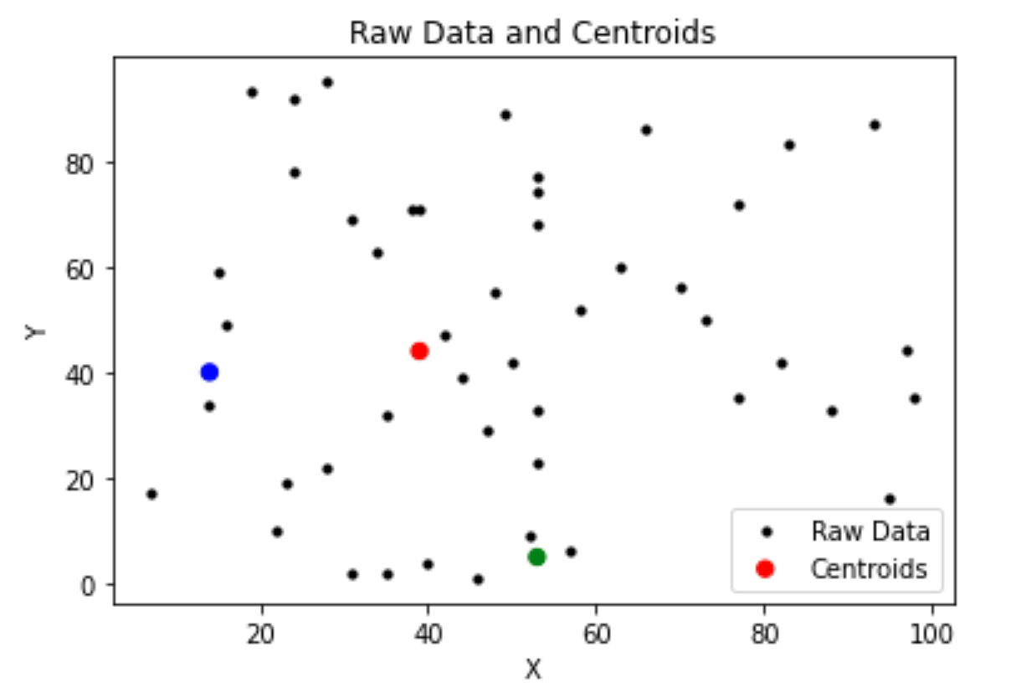
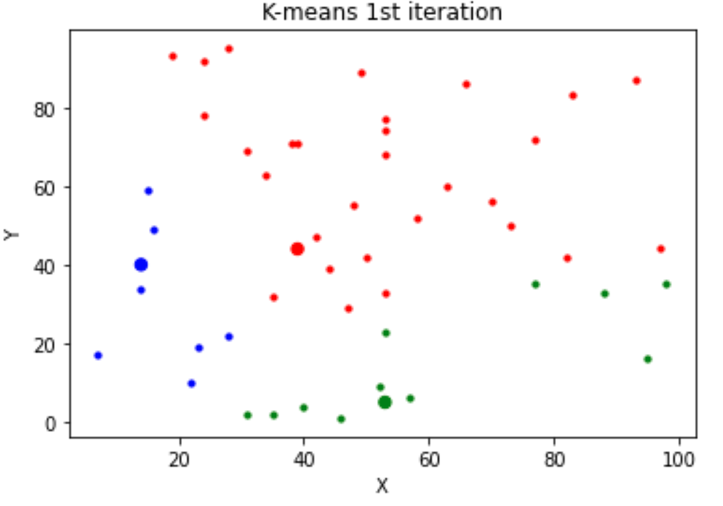
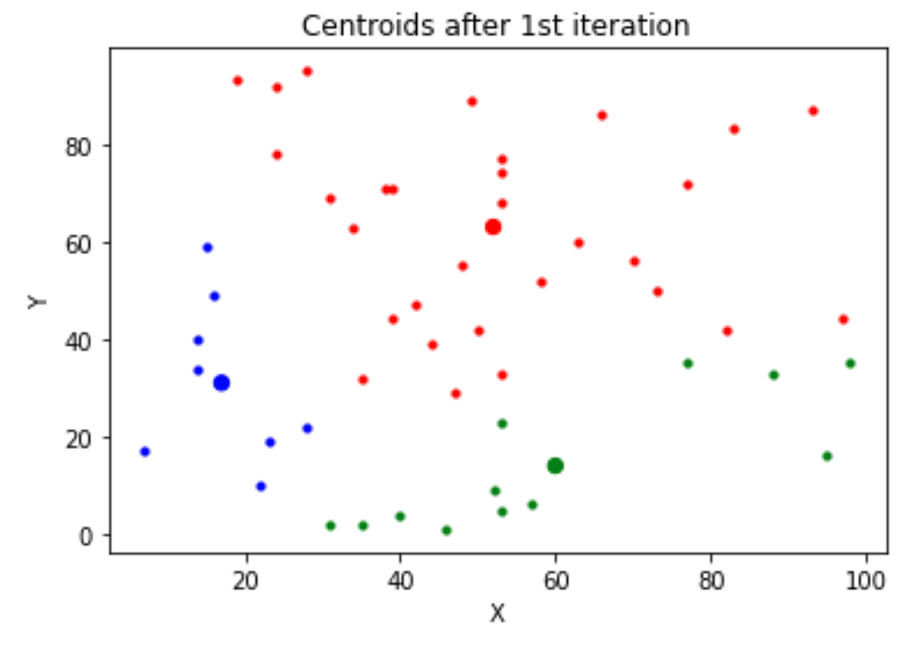
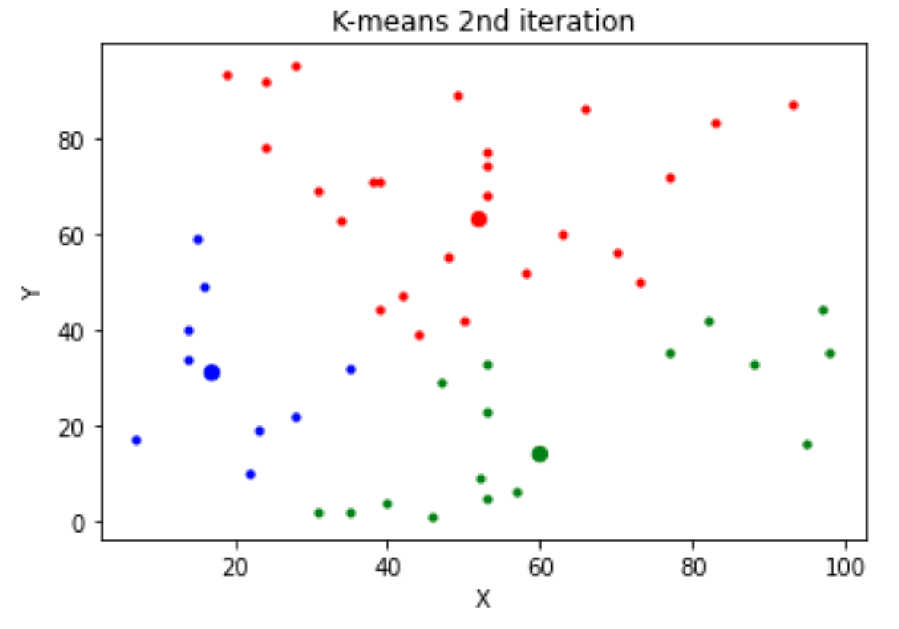
Unsupervised Learning - Clustering

Slide 18
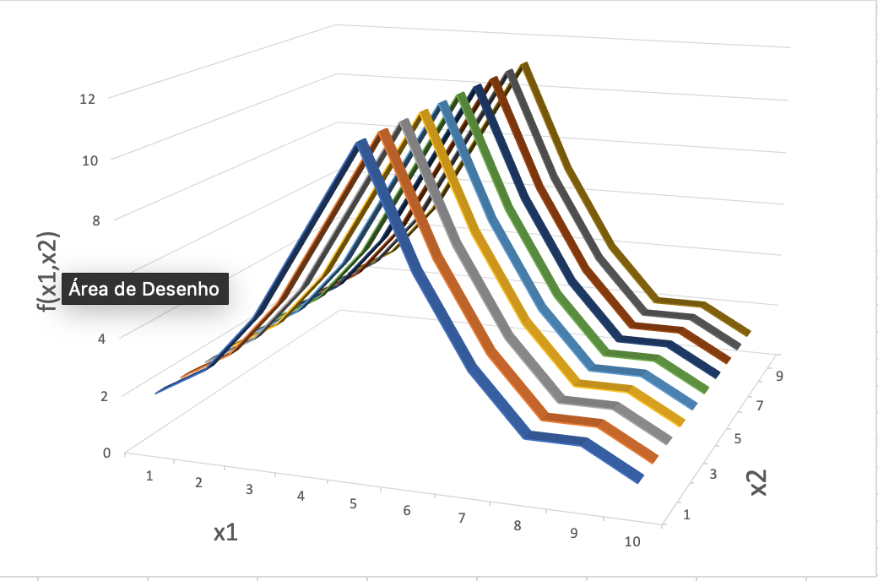
Unsupervised Learning – Dimensionality Reduction

Slide 19
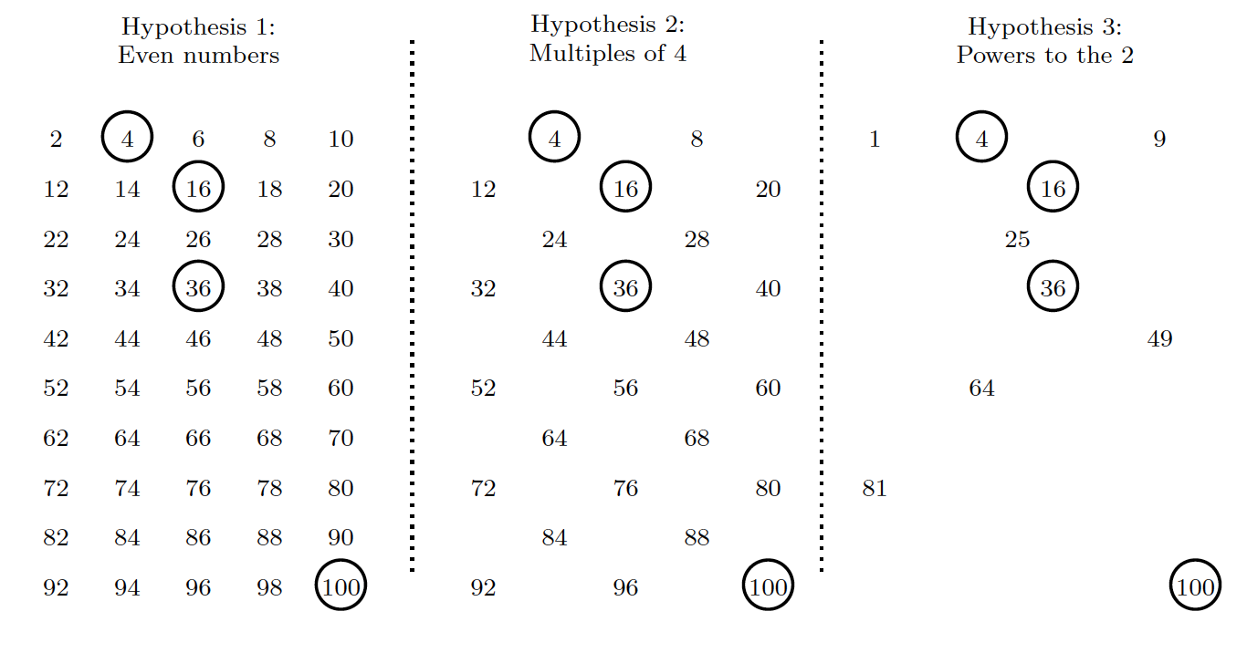

Unsupervised Learning - generative
Hypothesis guessing:
In the range $i∈\left\{1⋯100\right\}, i ∈ℕ$, the values $\left\{4,16,36,100\right\}$ are given according to a (unknown) rule.
Generate another sample with the same rule.

Slide 20


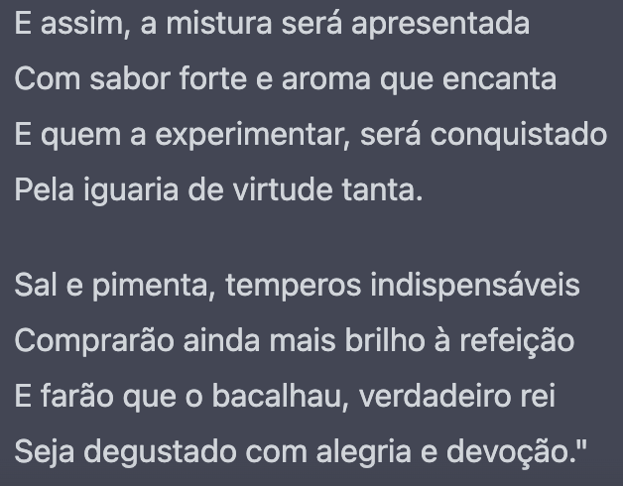
Unsupervised Learning - generative
Chat GPT
DALL-E
podes escrever a receita de bacalhau à Brás no estilo de Luís de Camões?

Slide 21
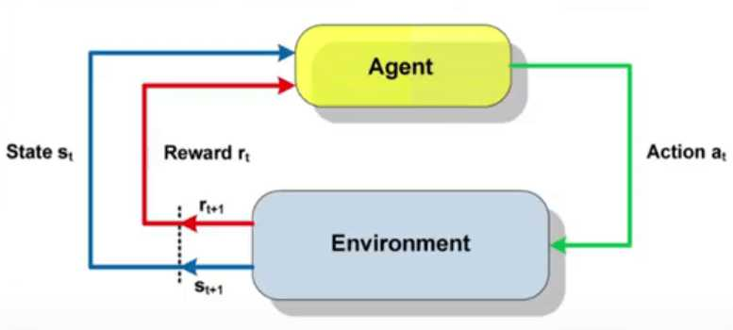

Types of ML - Reinforcement Learning
The agent learns good strategies by trial and error. Every time it acts on the environment it receives a reward. A good strategy maximizes the total received reward.
The agent might learn a policy, indicating, for each state, which action will maximize the total (expected) reward.

Slide 22
Regression

Slide 23

Supervised Learning: Regression
Problem: given a labelled dataset $𝒟∈𝒳⨂𝒴$, taken from an unknown function $f^{∗}:𝒳→𝒴$, learn a function $\hat{f}:𝒳→𝒴$ which approximates $f^{∗}$ and allows predicting $y=\hat{f}(x)$ for previously unseen $\left(x,y\right)$, i.e. $\left(x,y\right)∉𝒟$
Learnable functions $f_{θ}$ are parameterized with $θ$ being a vector of parameters. For linear regression $y=f_{θ}\left(x\right)=θ_{0}+\sum_{i=1}^{n}{θ_{i}∗x_{i}}$, with the number of parameters $T=n+1$, n being the number of features
For uni-dimensional data (n=1) and linear regression lines are used:
$$y=f_{θ}\left(x\right)=θ_{0}+θ_{1}∗x_{1}$$

Slide 24
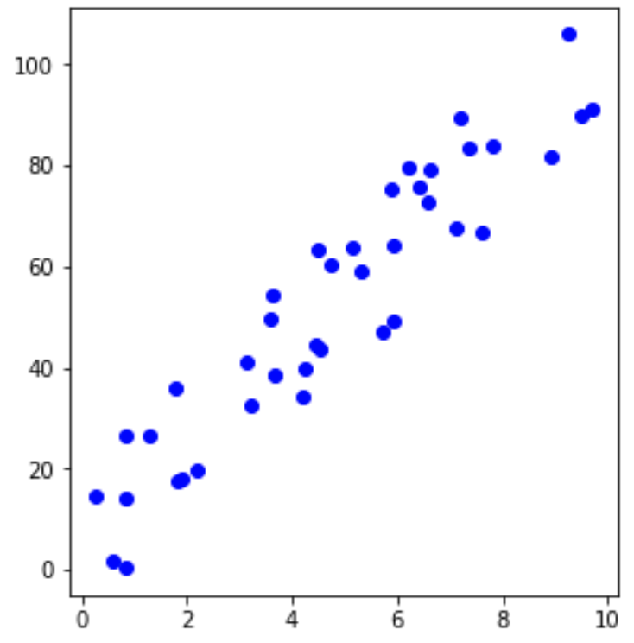



Supervised Learning: Regression
$$y=θ_{0}+θ_{1}∗x_{1}$$
$$θ_{1}$$
$$θ_{0}$$

Slide 25

Linear Regression: algorithm
Dtrain, Dtest = separate (D, fraction)
$θ$ = Initialize ()
Repeat many times
take a subset Di from Dtrain
$θ$new = update_theta (Di, $θ$)
$θ$ = $θ$new
verify (Dtest, $θ$)

Slide 26
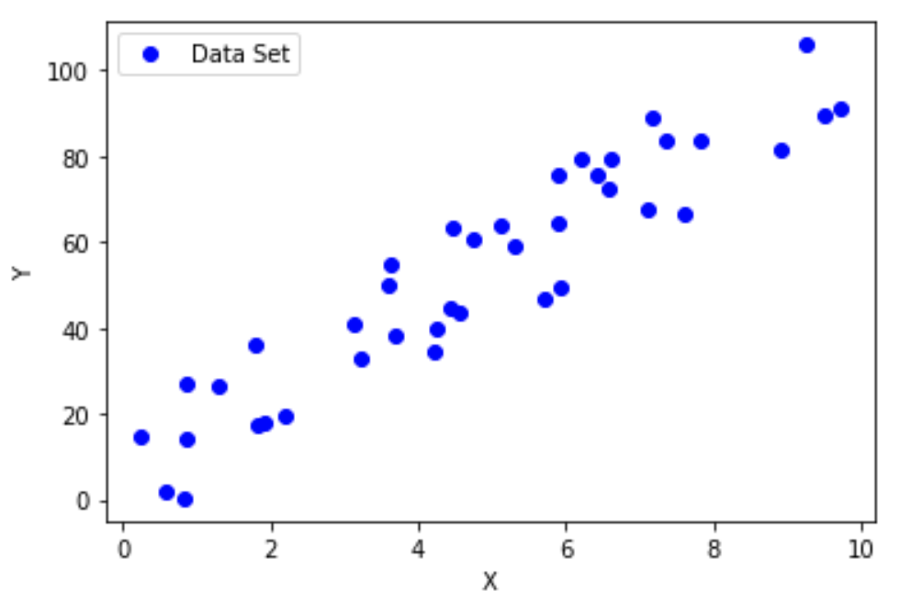
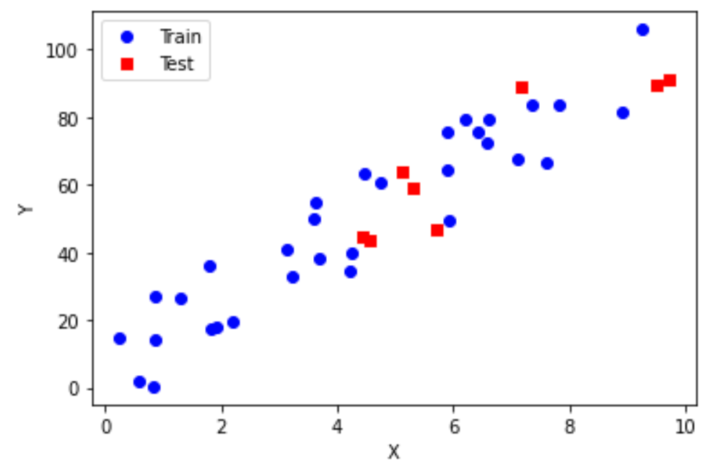
Linear Regression: algorithm
Dtrain, Dtest = separate (D, 0.8)
(rnd,rnd)
(0,0)
$θ$ = Initialize ()

Slide 27

Optimization: gradient descent
$θ$new = update_theta (Di, $θ$)
The goal is to learn a model that minimizes the empirical risk ${\hat{R}}_{f_{θ}}\left(𝒟\right)$:
$${\hat{f}}_{θ}=\underset{f_{θ}εℱ}{argmin}{\sum_{i=1}^{M}{L\left(f_{θ}\left(x^{i}\right),y^{i}\right)}}$$
The loss quantifies the distance between each prediction and the true value. Let’s use the square error as the example:
$$L\left(f_{θ}\left(x^{i}\right),y^{i}\right)={\left(f_{θ}\left(x^{i}\right)−y^{i}\right)}^{2}={\left(θ_{0}+θ_{1}∗x^{i}−y^{i}\right)}^{2}$$
The goal is to find $θ$ that minimizes the objective function:
$$\sum_{i=1}^{M}{{\left(θ_{0}+θ_{1}∗x^{i}−y^{i}\right)}^{2}}$$

Slide 28
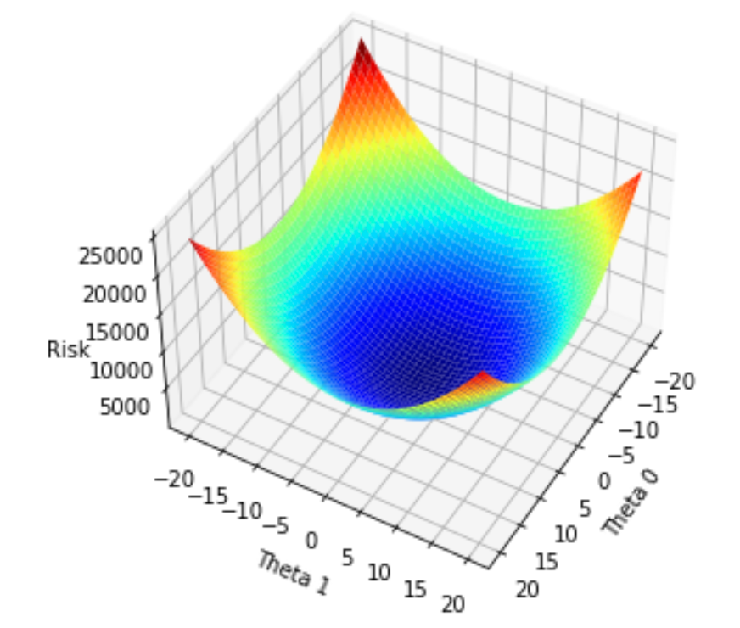








Optimization: gradient descent
$θ$new = update_theta (Di, $θ$)
The goal is to find $θ$ that
minimizes the objective function:
$${\hat{R}}_{f_{θ}}\left(𝒟\right)=\sum_{i=1}^{M}{{\left(θ_{0}+θ_{1}∗x^{i}−y^{i}\right)}^{2}}$$
$$θ^{0}$$
$$θ^{1}$$
$${\hat{R}}_{f_{θ}}\left(𝒟\right)$$
At each iteration change $θ$ slightly along the direction of maximum gradient (change in ${\hat{R}}_{f_{θ}}\left(𝒟\right)$ )
$$θ^{2}$$
$$θ^{3}$$
$$θ^{t+1}=θ^{t}−η∗∇\sum_{i=1}^{M}{{\left(θ_{0}^{t}+θ_{1}^{t}∗x^{i}−y^{i}\right)}^{2}}$$

Slide 29


Optimization: gradient descent
$$∇\sum_{i=1}^{M}{{\left(θ_{0}^{t}+θ_{1}^{t}∗x^{i}−y^{i}\right)}^{2}}=\left(\begin{matrix}\frac{∂}{∂θ_{0}} \\ \frac{∂}{∂θ_{1}}\end{matrix}\right)=\left(\begin{matrix}2\sum_{i=1}^{M}{\left(θ_{0}^{t}+θ_{1}^{t}∗x^{i}−y^{i}\right)} \\ 2\sum_{i=1}^{M}{\left(θ_{0}^{t}+θ_{1}^{t}∗x^{i}−y^{i}\right)∗x^{i}}\end{matrix}\right)$$
$$=\left(\begin{matrix}2\sum_{i=1}^{M}{\left(f_{θ^{t}}(x^{i})−y^{i}\right)} \\ 2\sum_{i=1}^{M}{\left(f_{θ^{t}}(x^{i})−y^{i}\right)∗x^{i}}\end{matrix}\right)$$

Slide 30
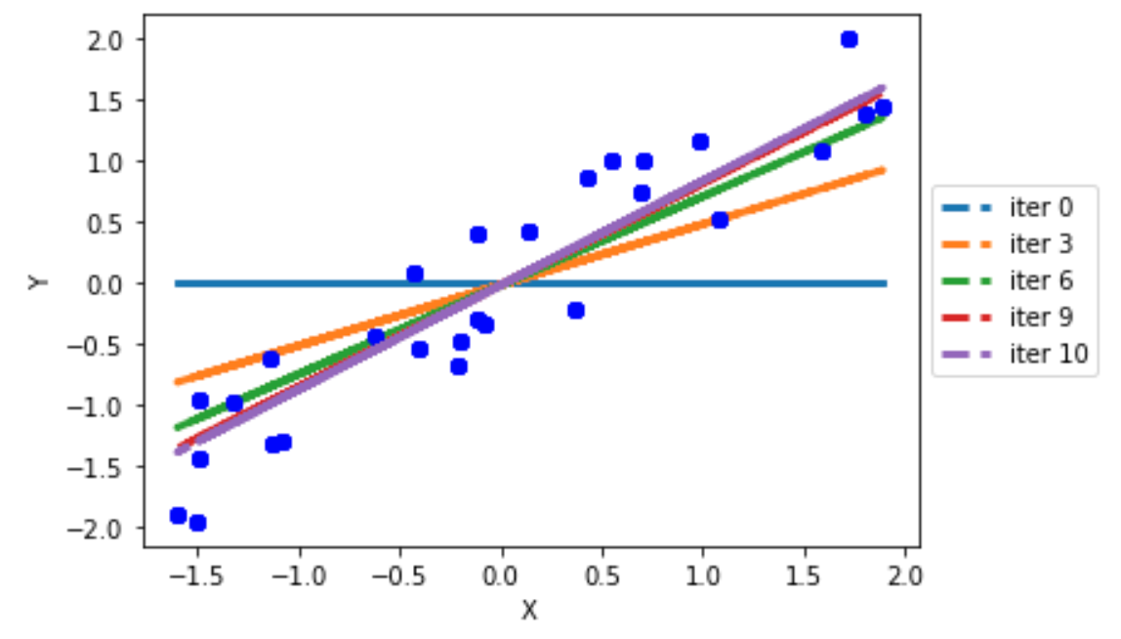
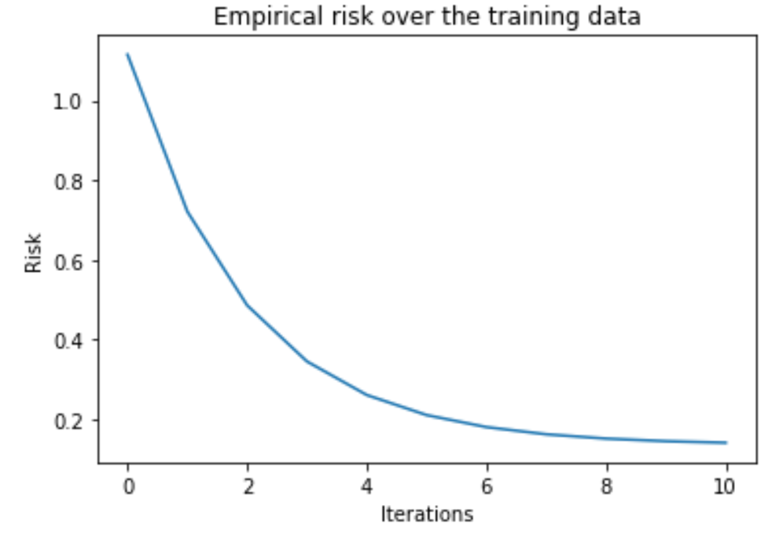

Linear Regression
$${\hat{R}}_{f_{θ}}\left(𝒟\right)$$

Slide 31
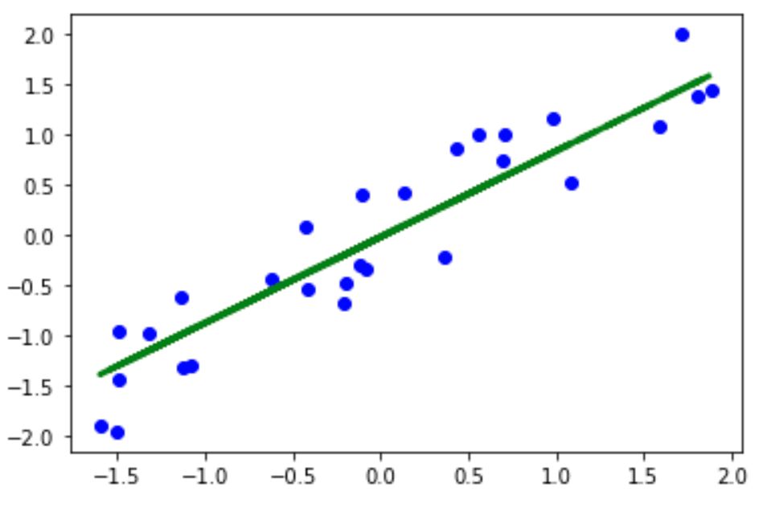
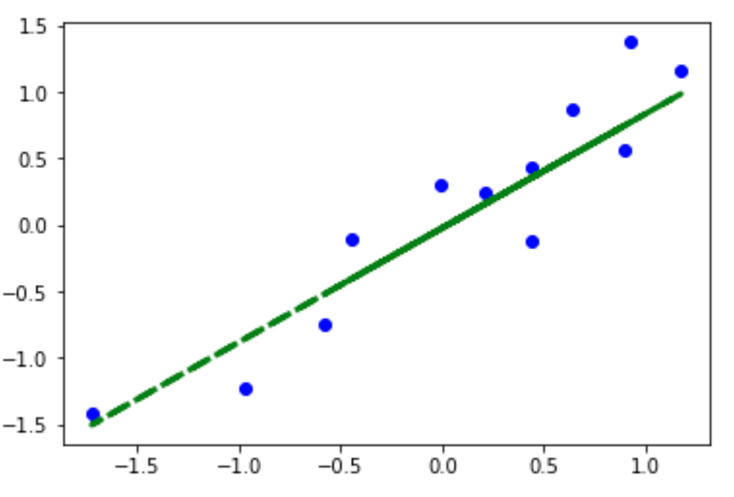

Linear Regression: testing
verify (Dtest, $θ$)
train data set
test data set
MSE = 0.0989

Slide 32
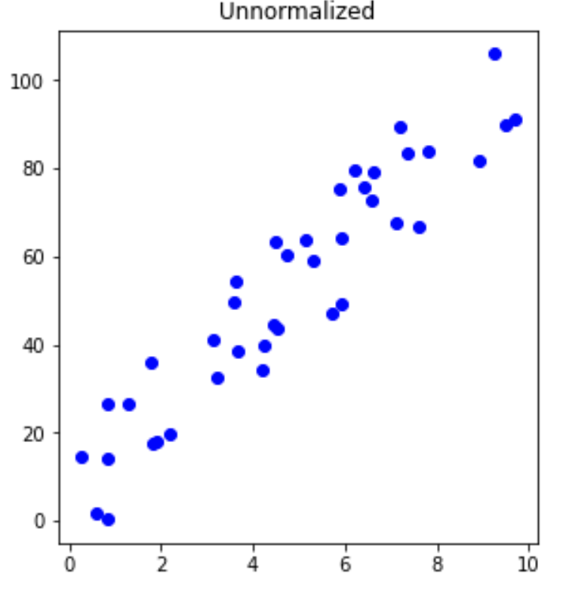
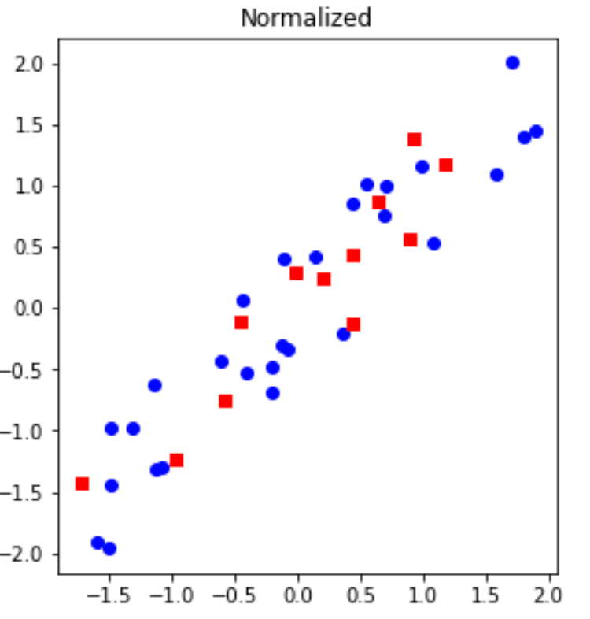

Linear Regression: data shifting and normalization
$x=\frac{\left(x−\overline{x}\right)}{σ_{x}}$ $y=\frac{\left(y−\overline{y}\right)}{σ_{y}}$ $∀(x,y)∈𝒟$

Slide 33
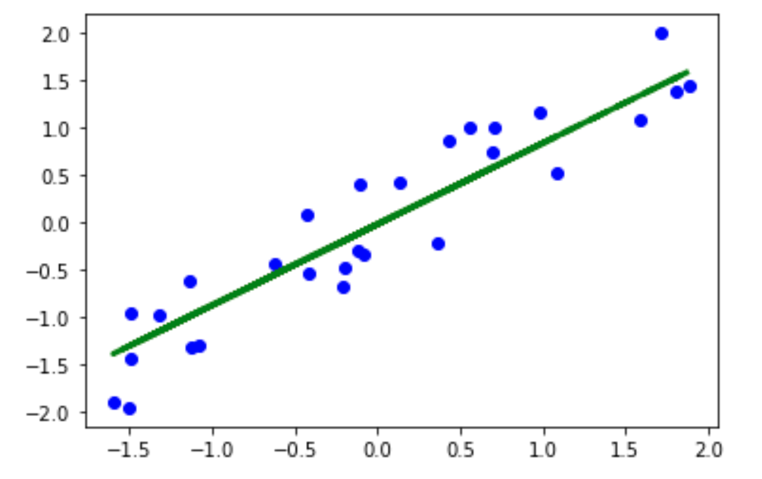
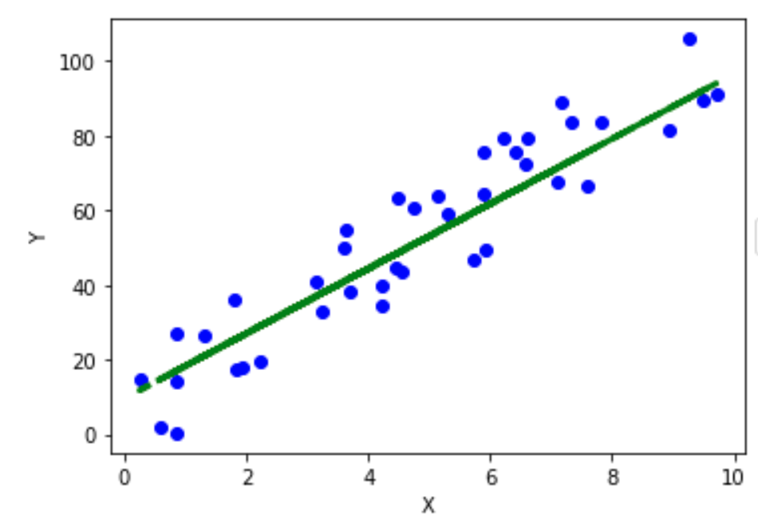

Linear Regression: data shifting and normalization
$θ_{0}=\frac{σ_{y}\left(θ_{0,n}−θ_{1,n}∗\overline{x}\right)}{σ_{x}}+\overline{y}$ $θ_{1}=\frac{σ_{y}∗θ_{1,n}}{σ_{x}}$

Slide 34
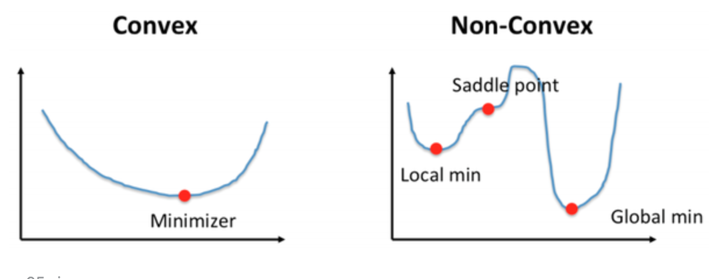


Optimization: convexity and local minima
Convexity: non-convex objective functions are much harder to optimize
$${\hat{R}}_{f_{θ}}\left(𝒟\right)$$
$${\hat{R}}_{f_{θ}}\left(𝒟\right)$$
Θ
Θ
Many machine learning problems are high-dimensional (large number of parameters) non convex

Slide 35
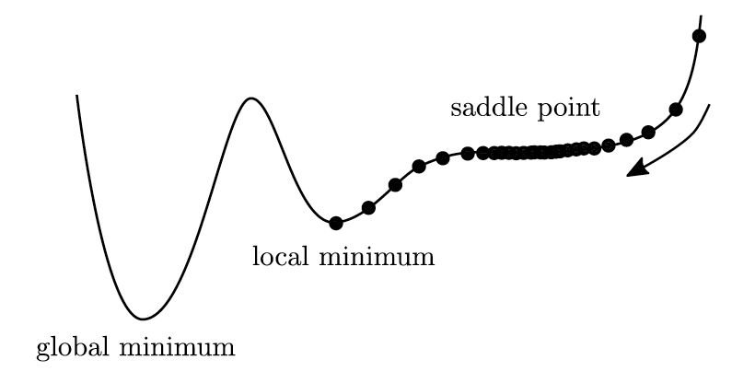


Optimization: local minima
$${\hat{R}}_{f_{θ}}\left(𝒟\right)$$
clever initialization of $θ$
random restart
clever choice of the learning rate $η$
stochastic gradient descent: use a stochastic subset of the training data at each step
natural gradient: use geometric information on the curvature of the landscape

Slide 36

Multivariate Linear Regression
Loss
$$L(f_{θ}\left(x\right),y)={\left(f_{θ}\left(x\right)−y\right)}^{2}={\left(θ_{0}+\sum_{i=1}^{n}{\left(θ_{i}∗x_{i}\right)}−y\right)}^{2}$$
Empirical Risk
$${\hat{R}}_{f_{θ}}\left(𝒟\right)=\frac{1}{M}\sum_{j=1}^{M}{L(f_{θ}\left(x^{(j)}\right),y^{(j)})}=\frac{1}{M}\sum_{j=1}^{M}{{\left(θ_{0}+\sum_{i=1}^{n}{\left(θ_{i}∗x_{i}^{(j)}\right)}−y^{(j)}\right)}^{2}}$$
Gradient
$$∇{\hat{R}}_{f_{θ}}\left(𝒟\right)=\left(\begin{matrix}\begin{matrix}\frac{∂}{∂θ_{0}} \\ \frac{∂}{∂θ_{1}}\end{matrix} \\ \begin{matrix}⋮ \\ \frac{∂}{∂θ_{T−1}}\end{matrix}\end{matrix}\right)=\left(\begin{matrix}\begin{matrix}2\sum_{j=1}^{M}{\left(f_{θ}\left(x^{(j)}\right)−y^{(j)}\right)} \\ 2\sum_{j=1}^{M}{\left(f_{θ}\left(x^{(j)}\right)−y^{(j)}\right)∗x_{1}^{(j)}}\end{matrix} \\ \begin{matrix}⋮ \\ 2\sum_{j=1}^{M}{\left(f_{θ}\left(x^{(j)}\right)−y^{(j)}\right)∗x_{T−1}^{(j)}}\end{matrix}\end{matrix}\right)$$

Slide 37



Polynomial Regression
Loss
$$L(f_{θ}\left(x\right),y)={\left(f_{θ}\left(x\right)−y\right)}^{2}={\left(θ_{0}+\sum_{i=1}^{T−1}{\left(θ_{i}∗x^{i}\right)}−y\right)}^{2}$$
Empirical Risk
$${\hat{R}}_{f_{θ}}\left(𝒟\right)=\frac{1}{M}\sum_{j=1}^{M}{L(f_{θ}\left(x^{(j)}\right),y^{(j)})}=\frac{1}{M}\sum_{j=1}^{M}{{\left(θ_{0}+\sum_{i=1}^{T−1}{\left(θ_{i}∗{x_{}^{(j)}}^{i}\right)}−y^{(j)}\right)}^{2}}$$
Gradient
$$∇{\hat{R}}_{f_{θ}}\left(𝒟\right)=\left(\begin{matrix}\begin{matrix}\frac{∂}{∂θ_{0}} \\ \frac{∂}{∂θ_{1}}\end{matrix} \\ \begin{matrix}⋮ \\ \frac{∂}{∂θ_{T−1}}\end{matrix}\end{matrix}\right)=\left(\begin{matrix}\begin{matrix}2\sum_{j=1}^{M}{\left(f_{θ}\left(x^{(j)}\right)−y^{(j)}\right)} \\ 2\sum_{j=1}^{M}{\left(f_{θ}\left(x^{(j)}\right)−y^{(j)}\right)∗{x_{}^{(j)}}^{1}}\end{matrix} \\ \begin{matrix}⋮ \\ 2\sum_{j=1}^{M}{\left(f_{θ}\left(x^{(j)}\right)−y^{(j)}\right)∗{x_{}^{(j)}}^{T−1}}\end{matrix}\end{matrix}\right)$$
$x$ to the power of $i$
$x^{(j)}$ to the power of $i$

Slide 38
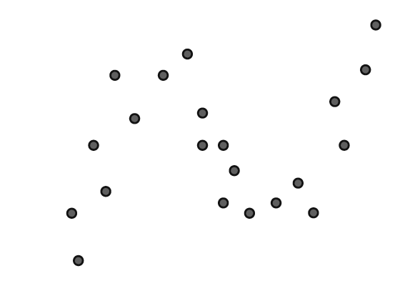
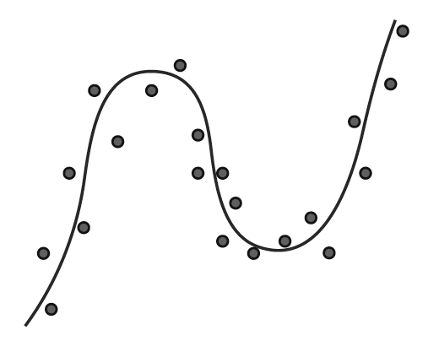
Polynomial Regression
POLYNOMIAL
LINEAR

Slide 39

Model Learning: under and over fitting
underfitting occurs when a too simple model is used
overfitting occurs when a too complex model is used
[Serrano2021]

Slide 40
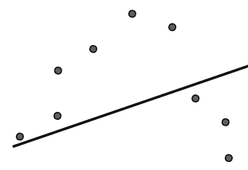
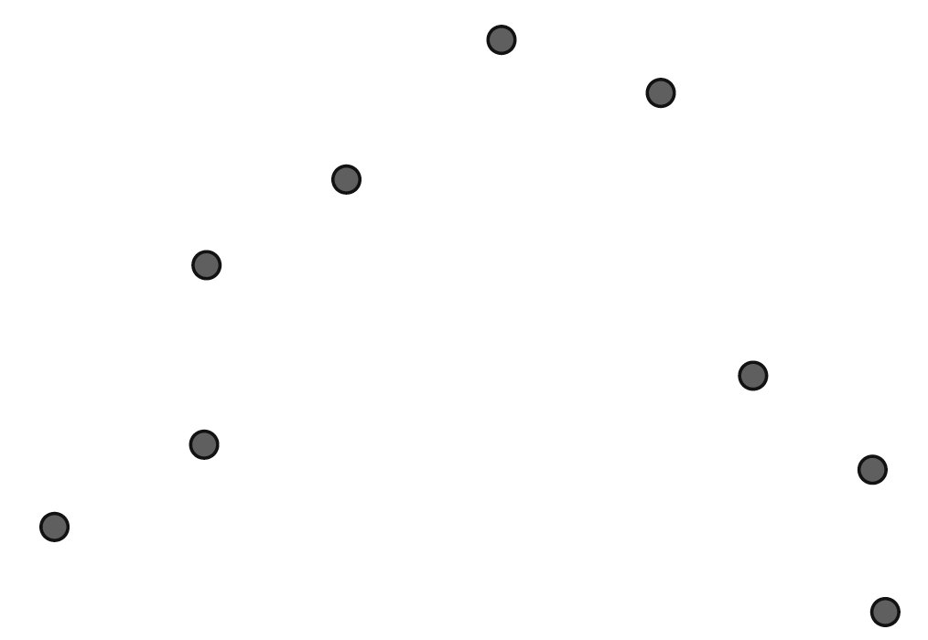
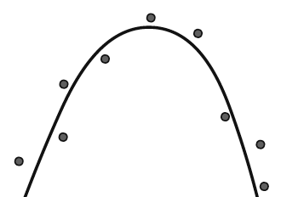
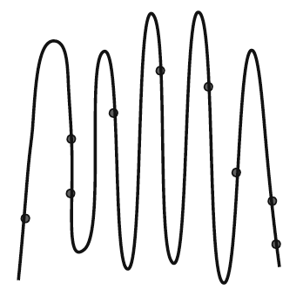
Model Learning: under and over fitting
LINEAR
DEGREE 2
[Serrano2021]
DEGREE 10

Slide 41
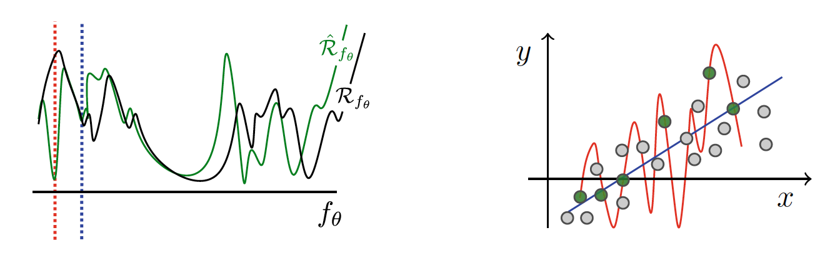
Overfitting
What if empirical risk minimization does not lead to actual risk minimization?
What if the trained model does really well on the data it was trained with, but performs poorly on new data?

Slide 42

Regularization
Strategies to avoid overfitting
Choose less flexible families of models
Stop training prematurely
Add a regularization term: $C\left(θ\right)={\hat{R}}_{f_{θ}}\left(𝒟\right)+g(θ)$ and minimize $C\left(θ\right)$
Regularizers impose constraints on the model:
$g_{ℓ1} \left(θ\right)=\sum_{i=1}^{T}{\left|θ_{i}\right|}$ - the $ℓ1$ regularizer leads to sparser parameters’ vectors
$g_{ℓ2} \left(θ\right)=\sum_{i=1}^{T}{{θ_{i}}^{2}}$ - the $ℓ2$ regularizer leads to shorter parameters’ vectors, i.e. parameters with smaller absolute values

Slide 43


$ℓ_{2}$ Regularized Multivariate Linear Regression
Cost Function
$$C\left(θ\right)={\hat{R}}_{f_{θ}}\left(𝒟\right)+g\left(θ\right)=\frac{1}{M}\sum_{j=1}^{M}{{\left(θ_{0}+\sum_{i=1}^{n}{\left(θ_{i}∗x_{i}^{(j)}\right)}−y^{(j)}\right)}^{2}}+\sum_{i=0}^{T−1}{{θ_{i}}^{2}}$$
Gradient
$$∇{\hat{R}}_{f_{θ}}\left(𝒟\right)=\left(\begin{matrix}\begin{matrix}\frac{∂}{∂θ_{0}} \\ \frac{∂}{∂θ_{1}}\end{matrix} \\ \begin{matrix}⋮ \\ \frac{∂}{∂θ_{T−1}}\end{matrix}\end{matrix}\right)=\left(\begin{matrix}\begin{matrix}2\sum_{j=1}^{M}{\left(f_{θ}\left(x^{(j)}\right)−y^{(j)}\right)}+2θ_{0} \\ 2\sum_{j=1}^{M}{\left(f_{θ}\left(x^{(j)}\right)−y^{(j)}\right)∗x_{1}^{(j)}}+2θ_{1}\end{matrix} \\ \begin{matrix}⋮ \\ 2\sum_{j=1}^{M}{\left(f_{θ}\left(x^{(j)}\right)−y^{(j)}\right)∗x_{T−1}^{(j)}}+2θ_{T−1}\end{matrix}\end{matrix}\right)$$

Slide 44
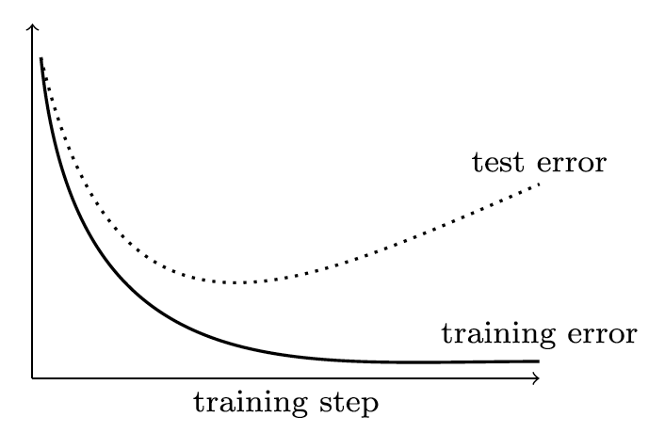
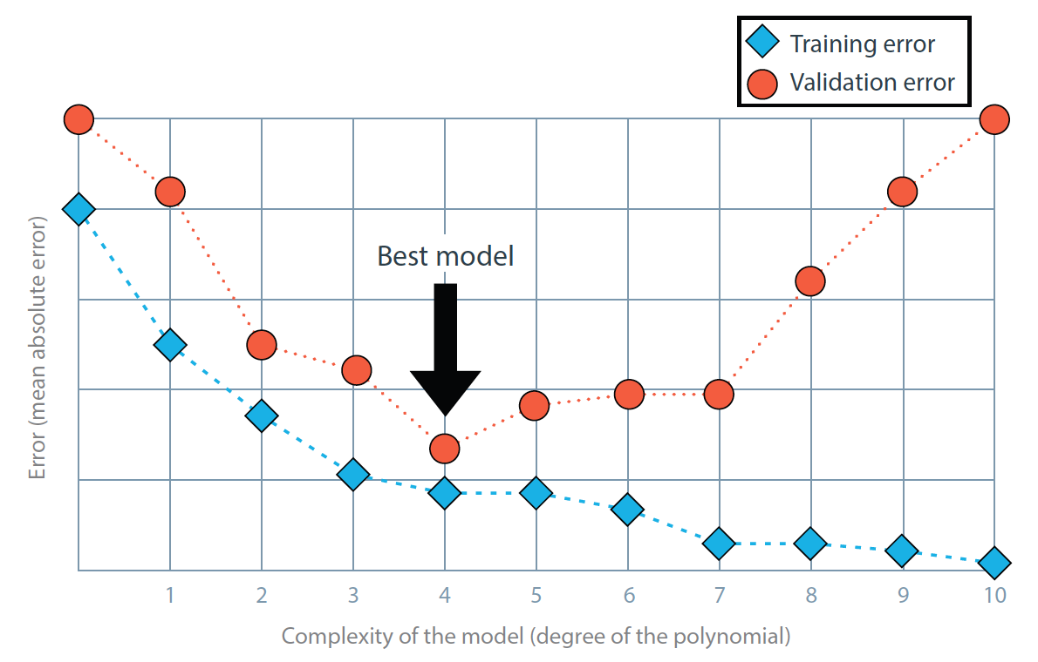
Generalization: training vs. test/validation errors
the input data $𝒟$ is divided into a training set and a test set
the model is overfitting the training data when the training error keeps decreasing, while the test error starts increasing.
The optimal point to stop training is near the test error inflection point OR choose the model to use based on the model complexity graph

Slide 45
Classification

Slide 46

Supervised Learning: Classification
Problem: given a labelled dataset $𝒟∈𝒳⨂𝒴$, taken from an unknown function $f^{∗}:𝒳→𝒴$, learn a function $\hat{f}:𝒳→𝒴$ which approximates $f^{∗}$ and allows predicting $\hat{y}=\hat{f}(x)$ for previously unseen $\left(x,y\right)$, i.e. $\left(x,y\right)∉𝒟$
Classification entails that $𝒴$ is a discrete set of labels
Binary Classification entails that $𝒴$ is a discrete set of two labels Without loss of generality $𝒴=\left\{0,1\right\}$

Slide 47
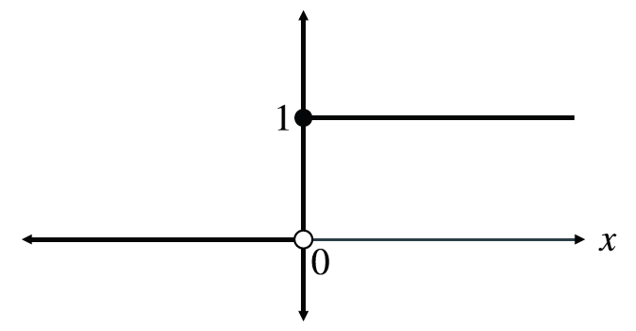


Perceptron Classifier
The perceptron classification line is expressed as an identity to 0 (small difference compared to the regression in the previous section)
If there are $n$ features $x_{i}$ per data point $x$ and $T=n+1$ parameters $θ_{t}$ then the classifier produces a score: $score\left(x\right)=θ_{0}+\sum_{i=1}^{n}{θ_{i}x_{i}}$
$\hat{y}(x)=\left\{\begin{matrix}0 & ←score\left(x\right)<0 \\ 1 & ←score\left(x\right)≥0\end{matrix}\right.$
$\hat{y}(x)=step\left(score\left(x\right)\right)$ $=step\left(θ_{0}+\sum_{i=1}^{n}{θ_{i}x_{i}}\right)$
Activation function:
$$step\left(x\right)=\left\{\begin{matrix}0 & ←x<0 \\ 1 & ←x≥0\end{matrix}\right.$$

Slide 48
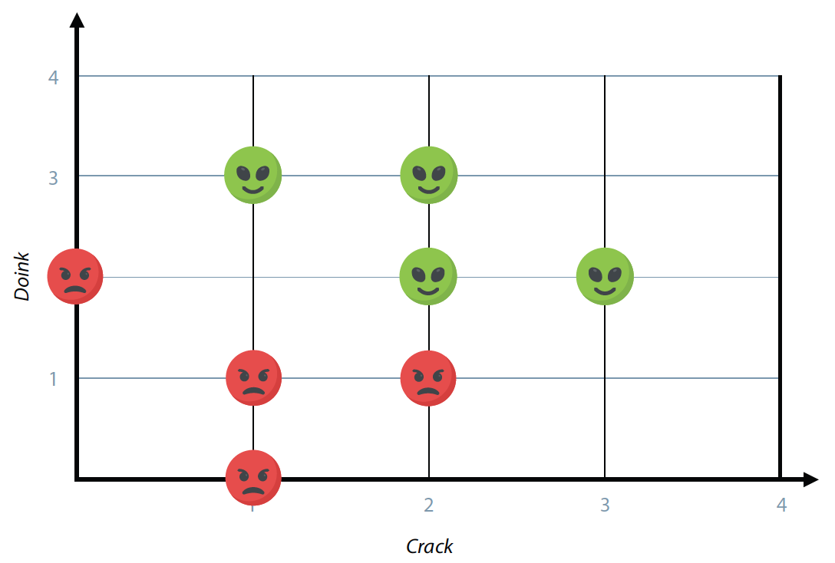
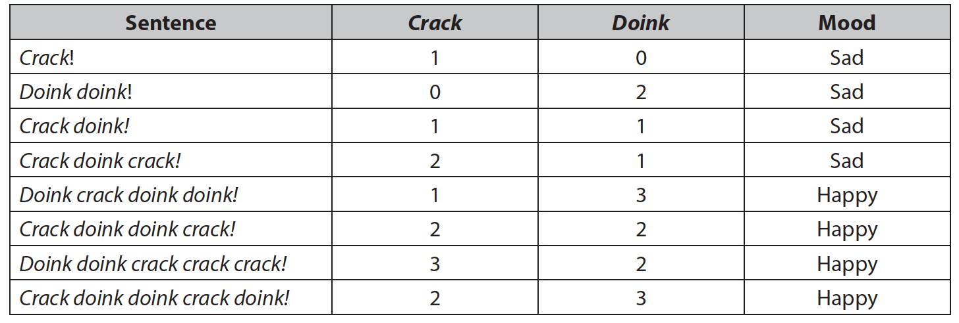


The ”alien” dataset [Serrano’2021-cap 5]
$$x_{2}$$
$$x_{1}$$

Slide 49
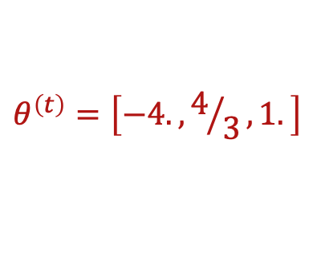

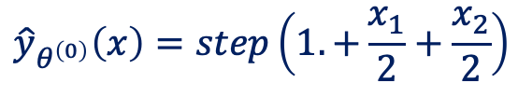
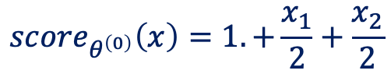

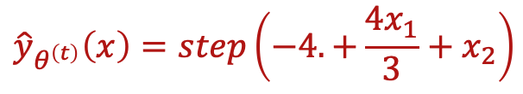

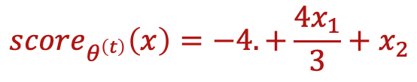
The ”alien” dataset [Serrano’2021-cap 5]
$$θ^{\left(0\right)}=\left[1., 0.5, 0.5\right]$$
$$x_{2}$$
$${score}_{θ^{\left(0\right)}}\left(x\right)=1.+\frac{x_{1}}{2}+\frac{x_{2}}{2}$$
$${\hat{y}}_{θ^{\left(0\right)}}\left(x\right)=step\left(1.+\frac{x_{1}}{2}+\frac{x_{2}}{2}\right)$$
HAPPY
SAD
$$θ^{\left(t\right)}=\left[−4., 4/3, 1.\right]$$
$${score}_{θ^{\left(t\right)}}\left(x\right)=−4.+\frac{4x_{1}}{3}+x_{2}$$
HAPPY
SAD
$${\hat{y}}_{θ^{\left(t\right)}}\left(x\right)=step\left(−4.+\frac{4x_{1}}{3}+x_{2}\right)$$
$$x_{1}$$

Slide 50
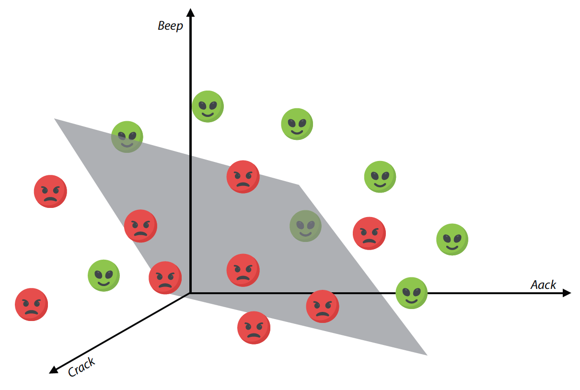

Hyper-Planes
$$score\left(x\right)=θ_{0}+\sum_{i=1}^{n}{θ_{i}x_{i}}$$
The classifier is represented by an hyperplane with $(n−1)$-dimensionality

Slide 51
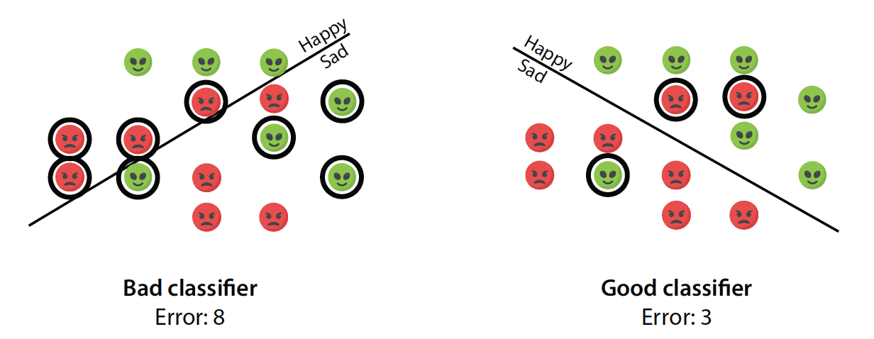
Perceptron Error Function
Option 1: count the number of errors
Does not capture how misclassified each point was!

Slide 52
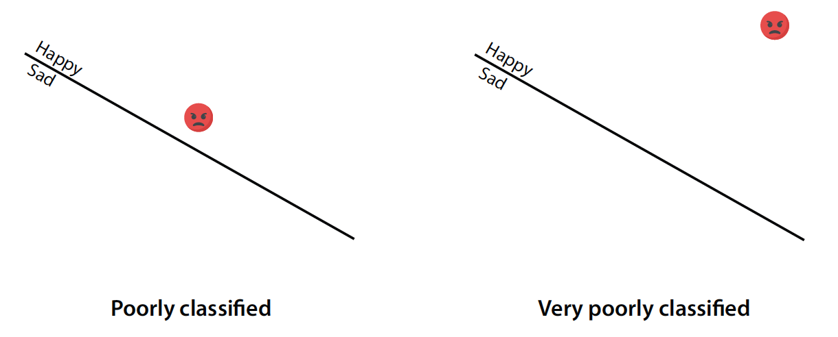
Perceptron Error Function
Option 1: count the number of errors Does not capture how misclassified each point was!
distance proportional to the absolute score

Slide 53
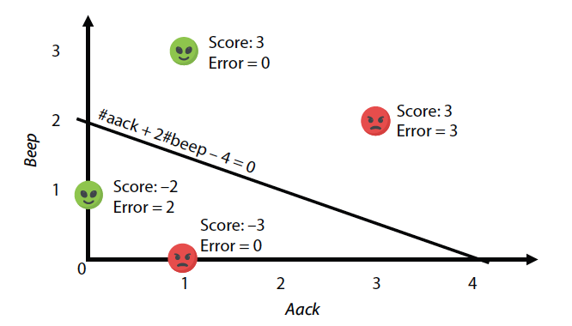

Perceptron Error Function
Option 2: absolute score of misclassified points $L\left(\hat{y}\left(x\right),y\right)=\left\{\begin{matrix}0 & ←\hat{y}\left(x\right)=y \\ \left|θ_{0}+\sum_{i=1}^{n}{θ_{i}x_{i}}\right| & ←\hat{y}\left(x\right)≠y\end{matrix}\right.$

Slide 54
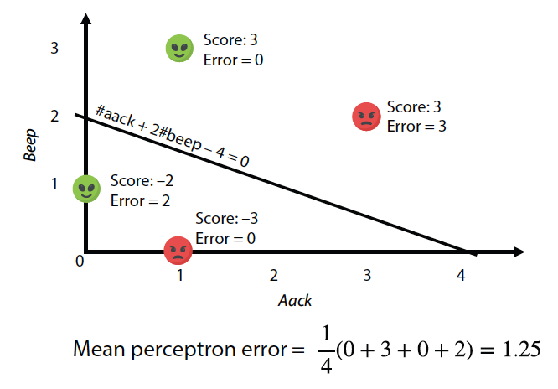

Mean Perceptron Error Function (Risk)
average over the dataset of the absolute scores of misclassified points ${\hat{ℛ}}_{θ}\left(𝒟\right)=\frac{1}{M}\sum_{x^{(j)}∈𝒟}{L\left(\hat{y}\left(x^{(j)}\right),y^{(j)}\right)}$

Slide 55
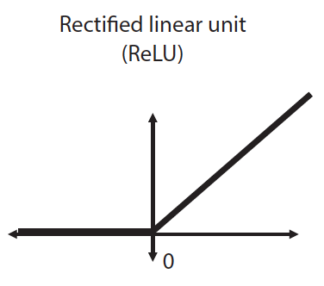




Gradient Descent
${\hat{ℛ}}_{θ}\left(𝒟\right)=\frac{1}{M}\sum_{j=1}^{M}{L\left(\hat{y}\left(x^{(j)}\right),y^{(j)}\right)}$ $L\left(\hat{y}\left(x\right),y\right)=\left\{\begin{matrix}0 & ←\hat{y}\left(x\right)=y \\ \left|θ_{0}+\sum_{i=1}^{n}{θ_{i}x_{i}}\right| & ←\hat{y}\left(x\right)≠y\end{matrix}\right.$
$$\frac{∂ReLU\left(f(x) \right)}{∂x}=step(f\left(x\right))\frac{∂f(x) }{∂x}$$
$$ReLU\left(x\right)=\left\{\begin{matrix}0 & ←x<0 \\ x & ←x≥0\end{matrix}\right.$$
$L\left(\hat{y}\left(x\right),y\right)=y∗ReLU\left({−θ}_{0}−\sum_{i=1}^{n}{θ_{i}x_{i}}\right)+\left(1−y\right)$ $∗ReLU\left(θ_{0}+\sum_{i=1}^{n}{θ_{i}x_{i}}\right)$
$\frac{∂L\left(\hat{y}\left(x\right),y\right)}{∂θ_{>0}}=y∗step\left(−score\left(x\right)\right)∗\left(−x_{i}\right)+\left(1−y\right)∗step\left(score\left(x\right)\right)∗x_{i}$

Slide 56



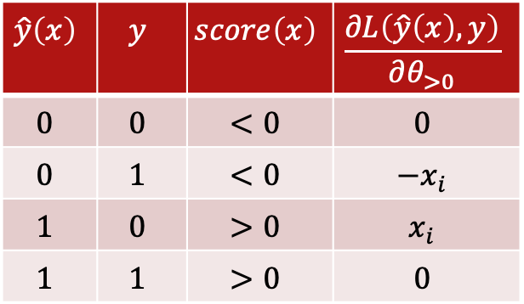

Gradient Descent
$L\left(\hat{y}\left(x\right),y\right)=y∗ReLU\left({−θ}_{0}−\sum_{i=1}^{n}{θ_{i}x_{i}}\right)+\left(1−y\right)$ $∗ReLU\left(θ_{0}+\sum_{i=1}^{n}{θ_{i}x_{i}}\right)$
$\frac{∂L\left(\hat{y}\left(x\right),y\right)}{∂θ_{>0}}=y∗step\left(−score\left(x\right)\right)∗\left(−x_{i}\right)+\left(1−y\right)∗step\left(score\left(x\right)\right)∗x_{i}=$
$=\left(−y∗step\left(−score\left(x\right)\right)+\left(1−y\right)∗step\left(score\left(x\right)\right)\right)x_{i}$
$$\hat{y}\left(x\right)$$ | $$y$$ | $$score\left(x\right)$$ | $$\frac{∂L\left(\hat{y}\left(x\right),y\right)}{∂θ_{>0}}$$
$$0$$ | $$0$$ | $$<0$$ | $$0$$
$$0$$ | $$1$$ | $$<0$$ | $$−x_{i}$$
$$1$$ | $$0$$ | $$>0$$ | $$x_{i}$$
$$1$$ | $$1$$ | $$>0$$ | $$0$$
$\frac{∂L\left(\hat{y}\left(x\right),y\right)}{∂θ_{0}}=−y∗step\left(−score\left(x\right)\right)+\left(1−y\right)∗step\left(score\left(x\right)\right)$
${\hat{ℛ}}_{θ}\left(𝒟\right)=\frac{1}{M}\sum_{j=1}^{M}{L\left(\hat{y}\left(x^{(j)}\right),y^{(j)}\right)}$
$$∇{\hat{R}}_{f_{θ}}\left(𝒟\right)=\left(\begin{matrix}\begin{matrix}\frac{∂}{∂θ_{0}} \\ \frac{∂}{∂θ_{1}}\end{matrix} \\ \begin{matrix}⋮ \\ \frac{∂}{∂θ_{T−1}}\end{matrix}\end{matrix}\right)=\left(\begin{matrix}\begin{matrix}\frac{1}{M}\sum_{j=1}^{M}{\left[−y^{(j)}∗step\left(−score\left(x^{(j)}\right)\right)+\left(1−y^{(j)}\right)∗step\left(score\left(x^{(j)}\right)\right)\right]} \\ \frac{1}{M}\sum_{j=1}^{M}{\left[−y^{(j)}∗step\left(−score\left(x^{(j)}\right)\right)+\left(1−y^{(j)}\right)∗step\left(score\left(x^{(j)}\right)\right)\right]∗x_{1}^{(j)}}\end{matrix} \\ \begin{matrix}⋮ \\ \frac{1}{M}\sum_{j=1}^{M}{\left[−y^{(j)}∗step\left(−score\left(x^{(j)}\right)\right)+\left(1−y^{(j)}\right)∗step\left(score\left(x^{(j)}\right)\right)\right]∗x_{T−1}^{(j)}}\end{matrix}\end{matrix}\right)$$

Slide 57
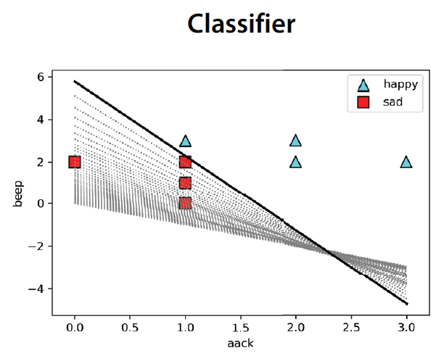
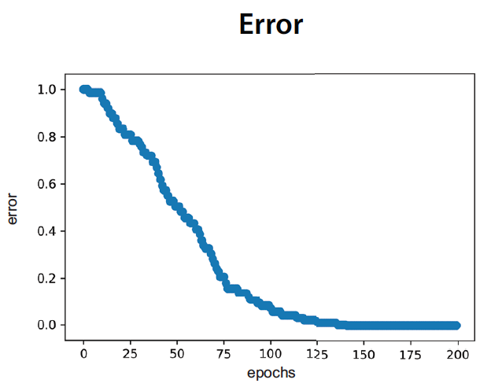
Perceptron Classifier

Slide 58
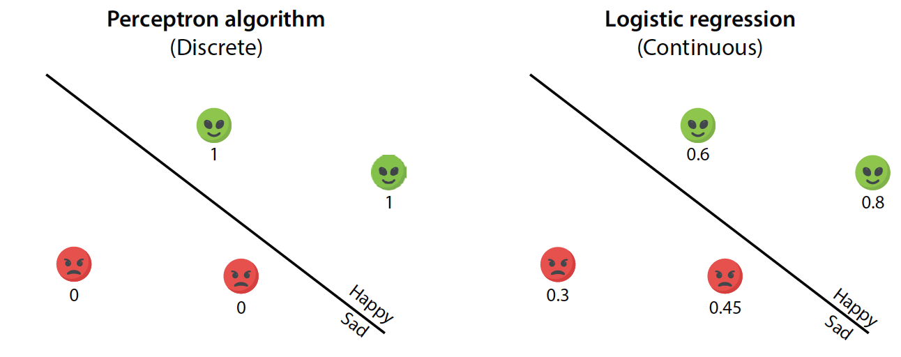

Logistic Classifiers
Binary classifiers which return a continuous value in [0..1]
The number assigned to each data point is the probability that its label is y=1: $p_{1}\left(x\right)$
The probability of being y=0 is $p_{0}\left(x\right)$=1- $p_{1}\left(x\right)$

Slide 59




Logistic Classifiers
Sigmoid function: the score $∈ℝ$ is compressed into [0..1]
$$σ\left(x\right)=\frac{1}{1+e^{−x}}$$
$$\hat{y}(x)=σ\left(score\left(x\right)\right) \\ =σ\left(θ_{0}+\sum_{i=1}^{n}{θ_{i}x_{i}}\right)$$

Slide 60


Logistic Classifier Error: log loss
If $y=1$ then $L\left(\hat{y}\left(x\right),y\right)=−ln\left(\hat{y}\left(x\right)\right)$
If $y=0$ then $L\left(\hat{y}\left(x\right),y\right)=−ln\left(1−\hat{y}\left(x\right)\right)$
$$L\left(\hat{y}\left(x\right),y\right)=−y ∗ ln\left(\hat{y}\left(x\right)\right)−\left(1−y\right)∗ln\left(1−\hat{y}\left(x\right)\right)$$
$${\hat{ℛ}}_{θ}\left(𝒟\right)=\sum_{j=1}^{M}{L\left(\hat{y}\left(x^{(j)}\right),y^{(j)}\right)}$$

Slide 61






Gradient Descent
$$\hat{y}(x)=σ\left(θ_{0}+\sum_{i=1}^{n}{θ_{i}x_{i}}\right)$$
$$L\left(\hat{y}\left(x\right),y\right)=−y ∗ ln\left(\hat{y}\left(x\right)\right)−\left(1−y\right)∗ln\left(1−\hat{y}\left(x\right)\right)$$
$$\frac{∂σ\left(f\left(θ\right)\right)}{∂θ}=σ\left(f\left(θ\right)\right)\left(1−σ\left(f\left(θ\right)\right)\right)\frac{∂f\left(θ\right)}{∂θ}$$
$$\frac{∂ln\left(f\left(z\right)\right)}{∂z}=\frac{1}{f\left(z\right)}\frac{∂f\left(z\right)}{∂z}$$
$$\frac{∂\hat{y}(x)}{∂θ_{>0}}=σ\left(θ_{0}+\sum_{i=1}^{n}{θ_{i}x_{i}}\right)\left(1−σ\left(θ_{0}+\sum_{i=1}^{n}{θ_{i}x_{i}}\right)\right)x_{i}=\hat{y}(x)\left(1−\hat{y}(x)\right)x_{i}$$
$\frac{∂L\left(\hat{y}\left(x\right),y\right)}{∂θ_{>0}}=−y ∗\frac{1}{\hat{y}\left(x\right)}\frac{∂\hat{y}\left(x\right)}{∂θ_{>0}}−\left(1−y\right)∗\frac{−1}{1−\hat{y}\left(x\right)}\frac{∂\hat{y}\left(x\right)}{∂θ_{>0}}=…=\left(\hat{y}−y\right)$ $x_{i}$
$$\frac{∂L\left(\hat{y}\left(x\right),y\right)}{∂θ_{0}}=\left(\hat{y}−y\right)$$

Slide 62


Gradient Descent
$${\hat{ℛ}}_{θ}\left(𝒟\right)=\sum_{j=1}^{M}{L\left(\hat{y}\left(x^{(j)}\right),y^{(j)}\right)}$$
$$∇{\hat{R}}_{f_{θ}}\left(𝒟\right)=\left(\begin{matrix}\begin{matrix}\frac{∂}{∂θ_{0}} \\ \frac{∂}{∂θ_{1}}\end{matrix} \\ \begin{matrix}⋮ \\ \frac{∂}{∂θ_{T−1}}\end{matrix}\end{matrix}\right)=\left(\begin{matrix}\begin{matrix}\sum_{j=1}^{M}{\left[\hat{y}\left(x^{(j)}\right)−y^{(j)}\right]} \\ \sum_{j=1}^{M}{\left[\hat{y}\left(x^{(j)}\right)−y^{(j)}\right]∗x_{1}^{(j)}}\end{matrix} \\ \begin{matrix}⋮ \\ \sum_{j=1}^{M}{\left[\hat{y}\left(x^{(j)}\right)−y^{(j)}\right]∗x_{T−1}^{(j)}}\end{matrix}\end{matrix}\right)$$

Slide 63

Logistic Classifier

Slide 64



Perceptrons
Perceptron Classifier: $f_{activation}\left(\right)=step\left(\right)$
$$\hat{y}(x)=f_{activation}\left(θ_{0}+\sum_{i=1}^{n}{θ_{i}x_{i}}\right)$$
Logistic Classifier:
$$f_{activation}\left(\right)=σ\left(\right)$$

Slide 65

Multi Label Classifier
Train one classifier for each class $l_{i}∈𝒴=\left\{l_{0},⋯,l_{L−1}\right\},i=0…L−1$
To classify a data point $x$ obtain the $L$ different scores
Compute a probability distribution over $𝒴$ by normalizing the scores

Slide 66

Multi Label Classifier: Example
$𝒴=\left\{”dog”,”cat”,”bird” \right\}, L=3$
$scores\left(x\right)=\left\{3,2,−1\right\}$
Get a probability distribution:
normalize $p\left(\hat{y}\left(x\right)\right)=\left\{3/5,2/5,−1/5\right\}$
use softmax $p\left({\hat{y}}_{i}\left(x\right)\right)=\frac{e^{{\hat{y}}_{i}\left(x\right)}}{\sum_{l=0}^{L−1}{e^{{\hat{y}}_{l}\left(x\right)}}}$ $p\left(\hat{y}\left(x\right)\right)=\left\{0.721,0.265,0.013\right\}$
Not good!

