Slide 1
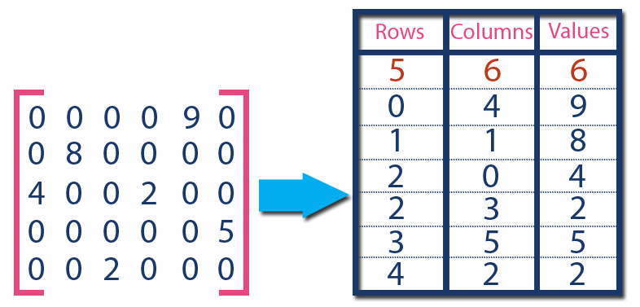





Machine Learning Pipelines / End Users
Request Server
Visual Compute Module
Persistent Memory
Graph DB
TileDB
OpenCV

