Slide 1
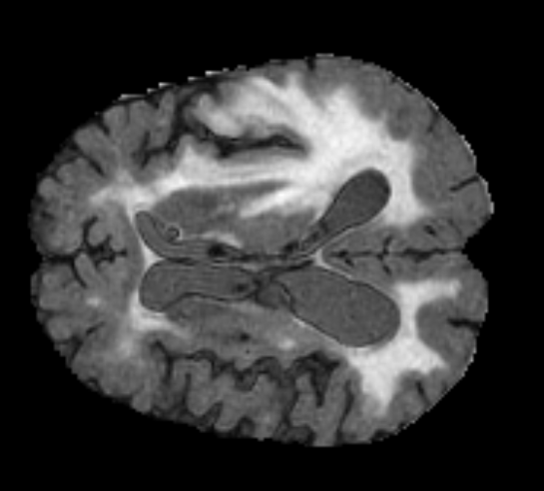
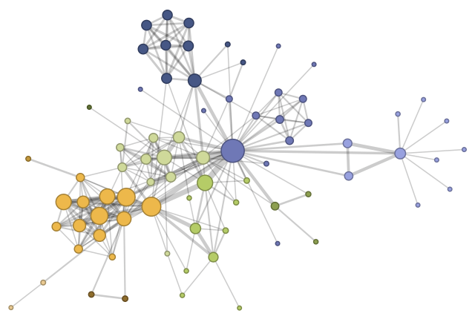
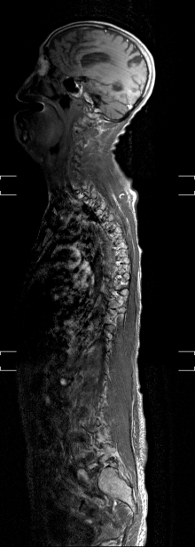
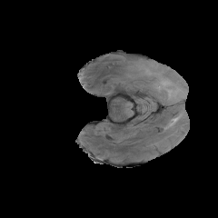
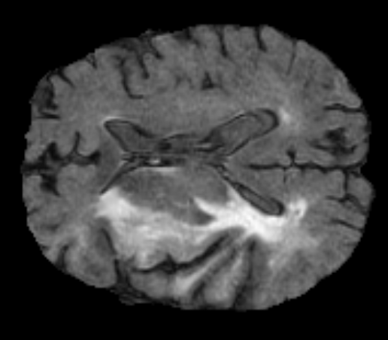
Visual Data Management System
1
Descriptor: [2.12, 3.4, 56.3, … ]
Label: Astrocytoma
2
Descriptor: [1.52, 7.4, 98.7, … ]
Label: Glioblastoma (GBM)
Descriptor: [16.5, 4.7, 28.1, … ]
Label: Choroid Plexus
3
4
Query:
Descriptor: [16.1, 4.3, 27.8, … ]
[2.12, 3.4, 56.3, … ]
[1.52, 7.4, 98.7, … ]
[16.5, 4.7, 28.1, … ]
5
Choroid Plexus

