Slide 1
47th International Conference on Very Large Data Bases
Using VDMS to Index and Search 100M Images
Luis Remis
luis@aperturedata.io
Chaunté W. Lacewell
chaunte.w.lacewell@intel.com
Copenhagen, Denmark - August 16-20, 2021
Notes:
AD is redefining how visual data is managed to enable efficient data science workflows.

Slide 2

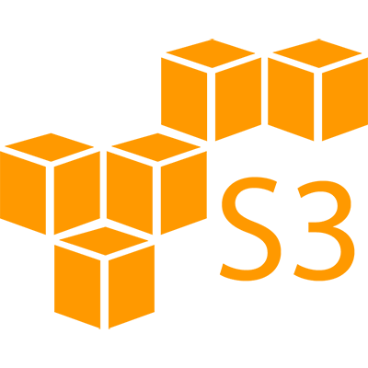


Motivation
Visual Workload: Visual Data + Metadata
Metadata -> Relational Database, Graph Database
Service for storing the images -> HTTP Server, DFS
Library for preprocessing -> OpenCV, TensorFlow
Information is segregated among different systems
Notes:
Usually, visual applications rely on a combinations of different systems design for a particular purpose.
A visual workload will use a combination of a database to store metadata, a service/file system to store the images, and a separate library to run preprocessing. The information is segregated and knowledge on each of the systems is required. Deploying and optimizing such combinations of systems is complicated. VDMS proposes a way to provide visual applications with all the functionality they need to run processing over visual data and metadata. The information is accessible behind a common interface designed to operation over visual data.

Slide 3
Design Principles
Enables storing, accessing, and transforming visual data behind a single interface
Designed for visual analytics pipelines and data science queries
Provides General Purpose building blocks and functionalities
Ultimate goal: efficient data access at cloud scale while maintaining ease-of-use

Slide 4



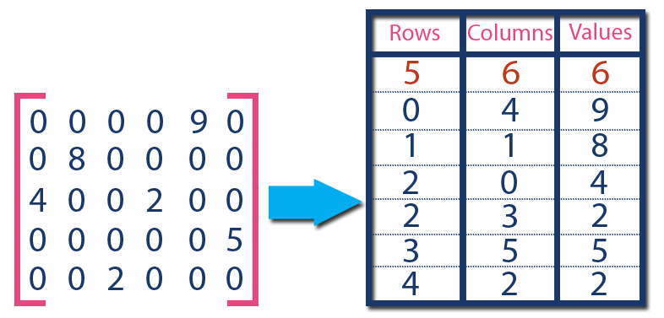



VDMS Architecture
Applications
Python Connector
C++ Connector
Query Engine
(implements JSON-based VDMS API)
Visual Compute Module
Graph Engine
VDMS Server
TileDB
OpenCV
Faiss/Others
FFMPEG
File System (Local or Distributed)

Slide 5
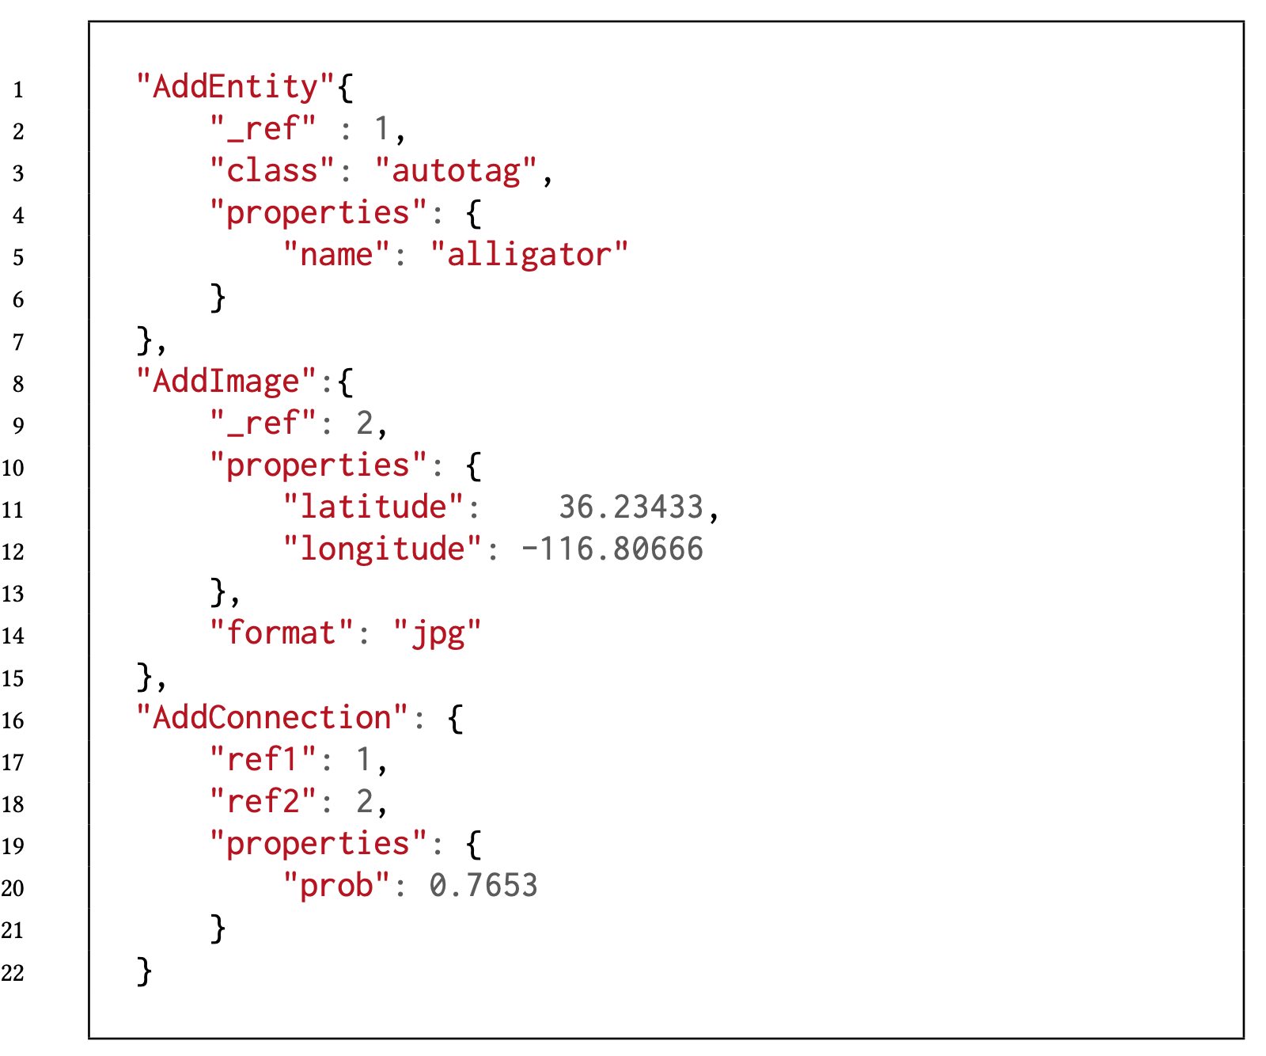
VDMS API
Application-defined entities
Transaction
Image insertion
Relationship

Slide 6
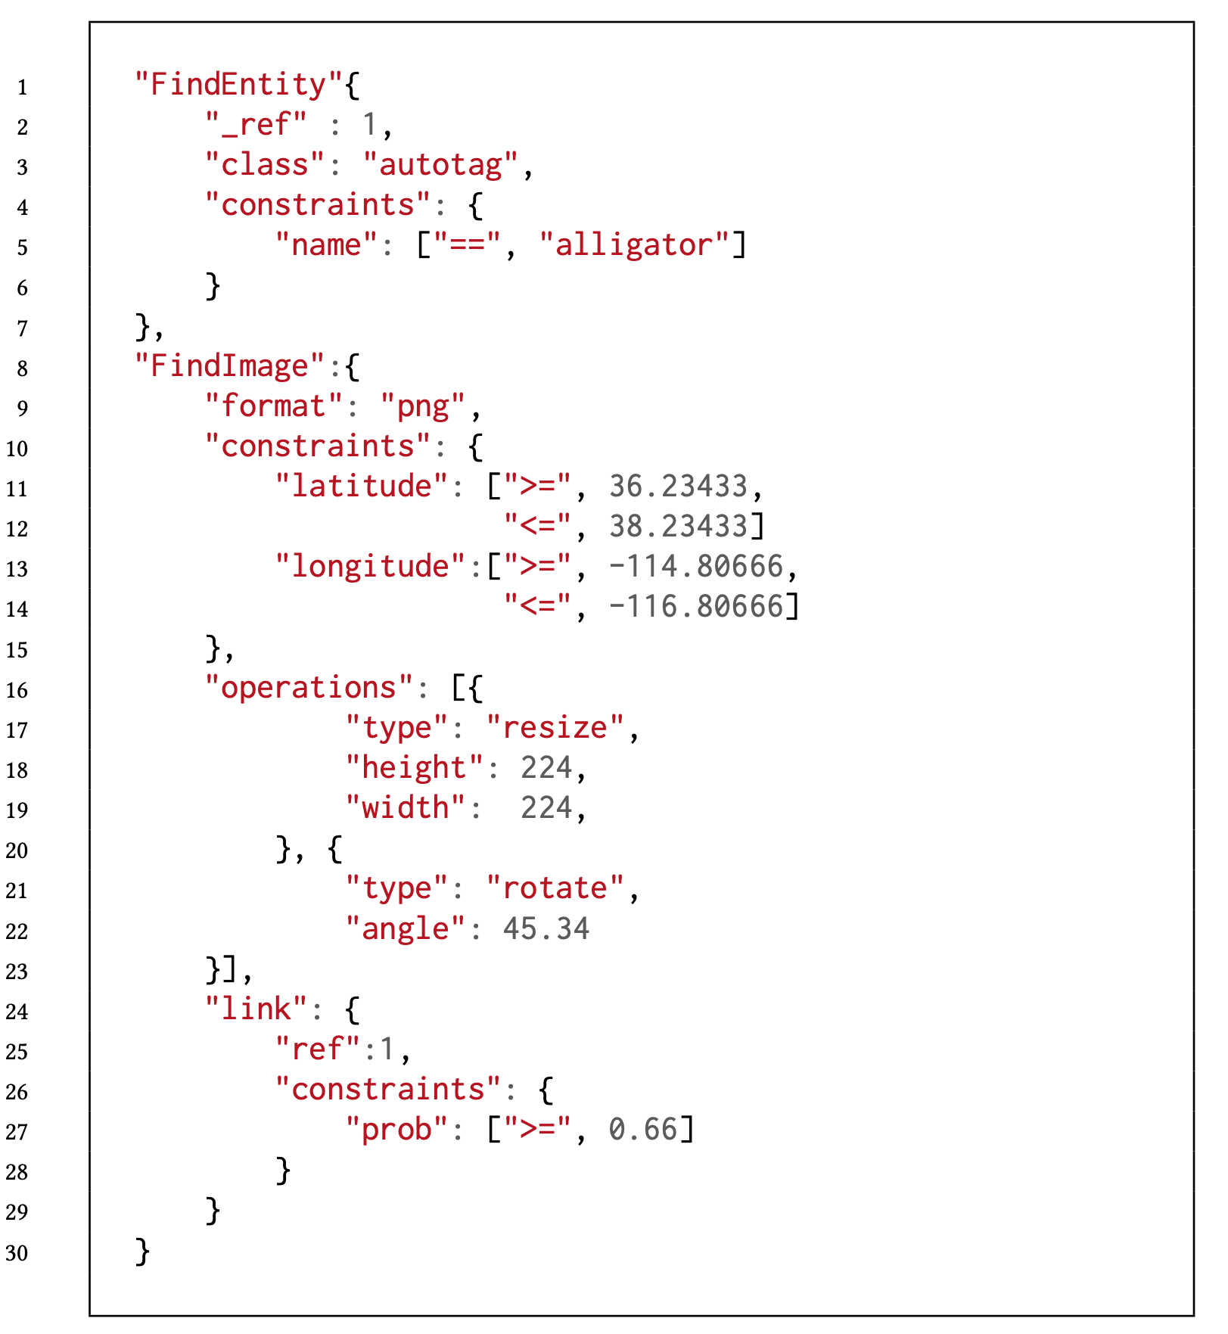
VDMS API
Search for Entities
Filter
On-the-fly transcoding
Image search
Filter
Transaction
On-the-fly pre-processing
Graph traversal

Slide 7
Evaluation Goals
The ability to scale with the number of simultaneous clients is key for the applicability of visual data management systems like VDMS.
Killer Use case:
Large ML pipelines running training/inference over a large volume of images
Because of this, we put emphasis on the analysis of concurrency and throughput, rather than latency.

Slide 8


Evaluation Setup
vdms app
postgresql app
mysql app
OpenCV
OpenCV
metadata
+ images
metadata
images
images
metadata
VDMS
ext4 Filesystem
ext4 Filesystem
ext4 Filesystem
Image Repository – ext4 Filesystem over RAID5
Server Configuration:
Intel® Xeon® Platinum 8180 CPU @ 2.50GHz (Skylake)
Dual-socket, hyperthreading (112 total cores)
256GB DDR4 DRAM

Slide 9
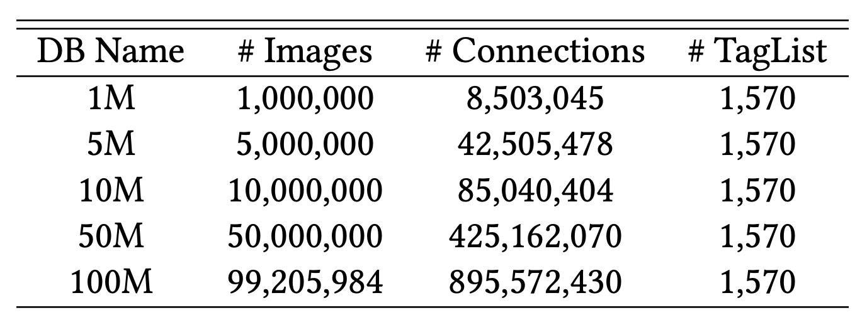
Data Representation

Slide 10
Queries
Query Name | Action Performed
q1 - 1tag_resize | Retrieve images with one specific autotag and resize to 224x224.
q2 - 1tag_geo_resize | Retrieve images with one specific autotag, in a particular geo-location, and resize to 224x224,.
q3 - 2tag_resize_and | Retrieve images with two specific autotags (i.e. alligator AND lake), and resize to 224x224.
q4 - 2tag_resize_or | Retrieve images with either of two specific autotags (i.e. alligator OR lake), and resize to 224x224.
q5 - 2tag_geo_resize_and | Retrieve images with two specific autotags (i.e. alligator AND lake), in a particular geo-location, and resize to 224x224
q6 - 2tag_geo_resize_or | Retrieve images with either of two specific autotags (i.e. alligator OR lake), in a particular geo-location, and resize to 224x224.

Slide 11
Metadata Space Comparison
This represents less than 1% of the overall space (images are the rest)

Slide 12
Evaluation – Scaling Concurrency
Throughput (images per second) for q2 (1tag_geo_resize)
Hardware concurrency = 56
For the baseline systems, in the case of 100M, the increase in the size of data seems to have a larger impact in performance.
This result can be attributed to the increase in the complexity of the JOIN operation as the number of rows in the tables increases.

Slide 13
Evaluation – Scaling Concurrency
Throughput (images per second) for all queries and a 10M database
Hardware concurrency = 56
VDMS, we see the performance in the case of q3 and q5 suffers significantly in comparison to the other queries
VDMS does not yet support operators that enable querying images that have both connections to a tagA and a tagB; we have to implement this transaction by doing 2 retrievals

Slide 14
Evaluation – Scaling Concurrency
Throughput (images per second) for q4(2tag_resize_or) as concurrency increases.
VDMS delivers higher throughput for databases 1M through 10M for all concurrent clients.
For 32 concurrent clients the throughput of VDMS drops drastically with the 100M database and postgresql outperforms VDMS.
As the clients increase, we see this trade-off occurs with the 50M database instead of 100M while in the 100M database, VDMS outperforms both baselines.

Slide 15
Evaluation – Scaling DB Size
Throughput (images per second) for all systems as the database size increases.
For q3 and q5, we see that VDMS performs best when the database size is small, but as the database size increases, the performance degrades as well.
This is entirely attributed to the 2-round process needed for this query, as we explained before which is more visible in the larger databases.
For all other queries, VDMS significantly outperform the baselines.

Slide 16
Evaluation – Scaling DB Size, Resize effect
Throughput (images per second) using a subset of the queries, with and without resize.
The first thing to notice is that a resize operation is a significant part of the overall operation (retrieval + preprocessing).
VDMS is orders of magnitude faster when retrieving images both with and without resize operations.
Notes:
An important thing to notice is that, even if a resized image is smaller, and thus transfered faster between the server and the client, transferring the image as is (without resize) is faster in this case. This is a characteristic of the dataset, which has relatively small images (the average image is about 150KB in size). We have seen on other applications and datasets with higher resolution images that transferring resized (or cropped) images is significantly faster than transferring images as they are stored.

Slide 17
Evaluation – Latency (not key)
Even if VDMS was not design to minimize latency, a unified backend provides, by design, lower latency when compared with a combination of systems.
VDMS has higher latency only in the cases where a two round-trip is needed to complete que query.
This issues is not inherent to the design, and will be addressed in follow-up iterations.

Slide 18
Evaluation – Overall Performance Improvements

Slide 19
Conclusion
The design of VDMS can remove inefficiencies that result from re-purposing and combining solutions while providing simpler and richer interfaces.
We see improvements up to 364x in certain queries, and an average improvement of about 85x when compared to PostgreSQL+Apache.
When compared to MySQL+Apache, we see up to 96x speedup and an average improvement of 31x.
VDMS was designed for analytics and it can efficiently handle complex queries which can simplify the design of future applications that rely on visual data.

