Slide 1

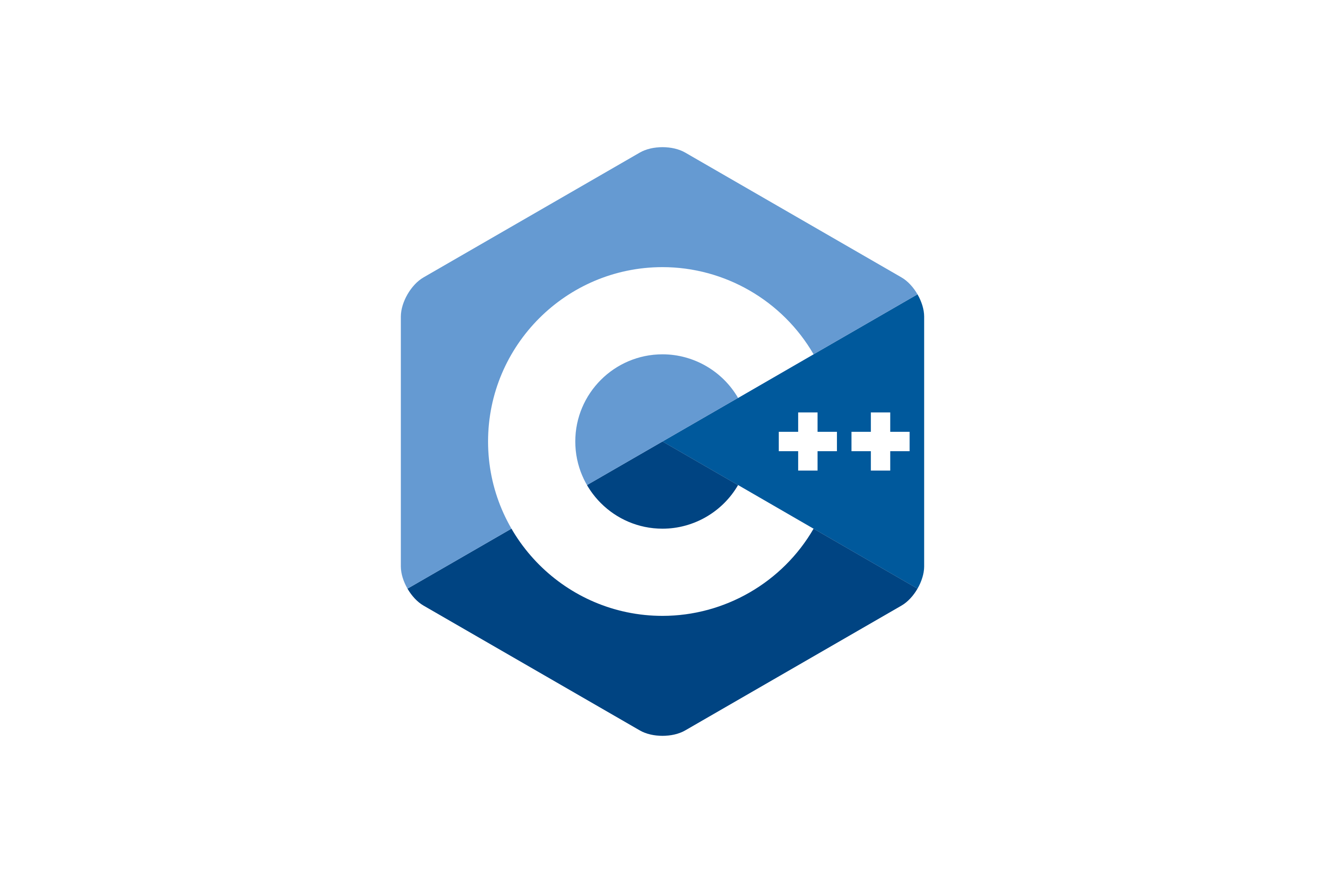

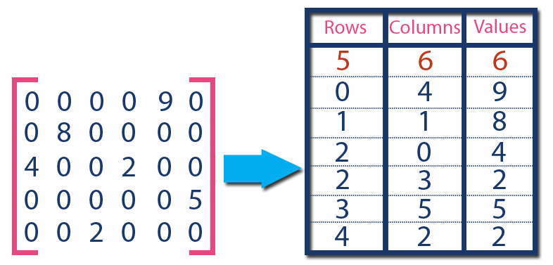



Applications
Python Connector
C++ Connector
Query Engine
(implements JSON-based VDMS API)
Visual Compute Module
Graph Engine
VDMS Server
TileDB
OpenCV
Faiss/Others
FFMPEG
File System (Local or Distributed)

Slide 2


Machine Learning Pipelines / End Users
Request Server
Visual Compute Module
Persistent Memory
Graph DB
TileDB
OpenCV

