Slide 1
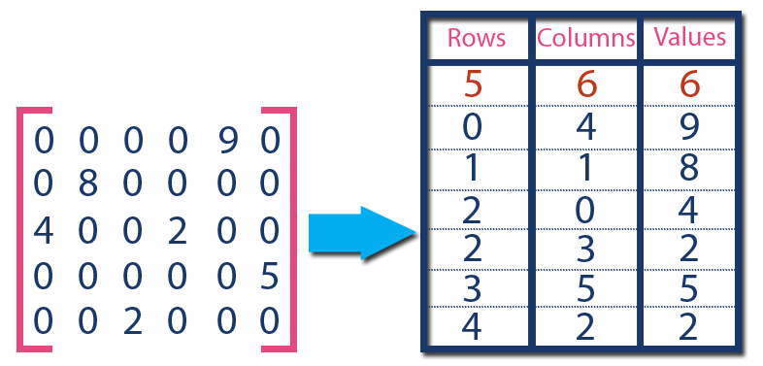





Machine Learning Pipelines / End Users
Request Server
Visual Compute Module
Persistent Memory
Graph DB
TileDB
OpenCV

Slide 2

Applications
VDMS API
Visual Compute Module
Persistent Memory
Graph DB
TileDB
OpenCV
File System (Local or Distributed)
System

