Slide 1
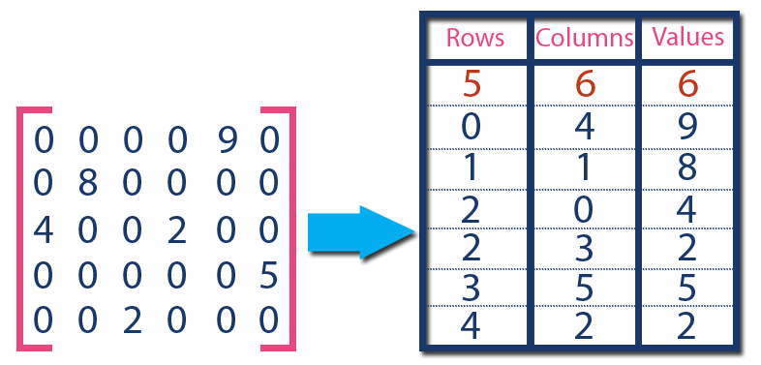





Client Application
Client Application
OpenCV
metadata
+ images
metadata
images
Request Server
Visual Compute Module
Persistent Memory
Graph DB
TileDB
OpenCV

Slide 2

Client Application
Client Application
OpenCV
metadata
+ images
metadata
images
Request Server
OR
Visual Compute Module
Persistent Memory
Graph DB
TileDB
OpenCV
EXT4 Filesystem over RAID5
EXT4 Filesystem over RAID5

Slide 3
Client Application
Client Application
Client Application
OpenCV
OpenCV
metadata
+ images
metadata
images
images
metadata
VDMS
EXT4 Filesystem
EXT4 Filesystem
EXT4 Filesystem
Image Repository - EXT4 Filesystem over RAID5

