Slide 1


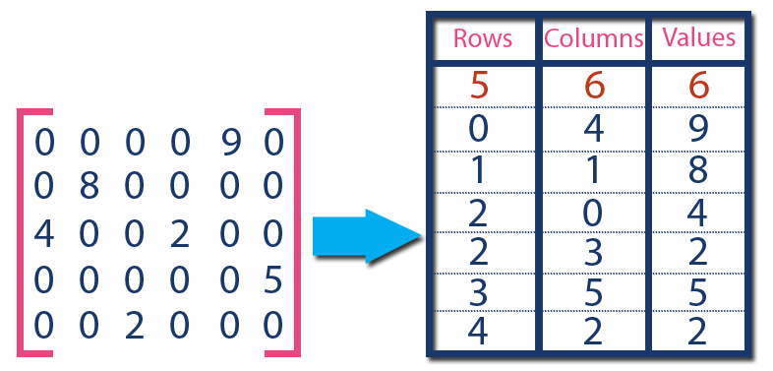



Client Application
Client Application
metadata
+ images
images
metadata
Machine Learning Pipelines / End Users
Request Server
Visual Compute Module
Persistent Memory
Graph DB
TileDB
OpenCV

