Slide 1
PSOC™ Control C3 (PSC3x7, PSC3x8) - Security introduction
Customer training workshop (CTW)
June 2026
Notes:
Welcome to Security Introduction Training on PSOC Control C3.
This session is the entry point to PSOC™ C3 security. Everything that follows in later trainings — firmware update, memory isolation, debug authentication — depends on the device being in the right lifecycle state with the right policy provisioned.

Slide 2
Table of contents
1
Security by design
  3
2
Device life cycle stage (LCS)
  6
3
Ownership transfer and provisioning
  11
4
Secure boot
  17
Notes:
We cover three topics, and they build on each other in order.
First, Device Lifecycle Stages. You need to understand the LCS model before anything else, because it governs what operations are even legal to perform on a device at any given moment.
Second, Ownership Transfer and Provisioning. This is where we actually do something to the device — install your keys, commit your policy, and extend trust from Infineon to your organization. By the end of this block you will have a provisioned device that BootROM considers yours.
Third, Secure Boot. With ownership transferred and your public key in SFlash, we configure BootROM to authenticate every image before executing it. This closes the loop: a device that boots only what you signed.

Slide 3
Table of contents
1
Security by design
3
2
Device life cycle stage (LCS)
  6
3
Ownership transfer and provisioning
  11
4
Secure boot
  17

Slide 4
Why security on embedded MCUs?
The threat is real
  Motor and power control systems directly affect physical infrastructure
  A compromised device is not just a data breach — it is a safety risk
What attackers exploit
Security must be built in – not bolted on
Attack vector | Example
Software | Malicious firmware update, debug port abuse
Physical | Voltage glitch, clock manipulation, flash readout
Supply chain | Counterfeit devices, cloned firmware
Lifecycle | Devices in wrong hands at wrong stage
Notes:
The devices we are working with are not isolated lab components. They end up in motor drives, power converters, and industrial systems — controlling real physical processes. That changes the threat profile significantly compared to a general-purpose application processor.
The attacks we need to think about fall into a few categories. Software attacks target the firmware update path or debug interfaces — an attacker who can push arbitrary firmware owns the device. Physical attacks — voltage glitching and clock manipulation — try to skip security checks at the silicon level. Supply chain attacks involve counterfeit devices or stolen firmware being loaded onto unauthorized hardware. And lifecycle attacks exploit a device that ends up in the wrong hands at the wrong stage
The answer to all of these is the same: security has to be built into the silicon from the start. It cannot be added in software later. This is exactly what PSOC™ C3 addresses, and it is why the device holds PSA L3 certification.

Slide 5

PSOC™ C3 security architecture
Lifecycle management
OTP-locked LCS
Device ownership
Debug Access Port management
  Permanently lock DAP
  Authenticated Debug access
Hardware primitives
TrustZone® (SAU/IDAU)
Crypto accelerators (AES, SHA2, ECC)
TRNG
Supply Voltage Glitch Sensor
Memory and Peripheral Isolation
Infineon proprietary MPC, PPC, and Protection Context (PC)
Memory Protection Unit (MPU)
Secure Firmware update
Authenticated updates
DFU serial interface
Live Firmware Update support (LFU)
PSOC™ C3
Boot and code integrity
Immutable BootROM
Anti-rollback
Image authentication
  ECDSA P256, 384 and 521
  SHA 256, 384 and 512
  Post-quantum crypto security with EdgeProtect Bootloader using wolfSSL
DICE Ready
PSA L3 certified
CNSA 2.0 compliance

Slide 6
Table of contents
1
Security by design
  3
2
Device life cycle stage (LCS)
6
3
Ownership transfer and provisioning
  11
4
Secure boot
  17

Slide 7
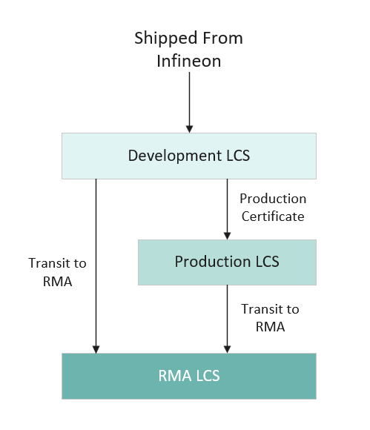
Device lifecycle stages - overview
Every PSOC™ C3 device has following three life cycle stages
  Development LCS
  Production LCS
  RMA LCS
LCS transitions are irreversible - you cannot go backwards

Slide 8
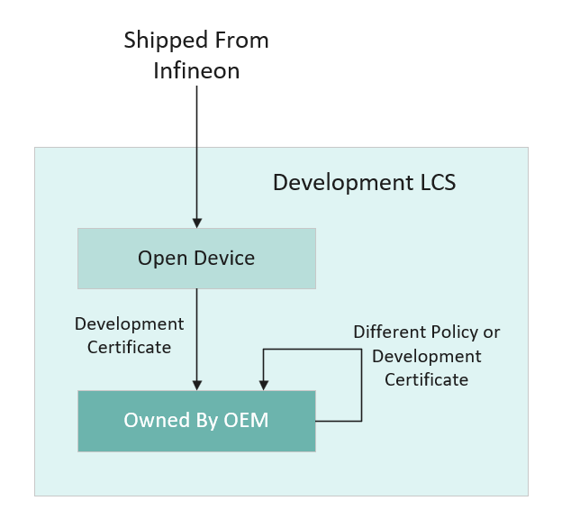
Development LCS - bring-up
Out of the box
  Factory default policy: DAP is open
  No signature verification - program and debug freely
OEM ownership
  Install your keys and custom policy via development certificate
  Re-provision as many times as needed - LCS does not change
  No fear of loosing keys, can install new keys (Temporary ownership)
Test production readiness - without leaving development LCS
  Enable Secure boot, sign your image, validate authenticated boot
  Confirm your policy, keys, and signing flow are correct first
Recommended workflow
  Develop → Test → Validate → Finalize → then transition
Notes:
Development LCS is your working environment. The device arrives from Infineon with a default policy already installed: all debug ports open, secure boot is not enforced, meaning BootROM runs whatever image you program without any signature check. This is intentional — you should not need cryptographic infrastructure just to bring up hardware or test other capabilities of the device like motor control, power conversion etc
When you install your OEM keys and a custom policy using a development certificate, the LCS does not advance. You can redo this operation as many times as you need — different keys, different policy, different boot mode. The three things that define this stage: debug is fully open, policy is writable, and BootROM does not verify application signatures.
Critically, you can fully simulate a near-production security posture without ever leaving Development LCS. Enable secure boot, sign your image with your OEM private key, provision with a development certificate, and boot. BootROM will enforce signature verification exactly as it will in production. This lets you validate that your keys are correct, your policy is right, and your signing pipeline works — before making any irreversible decisions. If something is wrong, you re-provision and fix it.
Only once you have validated all of that do you request a production certificate and make the transition. That transition is irreversible — one device, one chance. The development LCS is your safety net.

Slide 9
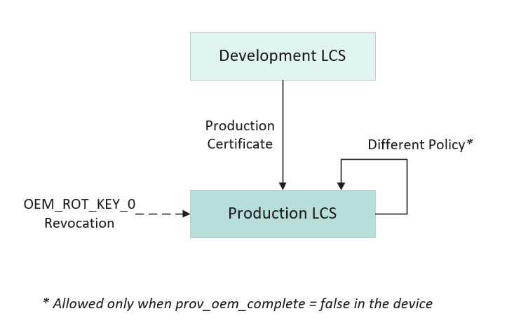
Production LCS - field deployment
Transiting to Production LCS
  Provision with a production certificate from Infineon EPSS
  Irreversible - no return to development LCS. One device, one chance
Asset locking
  OEM ROT keys in SFlash finalized (Ownership is permanent)
  prov_oem_complete = true locks all SFlash assets permanently
Key rotation
  OEM_ROT_KEY_0 → OEM_ROT_KEY_1 (once irreversible)
Authenticated debug via signed debug token (if configured)
Note: Infineon recommends to deploy the devices in production LCS
Notes:
Production LCS is your deployment environment
You enter Production LCS by provisioning with a production certificate obtained from Infineon EPSS. The moment that operation completes, the transition is recorded in eFuse — it cannot be undone. Do not do this until you have fully validated your policy and keys in Development LCS.
Once here, the device is in a committed state. Your OEM root keys in SFlash are finalized. All the policy fields are still configurable. And when you eventually set prov_oem_complete = true and run provisioning again, every SFlash asset locks permanently — that flag itself is irreversible, so it should be the last provisioning operation you perform on a device.
Some things remain possible. Key rotation is available once: you can retire OEM_ROT_KEY_0 and promote OEM_ROT_KEY_1 as the new root — but this is also a one-way operation. Plan your key hierarchy before you ever enter production.
Debug in Production LCS is controlled by ap_cm33. If you need to debug a field-returned device, you do it through an authenticated debug token signed with your OEM debug private key — BootROM validates the token and temporarily re-enables the access port. No token, no access. Permanently Disable is exactly what it says — it writes to eFuse and cannot be reversed. Only use that if your threat model specifically requires it and you are certain you will never need in-circuit debug again.

Slide 10
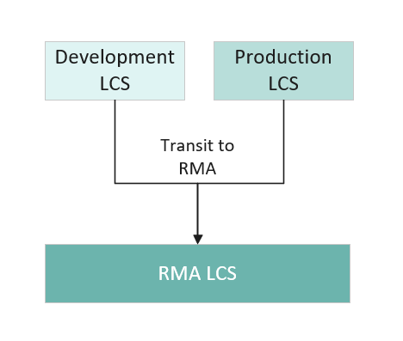
RMA LCS - failure analysis
RMA LCS purpose is to allow Infineon to perform device Failure Analysis (FA)
Potential device issues that can be analysed in RMA
  Improper behaviour of Infineon BOOT Firmware code
  Issues caused by HW configuration (e.g. wounding, specific trim values)
  Hardware issues
OEM/Customer transitions the device LCS to RMA
During transition, all OEM secrets are erased
OEM ships the device to Infineon in RMA LCS
Only Infineon can unlock and perform analysis
Notes:
RMA is the final LCS. You will rarely encounter it in normal development, but you should know what it is and what it does.
Its sole purpose is to allow Infineon to perform failure analysis on a device that has exhibited a suspected silicon defect. It is not a recovery mechanism — you cannot use it to reset a misconfigured device or recover a locked one.
Before initiating the transition, always run integrity-exam. This command captures a status report of the device's current state. Infineon can use that report during analysis, so running it beforehand gives them the most useful starting point.
The transition itself uses the transit-to-rma command, which requires a valid RMA token — signed by OEM-ROT-KEY. When executed, it erases all OEM assets from the device: your keys, your policy, everything. From that point, Infineon uses its RMA master key to access the device for analysis. There is no way back from this state.

Slide 11
Table of contents
1
Security by design
  3
2
Device life cycle stage (LCS)
  6
3
Ownership transfer and provisioning
11
4
Secure boot
  17
Notes:
Provisioning is the mechanism by which the OEM installs its identity (keys + policy) into the device.

Slide 12
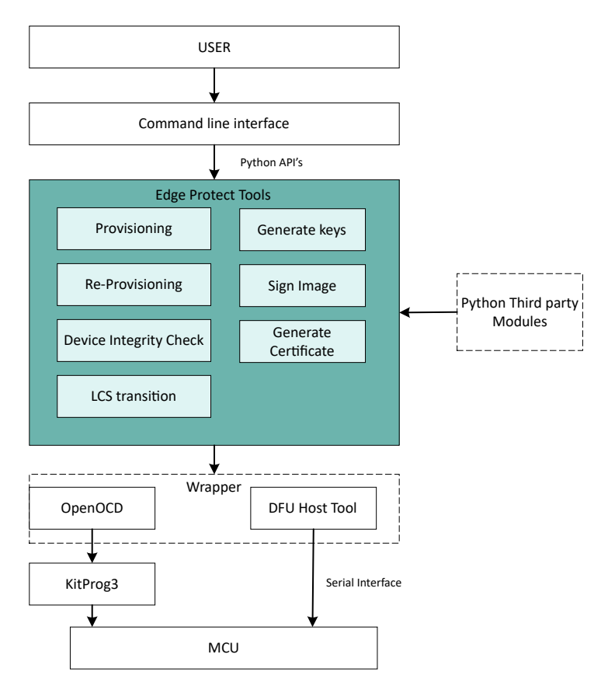
Edge protect tools (EPT) - overview
EPT is the command line tools that enables security configuration and processing essential for PSOC™ C3
Capabilities
  Key generation.
  Provisioning
  Debug and RMA token generation
  Image signing
Device to host communication
  SWD interface using OpenOCD
  Serial interface using DFU HostTool
Recommended shell: Modus-shell (bundled with ModusToolbox™)
Notes:
Before we walk through the provisioning or ownership transfer steps, let's establish the tool we will be using for it — Edge Protect Tools, or EPT.
EPT is the command-line interface for all security-related operations on the device. Every operation we cover in the next slides — generating keys, creating a CSR, provisioning the device, signing images — is done through EPT commands.
It is Python-based, which means it is cross-platform and scriptable. Under the hood it uses third-party Python modules for JSON policy file handling, ELF object file processing, and cryptographic operations. You do not need to interact with any of that directly — the CLI abstracts it.
For device communication, EPT uses two different tools depending on the interface. For SWD it drives OpenOCD, which is the standard path for provisioning during development. For serial interfaces — UART, I2C, SPI — it uses the DFU Host Tool, which is used for factory loading and field updates without a debug probe.
You can run EPT from any shell, but Infineon recommends Modus-Shell, which ships with ModusToolbox.

Slide 13
Two certificate types - development vs production
Development certificate
Device stays in development LCS after provisioning
OEM ROT Keys can be changed (Ownership is temporary)
Use case: bring-up, development, and validation work
Security features can be fully tested with a development certificate — no need to transition to Production LCS
Use cert-type as development while generating the CSR to obtain the certificate
Production certificate
Triggers irreversible LCS transition to production LCS
OEM ROT Keys are fixed (Ownership is permanent)
Use case: final factory provisioning for field deployment
Only use when you are completely ready
All policy settings verified
Ensure private key security is in place
Use cert-type as production while generating the CSR to obtain the certificate
Text
VS
Notes:
For ownership transfer or provisioning we need a certificate, the certificate type you use determines what happens to the device LCS during provisioning. This is one of the most important decisions in the provisioning workflow.
DEVELOPMENT certificate: use for everything during development. The device stays in Development LCS. Your keys are not fixed; you can undo mistakes with a different certificate. You can fully test secure boot, debug lockdown, and all other security features with a development certificate — you do not need a production certificate to test security.
PRODUCTION certificate: use only once per device, only when preparing for actual production. This is a one-way gate. If you provision with a production certificate and something is wrong with your keys, you have no room to recover. Key rotation to KEY_1 is still possible, but you cannot replace KEY_0 with an entirely new key.
Both certificates are obtained by providing oem-csr to IFX EPSS portal. The cert-type flag in the oem-csr is the only thing that differs between creating a development and production certificate.

Slide 14
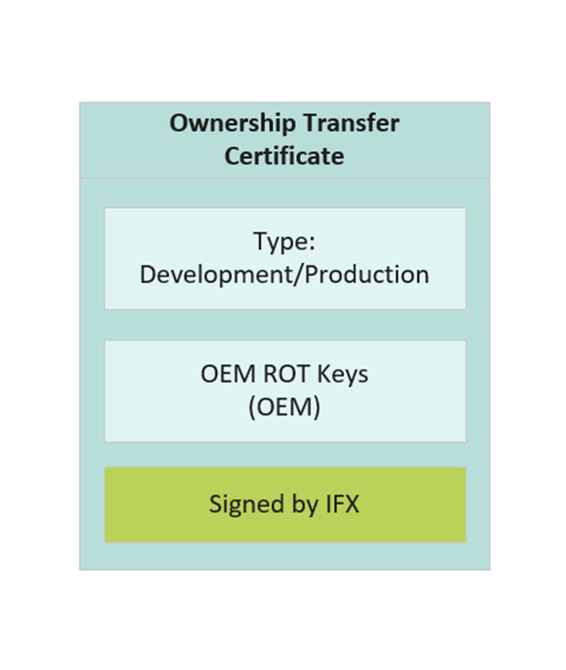
Ownership transfer - create certificate
Step 01
Initialize the EPT
Generates folder structure and default policy
For production, certificate can be per-device
or per batch. It is up to the OEM to decide
Step 02
Create OEM ROT keys
Generate ECC key pairs
Private Key should be protected
Step 03
Create OEM Certificate Signing Request (CSR)
CSR contains: OEM ROT public keys, cert type, OEM name and project information
Signed by the OEM private key
Step 04
Get Infineon-signed certificate
Upload CSR to Infineon Edge Protect Signing Service
Enter certificate name and silicon revision (PSOCC3X8)
Download signed certificate (.bin)
Notes:
This is the complete ownership transfer flow. Five steps, can be done multiple times during development, and for production, once per device.
Step 1 — init creates your working folder structure: a keys/ directory, the policy template JSON, and the pre-signed Infineon DLM packages that BootROM needs to execute the provisioning operation. Start here on every new project.
Step 2 — create-key generates your OEM ROT key pair as PEM files. The public key goes into the certificate and eventually into SFlash. The private key must go directly into secure storage — HSM or air-gapped system. It should never sit on a developer workstation beyond the time needed to complete this flow.
Step 3 — oem-csr creates the Certificate Signing Request. This is where the --cert-type flag matters — development or production. Everything else in the CSR is the same; the type determines what Infineon's EPSS system will issue back and what effect it will have on the device LCS.
Step 4 is the only step that happens outside your environment. You submit the CSR to Infineon EPSS and receive a signed certificate in return.

Slide 15
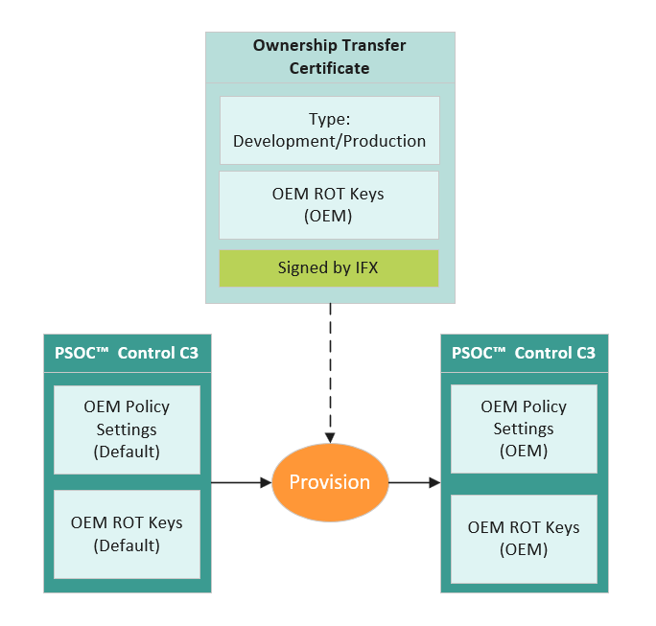
Ownership transfer - provision
Create provisioning packet (Policy JSON, certificate, RAM APP)
Send provisioning packet to device
BootROM verifies the Infineon certificate signature
Writes OEM keys and policy into SFlash
Device ownership transferred to OEM
Notes:
provision-device does the actual work on the device. EPT assembles a DLM package containing your policy and certificate, downloads it to the device over SWD or UART, and BootROM validates then launches the Infineon RAM application that writes your keys and policy to SFlash.

Slide 16
OEM policy
JSON file that defines the device's complete security configuration
Created in the policy/ folder when EPT is initialized: policy_oem_provisioning.json
Written to SFlash during provisioning - BootROM reads it at every boot
Device behavior is entirely driven by the provisioned policy
  Boot behavior - Boot mode, image slots, signature scheme
  Debug access - DAP enable/disable
  DFU serial interface - BootROM UART download channel on/off
Notes:
The policy file is the central configuration artefact for device security. It is a JSON file generated automatically when you run edgeprotecttools init — it lands in the policy/ folder as policy_oem_provisioning.json.
During provisioning, the contents of this file are written to SFlash. From that point on, BootROM reads the policy at every power-on reset and configures itself accordingly. The policy is the authoritative source of truth at runtime — it governs everything from which boot mode is active to whether the debug port is open.
The key message for this slide is that there is no hardcoded device behavior. Everything in the table — boot mode, debug access, DFU availability, flash bank configuration — is a policy decision that you make and provision. A device with no policy provisioned has no security. A device with a well-crafted policy behaves exactly as you intend, and nothing outside that policy can change it.

Slide 17
Table of contents
1
Security by design
  3
2
Device life cycle stage (LCS)
  6
3
Ownership transfer and provisioning
  11
4
Secure boot
17

Slide 18
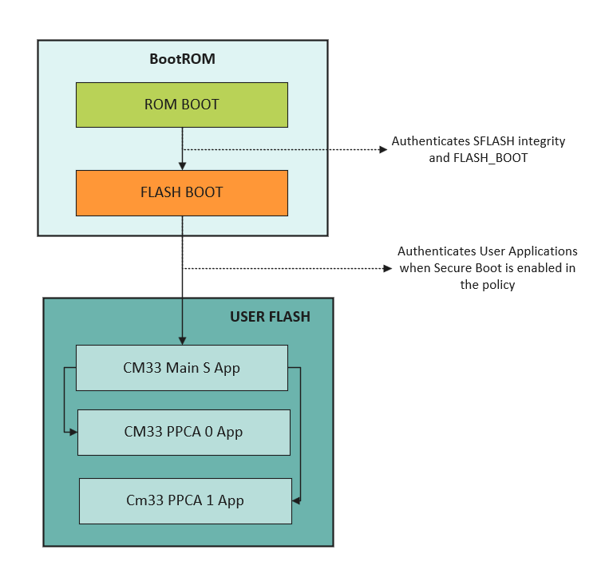
BootROM - root of trust
BootROM is immutable - it is the hardware root of trust
Chain of trust
  BootROM verifies SFlash using ASSET_HASH / FACTORY_HASH
  BootROM verifies OEM application using OEM_ROT_KEY
  BootROM launches the application on successful authentication
  Authentication failure → Device does not boot
Trust anchored at silicon
  BootROM → OEM Application

Slide 19
Policy fields for secure boot
boot_cfg_id
  Sets the boot mode: SIMPLE_APP or SECURE_APP
  Set this field to SEURE_APP for secure boot
boot_auth_signature
  ECDSA scheme for image verification
  ES256 (P-256) / ES384 (P-384) / ES512 (P-521)
  Must match the key type used to sign the image
boot_app_layout
  Array of up to 5 entries: address + size per image
  Number of entries in this field decides how many images gets verified
failed_signature_counter
  Per-slot budget: 65535 = unlimited retries
// Policy file
"boot_cfg_id": { "value": "SECURE_APP" },
"boot_auth_signature": { "value": "ES512" },
"boot_app_layout": {
"value": [
// Slot 0: Secure CM33 application
{ "address": "0x32000000", "size": "0x6E000" },
// Slot 1: PPCA0
{ "address": "0x3206E000", "size": "0x9000" },
// Slot 2: PPCA1
{ "address": "0x32077000", "size": "0x9000" },
// Slots 3,4: unused
{ "address": "0x00000000", "size": "0x00" },
{ "address": "0x00000000", "size": "0x00" }
]
}
Notes:
These are the four policy fields that directly control secure boot behaviour. You will touch all of them when configuring a device for authenticated boot.
boot_cfg_id is the on/off switch. SIMPLE_APP means BootROM boots whatever is in the slot with no verification — this is the default configuration, fine for early development, not for deployment. SECURE_APP enables ECDSA verification at every boot. Flip this field and re-provision when you are ready to start testing authenticated boot.
boot_auth_signature selects the ECDSA curve. This value must be consistent across three things: the OEM_ROT_KEY you provisioned during ownership transfer, the key used to sign the image, and this policy field. If any one of them uses a different curve, authentication will fail. Pick your curve once and keep it consistent throughout.
boot_app_layout tells FLASH_BOOT where your application images live in flash. Slot 0 is mandatory — it is the Secure CM33 application. Slots 1 through 3 are optional and cover the Non-Secure application and PPCA images. Basically, this field decides how many images BootROM needs to verify and where to find them.
Any slot you are not using must be zeroed out — address and size both set to 0x00.
failed_signature_counter is a per-slot watchdog. Each consecutive authentication failure decrements the counter; when it reaches zero the slot is permanently rejected and will never boot again. Set it to 65535 in production — this means BootROM always checks and a bad image never permanently locks out the slot. Lower values give you a hard limit on consecutive failures, which some security policies require.

Slide 20
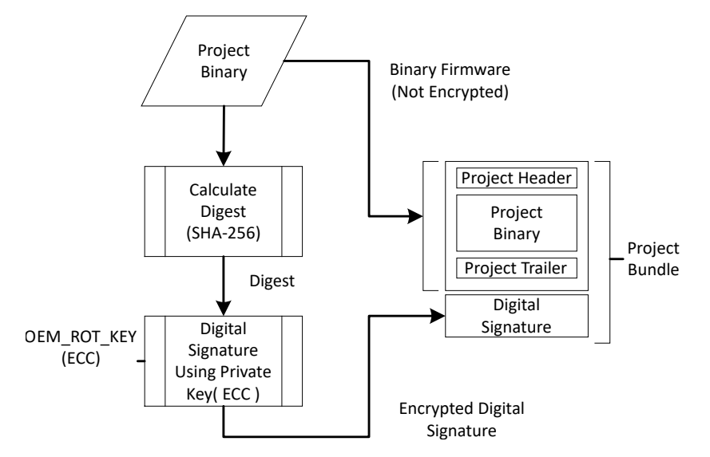
Image signing
Notes:
Signing is the operation that produces the image BootROM can actually authenticate. It takes your raw application binary and wraps it with three additional structures.
The MCUboot header carries metadata: the load address, image size, version number, and flags. The Protected TLV contains a hash of the firmware payload and the security counter — this counter is used for anti-rollback, preventing older firmware versions from being installed over newer ones.
The Signature TLV holds the ECDSA signature computed over both the header and the payload. BootROM verifies this signature using the OEM_ROT_KEY stored in SFlash.
In practice, most teams will use the ModusToolbox integration. EPT provides a sign-combine extension that plugs into the ModusToolbox build system. You configure it once in signer_config.json — specifying the key, slot parameters, version — and from that point signing happens automatically as a post-build step. The output of every build is a signed image ready to flash.
The manual sign-image command is the underlying operation that the extension calls. It is useful to know for scripting, CI pipelines, or situations where you are signing outside of ModusToolbox. The parameters are the same either way: key, header size, slot size, image version.
One important note: the slot address and size you pass to the signing command must match exactly what is configured in boot_app_layout in your policy. A mismatch here is one of the most common causes of authentication failure.

Slide 21
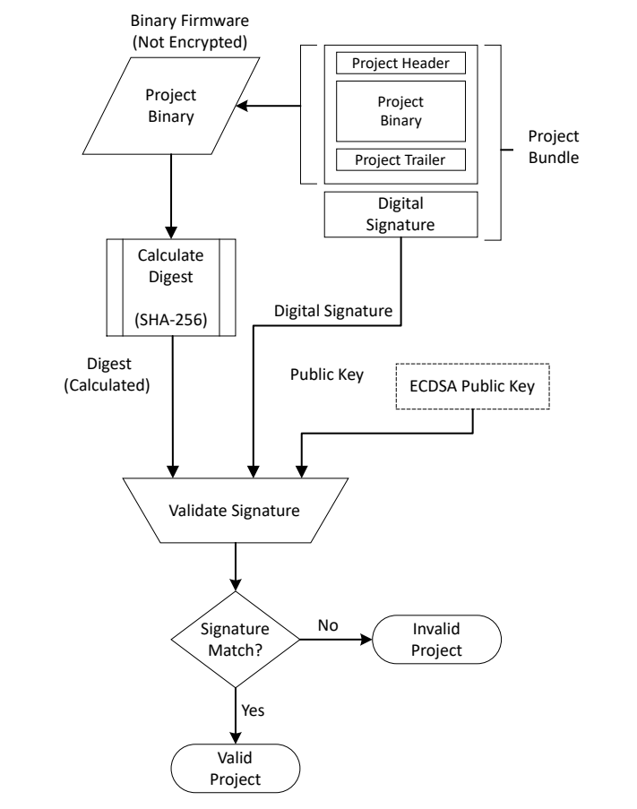
Image verification

Slide 22
Key takeaways
LCS is a one-way progression stored in hardware (OTP)
  Development → Production → RMA; irreversible at each step
Ownership transfer is the act of installing OEM keys into SFlash via provisioning
  After provisioning: BootROM trusts the OEM ROT key
  Development certificate – LCS does not change and the ownership is non-permanent
  Production certificate – LCS advances to Production LCS and ownership becomes permanent
Use development certificate for all testing and validation
  LCS stays in Development; re-provisioning is always possible
  You can fully test secure boot without a production certificate
Secure boot (SECURE_APP) requires three things to align:
  Policy: boot_cfg_id = SECURE_APP, boot_app_layout addresses/sizes correct
  Keys: OEM_ROT_KEY in SFlash matches the signing key
  Image: signed with OEM_ROT_KEY before flashing
Private keys must never leave a secure, controlled environment (Caution for production)

Slide 23
Notes:
End of theory session. Transition to the lab.

Slide 24
Appendix

Slide 25
Attack types vs security features
Notes:
This slide maps each attack vector to the hardware or firmware mechanism that addresses it. The goal is to show that the security features are not a collection of independent checkboxes — each one exists to close a specific gap.
Secure boot and image signing directly address firmware tampering and the firmware update path. The security counter in the MCUboot image format prevents an attacker from rolling back to an older, potentially vulnerable firmware version.
Debug port exploitation is a common vector on deployed embedded devices. Closing the debug port before deployment, and the authenticated debug token provides a controlled way to re-enable it when legitimately needed.
Physical attacks — voltage glitching and clock manipulation — are used to cause the CPU to skip instructions, including security checks. The hardware fault injection hardening countermeasures are in silicon; they cannot be patched away or bypassed by modifying software.
IP protection — keeping your motor control algorithms or other proprietary firmware confidential — is addressed by Memory Protection Controller isolation and the PROT_FW boot mode, which we will cover in an advanced session.
The OEM key hierarchy and ownership transfer model address supply chain risk. A device that has not been provisioned with your keys will not run your firmware, and a device provisioned with your keys will not run anyone else's.
The overall picture: each layer of the security architecture closes a different attack surface. Together they provide defence in depth — if one layer is compromised or misapplied, the others continue to provide protection.

Slide 26
What happens when authentication fails
Slot 0 failure (secure application) → DEAD
  Device halts — no code executes
  Persists until next reset
  Recovery: flash a correctly signed image or re-provision
Slots 1–3 failure (optional images) → skip and continue
  Secure application still launches
  Secure app is responsible for handling the missing sub-image
  failed_signature_counter decremented on each failure per slot
Common causes
  Image not signed
  Key mismatch between signing key and provisioned OEM_ROT_KEY
  Slot address or size mismatch between policy and image
  Corrupted image in flash
Notes:
Authentication failure behavior depends entirely on which slot fails.
If Slot 0 fails — the Secure CM33 application — the device enters the DEAD branch. No code executes. The device halts and stays halted until the next reset. This is by design: if the primary application cannot be authenticated, the device has no safe state to fall back to. Recovery means getting a correctly signed image into Slot 0, either by flashing it directly over SWD in Development LCS or by re-provisioning if the policy itself is the problem.
If any of Slots 1 through 3 fail, BootROM skips that slot and continues. The Secure application still launches. The responsibility for handling the missing sub-image — whether that means degraded operation, an error flag, or refusing to run — lies entirely with the Secure application code.
The failed_signature_counter tracks consecutive failures per slot and decrements on each one. Keep this in mind during debugging: repeated failed boot attempts on a slot with a low counter value will eventually lock that slot out permanently.
The four most common causes of authentication failure in the lab: the image was never signed, the image was signed with a different key than the one provisioned as OEM_ROT_KEY, the slot address or size in the policy does not match where the image was actually linked or flashed, or the image in flash is corrupted. When authentication fails unexpectedly, check these four things in order before looking elsewhere.

Slide 27
Revision history
Document revision | Date | Description of change
** | 2026-06-26 | Initial release

