Slide 1
E2 - Getting Started with the Development Ecosystem for PSOC™ Edge E84
Notes:
Hello attendees, a warm welcome to all of you. This presentation provides an overview of the development ecosystem and resources available for PSOC™ Edge E84.
It also explains how to get started on PSOC™ Edge E84 through code examples at the end of the presentation.
Let’s get started!

Slide 2
Table of contents
1
Development ecosystem for PSOC™ Edge E84
  3
2
Code Example #1: Hello World + Blinky
  46
3
Code Example #2: IPC Semaphores using PDL API
  50
Notes:
Our training will first explore the ecosystem available for the PSOC™ Edge. After touring the ecosystem, we will experience firsthand several aspects of it as we write our first code example, utilizing the classic 'Hello World' with Blinky in one application. Finally, we will approach a code example that highlights the basic interaction between the PSOC™ Edge's dual cores, the Cortex®-M33 and Cortex®-M55.

Slide 3
Table of contents
1
Development ecosystem for PSOC™ Edge E84
3
2
Code Example #1: Hello World + Blinky
  46
3
Code Example #2: IPC Semaphores using PDL API
  50
Notes:
The PSOC™ Edge Development Ecosystem provides developers with intuitive, end-to-end workflows and resources that accelerate development by putting reference materials at their fingertips, offering easy-to-use and feature-rich configurator tools, as well as middleware, that abstract low-level MCU details. This allows developers to focus on getting their applications to market quickly. In addition, the ecosystem enables developers to integrate their favorite IDE, provide real-time control with supported RTOS environments like Zephyr and FreeRTOS, implement advanced Edge ML models, and industry-leading security measures. Further, the ecosystem offers flexible options that fit a team's workflow, allowing for seamless integration and development.

Slide 4
PSOC™ Edge E84 Resources
PSOC™ Edge E84 MCU Product page and PSOC™ Developer Journey on Infineon.com
Datasheets
Reference manuals (RM): architecture and registers
Application notes
Code examples
Development kits
KBAs and community forum
Notes:
Here is the list of PSOC™ Edge E84 resources. Resources play a vital role in the success of any product.
[Press Enter for animation] PSOC™ Edge E84 MCU product page for PSOC™ Edge E84 MCU related documents and the PSOC™ Developers Journey
[Press Enter for animation] PSOC™ Edge E84 MCU datasheets that describe and provide electrical specifications for each device family
[Press Enter for animation] Technical reference manuals (TRMs) provide detailed descriptions of the architecture and registers in each device family.
[Press Enter for animation] Application notes and Code examples cover a broad range of topics, from basic to advanced. You can browse our collection of application notes and code examples

Slide 5
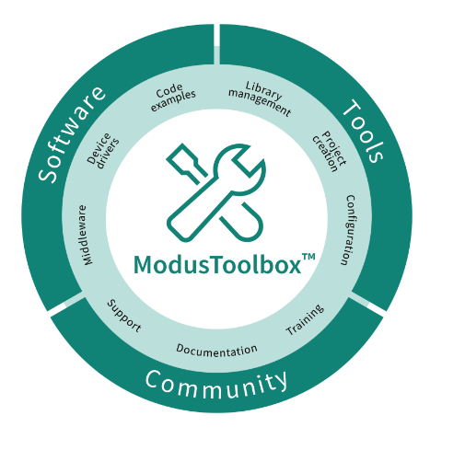
Firmware / Application Development
ModusToolbox™ provides
  Development environment for Infineon MCUs
  Flexible set of tools for project and system
  level configuration
  Low-level drivers
  Libraries
  Operating system support (Linux, macOS,
    Windows)
    Reference link : https://www.infineon.com/ModusToolboxInstallguide
Notes:
For Firmware or application development, development tools are necessary.
ModusToolbox™ Software is a modern, extensible development environment supporting a wide range of Infineon MCUs, including PSOC™ Edge E84.
The ModusToolbox™ tools package includes tools and configurators for creating and managing your application, as well as configuring your device. With ModusToolbox, you can choose your preferred compiler, IDE, RTOS, and ecosystem while maintaining usability, and easily create applications that leverage our industry-leading CAPSENSE™ (Human-Machine Interface), AIROC™ Wi-Fi and Bluetooth®, security, and various other features.
It also provides the Make build system infrastructure allowing you to control the build flow and build your application across platforms.

Slide 6
Support for IDEs
ModusToolbox™
IDE Tool Support
ModusToolbox™
IDE Tool Support
Eclipse IDE
Eclipse IDE for ModusToolbox™
Visual Studio
Code
Visual Studio
Code
Arm® MDK
µVision
IAR
Embedded
Workbench
Arm® MDK
with µVision IDE
IAR
Embedded Workbench
Command-line Interface
Command-line Interface
Embedded Workbench and µVision require additional post-build step configuration
Details documented within IDE respective user manuals
Notes:
ModusToolbox™ software supports 3rd-party IDEs like
[Press Enter for animation] Eclipse IDE
[Press Enter for animation] Visual Studio Code, Arm® MDK (μVision), and IAR Embedded Workbench. The tools package includes Eclipse IDE for your convenience.
[Press Enter for animation] Additionally, a command line interface is also available for developers who prefer working without a graphical interface.
[Press Enter for animation] While the Eclipse IDE for ModusToolbox™ provides a downloadable binary after the build process
[Press Enter for animation] IDEs sucah as IAR Workbench and μVision will require an additional step.
In the next section of this video walk through tools like Project Creator, Library Manager, and a few of the configurators available in ModusToolbox™ for PSOC™ Edge Development.

Slide 7
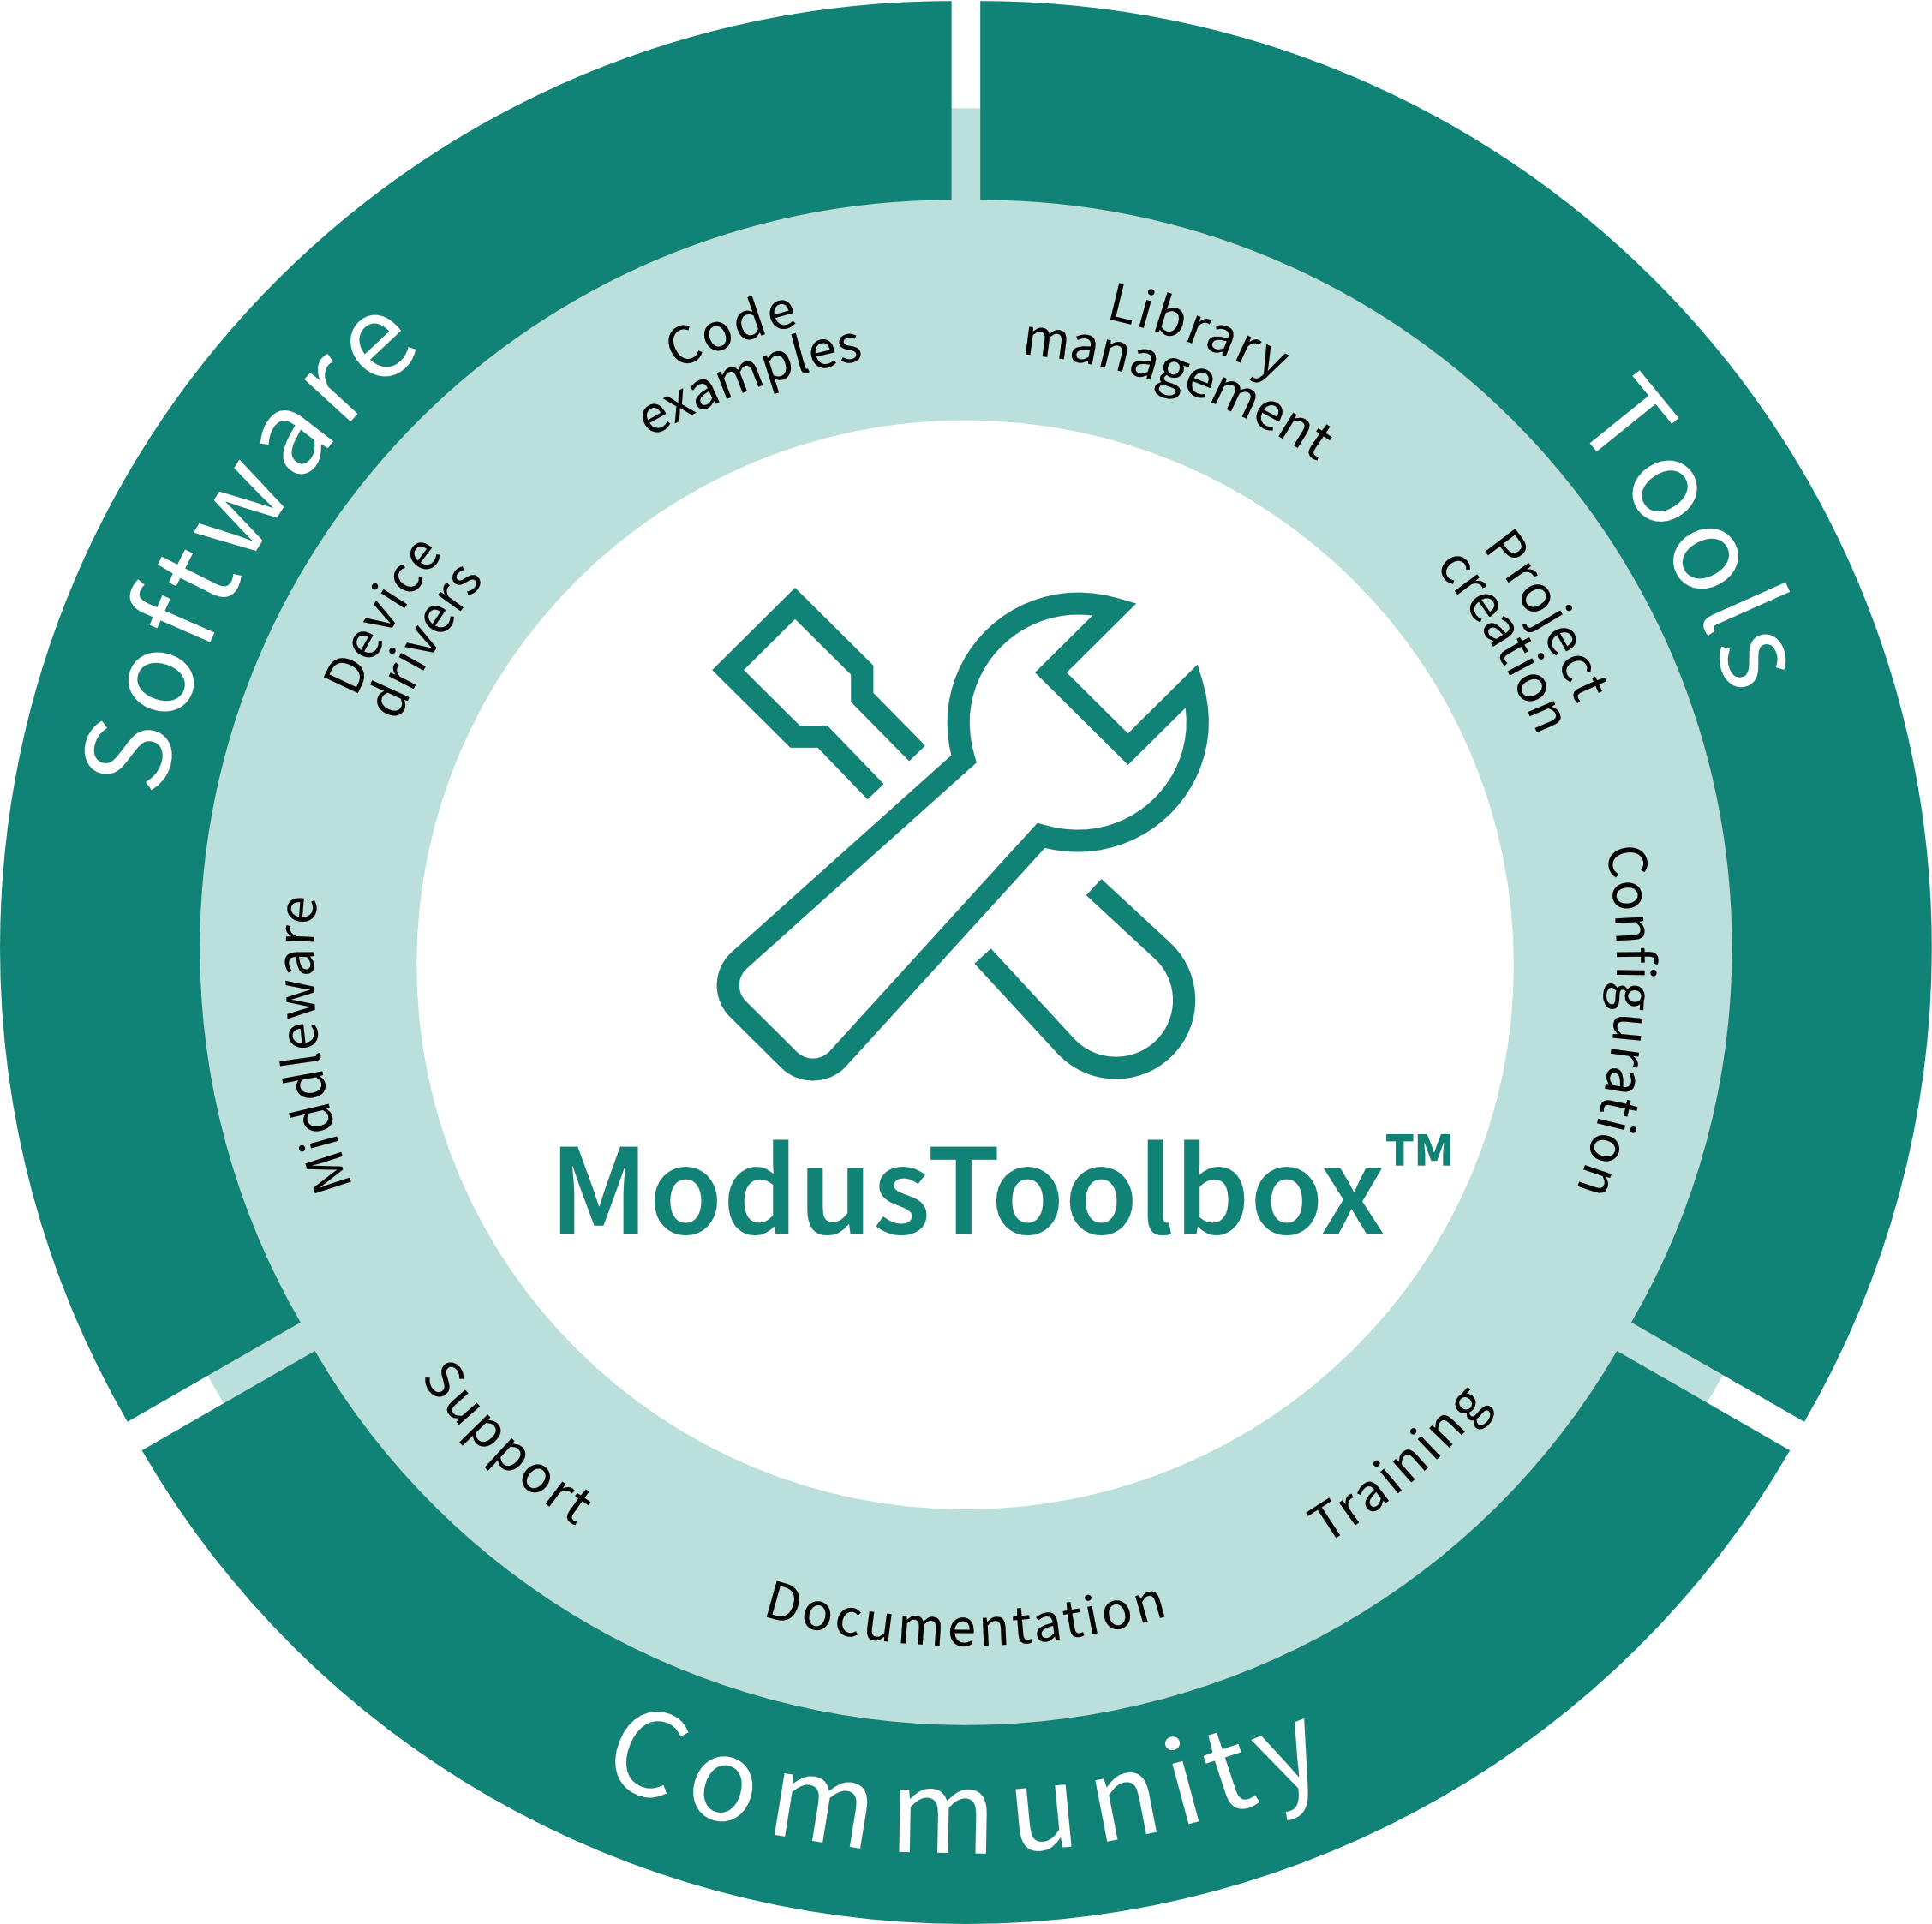

Understanding ModusToolbox™ and Zephyr
Provides a targeted ecosystem focused on development of Infineon devices.
Provides a community driven ecosystem with support for a targeted set of MCUs from a wide range of silicon providers.
IDE support, including Eclipse IDE,
VS Code, and 3rd party IDEs.
Support for GCC, IAR, and Arm compilers using ‘make’ based ModusToolbox™ build system.
Graphical UI configurations tool
Leverages Infineon developed low-level drivers, middleware abstraction, middleware, and code examples.
Enables key partner middleware via ModusToolbox™ & Friends program
Targeted at command-line users with some community support for VS Code.
Default support for GCC compiler using ‘west’ based Zephyr build environment. Additional toolchains are now being supported.
Text-based configuration via devicetree and Kconfig.
Leverages vendor provided device support; Infineon support based on low-level drivers.
Community contributed middleware, with support for Zephyr defined driver API, stacks, and RTOS.
Notes:
Zephyr and ModusToolbox™ are two different ecosystems and development environments that include support for Infineon devices.
ModusToolbox™ is a targeted ecosystem focused specifically on Infineon devices and the differentiation that can be achieved, while Zephyr is a community‑driven ecosystem with support for a wide range of devices and silicon companies. As such, much of the support in Zephyr focuses on device capabilities that are common across the broader market.
ModusToolbox™ includes support for development within an IDE, including Eclipse, VS Code, and third‑party IDEs like IAR and Keil. Zephyr development is targeted at command‑line users, with some community support for working in VS Code.
Regarding toolchains, ModusToolbox™ includes support for GCC, IAR, and Arm compilers and is implemented using a make‑based build system, while Zephyr primarily uses GCC with a west‑based build system. There is growing community support for additional toolchains.
ModusToolbox™ is enabled via graphical device‑configuration tools that auto‑generate code. Zephyr does not have standard graphical code‑generation tools. However, traction is increasing for vendor‑specific code‑generation tools to produce Zephyr‑compatible devicetree files and related code. This is a planned roadmap item for the ModusToolbox™ Device Configurator.
Both ModusToolbox™ and Zephyr rely on the underlying low‑level drivers that are developed and maintained by Infineon. ModusToolbox™ builds on top of this with middleware portability APIs, middleware libraries, and Infineon‑specific code examples, with content coming from Infineon and partners. Zephyr utilizes standardized Zephyr driver APIs, a common set of sample applications, and middleware modules from the Zephyr ecosystem, including assets contributed by the community.

Slide 8
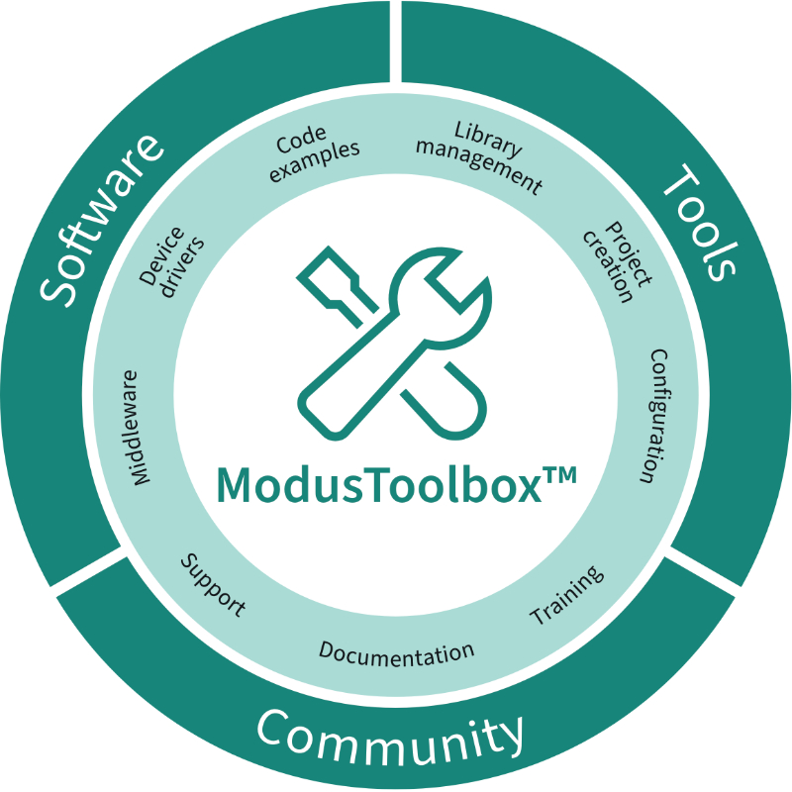

Overview of DEEPCRAFT™ Studio and ModusToolbox™ workflow
Installation of ModusToolbox™ and DEEPCRAFT™ supported within the ModusToolbox™ Setup program
Code Examples aligned with DEEPCRAFT™ Studio Accelerator projects for IMU, Vibration, and Microphone
Code Examples aligned with DEEPCRAFT™ Studio Data Collection with Graph UX
Code Examples aligned with DEEPCRAFT™ Model Converter Profiling
Project connector files in ModusToolbox™ applications with Quick Panel shortcuts for linking to DEEPCRAFT™ Studio Projects
Integration of ModusToolbox™ Project Creator, supporting coordinated DEEPCRAFT™ Studio and ModusToolbox™ project creation
Integration ModusToolbox™ Machine Learning Core Tools (ml-coretools), leveraged during Infineon device specific code generations and optimization
ModusToolbox™ project detection and selection during model code generation
Notes:
Starting with ModusToolbox™ 3.6, integration with DEEPCRAFT™ Studio has been expanded.
DEEPCRAFT™ can be installed directly through the ModusToolbox™ Setup program.
ModusToolbox™ provides code examples in Project Creator that align with DEEPCRAFT™ Studio Accelerator projects for IMU, vibration, and microphone use cases. Additional ModusToolbox™ code examples are available to facilitate the collection of data into Studio using the Graph UX workflows.
The DEEPCRAFT™ Model Converter is supported via dedicated profiling examples that let you evaluate the impact of different conversion options.
You can create ModusToolbox™ projects directly within DEEPCRAFT™ Studio, or associate a Studio project with an existing ModusToolbox™ application—simplifying updates to generated models and source code within the embedded project.

Slide 9
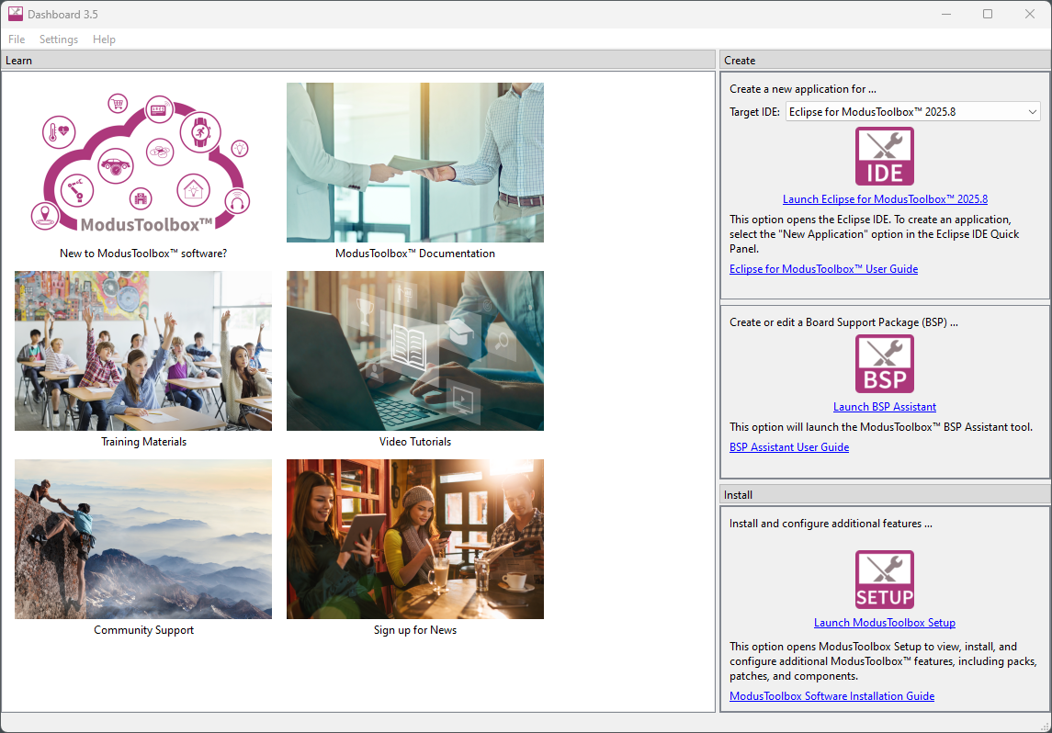
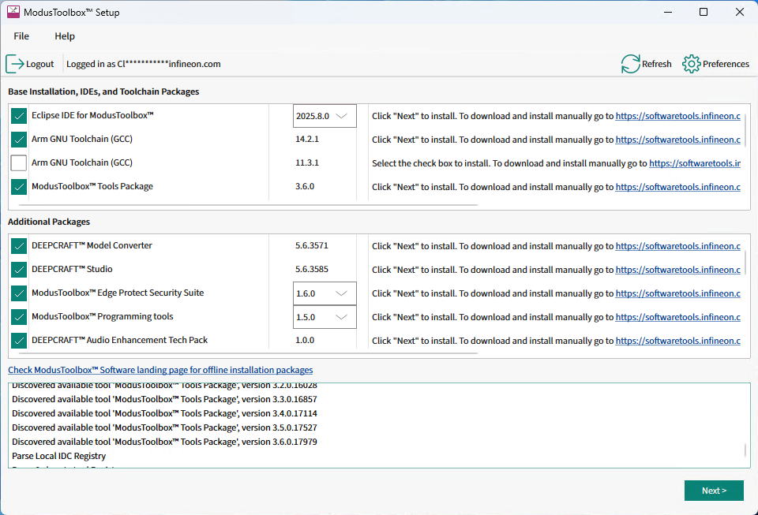
Installation support within ModusToolbox™ Setup
ModusToolbox™ Setup program can be used to install and manage DEEPCRAFT™ applications, including Studio, Model Converter, and Audio Enhancement Tech Pack
Notes:
The ModusToolbox™ Setup program is the recommended tool for installation of ModusToolbox™ packages.
This tool can be used to update to the latest releases and can resolve dependencies to ensure that the user has the correct applications installed on their development machine.
This includes installing and managing the version of DEEPCRAFT™ Studio, Model Converter, and supported Audio Enhancement packages.

Slide 10
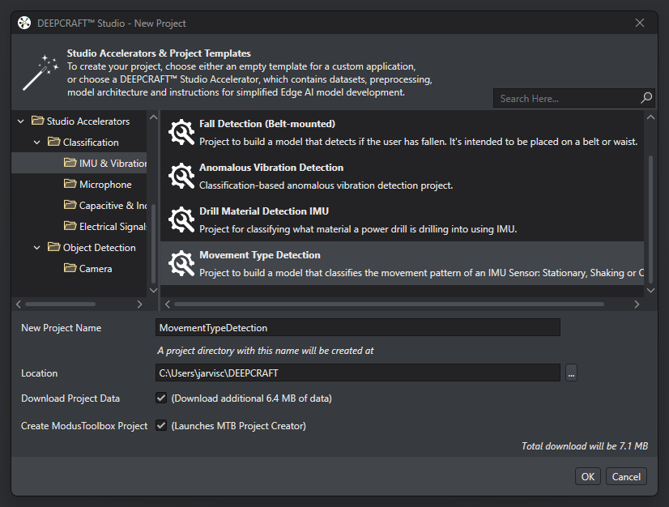
Code Examples with DEEPCRAFT™ and ModusToolbox™
When creating a new DEEPCRAFT™ Studio project, a ModusToolbox™ project can be created at the same time.
DEEPCRAFT™ Studio includes Studio Accelerator projects that align with ModusToolbox™ code examples, enabling models generated from Studio to be more easily leveraged within a ModusToolbox™ application.
ModusToolbox™ code examples include DEEPCRAFT™ Deploy Audio and Deploy Motions applications.
Notes:
When you create a new DEEPCRAFT™ Studio project, you can also create an associated ModusToolbox™ code example directly from Studio.
Studio Accelerator projects align with the corresponding ModusToolbox™ code examples to speed development for IMU/vibration and microphone use cases.
Using these accelerator projects, you can update and regenerate models directly into the ModusToolbox™ code example.
When working with DEEPCRAFT™ Ready Models, dedicated “Deploy” code examples let you evaluate each model’s performance on the target hardware.

Slide 11
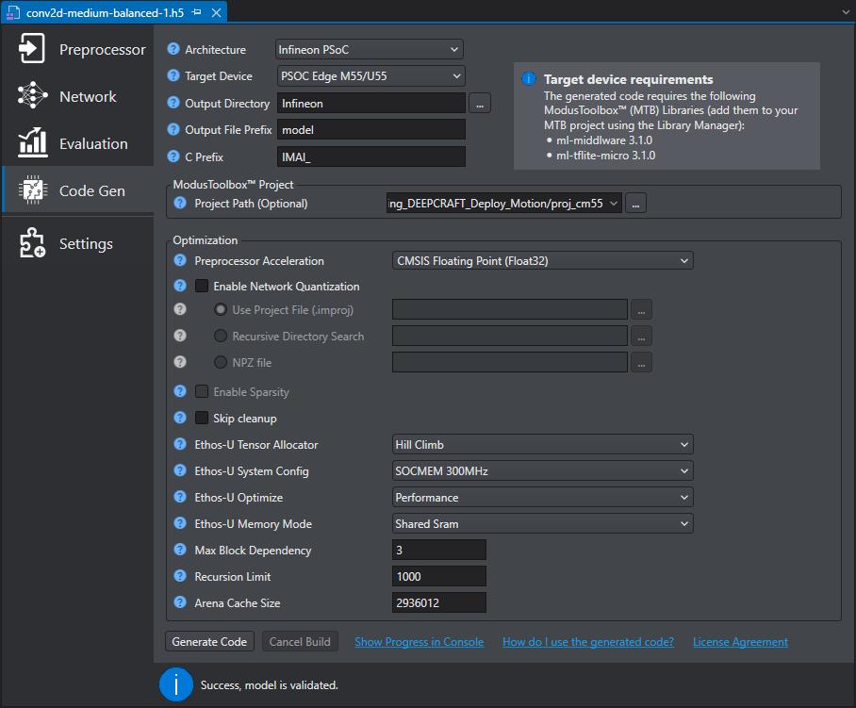
DEEPCRAFT™ Studio Model Code Generation
DEEPCRAFT™ Studio code generation dialog includes pre-defined architecture selections for Infineon devices, including PSOC™ Edge E84
DEEPCRAFT™ Studio code generation integrates the ModusToolbox™ Machine Learning Core Tools (ml-coretool) with integrated Vela compiler supporting PSOC™ Edge E84.
Selection of Infineon device enables project selection of the connected ModusToolbox™ project and core specific project path.
Selected ModusToolbox™ project path will be used during the code generation step to enable iterative model development and updates.
Notes:
When generating device‑optimized code in DEEPCRAFT™ Studio, select the associated ModusToolbox™ project in the code‑generation dialog so the sources are updated directly within your embedded PSOC™ project.
Details of the association between DEEPCRAFT™ Studio and ModusToolbox™ are saved in the ModusToolbox™ project folder structure, allowing the Studio project to be referenced and opened directly from ModusToolbox™.

Slide 12
Tools utilized in this presentation
  ModusToolbox™ v3.6
  Eclipse IDE for ModusToolbox™ v2025.4.0
  Edge Protect Security Suite v1.6
  ModusToolbox™ Programming Tools v1.5.0
  KIT_PSE84_EVAL_EPC2 BSP v1.0.0
  Terminal Emulator
  KIT_PSE84_EVAL revG
Key documentation leveraged in this video
AN235935 – Getting started with PSOC™ Edge E84 on ModusToolbox™ software
ModusToolbox™ PSE8xxGP Device Support Library (DSL)
Notes:
Now that we have seen an overview of the ecosystem for PSOC™ Edge, it is time to dive into some demonstrations. The tools utilized in this presentation are
[Press Enter for animation] of course ModusToolbox™ and the Eclipse IDE for ModusToolbox™.
[Press Enter for animation] The Edge Protect Security Suite
[Press Enter for animation] The ModusToolbox™ Programming Tools
[Press Enter for animation] The Board Support Package, BSP, for the PSE84 EVK
[Press Enter for animation] A serial terminal emulator such as Terra Term or PuTTy
[Press Enter for animation] And finally, the PSE84 EVK itself.
In addition to the tools mentioned above, further details about the content in this presentation are leveraged from information in
[Press Enter for animation] the Application note “Getting started with PSOC™ Edge on ModusToolbox0153 software” and the ModusToolbox™ DSL, Devive Support Library , for the PSOC™ Edge.

Slide 13
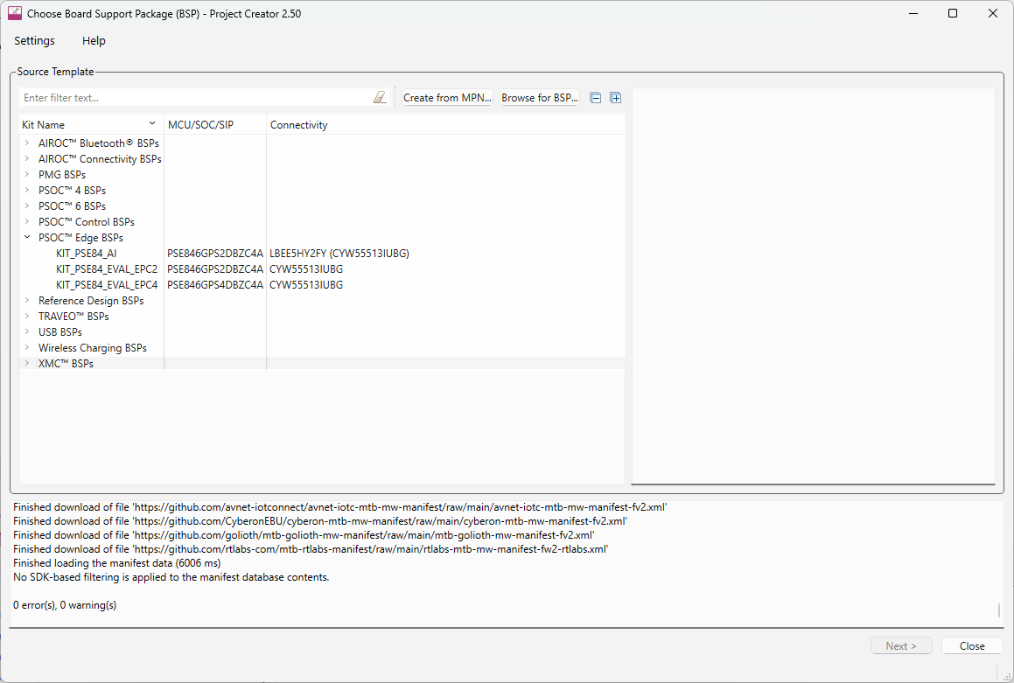
Project Creator
Notes:
(Will show actual tool)
First, we have the Project Creator tool.
The Project Creator tool is used to create applications targeting specific Board Support Packages (BSPs) from available code example templates.
It is available both as a graphical user interface (GUI) and a command-line interface (CLI) to create applications for use in any software environment as per preference.
To launch Project Creator,
Open Eclipse IDE for ModusToolbox™
[Press Enter for animation] Launch Project Creator by clicking New Application in the Quick Panel
[Press Enter for animation] Project Creator lists all the BSPs you can select from
[Press Enter for animation] The PSOC™ Edge E84 MCU development kit is listed as KIT_PSOCE84_EVAL_EPC2 under PSOC™ Edge BSPs. We will be using this in our training, please take note of it.
You can also launch the tool standalone by running the executable version of the tool from a command line.

Slide 14
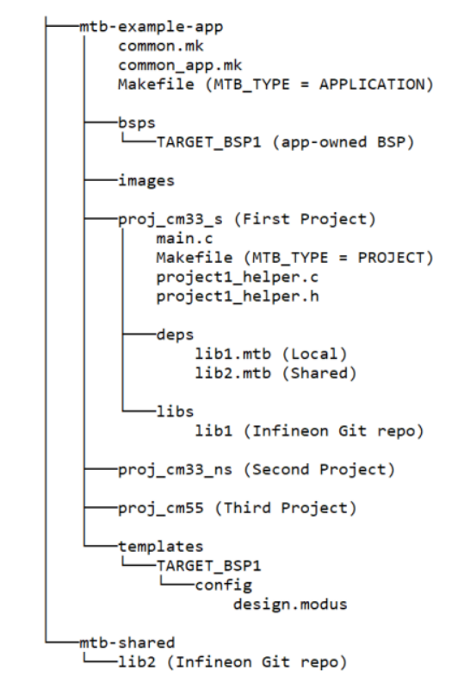
Understanding the Application Structure
Notes:
(Will show actual tool)
After creating an application, it will be located in a top-level container, or workspace directory, that contains multiple files, one or more application directories, plus a mtb_shared directory.
A typical PSOC™ edge application contains three projects: Proj_cm33_s (s stands for secure), Proj_cm33_ns (s stands for non secure) and proj_cm55
common.mk :
This makefile is shared across all projects. It contains variables including: MTB_TYPE, TARGET,TOOLCHAIN, and CONFIG. In this case, we have a multi-project structure for all Explorer MCU applications, hence MTB_TYPE=PROJECT. This file includes a reference to the common_app.mk file
common_app.mk
This makefile is shared across the entire application and all its projects. It contains path information to indicate the location of the installation tools_version directory
Application Level Makefile
An application contains a Makefile which is in the application's root folder. This file contains the set of directives that the make tool uses to compile and link the application project. This Makefile contains the MTB_TYPE variable set to APPLICATION, plus the MTB_PROJECTS variable to specify the included projects. This file also includes the common_app.mk file and the path information to the application.mk file in the installation tools_<version> directory. This is responsible for forwarding build-related requests to the individual core projects and dealing with post-build activities (for example, generating single monolithic HEX files that can be used to program all projects simultaneously) when they are complete.
bsps folder
The bsps folder is common to all projects in a multi-core application. The files provided by the BSP are present here and are listed under TARGET_<bsp name> sub-folders. All the input files for the device and peripheral configurators are in the config folder inside the BSP. The Generated Source folder in the BSP contains the files that are generated by the configurators and are prefixed with cycfg_. These files contain the design configuration as defined by the BSP. From ModusToolbox™ 3.x or later, you can directly customize configurator files of BSP for your application rather than overriding the default design configurator files with custom design configurator files since BSPs are completely owned by the application.
The BSP folder also contains the linker scripts and the start-up code for the Explorer MCU used on the board.
main.c file
This is the file containing the source code of the project. Each project has its own source code file. If a project has multiple source code files, they can be grouped under a "source" folder
Project Level Makefile
This is the project's Makefile. It includes numerous variables used for the projects, such as COMPONENTS, CORE, CORE_NAME, and other variables used to specify flags and pre-build and post build commands. This file also includes path information for source code discovery, shared repo location, and path to the
complier. Plus, it includes the common.mk file from the application and the path information to the start.mk file in the installation tools_ directory
libs folder
The libs folder also contains .mtb files. In this case, they point to libraries that are included indirectly as a dependency of a BSP or another library. For each indirect dependency, the Library Manager places an .mtb file in this folder. These files have been populated based on the targets available in deps folder. For example using BSP KIT_PSOCE84_EVK populates libs folder with the following .mtb files:cmsis.mtb, core-lib.mtb, core-make.mtb, mtb-hal-cat1.mtb, mtb-pdl-cat1.mtb, recipe-make-cat1d.mtb The libs folder contains the file mtb.mk, which stores the relative paths of the all the libraries required by the application. The build system uses this file to find all the libraries required by the application. Everything in the libs folder is generated by the Library Manager so you should not manually edit
anything in that folder
build folder
The build folder contains all the artifacts resulting from a build of the project. The output files are organized by target BSPs
deps folder
The deps folder contains .mtb files, which provide the locations from which ModusToolbox' pulls the libraries that are directly referenced by the application. These files typically each contain the GitHub location of a library. The .mtb files also contain a git Commit Hash or Tag that tells which version of the
library is to be fetched and a path as to where the library should be stored locally
For example, Here, retarget-io.mtb points to mtb://retarget-io#latest-v1.X#$$ASSET_REPO$$/retarget-io/latest-v1.X. The variable $$ASSET_REPO$$ points to the root of the shared location which defaults to mtb_shared. If the library must be local to the application instead of shared, use $$LOCAL$$ instead
of $$ASSET_REPO$$.This subdirectory also contains the locking_commit.log file, which keeps track of the version for each dependent library
mtb_shared folder
By default, when creating a new application or adding a library to an existing application and specifying it as shared, all libraries are placed in an mtb_shared directory adjacent to the application directories.The mtb_shared folder is shared between different applications within a workspace. Different
applications may use different versions of shared libraries if necessary Each workspace you create with one or more applications will include a mtb_shared directory adjacent to the application directories, and this is where the shared libraries are cloned by default. This location can be modified by specifying the CY_GETLIBS_PATH variable. Duplicate libraries are checked to see if they point to the same commit, and if so, only one copy is kept in the mtb_shared directory. You can regenerate these files using the Library Manager as and when needed
Similar project structure can be observed in our created hello world project

Slide 15
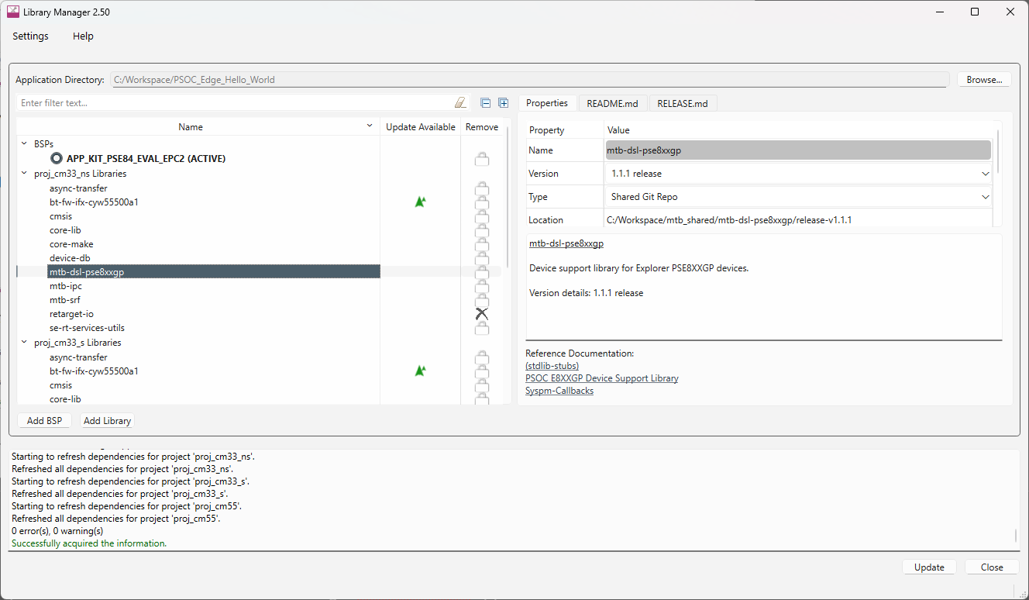
Library Manager
Notes:
(Will show actual tool)
Next we have the Library Manager
The Library Manager provides a GUI to select which Board Support Package (BSP) and version should be used when building a ModusToolbox™ application.
The tool also allows you to add and remove libraries, as well as change their versions for the selected project. This way you can easily manage libraries without having to create a new project.
Launch library manager from windows. Click Browse and point to the application directory.
[Press Enter for animation] The tool will list all the libraries, middleware's and BSP’s added for each project in the application
[Press Enter for animation] Once you click on particular library, Properties tab on the right hand side shows the details of the library like name, version, type etc. Specific versions can be selected using the properties tab
[Press Enter for animation] More BSPs can be added using “Add BSP”,
[Press Enter for animation] More libraries can be added using “Add library”
[Press Enter for animation] Once all the changes are made, click on Update for changes to reflect in your project

Slide 16
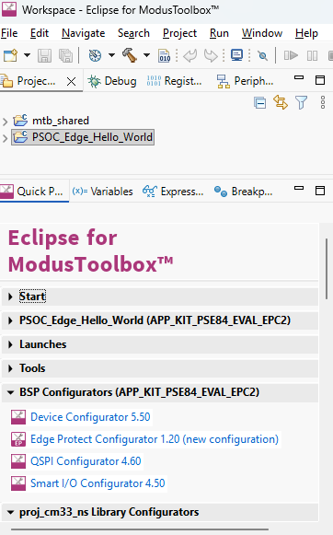
BSP Configurators
Device Configurator
QSPI Configurator
Smart I/O Configurator
Edge Protect Configurator
Configurators
  Creates structures needed for peripherals
  used by PDL
Notes:
(Will show actual tool)
Moving on to configurators
Modus Toolbox™ software provides configurators that make it easier to configure a hardware block. Some functionalities include
• Setting options and generating code to configure drivers
• Setting up connections such as pins and clocks for a peripheral
• Setting options and generating code to configure middleware
For PSOC™ Edge E84 MCU applications are supported by many configurators such as Device, ML, USB, QSPI Configurators, etc.
NOTE : Configurators make initial setup easier for hardware accessed using the PDL. The configurators create structures that the PDL requires. You don’t need to know the exact composition of each structure. After you initialize a peripheral with the PDL you can view and modify the object.
[Press Enter for animation] Quick panel list all configurators or Right click on project on select ModusToolbox™
option for list of configurators
Let’s look at the configurators in detail

Slide 17
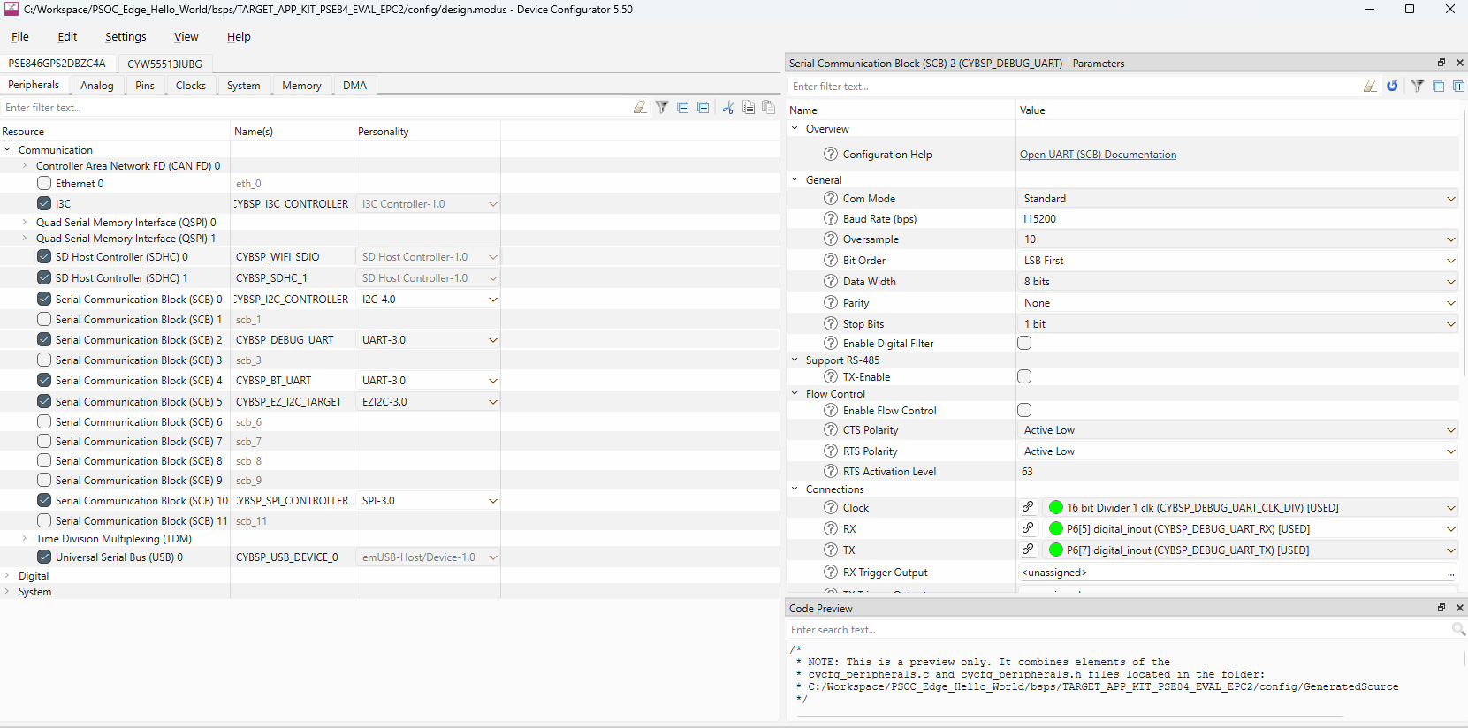
Device Configurator
Notes:
(Will show actual tool)
Device Configurator helps in setting up the system-level functions, pins, and basic peripherals like UART, Timer, PWM, etc.
The Device Configurator GUI contains menus, icons, tabs, and several panes used to configure MCU peripherals. Let’s look at a few important ones.
[Press Enter for animation] Peripherals tab: The Peripherals tab is where you enable various analog, digital, system, and communication peripherals for the device to include in your application.
[Press Enter for animation] By selecting the specific peripheral as shown here - “serial communication block (SCB) 2 with UART”, a parameter pane on the right-hand side shows up and contains all the parameters for the enabled resource.

Slide 18
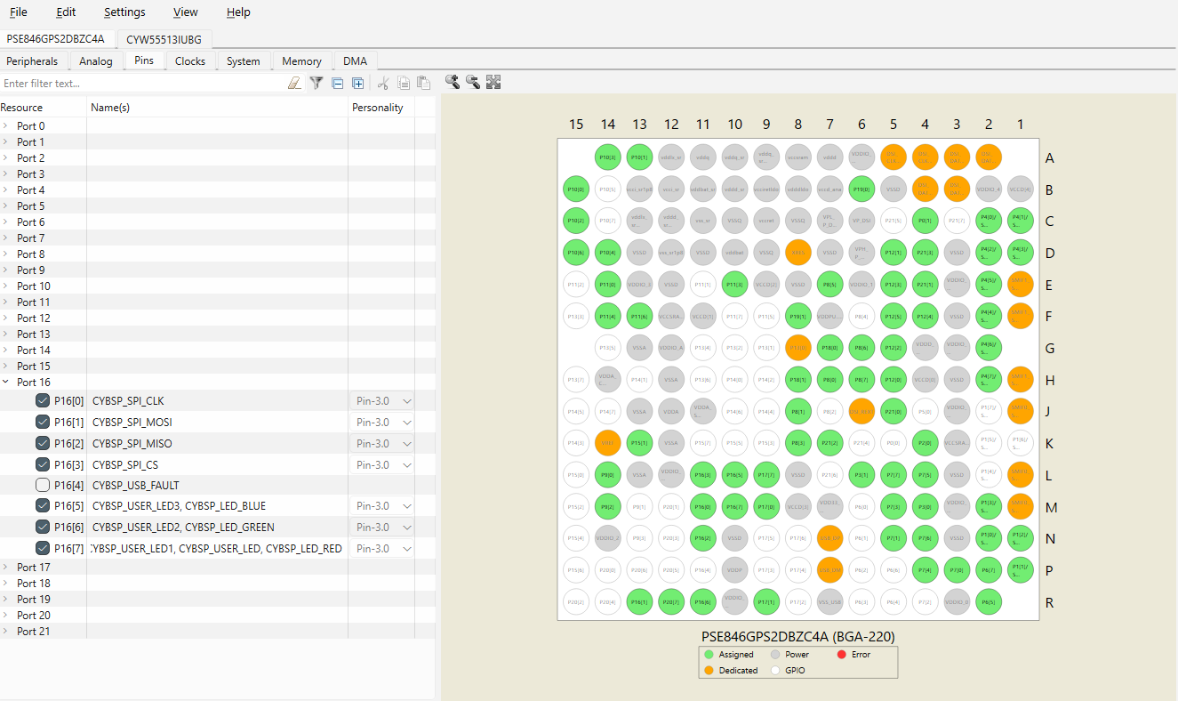
Device Configurator contd…
Notes:
(Will show actual tool)
[Press Enter for animation] The Pins tab is where you configure all the pin-related settings. All available pins are shown in an expandable tree, arranged by port number.
[Press Enter for animation] The interactive pin package diagram shows the different states of the pins; there is a legend on the diagram. You can enable/disable a pin by double-clicking it in the diagram.
Pin states are shown in different colors: ◼ White – GPIO ◼ Green – Assigned ◼ Grey – Power/ground pins ◼ Orange – Fixed function pins ◼ Red – Error state ◼ Semi-transparent – Indicates the hardware resource has been locked.

Slide 19
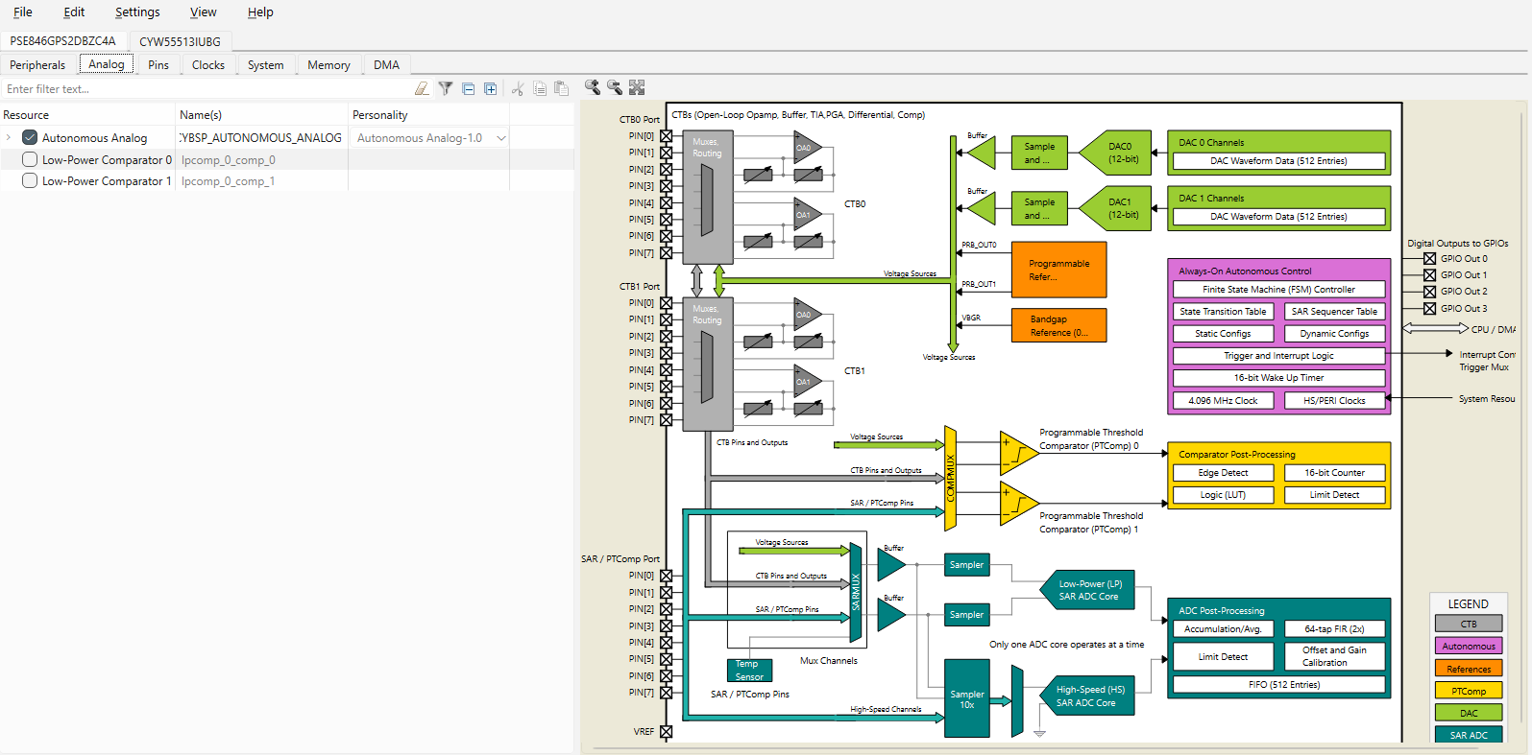
Device Configurator contd…
Notes:
(Will show actual tool)
[Press Enter for animation] The Analog and Analog-Routing tabs help configure the various analog resources in your application. Enabled resources are indicated in green.
The Analog Routing allows you to manually edit the routing of analog resources in your application. It also provides the ability to lock down all, or some, of the results.

Slide 20
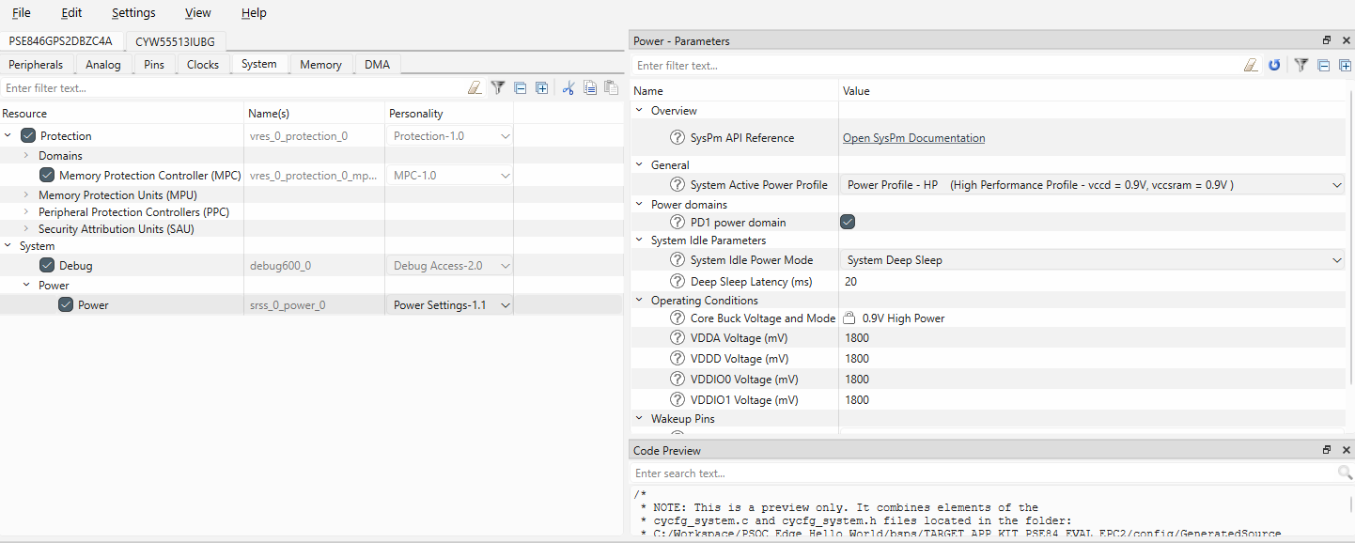
Device Configurator contd…
Notes:
(Will show actual tool)
[Press Enter for animation] The System tab provides access to system-level functions, such as protection, power management, and debug interfaces.
For a given resource, you can enable/disable the resource, as well as get an overview of the resources and set key parameters.

Slide 21
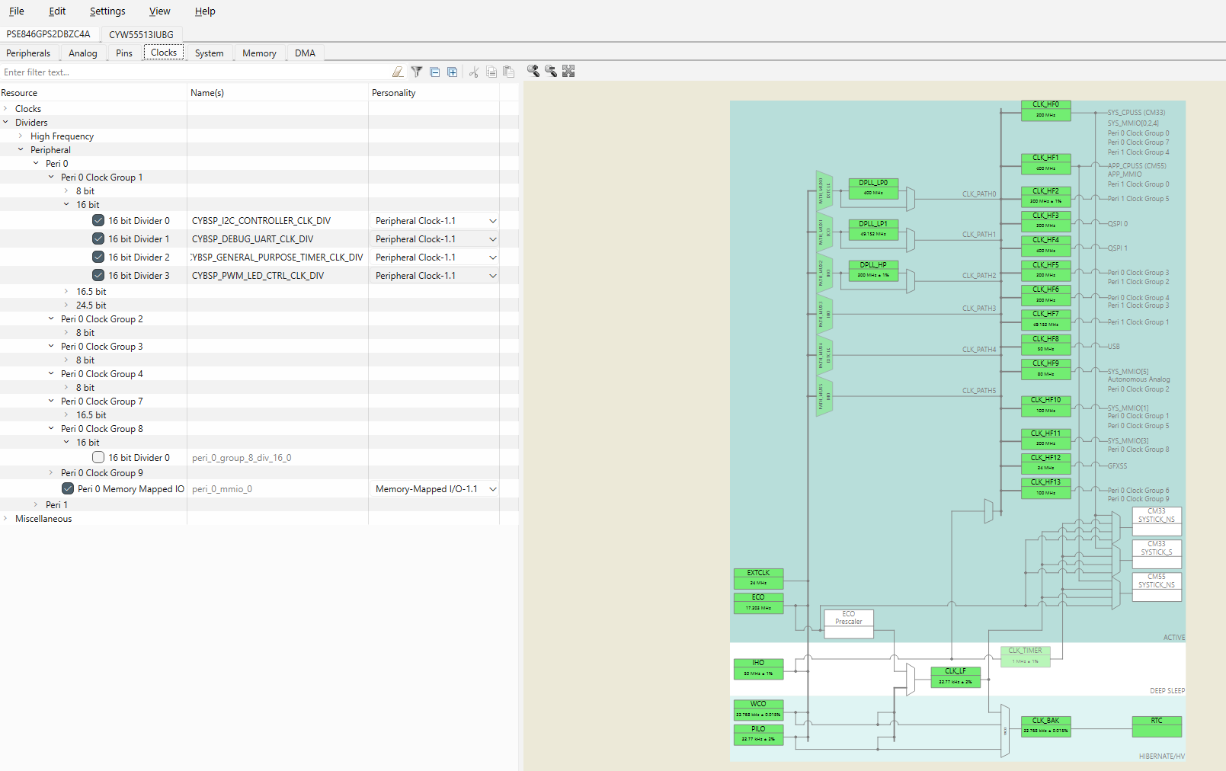
Device Configurator contd…
Notes:
(Will show actual tool)
[Press Enter for animation] The Clocks tab provides access to system clock resources.
The interactive clock diagram shows all the system clocks and how they connect to each other. You can enable/disable a clock by double-clicking it in the diagram. Enabled clocks are green, disabled clocks are white, and clocks in error state are red.

Slide 22
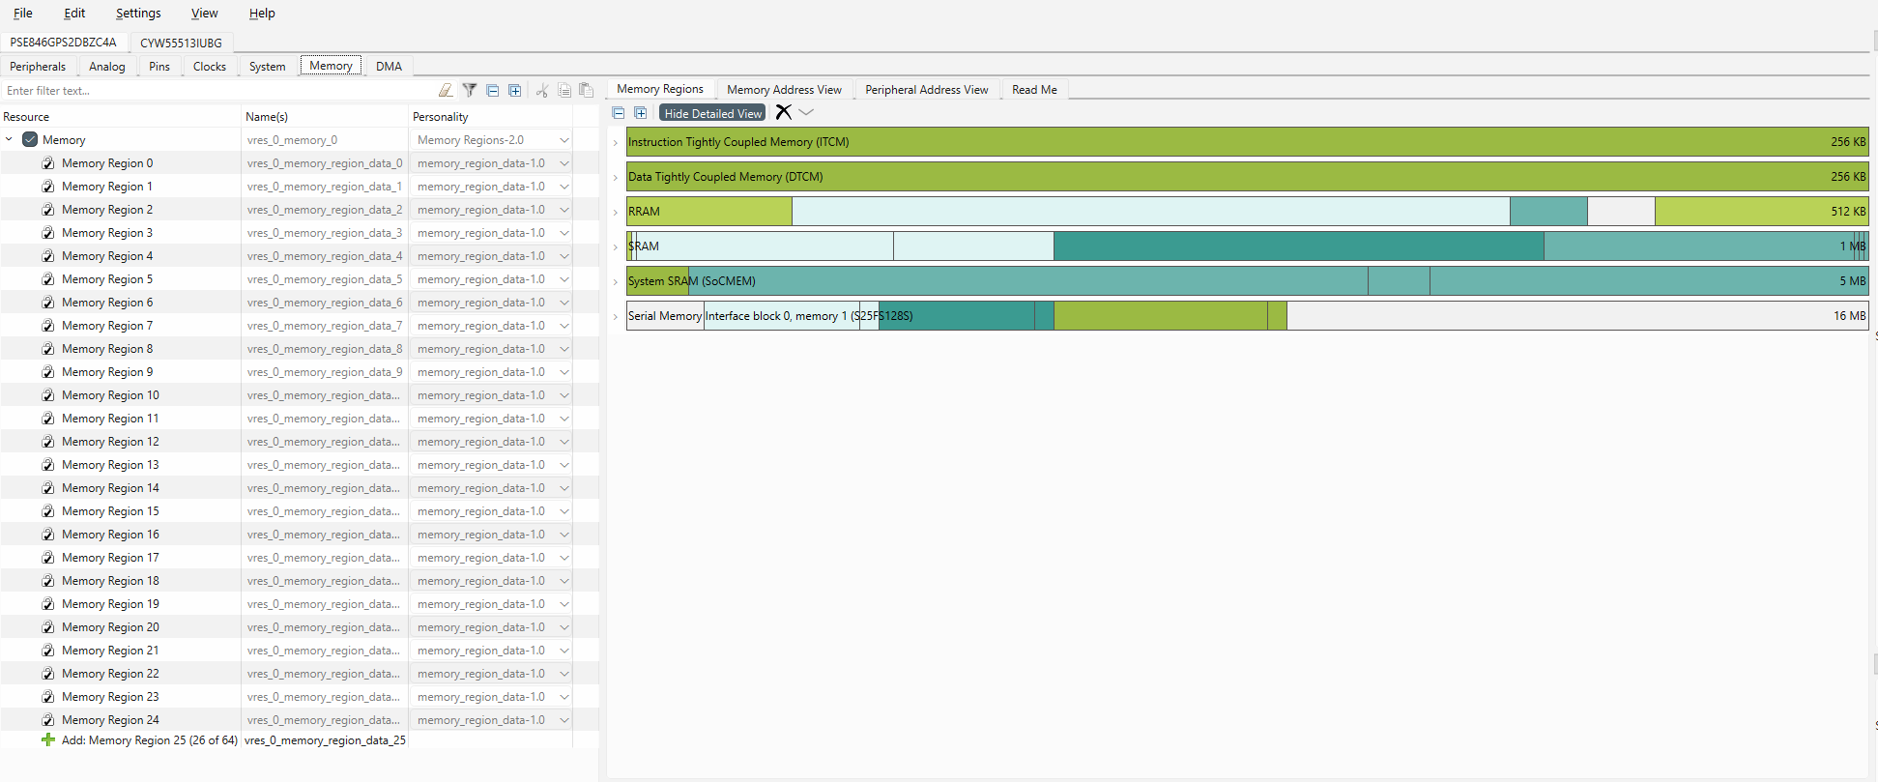
Device Configurator contd…
Notes:
(Will show actual tool)
[Press Enter for animation] The Memory tab provided access to the various memory regions to enable, disable, or create additional regions. Some memory regions cannot be modified.
The Memory Regions view shows a detailed view of types of memory allocated and their associated size.

Slide 23
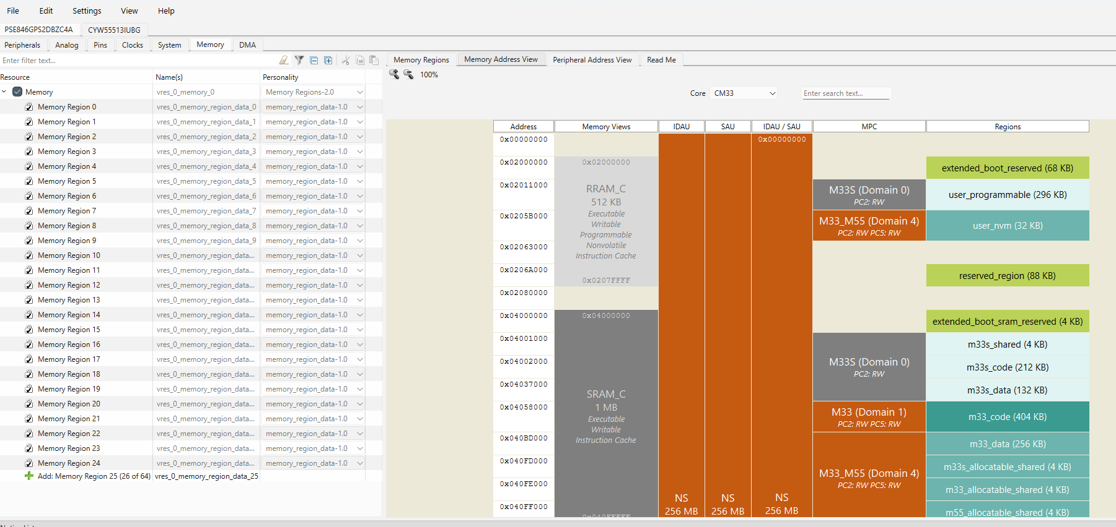
Device Configurator contd…
Notes:
(Will show actual tool)
[Press Enter for animation] Continuing on the Memory tab we can switch to the Memory Address View which shows the memory map for the various cores and how the IDAU, SAU, and MPC are configured along with the associated regions.

Slide 24
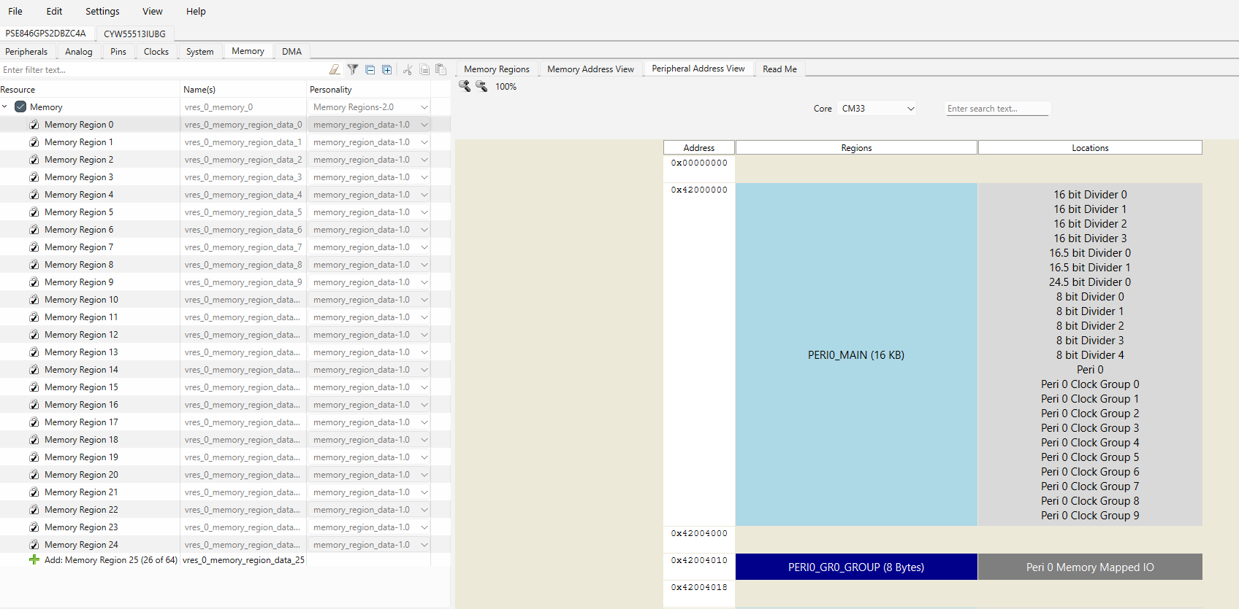
Device Configurator contd…
Notes:
(Will show actual tool)
[Press Enter for animation] In addition to viewing the memory regions and addresses, the Peripheral Address View shows the memory map for the a given core indicating their peripheral regions and associated locations.

Slide 25
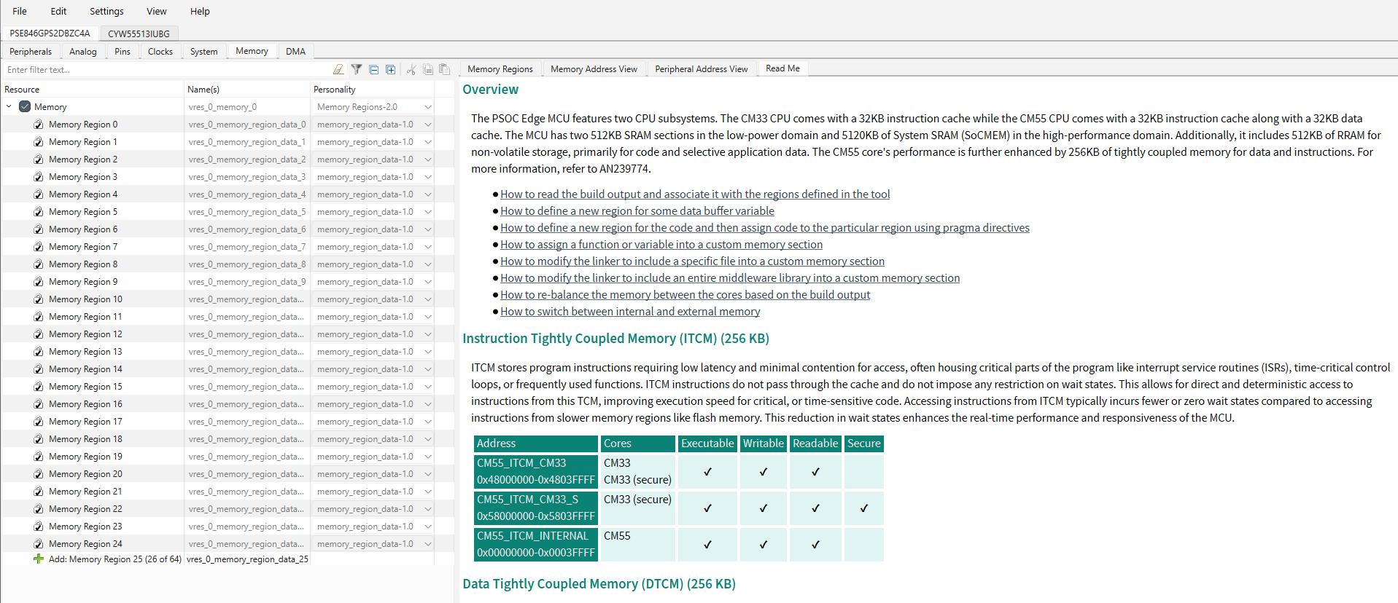
Device Configurator contd…
Notes:
(Will show actual tool)
[Press Enter for animation] Finally, the Memory tab’s Read Me tab provides the designer with an overview of the various types of memory and links to various How Tos when configuring and utilizing the various memories provided and supported on PSOC™ Edge.

Slide 26
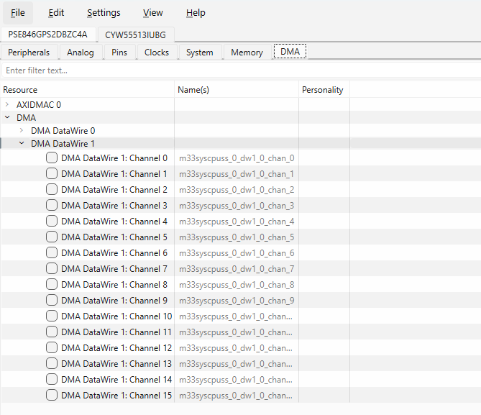
Device Configurator contd…
Notes:
(Will show actual tool)
[Press Enter for animation]
The DMA tab lists all the DMA resources in the available to the designer.
After the various settings and selections are made utilizing the Device Configurator, the configuration information saved in a design.modus file, which contains all the required information about the device and the application. When you save changes, the Device Configurator generates/updates firmware in the BSP’s "GeneratedSource" folder.

Slide 27
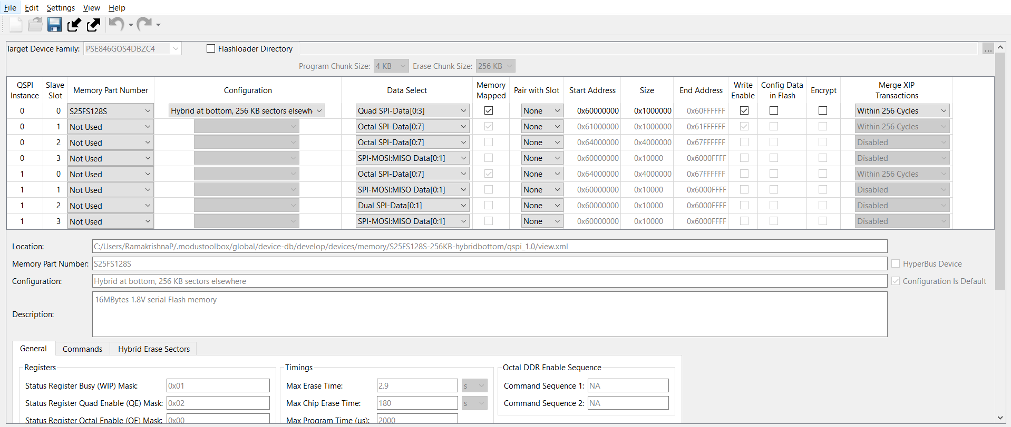
QSPI Configurator
Notes:
(Will show actual tool)
Now let’s take a look at the QSPI Configurator.
The Quad Serial Peripheral Interface (QSPI) Configurator helps configure external memories and generate code for easy integration into the application. You can open or create memory configuration files, configure memory slots, and generate code for your application.
The CAT1D category of devices where PSOC™ Edge E84 MCUs fall under, supports extending the default RAM and Flash with external memory chips of the following types: Flash, non-volatile FRAM, or RAM.
The QSPI Configurator holds information for a set of default memory parts. However, if your specific memory part is not present, you can create a new one.
The QSPI Configurator saves configuration information in a .cyqspi file, which contains all the required information about the device and the application. When you save changes, the QSPI Configurator generates/updates firmware in the BSP’s "GeneratedSource" folder.

Slide 28
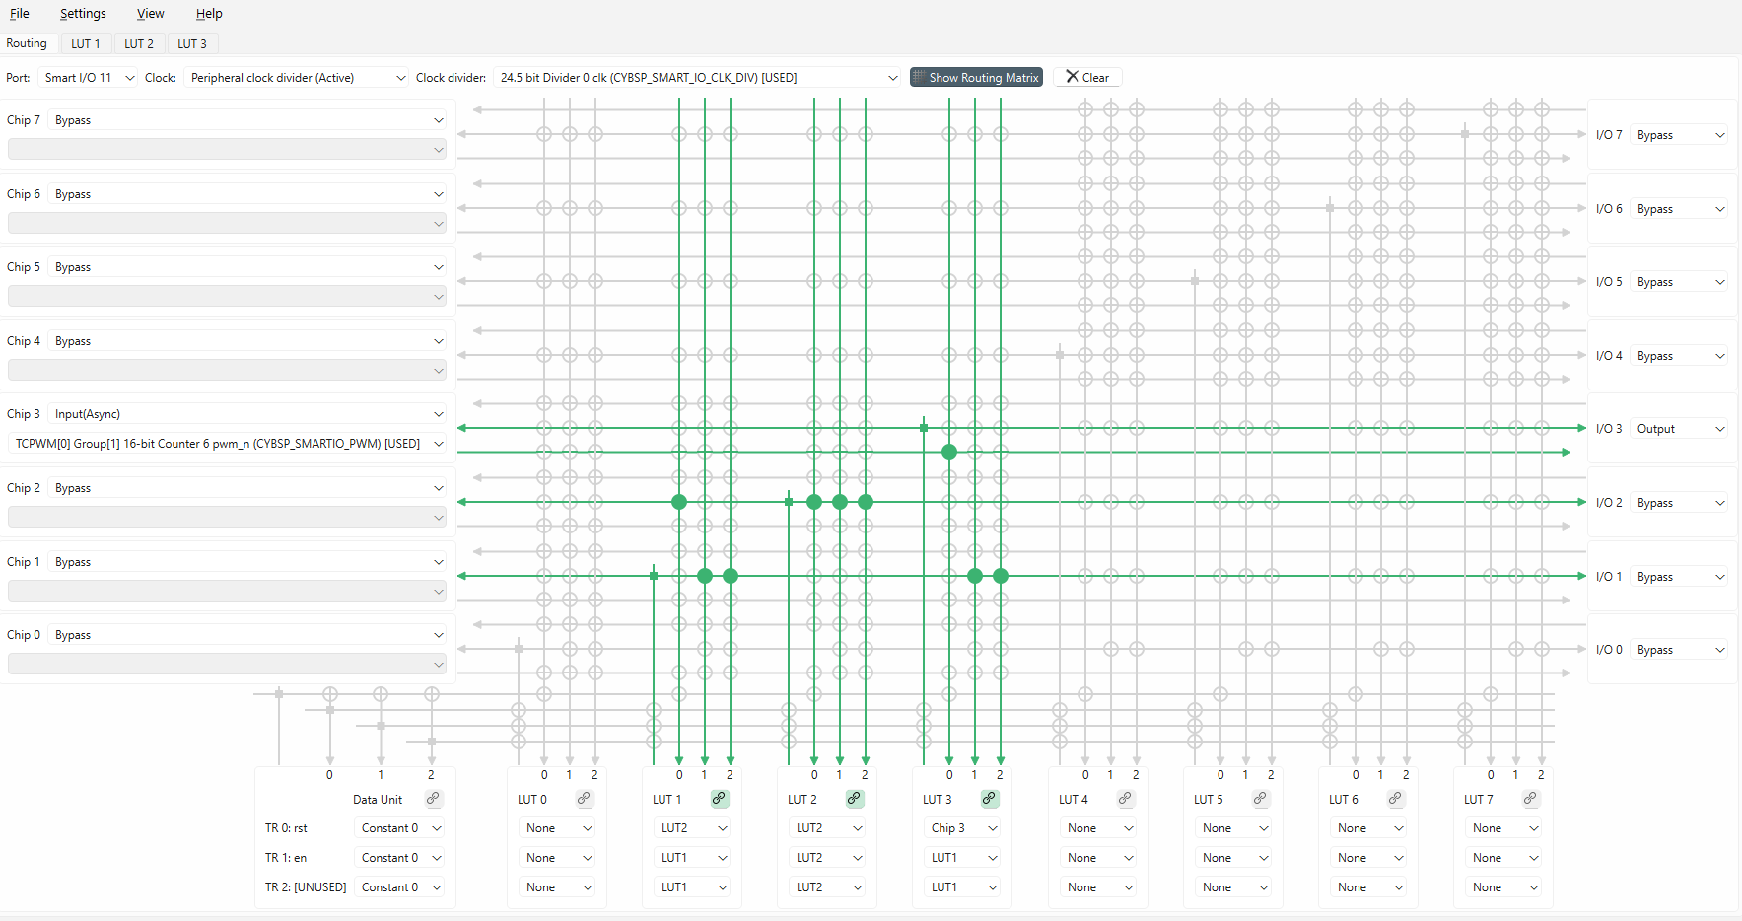
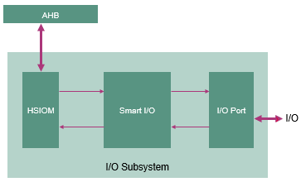
SMART I/O Configurator
Notes:
(Will show actual tool – need to leverage overlay)
Moving further, we have the SMART I/O Configurator.
The Smart I/O Configurator is part of a collection of tools included in the ModusToolbox™ software. It provides a GUI to configure the Smart I/O.
The Smart I/O block adds programmable logic to an I/O port.
[Press Enter for animation]
It is positioned in the signal path between the highspeed I/O matrix (HSIOM) and the I/O port. The HSIOM multiplexes the output signals from fixed-function peripherals and the CPU to a specific port pin and vice-versa. The Smart I/O block is placed on this signal path, acting as a bridge that can process signals between port pins and the HSIOM.
There are several areas in the GUI to configure signals: Chip, I/O, Data Unit, and LUT (Look-Up Table). Inputs to the chip from the I/O port can be logically operated upon before being routed to the peripheral blocks or internal connections of the chip. Likewise, outputs from the peripheral blocks or internal connections of the chip can be logically operated upon before being routed to the I/O port.

Slide 29
Application Booting sequence
Boot starts from Secured Enclave as the Root of Trust
Off-the-shelf extended boot software
  Boot from RRAM or external flash
  Alternate serial interface for recovery boot
  SRAM loading for enhanced security
Optional MCUboot based Edge Protect Bootloader
One-time revocable OEM RoT Key
Notes:
The PSOC™ Edge E84 secured boot process starts with BOOT_ROM. As a root-of-trust (RoT), it entails the next
level software authentication through the public key cryptography to ensure that only authorized software is
loaded and executed on the device.
Secured enclave boot
The PSOC™ Edge E84 secured enclave is based on the lock-step Cortex® M0+ CPU, coupled with dedicated local
ROM, SRAM, and islands of replication of hardware cryptographic accelerators.
The secured enclave has exclusive access to the sensitive data on the device. It is isolated from the rest of the system and provides a
secured environment for secure boot and PSA-compliant cryptographic services.
APPCPUSS and SYSCPUSS can communicate with the secured enclave through a tightly-controlled IPC mechanism. The secure enclave
decides what information should be shared in response to an IPC request.
The secured enclave provides multi-stage booting through immutable ROM_BOOT and RRAM_BOOT.
Together, BOOT_ROM and RRAM_BOOT offer the following functionality:
• Implements a hardware RoT in protection-context 0 and provides an immutable trust anchor based on
authorization from Infineon
• Applies the trims and performs authentication of Extended Boot and launches them on successful
authentication
• Authenticates and launches the SE RAMApps (Secured Enclave RAMApps) and enables the device
provisioning
• Facilitates “secured debug” by enforcing access restrictions on the debug access port (SWD/JTAG)
• Provides PSA-compliant Crypto services for Application CPUs
Extended Boot
Extended Boot is the first code executed by the CM33 CPU of PSOC™ Edge E84. The secured enclave boot
software authenticates the Extended Boot image on RRAM, and launches it if authentication is successful.
Devices are shipped out from Infineon in development lifecycles.
In this lifecycles, Extended Boot is pre-programmed into the device, but not locked down.
The stock version of the Extended Boot offers the serial interface (I2C, SPI,
UART and USB) capability.
Infineon also releases a version of Extended Boot without alternate serial interfaces, which reduces the footprint on RRAM.
As long as the device is in development lifecycles, Extended Boot can be re-programmed via the secured enclave RAMApps provided by Infineon.
Extended Boot gets locked down when device transitions to production lifecycle. Note that since Secured Enclave can only authenticate
Infineon-signed versions of Extended Boot , it is mandatory to use Infineon-released versions.
Extended Boot launches CM33 Secure project present in RRAM from a fixed location, which then configures external QSPI flash in XIP mode and launches CM33 Non-Secure application.
Additionally CM33 Non-Secure application enables CM55 CPU and launches the CM55 application in external flash.

Slide 30
Device lifecycle and provisioning
Development
  Shipped from Infineon
  Provision with OEM certificate and policy
  For OEM development; until production
Production
  One-time provisioning with “Production” certificate
  Re-provisioning if allowed by policy
RMA
  Transition from Development or Production
  Performed by Infineon signed SE Service Application
  Devices in RMA mode can be shipped to Infineon for field failure analysis
Notes:
Now that we have an understanding of the application boot process, it is important to understand the lifecycle and provisioning of a device.
Initially, the device is in the Development stage.
This phase is marked by the device being shipped from Infineon having been provisioned with the OEM Certificate and policy.
The OEM can extend the ownership of the device by provisioning the device with OEM certificate.
This provisioning process installs the OEM keys; debug, boot, and system configuration policies; as well as the extended boot software
The development lifecycle is recommended for all development activity until the device is ready for production.
In this lifecycle, the OEM can enable or disable the secure boot.
When a device is ready for production, the OEM can transition the device from “Development” to “Production” by provisioning the device with a OEM “Production certificate”.
Re-provisioning is possible only if allowed by the policy already installed in the device.
Secure boot is always enabled in this lifecycle.
It is important to note, most device assets are “frozen” in the production lifecycle and cannot be changed unless allowed by the re-provisioning policy.
Further the OEM Certificate for provisioning is required to be signed by Infineon. The Edge Protect Signing service can be utilized to sign the updated certificate.
If a device needs to the to the RMA cycle this can be achieve from either Development or Production lifecycles.
The transition of the certificate must be performed by an SE Service application, which is provided by Infineon.
A device in the RMA cycle can be shipped to Infineon for failure analysis.

Slide 31
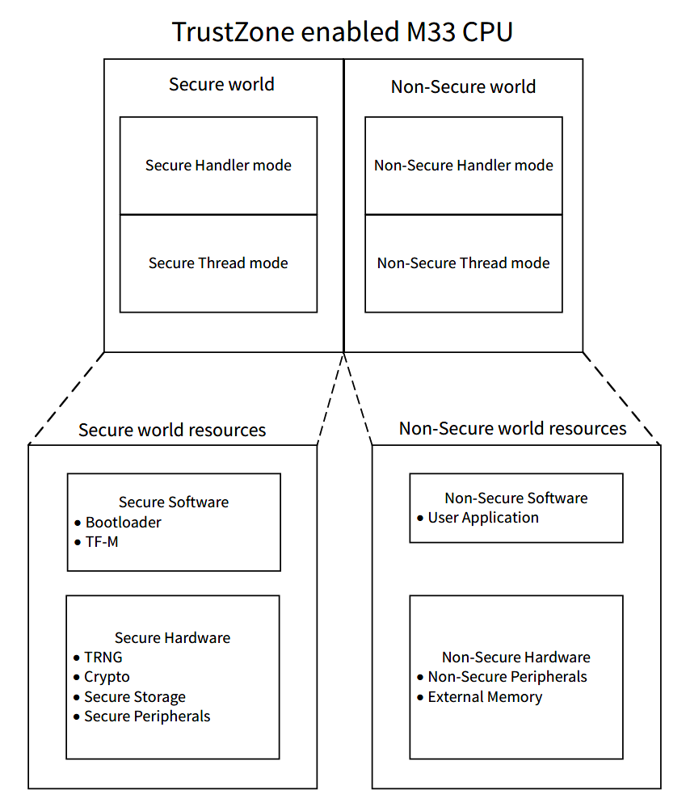
Secure and Non-Secure Operating Modes
Arm® TrustZone- enabled Cortex® -M33 CPU
Secure and non-secure CPU states
Attribution units - Secure Attribution Unit (SAU) and Implementation Defined Attribution Unit (IDAU)
Banked resources between secure and non-secure states
Secure and non-secure
  aliasing of the memory map
  interrupts
  peripherals
  debug
Notes:
The PSOC™ Edge MCU implements Arm® TrustZone on the Cortex® M33 CPU.
Arm® TrustZone defines security domains, which are software abstractions that group system resources into domains and isolate those resources from other domains.
These secure states are applied on top of the well established operating modes for Arm Cortex® MCUs, handler mode and thread mode.
At Isolation Level 1, there are two domains, the Secure Processing Environment (SPE) and Non-Secure Processing Environment (NSPE). The SPE represents in the Secure CM33 and the NSPE represents both the Non-Secure CM33 and Non-Secure CM55.
At Isolation Level 2, we drill down further into the SPE to isolate the Platform Root Of Trust (RoT) and Application Root of Trust (RoT).
At Isolation Level 3, we isolate all the secure services that are offered as part of the Platform RoT and Application RoT.

Slide 32
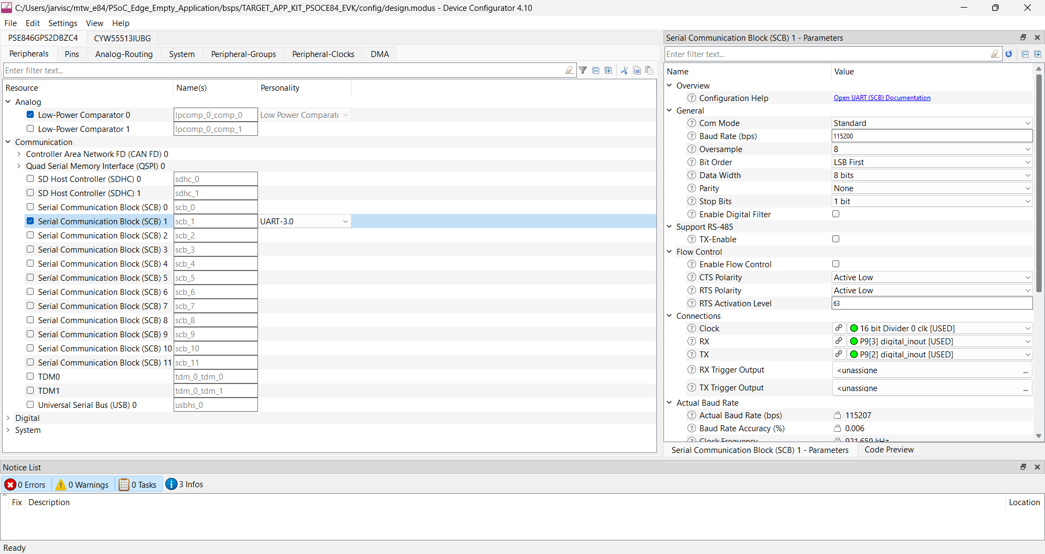
Security Domain Assignment
Security Domain
NSPE Domain
NSPE Domain
NSPE Domain
NSPE Domain
NSPE Domain
NSPE Domain
SPE Domain
NSPE Domain
NSPE Domain
SPE Domain
NSPE Domain
NSPE Domain
NSPE Domain
NSPE Domain
NSPE Domain
NSPE Domain
Notes:
In the Device Configurator, resources can be assigned to a security domain in the device configurator to isolate them from one another.
In this example, we can see the peripheral SCB 1 is in the non-secure processing environment.

Slide 33
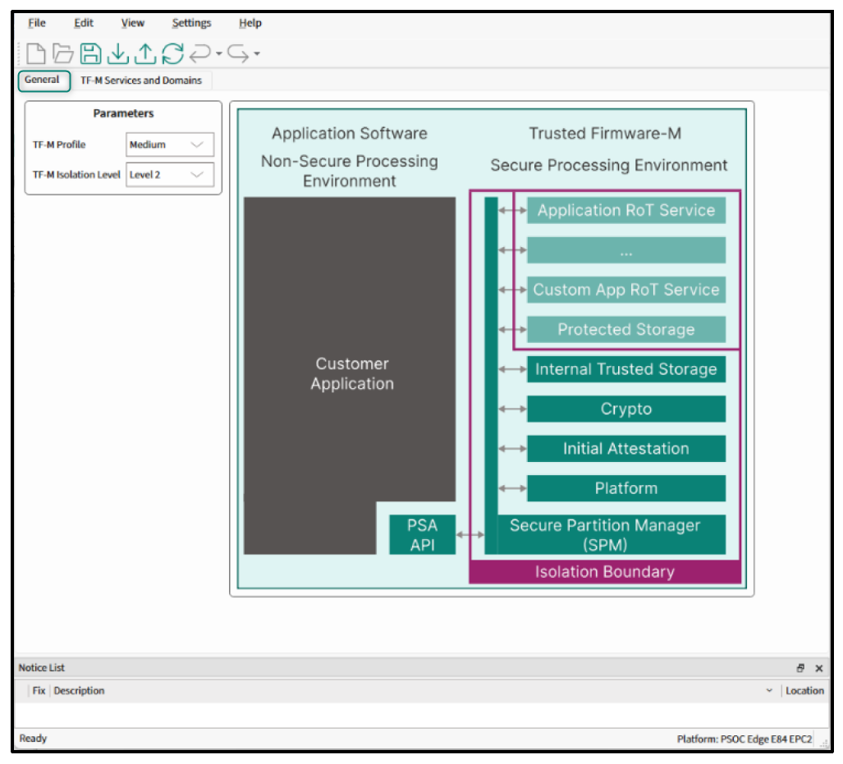
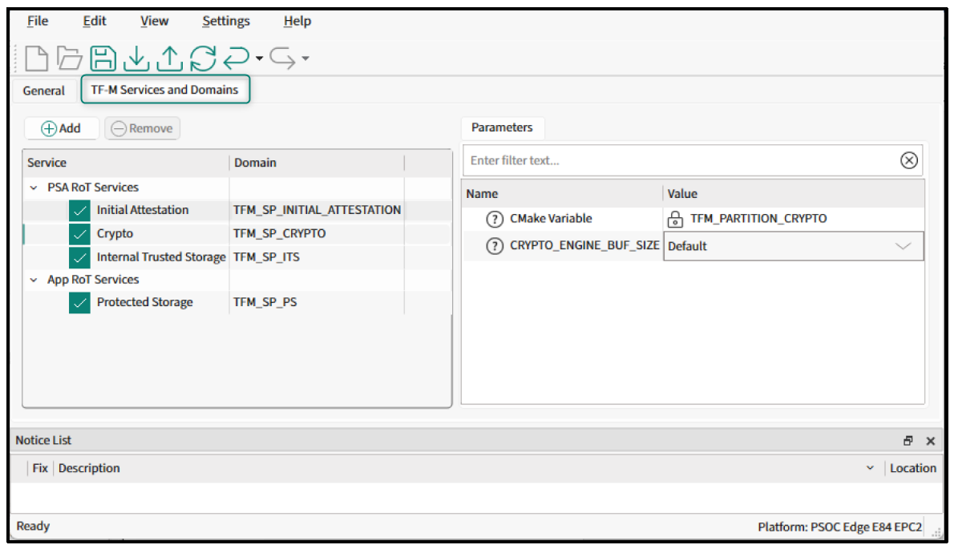
Edge Protect Configurator
TF-M Services and Domains tab
General tab
Notes:
To implement Platform Security Architecture (PSA) on PSOC™ Edge, Infineon provides a Trusted Firmware‑M (TF‑M) library that can be added to any existing or new firmware project.
TF‑M relies on the MCUboot‑based Edge Protect Bootloader for secure boot and secure firmware‑update services.
This implementation enables products and real‑time operating systems utilizing PSOC™ Edge to achieve PSA Certified status.
TF‑M leverages MCU security features to establish an isolated Secure Processing Environment (SPE), where sensitive information can be processed and stored securely.
TF‑M includes secure services such as Crypto, Internal Trusted Storage (ITS), Protected Storage (PS), firmware update, attestation, and TF-M platform service (used for items such as message logging and non-volatile counters
). These services are accessed by the NSPE application via PSA APIs.
The Edge Protect Configurator provides an easy‑to‑use GUI to update an application’s memory and protection/security configurations, as well as to enable or disable secure services. Developers can choose from predefined TF‑M profiles and isolation levels or create their own user‑defined Application RoT partitions.

Slide 34
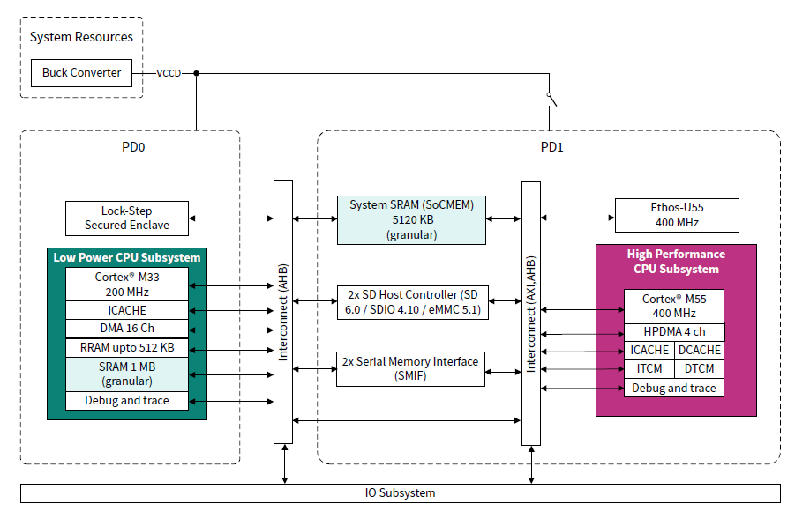
PSOC™ Edge memory architecture
The PSOC™ Edge features two power domains:
  PD0: Always-on low-power domain.
  PD1: High-performance domain.
Power Source and Operating voltage:
  Both PD0 and PD1 are powered by the internal buck output and operate at same voltage level.
Independent Control and flexibility:
  PD1 can be independently switched off without affecting PD0.
  PD1 can be reactivated as necessary for performance needs.
Power Conservation:
  When high-performance peripherals are not needed, PD1 can be turned off to save power.
Notes:
Moving on from the robust security features of PSOC™Edge, let’s examine the extensive memory resources available to the system developer.
This diagram shows the different memories implemented on PSOC™ Edge, but it’s important to highlight the two power domains: PD0 and PD1.
PD0, the always-on low-power domain, provides critical functions that remain operational even when the device is in a low-power state.
PD1, the high-performance domain, provides performance features for demanding applications, such as high-speed data processing and intense computational tasks.
Both power domains are powered by the same internal buck output. This means that both domains operate at the same voltage level, ensuring seamless communication and coordination between them.
However, one of the key benefits of PSOC™ Edge's power domain architecture is its independent control and flexibility. PD1 can be independently switched off without affecting PD0, allowing for significant power savings when high-performance peripherals are not needed. And when those peripherals are required, PD1 can be quickly reactivated to meet the performance demands.
In the same way, it’s important to consider the power domain of each memory, since –just like peripherals-, memories associated with PD1 can also be switched off when not needed.
An example use case is a system which can leverage PD0 to perform low-power activities, such as utilizing the Cortex­® M33 processor and some analog peripherals and to check for a wake word detect while PD1 is completely powered down. Only when activation is detected, would PD1 can get enabled leveraging the M55 processor and U55 NN co-processor in addition to larger memories to perform more computationally-intensive activities.

Slide 35
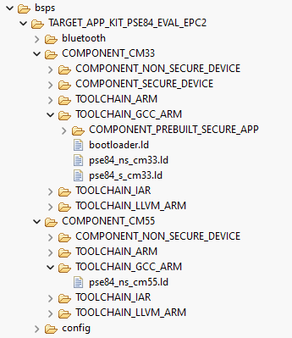
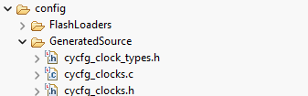
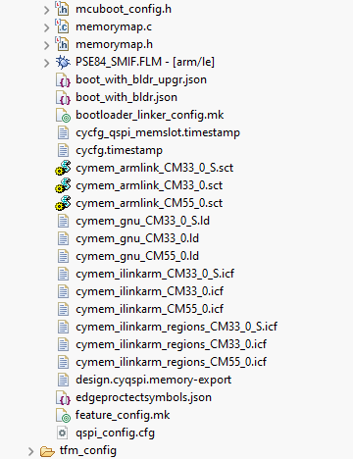
Linker Scripts
Four top-level linker files
  Bootloader
  CM33 Secure
  CM33 Non-secure
  CM55
Three generated memory include files
  CM33 Secure
  CM33 Non-secure
  CM55
Generated memory include files come from the Device Configurator
New user defined memory regions require direct modification to top-level linker files to leverage generated content
Notes:
Developers should be aware of the linker scripts included in a typical ModusToolbox™ application for PSOC™ Edge.
There are four top‑level linker files in the default project structure.
For the CM33 core, one linker file is used for the bootloader, and separate linker files are used for the CM33 Secure and Non‑secure domains.
For the CM55 core, there is a CM55 linker file.
The example shown uses the GCC toolchain, but equivalent structures and files exist for the other supported toolchains.
Each linker file includes a default template with predefined memory regions that align with content generated by the ModusToolbox™ Device Configurator.
Developers can modify the order, size, and physical location of these predefined regions using the graphical view in the ModusToolbox™ Device Configurator; changes are reflected in the build.
If additional memory regions are required beyond the predefined set, the linker files must be updated accordingly.

Slide 36
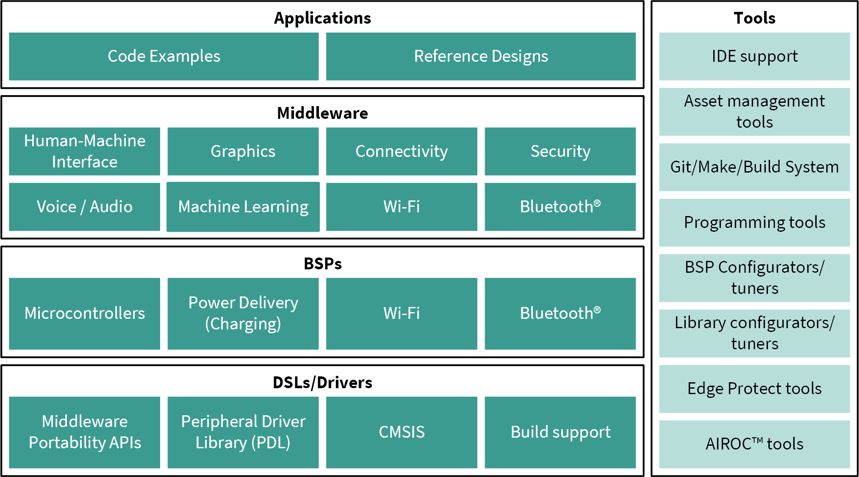
Firmware/application development :Software Resources
Applications
  Code examples
  Reference Designs
Middleware Libraries
Notes:
The PSOC™ Edge ecosystem provides a rich set of software resources.
[Press Enter for animation] At the application layer, we offer more than 100 code examples and reference designs to help you build applications faster.
[Press Enter for animation] The middleware layer provides an extensive set of libraries for graphics, touch‑sensing, machine learning, USB, and security. You can add these to your application using the Library Manager.

Slide 37
Firmware/application development : Software Resources
Middleware Portability APIs
  High-level APIs built on top of PDL
  Hardware generic, so more portable
  Architected to enable Infineon maintained middleware to work across a wider range of devices
  Replacement of the former ModusToolbox™ HAL layer
Notes:
Next, let’s examine the Middleware Portability APIs
[Press Enter for animation] Middleware libraries provide hardware generic, high-level APIs enabling increasing portability across devices. These Middleware Portability APIs have replaced the former HAL layers, making code reuse noticeably easier.

Slide 38
Firmware/application development : Software Resources
Peripheral Driver Library (PDL)
  Set of low-level APIs
  Hardware specific so less portable
Notes:
Finally, let’s review the Peripheral Driver Library (PDL).
[Press Enter for animation] The PDL contains a set of low-level APIs to control hardware peripherals such as UART, SPI and many other peripherals. These drivers are often specific to a particular device, thus providing the developer with finer control of a peripheral, but at the expense of less code portability.

Slide 39
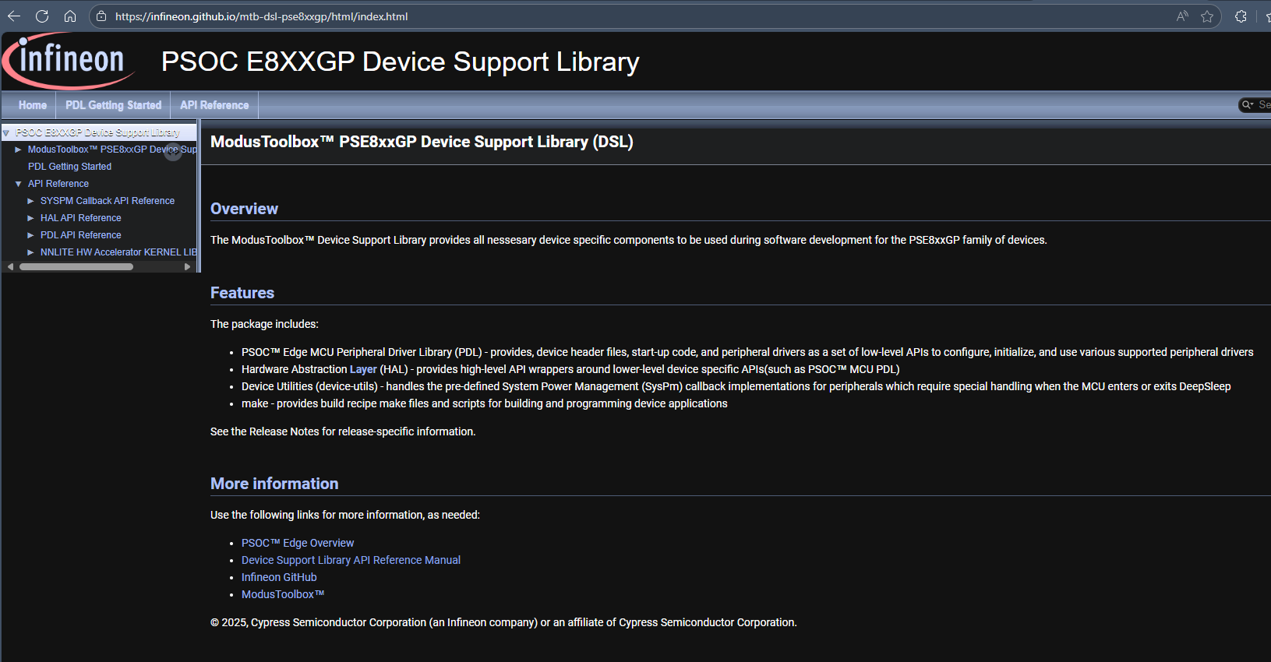
Firmware/application development : Software Resources
https://infineon.github.io/mtb-dsl-pse8xxgp/html/index.html
Notes:
The ModusToolbox™ Device Support Library provides all necessary device specific components to be used during software development for the PSE8xxGP family of devices.
The DSL package includes:
The previously mentioned Peripheral Driver Library (PDL)
Device Utilities which handles the pre-defined System Power Management (SysPm) callback implementations for peripherals which require special handling when the MCU enters or exits DeepSleep
make files which provide the build recipes and scripts for building and programming device applications
[Press Enter for animation] Here is the link for DSL documentation. The DSL documentation can also be accessed in the Quick Panel of Eclipse of ModusToolbox™ in the API Documentation sections for each .

Slide 40
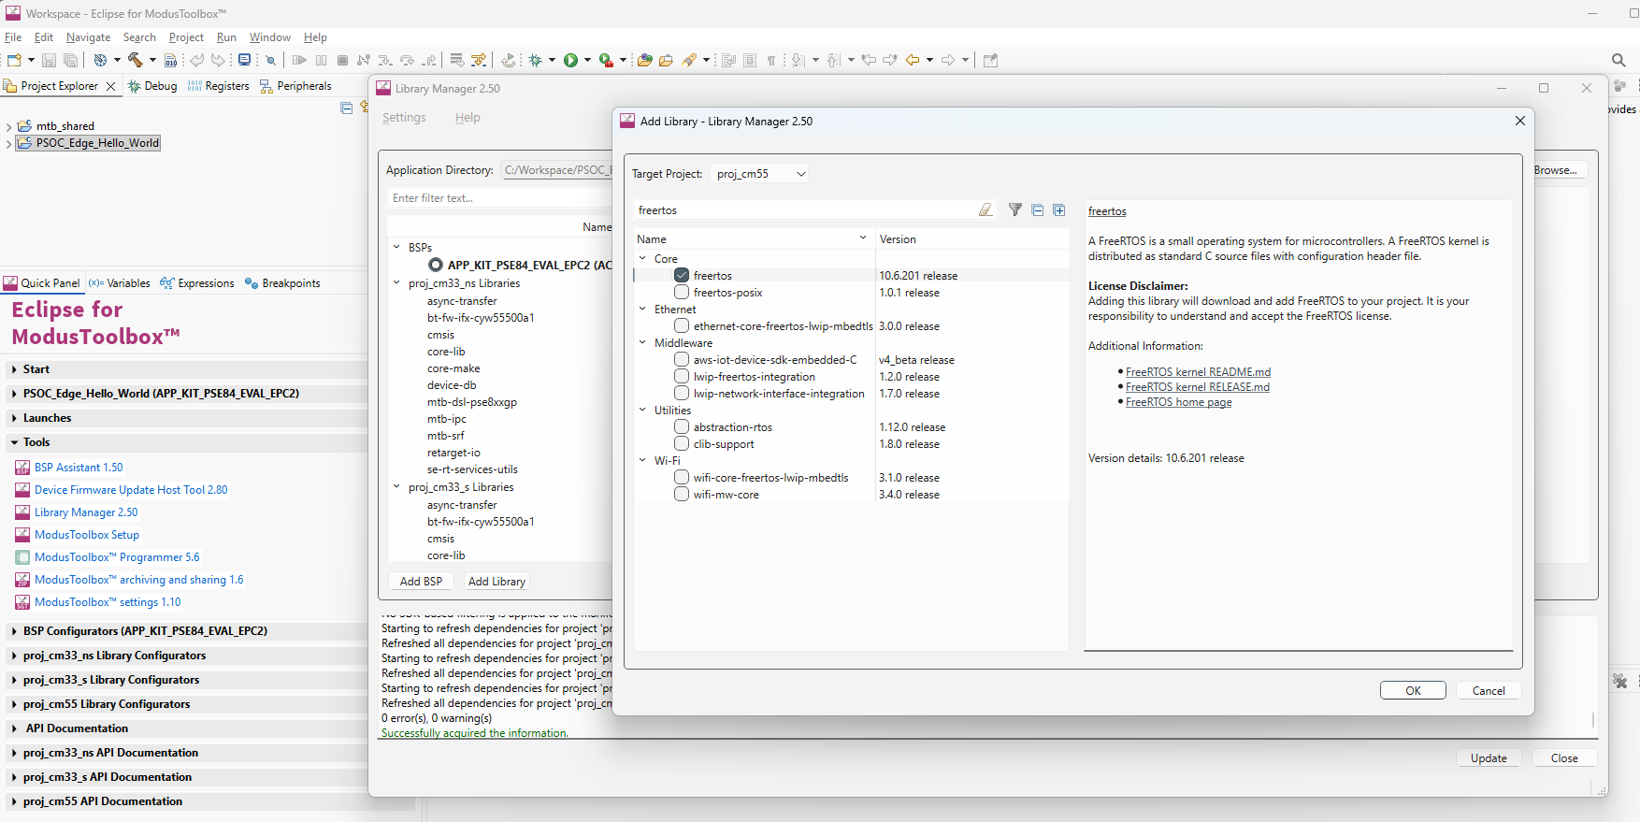
FreeRTOS support with ModusToolbox™
Notes:
(Will show actual tool)
Moving on let’s look at how to add FreeRTOS to your application
Adding native FreeRTOS support to a ModusToolbox™ application project is like adding any middleware library.
You can include the FreeRTOS middleware in your application by using the Library Manager.
If using the Eclipse IDE, select the application and
[Press Enter for animation] Click the Library Manager link in the Quick Panel.
[Press Enter for animation] Click Add Library and
[Press Enter for animation] Select freertos from the Core dialog.
[Press Enter for animation] Click OK and
[Press Enter for animation] Update

Slide 41
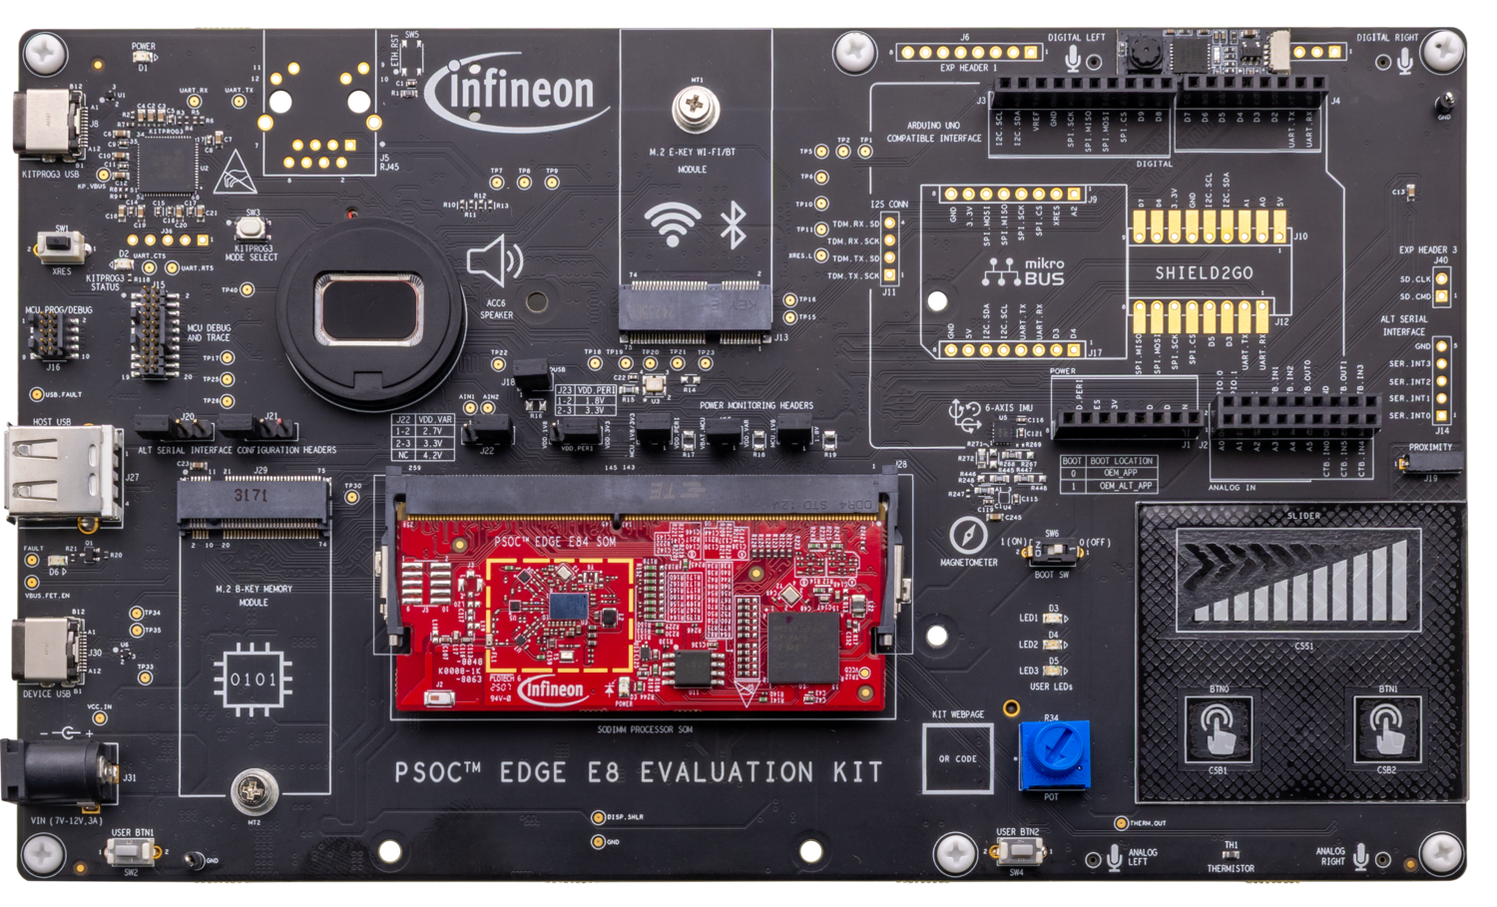
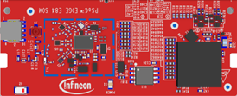
PSOC™ Edge E84 MCU development kit – Top View
Power LED
Ethernet RJ45; (DNI)
M.2 Radio Socket
I2S I/Os
(DNI)
mikroBUS socket (Click); (DNI)
I/O Headers
(DNI)
Arduino UNO socket
KitProg (P5LP)
KitProg USB
KitProg Mode Select Button
Sheild2GO socket;
(DNI)
Reset Button
ETM Header
Alt. Serial Interface;
(DNI)
SWD/JTAG Header (M33/M55/U55)
Proximity
Speaker
USB Host
IMU (Accelerometer + Gyro) &
Magnetometer
M.2 Memory Socket
Boot Select
Power Selection
Power Monitoring
CAPSENSE™ Slider and Buttons
USB Device
DC Power Socket
User Button
*DNI – Do not insert / load
Processor SoM socket
Potentiometer
User Button
Thermistor
User LED (x3)
Notes:
Now that we’ve covered the software resources available to the PSOC™ Edge developer, let’s look at some of the hardware options.
The PSOC™ Edge E84 Evaluation Kit (EVK) enables applications using the PSOC™ Edge MCU alongside multiple on‑board multimedia, machine‑learning, and connectivity features, including MIPI DSI displays, audio interfaces, and AIROC™ Wi‑Fi and Bluetooth®.
Shown here is the top view of the EVK, with many hardware resources such as the on‑board programmer/debugger (KitProg3), CapSense™ slider and buttons, USB Host Type‑A and Type‑C connectors, and an on‑board speaker.
Additional sensors include proximity, IMU, and magnetometer devices, as well as user LEDs and push buttons.
There are also numerous interfaces and components for expansion and rapid prototyping, plus key jumpers that facilitate power measurements to validate the low‑power performance of the PSOC™ Edge device.
At the center is a SODIMM‑based, detachable SOM that hosts the PSOC™ Edge MCU and AIROC™ devices.

Slide 42
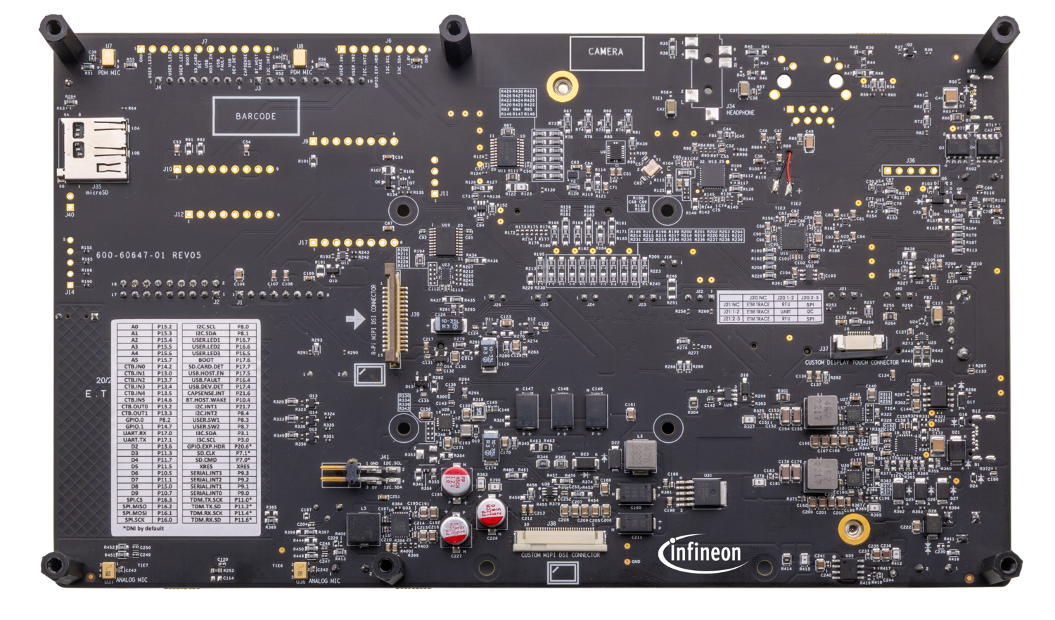
PSOC™ Edge E84 MCU development kit – Back View
DMIC
DMIC
Headphone Jack (DNI)
SD Card Socket
10” Display Touchpad connector
AMIC
AMIC
MIPI-DSI R-Pi Display connector
10” MIPI-DSI Display connector
Notes:
Turning to the back view of the EVK, you’ll find support for an SD card, on‑board dual digital and analog microphones (DMICs and AMICs), connectors for an external MIPI DSI display, and a headphone jack.

Slide 43
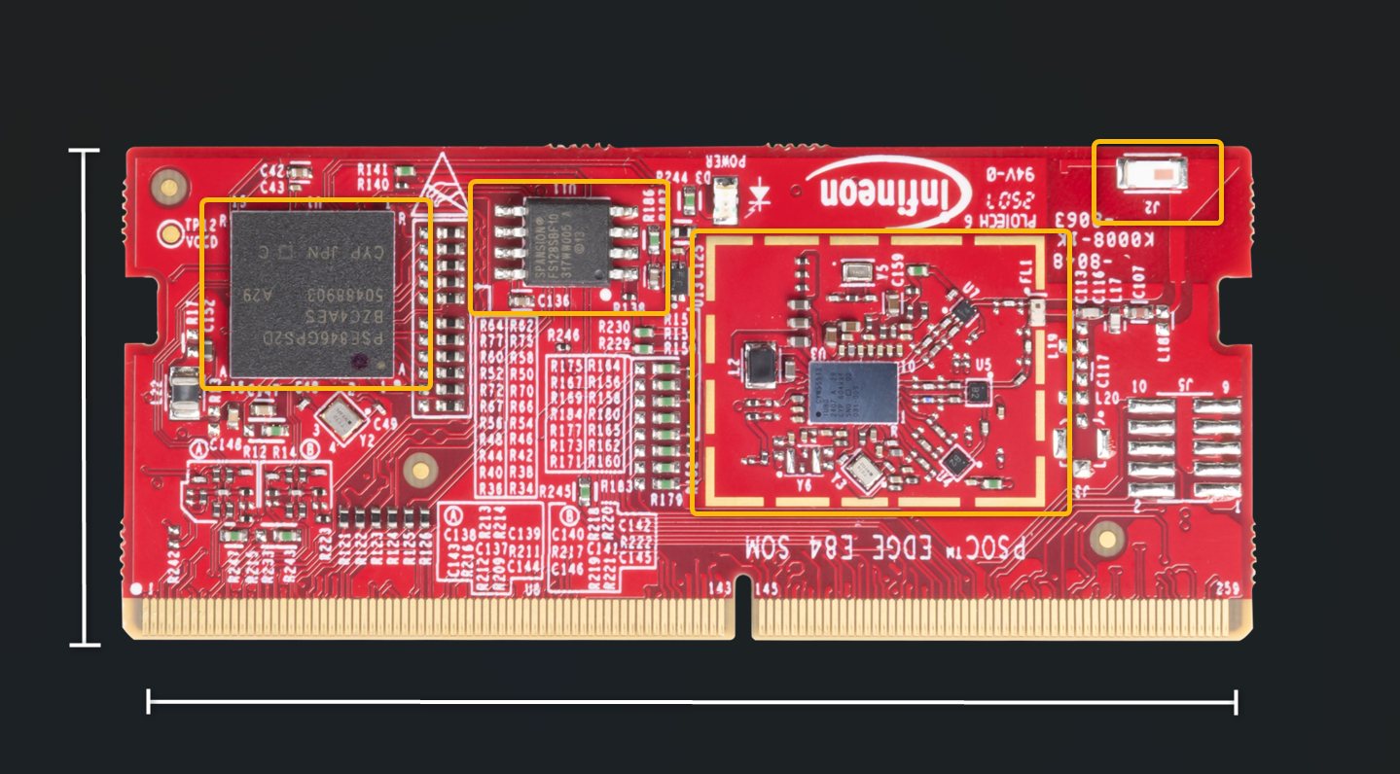
PSOC™ Edge E84 MCU SOM – Top View
PSOC™ Edge MCU (220-BGA)
QSPI Flash
CYW55513 Radio Section
Antenna
30mm
69.6mm
Notes:
In a close-up of the SOM’s top side, you can see the PSOC™ Edge MCU, its QSPI flash, and the AIROC™ Wi‑Fi/Bluetooth combo module with an associated antenna.

Slide 44
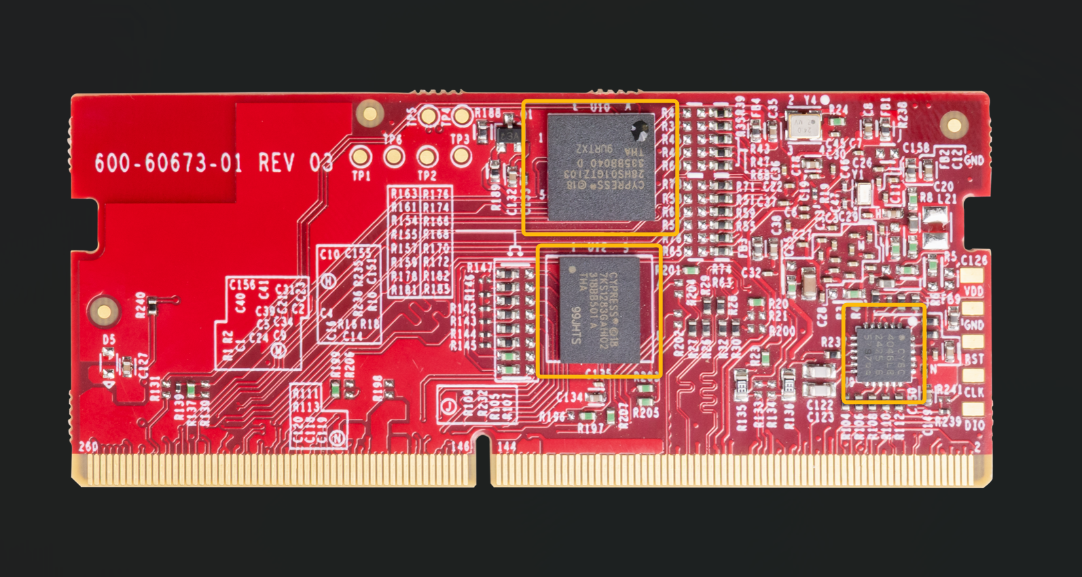
PSOC™ Edge E84 MCU SOM – Bottom View
Octal RAM
Octal Flash
CAPSENSE™ Co-Processor
Notes:
Turning to the bottom view of the SOM, you’ll find octal RAM, octal flash, and the CapSense™ co‑processor.

Slide 45
Programming/debugging
  Programming and Debugging PSOC™ Edge E84 MCU.
    Comes with a KitProg3 onboard programmer and debugger.
    Supports CMSIS-DAP.
    Supports OpenOCD using a GDB server and the J-Link debug probe.
    Debug environment is IDE specific – refer to ModusToolbox™ documentation.
Notes:
Finally, the EVK provides robust support for programming and debugging PSOC™ Edge.
ModusToolbox™ supports programming the device and debugging your code.
The PSOC™ Edge development kit includes a KitProg3 on‑board programmer/debugger. It supports CMSIS‑DAP (Cortex Microcontroller Software Interface Standard – Debug Access Port).
Programming and debugging integrate with your chosen development environment. Infineon devices are supported by major programming and debug tools such as J‑Link and OpenOCD (Open On‑Chip Debugger).

Slide 46
Table of contents
1
Development ecosystem for PSOC™ Edge E84
  3
2
Code Example #1: Hello World + Blinky
46
3
Code Example #2: IPC Semaphores using PDL API
  50

Slide 47
LAB1: Hello world + Blinky
What will you learn ?
  How to run a basic hello world example
  Understanding the structure of PSOC™ Edge projects
  How to rename pins using Device Configurator
Notes:
Now it's time for the first hands-on section of this
presentation.
Feel free to pause this video at this point and proceed
with the detailed instructions in the lab manual.
Note that the manual not only includes the steps to
run the basic lab, but it also includes additional
instructions to modify the example in different ways.
Give them a try to learn more about PSOC Edge E84,
its capabilities and its tools.

Slide 48
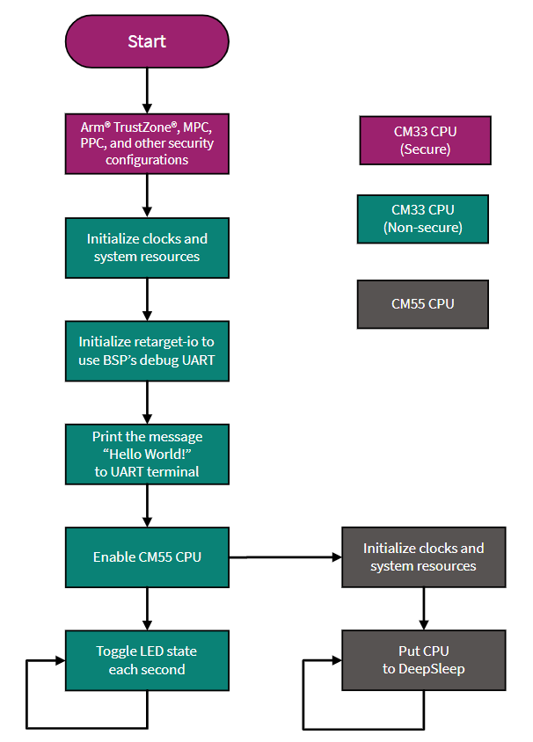
Description of Hello World + Blinky example
Notes:
Let’s take a look at the steps the Hello World plus Blinky example will take:
Step 1: The CM33 secure application initializes secure resources
Step 2: The CM33 secure application calls the CM33 non-secure application, which initializes resources including clocks, system and IOs
Step 3: The retarget-io library is initialized to use the debug UART to print information to the console
Step 4: The CM33 non-secure application prints the hello world message to the terminal
Step 5: The CM33 non-secure application initializes the CM55 application
Step 6: The CM55 initializes and goes to deep sleep
Step 7: The CM33 keeps executing, toggling a LED every second

Slide 49
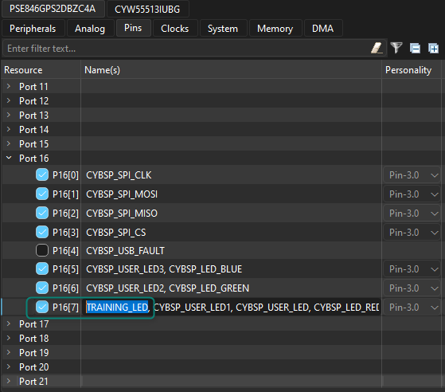
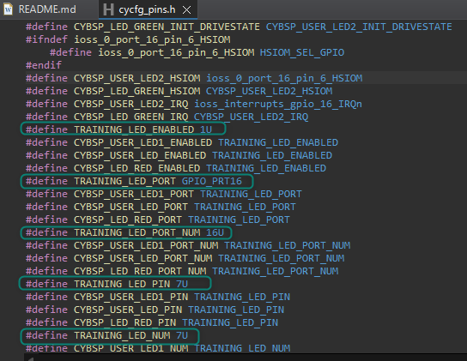
Using Device Configurator
Notes:
The modification included in the training manual explains how to use Device Configurator to modify the alias of the pin driving the LED.
Try it and observe how the Device Configurator generates initialization code for your application.

Slide 50
Table of contents
1
Development ecosystem for PSOC™ Edge E84
  3
2
Code Example #1: Hello World + Blinky
  46
3
Code Example #2: IPC Semaphores using PDL API
50
Notes:
Now, on to our last code example for this presentation.
In this hands-on lab, we will build firmware that enables communication between the CM33 and CM55 core using Inter Processor Communication (IPC) via the AHB5 interface using semaphores available in the IPC PDL.
But first, let’s learn a bit about the IPC resources and overall structure.

Slide 51
Overview of IPC
Supports 16 communication channels
Supports 16 interrupt structures
Inter processor communication methods
  Half-duplex with shared event handling
  Half-duplex with independent event handling
  Full-duplex communication
IPC is available in CPU active power mode only.
AHB5 slave
AHB5 Slave interface
SRSS
IPC Structure
ACQUIRE*
NOTIFY
RELEASE
DATA
STATUS
Interrupt Structure
NOTIFY
RELEASE
Interrupts
* MS field of the Acquire register width has been expanded to 8 bits
Notes:
The PSOC™ Edge E84 Inter-Processor Communication module is designed to facilitate the exchange of signaling messages between CPUs. The Inter-Processor Communication (IPC) module plays an important role in enabling multiple processors to effectively communicate and synchronize their operations.
IPC module support for up to 16 communication channels and 16 interrupts, adding a significant degree of versatility and flexibility to the communication framework. The IPC module operates when the CPU is in the Active power mode, but it becomes inactive the Sleep and Deep Sleep CPU power modes.

Slide 52
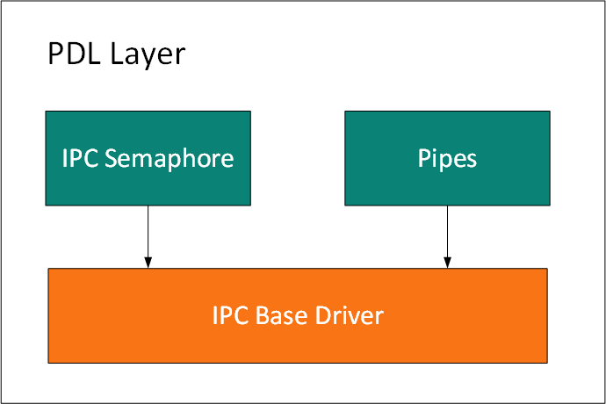
Block Diagram of IPC PDL
Notes:
The communication between more than one thread (CPU or task) is supported using an IPC driver. It implements two common methods, typically available in RTOS environments for thread interactions:
Semaphore (or binary): used to regulate accesses to shared resources between two or more threads or used for signaling between two tasks. This type of semaphore can assume only values 0 or 1. Any thread can take (value set to 1) or give (value set to 0) the semaphore.
Pipes: A pipe is typically a full-duplex communication channel between CPU cores. A pipe allows a single conduit to transfer messages or data to and from multiple processes or CPUs

Slide 53
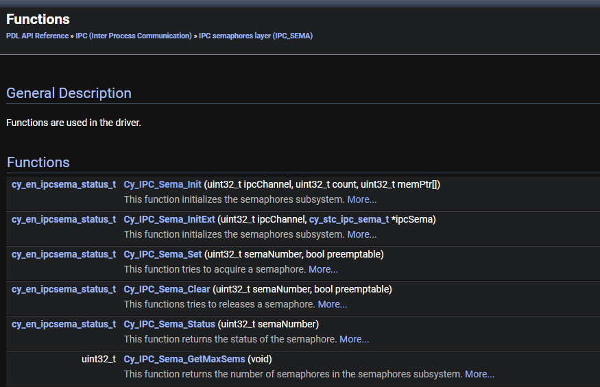
IPC PDL (Peripheral Abstraction Layer) Functions
Notes:
This lab will use the IPC semaphore layer. Shown here are the IPC Peripheral abstraction layer APIs for binary semaphores.
Note, we will utilize the semaphore features, init, set and clear, and get the current status of a given semaphore.

Slide 54
Flow chart
Notes:
Let’s take a look at the flow diagram for our lab.
In this lab, we will use an IPC semaphore to synchronize access to a common UART between the CM33 and CM55 cores.
The CM33 code is highlighted in green, while the CM55 code is highlighted in dark gray.
The boot process proceeds as usual, with the CM33 non-secure application taking control from the CM33 secure application.
The CM33 will initialize the BSP, enable global interrupts (keep in mind “global” is relative to a core, not the device), and set up the semaphore subsystem.
The CM33 then initializes the CM55 application.
Once enabled, the CM55 initializes clock resources, enables global interrupts, calls the semaphore init function—only to confirm that the semaphore subsystem is running—and initializes the retarget-io middleware.
At this point, both CPUs will wait for the assigned user button on the EVK to be pressed.
Once the user button is pressed, both CPUs will attempt to acquire the semaphore. Once acquired, each CPU will print a message to UART and then it will release the semaphore.
Without the semaphore, you should observe that the messages get corrupted in the terminal; but this will be prevented after using the IPC semaphores.

Slide 55
LAB2: IPC Semaphores using PDL
What will you learn ?
  How to use the Library Manager in ModusToolbox™
  How to share a resource between CPUs
  How to use IPC semaphores to synchronize a shared resource
Notes:
Now it's time for the second hands-on section of this
presentation.
Feel free to pause this video at this point and proceed
with the detailed instructions in the lab manual.
Note that ModusToolbox includes examples showing how to use IPC semaphores; however, the training manual explains how to add them from scratch to the hello-world code example.
The lab manual starts by showing how to use the library manager to move the retarget-io library from CM33 to CM55.
Then, it shows how to print messages to UART interface shared by both CPUs.
And lastly, it enables IPC semaphores to synchronize access to UART.
Enjoy the lab!

Slide 56
Revision history
Document revision | Date | Description of change
** | 2025-11-25 | Initial release.

