Slide 1
Consumer Behavior in E-Commerce - Dataset Analysis
Karen Reyes Villarreal
Daniela Ragatuso
Luis Rodríguez
Luis Edgar Álvarez
Francisco H. Muñoz Ceballos

Slide 2
About the dataset
The dataset contains 3900 entries with detailed information about an online retailer and the transactions on their platform. It includes client-specific data such as age, gender, location, purchase amount, previous purchases, and purchase frequency.
1
2
4
Objective:
A marketing company is hired by a retailer to optimize their advertising spend by analyzing patterns among their current clients. The goal is to enhance effectiveness and tailor marketing strategies based on individual purchase behavior.
6
3
5

Slide 3



Libraries & Tools used:
import pandas as pd
import numpy as np
import matplotlib.pyplot as plt
import seaborn as sns
from pathlib import Path
from sqlalchemy import create_engine
from sqlalchemy.engine.url import URL
import config
from config import CONNSTRING
from sklearn.model_selection import train_test_split
from tensorflow.keras.utils import to_categorical

Slide 4
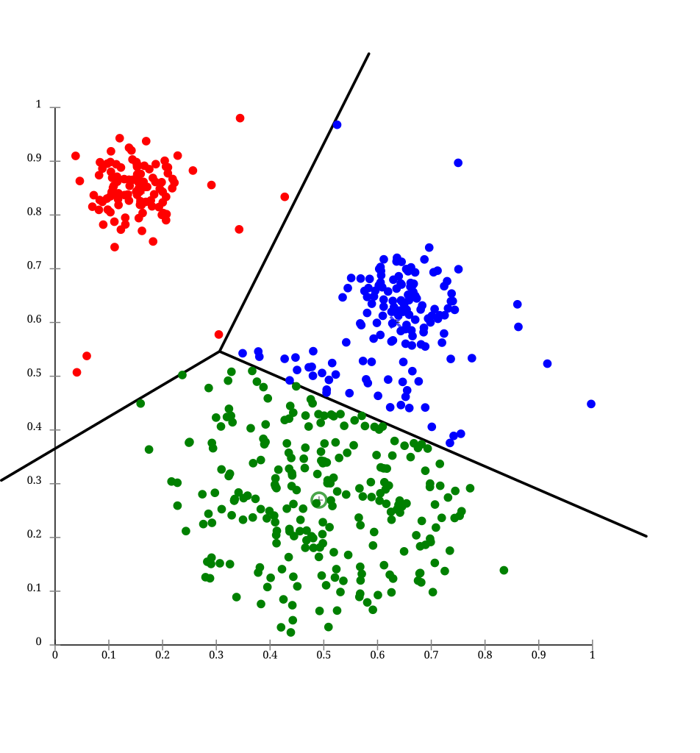
Descriptive Machine Learning Model:
K-Means
Clustering

Slide 5
A cluster analysis was conducted to identify distinct customer segments based on specific behavioral attributes.
The selected features were selected as follows:
categorical =['gender', 'category', 'location', 'Payment Method']
numerical = ['age', 'Previous Purchases','Purchase Amount (USD)']

Slide 6
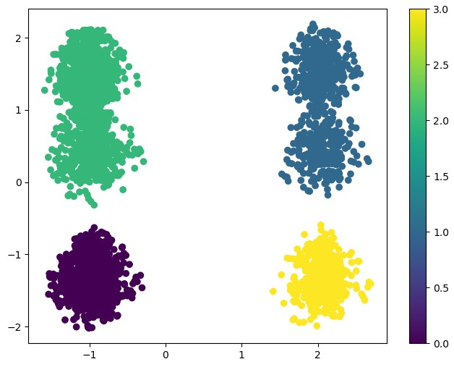
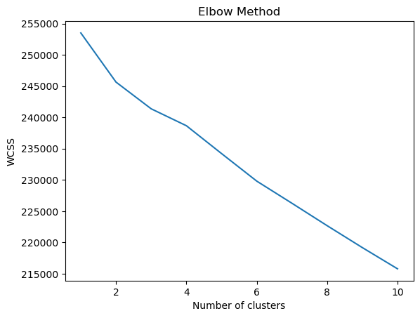
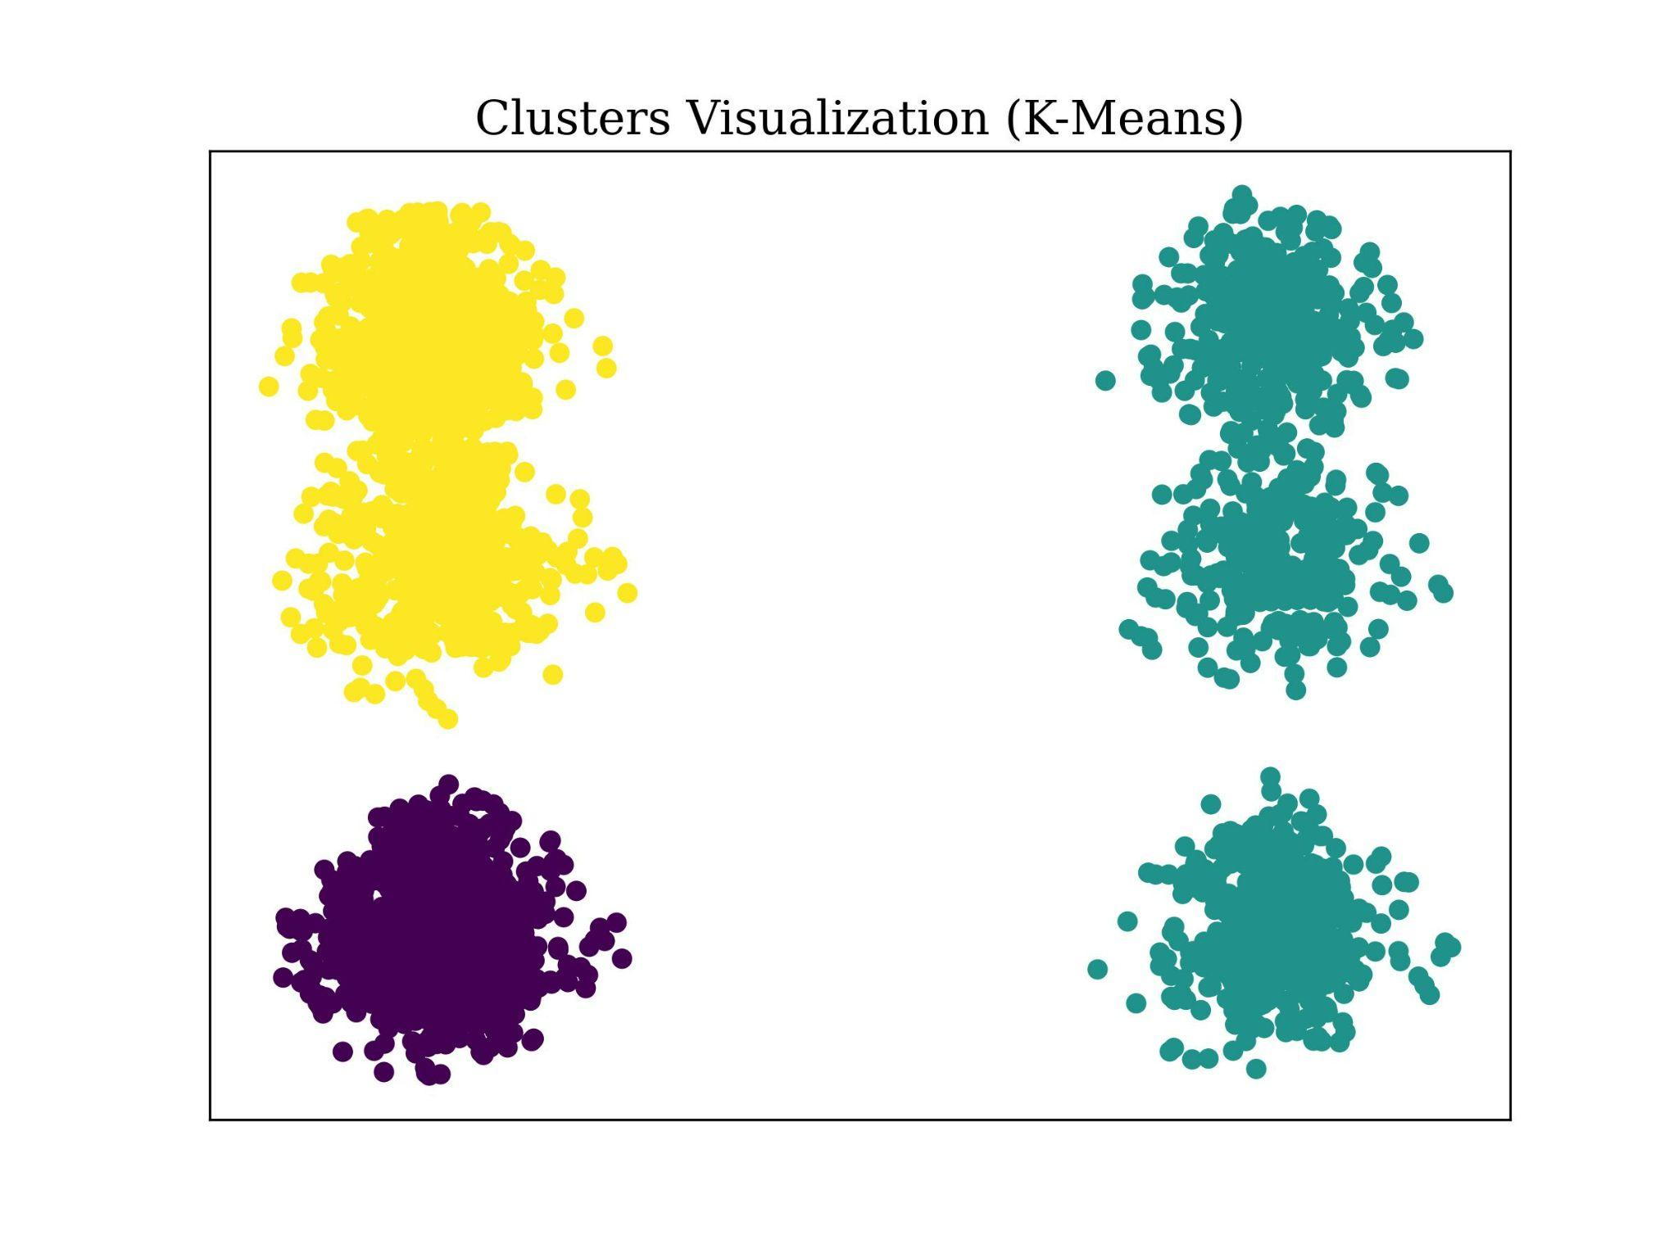
Cluster Visualization (K-Means)
Distribution of data points into four clusters.
2
1
0 | 1181
1 | 556
2 | 1471
3 | 692
0
3
First distribution of data points into three clusters.

Slide 7
Descriptive
analysis of
Clusters
Cluster 0 | Cluster 1 | Cluster 2 | Cluster 3
Age: 43 +- 15 | Age: 43 +- 15 | Age: 44 +- 15 | Age: 44 +- 15
Previous Purchases: 25+-14 | Previous Purchases: 25+-14 | Previous Purchases: 25+-14 | Previous Purchases: 24+-14
Purchase Amount: 59 +- 23 | Purchase Amount: 60 +- 23 | Purchase Amount: 59 +- 23 | Purchase Amount: 60 +- 23
Male | Female | Male | Female
They bought only clothing (1181) | They bought only clothing (556) | They bought accessories (848), Footwear (400) and Outerwear (223). | They bought accessories (392), Footwear (199) and Outerwear (101).
Main locations: Indiana, Louisiana, Missouri, Alabama and Illinois. | Main Locations: Montana, California, Idaho, Georgia and Ohio. | Main locations: New Mexico, Nebraska, California, Idaho and North Dakota. | Main Locations: Texas, Kentucky, Kansas, Montana and Alabama.

Slide 8
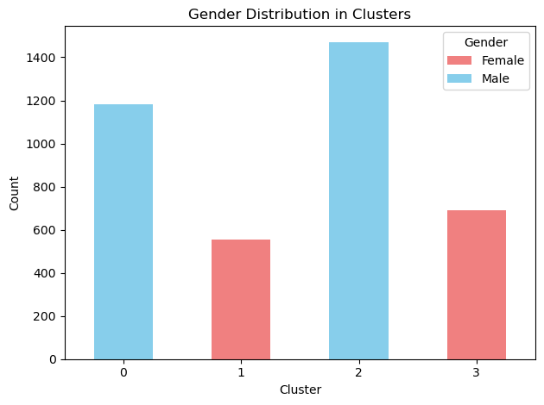
Gender Distribution in Clusters

Slide 9
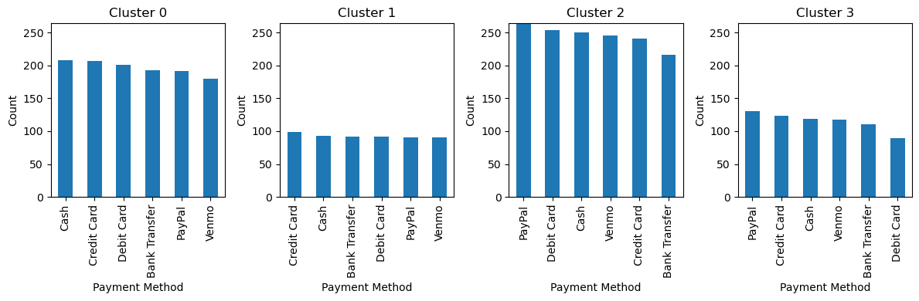
Payment Method Distribution in Clusters

Slide 10

Predictive Machine Learning Models:

Slide 11
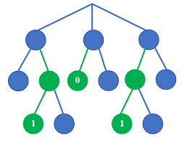
Random Forest Classifier: High-Spending Prediction Model
Utilizing a Random Forest Classifier model, we achieved an 80% accuracy rate in predicting whether a customer's purchase amount will exceed $85, classifying them into a very high spending category. It demonstrates the capability of machine learning to identify potential high-value customers.
The prediction is based on age, gender, location, previous purchases, and purchase frequency.

Slide 12
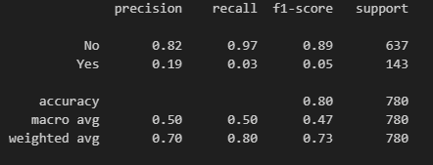
Classification Report and Confusion Matrix:

Slide 13
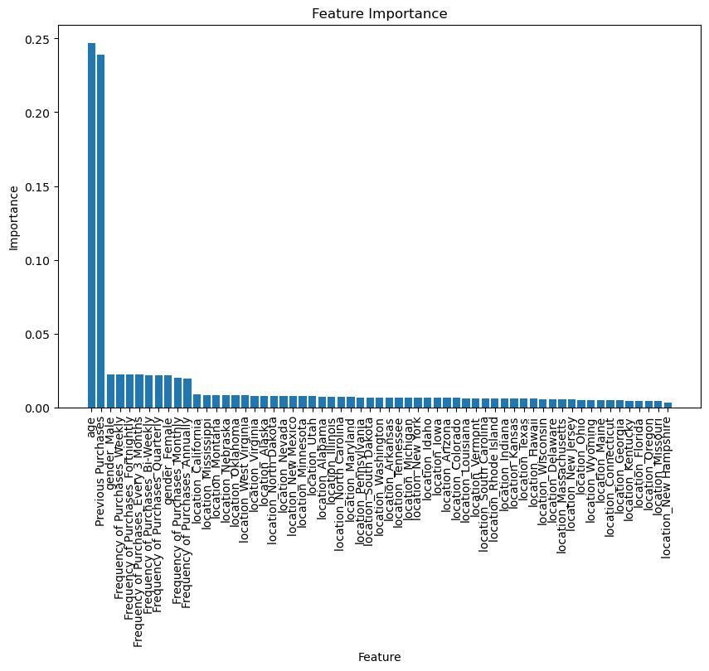
Features Importance: High-Spending Prediction Model
Order of Relevance of Features
1. Age | 25%
2. Previous Purchases | 23%
3. Gender | 2%
4. Frequencies of Purchases | 2%
5. Location | 1%

Slide 14
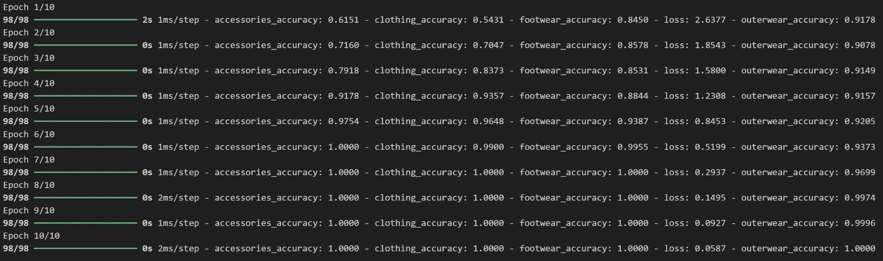
2. Neural Network Model: Purchased Category Prediction Model
We decided to develop a neural network model to predict the categories of products customers are likely to purchase based on their characteristics. This model will help us design targeted marketing campaigns, sending specific promo codes and advertisements to each customer.
First attempt
Targets: Clothing, Footwear, Accessories and Outerwear.
Features: age, gender, item purchased, purchased amount in USD and location.
Epochs: 10
Layers: 3 shared layers and 1 output layer for each target.
Result: 100% accuracy for all targets.
Overfitting?

Slide 15
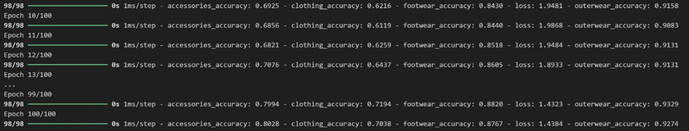
Neural Network Model: Purchased Category Prediction Model
Fixing Overfitting:
Adding more training data?
Reducing number of epochs?
Strong relationship between item purchased and item’s category?
Second attempt
Targets: Clothing, Footwear, Accessories and Outerwear.
Features: age, gender, item purchased, purchased amount in USD and location.
Epochs: 100
Layers: 3 shared layers and 1 output layer for each target.
Although the accuracy for clothing is lower than for other categories, this second attempt more realistically predicts the intention to buy accessories, footwear, or outerwear based on customer characteristics. These results can help us create targeted marketing campaigns for customers with specific traits.
Result:

Slide 16
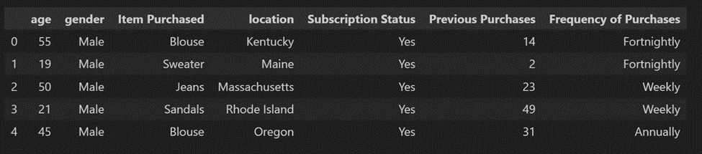
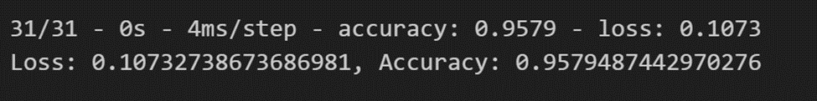
3. Neural Network Model: Purchased Item Prediction Model
We also tried to developed a neural network model to predict the specific items (for example, Jewelry) customers are likely to purchase based on their characteristics.
Model Characteristics
Target: Item Purchased – Jewelry
Features: all other purchased items, age, gender, location, subscription status, previous purchases, frequency of purchases, category, purchase amount in USD.
Epochs: 10
Layers: 3
Result:
In this case, the model achieved very high accuracy with just 10 epochs. We also tested it on other items, such as blouses and belts, and observed similar results. We believe that we could be facing another potential overfitting and that with more data labels, the model could maintain this accuracy even after a higher number of epochs.

Slide 17
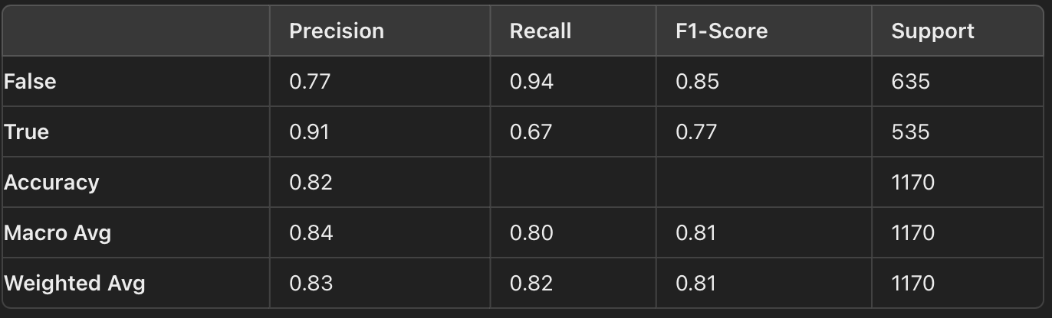
4. Random Forest Classifier Model: E-mail marketing optimization
We trained a model with RandomForestClassifier selecting the variables that can affect the decision of the customer to choose or not to choose to make a purchase with a promocode.
Who should we send discount codes to?
First attempt: We chose age, gender, category, purchase amount, location, season, review rating, subscription status, previous purchases, promo code used (Yes/No).

Slide 18
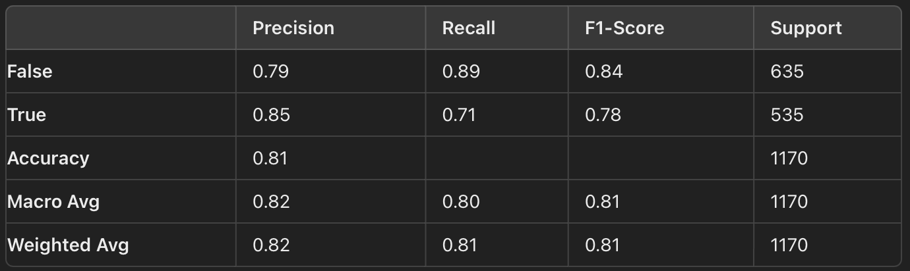
Second attempt: We removed the location, season and review rating as they didn’t seem that important for the model.
When comparing models for identifying customers who will use promo codes, Option 2 is preferable. Although its precision is slightly lower (0.85 versus 0.91), it offers better recall (0.71 versus 0.67). This means that Option 2 is more effective at capturing potential customers, aligning better with the goal of maximizing the use of promotions. The accuracy is nearly identical between the two options.

Slide 19
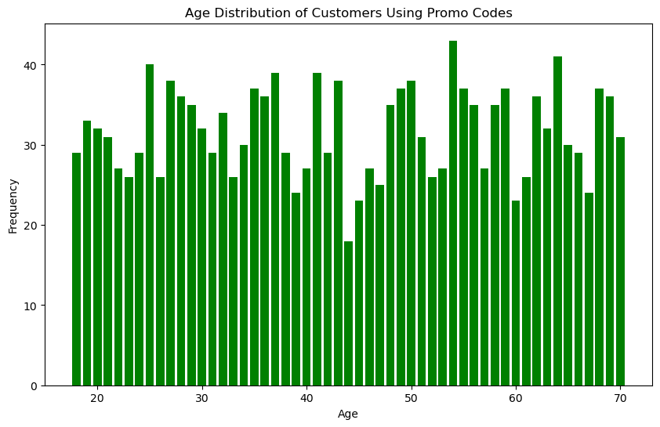
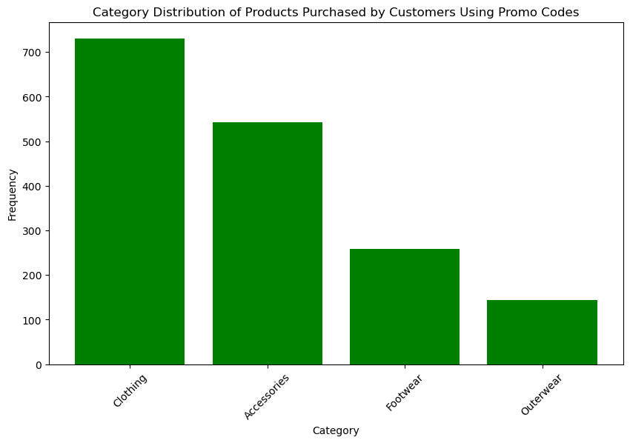
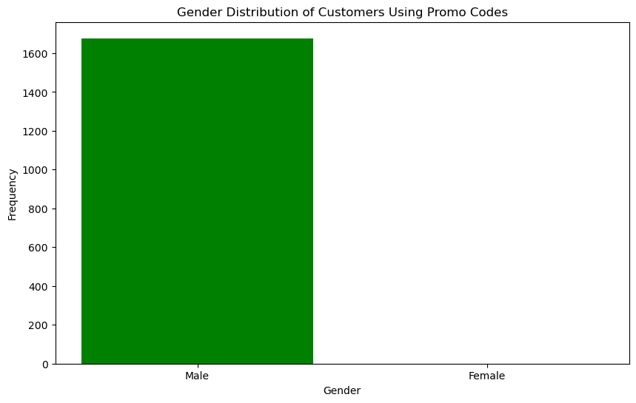
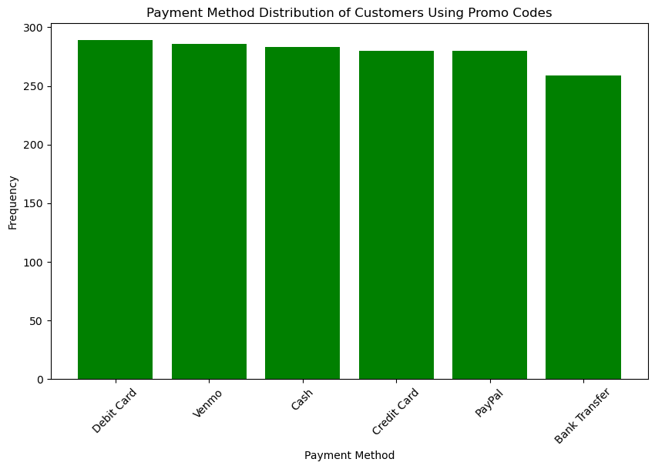
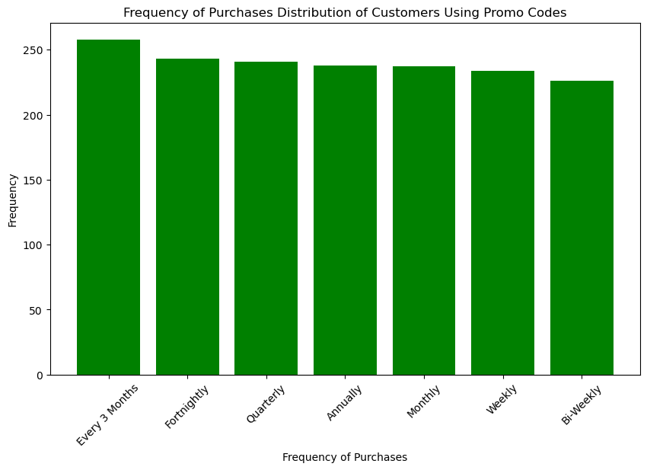
Results of the predicted promo-code usage

Slide 20
Conclusions
By leveraging K-means clustering, neural networks, and random forest models, we've developed a comprehensive understanding of customer behavior for an online clothing retailer. Our analysis empowers marketing agencies to optimize ad spending, personalize customer experiences, and drive sales by accurately predicting purchase preferences, high-spending customers, and promo code usage.

Slide 21
Conclusions
Relevance of Additional Data:
To improve accuracy and avoid overfitting in predictive models, it is crucial to have more data and additional features. This will enable the training of more robust models and obtain results that better reflect real customer behaviors, further optimizing marketing strategies.

Slide 22
E-mail marketing optimization
First attempt: We chose age, gender, category, purchase amount, location, season, review rating, subscription status, previous purchases, promo code used (Yes/No).
Who should we send discount codes to?
When comparing models for identifying customers who will use promo codes, Option 2 is preferable. Although its precision is slightly lower (0.85 versus 0.91), it offers better recall (0.71 versus 0.67). This means that Option 2 is more effective at capturing potential customers, aligning better with the goal of maximizing the use of promotions. The accuracy is nearly identical between the two options.
Second attempt: We removed the location, season and review rating as they didn’t seem that important for the model.

Slide 23
Online Shopping Sales Infographics
Earth
Earth is the third planet and is where we live on
Mercury
Venus
It’s the smallest planet in the Solar System
It’s terribly hot, even hotter than Mercury
Saturn
Mars
Saturn is a gas giant and has several rings
Despite being red, It is actually a cold place

Slide 24
Cluster Segmentation of Customers
Cluster 1
Cluster 2
Cluster 3
Cluster 4

Slide 25
Online Shopping Sales Infographics
Earth
Earth is the third planet and is where we live on
Mercury
Venus
It’s the smallest planet in the Solar System
It’s terribly hot, even hotter than Mercury
Saturn
Mars
Saturn is a gas giant and has several rings
Despite being red, It is actually a cold place

Slide 26
Online Shopping Sales Infographics
Mercury
Venus
Mercury is the smallest planet in the Solar System
Venus is terribly hot, even hotter than Mercury
Saturn
Mars
Saturn is a gas giant and has several rings
Despite being red, Mars is actually a cold place
Jupiter
Earth
Jupiter is the biggest planet in the Solar System
Earth is the third planet and is where we all live on

Slide 27
Online Shopping Sales Infographics
Venus has a beautiful name and is the second planet from the Sun
Venus
Mercury is the closest planet to the Sun and the smallest one
Mercury
Jupiter is a gas giant and the biggest planet in the Solar System
Jupiter
Despite being red, Mars is actually a cold place full of iron oxide dust
Mars

Slide 28
Online Shopping Sales Infographics
Mars
Mercury
Saturn
Jupiter
Despite being red, Mars is actually a cold place
It’s the smallest planet in the Solar System
Saturn is a gas giant and has several rings
It’s the biggest planet in the Solar System

Slide 29
Online Shopping Sales Infographics
Express shipping | Fast shipping | Standard shipping
+ 10$ | + 6$ | + 2$
2 days | 4 days | 7 days
2-4 lbs | 2-4 lbs | 3-5 lbs

Slide 30
Online Shopping Sales Infographics
Mercury
Venus
Mercury is the smallest planet in the Solar System
Venus is terribly hot, even hotter than Mercury
Saturn
Mars
Saturn is a gas giant and has several rings
Despite being red, Mars is actually a cold place
Jupiter
Earth
Jupiter is the biggest planet in the Solar System
Earth is the third planet and is where we all live on

Slide 31
Online Shopping Sales Infographics
Mercury
Jupiter
Earth
Mars
Mercury is the smallest planet in the Solar System
It’s the biggest planet in the Solar System
Earth is the third planet and is where we all live on
Despite being red, It is actually a cold place

Slide 32
Online Shopping Sales Infographics
Saturn
Jupiter
Neptune is the farthest planet
Jupiter is the biggest planet
Mercury
Earth
Mars
Venus
Mercury is the smallest planet
Earth is the planet where we all live on
Mars is actually a cold place
Venus is hotter than Mercury

Slide 33
Online Shopping Sales Infographics
Item 1
-10%
Mercury is the smallest planet
Item 2
-5%
Neptune is the farthest planet
Item 3
-20%
It’s the planet where we live on
Item 4
-25%
Jupiter is the biggest planet
Item 5
-35%
Mars is actually a cold place
Item 6
-20%
It’s even hotter than Mercury

Slide 34
Online Shopping Sales Infographics
1
Venus
2
Mercury
Venus is terribly hot, even hotter than Mercury
Mercury is the closest planet to the Sun
3
Earth
4
Mars
Earth is the third planet and is where we all live on
Despite being red, Mars is actually a cold place
6
Jupiter
6
Saturn
Jupiter is the biggest planet in the Solar System
It’s composed of hydrogen and helium

Slide 35
Online Shopping Sales Infographics
Mercury
Venus
Jupiter
Mercury is the smallest planet in the Solar System
Venus is terribly hot, even hotter than Mercury
Jupiter is the biggest planet in the Solar System
Earth
Saturn
Mars
Earth is the third planet and is where we all live on
Saturn is a gas giant and has several rings
Despite being red, Mars is actually a cold place

Slide 36
Online Shopping Sales Infographics
These are the shipping costs of your online purchases
Shipping | Rate
6 Days | + $4
4 Days | + $6
2 Days | + $10
1 Day | + $16

Slide 37
Online Shopping Sales Infographics
Venus
Mars
Earth
Venus is terribly hot, even hotter than Mercury
Despite being red, Mars is actually a cold place
Earth is the third planet and is where we all live on

Slide 38
Online Shopping Sales Infographics
Search product
Payment
Happy shopping
Mercury is the smallest planet in the Solar System
Earth is the third planet and is where we all live on
Despite being red, Mars is actually a cold place

Slide 39
Online Shopping Sales Infographics
1
Jupiter
Venus
2
Jupiter is the biggest planet in the Solar System
Venus is terribly hot, even hotter than Mercury
3
Mercury
Saturn
4
Mercury is the smallest planet in the Solar System
Saturn is a gas giant and has several rings
5
Mars
Earth
6
Despite being red, Mars is actually a cold place
Earth is the third planet and is where we all live on

Slide 40
Online Shopping Sales Infographics
Jupiter
Mars
Jupiter is a gas giant and the biggest object in the Solar System
Despite being red, Mars is actually a very cold place
Saturn
Mercury
Saturn is composed mostly of hydrogen and also of helium
Mercury is the closest planet to the Sun and the smallest one

Slide 41
Online Shopping Sales Infographics
Mercury
Venus
Mercury is the smallest planet in the Solar System
Venus is terribly hot, even hotter than Mercury
Saturn
Mars
Saturn is a gas giant and has several rings
Despite being red, Mars is actually a cold place
Jupiter
Earth
Jupiter is the biggest planet in the Solar System
Earth is the third planet and is where we all live on

Slide 42
Online Shopping Sales Infographics
Online shopping process
1 | 2 | 3 | 4 | 5 | 6
Mars | Venus | Jupiter | Neptune | Saturn | Mercury
Despite being red, Mars is a cold place | Venus is the second planet from the Sun | Jupiter is the biggest planet in the Solar System | Neptune is the farthest planet from the Sun | Saturn is a gas giant and has several rings | It is the smallest planet in the Solar System

Slide 43
Online Shopping Sales Infographics
Venus has a beautiful name and is the second planet from the Sun
Venus
Mercury is the closest planet to the Sun and the smallest one
Mercury
Jupiter is a gas giant and the biggest planet in the Solar System
Jupiter
Despite being red, Mars is actually a cold place full of iron oxide dust
Mars

Slide 44

Online Shopping Sales Infographics
Most purchased products online
35%
25%
Devices
Clothes
Mercury is the closest planet to the Sun and the smallest one
It has a beautiful name and is the second planet from the Sun
15%
25%
Toys
Media File
Jupiter is a gas giant and the biggest planet in the Solar System
Despite being red, Mars is actually a cold place full of iron oxide dust
Follow the link in the graph to modify its data and then paste the new one here. For more info, click here

Slide 45
Online Shopping Sales Infographics
Mercury
Mercury is the smallest planet in the Solar System
Mars
Saturn
Despite being red, Mars is actually a cold place
Saturn is a gas giant and has several rings
Earth
Jupiter
Earth is the third planet and is where we all live on
Jupiter is the biggest planet in the Solar System

Slide 46
Online Shopping Sales Infographics
Devices
Travels
Earth is the only planet that harbors life in the Solar System
1
2
Despite being red, Mars is actually a cold place full of iron oxide dust
Office supplies
Presents
Mercury is the closest planet to the Sun and the smallest one
3
4
Venus has a beautiful name and is the second planet from the Sun
Sports
Food
Jupiter is a gas giant and the biggest planet in the Solar System
5
6
Saturn was named after the Roman god of wealth and agriculture

Slide 47
Online Shopping Sales Infographics
Venus
Venus is terribly hot, even hotter than Mercury
Mars
Despite being red, Mars is actually a cold place
Jupiter
Jupiter is the biggest planet in the Solar System
Earth
Earth is the third planet and is where we all live on
Mercury
Mercury is the smallest planet in the Solar System

Slide 48
Online Shopping Sales Infographics
1
2
3
4
Jupiter
Mars
Earth
Venus
Jupiter is a gas giant and the biggest planet in the Solar System
Despite being red, Mars is actually a cold place full of iron oxide dust
Earth is the only planet that harbors life in the Solar System
It has a beautiful name and is the second planet from the Sun

Slide 49
Online Shopping Sales Infographics
Mercury
Venus
Mercury is the smallest planet in the Solar System
Venus is terribly hot, even hotter than Mercury
Saturn
Mars
Saturn is a gas giant and has several rings
Despite being red, Mars is actually a cold place
Jupiter
Earth
Jupiter is the biggest planet in the Solar System
Earth is the third planet and is where we all live on

Slide 50
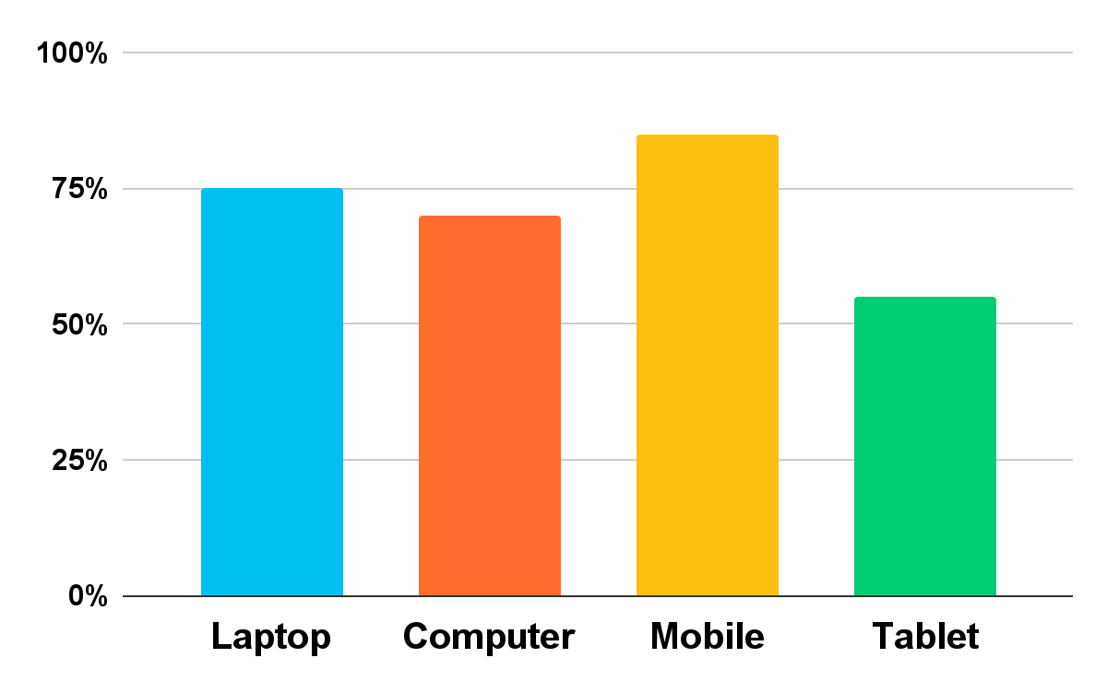
Online Shopping Sales Infographics
Most used devices to buy online
75%
70%
85%
55%
Laptop
Computer
Mercury is the smallest planet in the Solar System
Saturn is a gas giant and has several rings
Mobile
Tablet
Earth is the third planet and is where we all live on
Jupiter is the biggest planet in the Solar System
Follow the link in the graph to modify its data and then paste the new one here. For more info, click here

Slide 51
Online Shopping Sales Infographics
Venus
Venus has a beautiful name and is the second planet from the Sun
Mercury
Mercury is the closest planet to the Sun and the smallest one
Mars
Despite being red, It is actually a cold place full of iron oxide dust
Jupiter
It is a gas giant and the biggest planet in the Solar System

Slide 52
Instructions for use
In order to use this template, you must credit Slidesgo in your final presentation.
You are allowed to:
- Modify this template.
- Use it for both personal and commercial projects.
You are not allowed to:
- Sublicense, sell or rent any of Slidesgo Content (or a modified version of Slidesgo Content).
- Distribute Slidesgo Content unless it has been expressly authorized by Slidesgo.
- Include Slidesgo Content in an online or offline database or file.
- Offer Slidesgo templates (or modified versions of Slidesgo templates) for download.
- Acquire the copyright of Slidesgo Content.
For more information about editing slides, please read our FAQs or visit Slidesgo School:
https://slidesgo.com/faqs and https://slidesgo.com/slidesgo-school

Slide 53
Instructions for use (premium users)
As a Premium user, you can use this template without attributing Slidesgo.
You are allowed to:
Modify this template.
Use it for both personal and commercial purposes.
Hide or delete the “Thanks” slide and the mention to Slidesgo in the credits.
Share this template in an editable format with people who are not part of your team.
You are not allowed to:
Sublicense, sell or rent this Slidesgo Template (or a modified version of this Slidesgo Template).
Distribute this Slidesgo Template (or a modified version of this Slidesgo Template) or include it in a database or in any other product or service that offers downloadable images, icons or presentations that may be subject to distribution or resale.
Use any of the elements that are part of this Slidesgo Template in an isolated and separated way from this Template.
Register any of the elements that are part of this template as a trademark or logo, or register it as a work in an intellectual property registry or similar.
For more information about editing slides, please read our FAQs or visit Slidesgo School:
https://slidesgo.com/faqs and https://slidesgo.com/slidesgo-school

Slide 54
Infographics
You can add and edit some infographics to your presentation to present your data in a visual way.
Choose your favourite infographic and insert it in your presentation using Ctrl C + Ctrl V or Cmd C + Cmd V in Mac.
Select one of the parts and ungroup it by right-clicking and choosing “Ungroup”.
Change the color by clicking on the paint bucket.
Then resize the element by clicking and dragging one of the square-shaped points of its bounding box (the cursor should look like a double-headed arrow). Remember to hold Shift while dragging to keep the proportions.
Group the elements again by selecting them, right-clicking and choosing “Group”.
Repeat the steps above with the other parts and when you’re done editing, copy the end result and paste it into your presentation.
Remember to choose the “Keep source formatting” option so that it keeps the design. For more info, please visit Slidesgo School.

