Slide 1

EMBEDDED SOFTWARE FOR IOT: LAVALAMP
ENCRYPTION
Luigi Dell’Eva, Riccardo Germenia, Luca Cavalcanti
Università degli studi di Trento, 2023

Slide 2
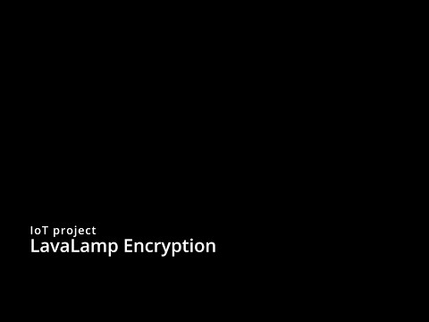

Slide 3
TABLE OF CONTENTS
01
02
03
THE PROBLEM
BASIC SCHEME
ARCHITECTURE
Providing true randomness for computing systems is a common known problem, even more so for embedded systems with limited memory constraints.
LavaLamp Encryption makes full use of the MSP432 microcontroller, the MKII Boosterpack and the ESP32 Wrover Cam in order to provide the end user a safe encryption system.
Our complex codebase allows for managing both the MSP and the ESP, generating easy to use Telegram endpoints, taking precise pictures and managing an user-friendly interface.

Slide 4
01
THE PROBLEM
How can we provide more security in smaller systems?

Slide 5
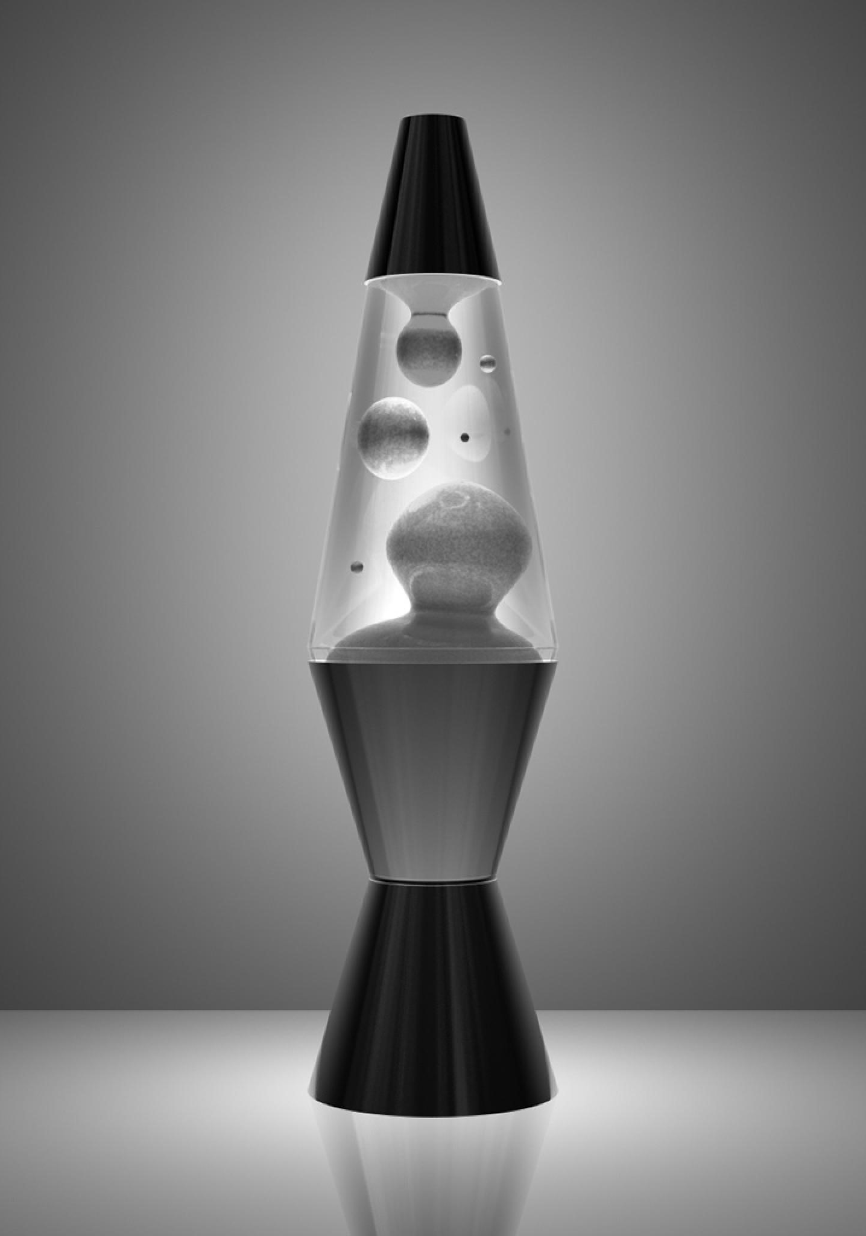
THE PROBLEM
Randomness is a core value for encrypting data.
By encrypting with random keys a higher level of security will be achieved, as an attacker won’t be able to predict the generated seed.
In a computer, there are many possible sources of randomness, but they are usually bound by a slow frequency of sampling or even high predictability.
We decided to take it up a notch. We use a lava lamp as a source of randomness by taking a photo of it to generate a seed for a pseudorandom generator.

Slide 6
02
BASIC SCHEME
How does the magic happen?

Slide 7
BASIC SCHEME
ESP WROVER
MSP432
01
TAKE A PIC
03
INTERACT
Take a picture with the ESP via the Telegram bot
Navigate the pages in the LCD using the Joystick and push buttons
02
ENCRYPT
04
GENERATE
Enjoy the benefits of a secure encryption
Generate a random number with the lava lamp pic

Slide 8
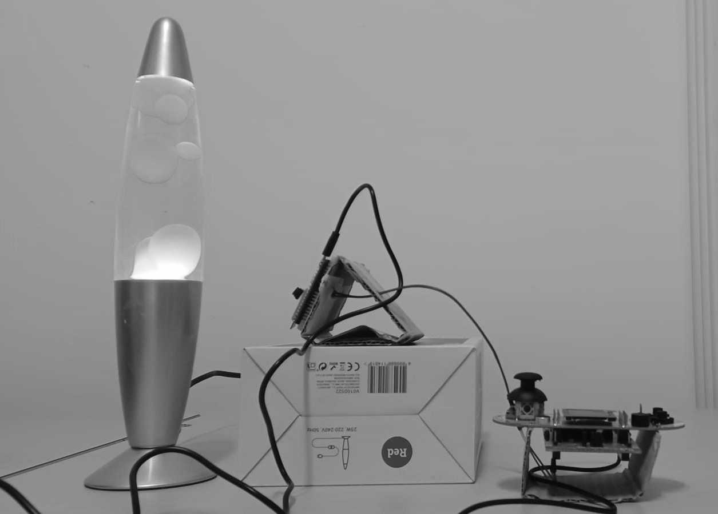
LAVALAMP ENCRYPT

Slide 9
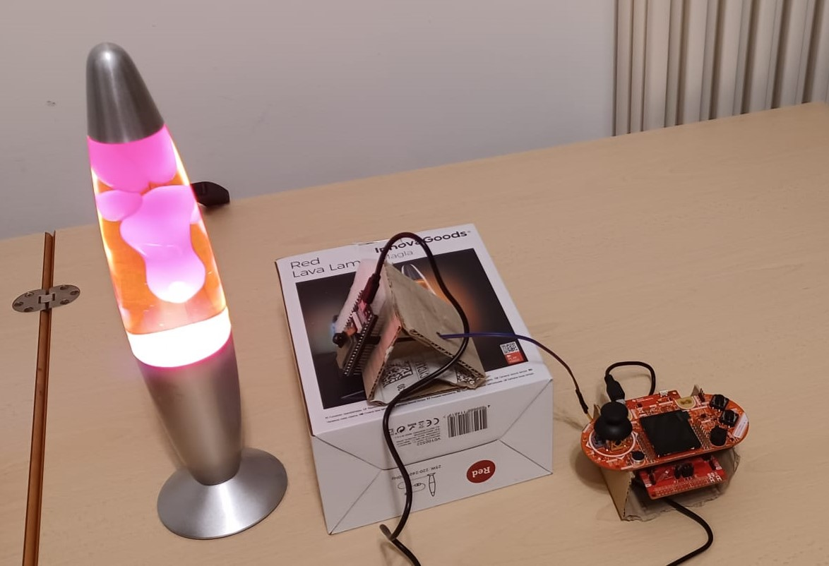
LAVALAMP ENCRYPT

Slide 10
03
ARCHITECTURE
The inner workings of our system

Slide 11
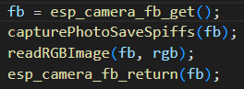

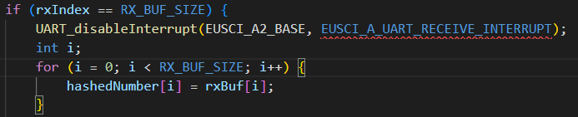
ARCHITECTURE
To take a photo, a pointer to the camera frame buffer is obtained. The buffer is then used to take the photo, and is then converted into rgb.
A plethora of functions are available to control the telegram bot. They allow the ESP to send photos to telegram, or to receive a request for a new picture.
Joystick and pushbuttons data is handled by three interrupts that modify external global variables. They are then used by the file handling the LCD screen, reacting appropriately to the information.
UART allows ESP and MSP to communicate. When the receive buffer is full, the cryptographic seed is updated via an interrupt.

Slide 12
THANKS!
Big thanks to:
Dr. Kasım Sinan Yıldırım
Cloudflare
Original patent

