Slide 1
Structural Equation Modelling (SEM) using R
Luis D. Torres, PhD
Assistant Professor in OB, Business & Society
Nottingham University Business School
luis.torres@nottingham.ac.uk

Slide 2
Agenda
The problem
Before running SEM
Running SEM in R
What to report

Slide 3
The problem
Overall justice
CSR
Training
Gender diversity
Equal opportunities
Gender infrastructure
CSR | Justice | Training | Diversity | Opportunities | Infrastructure
6 factors 27 indicators | 3 indicators | 3 indicators | 3 indicators | 6 indicators | 6 indicators

Slide 4
What method can we use?
Research involves dependent variables (Supervised modelling in ML) | Research does not involve dependent variables (Unsupervised modelling in ML)
Regression (in all its forms: OLS; Logit; Probit, Poisson; etc.) | Cluster analysis (clustering of variables or of cases); Latent Class Analysis
(M)AN(C)OVA | Multi-Dimensional Scaling
Loglinear Analysis* | Canonical correlation
Partial Least Squares Regression | IRT scaling (e.g., Mokken, Rasch)
Path analysis (part of SEM) | Confirmatory Factor Analysis (part of SEM)

Slide 5
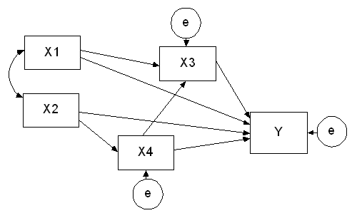
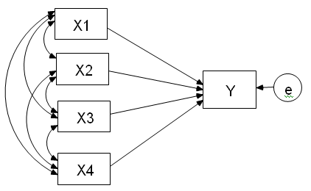
Why not just regression?
Regression SEM

Slide 6
Why not just regression?
Regression | SEM
Only 1 endogenous (dependent) variable (Y) hence only 1 error term | Several endogenous variables (X3, X4, Y), each with its own error term
Focus on explanation of individual variation in Y | Focus on the pathways via which variables influence each other
Uses individual-level data | Uses aggregate data (correlations/co-variances)
Yields individual residuals | Yields aggregate residuals

Slide 7
What is SEM?
Structural equation modelling (SEM) is a series of statistical methods that allow complex relationships between one or more independent variables and one or more dependent variables.
The aim of SEM is to model the relationships between variables (rather than the scores of individual cases) in a way that fits empirical observations in a parsimonious manner.
SEM is a confirmatory technique

Slide 8
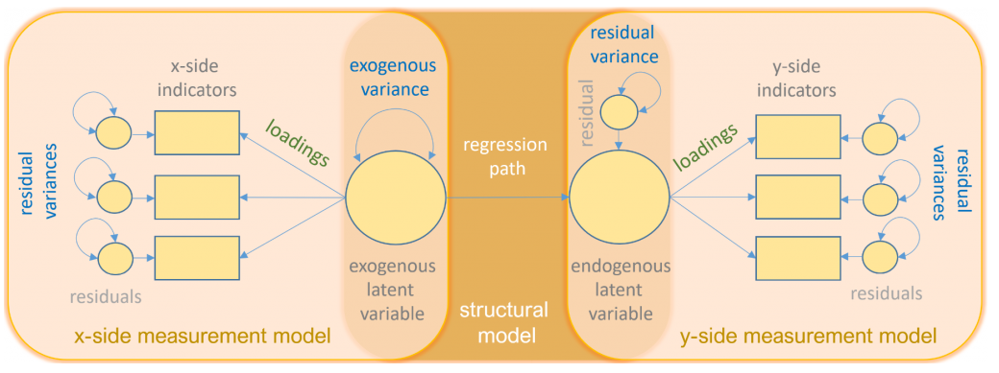
Key elements in SEM
Source: https://stats.idre.ucla.edu/r/seminars/rsem/

Slide 9
Basic assumptions
The good news is that normality requirements are more flexible depending on the estimation procedure we use
Sufficient sample size (but how much is enough?)
Multicollinearity
Observations are drawn from a continuous and multivariate normal population (always?)
Complete data (no missing values)
No influential outliers

Slide 10

Fit indexes
Fit involves the degree of correspondence between the observed correlations (or co-variances), and the correlations (or co-variances) that can be calculated (reconstructed) under the assumption that the estimated parameters are correct.
Fit can be assessed in a variety of ways, only some of which involve a formal test against a null-hypothesis, while others are more heuristic in character
Typically, rejecting the null hypothesis is a good thing, but if we reject the SEM null hypothesis then we would reject our model.
BUT, failing to reject the null hypothesis does not prove that our model is the true model, nor can we say it is the best model, as there may be many other competing models that can also fail to reject the null hypothesis.
This is why we report more than one fit index, including global and local fit indexes.

Slide 11
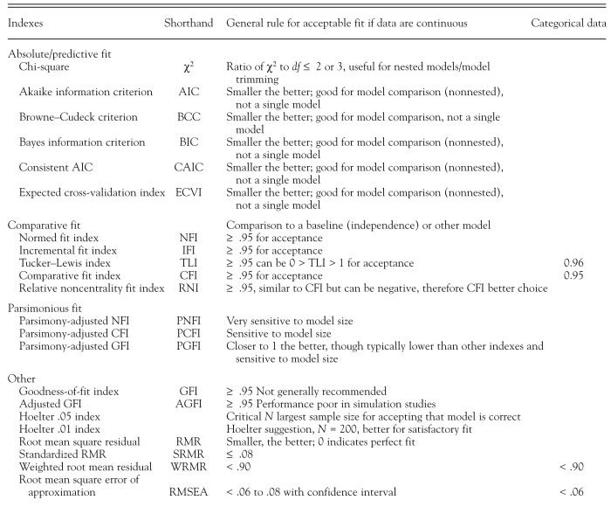
Cut-off criteria for several global fit indexes
Schreiber, J. B., Stage, F. K., King, J., Nora, A., & Barlow, E. A. (2006). Reporting structural equation modeling and confirmatory factor analysis results: A review. Journal of Educational Research, 99(6), 323–337. https://doi.org/10.3200/JOER.99.6.323-338

Slide 12

What if fit indexes do not fit?
Check measurement and structural model separately. Maybe do a CFA first and then use the factor scores for a path analysis
You can also check the modification indexes and make those changes that make conceptual sense

Slide 13


Running SEM in R
First install R if you have not already https://www.r-project.org/
Then, install R Studio: https://www.rstudio.com/products/rstudio/download/
Now, download the example code:
https://github.com/luistorresr/SEM_example

Slide 14
What to report?
Model specification, including prior knowledge of the theoretically plausible models, prior knowledge of the positive or negative direct effects among variables, data sampling method, sample size, and model type.
Data preparation, including the assessment of multivariate normality, analysis of missing data, method to address missing data, and data transformations if any.
Estimation procedure, including the input matrix, estimation method, software brand and version, and method for fixing the scale of latent variables.
Model evaluation and modification, including fit indices with cut-off values and model modification.
All of the findings from an SEM analysis should be reported, including latent variables, factor loadings, standard errors, p values, R2 , standardized coefficients, and graphic representations of the model.

Slide 15
Structural Equation Modelling (SEM) using R
Luis D. Torres, PhD
Assistant Professor in OB, Business & Society
Nottingham University Business School
luis.torres@nottingham.ac.uk

