Slide 1
Structural Equation Modelling (SEM) using R
Luis D. Torres, PhD
Nottingham University Business School

Slide 2
Agenda
The problem
Before running SEM
Running SEM in R
What to report

Slide 3
The problem
Overall justice
CSR
Training
Gender diversity
Equal opportunities
Gender infrastructure

Slide 4
What is SEM?
Structural equation modelling (SEM) is a series of statistical methods that allow complex relationships between one or more independent variables and one or more dependent variables.
The aim of SEM is to model the relationships between variables (rather than the scores of individual cases) in a way that fits empirical observations in a parsimonious manner.
SEM is a confirmatory technique

Slide 5
SEM vs other common methods
Research involves dependent variables (Supervised modelling in ML) | Research does not involve dependent variables (Unsupervised modelling in ML)
Regression (in all its forms: OLS; Logit; Probit, Poisson; etc.) | Cluster analysis (clustering of variables or of cases); Latent Class Analysis
(M)AN(C)OVA | Multi-Dimensional Scaling
Loglinear Analysis* | Canonical correlation
Partial Least Squares Regression | IRT scaling (e.g., Mokken, Rasch)
Path analysis (structural model in SEM) | Confirmatory Factor Analysis (measurement model in SEM)

Slide 6
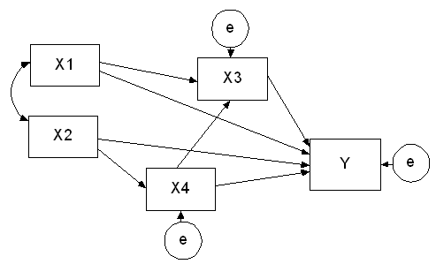
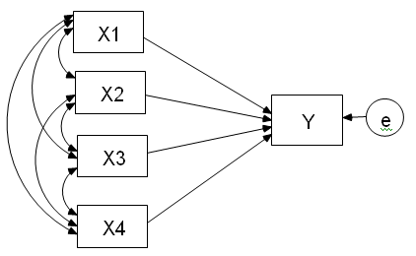
SEM vs Regression
Compare a graphical representation of a typical regression model (left) and a path analytical model (also known as the ‘structural’ part of SEM) (right):

Slide 7
SEM vs Regression
Regression | SEM
Only 1 endogenous (dependent) variable (Y) hence only 1 error term | Several endogenous variables (X3, X4, Y), each with its own error term
Focus on explanation of individual variation in Y | Focus on the pathways via which variables influence each other
Uses individual-level data | Uses aggregate data (correlations/co-variances)
Yields individual residuals | Yields aggregate residuals

Slide 8
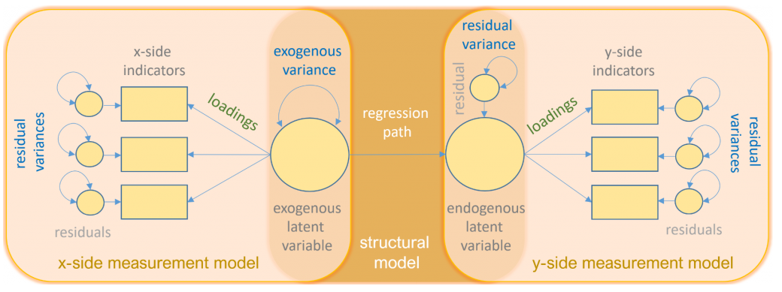
Key elements in SEM
Source: https://stats.idre.ucla.edu/r/seminars/rsem/

Slide 9
Basic assumptions
Sufficient sample size
Multicollinearity
Observations are drawn from a continuous and multivariate normal population
Complete data (no missing values)
No outliers
The good news is that normality requirements are more flexible depending on the estimation procedure we use
Notes:
This assumption is violated in the case of clustered sampling with intra-class correlations ≠ 0. In such situations multi-level extensions of SEM have to be used. Similarly, in the case of longitudinal data this assumption is likely to be violated, and models have to include specifications to account for this.
This is violated in the case where different groups of individual-level cases follow different multivariate distributions, and in the case of (individual-level) outliers.
Relatively little is known about the robustness of outcomes for violations of some of these assumptions
This assumption is also made in standard regression analysis. It is an utterly unrealistic assumption. One of advantage of SEM over regression is that when some of the independent variables in regression become endogenous variables in SEM, the number of variables for which this assumption is made is reduced.
Relatively little is known about the robustness of outcomes for violations of some of these assumptions
This is easily violated when observed variables are ordered-categorical (e.g., in the case of much survey-based data). The consequences of such violations for the (CFA) measurement part are known and consist in severe risks of overdimensionalisation (or unacceptably poor fit of the measurement parts of the model; see van der Eijk and Rose 2015). Less is known about the consequences of such violations for the structural part of a model.

Slide 10
Basic assumptions
The individual-level observations underlying the correlations (or co-variances) are sampled independently
Unit-homogeneity
(measurement) error terms have expected values of 0, are independent of each other at the individual level, are independent of latent variables, follow a multivariate normal distribution
Distribution of latent exogenous variables is multivariate normal; manifest exogenous variables are measured without error
Structural disturbances have expected value 0, follow a multivariate normal distribution, and are independent of latent exogenous variables
Observed relationships between variables are linear and additive
The good news is that normality requirements are more flexible depending on the estimation procedure we use
Notes:
This assumption is violated in the case of clustered sampling with intra-class correlations ≠ 0. In such situations multi-level extensions of SEM have to be used. Similarly, in the case of longitudinal data this assumption is likely to be violated, and models have to include specifications to account for this.
This is violated in the case where different groups of individual-level cases follow different multivariate distributions, and in the case of (individual-level) outliers.
Relatively little is known about the robustness of outcomes for violations of some of these assumptions
This assumption is also made in standard regression analysis. It is an utterly unrealistic assumption. One of advantage of SEM over regression is that when some of the independent variables in regression become endogenous variables in SEM, the number of variables for which this assumption is made is reduced.
Relatively little is known about the robustness of outcomes for violations of some of these assumptions
This is easily violated when observed variables are ordered-categorical (e.g., in the case of much survey-based data). The consequences of such violations for the (CFA) measurement part are known and consist in severe risks of overdimensionalisation (or unacceptably poor fit of the measurement parts of the model; see van der Eijk and Rose 2015). Less is known about the consequences of such violations for the structural part of a model.

Slide 11

Fit indexes
Fit involves the degree of correspondence between the observed correlations (or co-variances), and the correlations (or co-variances) that can be calculated (reconstructed) under the assumption that the estimated parameters are correct.
Fit can be assessed in a variety of ways, only some of which involve a formal test against a null-hypothesis, while others are more heuristic in character
Typically, rejecting the null hypothesis is a good thing, but if we reject the SEM null hypothesis then we would reject our model.
BUT, failing to reject the null hypothesis does not prove that our model is the true model, nor can we say it is the best model, as there may be many other competing models that can also fail to reject the null hypothesis.
This is why we report more than one fit index, including global and local fit indexes.

Slide 12
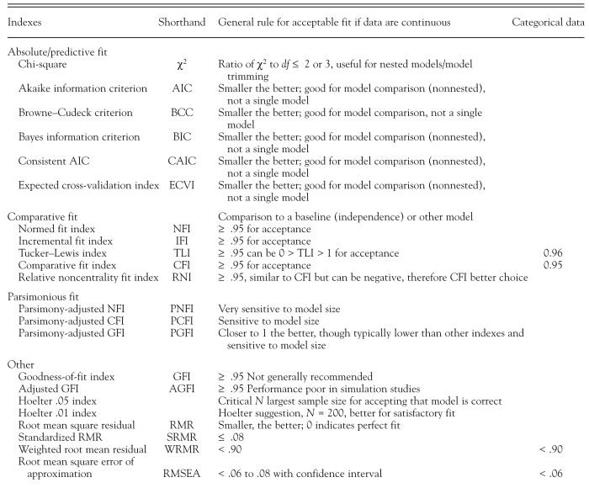
Cut-off criteria for several global fit indexes
Schreiber, J. B., Stage, F. K., King, J., Nora, A., & Barlow, E. A. (2006). Reporting structural equation modeling and confirmatory factor analysis results: A review. Journal of Educational Research, 99(6), 323–337. https://doi.org/10.3200/JOER.99.6.323-338

Slide 13

What if fit indexes do not fit?
Check measurement and structural model separately. Maybe do a CFA first and then use the factor scores for a path analysis
You can also check the modification indexes and make those changes that make conceptual sense

Slide 14


Running SEM in R
First install R if you have not already https://www.r-project.org/
Then, install R Studio: https://www.rstudio.com/products/rstudio/download/

Slide 15
What to report?
Model specification, including prior knowledge of the theoretically plausible models, prior knowledge of the positive or negative direct effects among variables, data sampling method, sample size, and model type.
Data preparation, including the assessment of multivariate normality, analysis of missing data, method to address missing data, and data transformations if any.
Estimation procedure, including the input matrix, estimation method, software brand and version, and method for fixing the scale of latent variables.
Model evaluation and modification, including fit indices with cut-off values and model modification.
All of the findings from an SEM analysis should be reported, including latent variables, factor loadings, standard errors, p values, R2 , standardized coefficients, and graphic representations of the model.

