Slide 1
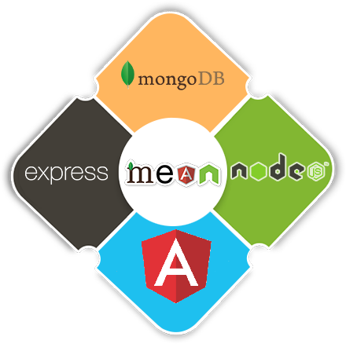
CBD MEAN
Team
Ángel Pérez
Luis Valero

Slide 2
Introduction
Technologies and tools
SQL vs NoSQL
Demo
Conclusions
ROADMAP

Slide 3
Introduction
Technologies and tools
SQL vs NoSQL
Demo
Conclusions
ROADMAP

Slide 4

1. Introduction
1
What is CBD MEAN?

Slide 5
Introduction
Technologies and tools
SQL vs NoSQL
Demo
Conclusions
ROADMAP

Slide 6


2. Technologies and tools
2
Database

Slide 7




2. Technologies and tools
3
Backend

Slide 8




2. Technologies and tools
4
Frontend

Slide 9
2. Technologies and tools
5

Slide 10
Introduction
Technologies and tools
SQL vs NoSQL
Demo
Conclusions
ROADMAP

Slide 11




3. SQL vs NoSQL
6

Slide 12
Introduction
Technologies and tools
SQL vs NoSQL
Demo
Conclusions
ROADMAP

Slide 13

4. Demo
7
A little demo!

Slide 14
Introduction
Technologies and tools
SQL vs NoSQL
Demo
Conclusions
ROADMAP

Slide 15

5. Conclusions
8

Slide 16
Thank you!
Any questions?
Team
Ángel Pérez Llorente
Luis Valero García

