Slide 1
Chapter 8: Queues
Fundamentals of Python: Data Structures, Second Edition
Fundamentals of Python: Data Structures, Second Edition. © 2019 Cengage. May not be copied, scanned, or duplicated, in whole or in part, except for use as permitted in a license distributed with a certain product or service or otherwise on a password-protected website for classroom use.

Slide 2
Learning Objectives
Describe the features of a queue and the operations on it
Choose a queue implementation based on its performance characteristics
Recognize applications where it is appropriate to use a queue
Explain the difference between a queue and a priority queue
Recognize applications where it is appropriate to use a priority queue

Slide 3
Overview of Queues (1 of 3)
Queues are linear collections:
Insertions are restricted to one end, called the rear
Removals are restricted to the other end, called the front
A queue supports a first-in-first-out (F I F O) protocol
Queues have two fundamental operations:
add – adds an item to the rear of a queue
pop – removes an item from the front

Slide 4
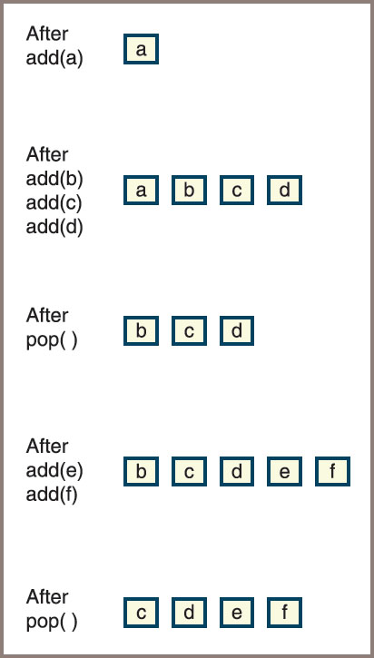
Overview of Queues (2 of 3)
Figure 8-1: The states in the lifetime of a queue

Slide 5
Overview of Queues (3 of 3)
Initially, the queue is empty:
Then an item called a is added
Next, three more items called b, c, and d are added, after which an item is popped, and so forth
Priority queue
Higher-priority items are popped before those of lower priority
Items of equal priority are popped in F I F O order
Queue examples in computer science
C P U access—Processes are queued for access to a shared C P U
Disk access—Processes are queued for access to a shared secondary storage device
Printer access—Print jobs are queued for access to a shared laser printer

Slide 6
The Queue Interface and Its Use (1 of 5)
You can use a Python list to emulate a queue:
Simplest strategy is to use the list method append to add an item to the rear of a queue
Use the list method pop(0) to remove and return the item at the front of its queue
Drawback to this method
All the other list operations can manipulate the queue as well
Aside from the add and pop operations,
It will be useful to have a peek operation, which returns the item at the front of the queue

Slide 7
The Queue Interface and Its Use (2 of 5)
Table 8.1 The Methods in the Queue Interface
Queue Method | What It Does
q.isEmpty() | Returns True if q is empty or False otherwise.
__len__(q) | Same as len(q). Returns the number of items in q.
__str__(q) | Same as str(q). Returns the string representation of q .
q.__iter__() | Same as iter(q), or for item in q. Visits each item in q , from front to rear.
q.__contains__(item) | Same as item in q. Returns True if item is in q or False otherwise.
q1__add__(q2) | Same as q1 + q2. Returns a new queue containing the items in q1 followed by the items in q2 .

Slide 8
The Queue Interface and Its Use (3 of 5)
Table 8.1 The Methods in the Queue Interface (continued)
Queue Method | What It Does
q.__eq__(anyObject) | Same as q == anyObject. Returns True if q equals anyObject or False otherwise. Two queues are equal if the items at corresponding positions are equal.
q.clear() | Makes q become empty.
q.peek() | Returns the item at the front of q . Precondition: q must not be empty; raises a KeyError if the queue is empty.
q.add(item) | Adds item to the rear of q .
q.pop() | Removes and returns the item at the front of q . Precondition: q must not be empty; raises a KeyError if the queue is empty.

Slide 9
The Queue Interface and Its Use (4 of 5)
Table 8.2 The Effects of Queue Operations
Operation | State of the Queue after Operation | Value Returned | Comment
q = <Queue Type>() | blank | blank | Initially, the queue is empty.
q.add(a) | a | blank | The queue contains the single item a .
q.add(b) | a b | blank | a is at the front of the queue and b is at the rear.
q.add(c) | a b c | blank | c is added at the rear.
q.isEmpty() | a b c | False | The queue is not empty.
len(q) | a b c | 3 | The queue contains three items.
q.peek() | a b c | a | Return the front item on the queue without removing it.

Slide 10
The Queue Interface and Its Use (5 of 5)
Table 8.2 The Effects of Queue Operations (continued)
Operation | State of the Queue after Operation | Value Returned | Comment
q.pop() | b c | a | Remove the front item from the queue and return it. b is now the front item.
q.pop() | c | b | Remove and return b.
q.pop() | blank | c | Remove and return c.
q.isEmpty() | blank | True | The queue is empty.
q.peek() | blank | exception | Peeking at an empty queue throws an exception.
q.pop() | blank | Exception | Trying to pop an empty queue throws an exception.
q.add() | d | blank | d is the front item.

Slide 11
Two Applications of Queues
This section looks briefly at two applications of queues:
One involving computer simulations
One involving round-robin C P U scheduling

Slide 12
Simulations (1 of 2)
Computer simulations are used to study behavior of real-word systems
Especially when it is impractical or dangerous to experiment directly
Examples
Simulation that mimics traffic flow on a busy highway
Simulation that helps managers schedule employees and monitor technology
Simulation programs use a simple technique to mimic variability:
Suppose new customers are expected on average once every 4 minutes
Then, during each minute of simulated time, a program can generate a random number between 0 and 1
If the number is less than
the program adds a new customer to a
checkout line; otherwise, it does not

Slide 13
Simulations (2 of 2)
Simulations operate by manipulating queues:
Example: associate each service provider with a queue of service customers
Adds varying numbers of consumers to the queues and gives consumers at the head of the queue another unit of service
Once a consumer receives service, it leaves the queue and next consumer steps forward
Use object-oriented methods to implement simulation programs:
Generates new customer objects as appropriate
Assigns customers to cashiers
Tells each cashier to provide one unit of service to the customer at the head of the queue

Slide 14
Round-Robin C P U Scheduling (1 of 2)
Round-robin scheduling
Adds new processes to the end of a ready queue
Consists of processes waiting to use the C P U
Each process on the ready queue is popped in turn and given a slice of C P U time
When the time slice runs out, the process is returned to the rear of the queue

Slide 15
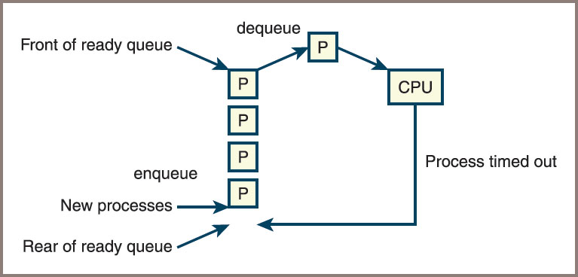
Round-Robin C P U Scheduling (2 of 2)
Figure 8-2: Scheduling processes for a C P U

Slide 16
Implementations of Queues
The structure of a queue lends itself to either an array implementation or a linked implementation:
Similar to approaches used for stacks in the previous chapter

Slide 17
A Linked Implementation of Queues (1 of 6)
Both LinkedStack and LinkedQueue classes
Use a singly linked Node class to implement nodes
The operation pop removes the first node in the sequence in both collections
LinkedQueue.add and LinkedStack.push differ:
push adds a node at the head of the sequence
add adds a node at the tail
To provide fast access to both ends of a queue’s linked structure,
There are external pointers to both ends

Slide 18
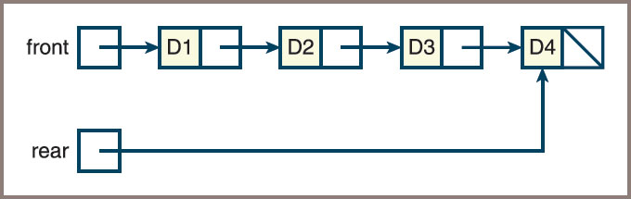
A Linked Implementation of Queues (2 of 6)
Figure 8-3: A linked queue with four items

Slide 19
A Linked Implementation of Queues (3 of 6)
The instance variables front and rear of the LinkedQueue class are given an initial value of None
A variable named size , already defined in the collection framework, tracks the number of elements currently in the queue
During an add operation,
Create a new node
Set the next pointer of the last node to the new node
Set the variable rear to the new node

Slide 20
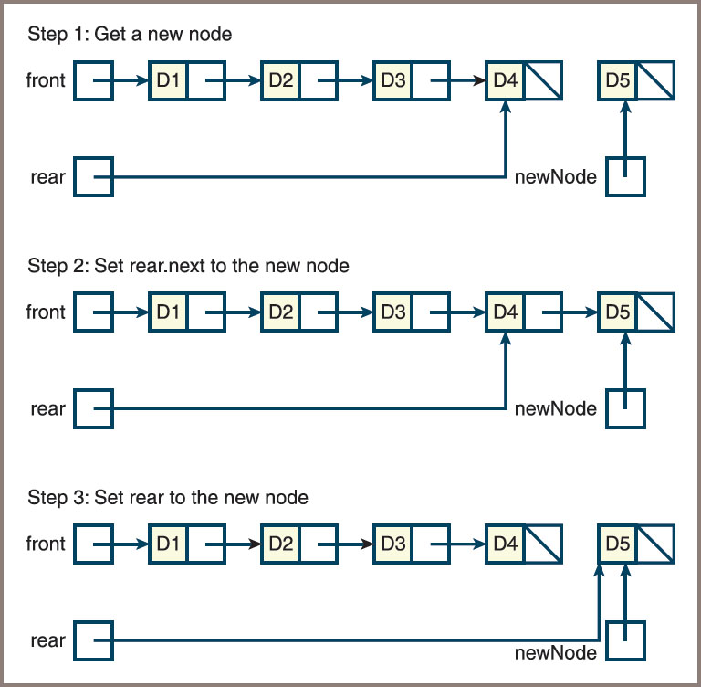
A Linked Implementation of Queues (4 of 6)
Figure 8-4: Adding an item to the rear of a linked queue

Slide 21
A Linked Implementation of Queues (5 of 6)
Code for the add method:
def add(self, newItem):
"""Adds newItem to the rear of the queue."""
newNode = Node(newItem, None)
if self.isEmpty():
self.front = newNode
else:
self.rear.next = newNode
self.rear = newNode
self.size += 1

Slide 22
A Linked Implementation of Queues (6 of 6)
If the queue becomes empty after a pop operation, the front and rear pointers must both be set to None
Here is the code:
def pop(self):
"""Removes and returns the item at front of the queue.
Precondition: the queue is not empty."""
# Check precondition here
oldItem = self.front.data
self.front = self.front.next
if self.front is None:
self.rear = None
self.size -= 1
return oldItem

Slide 23
An Array Implementation (1 of 6)
The array implementation of a queue must access items at the logical beginning and the logical end
Best to approach the problem in a sequence of three attempts
First attempt
Fixes the front of the queue at index position 0 and maintains an index variable, called rear, that points to the last item at position n − 1
See Figure 8.5

Slide 24
An Array Implementation (2 of 6)
Second attempt
You can avoid pop ’s linear behavior by not shifting items left each time the operation is applied
The modified implementation maintains a second index, called front , that points to the item at the front of the queue
The front pointer starts at 0 and advances through the array as items are popped
Figure 8.6 shows such a queue after five add and two pop operations

Slide 25
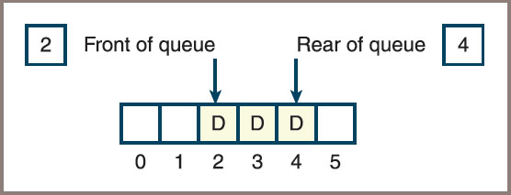
An Array Implementation (3 of 6)
Figure 8-6: An array implementation of a queue with a front pointer

Slide 26
An Array Implementation (4 of 6)
Third attempt
By using a circular array implementation, you can simultaneously achieve good running times for both add and pop
The implementation resembles the previous one in one respect: the front and rear pointers both start at the beginning of the array
See Figure 8.7

Slide 27
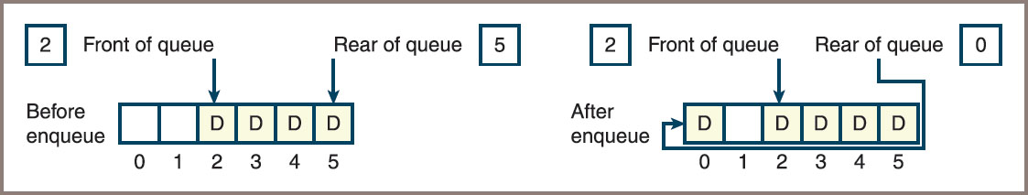
An Array Implementation (5 of 6)
Figure 8-7: Wrapping data around a circular array implementation of a queue

Slide 28
An Array Implementation (6 of 6)
After resizing, you would like the queue to occupy the initial segment of the new array with the front pointer set to 0
Perform the following steps:
Create a new array that is twice the size of the current array
Iterate through the queue, using its for loop to copy items to the new array, starting at position 0 in that array
Reset the items variable to the new array
Set front to 0 and rear to the queue’s length minus 1

Slide 29
Time and Space Analysis for the Two Implementations
The time and space analysis for the two queue classes parallels that for the corresponding stack classes
Linked implementation of queues
The running time of the __str__ , __add__ , and __eq__ methods is O(n)
The maximum running time of all the other methods is O(1)
For the circular array implementation of queues,
If the array is static, the maximum running time of all methods other than __str__ , __add__ , and __eq__ is O(1)

Slide 30
Priority Queues (1 of 11)
Priority queues
Items added to the queue are assigned an order of rank
Items of higher priority are removed before those of lower priority
Items of equal priority are removed in F I F O order
Integers, strings, or any other objects that recognize comparison operators can be ordered in priority queues
If an object does not recognize these operators,
It can be wrapped, or bundled, with a priority number in another object that does recognize these operators
The queue will then recognize this object as comparable with others of its type

Slide 31
Priority Queues (2 of 11)
Table 8.6 States in the Lifetime of a Priority Queue
Operation | State of Queue after Operation | Value Returned | Comment
q = <Priority queue type>() | blank | blank | Initially, the queue is empty
q.add(3) | 3 | blank | The queue contains the single item 3
q.add(1) | 1 3 | blank | 1 is at the front of queue and 3 is at the rear of queue because 1 has higher priority
q.add(2) | 1 2 3 | blank | 2 is added but has a higher priority than 3, so 2 moves ahead of 3
q.pop() | 2 3 | 1 | Remove the front item from the queue and return it; 2 is now the front item
q.add(3) | 2 3 3 | blank | The new 3 is inserted after the existing 3, in F I F O order
q.add(5) | 2 3 3 5 | blank | 5 has the lowest priority, so it goes to rear

Slide 32
Priority Queues (3 of 11)
You define a wrapper class used to build a comparable item from one that is not already comparable
This new class is named Comparable:
It includes a constructor that expects an item and the item’s priority as arguments
The priority must be an integer, a string, or another object that recognizes the comparison operators
Code for the Comparable class:
class Comparable(object):
"""Wrapper class for items that are not comparable."""
def __init__(self, data, priority = 1):
self.data = data
self.priority = priority
def __str__(self):
"""Returns the string rep of the contained datum."""
return str(self.data)

Slide 33
Priority Queues (4 of 11)
Code for the Comparable class (continued):
def __eq__(self, other):
"""Returns True if the contained priorities are equal
or False otherwise."""
if self is other: return True
if type(self) != type(other): return False
return self.priority == other.priority
def __lt__(self, other):
"""Returns True if self’s priority < other’s priority,
or False otherwise."""
return self.priority < other.priority
def __le__(self, other):
"""Returns True if self’s priority <= other’s priority,
or False otherwise."""
return self.priority <= other.priority
def getData(self):
"""Returns the contained datum."""
return self.data
def getPriority(self):
"""Returns the contained priority."""
return self.priority

Slide 34
Priority Queues (5 of 11)
During insertions, a priority queue does not know whether it is comparing items in wrappers or just items
When a wrapped item is accessed with the method peek or pop or in the context of a for loop,
It must be unwrapped with the method getItem before processing
For example, assume that the items labeled a, b, and c are not comparable but should have the priorities 1, 2, and 3, respectively, in a queue:
Write code to add them to a priority queue named queue and retrieve them from it
See code on next slide

Slide 35
Priority Queues (6 of 11)
Code:
queue.add(Comparable(a, 1))
queue.add(Comparable(b, 2))
queue.add(Comparable(c, 3))
while not queue.isEmpty():
item = queue.pop().getItem()
<do something with item>

Slide 36
Priority Queues (7 of 11)
Sorted list
A list of comparable elements that are maintained in a natural order
A priority queue’s list should be arranged so that the minimum element is always accessed at or removed from just one end of the list:
The elements are inserted in their proper places in the ordering
A singly linked structure represents this type of list well if the minimum element is always removed from the head of the structure
If this structure is inherited from the singly linked structure used in the LinkedQueue class, you can continue to remove an element by running that class’s pop method:
Only the add method needs to change; its definition is overridden in the new subclass, called LinkedPriorityQueue

Slide 37
Priority Queues (8 of 11)
The new implementation of add conducts a search for the new item’s position in the list
It considers the following cases:
If the queue is empty or the new item is greater than or equal to the item at the rear, add it as before (It will be placed at the rear)
Otherwise, begin at the head and move forward through the nodes until the new item is less than the item in the current node (At that point, a new node containing the item must be inserted between the current node and the previous node, if there is one)
Figure 8.10 depicts the state of a priority queue containing the three integers 1, 3, and 4 during the add of the value 2

Slide 38
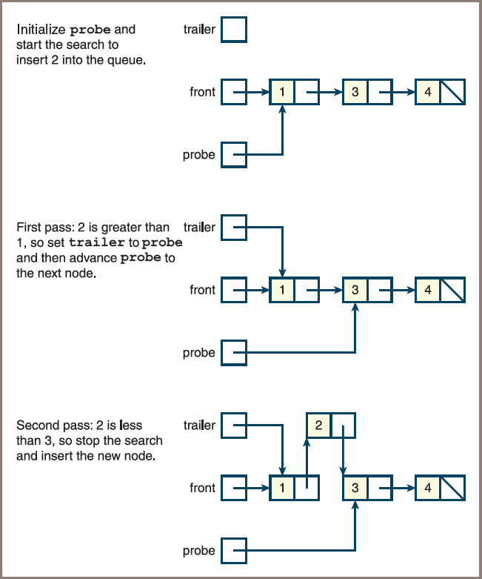
Priority Queues (9 of 11)
Figure 8-10: Inserting an item into a priority queue

Slide 39
Priority Queues (10 of 11)
Code for the class LinkedPriorityQueue:
"""
File: linkedpriorityqueue.py
"""
from node import Node
from linkedqueue import LinkedQueue
class LinkedPriorityQueue(LinkedQueue):
"""A link-based priority queue implementation.""“
def __init__(self, sourceCollection = None):
"""Sets the initial state of self, which includes the
contents of sourceCollection, if it’s present."""
LinkedQueue.__init__(self, sourceCollection)

Slide 40
Priority Queues (11 of 11)
Code for the class LinkedPriorityQueue: (continued)
def add(self, newItem):
"""Inserts newItem after items of greater or equal
priority or ahead of items of lesser priority.
A has greater priority than B if A < B."""
if self.isEmpty() or newItem >= self.rear.data:
# New item goes at rear
LinkedQueue.add(self, newItem)
else:
# Search for a position where it’s less
probe = self.front
while newItem >= probe.data:
trailer = probe
probe = probe.next
newNode = Node(newItem, probe)
if probe == self.front:
# New item goes at front
self.front = newNode
else:
# New item goes between two nodes
trailer.next = newNode
self.size += 1

Slide 41
Chapter Summary (1 of 2)
A queue is a linear collection that adds elements to one end, called the rear, and removes them from the other end, called the front
Other operations on queues include peeking at the top element, determining the number of elements, determining whether the queue is empty, and returning a string representation
Queues are used in applications that manage data items in a F I F O order
Arrays and singly linked structures support simple implementations of queues

Slide 42
Chapter Summary (2 of 2)
Priority queues schedule their elements using a rating scheme as well as a F I F O order
If two elements have equal priority, they are scheduled in F I F O order:
Otherwise, elements are ranked from smallest to largest, according to some attribute, such as a number or an alphabetical content

