Slide 1
Chapter 10: Trees
Fundamentals of Python: Data Structures, Second Edition
Fundamentals of Python: Data Structures, Second Edition. © 2019 Cengage. May not be copied, scanned, or duplicated, in whole or in part, except for use as permitted in a license distributed with a certain product or service or otherwise on a password-protected website for classroom use.

Slide 2
Learning Objectives (1 of 2)
Describe the features of a tree
Describe various types of tree traversals
Recognize three common applications where it is appropriate to use a tree
Describe the features of a binary search tree and the operations on it
Recognize the three common applications where it is appropriate to use a binary search tree

Slide 3
Learning Objectives (2 of 2)
Describe the features of an expression tree and the operations on it
Use an expression tree in recursive descent parsing
Describe the features of a heap and the operations on it
Provide a complexity analysis of the heap sort

Slide 4
An Overview of Trees
In a tree
Ideas of predecessor and successor are replaced with parent and child
Two main characteristics:
Each item can have multiple children
All items, except a privileged item called the root, have exactly one parent
Root has no parent

Slide 5
Tree Terminology (1 of 3)
Table 10.1 Summary of Terms Used to Describe Trees
Term | Definition
Node | An item stored in a tree
Root | The topmost node in a tree (only node without a parent)
Child | A node immediately below and directly connected to a given node
Parent | A node immediately above and directly connected to a given node
Siblings | The children of a common parent
Leaf | A node that has no children
Interior node | A node that has at least one child

Slide 6
Tree Terminology (2 of 3)
Table 10.1 Summary of Terms Used to Describe Trees (continued)
Term | Definition
Edge/Branch/Link | The line that connects a parent to its child
Descendant | A node’s children, it’s children’s children, and so on
Ancestor | A node’s parent, it’s parent’s parent, and so on
Path | The sequence of edges that connect a node and one of its descendants
Path length | The number of edges in a path
Depth or level | Equals the length of the path connecting it to the root
Height | The length of the longest path in the tree
Subtree | The tree formed by considering a node and all its descendants

Slide 7
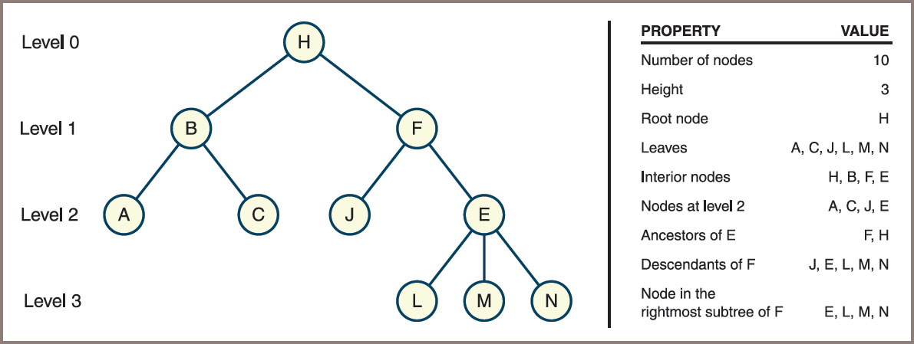
Tree Terminology (3 of 3)
Figure 10-1: Some properties of a tree

Slide 8
General Trees and Binary Trees (1 of 2)
General tree is shown in Figure 10.1 (see previous slide)
Binary tree
Each node has at most two children
Children are referred to as the left child and the right child
Two trees shown in Figure 10.2 (next slide)
Are not the same when they are considered binary trees
Are the same when they are considered general trees

Slide 9
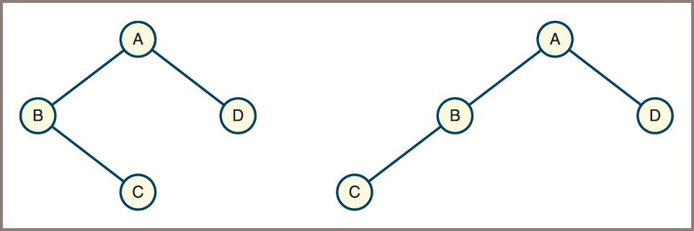
General Trees and Binary Trees (2 of 2)
Figure 10-2: Two unequal binary trees that have the same sets of nodes

Slide 10
Recursive Definitions of Trees
General tree—A general tree is either empty or consists of a finite set of nodes T
One node r is distinguished from all others and is called the root
In addition, the set T − {r} is partitioned into disjointed subsets, each of which is a general tree
Binary tree—A binary tree is either empty or consists of a root plus a left subtree and a right subtree, each of which is a binary tree

Slide 11
Why Use a Tree? (1 of 4)
Trees nicely represent hierarchical structures
Parse tree
Describes the syntactic structure of a sentence in terms of its components
Such as noun phrases and verb phrases
See Figure 10.3 on the next slide
File system structures are also tree-like
See Figure 10.4 on 13th slide.

Slide 12
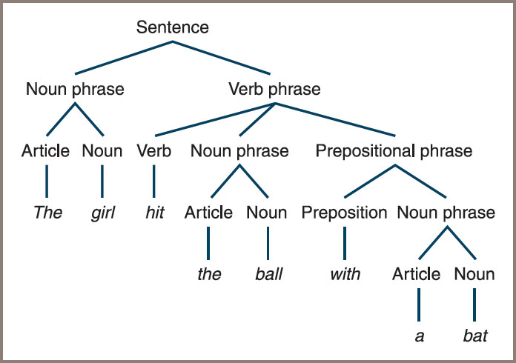
Why Use a Tree? (2 of 4)
Figure 10-3: A parse tree for a sentence

Slide 13
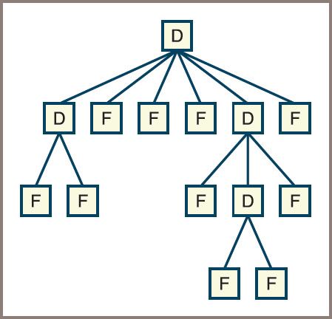
Why Use a Tree? (3 of 4)
Figure 10-4: A file system structure

Slide 14
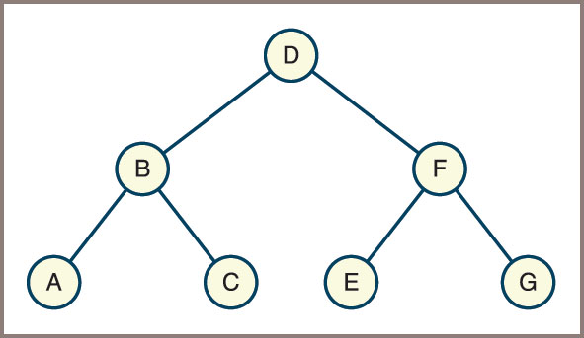
Why Use a Tree? (4 of 4)
Figure 10.5 shows a binary representation of a sorted collection that contains the letters A through G
Figure 10-5: A sorted collection as a binary search tree

Slide 15
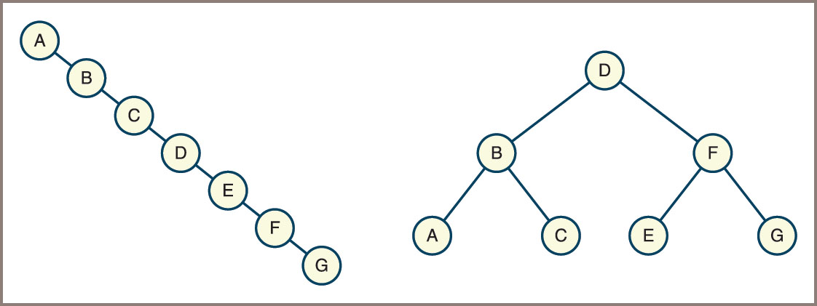
The Shape of Binary Trees (1 of 5)
Trees as data structures come in various shapes and sizes
Some are vine-like and some are bushy
Figure 10-6: A vine-like tree and a bushy tree

Slide 16
The Shape of Binary Trees (2 of 5)
The shape of a binary tree can be described by specifying the relationship between its height and the number of nodes it contains
A binary tree can be vine-like with N nodes and a height of N − 1
A full binary tree contains the full complement of nodes at each level

Slide 17
The Shape of Binary Trees (3 of 5)
Table 10.2 The Relationship Between the Height and the Number of Nodes in Full Binary Tree
Height of the Tree | Number of Nodes in the Tree
0 | 1
1 | 3
2 | 7
3 | 15

Slide 18
The Shape of Binary Trees (4 of 5)
Not all bushy trees are full binary trees
However, a perfectly balanced binary tree, is bushy enough to support worst-case logarithmic access to leaf nodes
A complete binary tree, in which any nodes on the last level are filled in from left to right, is, like a full binary tree
A special case of a perfectly balanced binary tree

Slide 19
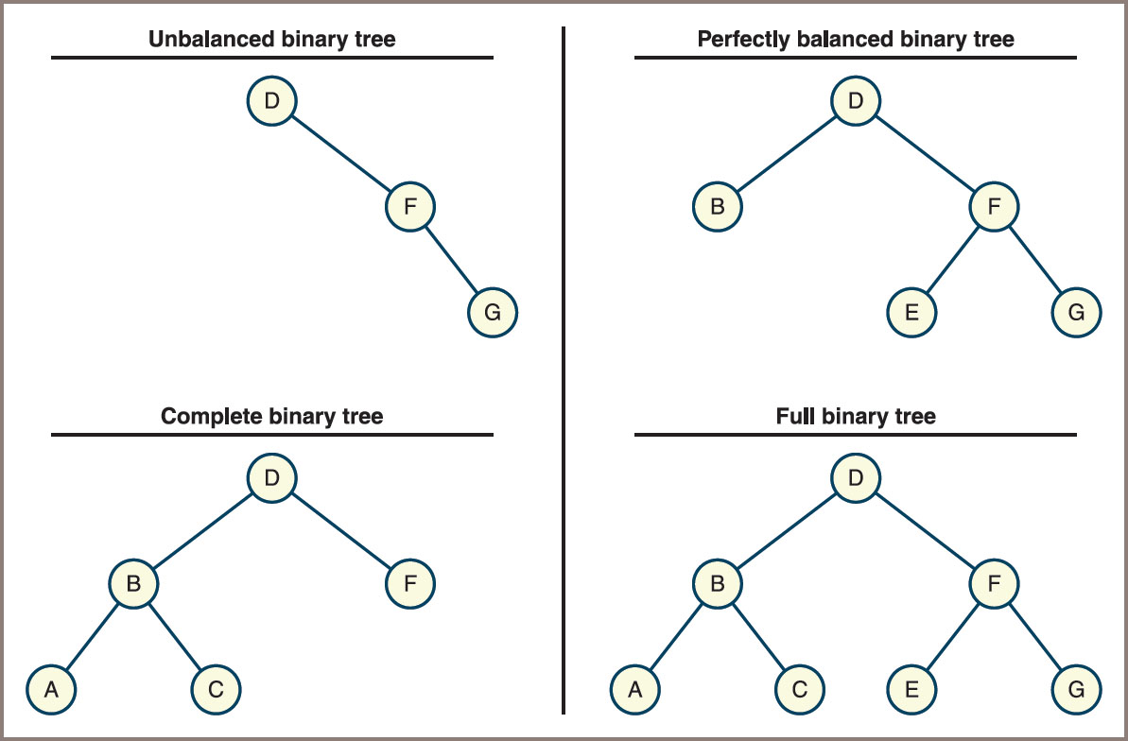
The Shape of Binary Trees (5 of 5)
Figure 10-7: Four types of shapes of binary trees

Slide 20
Binary Tree Traversals
Four standard types of traversals for binary trees:
Preorder
Inorder
Postorder
Level order
Each type follows a particular path and direction as it visits the nodes in the tree

Slide 21
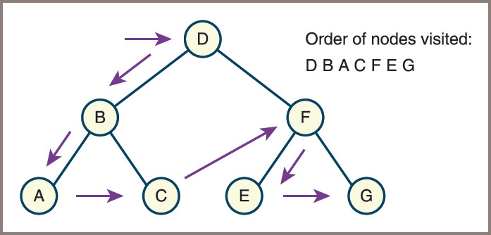
Preorder Traversal
Preorder traversal algorithm visits a tree’s root node and then traverses the left subtree and the right subtree in a similar
Figure 10-8: A preorder traversal

Slide 22
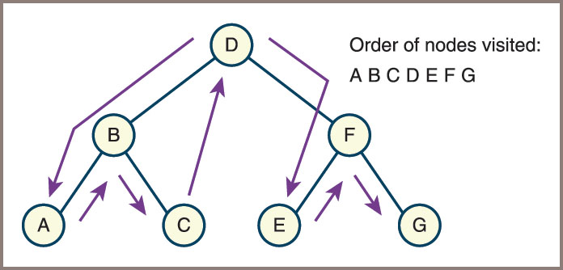
Inorder Traversal
Inorder traversal algorithm traverses the left subtree, visits the root node, and traverses the right subtree
Figure 10-9: An inorder traversal

Slide 23
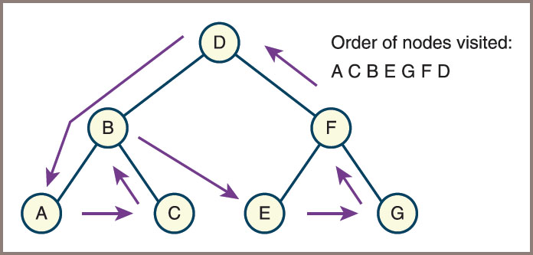
Postorder Traversal
Postorder traversal algorithm traverses the left subtree, traverses the right subtree, and visits the root node
Figure 10-10: A postorder traversal

Slide 24
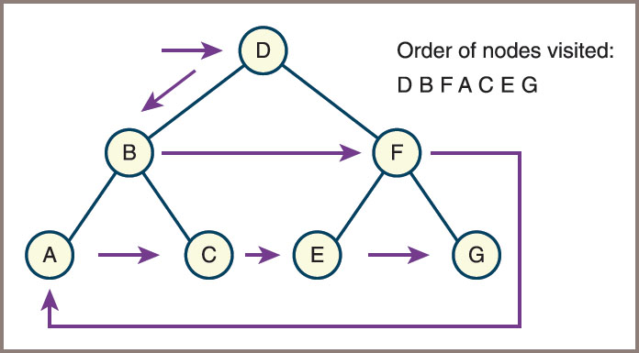
Level Order Traversal
Beginning with level 0, this algorithm visits the nodes at each level in left-to-right order
Figure 10-11: A level order traversal

Slide 25
Three Common Applications of Binary Trees
Heaps
Binary search trees
Expression trees

Slide 26
Heaps (1 of 2)
Min-heap
A binary tree in which each node is less than or equal to both of its children
Max-heap
Places the larger nodes nearer to the root
Either constraint on the order of the nodes is called the heap property
Heap sort
Algorithm that builds a heap from a set of data and then repeatedly removes the root item and adds it to the end of a list
Heaps are also used to implement priority queues

Slide 27
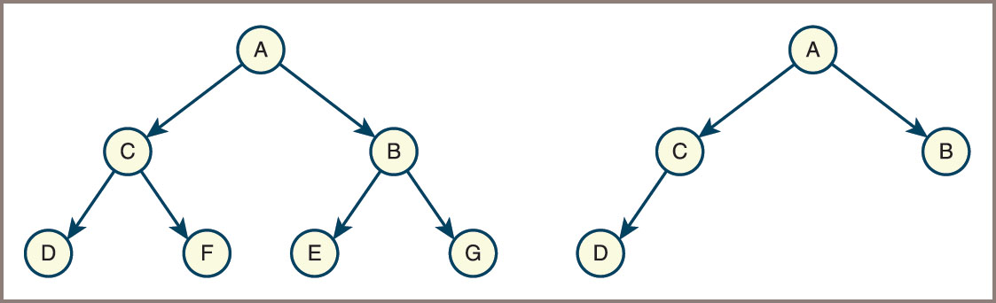
Heaps (2 of 2)
Figure 10-12: Examples of min-heaps

Slide 28
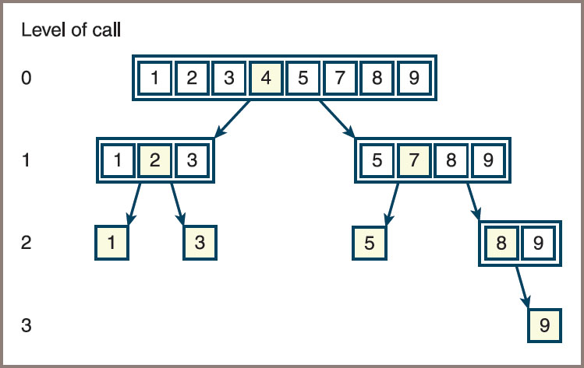
Binary Search Trees (1 of 2)
Figure 10-13: The possible search paths for the binary search of a sorted list

Slide 29
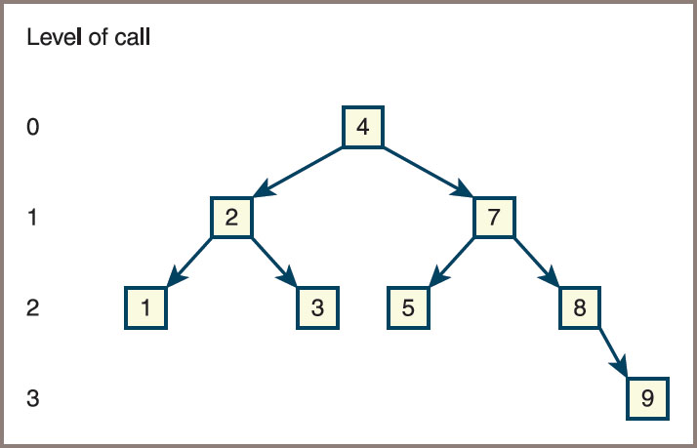
Binary Search Trees (2 of 2)
Figure 10-14: A binary search tree

Slide 30
Expression Trees (1 of 2)
A way to process sentences is to build a parse tree during parsing
For a language of expressions
This structure is also called an expression tree
Points to remember:
An expression tree is never empty
Each interior node represents a compound expression, consisting of an operator and its operands
Each leaf node represents an atomic, numeric operand
Operators of higher precedence usually appear near the bottom of the tree, unless they are overridden in the source expression by parentheses

Slide 31
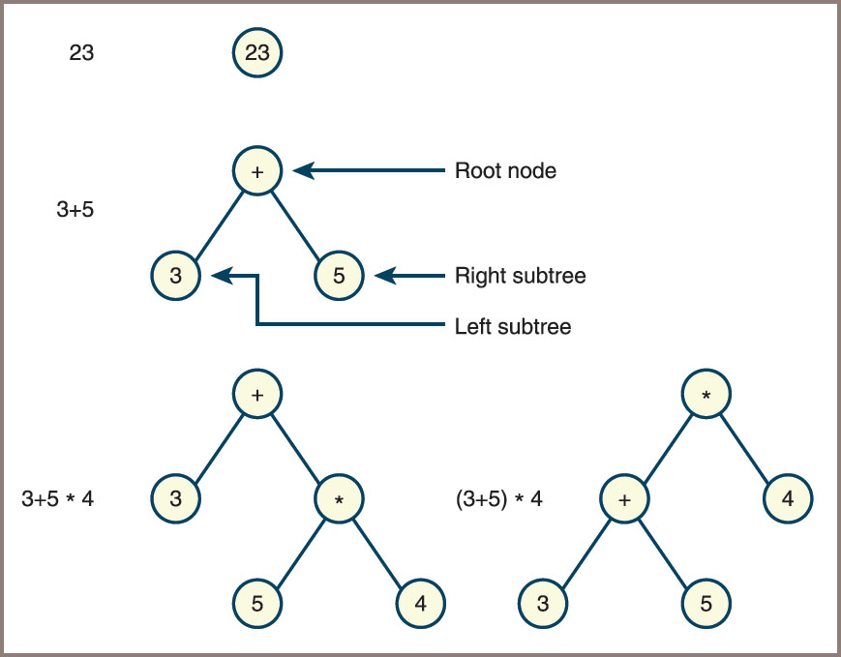
Expression Trees (2 of 2)
Figure 10-15: Some expression trees

Slide 32
Developing a Binary Search Tree
A binary search tree imposes a special ordering on the nodes in a binary tree
So it supports logarithmic searches and insertions
This section develops a binary search tree collection and assesses its performance

Slide 33
The Binary Search Tree Interface (1 of 3)
The interface for a binary search tree should include a constructor and the basic operations common to all collections
isEmpty , len , str , + , == , in , add , and count
As with bags and sets
Insertions and removals are accomplished by the add and remove methods
The method __contains__
Performs a binary search in any BST implementation
To allow users to retrieve and replace items in a binary search tree, the methods find and replace are also included
The method find expects an item as an argument and returns the item matching it in the tree, or None otherwise
The method replace expects two items as arguments

Slide 34
The Binary Search Tree Interface (2 of 3)
Because there are four ways to traverse a binary tree
You include methods for each one
Each traversal method returns an iterator
The tree’s __iter__ method supports a preorder traversal
Two trees are considered equal if they contain the same items in the same positions
The str operation returns a string that shows the shape of the tree when printed.
The methods included in any binary search tree class are described in Table 10.3 in the text

Slide 35
The Binary Search Tree Interface (3 of 3)
The following script creates a BST containing the letters shown in Figure 10.15 and prints its shape:
from linkedbst import LinkedBST
tree = LinkedBST()
print("Adding D B A C F E G")
tree.add("D")
tree.add("B")
tree.add("A")
tree.add("C")
tree.add("F")
tree.add("E")
tree.add("G")
# Display the structure of the tree
print("\nTree structure:\n")
print(tree)

Slide 36
Data Structure for the Linked Implementation (1 of 7)
Code for the part of the LinkedBST class that creates a tree:
"""
File: linkedbst.py
Author: Ken Lambert
"""
from abstractCollection import AbstractCollection
from bstnode import BSTNode
class LinkedBST (AbstractCollection):
"""A link-based binary search tree implementation."""
def __init__(self, sourceCollection = None):
"""Sets the initial state of self, which includes the
contents of sourceCollection, if it’s present."""
self.root = None
AbstractCollection.__init__(sourceCollection)
# Remaining method definitions go here

Slide 37
Data Structure for the Linked Implementation (2 of 7)
Searching a Binary Search Tree
The find method returns the first matching item if the target item is in the tree
Otherwise, it returns None
Pseudocode algorithm for this process:
if the tree is empty
return None
else if the target item equals the root item
return the root item
else if the target item is less than the root item
return the result of searching the left subtree
else
return the result of searching the right subtree

Slide 38
Data Structure for the Linked Implementation (3 of 7)
Traversing a Binary Search Tree
General recursive strategy for an inorder traversal of a binary tree:
if the tree is not empty
visit the left subtree
visit the item at the root of the tree
visit the right subtree
Code for the recursive implementation of the inorder method:
def inorder(self):
"""Supports an inorder traversal on a view of self."""
lyst = list()
def recurse(node):
if node != None:
recurse(node.left)
lyst.append(node.data)
recurse(node.right)
recurse(self.root)
return iter(lyst)

Slide 39
Data Structure for the Linked Implementation (4 of 7)
The String Representation of a Binary Search Tree
Code that builds the appropriate string by first recusing with the right subtree, then visiting an item, and finally recursing with the left subtree:
def __str__(self):
"""Returns a string representation with the tree rotated
90 degrees counterclockwise."""
def recurse(node, level):
s = ""
if node != None:
s += recurse(node.right, level + 1)
s += "| " * level
s += str(node.data) + "\n"
s += recurse(node.left, level + 1)
return s
return recurse(self.root, 0)

Slide 40
Data Structure for the Linked Implementation (5 of 7)
Inserting an Item into a Binary Search Tree
The add method inserts an item into its proper place in the binary search tree
An item’s proper place will be in one of three positions:
The root node, if the tree is already empty
A node in the current node’s left subtree, if the new item is less than the item in the current node
A node in the current node’s right subtree, if the new item is greater than or equal to the item in the current node
For the second and third options, the add method uses a recursive helper function named recurse

Slide 41
Data Structure for the Linked Implementation (6 of 7)
Code for the add method:
def add(self, item):
"""Adds item to the tree."""
# Helper function to search for item’s position
def recurse(node):
# New item is less; go left until spot is found
if item < node.data:
if node.left == None:
node.left = BSTNode(item)
else:
recurse(node.left)
# New item is greater or equal;
# go right until spot is found
elif node.right == None:
node.right = BSTNode(item)
else:
recurse(node.right)
# End of recurse
# Tree is empty, so new item goes at the root
if self.isEmpty():
self.root = BSTNode(item)
# Otherwise, search for the item’s spot
else:
recurse(self.root)
self.size += 1

Slide 42
Data Structure for the Linked Implementation (7 of 7)
Removing an Item from a Binary Search Tree
Save a reference to the root node
Locate the node to be removed, its parent, and its parent’s reference to this node
If the node has a left child and a right child, replace the node’s value with the largest value in the left subtree and delete that value’s node from the left subtree
Otherwise, set the parent’s reference to the node to the node’s only child
Reset the root node to the saved reference
Decrement the size and return the item

Slide 43
Complexity Analysis of Binary Search Trees
Optimal behavior depends on the height of the tree
Run time of insertions is also highly dependent on the height of the tree
Removals also require a search for the target item
Strategies for maintaining a tree structure that supports optimal insertions and searches in all cases
Are the subject of advanced computer science courses

Slide 44
Recursive Descent Parsing and Programming Languages
This section gives a brief overview of some resources for processing languages
Including grammars, parsing, and a recursive descent-parsing strategy

Slide 45
Introduction to Grammars (1 of 4)
A grammar consists of a few parts:
A vocabulary (or dictionary or lexicon) consisting of words and symbols allowed in sentences in the language
A set of syntax rules that specify how symbols in the language are combined to form sentences
A set of semantic rules that specify how sentences in the language should be interpreted
For example, the statement x = y might mean “copy the value of y to the variable x

Slide 46
Introduction to Grammars (2 of 4)
Example: suppose you don’t want to allow expressions, such as 4 + 3 − 2 or 4 * 3 / 2, that contain consecutive adding operations or consecutive multiplying operations
The following grammar defines the syntax and vocabulary of this new little language:
expression = term [ addingOperator term ]
term = factor [ multiplyOperator factor ]
factor = number | "(" expression ")"
number = digit { digit }
digit = "0" | "1" | "2" | "3" | "4" | "5" | "6" | "7" | "8" | "9"
addingOperator = "+" | "-"
multiplyingOperator = "*" | "/"

Slide 47
Introduction to Grammars (3 of 4)
This type of grammar is called an Extended Backus-Naur Form (EBNF) grammar
An EBNF grammar uses three kinds of symbols:
Terminal symbols—These symbols are in the vocabulary of the language and literally appear in programs in the language—for instance, + and * in the preceding examples
Nonterminal symbols—These symbols name phrases in the language, such as expression or factor in the preceding examples
Metasymbols—These symbols are used to organize the rules in the grammar

Slide 48
Introduction to Grammars (4 of 4)
Table 10.4 Metasymbols in EBNF
Metasymbols | Use
"" | Enclose literal items
= | Means “is defined as”
[ ] | Enclose optional items
{ } | Enclose zero or more items
( ) | Group together required choices
| | Indicates a choice

Slide 49
Recognizing, Parsing, and Interpreting Sentences in a Language
To process sentences in a language you use:
Recognizer – analyzes a string to determine if it is a sentence in a given language
Parser – has all the features of a recognizer and returns information about the syntactic and semantic structure of a sentence
Interpreter – carries out the actions specified by a sentence

Slide 50
Lexical Analysis and the Scanner (1 of 2)
When developing a parser
It is convenient to assign the task of recognizing symbols in a string to a lower-level module called a scanner
Scanner performs lexical analysis
In which individual words are picked out of a stream of characters
Output of the scanner is a stream of words called tokens
These become the input to a syntax analyzer that uses the tokens and the grammar rules to determine whether the program is syntactically correct

Slide 51
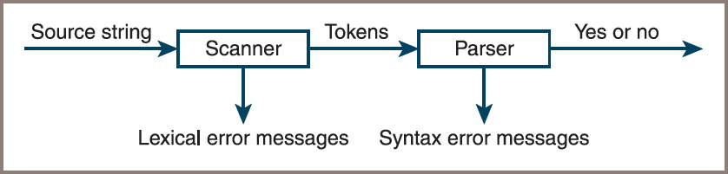
Lexical Analysis and the Scanner (2 of 2)
Figure 10-16: A scanner and parser working in tandem

Slide 52
Parsing Strategies
Recursive descent parsing
Defines a function for each rule in the grammar
Each function process the phrase or portion of the input sentence covered by its rule
Note the following:
Each nonterminal symbol in the grammar becomes the name of a function in the parser
The body of a function processes the phrases on the right side of the rule
To process a nonterminal symbol, you simply invoke a function having the symbol’s name
To process an optional item, you use an if statement
You observe the current token by calling the method get on the scanner object
You scan to the next token by calling the method next on the scanner object

Slide 53
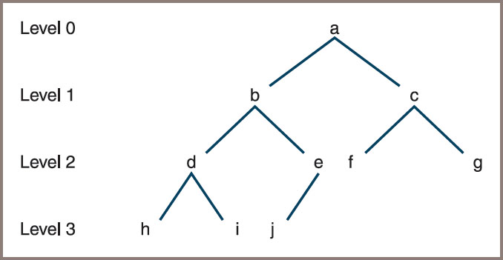
An Array Implementation of Binary Trees (1 of 4)
Figure 10-18: A complete binary tree

Slide 54
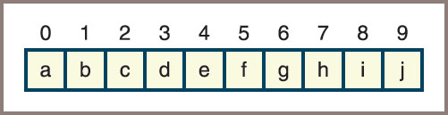
An Array Implementation of Binary Trees (2 of 4)
In an array-based implementation, the elements are stored by level
As shown in Figure 10.19
Figure 10-19: An array representation of a complete binary tree

Slide 55
An Array Implementation of Binary Trees (3 of 4)
Table 10.6 The Locations of Items in an Array Representation of a Complete Binary Tree
Item | Location
Parent | (i − 1) / 2
Left sibling, if there is one | i − 1
Right sibling, if there is one | i + 1
Left child, if there is one | i * 2 + 1
Right child, if there is one | i * 2 + 2

Slide 56
An Array Implementation of Binary Trees (4 of 4)
Thus, for item d at location 3, you get the result shown below
Table 10.7 The Relatives of Item d in an Array Representation of a Complete Binary Tree
Item | Location
Parent | b at 1
Left sibling, if there is one | Not applicable
Right sibling, if there is one | e at 4
Left child, if there is one | h at 7
Right child, if there is one | i at 8

Slide 57
Implementing Heaps (1 of 7)
Table 10.8 The Methods in the Heap Interface
Method | What It Does
heap.isEmpty() | Returns True if heap is empty or False otherwise.
heap.__len__() | Same as len(heap) . Returns the number of items in heap .
heap.__iter__() | Same as iter(heap) or for item in heap: . Visits the items from least to greatest.
heap.__str__() | Same as str(heap) . Returns a string that shows the shape of the heap.
heap.__contains__(item) | Same as item in heap . Returns True if item is in the heap or False otherwise.

Slide 58
Implementing Heaps (2 of 7)
Table 10.8 The Methods in the Heap Interface (continued)
Method | What It Does
heap.__add__(otherHeap) | Same as heap + otherHeap . Returns a new heap with the contents of heap and otherHeap .
heap.__eq__(anyObject) | Same as heap == anyObject . Returns True if heap equals anyObject or False otherwise. Two heaps are equal if they contain the same items.
heap.peek() | Returns the topmost item in heap . Precondition: heap is not empty.
heap.add(item) | Inserts item in its proper place in heap .
heap.pop() | Removes and returns the topmost item in heap . Precondition: heap is not empty.

Slide 59
Implementing Heaps (3 of 7)
The two most critical heap operations are:
add method – expects a comparable element as an argument and inserts the element into its proper place in the heap
pop method – deletes the topmost node in the heap, returns the element contained there, and maintains the heap property
The peek operation returns but does not remove the topmost element in a heap

Slide 60
Implementing Heaps (4 of 7)
Code for the add method:
def add(self, item):
self.size += 1
self.heap.append(item)
curPos = len(self.heap) - 1
while curPos > 0:
parent = (curPos - 1) // 2 # Integer quotient!
parentItem = self.heap[parent]
if parentItem <= item: # Found the spot
break
else: # Continue walking up
self.heap[curPos] = self.heap[parent]
self.heap[parent] = item
curPos = parent

Slide 61
Implementing Heaps (5 of 7)
Strategy for removals:
Begin by saving pointers to the top element and the bottom element in the heap and by moving the element from the bottom of the heap to the top
Walk down the heap from the top, moving the smallest child up one level, until the bottom of the heap is reached

Slide 62
Implementing Heaps (6 of 7)
Code for the pop method:
def pop(self):
if self.isEmpty():
raise AttributeError("Heap is empty")
self.size -= 1
topItem = self.heap[0]
bottomItem = self.heap.pop(len(self.heap) - 1)
if self.isEmpty():
return bottomItem
self.heap[0] = bottomItem
lastIndex = len(self.heap) - 1
curPos = 0
while True:
leftChild = 2 * curPos + 1
rightChild = 2 * curPos + 2
if leftChild > lastIndex:
break

Slide 63
Implementing Heaps (7 of 7)
Code for the pop method: (continued)
if rightChild > lastIndex:
maxChild = leftChild
else:
leftItem = self.heap[leftChild]
rightItem = self.heap[rightChild]
if leftItem < rightItem:
maxChild = leftChild
else:
maxChild = rightChild
maxItem = self.heap[maxChild]
if bottomItem <= maxItem:
break
else:
self.heap[curPos] = self.heap[maxChild]
self.heap[maxChild] = bottomItem
curPos = maxChild
return topItem

Slide 64
Chapter Summary (1 of 2)
Trees are hierarchical collections
The topmost node in a tree is called its root
In a binary tree, a node can have at most two children
There are four standard types of tree traversals: preorder, inorder, postorder, and level order
An expression tree is a type of binary tree in which the interior nodes contain operators and the successor nodes contain their operands
A binary search tree is a type of binary tree in which each nonempty left subtree contains data that are less than the datum in its parent node
Each nonempty right subtree contains data that are greater than the datum in its parent node

Slide 65
Chapter Summary (2 of 2)
A binary search tree supports logarithmic searches and insertions if it is close to complete
A heap is a type of binary tree in which smaller data items are located near the root
You can use a heap to implement the n log n heap sort algorithm and a priority queue

