Slide 1
Chapter 11: Sets and Directories
Fundamentals of Python: Data Structures, Second Edition
Fundamentals of Python: Data Structures, Second Edition. © 2019 Cengage. May not be copied, scanned, or duplicated, in whole or in part, except for use as permitted in a license distributed with a certain product or service or otherwise on a password-protected website for classroom use.

Slide 2
Learning Objectives (1 of 2)
Describe the features of a set and the operations on it
Choose a set implementation based on its performance characteristics
Recognize applications where it is appropriate to use a set
Describe the features of a dictionary and the operations on it
Choose a dictionary implementation based on its performance characteristics

Slide 3
Learning Objectives (2 of 2)
Recognize applications where it is appropriate to use a dictionary
Use a hashing strategy to implement unordered collections with constant-time performance

Slide 4
Using Sets (1 of 2)
Set
A collection of items in no particular order
In mathematics
You perform many operations on sets
To describe the contents of a set,
You use the notation {<item-1> … <item-n>}
Assume the items are in no particular order

Slide 5
Using Sets (2 of 2)
Table 11.1 Results of Some Typical Set of Operations
Set | Value | Union | Intersection | Difference | Subset
A | {12 5 17 6} | {12 5 42 17 6} | {17 6} | {12 5} | False
B | {42 17 6} | Blank | Blank | Blank | Blank
A | {21 76 10 3 9} | {21 76 10 3 9} | {} | {21 76 10 3 9} | True
B | {} | Blank | Blank | Blank | Blank
A | {87} | {22 87 23} | {87} | {} | False
B | {22 87 23} | Blank | Blank | Blank | Blank
A | {22 87 23} | {22 87 23} | {87} | {22 23} | True
B | {87} | Blank | Blank | Blank | Blank

Slide 6
The Python Set Class (1 of 2)
Table 11.2 The Commonly Used Operations on the Set Type
Set Method | What It Does
s = set() | Creates an empty set and assigns it to s.
s = set(anIterable) | Creates a set that contains the unique items in anIterable object and assigns it to s.
s.add(item) | Adds item to s if it is not already in s.
s.remove(item) | Removes item from s.
s.__len__() | Same as len (s). Returns the number of items currently in s.
s.__iter__() | Returns an iterator on s. Supports a for loop with s. Items are visited in an unspecified order.
s.__str__() | Same as str(s). Returns a string containing the string representation of the items in s.

Slide 7
The Python Set Class (2 of 2)
Table 11.2 The Commonly Used Operations on the Set Type (continued)
Set Method | What It Does
s.__contains__(item) | Same as item in s. Returns True if item is in s, or False otherwise.
S1.__or__(s2) | Set union. Same as s1 | s2. Returns a set containing items in s1 and s2.
S1.__and__(s2) | Set intersection. Same as s1 & s2. Returns a set containing the items in s1 that are also in s2.
S1.__sub__(s2) | Set difference. Same as s1 − s2. Returns a set containing the items in s1 that are not in s2.
S1.issubset(s2) | Returns True if s1 is a subset of s2, or False otherwise.

Slide 8
A Sample Session with Sets
For example, create two sets named A and B and perform some operations on them:
>>> A = set([0, 1, 2])
>>> B = set()
>>> 1 in A
True
>>> A & B
{}
>>> B.add(1)
>>> B.add(1)
>>> B.add(5)
>>> B
{1, 5}
>>> A & B
{1}
>>> A | B
{0, 1, 2, 5}
>>> A - B
{0, 2}
>>> B.remove(5)
>>> B
{1}
>>> B.issubset(A)
True
>>> for item in A:
print(item, end = "")
0 1 2

Slide 9
Application of Sets
Sets have many applications in the area of data processing
For example, in the field of database management,
The answer to a query that contains the conjunction of two keys could be constructed from the intersection of the sets of items associated with those keys

Slide 10
Relationship between Sets and Bags
Primary difference between sets and bags
Sets contain unique items
Bags can contain multiple instances of the same item
A set type also includes operations
Such as intersection, difference, and subset

Slide 11
Relationship between Sets and Dictionaries
Dictionary
An unordered collection of elements called entries
Each entry consists of a key and an associated value
Keys must be unique, but its values may be duplicated
Think of dictionary as having a set of keys

Slide 12
Implementation of Sets
Use arrays or linked structures to contain the data of items of a set
Linked structure
Has an advantage of supporting constant-time removals of items once they are located in the structure
Another strategy called hashing
Attempts to approximate random access into an array for insertions, removals, and searches

Slide 13
Array-Based and Linked Implementations of Sets (1 of 2)
Set implementations
ArraySet, LinkedSet, and ArraySortedSet support the methods in the set interface
Receive most of their code via inheritance from parent classes
ArrayBag, LinkedBag, and ArraySortedBag
Set-specific methods _and_, _or_, _sub_, and issubset
Could be included in each set class
Only run other methods in the set interface, so they have the same code in all implementations

Slide 14
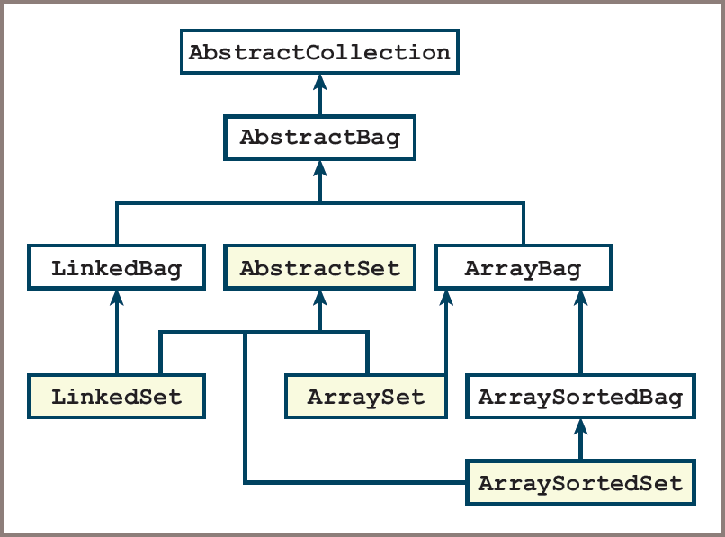
Array-Based and Linked Implementations of Sets (2 of 2)
Figure 11-1: Array-based and linked set implementations

Slide 15
The AbstractSet Class (1 of 2)
Code for AbstractSet:
"""
File: abstractset.py
Author: Ken Lambert
"""
class AbstractSet(object):
"""Generic set method implementations."""
# Accessor methods
def __or__(self, other):
"""Returns the union of self and other."""
return self + other
def __and__(self, other):
"""Returns the intersection of self and other."""
intersection = type(self)()
for item in self:
if item in other:
intersection.add(item)
return intersection

Slide 16
The AbstractSet Class (2 of 2)
Code for AbstractSet (continued):
def __sub__(self, other):
"""Returns the difference of self and other."""
difference = type(self)()
for item in self:
if not item in other:
difference.add(item)
return difference
def issubset(self, other):
"""Returns True if self is a subset of other
or False otherwise."""
for item in self:
if not item in other:
return False
return True
# The __eq__ method for sets goes here (exercise)

Slide 17
The ArraySet Class
Code for ArraySet:
"""
File: arrayset.py
Author: Ken Lambert
"""
from arraybag import ArrayBag
from abstractset import AbstractSet
class ArraySet(AbstractSet, ArrayBag):
"""An array-based implementation of a set."""
def __init__(self, sourceCollection = None):
ArrayBag.__init__(self, sourceCollection)
def add(self, item):
"""Adds item to the set if it is not in the set."""
if not item in self:
ArrayBag.add(self, item)

Slide 18
Using Dictionaries
dict type
Values are inserted or replaced at given keys using the subscript operator [ ]
pop method
Removes a value at a given key
keys and values methods
Return iterators on a dictionary’s set of keys and collection of values
_iter_ method
Supports a for loop over a dictionary’s keys
get method
Allows you to access a value at a key or recovery by returning a default value if the key is not present

Slide 19
Array-Based and Linked Implementations of Dictionaries (1 of 4)
Design strategy
Place the new classes in the collections framework so that they get some data and methods for free by means of inheritance from ancestor classes
If other methods in the new interface have the same implementation in all classes, place them in a new abstract class
To achieve design goals,
Add an AbstractDict class to the framework as a subclass of AbstractCollection

Slide 20
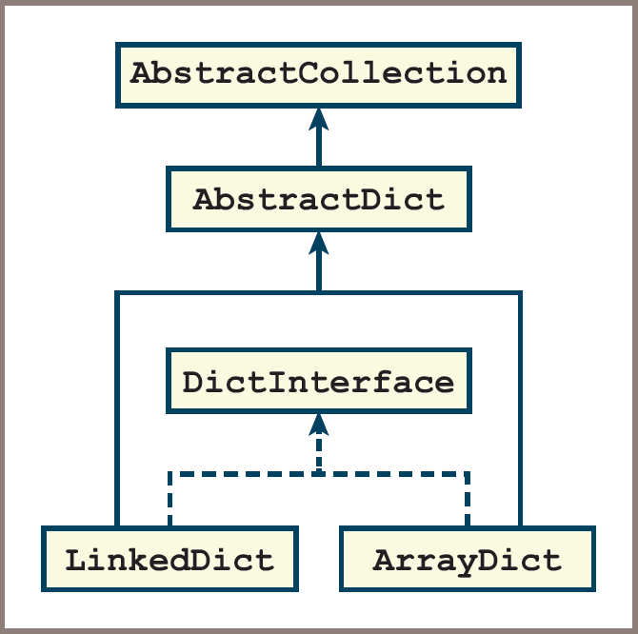
Array-Based and Linked Implementations of Dictionaries (2 of 4)
Figure 11-2: Array-based and linked dictionary implementations

Slide 21
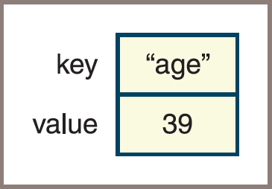
Array-Based and Linked Implementations of Dictionaries (3 of 4)
Figure 11-3: An entry for a dictionary

Slide 22
Array-Based and Linked Implementations of Dictionaries (4 of 4)
Code:
class Entry(object):
"""Represents a dictionary entry.
Supports comparisons by key."""
def __init__(self, key, value):
self.key = key
self.value = value
def __str__(self):
return str(self.key) + ":" + str(self.value)
def __eq__(self, other):
if type(self) != type(other): return False
return self.key == other.key
def __lt__(self, other):
if type(self) != type(other): return False
return self.key < other.key
def __le__(self, other):
if type(self) != type(other): return False
return self.key <= other.key

Slide 23
The AbstractDict Class (1 of 3)
The AbstractDict class includes all methods that call only other dictionary methods to do their work
Such as _str_, _add_, and _eq_
The _init_ method in AbstractDict
Does the work of copying keys and values from the optional source collections to the new dictionary object
Done after the _init_ method in AbstractCollection is called with no collection argument

Slide 24
The AbstractDict Class (2 of 3)
Code:
"""
File: abstractdict.py
Author: Ken Lambert
"""
from abstractcollection import AbstractCollection
class AbstractDict(AbstractCollection):
"""Common data and method implementations
for dictionaries."""
def __init__(self, keys, values):
"""Will copy entries to the dictionary
from keys and values if they are present."""
AbstractCollection.__init__(self)
if keys and values:
valuesIter = iter(values)
for key in keys:
self[key] = next(valuesIter)
def __str__(self):
return "{" + ", ".join(map(str, self.entries())) + "}"
def __add__(self, other):
"""Returns a new dictionary containing the contents
of self and other."""
result = type(self)(self.keys(), self.values())
for key in other:
result[key] = other[key]
return result

Slide 25
The AbstractDict Class (3 of 3)
Code (continued):
def __eq__(self, other):
"""Returns True if self equals other,
or False otherwise."""
if self is other: return True
if type(self) != type(other) or \
len(self) != len(other):
return False
for key in self:
if not key in other:
return False
return True
def keys(self):
"""Returns a iterator on the keys in
the dictionary."""
return iter(self)
def values(self):
"""Returns an iterator on the values in
the dictionary."""
return map(lambda key: self[key], self)
def entries(self):
"""Returns an iterator on the entries in
the dictionary."""
return map(lambda key: Entry(key, self[key]), self)
def get(self, key, defaultValue = None):
"""Returns the value associated with key if key is
present, or defaultValue otherwise."""
# Exercise
return defaultValue

Slide 26
The ArrayDict Class (1 of 2)
The ArrayDict Class is responsible for initializing the collection’s container object
And implementing the methods that must directly access this container
Code:
"""
File: arraydict.py
Author: Ken Lambert
"""
from abstractdict import AbstractDict, Entry
class ArrayDict(AbstractDict):
"""Represents an array-based dictionary."""
def __init__(self, keys = None, values = None):
"""Will copy entries to the dictionary
from keys and values if they are present."""
self.items = list()
AbstractDict.__init__(self, keys, values)
# Accessors
def __iter__(self):
"""Serves up the keys in the dictionary."""
cursor = 0
while cursor < len(self):
yield self.items[cursor].key
cursor += 1

Slide 27
The ArrayDict Class (2 of 2)
Code (continued):
def __getitem__(self, key):
"""Precondition: the key is in the dictionary.
Raises: a KeyError if the key is not in the dictionary.
Returns the value associated with the key."""
index = self.getIndex(key)
if index == -1:
raise KeyError("Missing: " + str(key))
return self.items[index].value
# Mutators
def __setitem__(self, key, value):
"""If the key is not in the dictionary, adds the key
and value to it.
Otherwise, replaces the old value with the new value."""
index = self.getIndex(key)
if index == -1:
self.items.append(Entry(key, value))
self.size += 1
else:
self.items[index].value = value
def pop(self, key, defaultValue = None):
"""Removes the key and returns the associated value
if the key is in the dictionary,
or returns the default value otherwise."""
index = self.getIndex(key)
if index == -1:
return defaultValue
self.size -= 1
return self.items.pop(index).value
def getIndex(self, key):
"""Helper method for key search."""
index = 0
for nextKey in self:
if nextKey == key:
return index
index += 1
return -1

Slide 28
Complexity Analysis of the Array-Based and Linked Implementation of Sets and Dictionaries
Array-based implementations of sets and dictionaries require little programmer effort,
But, they do not perform well
Each one must perform a linear search of the underlying array:
Each basic accessing method is O (n)

Slide 29
Hashing Strategies (1 of 3)
Suppose the first key is 15,000:
Following keys are numbered consecutively
Position of a given key in an array could be compared with the expression key – 15000
This type of computation is known as a key-to-address transformation or a hashing function
The array used with a hashing strategy is called a hash table
If the hashing function runs in constant time,
Insertions, accesses, and removals of the associated keys are O(1)

Slide 30
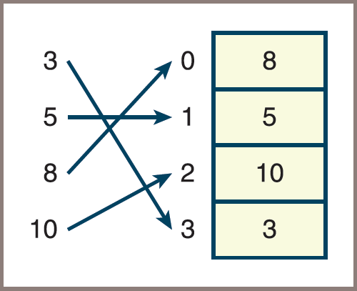
Hashing Strategies (2 of 3)
Figure 11-4: Placement of the keys 3, 5, 8, and 10 using the hashing function key % 4

Slide 31
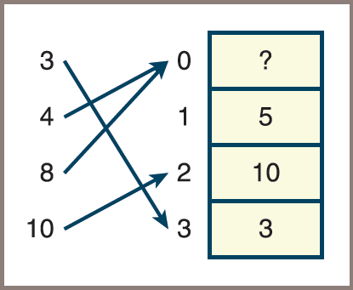
Hashing Strategies (3 of 3)
The hashing of the keys 4 and 8 to the same index is called a collision
Figure 11-5: Placement of the keys 3, 4, 8, and 10 using the hashing function key % 4

Slide 32
The Relationship of Collisions to Density (1 of 2)
Do collisions occur when extra cells (beyond those needed for the data) are available in the array?
To answer this question,
You’ll write a Python function, keysToIndexes, which generates the indexes in an array of size N from a list of keys
Definition of keysToIndexes:
def keysToIndexes(keys, n):
"""Returns the indexes corresponding to
the keys for an array of length n."""
return list(map(lambda key: key % n, keys))
>>> keysToIndexes([3, 5, 8, 10], 4) # No collisions
[3, 1, 0, 2]
>>> keysToIndexes([3, 4, 8, 10], 4) # One collision
[3, 0, 0, 2]

Slide 33
The Relationship of Collisions to Density (2 of 2)
Runs of both sets of keys with increasing array lengths show that no collisions occur when the array length reaches 8:
>>> keysToIndexes([3, 5, 8, 10], 8)
[3, 5, 0, 2]
>>> keysToIndexes([3, 4, 8, 10], 8)
[3, 4, 0, 2]

Slide 34
Hashing with Nonnumeric Keys
Definition of stringHash function followed by a demonstration of how it handles anagrams:
def stringHash(item):
"""Generates an integer key from a string."""
if len(item) > 4 and \
(item[0].islower() or item[0].isupper()):
item = item[1:] # Drop first letter
total = 0
for ch in item:
total += ord(ch)
if len(item) > 2:
total -= 2 * ord(item[-1]) # Subtract last ASCII
return total
>>> stringHash("cinema")
328
>>> stringHash("iceman")
296

Slide 35
Linear Probing (1 of 4)
For insertions
Simplest way to resolve a collision is to search the array, starting from the collision spot, for the first available position
Process is referred to as linear probing
A position is considered to be available for the insertion of a key if it has never been occupied or if a key has been deleted from it:
The values EMPTY and DELETED designate these two states
At the start of an insertion, the hashing function is run to compute the home index of the item:
The home index is the position where the item should go if the hash function works perfectly
If the cell at the home index is not available, the algorithm moves the index to the right to probe for an available cell
When the search reaches the last position of the array, the probing wraps around to continue from the first position

Slide 36
Linear Probing (2 of 4)
Code for insertions into an array named table:
# Get the home index
index = abs(hash(item)) % len(table)
# Stop searching when an empty cell is encountered
while not table[index] in (EMPTY, DELETED):
# Increment the index and wrap around to first
# position if necessary
index = (index + 1) % len(table)
# An empty cell is found, so store the item
table[index] = item

Slide 37
Linear Probing (3 of 4)
Problems with resolving collisions
After several insertions and removals, a number of cells marked DELETED may lie between a given item and its home index
When the items that cause a collision are relocated in the same region (a cluster) within the array, it is known as clustering
Clustering usually leads to collisions with other relocated items

Slide 38
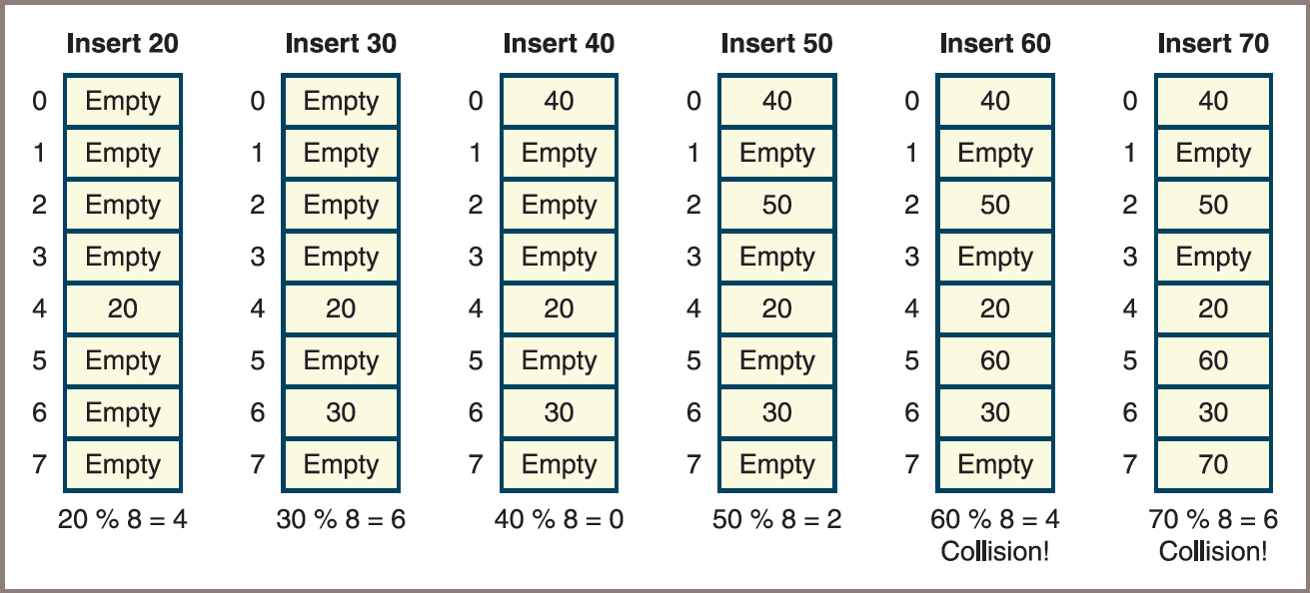
Linear Probing (4 of 4)
Figure 11-6: Clustering during linear probing

Slide 39
Quadratic Probing (1 of 2)
Way to avoid the clustering associated with linear probing
To advance the search for an empty position a considerable distance from the collision point
Quadratic probing accomplishes this by incrementing the home index by the square of a distance on each attempt:
If you begin with home index k and a distance d, the formula used on each pass is

Slide 40
Quadratic Probing (2 of 2)
Code for insertions, updated to use quadratic probing:
# Set the initial key, index, and distance
key = abs(hash(item))
distance = 1
homeIndex = key % len(table)
index = homeIndex
# Stop searching when an unoccupied cell is encountered
while not table[index] in (EMPTY, DELETED):
# Increment the index and wrap around to the
# first position if necessary
index = (homeIndex + distance ** 2) % len(table)
distance += 1
# An empty cell is found, so store the item
table[index] = item

Slide 41
Chaining (1 of 3)
Chaining
A collision-processing strategy where the items are stored in an array of linked lists, or chains
Each item’s key locates the bucket, or index, of the chain in which the item already resides or is to be inserted
The retrieval and removal operations perform the following:
Compute the item’s home index in the array
Search the linked list at that index for the item

Slide 42
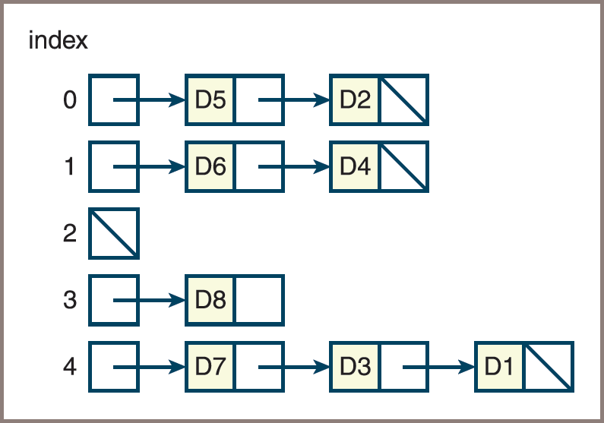
Chaining (2 of 3)
Figure 11-7: Chaining with five buckets

Slide 43
Chaining (3 of 3)
Code for inserting an item using chaining:
# Get the home
index = abs(hash(item)) % len(table)
# Access a bucket and store the item at the head
# of its linked list
table[index] = Node(item, table[index])

Slide 44
Complexity Analysis (1 of 2)
Complexity of linear collision processing
Depends on the load factor and the tendency of relocated items to cluster
Because the quadratic method tends to mitigate clustering, you can expect its average performance to be better than that of the linear method
According to Knuth (cited in text), the average search complexity for the quadratic method is
for the successful case and
for the unsuccessful case

Slide 45
Complexity Analysis (2 of 2)
Analysis of the bucket/chaining method shows that the process of locating an item consists of two parts:
Computing the home index
Searching a linked list when collisions occur

Slide 46
Hashing Implementation of Sets (1 of 6)
The hashing implementation of a set is called HashSet:
It uses the bucket/chaining strategy
The implementation must maintain an array and represent entries in such a manner as to allow chaining
To manage the array, you include three instance variables: items (the array), size (the number of items in the set), and capacity (the number of cells in the array)
The value of capacity is by default a constant, which is defined as 3 to ensure frequent collisions

Slide 47
Hashing Implementation of Sets (2 of 6)
Table 11.6 The Variables Used for Accessing Entries in the Class HashSet
Instance Variable | Purpose
self.foundNode | Refers to the node just located, or is None otherwise.
self.priorNode | Refers to the node prior to the one just located, or is None otherwise.
self.index | Refers to the index of the chain in which the node was just located, or is −1 otherwise.

Slide 48
Hashing Implementation of Sets (3 of 6)
Pseudocode for how _contains_ locates a node’s position and sets variables:
__contains__ (item)
Set index to the hash code of the item
Set priorNode to None
Set foundNode to table[index]
while foundNode != None
if foundNode.data == item
return true
else
Set priorNode to foundNode
Set foundNode to foundNode.next
return false

Slide 49
Hashing Implementation of Sets (4 of 6)
Partial implementation of the class HashSet:
from node import Node
from arrays import Array
from abstractset import AbstractSet
from abstractcollection import AbstractCollection
class HashSet( AbstractSet, AbstractCollection):
"""A hashing implementation of a set."""
DEFAULT_CAPACITY = 3
def __init__(self, sourceCollection = None,
capacity = None):
if capacity is None:
self.capacity = HashSet.DEFAULT_CAPACITY
else:
self.capacity = capacity
self.items = Array(self.capacity)
self.foundNode = self.priorNode = None
self.index = -1
AbstractCollection.__init__(self, sourceCollection)

Slide 50
Hashing Implementation of Sets (5 of 6)
Partial implementation of the class HashSet (continued):
# Accessor methods
def __contains__(self, item):
"""Returns True if item is in the set or
False otherwise."""
self.index = abs(hash(item)) % len(self.items)
self.priorNode = None
self.foundNode = self.items[self.index]
while self.foundNode != None:
if self.foundNode.data == item:
return True
else:
self.priorNode = self.foundNode
self.foundNode = self.foundNode.next
return False
def __iter__(self):
"""Supports iteration over a view of self."""
# Exercise
def __str__(self):
"""Returns the string representation of self."""
# Exercise

Slide 51
Hashing Implementation of Sets (6 of 6)
Partial implementation of the class HashSet (continued):
# Mutator methods
def clear(self):
"""Makes self become empty."""
self.size = 0
self.foundNode = self.priorNode = None
self.index = -1
self.array = Array(HashSet.DEFAULT_CAPACITY)
def add(self, item):
"""Adds item to the set if it is not in the set."""
if not item in self:
newNode = Node(item,
self.items[self.index])
self.items[self.index] = newNode
self.size += 1
def remove(self, item):
"""Precondition: item is in self.
Raises: KeyError if item in not in self.
Postcondition: item is removed from self."""
# Exercise

Slide 52
Hashing Implementation of Dictionaries (1 of 4)
The hashing implementation of a dictionary is called HashDict:
It uses a bucket/chaining strategy (similar to HashSet)
To represent a key/value entry, you use the Entry class defined earlier in the other implementations:
The data field of each node in a chain now contains an Entry object
The __contains__ method now looks for a key in the underlying structure and updates the pointer variables

Slide 53
Hashing Implementation of Dictionaries (2 of 4)
The method __getitem__ simply calls __contains__ and returns the value contained in foundNode.data if the key was found:
__getitem__(key)
if key in self
return foundNodedata.value
else
raise KeyError

Slide 54
Hashing Implementation of Dictionaries (3 of 4)
The method __setitem__ calls __contains__ to determine whether or not an entry exists at the target key’s position:
If the entry is found, __setitem__ replaces its value with the new value
Otherwise, __setitem__ performs the following steps:
Creates a new item object containing the key and value
Creates a new node whose data is the item and whose next pointer is the node at the head of the chain
Sets the head of the chain to the new node
Increments the size

Slide 55
Hashing Implementation of Dictionaries (4 of 4)
Pseudocode for _setitem_:
__setitem__(key, value)
if key in self
foundNode.data.value = value
else
newNode = Node(Item(key, value), items[index])
items[index] = newNode
size = size + 1

Slide 56
Sorted Sets and Dictionaries (1 of 3)
Sorted set and sorted dictionary
Have the behaviors of a set and a dictionary
But the user can visit their data in sorted order
Each item added to a sorted set must be comparable with its other items
And each key added to a sorted dictionary must be comparable with its other keys
The iterator for each type of collection guarantees its users access to the items or the keys in sorted order

Slide 57
Sorted Sets and Dictionaries (2 of 3)
A common implementation of sorted sets uses a binary search tree:
Sorted sets and sorted dictionaries that use a tree-based implementation can provide logarithmic access to data items
There are two design strategies for using a binary search tree in a sorted set implementation:
One strategy is to develop a tree sorted bag class that contains a binary search tree for its data items, and calls methods on that tree
Second strategy uses the LinkedBST class in a partially defined sorted set class called TreeSortedSet (see code on next slide)

Slide 58
Sorted Sets and Dictionaries (3 of 3)
from linkedbst import LinkedBST
from abstractCollection import AbstractCollection
from abstractset import AbstractSet
class TreeSortedSet(AbstractSet):
"""A tree-based implementation of a sorted set."""
def __init__(self, sourceCollection = None ):
self.items = LinkedBST()
if sourceCollection:
for item in sourceCollection:
self.add(item)
def __contains__(self, item):
"""Returns True if item is in the set or
False otherwise."""
return item in self.items
def __iter__(self):
"""Supports an inorder traversal on a view of self."""
return self.items.inorder()
def add(self, item):
"""Adds item to the set if it is not in the set."""
if not item in self:
self.items.add(item)
# Remaining methods are exercises

Slide 59
Chapter Summary (1 of 2)
A set is an unordered collection of items
A list-based implementation of a set supports linear-time access:
A hashing implementation of a set supports constant-time access
The items in a sorted set can be visited in sorted order:
A tree-based implementation of a sorted set supports logarithmic-time access
A dictionary is an unordered collection of entries, where each entry consists of a key and a value:
Each key in a dictionary is unique, but its values may be duplicated
A sorted dictionary imposes an ordering by comparison on its keys

Slide 60
Chapter Summary (2 of 2)
Implementations of both types of dictionaries are similar to those of sets
Hashing is a technique for locating an item in constant time:
This technique uses a hash function to compute the index of an item in an array
When using hashing, the position of a new item can collide with the position of an item already in an array
Chaining employs an array of buckets, which are linked structures that contain the items
The run-time and memory aspects of hashing methods involve the load factor of the array

