Slide 1
Chapter 12: Graphs
Fundamentals of Python: Data Structures, Second Edition
Fundamentals of Python: Data Structures, Second Edition. © 2019 Cengage. May not be copied, scanned, or duplicated, in whole or in part, except for use as permitted in a license distributed with a certain product or service or otherwise on a password-protected website for classroom use.

Slide 2
Learning Objectives
Describe the features of a graph
Describe various types of graph traversals
Recognize applications where it is appropriate to use a graph
Choose an appropriate implementation of a graph, based on its performance characteristics
Develop algorithms for processing graphs

Slide 3
Why Use Graphs? (1 of 2)
Graphs serve as models of a wide range of objects:
A roadmap
A map of airline routes
A layout of an adventure game world
A schematic of the computers and connections that make up the Internet
The links between pages on the Internet
The relationship between students and courses
The prerequisite structure of courses in a computer science department
A diagram of the flow capacities in a communications or transportation network

Slide 4
Why Use Graphs? (2 of 2)
Primary feature of graphs
Consist of a set of objects connected by links
Allow the user to navigate from one object to another
The graph is the most general category of collection:
Encompasses the linear, hierarchical, and unordered collections as special cases

Slide 5
Graph Terminology (1 of 12)
A graph is a set V of vertices and a set E of edges:
Each edge in E connects two of the vertices in V
Node
Used as a synonym for vertex
Vertices and edges can be labeled or unlabeled:
When edges are labeled with numbers, the numbers can be viewed as weights (known as a weighted graph)

Slide 6
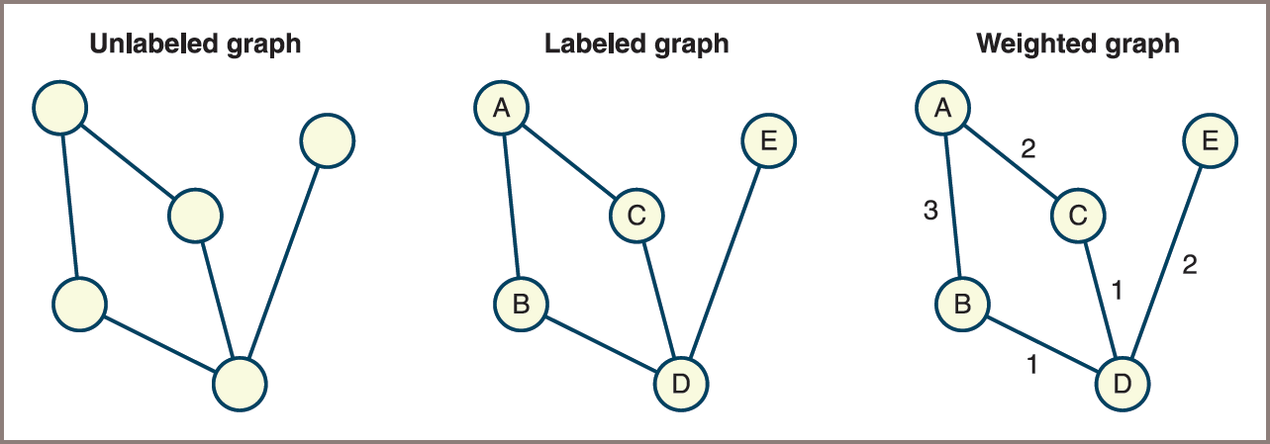
Graph Terminology (2 of 12)
Figure 12-1: Unlabeled, labeled, and weighted graphs

Slide 7
Graph Terminology (3 of 12)
One vertex is v to another if there is an edge connecting the two vertices:
These two vertices are also called neighbors
A path is a sequence of edges that allows one vertex to be reached from another vertex in a graph
A vertex is reachable from another vertex if there is a path between the two:
Length of a path is the number of edges on the path
A graph is connected if there is a path from each vertex to every other vertex
A graph is complete if there is an edge from each vertex to every other vertex

Slide 8
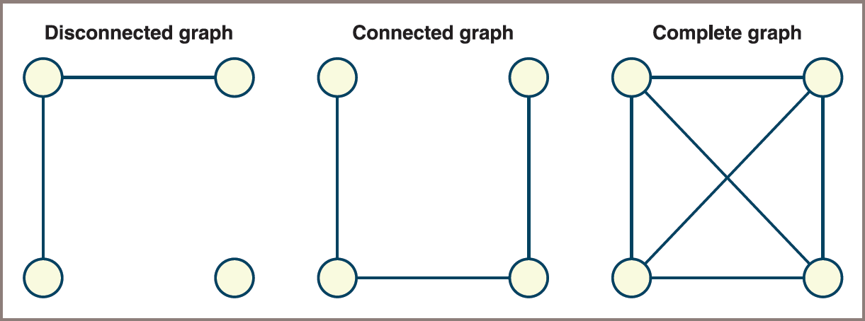
Graph Terminology (4 of 12)
Figure 12-2: Disconnected, connected but not complete, and complete graphs

Slide 9
Graph Terminology (5 of 12)
The degree of a vertex is equal to the number of edges connected to it
A subgraph of a given graph consists of a subset of that graph’s vertices and the edges connecting those vertices
A connected component is a subgraph consisting of the set of vertices that are reachable from a given vertex
A simple path is a path that does not pass through the same vertex more than once
A cycle is a path that begins and ends at the same vertex

Slide 10
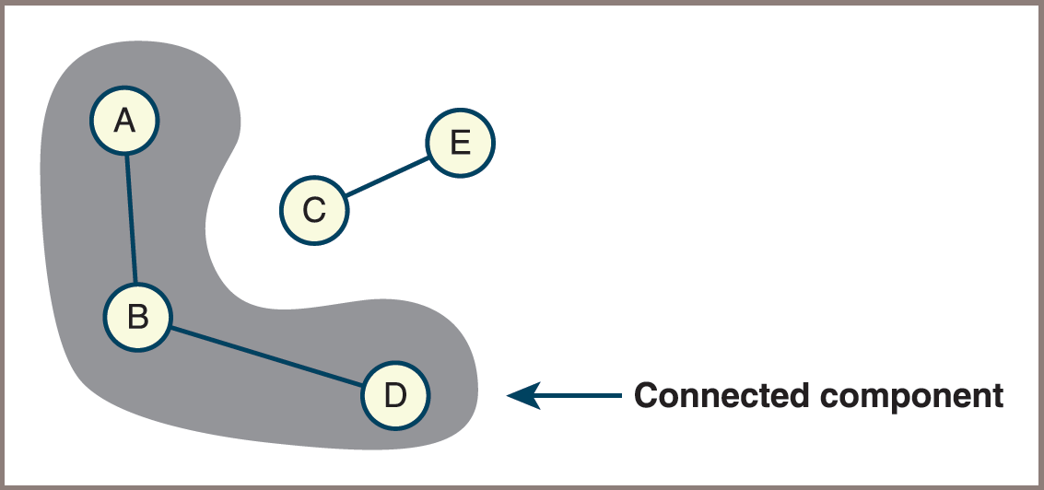
Graph Terminology (6 of 12)
Figure 12-3: A connected component of a graph

Slide 11
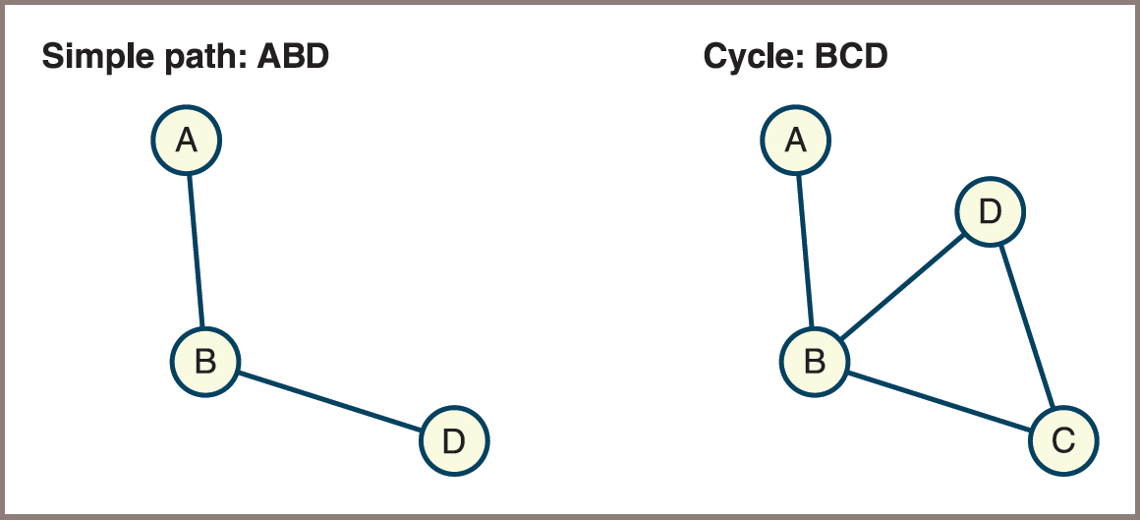
Graph Terminology (7 of 12)
Figure 12-4: A simple path and a cycle

Slide 12
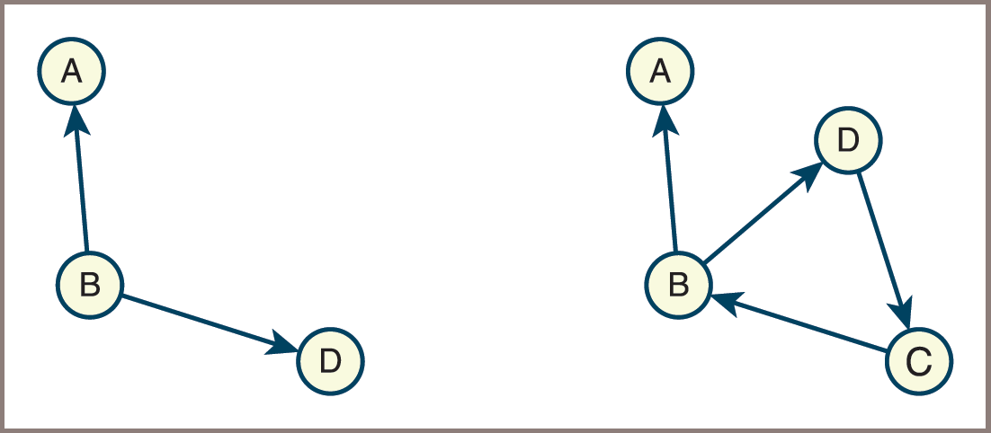
Graph Terminology (8 of 12)
Graphs shown in Figures 12.1 – 12.4 are undirected:
Their edges indicate no direction
Edges in a directed graph (digraph) specify an explicit direction
Figure 12-5: Directed graphs (digraphs)

Slide 13
Graph Terminology (9 of 12)
Each edge in a digraph is called a directed edge
It has a source vertex and a destination vertex
When there is only one directed edge connecting two vertices, the vertices are in the relation of a predecessor (the source vertex) and a successor (the destination vertex):
The relation of adjacency between them is asymmetric
The edges emanating from a given source vertex are called its incident edges

Slide 14
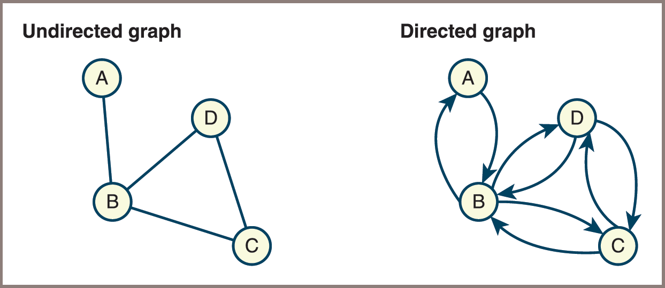
Graph Terminology (10 of 12)
Figure 12-6: Converting an undirected graph to a directed graph

Slide 15
Graph Terminology (11 of 12)
Directed acyclic graph
A special case of digraph that contains no cycles
Lists and trees are special cases of directed graphs
Dense graph
A connected graph that has relatively many edges
Sparse graph
A graph that has relatively few edges

Slide 16
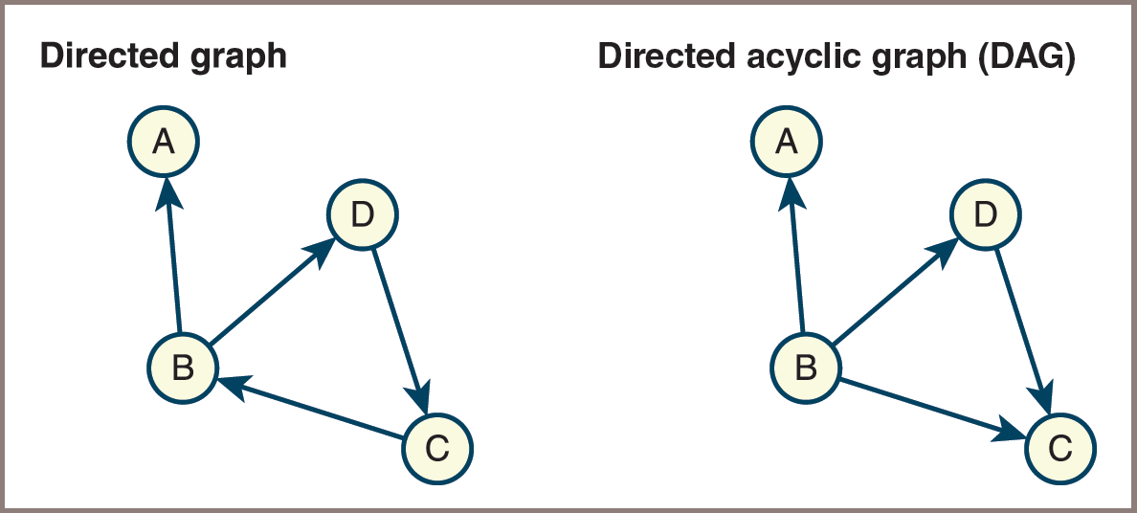
Graph Terminology (12 of 12)
Figure 12-7: A directed graph and a directed acyclic graph (D A G)

Slide 17
Representations of Graphs
To represent graphs,
You need a convenient way to store the vertices and the edges that connect them
Two commonly used representations of graphs are the adjacency matrix and adjacency list

Slide 18
Adjacency Matrix (1 of 3)
Assume that a graph has N vertices labeled 0, 1, …, N − 1, and then the following applies:
The adjacency matrix for the graph is a grid G with N rows and N columns
The cell G[i][j] contains 1 if there is an edge from vertex i to vertex j in the graph; otherwise, there is no edge, and that cell contains 0

Slide 19
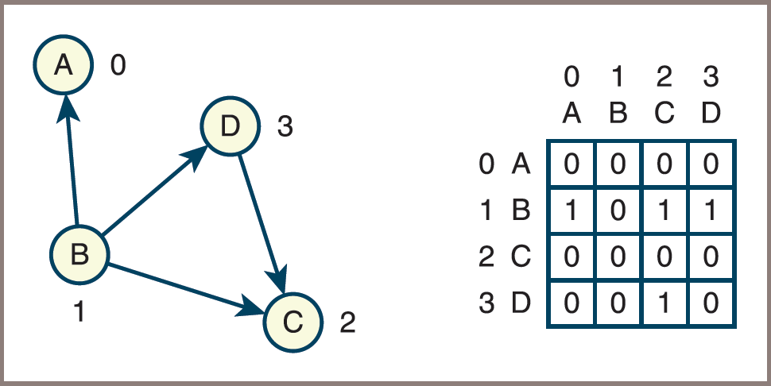
Adjacency Matrix (2 of 3)
Figure 12-8: A directed graph and its adjacency matrix

Slide 20
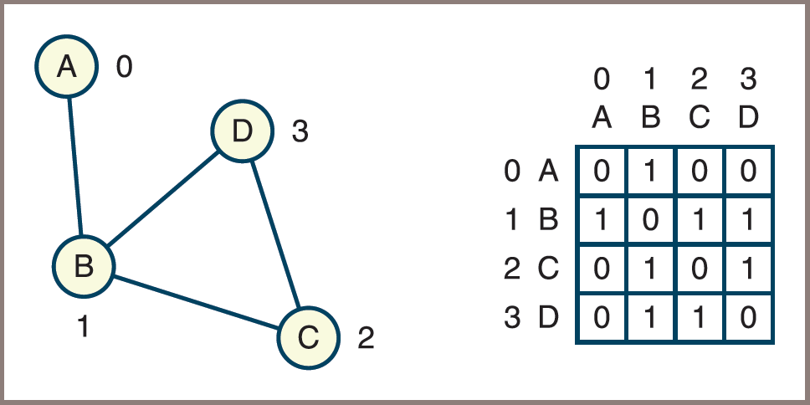
Adjacency Matrix (3 of 3)
Figure 12-9: An undirected graph and its adjacency matrix

Slide 21
Adjacency List (1 of 4)
Assume that a graph has N vertices labeled 0, 1, …, N − 1, and then the following applies:
The adjacency list for the graph is an array of N linked lists
The ith linked list contains a node for vertex j if and only if there is an edge from vertex i to vertex j

Slide 22
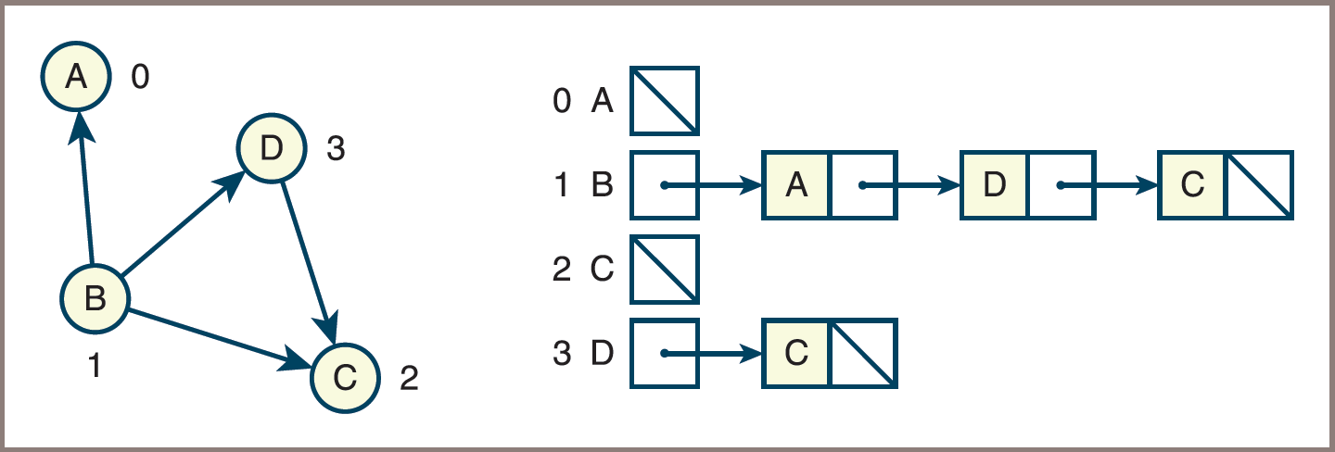
Adjacency List (2 of 4)
Figure 12-10: A directed graph and its adjacency list

Slide 23
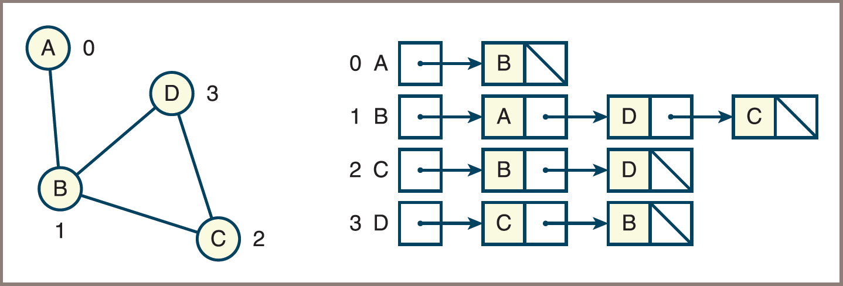
Adjacency List (3 of 4)
Figure 12-11: An undirected graph and its adjacency list

Slide 24
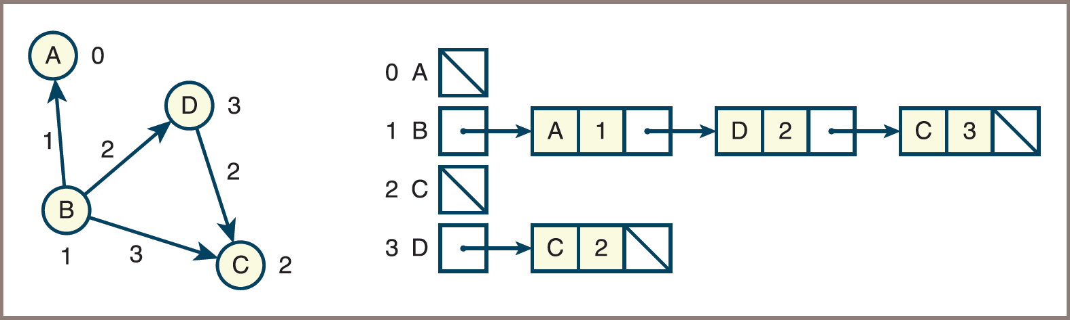
Adjacency List (4 of 4)
Figure 12-12: A weighted, directed graph and its adjacency list

Slide 25
Analysis of the Two Representations (1 of 2)
Regarding running time,
The behavior of two commonly used graph operations illustrates the difference in computational efficiency between the adjacency matrix and the adjacency list
These operations are the following:
Determine whether or not there is an edge between two given vertices
Find all the vertices adjacent to a given vertex
The adjacency matrix supports the first operation in constant time:
It requires just an index operation into a two-dimensional array
The linked adjacency list requires an index into an array of linked lists and then a search of a linked list for a target vertex

Slide 26
Analysis of the Two Representations (2 of 2)
The adjacency list tends to support finding all the vertices adjacent to a given vertex more efficiently than the adjacency matrix
The linked adjacency list and the array-based adjacency list exhibit performance trade-offs for insertions of edges into the lists:
The array-based insertion takes linear time, whereas the linked-based insertion requires constant time
Regarding memory
Adjacency matrix always requires
cells, no matter how many edges
connect the vertices
Adjacency list requires an array of N pointers and a number of nodes equal to twice the number of edges in the case of an undirected graph

Slide 27
Further Run-Time Considerations
Another commonly performed operation in graph algorithms is to iterate across all the neighbors of a given vertex
Let N = number of vertices and M = number of edges, then the following applies:
Using an adjacency matrix to iterate across all neighbors, you must traverse a row in a time that is O(N):
To repeat this for all rows is
Using an adjacency list, the time to traverse across all neighbors depends on the number of neighbors:
On the average, this time is O(M/N)
To repeat this for all vertices is O(max(M, N)), which for a dense graph is
and for a sparse graph is O(N)
Thus, adjacency lists can provide a run-time advantage when working with sparse graphs

Slide 28
Graph Traversals
Important graph-processing operations include the following:
Finding the shortest path to a given item in a graph
Finding all the items to which a given item is connected by paths
Traversing all the items in a graph

Slide 29
A Generic Traversal Algorithm (1 of 2)
Graph traversal algorithms start at a given vertex and move outward to explore paths to neighboring vertices
You’ll use a generic function that performs a graph traversal, which starts at an arbitrary vertex startVertex
Pseudocode:
traverseFromVertex(graph, startVertex, process):
mark all vertices in the graph as unvisited
add the startVertex to an empty collection
while the collection is not empty:
pop a vertex from the collection
if the vertex has not been visited:
mark the vertex as visited
process(vertex)
add all adjacent unvisited vertices to the collection

Slide 30
A Generic Traversal Algorithm (2 of 2)
In the foregoing function, for a graph that contains N vertices, the following applies:
All vertices reachable from startVertex are processed exactly once
Determining all the vertices adjacent to a given vertex is straightforward:
When an adjacency matrix is used, you iterate across the row corresponding to the vertex:
This is an O(N) operation
Repeating this for all rows is
When an adjacency list is used, you traverse the vertex’s linked list:
Performance depends on how many vertices are adjacent to the given vertex
Repeating this for all vertices is O(max(M, N), where M is the number of edges

Slide 31
Breadth-First and Depth-First Traversals (1 of 5)
Two common orders in which vertices can be visited during a graph traversal:
Depth-first traversal – uses a stack as the collection in the generic algorithm
Breadth-first traversal – uses a queue as the collection in the generic algorithm
The use of a stack forces the traversal process to go deeply into the graph before backtracking to another path
The use of a queue forces the traversal process to visit every vertex adjacent to a given vertex before it moves deeper into the graph

Slide 32
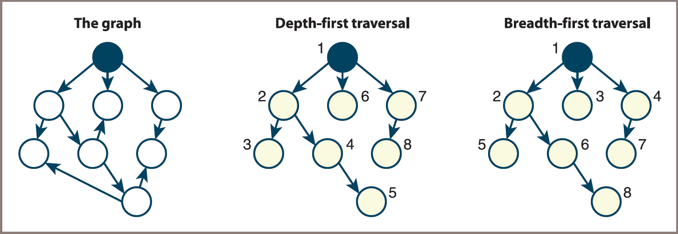
Breadth-First and Depth-First Traversals (2 of 5)
Figure 12-13: Depth-first and breadth-first traversals of a given graph

Slide 33
Breadth-First and Depth-First Traversals (3 of 5)
Psedocode for the two functions:
traverseFromVertex(graph, startVertex, process):
mark all vertices in the graph as unvisited
dfs(graph, startVertex, process)
dfs(graph, v, process):
mark v as visited
process(v)
for each vertex, w, adjacent to v:
if w has not been visited:
dfs(graph, w, process)

Slide 34
Breadth-First and Depth-First Traversals (4 of 5)
Iterative version:
traverseAll(graph, process):
mark all vertices in the graph as unvisited
instantiate an empty collection
for each vertex in the graph:
if the vertex has not been visited:
add the vertex to the collection
while the collection is not empty:
pop a vertex from the collection
if the vertex has not been visited:
mark the vertex as visited
process(vertex)
add all adjacent unvisited vertices to the collection

Slide 35
Breadth-First and Depth-First Traversals (5 of 5)
Recursive version:
traverseAll(graph, process):
mark all vertices in the graph as unvisited
for each vertex, v, in the graph:
if v is unvisited:
dfs(graph, v, process)
dfs(graph, v, process):
mark v as visited
process(v)
for each vertex, w, adjacent to v:
if w is unvisited
dfs(graph, w, process)

Slide 36
Graph Components
Here, each component is stored in a set and sets are stored in a list:
partitionIntoComponents(graph):
components = list()
mark all vertices in the graph as unvisited
for each vertex, v, in the graph:
if v is unvisited:
s = set()
components.append(s)
dfs(graph, v, s)
return components
dfs(graph, v, s):
mark v as visited
s.add(v)
for each vertex, w, adjacent to v:
if w is unvisited:
dfs(graph, w, s)

Slide 37
Trees within Graphs
The function traverseFromVertex implicitly yields a tree rooted at the vertex from which the traversal starts and includes all the vertices reached during the traversal
Suppose dfs has just been called using vertex v:
If a recursive call using vertex w now occurs, you can consider w to be a child of v
The edge ( v , w ) corresponds to the parent-child relationship, or edge, between v and w
The starting vertex is the root of this tree
The tree is called a depth-first search tree

Slide 38
Spanning Trees and Forests
Spanning tree
Has the fewest number of edges possible while still retaining a connection between all the vertices in the component
If the component contains n vertices, the spanning tree contains n − 1 edges
When you traverse all the vertices of an undirected graph, not just those in a single component, you generate a spanning forest

Slide 39
Minimum Spanning Tree
When the edges in a graph are weighted,
You can sum the weights for all edges in a spanning tree and attempt to find a spanning tree that minimizes this sum
There are several algorithms for finding a minimum spanning tree for a component
Repeated application to all the components in a graph yields a minimum spanning forest for a graph

Slide 40
Algorithms for Minimum Spanning Trees
Robert C. Prim’s algorithm for finding a minimum spanning tree:
minimumSpanningTree(graph):
mark all vertices and edges as unvisited
mark some vertex, say v, as visited
for all the vertices:
find the least weight edge from a visited vertex to an
unvisited vertex, say w
mark the edge and w as visited

Slide 41
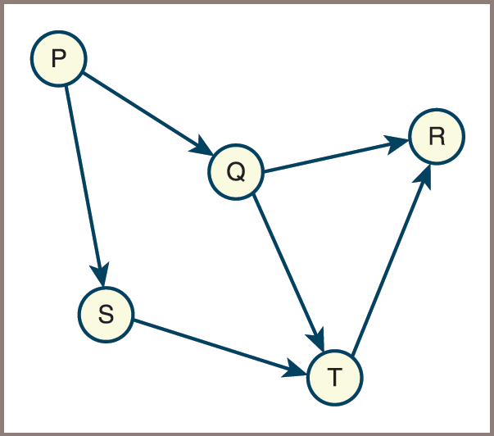
Topological Sort (1 of 4)
Topological order
Assigns a rank to each vertex such that the edges go from lower-ranked to higher-ranked vertices
Figure 12-14: A graph of courses

Slide 42
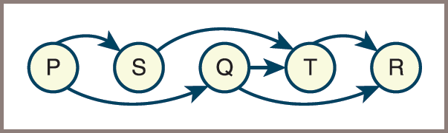
Topological Sort (2 of 4)
Figure 12-15: The first topological ordering of the graph

Slide 43
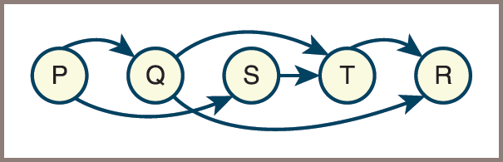
Topological Sort (3 of 4)
Figure 12-16: The second topological ordering of the graph

Slide 44
Topological Sort (4 of 4)
Topological sort
The process of finding and returning a topological order of vertices in a graph
One topological sort is based on a graph traversal
A depth-first traversal is used here:
topologicalSort(graph g):
stack = LinkedStack()
mark all vertices in the graph as unvisited
for each vertex, v, in the graph:
if v is unvisited:
dfs(g, v, stack)
return stack
dfs(graph, v, stack):
mark v as visited
for each vertex, w, adjacent to v:
if w is unvisited:
dfs(graph, w, stack)
stack.push(v)

Slide 45
The Shortest-Path Problem
It is often useful to determine the shortest path between two vertices in a graph
The single-source shortest path problem asks for a solution that contains the shortest paths from a given vertex to all other vertices:
Solution by Dijkstra:
Another problem, all-pairs shortest path problem, asks for the set of all the shortest paths in a graph:
Solution by Floyd:

Slide 46
Dijkstra’s Algorithm
The algorithm computes the distances of the shortest paths from the source vertex to all the other vertices in the graph. The output of the algorithm is a two-dimensional grid: results
The algorithm uses a temporary list, included , of N Booleans
To track whether or not a given vertex has been included in the set of vertices for which you already have determined the shortest path
The algorithm consists of two major steps:
An initialization step
A computation step

Slide 47
The Initialization Step (1 of 2)
Initialize all the columns in the results grid and all the cells in the included list according to the following algorithm:
for each vertex in the graph
Store vertex in the current row of the results grid
If vertex = source vertex
Set the row’s distance cell to 0
Set the row’s parent cell to undefined
Set included[row] to True
Else if there is an edge from source vertex to vertex
Set the row’s distance cell to the edge’s weight
Set the row’s parent cell to source vertex
Set included[row] to False
Else
Set the row’s distance cell to infinity
Set the row’s parent cell to undefined
Set included[row] to False
Go to the next row in the results grid

Slide 48
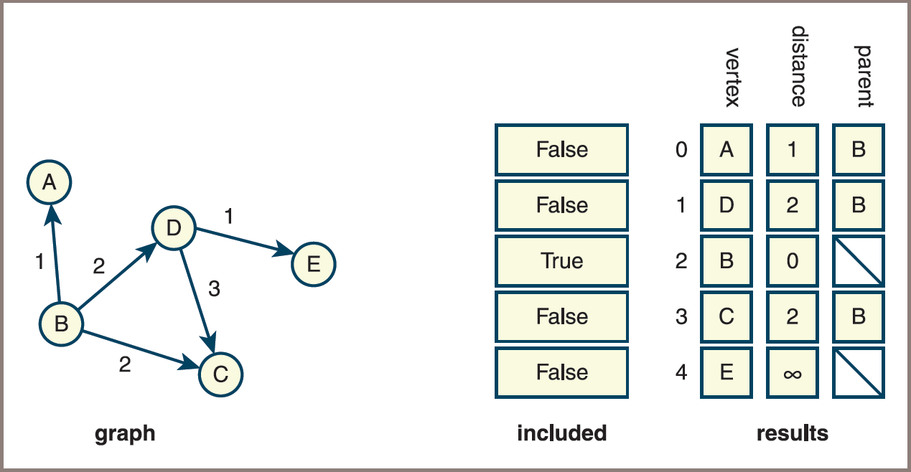
The Initialization Step (2 of 2)
Figure 12-17: A graph and the initial state of the data structures used to compute the shortest paths from a given vertex

Slide 49
The Computation Step (1 of 2)
Dijkstra’s algorithm finds the shortest path from the source to a vertex, marks this vertex’s cell in the included list, and continues this process until all these cells are marked:
Do
Find the vertex F that is not yet included and has the minimal
distance in the results grid
Mark F as included
For each other vertex T not included
If there is an edge from F to T
Set new distance to F’s distance + edge’s weight
If new distance < T’s distance in the results grid
Set T’s distance to new distance
Set T’s parent in the results grid to F
While at least one vertex is not included

Slide 50
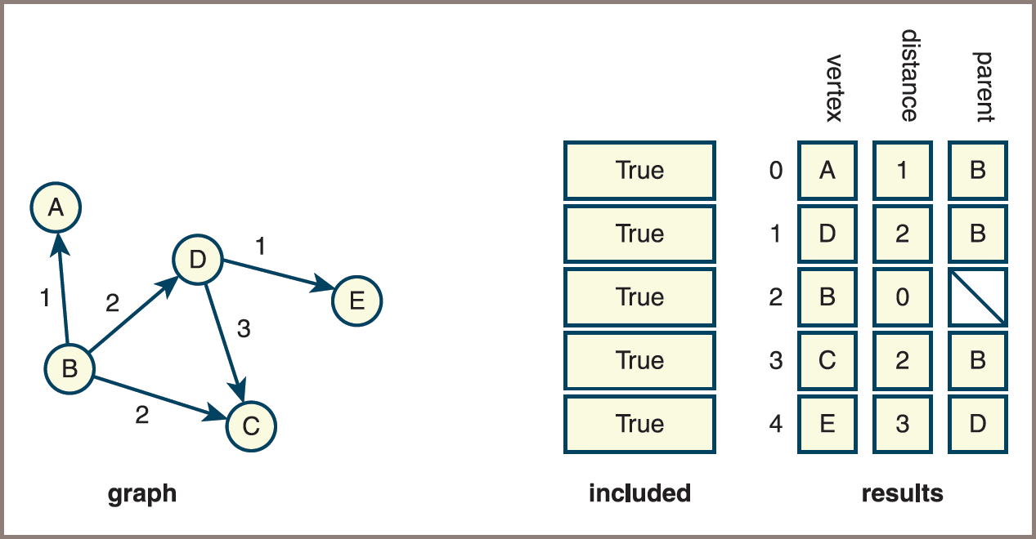
The Computation Step (2 of 2)
Figure 12-18: A graph and the final state of the data structures used to compute the shortest paths from a given vertex

Slide 51
Representing and Working with Infinity
As long as the operations on numbers are restricted to addition and comparisons, you can represent infinity as a nonnumeric value
In this implementation, you define a constant, INFINITY, to be the string value “-”
Example:
INFINITY = "-"
def addWithInfinity(a, b):
"""If a == INFINITY or b == INFINITY, returns INFINITY.
Otherwise, returns a + b."""
if a == INFINITY or b == INFINITY: return INFINITY
else: return a + b

Slide 52
Analysis (1 of 2)
The initialization step must process every vertex
So it is O(n)
The outer loop of the computation step also iterates through every vertex
The inner loop of this step iterates through every vertex not included thus far
The overall behavior of the computation step resembles that of other
algorithms, so Dijkstra’s algorithm is

Slide 53
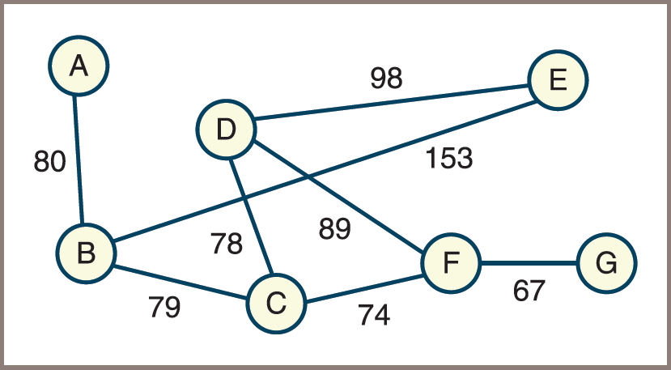
Floyd’s Algorithm (1 of 4)
For each vertex v in a graph, the algorithm finds the shortest path from vertex v to any other vertex w that is reachable from v
Consider the weighted graph in Figure 12.19
Figure 12-19: A weighted graph

Slide 54
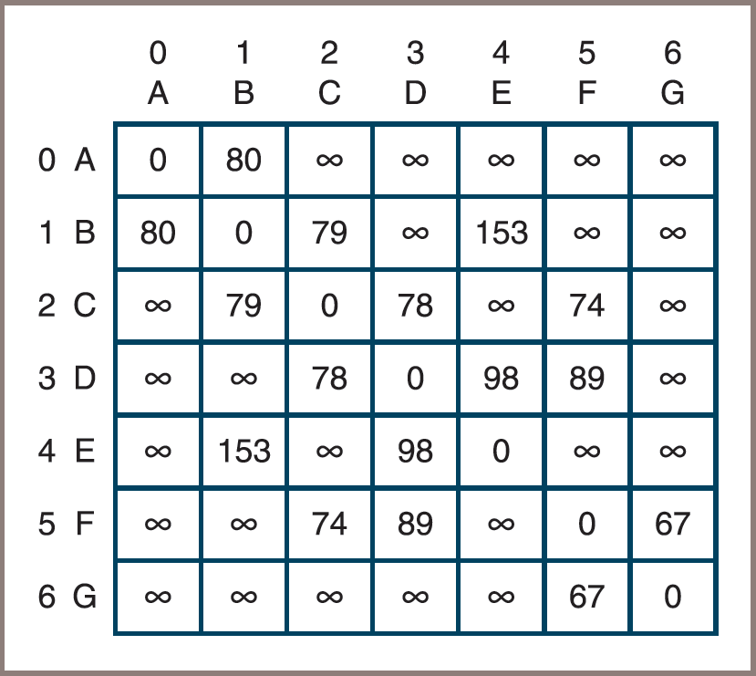
Floyd’s Algorithm (2 of 4)
In a preprocessing step,
You build an initial distance matrix whose cells contain the weights on the edges that connect each vertex with its neighbors
Figure 12-20: The initial distance matrix for the graph in Figure 12-19

Slide 55
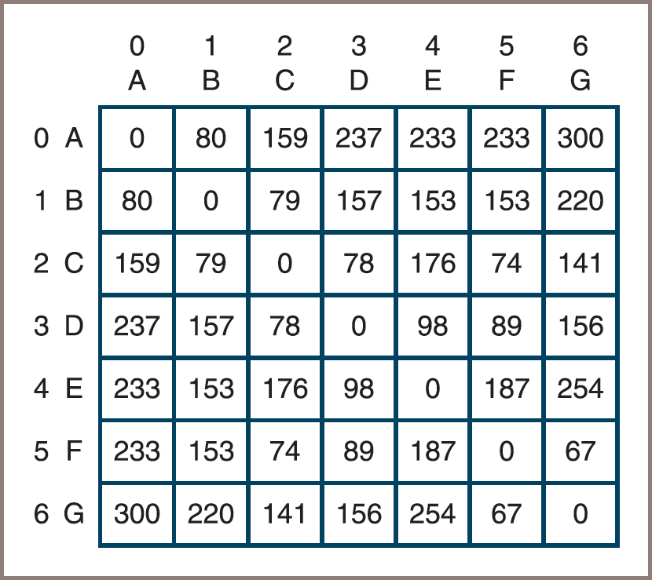
Floyd’s Algorithm (3 of 4)
Figure 12-21: The modified distance matrix for the graph in Figure 12-19

Slide 56
Floyd’s Algorithm (4 of 4)
Pseudocode for Floyd’s algorithm:
for i from 0 to n - 1
for r from 0 to n - 1
for c from 0 to n - 1
matrix[r][c] = min(matrix[r][c],
matrix[r][i] + matrix[i][c])
Note that the min and + operations must be capable of working with operands that might be infinite

Slide 57
Analysis (2 of 2)
The initialization step to create the distance matrix from the graph is
This matrix is actually the same as an adjacency matrix representation of the given graph
Because Floyd’s algorithm includes three nested loops over N vertices, the algorithm itself is
The overall running time of the process is bounded by

Slide 58
Developing a Graph Collection
To develop a graph collection, consider the following:
The requirements of users
The mathematical nature of graphs
The commonly used representations, adjacency matrix, and adjacency list
Users should be able to
Insert and remove vertices
Insert or remove an edge
Retrieve all the vertices and edges
Choose between directed and undirected graphs and between an adjacency matrix representation and an adjacency list representation

Slide 59
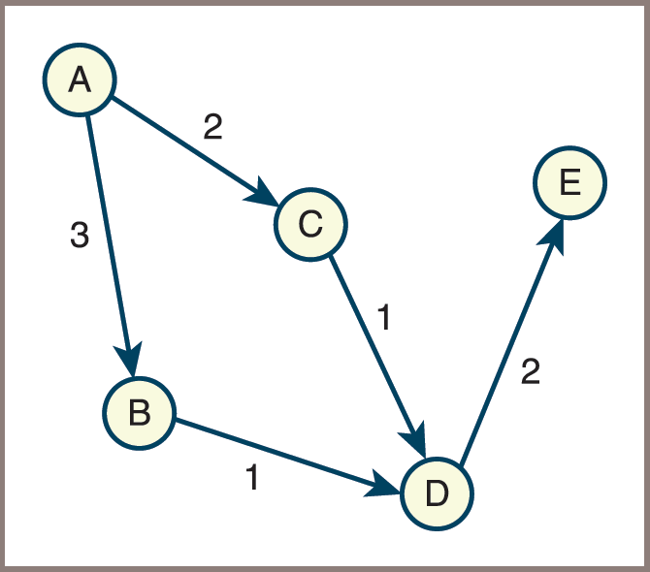
Example Use of the Graph Collection (1 of 3)
Figure 12-22: A weighted directed graph

Slide 60
Example Use of the Graph Collection (2 of 3)
Code:
from graph import LinkedDirectedGraph
g = LinkedDirectedGraph()
# Insert vertices
g.addVertex("A")
g.addVertex("B")
g.addVertex("C")
g.addVertex("D")
g.addVertex("E")
# Insert weighted edges
g.addEdge("A", "B", 3)
g.addEdge("A", "C", 2)
g.addEdge("B", "D", 1)
g.addEdge("C", "D", 1)
g.addEdge("D", "E", 2)
print(g)

Slide 61
Example Use of the Graph Collection (3 of 3)
Output:
5 Vertices: A C B E D
5 Edges: A>B:3 A>C:2 B>D:1 C>D:1 D>E:2

Slide 62
The Class LinkedDirectedGraph (1 of 4)
Paths of least resistance in the graph implementation
You make a graph class a subclass of AbstractCollection
You make a graph’s size equal to its number of vertices
The add method adds a vertex with the given label to a graph
You allow a graph’s iterator to visit its vertices
Consequences
The len function returns the number of the graph’s vertices
The graph constructor’s source collection contains the labels of the new graph’s vertices
The for loop visits the graph’s vertices
The in operator returns True if the graph contains a given vertex
The == operator compares vertices in the two graph operands
The + operator creates a new graph that contains the vertices of its two operands

Slide 63
The Class LinkedDirectedGraph (2 of 4)
See Table 12.1 in the text for the many methods in the class LinkedDirectedGraph
The implementation of LinkedDirectedGraph maintains a dictionary whose keys are labels and whose values are the corresponding vertices
Code for the class header and constructor:
class LinkedDirectedGraph(AbstractCollection):
def __init__(self, sourceCollection = None):
self.edgeCount = 0
self.vertices = dict() # Dictionary of vertices
AbstractCollection.__init__(self, sourceCollection)

Slide 64
The Class LinkedDirectedGraph (3 of 4)
The method removeVertex visits each remaining vertex in the graph to cut any connections to the deleted vertex
It does this by calling the LinkedVertex method removeEdgeTo , as follows:
def removeVertex(self, label):
"""Returns True if the vertex was removed, or False otherwise."""
removedVertex = self.vertices.pop(label, None)
if removedVertex is None:
return False
# Examine all other vertices to remove edges
# directed at the removed vertex
for vertex in self.getVertices():
if vertex.removeEdgeTo(removedVertex):
self.edgeCount -= 1
# Examine all edges from the removed vertex to others
for edge in removedVertex.incidentEdges():
self.edgeCount -= 1
self.size -= 1
return True

Slide 65
The Class LinkedDirectedGraph (4 of 4)
Code for adding, accessing, and removing an edge:
def addEdge(self, fromLabel, toLabel, weight):
"""Connects the vertices with an edge with the given weight."""
fromVertex = self.getVertex(fromLabel)
toVertex = self.getVertex(toLabel)
fromVertex.addEdgeTo(toVertex, weight)
self.edgeCount += 1
def getEdge(self, fromLabel, toLabel):
"""Returns the edge connecting the two vertices, or None if
no edge exists."""
fromVertex = self.getVertex(fromLabel)
toVertex = self.getVertex(toLabel)
return fromVertex.getEdgeTo(toVertex)
def removeEdge(self, fromLabel, toLabel):
"""Returns True if the edge was removed, or False otherwise."""
fromVertex = self.getVertex(fromLabel)
toVertex = self.getVertex(toLabel)
edgeRemovedFlg = fromVertex.removeEdgeTo(toVertex)
if edgeRemovedFlg:
self.edgeCount -= 1
return edgeRemovedFlg

Slide 66
The Class LinkedVertex (1 of 3)
Table 12.2 in the text lists the methods in the class LinkedVertex
The next code segment shows the constructor and the method setLabel:
class LinkedVertex(object):
def __init__(self, label):
self.label = label
self.edgeList = list()
self.mark = False
def setLabel(self, label, g):
"""Sets the vertex’s label to label."""
g.vertices.pop(self.label, None)
g.vertices[label] = self
self.label = label

Slide 67
The Class LinkedVertex (2 of 3)
The LinkedVertex class defines several other methods used by LinkedGraph to access the edges of a vertex
Adding and accessing an edge involve direct calls to the corresponding list methods, as does the iterator method incidentEdges
The method getNeighboringVertices builds a list of the other vertices from the list of edges:
Using the LinkedEdge method getOtherVertex
The method removeEdgeTo creates a dummy edge with the current vertex and the argument vertex
And removes the corresponding edge from the list if it is in the list

Slide 68
The Class LinkedVertex (3 of 3)
Code:
def neighboringVertices(self):
"""Returns the neighboring vertices of this vertex."""
vertices = list()
for edge in self.edgeList:
vertices.append(edge.getOtherVertex(self))
return iter(vertices)
def removeEdgeTo(self, toVertex):
"""Returns True if the edge exists and is removed,
or False otherwise."""
edge = LinkedEdge(self, toVertex)
if edge in self.edgeList:
self.edgeList.remove(edge)
return True
else:
return False

Slide 69
The Class LinkedEdge (1 of 2)
Table 12.3 in the text lists the methods in the class LinkedEdge
An edge maintains references to its two vertices, its weight, and a mark
Although the weight can be any object labeling the edge,
The weight is often a number or some other comparable value
Two edges are considered equal if they have the same vertices and weight

Slide 70
The Class LinkedEdge (2 of 2)
Code for the constructor and the _eq_ method:
class LinkedEdge(object):
def __init__(self, fromVertex, toVertex, weight = None):
self.vertex1 = fromVertex
self.vertex2 = toVertex
self.weight = weight
self.mark = False
def __eq__(self, other):
"""Two edges are equal if they connect
the same vertices."""
if self is other: return True
if type(self) != type(other): return False
return self.vertex1 == other.vertex1 and \
self.vertex2 == other.vertex2 and \
self.weight == other.weight

Slide 71
Chapter Summary (1 of 2)
A graph consists of one or more vertices (items) connected by one or more edges
A subgraph consists of a subset of a graph’s vertices and a subset of its edges
Directed graphs allow travel along an edge in just one direction, whereas undirected graphs allow two-way travel
An adjacency matrix implementation of a graph with N vertices uses a two-dimensional grid G with N rows and N columns
An adjacency list implementation of a graph with N vertices uses an array of N linked lists

Slide 72
Chapter Summary (2 of 2)
Graph traversals explore tree-like structures within a graph, starting with a distinguished start vertex:
A depth-first traversal visits all the descendants on a given path first, whereas a breadth-first traversal visits all the children of each vertex first
A spanning tree has the fewest number of edges possible and still retains a connection between all the vertices in a graph:
A minimum spanning tree is a spanning tree whose edges contain the minimum weights possible.
A topological sort generates a sequence of vertices in a directed acyclic graph
The single-source shortest path problem asks for a solution that contains the shortest paths from a given vertex to all the other vertices

