Slide 1
Introduction to Python programming language
Bhava Avula
Week#4, 9/27/2017

Slide 2
Agenda
Strings
format, print methods
Bytes
Dictionaries

Slide 3
Strings – format method
format method can be used to format strings in Python.
Offers a number of options to format strings
Almost a mini-language in itself.

Slide 4
Strings – format method, positional parameters
>>> "{0} is the {1} of {2}".format("Ambrosia", "food", "the gods")
'Ambrosia is the food of the gods'

Slide 5
String – format method and named parameters
>>> "{food} is the food of {user}".format(food="Ambrosia", user="the gods")
'Ambrosia is the food of the gods’
>>> "{{Ambrosia}} is the {0} of {1}".format("food", "the gods")
'{Ambrosia} is the food of the gods’
(Doubling the { } characters escapes them so that they don’t mark a replacement field.)

Slide 6
Strings – format method
You can also use both positional and named parameters, or even access elements and attributes within those parameters:
>>> "{0} is the food of {user[1]}".format("Ambrosia", user=["men", "the gods", "others"])
'Ambrosia is the food of the gods'

Slide 7
Strings – Format specifiers
Format specifiers allow you to set the formatting with great degree of control:
>>> "{0:10} is the food of gods".format("Ambrosia")
'Ambrosia is the food of gods’
:10 is a format specifier that makes the field 10 spaces wide and pads with spaces
>>> "{0:{1}} is the food of gods".format("Ambrosia", 10)
'Ambrosia is the food of gods'
:{1} takes the width from the second parameter.

Slide 8
Strings – Format specifiers
>>> "{food:{width}} is the food of gods".format(food="Ambrosia", width=10)
'Ambrosia is the food of gods'
>>> "{0:>10} is the food of gods".format("Ambrosia")
' Ambrosia is the food of gods'
:>10 forces right justification of the field and pads with spaces.
>>> "{0:&>10} is the food of gods".format("Ambrosia")
'&&Ambrosia is the food of gods'
:&>10 forces right justification and pads with & instead of spaces.

Slide 9
Strings – formatting strings with %
Older style of formatting, uses the % operator.
Similar to Printf in C
>>> "%s is the %s of %s" % ("Ambrosia", "food", "the gods")
'Ambrosia is the food of the gods'
Notice that the right side is a tuple.

Slide 10
Strings – formatting strings with %
>>> "Pi is <%-6.2f>" % 3.14159
'Pi is <3.14 >'
%-6.2f specifies the field width (total number of characters) of the printed number to be 6, specifies the number of characters after the decimal point to be 2, and left-justifies the number in its field.

Slide 11
print method
>>> print("a")
a
>>> print("b")
b
>>> print("a", "b", "c")
a b c
>>> print("a", "b", "c", sep="|")
a|b|c >>> print("a", "b", "c", sep=“”, end="\n\n")
abc
>>>
As you can see, print method already gives a lot of control, and the format method can be used for additional options as needed.

Slide 12
Bytes objects
Computers store data in Bytes. For example, music, images, text etc is stored in Bytes format.
Bytes object in Python is similar to String object, except string is immutable sequence of unicode characters, Bytes is a sequence of integers from 0 to 256.
Useful when dealing with binary data.
encode method can be used to convert string to bytes, and decode to convert from bytes to string.
Can not add/concatenate the two together.

Slide 13
Dictionaries
In some other languages dictionaries are called “Associative Arrays”
Example:
>>> e_to_f = {}
>>> e_to_f ['red'] = 'rouge’
>>> e_to_f ['blue'] = 'bleu’
>>> e_to_f ['green'] = 'vert’
>>> print("red is", e_to_f ['red'])
red is rouge

Slide 14
Dictionaries
Dictionaries access values by means of integers, strings, or other Python objects called keys, which indicate where in the dictionary a given value is found.
In the above example, ‘red’, ‘blue’ and ‘green’ are called keys, where as ‘rouge’, ‘bleu’ and ‘vert’ are called values.

Slide 15
Comparison between lists and dictionaries
Lists: The indices, using which values in lists are accessed, can only be integers.
Dictionaries: The keys, using which the values in dictionaries are accessed, can be any data type (with some restrictions, see next few slides).

Slide 16
Comparison between lists and dictionaries
Both lists and dictionaries can have values of any type.
Lists: Values in the list are implicitly ordered. For eg: if X is a list, X[0] is the first element, X[1] is the second and so on.
Dictionaries: Values in the list are not ordered. In the above e_to_f example, the red, blue and green keys can be in any order. Python does not store them in any particular order, and you should not assume any order of elements.

Slide 17
Comparison between lists and dictionaries
Empty Lists and dictionaries are created slightly differently. >>> x = []
>>> y = {}
Once created, new entries can simply be added to the dictionaries like below >>> y[0] = 'Hello'
>>> y[1] = 'Goodbye'
But not in lists:
>>> x[0] = 'Hello'
Traceback (innermost last):
File "<stdin>", line 1, in ? IndexError: list assignment index out of range

Slide 18
Other dictionary operations
Fast way to create a dictionary with keys and values: >>> e_to_f = {'red': 'rouge', 'blue': 'bleu', 'green': 'vert'}
Get the length of the dictionary: >>> len(e_to_f )
3

Slide 19
Other dictionary operations
Get a list of all the keys used in the dictionary
>>> e_to_f = {'red': 'rouge', 'blue': 'bleu',\ 'green': 'vert'}
>>>
>>> list(e_to_f.keys())
['green', 'blue', 'red']
Get a list of all the values used in the dictionary:
>>> list(e_to_f.values())
['vert', 'bleu', 'rouge']
Get all the keys and values as a sequence of tuples
>>> list(e_to_f.items())
[('green', 'vert'), ('blue', 'bleu'), ('red', 'rouge')]

Slide 20
Other dictionary operations
Note: The keys, values, and items methods return not lists, but views that behave like sequences but are dynamically updated whenever the dictionary changes. Applying the list function on the view generates the list.

Slide 21
Other dictionary operations
del statement can be used to remove an entry:
>>> e_to_f = {'red': 'rouge',\ 'blue': 'bleu', 'green': 'vert'}
>>>
>>> list(e_to_f.items())
[('green', 'vert'), ('blue', 'bleu'), ('red', 'rouge')]
>>> del e_to_f['green']
>>>
>>> list(e_to_f.items())
[('blue', 'bleu'), ('red', 'rouge')]

Slide 22
Other dictionary operations
in operator can be used to test for the presence of keys in the dictionary.
>>> e_to_f = {'red': 'rouge', 'blue': 'bleu',\ 'green': 'vert'}
>>>
>>> 'red' in e_to_f
True
>>> 'orange' in e_to_f
False
Get function can be used to get the value of a given key, but returns its second argument if the dictionary does not contain the key.
>>> print(e_to_f.get('blue', 'No translation'))
Bleu
>>> print(e_to_f.get('chartreuse', 'No translation'))
No translation
(If second argument is not supplied, get returns None if the dictionary does not contain the key.)

Slide 23
Other dictionary operations
If you want to get the value of a key, and make sure it is set to a value in case the key does not exist, then use the setdefault method:
>>> e_to_f = {'red': 'rouge', 'blue':\ 'bleu', 'green': 'vert'}
>>>
>>> print(e_to_f.setdefault('chartreuse', 'No translation'))
No translation
>>> e_to_f
{'blue': 'bleu', 'chartreuse': 'No translation', 'green': 'vert', 'red': 'rouge’}

Slide 24
Other dictionary operations
Make a copy of the dictionary
>>> x = {0: 'zero', 1: 'one'}
>>>
>>> y = x.copy()
>>> y
{0: 'zero', 1: 'one'}
Note that this makes a shallow copy of the dictionary, which is sufficient is most cases. If you want to make a deep copy, refer to the copy.deepcopy function.

Slide 25
update method
Update method updates a first dictionary with all the key/value pairs of a second dictionary. For keys that are common to both, the values from the second dictionary override the first:
>>> z = {1: 'One', 2: 'Two'}
>>> x = {0: 'zero', 1: 'one'}
>>> x.update(z)
>>>
>>> x
{0: 'zero', 1: 'One', 2: 'Two'}

Slide 26
Dictionaries - Example
Want to know how many times each word occurs in a particular english sentence:
sample_str = “to be or not to be" count = {}
for word in sample_str.split(): count[word] = count.get(word, 0) + 1
for word in count: print("The word", word, "occurs", count[word], \
"times in the string")

Slide 27
Dictionary keys
Any object that is immutable and hashable can be used as a key to a dictionary.
For eg: Strings can be used as keys since they are immutable and hashable.
Lists can not be used as keys since they are mutable (but its cousin, tuple, can be used instead)
To be hashable, a value must have a hash value (provided by a __hash__ method) that never changes throughout the life of the value (Eg: Checksum, Cyclic Redundancy Check (CRC)).
Any data type that is mutable can not be hashable, since, if a value changes its hash value will also change.
But if a data type is immutable, it does not automatically mean it is hashable (For eg: tuples are immutable, but if the elements of the tuples are lists, which is a mutable type, then that tuple is not hashable since the hash of that tuple can change)

Slide 28
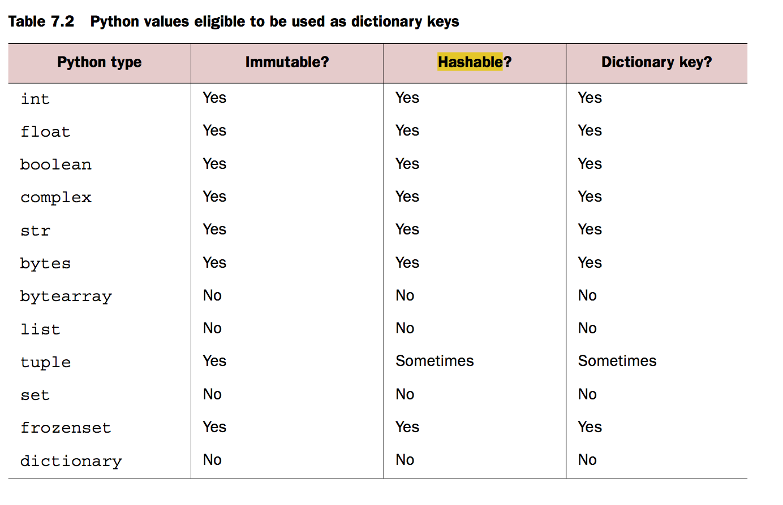
Dictionary Keys

Slide 29
Efficiencies of dictionaries
The implementation of dictionaries in Python is very efficient, fast, and highly optimized.

Slide 30
Dictionaries - Exercises
Sort by keys and sort by values: Write a function that accepts a dictionary as a parameter, and prints its keys and values. First print them sorted by key, and then print them again sorted by values.
>>> sort_print({'a':3, 'b':2, 'c':5})
Dictionary keys and values, sorted by keys:
a 3
b 2
c 5
Dictionary keys and values, sorted by values:
b 2
a 3
c 5
>>> sort_print({'a':3, 'b':2, 'c':5, ‘d’:3})
Dictionary keys and values, sorted by keys:
a 3
b 2
c 5
d 3
Dictionary keys and values, sorted by values:
b 2
a 3
d 3
c 5

Slide 31
Dictionaries - Exercises
Reverse Lookup: Write a function reverseLookup(dictionary, value) that takes in a dictionary and a value as arguments and returns a sorted list of all keys that contains the value. The function will return an empty list if no match is found.
>>> reverseLookup({'a':1, 'b':2, 'c':2}, 1)
['a']
>>> reverseLookup({'a':1, 'b':2, 'c':2}, 2)
['b', 'c']
>>> reverseLookup({'a':1, 'b':2, 'c':2}, 3)
[]

Slide 32
Dictionaries - Exercises
Invert Dictionary: Write a function invertDictionary(d) that takes in a dictionary as argument and return a dictionary that inverts the keys and the values of the original dictionary. SORT THE LIST(value list)
(NOTE: For this example, lists can not be the values in the input dictionary since they can not become keys when it is inverted. Remember that lists can not be dictionary keys since lists are mutable).
>>> invertDictionary({'a':1, 'b':2, 'c':3, 'd':2})
{1: ['a'], 2: ['b', 'd'], 3: ['c']}
>>> invertDictionary({'a':3, 'b':3, 'c':3})
{3: ['a', ‘b', ‘c']}
>>> invertDictionary({'a':2, 'b':1, 'c':2, 'd':1})
{1: ['b', 'd'], 2: ['a', 'c']}

Slide 33
Dictionaries - Exercises
Sparse Vector to Dictionary: A sparse vector is a vector whose entries are almost all zero, like [1, 0, 0, 0, 0, 0, 0, 2, 0]. Storing all those zeros wastes memory and dictionaries are commonly used to keep track of just the nonzero entries. For example, the vector shown earlier can be represented as {0:1, 7:2}, since the vector it is meant to represent has the value 1 at index 0 and the value 2 at index 7. Write a function that converts a sparse vector into a dictionary as described above.
>>> convertVector([1, 0, 0, 2, 0, 0, 0, 3, 0, 0, 0, 0, 4])
{0: 1, 3: 2, 7: 3, 12: 4}
>>> convertVector([1, 0, 1 , 0, 2, 0, 1, 0, 0, 1, 0])
{0: 1, 2: 1, 4: 2, 6: 1, 9: 1}
>>> convertVector([0, 0, 0, 0, 0])
{}

Slide 34
Dictionaries - Exercises
Dictionary to Spare Vector: A sparse vector is a vector whose entries are almost all zero, like [1, 0, 0, 0, 0, 0, 0, 2]. Storing all those zeros wastes memory and dictionaries are commonly used to keep track of just the nonzero entries. For example, the vector shown earlier can be represented as {0:1, 7:2}, since the vector it is meant to represent has the value 1 at index 0 and the value 2 at index 7. Write a function that converts a dictionary back to its sparese vector representation.
>>> convertDictionary({0: 1, 3: 2, 7: 3, 12: 4})
[1, 0, 0, 2, 0, 0, 0, 3, 0, 0, 0, 0, 4]
>>> convertDictionary({0: 1, 2: 1, 4: 2, 6: 1, 9: 1})
[1, 0, 1, 0, 2, 0, 1, 0, 0, 1]
>>> convertDictionary({})
[]

Slide 35
Dictionaries - Exercises
Human Resources. Create a simple name and employee number dictionary application. Have the user enter a list of names and employee numbers. Your interface should allow a sorted output (sorted by name) that displays employee names followed by their employee numbers. EXTRA CREDIT: come up with an additional feature that allows for output to be sorted by employee numbers.
def HR_database():
#Your code
return
Hint: Use “while”
loop to read the user
Input in a loop until
the string END is
Entered.
>>> HR_database()
Please enter employee number and name, type END when done:
487 John Campbell
533 Jane Smith
843 Steve John
964 David Clark
END
Here is the list you entered (sorted by name):
964 David Clark
533 Jane Smith
487 John Campbell
843 Steve John
Here is the list you entered (sorted by employee number):
487 John Campbell
533 Jane Smith
843 Steve John
964 David Clark
Taken from: http://my.safaribooksonline.com/book/programming/python/0130260363/dictionaries/ch07lev1sec6

Slide 36
Dictionaries - Exercises
Dice: If you roll 2 dice, then there are 36 possible combinations ((1,1), (1,2),(1,3),…(1,6),(2,1),(2,2),......(6,6)). And the sum of the 2 dice can be a number anywhere from 2 to 12: the lowest sum 2 occurs when both the dice roll 1 each, and the highest sum 12 occurs when both the dice roll 6 each. Write a program that generates a dictionary where the key is the sum of the dice. And the values are a list of tuples where each tuple is the value of the 2 dice.
The output of your program should return the following dictionary:
{2: [(1,1)],
3: [(1,2), (2,1)],
4: [(1,3), (2,2), (3,1)],
...
12: [(6,6)]}
Taken from: http://www.linuxtopia.org/online_books/programming_books/python_programming/python_ch15s08.html

Slide 37
Dictionaries - Exercises
“rot13” translator: Create a ‘rot13’ translator. “rot13” is an old and fairly simplistic encryption routine whereby each letter of the alphabet is rotated 13 characters. Letters in the first half of the alphabet will be rotated to the equivalent letter in the second half and vice versa, retaining case. For example, ‘a’ goes to ‘n’, and ‘x’ goes to ‘k’. Numbers and symbols are immune from translation. Accept the input string form the user and return the rotated string:
>>> python rot13.py
Please enter the string: This is a short sentence.
The rot13 string is : Guvf vf n fubeg fragrapr.
Taken from: http://www.greenteapress.com/thinkpython/html/thinkpython012.html

Slide 38
Dictionaries - Exercises
Write a function that accepts a list of integers and returns true if any integer occurs more than once in that list, false otherwise:
def has_duplicates():
#Your code
>>> has_duplicates()
Please enter the list of integers: [1,2,3,4,5,6,1]
True
>>> has_duplicates()
Please enter the list of integers: [1,2,3,4,5]
True
Hint: Use the method “literal_eval” in module “ast” to convert the input string into a list.
Taken from: http://www.greenteapress.com/thinkpython/html/thinkpython012.html

