Slide 1

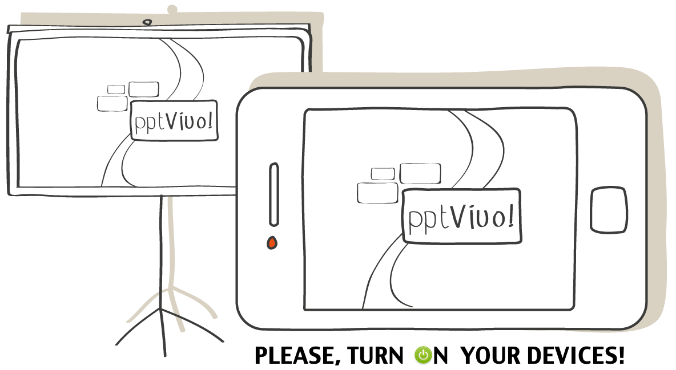
Belen Fernandez
belen.fernandez@pptvivo.com
Luis Videla
luis.videla@pptvivo.com

Slide 2

Engage the audience and get metrics to measure the event´s success.
Notes:
Get metrics to measure the event´s success with the 2nd screen for Presentations!
Overview:
For speakers it is increasingly difficult to deal with a multitasking audience.
Event planners look for more engagement in order to obtain quality metrics and participants’ data.
pptVivo! provides a 2nd screen to presentations and creates a channel between speaker and audience. The main beneficiary of this increased participation and engagement are the event’s organizers since they obtain the necessary metrics to measure the success of the event and the participants’ data to follow-up and generate leads for upcoming events.
Unlike existing solutions pptVivo! fully integrates with PowerPoint, preferred tool for professional speakers, creating less friction in its adoption.

Slide 3

Problem
Deal with a multitasking audience
Lack of feedback (Questions & polls).
Bad quality metrics to measure event ROI.
Lack of attendees info to lead generation.
Lack of direct communication between speaker and attendees
Notes:
Problem:
For speakers it is increasingly difficult to deal with a multitasking audience.
Event planner looks for more engagement in order to obtain quality metrics to measure the success of the event and the participants’ data to follow-up and generate leads.
Event planners need to encourage networking among participants.
Currently event planners use different tools: desktop, web apps, apps mobile, to accomplish these tasks

Slide 4
Value proposition
Live slide sharing and interaction tool for events
The second screen for Presentations
Increase engagement rates
Better event metrics
Increase leads & conversions
Notes:
We fully integrate with PowerPoint, preferred tool by professional speakers, creating less friction in its adoption: 80% of professional speakers use PowerPoint in its version for Windows and OSX.
We deliver a simple solution that does not overwhelm users with complicated features and allows a seamless networking among attendees
We offer a 30 days free trial for one event, no strings attached, and a multi-event custom branded version for sponsors.
No extra custom hardware needed.

Slide 5
Market Analysis
US Meetings Industry:
1.83M meetings were held during 2012 attended by 225M.
Employs 1.7M people
6% (102K) jobs specific to meeting planners and venues.
Event planner profession projected grow 33% 2012-2022.
US GDP contribution: more than the air transportation, motion picture, sound recording.
Notes:
Source:
Meeting Professionals International (MPI) OUTLOOK: 2014 Winter Edition
Meeting Professionals International (MPI) Business Barometer

Slide 6
Market Analysis
UK & Ireland Meetings Industry:
1.3M meetings in 2011 in 10,000 venues
Attendees spent £40B
Organizers staged on average 147 events per year and received £11B from meetings in the UK.
UK GDP contribution: £58.4B in 2011.
Rated 17th industry the UK.
Notes:
Source:
Meeting Professionals International (MPI) MPI UK & Ireland Report

Slide 7
Market Analysis
Asia Meetings Industry:
China Meeting Industry $150B market with annual growth of 20%
Asia takes 23.7% of the world’s total international meetings: Singapore 10%, Japan 7.4% & Korea 6.3%
Organizers staged on average 44 events per year and spent average $818K per event in China.
Notes:
There is no doubt that China’s meetings industry has huge potential with predictions that the sector is a
$150 billion market with annual growth of 20% (HelmsBriscoe April 2011).
Asia takes 23.7% of the world’s total international meetings
The results of the fifth IBTM Global Meetings Industry Research China and Asia have been launched at CIBTM 2013 (www.cibtm.com) and the research is promising, indicating that Asian economies continue to show higher growth figures than elsewhere in the world.
The findings state that ‘the top three countries from Asia are taking 23.7% of the world’s total international meetings and Singapore is at number one position with 10% of the world share.’ Japan follows with 7.4% and Korea Republic third with 6.3%.
Event planners organize an average of 44 events each, a much higher figure than last year.
The average spend per buyer on events in China was $818,038 with overall spend on events in Asia
by all buyers in the sample $207,075,000

Slide 8
US Market Analysis

Slide 9
US Market Analysis
US Meeting Industry
1.7M jobs
$280B Direct Spending
Meeting Planning
6% (102K) jobs
$116B Direct Spending
Target Market
54% (55K) Meet. Pro.
62.7B Direct Spending
Meeting Professionals International (MPI) OUTLOOK: 2014 Winter Edition
Meeting Professionals International (MPI) Business Barometer
Notes:
The US Meeting Industry involves 1.7M jobs and Direct Spending for $280B
6% (102K) of the jobs correspond to Event Organizers with Direct Spending of $116B.
Our Target Market is the 54% (55K) of those Event Planners with Direct Spending of $62,76B.
According to reports those amounts of professionals are relying upon ongoing education to stay current with the last technology and are more likely to use new technology to improve their business.
Meeting Professionals International (MPI) OUTLOOK: 2014 Winter Edition
Meeting Professionals International (MPI) Business Barometer

Slide 10
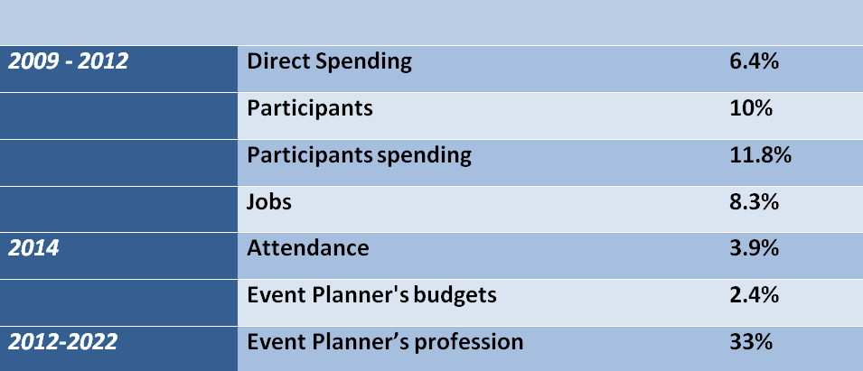
Market Growth perspectives
Notes:
2009-2012: Direct Spending 6.4%,
Participants 10%,
participants spending 11.8%,
Jobs 8.3%
2014: increase in attendance 3.9%
in budgets 2.4%
Event Planner profession is projected to grow 33% from 2012-2022

Slide 11
Business Model
B2B business model
Users: Professional Speakers & Attendees
Customers: Event Planners
Notes:
We have a B2B business model.
pptVivo!'s users are Professional Speakers to whom we provide a second screen to PowerPoint and a communication channel to increase engagement and feedback, and attendees who can follow the presentation from their devices and interact with the presenter and other attendees.
Our customers are Event Planners who hire Speakers and need more engagement and participation from audience to afford quality metrics to measure the success of the event and to generate more leads and conversions.

Slide 12
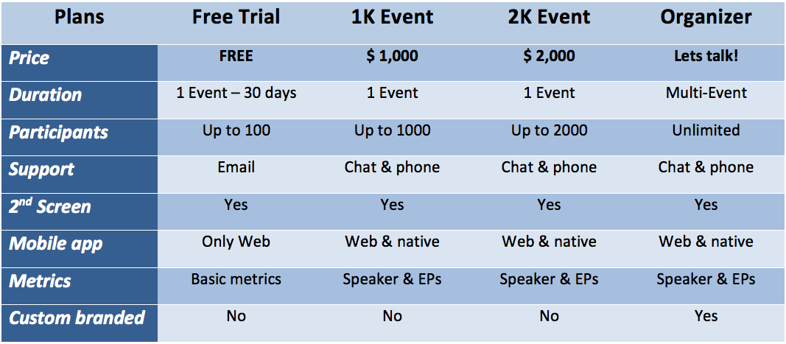
Revenue Model
Notes:
Revenue model:
We want to address events in all shapes and sizes, so we are going to offer a 30 days free trial for one event of up to 50 people, no strings attached. A layered pricing model based in attendee number, support type, advance features and metrics and a Multi-Event Custom Branded version for sponsors.

Slide 13
Differentiation
The 2nd screen for presentations.
Integration with speakers' favorite tools
Seamless networking among attendees.
Statistics for speakers and planners.
No extra custom hardware needed.
Notes:
Underlying Magic:
We fully integrate with PowerPoint and provide a 2nd screen for it, sharing slides to mobile devices and provide statistics for speakers and planners.
We deliver a simpler solution that does not overwhelm users with complicated features and that allows a seamless networking among attendees
We offer a 30 days free trial for one event, no strings attached and a Multi-Event Custom Branded version for sponsors.
No extra custom hardware needed.

Slide 14
Marketing and Sales
Influential professionals as evangelists.
Event technology workshops for organizers.
Alliances with communities of professional event and meeting planners
Promo discount and event sponsorship.
Notes:
We plan to contact influential professionals to show a demo and convert them in early adopters and evangelists of pptVivo!, we also plan to organize event technology workshops and consultancy sessions for event organizers and agencies looking for technology available for events, conferences and exhibitions.
It is important to establish alliances with communities of professional event and meeting planners to advertise our product, offer special promo discount or event sponsorship to increase traction.

Slide 15
Traction
pptVivo! has been used in 2014 by speakers in more than 50 events in Mendoza
75% of speakers have used it more than once
80% of event organizers have shown interest in continuing using when finished the app
The attendees have shown their satisfaction with the tool

Slide 16
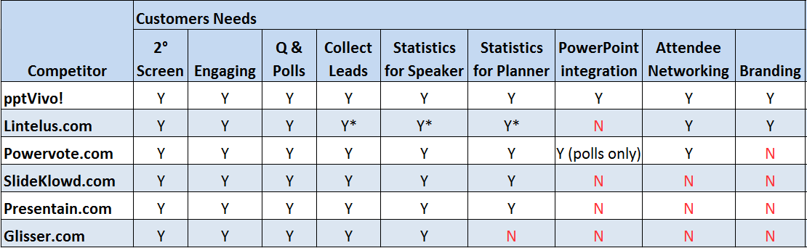
Competition
Notes:
SlideKlowd (slideklowd.com) & Presentain (presentain.com)
Share slides to mobile devices. Capture audience responses. Monitor attention levels. Follow-up with participants. Statistics for speakers and planners.
No integration with PowerPoint, ppt files must be converted; own app to present. Lack of features for Networking among assistants and a Custom Branded version for sponsors.
Presentation.io (presentation.io)
Share slides to mobile devices. Capture audience responses. Monitor attention levels. Follow-up with participants. Statistics for speakers and planners.
No integration with PowerPoint, ppt files must be converted; own app to present. Lack of features for Networking among assistants and requires a list of attendants
Lintelus (nicemeeting.com)
Share slides to mobile devices. Capture audience responses. Monitor attention levels. Follow-up with participants. Statistics for speakers and planners. Networking among assistants.
No integration with PowerPoint, ppt files must be converted; own app to present. Lack of a Custom Branded version. Event technology installed onsite required.
PowerVote (powervote.com)
Share slides to mobile devices. Capture audience responses. Monitor attention levels. Statistics for speakers and planners.
PowerPoint Integration only for polls. Lack of a Custom Branded version. Voting system requirement to buy or rent custom hardware
cvent (cvent.com) & BusyEvent (busyevent.com)
Both are complete event management platform that also provide a mobile app to engage assistants and allow networking, collect leads, provide statistics for planner and custom branded version of the app.
No integration with PowerPoint and no sharing slides to mobile devices. Lack of statistics for speakers.

Slide 17
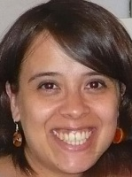
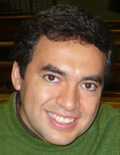
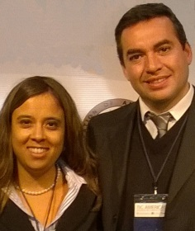
Team
Belen Fernandez: CEO, Project idea.
MBA candidate Universidad Francisco de Vitoria, Madrid, Spain. Postgraduate courses in HR and New Technologies for Education.
Universitary Professor in English UNCuyo. +10 years teaching experience. As entrepreneur: Valores Hoteleros: HR startup for hotels
Luis Videla: CTO.
Software Developer +15 year experience. Desktop, Web & Mobile
As entrepreneur: Aria TI: Software Development & IT Services
Since 2010 as a Team:
KloudCatch: Secure cloud storage service, selected Start-Up Chile 1st round.
i-meet: English teaching platform, Finalist at TIC Americas.
pptVivo!: Economic Entrepreneur Award at TIC Americas 2013.

Slide 18
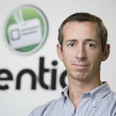
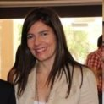
Advisors
Pablo Aquistapace
Founder and CEO of Eventioz (Acquired by Evenbrite in 2013). Expert in the event industry. Endeavor entrepreneur.
Marisol Biaggi
International speaker, consultant and communication skills trainer.
Founder of Marisol Biaggi Corporate Communications.
Member the Professional Council of Public Relations of Argentina.
University and Business School teacher.

Slide 19
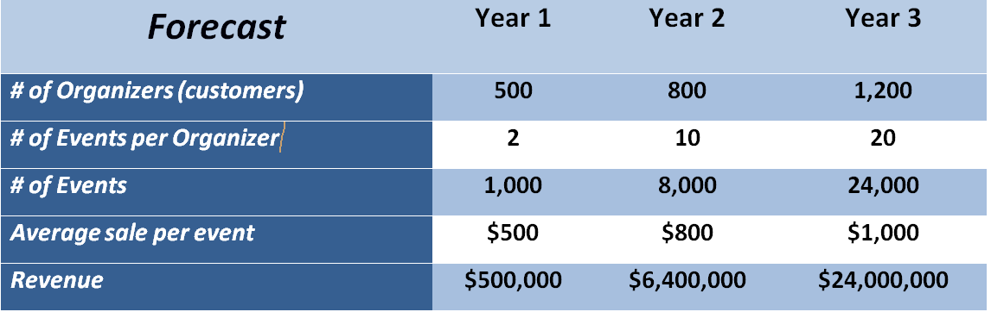
Financial Projections

Slide 20
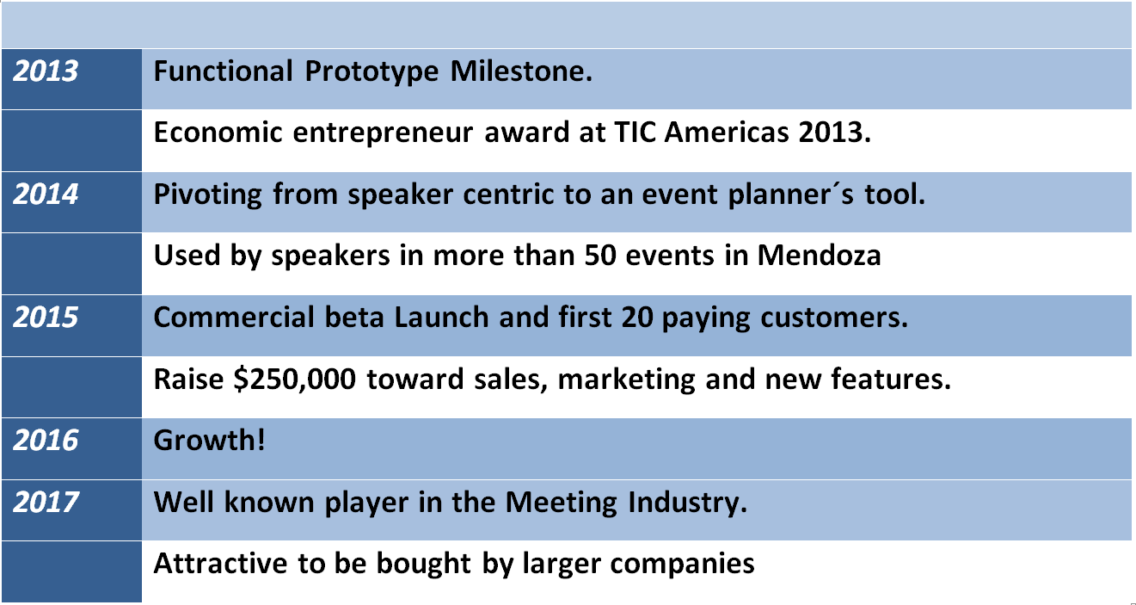
Current Status
Notes:
Accomplishments to Date, Timeline and Use of Funds
The Functional Prototype milestone led us to the customer validation, where we found that the speaker wasn't our customer, but the event planner
We are pivoting from a speaker centric service to an event planner´s tool that, besides engagement, also provides quality metrics. So after testing these new features with early adopters in a closed beta, our next milestone will be launching a commercial beta in five months and get our first twenty paying customers in two months after the commercial beta launching.
We plan to raise money by the second quarter of 2015. We think that it'll be good moment because in the while we plan to get enough traction and revenue needed to be more appealing to investors.
We expect to raise $250,000 that will be put toward sales, marketing and future enhancements of the service.
In 3 years, we expect to get a significant participation in the Meeting Industry being an alternative to existing solution.
We can be attractive for bigger companies in the meeting industry like BusyEvent that is raising money for acquisitions, or Cvent that went public in 2013 ($1.5 billion valuation) and already bought 2 companies, or by Microsoft, because pptVivo! is the only solution that gives a 2nd screen to PowerPoint, a very useful feature, especially to strengthen its Office 365 strategy

Slide 21
“Mobile audience engagement technology will dramatically change the quality and impact of live meetings. The live event industry is going through a mobile transformation – practically everybody these days bring a smartphone or a tablet to a conference.”
Corbin Ball
International Speaker, technology consultant, five times named as one of The 25 Most Influential People in the Meetings Industry.

Slide 22


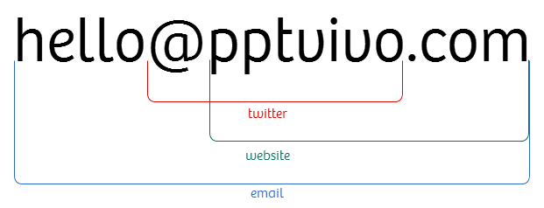
Thanks!

