Slide 1

Mask
BIT, First Semester
Aagaman Luitel (312929)
Nitesh Poudel (312940)
Jigyasha Lama (313376)
Notes:
Cover Slide
Project Title
Program and Semester
Project Member Name

Slide 2
Contents / Agenda
Introduction
Problem Statement
Objectives
Features
Flow chart
Gantt chart
Limitations
Future enhancements
References
Notes:
Content / Agenda
List of the topics to be presented

Slide 3
Problem Statement
Forgetting password is one thing but people also don’t know how dangerous using same password for every account is. If one of them is compromised then the other accounts are compromised as well. People can use password manager but most of them needs specific criteria like money and sometimes a browser to work. Some of them also lack a basic encryption. Similar to passwords confidentiality in sharing of information is also a concerning factor and for sharing information confidentially there are very few such services.

Slide 4
Introduction
Password and message encryption program written in C.
Organizes recorded data.
Simple interface.
Notes:
Introduction
Project Introduction in buttet points
3-4 points maximum

Slide 5
Objective
To save user id and passwords securely.
To create unique passwords.
To access saved data easily.
To share information confidentially.
Notes:
Objectives
List out the objective of the proposed project
Must start with Action verb (To ………)
Features and objective are different things

Slide 6
Features
Password encryption using ASCII modifications.
Use of text file to store password.
Random Password Generator.
Text search.
Encoding message in PNG and JPG file and decoding it.
Notes:
Features
- List out the features to be developed

Slide 7
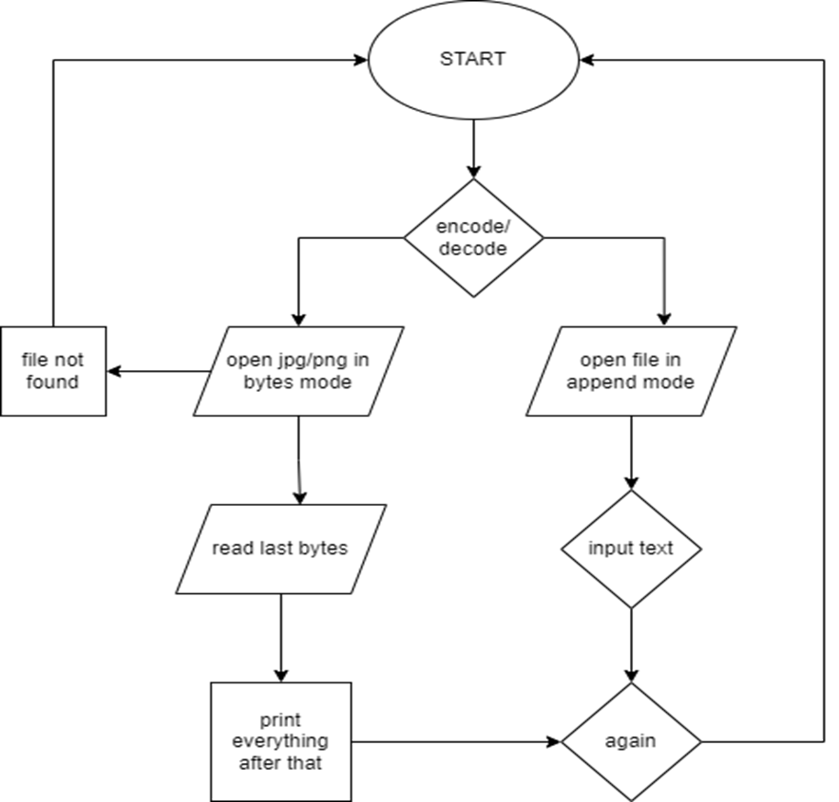
Flowchart
Text in image

Slide 8
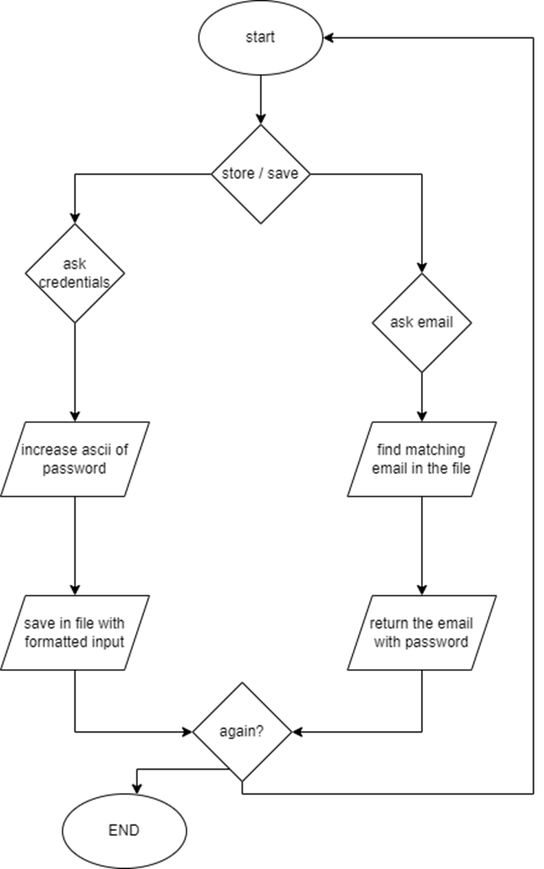
password

Slide 9
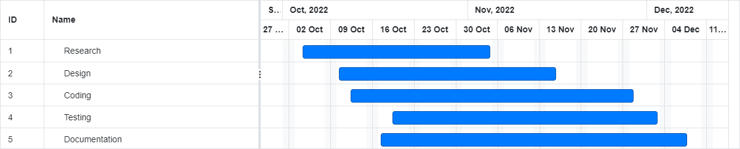
Gantt chart
Notes:
Platform / Development Environemnt
- List out the tools and technology to be used for the development of the project

Slide 10
Limitations
Message is deleted if image is edited
Windows specific
Memory allocation problem on large files

Slide 11
Future Enhancements

Slide 12
References
(n.d.). Retrieved from http://www.libpng.org/pub/png/spec/1.2/PNG-Contents.html
(2022). Retrieved from libpng.org.
fileformat.com. (2022). https://docs.fileformat.com/image/jpeg/. Retrieved from https://docs.fileformat.com/image/jpeg/.
Gauli, N. (2022). https://github.com/nixangauli/Finance-Tracker. Retrieved from https://github.com/nixangauli/Finance-Tracker.
Specification, P. (2022). https://www.w3.org/TR/2003/REC-PNG-20031110/. Retrieved from https://www.w3.org/TR/2003/REC-PNG-20031110/.
Stackoverflow. (2022). https://stackoverflow.com/questions/5918079/fgets-doesnt-work-after-scanf/591. Retrieved from https://stackoverflow.com/questions/5918079/fgets-doesnt-work-after-scanf/591.

Slide 13
THANK YOU
Notes:
Conclusion
Conclude the presentation.

