Slide 1

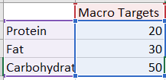
Home CalorieCulate MyMacros Meal-Plans
CalorieCalculator (Macro-Nutrient mix Calculation page)
Step 2 - Select your goals below to calculate your macro-nutrient splits:
Standard
High Protein
Low Carb
Facebook Twitter Instagram Youtube

Slide 2
Home CalorieCulate MyMacros Meal-Plans
CalorieCalculator (Custom Meal-Planner page)
Step 3 - Tick/check boxes for foods you like from each category below to generate sample meal-plan ideas which fit your caloric goals & macro-nutrient targets
Protein
Chicken
Eggs
Turkey
Salmon
Cod
Steak
Pork
Haddock
Whiting
Mackerel
Click to generate sample Meal-plan Idea
Breakfast
Set Calories = Daily Calories * 0.30
Select Random Protein + random Carb + random Fat
Lunch
Set Calories = Daily Calories * 0.30
Dinner
Set Calories = Daily Calories * 0.30
Set protein, carb, fats to Macros * 0.3 each / per gram
Set protein, carb, fats to Macros * 0.3 each / per gram
Select Random Protein + random Carb + random Fat
Set protein, carb, fats to Macros * 0.3 each / per gram
Select Random Protein + random Carb + random Fat
Carbohydrate
Bread
Pasta
Rice
Oats
Cereal
Bananas
Oranges
Apples
Potatoes
Sweet Potatoes
Beans/Pulses
Quinoa
Fats
Coconut Oil
Olive Oil
Butter
Bacon
Cheese
Cream
Almonds
Walnuts
Brazil Nuts
Seeds
Click to share this meal plan on Twitter / Instagram
Click to export to CSV
Facebook Twitter Instagram Youtube

Slide 3
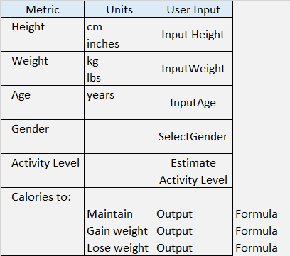
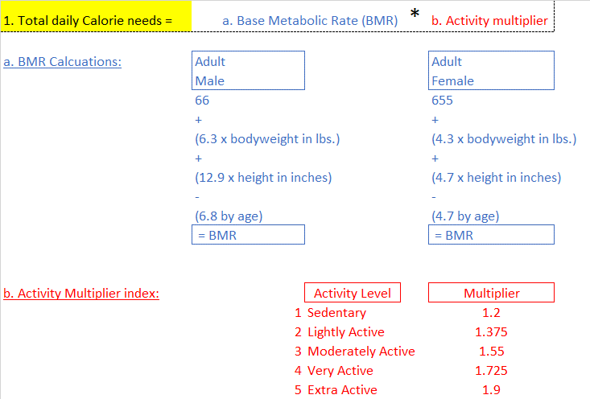
Formulas & Logic (For Javascript)
Populate the input fields below to calculate your calorie goals
Checks & controls (examples)
Age check
If <18 – throw a warning to come back when old enough
Calorie check
If calories fall below recommended minimums - warning

Slide 4
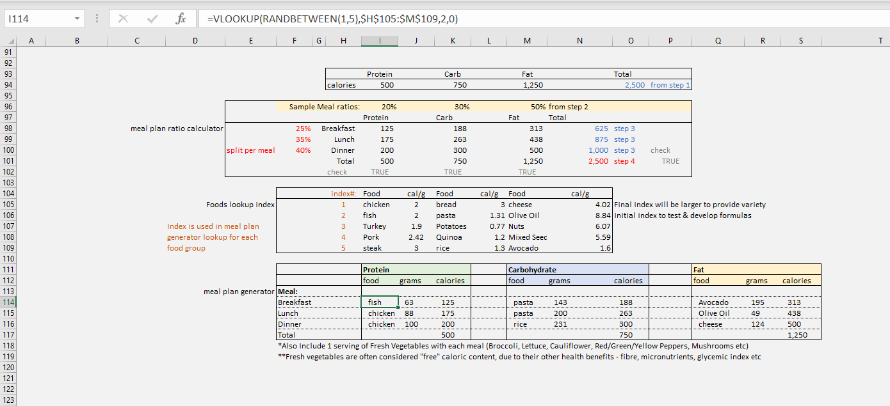
Random Number generated to select random foods from macro nutrient arrays
Start with PDCT
Standard static % split per meal
Use Macro Mix (selected by user in step 2) to allocate %’s across macronutrients (prot/carb/fat)
Use meal splits (pre-determined/static %) to allocate calories by macronutrient by meal
Food lookup index – cross referenced by meal plan generator

