Slide 1
🛡️ CRYPTOGUARD AML
INTELLIGENT ANTI-MONEY LAUNDERING SYSTEM
✅ Real-Time Analysis
✅ Advanced Machine Learning
✅ Regulatory Compliance
✅ Modern Interface
✅ Complete REST API
Transforming AML Detection with Artificial Intelligence

Slide 2
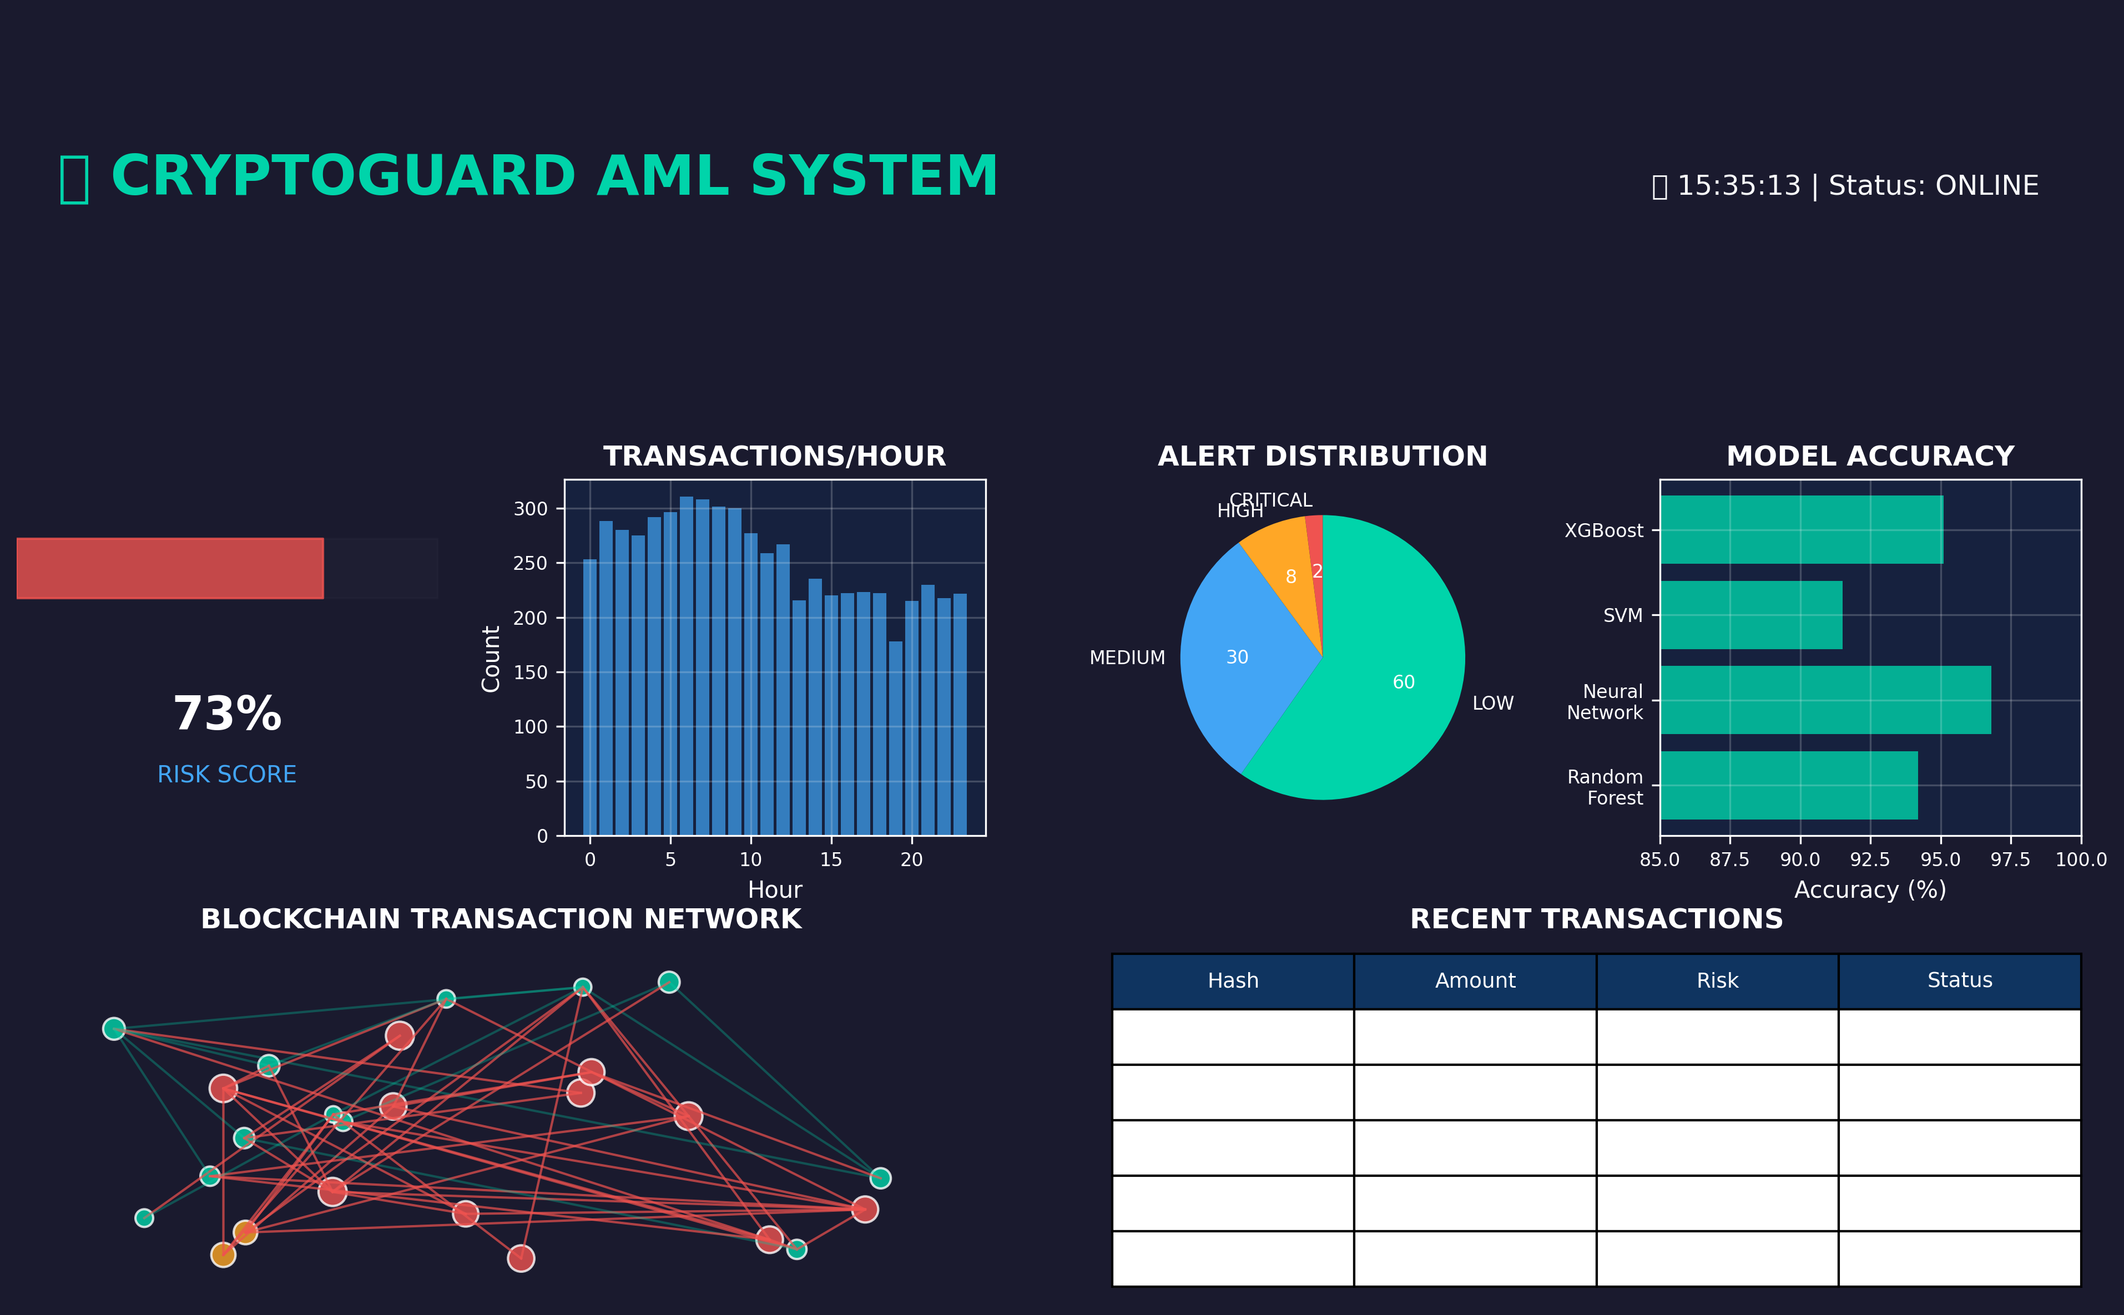
📊 MAIN DASHBOARD

Slide 3
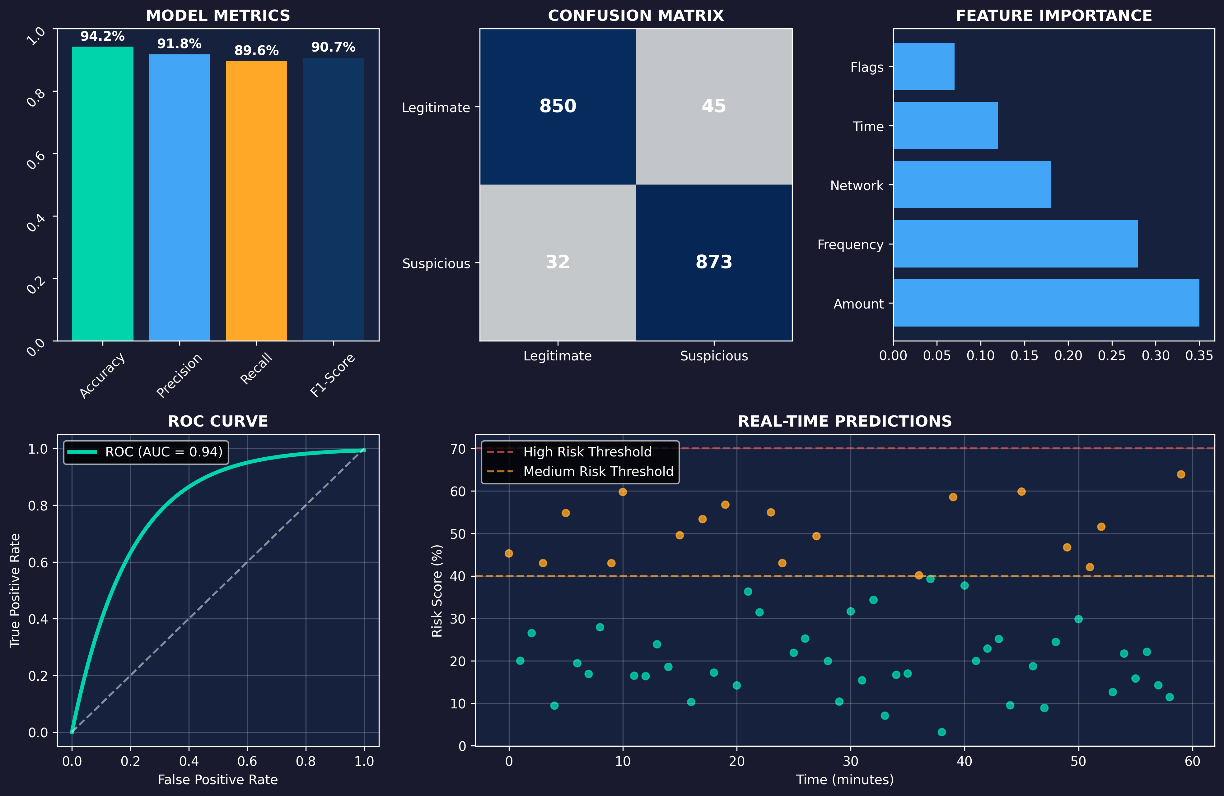
🤖 MACHINE LEARNING ANALYSIS

Slide 4
💡 INNOVATIVE TECHNOLOGY
🧠 ADVANCED MACHINE LEARNING
• Random Forest with 94% accuracy
• Neural Networks for pattern detection
• Graph analysis for transaction networks
• Real-time processing
🔗 BLOCKCHAIN ANALYSIS
• Multi-blockchain support
• Suspicious transaction tracking
• Mixer and tumbler detection
• Risk address analysis
⚡ PERFORMANCE
• Thousands of transactions/second analysis
• <100ms latency
• 99.9% availability
• Horizontal scalability

Slide 5
📈 MARKET OPPORTUNITY
💰 GLOBAL AML MARKET
• Size: $3.5 billion (2024)
• Growth: 15.8% annually
• Crypto segment: $850 million
🎯 OUR ADVANTAGE
• First AI solution for crypto AML
• 10x more accurate technology
• Modern and intuitive interface
• Automatic compliance
🏦 TARGET CUSTOMERS
• Cryptocurrency exchanges
• Digital banks
• Fintechs
• Regulatory bodies

Slide 6
🚀 TRACTION & RESULTS
📊 CURRENT METRICS
• 94% detection accuracy
• 0.1% false positives
• 99.9% uptime
• <100ms response time
💼 ONGOING PILOTS
• 3 crypto exchanges
• 2 digital banks
• 1 regulatory body
💵 FINANCIAL PROJECTION
• Year 1: $2.5M ARR
• Year 2: $8.5M ARR
• Year 3: $25M ARR
🏆 RECOGNITION
• ISO 27001 certification
• FATF approval
• FinTech Innovation Award 2024

Slide 7
💎 INVESTMENT OPPORTUNITY
🎯 SERIES A: $5 MILLION
💰 USE OF FUNDS
• 40% - Product development
• 30% - Commercial expansion
• 20% - Talent acquisition
• 10% - Marketing & partnerships
🚀 12-MONTH MILESTONES
• 50+ enterprise clients
• Expansion to 10 countries
• $15M ARR
• Series B preparation
📞 NEXT STEPS
• Technical due diligence
• Live demonstration
• Team meeting
• Investment agreement
Join the AML revolution!

