Slide 1

Investigating Agent Perception
Luiz Filipe P. Abrahao
luiz_filipe.abrahao@kcl.ac.uk
First Supervisor: Dr Thrishantha Nanayakkara
Second supervisor: Professor Kaspar Althoefer

Slide 2
Motivation
We are surrounded by cases in which very limited agents put together can give rise to very sophisticated overall behaviour.
Can we look at these groups of individuals as one super-organism?
Could an ant-colony be seen as a single organism? Yes.^{[1]}
[1] W. M. Wheeler, “The ant-colony as an organism.”. The journal of Morphology 22(2)

Slide 3
Motivation
Why to study social insects?
Although they represent only 2 percent of the approximately 900,000 known insect species in the world, they likely compose more than half o the biomass^{[2]}.
[2] E. J. Fittkau and H. Klinge, “On biomass and trophic structure of the central Amazonian rain forest”, Biotropica 5(1)

Slide 4
Objective
Use agent oriented techniques to design and implement a computational model to simulate and investigate aspects of the behaviour of ant-colonies as a super-organism

Slide 5

Computational Model
The environment is defined using a graph of nodes, that represent an infinitesimal part of the space;
Each node is linked to their neighbours and has a list of agents located in that node;
Different types of nodes and agents can be easily described;
Notes:
Inspired in the subsumption architecture proposed by Brooks in this famous paper “Intelligence Without Representation”

Slide 6
Computational Model
First implementation uses task-oriented agents;
Each agent is assigned a set of possible tasks;
The agent is able to choose which task to perform depending on the context, like real ants do^{[2]};
Each agent is ran as an independent thread in the available CPUs.
[3] The Superorganism, Holldobler Bert, E. O. Wilson, Norton.

Slide 7
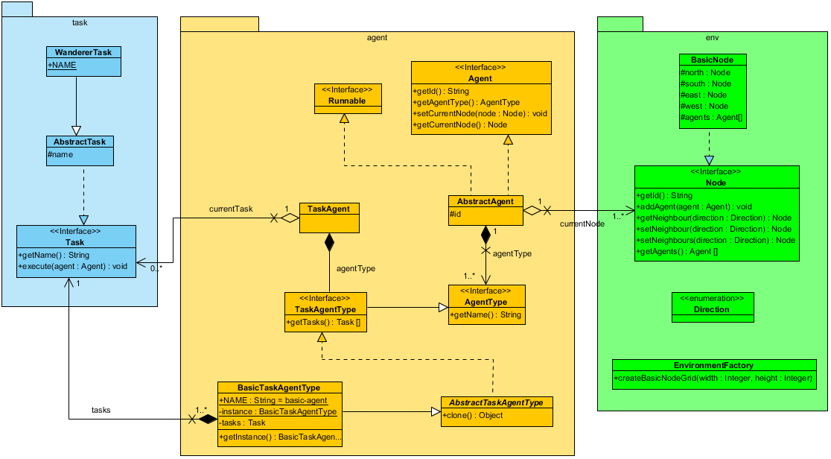
Computational Model

Slide 8
Task Allocation Model
Model that relies on response thresholds;
Every individual has a response threshold for every task;
Individuals engage in task performance when the level of the task-associated stimuli exceeds their thresholds.
Model proposed by Bonabeau at al. ^{[3]}
[4] Quantitative study of the Fixed Threshold Model of the Regulation of Division of Labour in Insect Societies, Bernabeau, E. Proceedings Roy. Soc. London B 365 (1996): 1565-1569
Notes:
Examples of stimulus: antennation

Slide 9
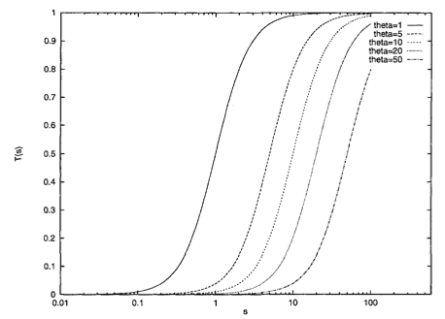
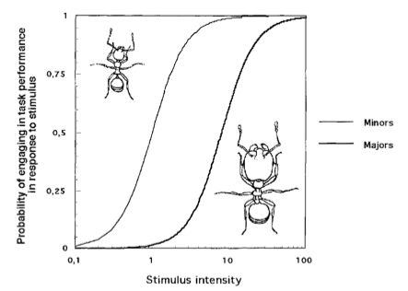
Task Allocation Model
Notes:
Examples of stimulus: antennation

Slide 10
Proposed Experiment
Objective: Investigate how information is propagated throughout the colony.
Study case: addition of a predator near the colony nest after sometime of simulation.
Notes:
How does this information about the predator travel through the colony?
Is the speed of the communication affected by the pheromone trail left by the colony when foraging?

Slide 11
Current Work
A first draft of the computational model has been implemented;
100% implemented in Java;
Tested with 30 000 nodes and 50 agents;
Currently studying what are the best ways to “produce the colony” and which tasks to implement.

Slide 12
Challenges
Biology, Biology and Biology!
Pheromone trail updates need to be local, how to implement?
Data output and processing.

Slide 13
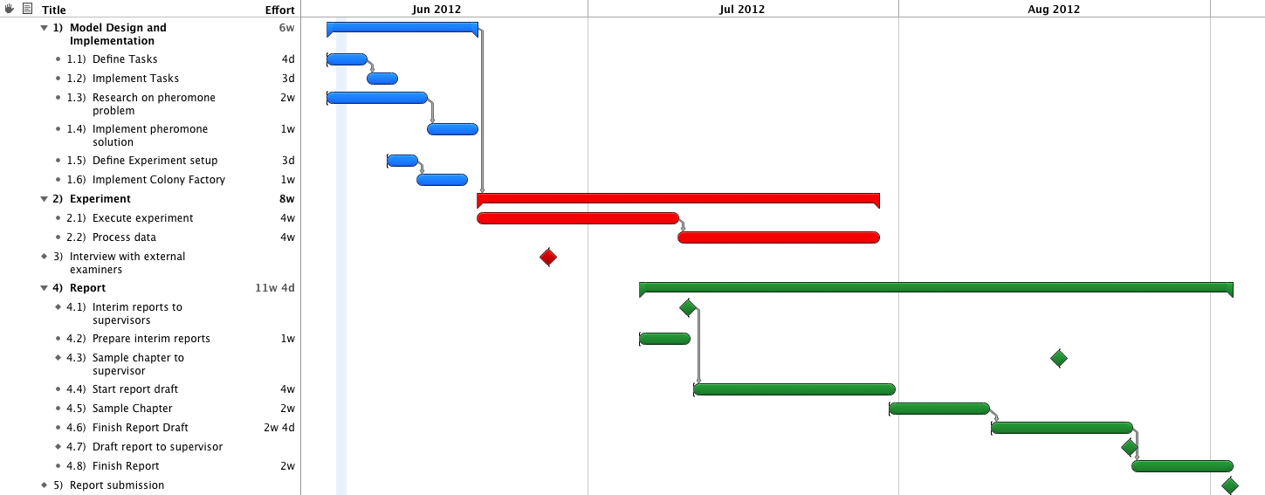
Planning

Slide 14




