Slide 1
Introduction to Linux and the terminal
Speaker: Luiz Aldeia Machado, PhD Candidate
Feb 12, 2025

Slide 2
The Linux operational system
1969 – Ken Thompson and Dennis Ritchie developed Unix (a simple and portable operational system)
1970 - Unix spread to universities and research institutions
1983 - Richard Stallman launches the GNU Project to create a free Unix-like operational system
1991 - Linus Torvalds, a Finnish computer science student, begins developing a new free and open-source Unix-like kernel as a hobby
1992 - Linux is licensed under the GNU General Public License (GPL), ensuring it remains open-source.

Slide 3
The Linux operational system
Before starting:
CLONE THE GITHUB FILES

Slide 4
The Linux operational system
Some of the key advantages of using a Linux based OS are:
Linux is open-source and community-driven
Linux is secure and stable (ideal for servers and scientific computing)
Linux can be customized based on the user needs
Linux can run from cellphones to supercomputers (Sawtooth, Frontier, Roar)
Some of the downsides of using Linux are:
Many proprietary software are not compatible with Linux (including many games)
Some hardware may not have official Linux drivers
Linux is not as user-friendly as other OS options, which requires, sometimes, more technical knowledge to troubleshooting issues

Slide 5
Linux vs Windows vs macOS
 | Linux | Windows | macOS
Customization | Highly customizable | Limited UI customization | Limited to macOS ecosystem
Software availability | Many open-source programs, lacy of support to many proprietary software | Mostly widely supported OS for commercial applications and games | Well-supported for creative applications but lack variety outside the Apple ecosystem
Performance | Lightweight, excellent for older hardware | Can be resource-heavy | Highly optimized, smooth experience, but limited hardware choices
Security | Highly secure, minimal malware, user control over permissions | Most targeted OS for malware and viruses | Secure, sandboxed applications, fewer security threats than Windows
Best for | Advanced users, cybersecurity, developers, servers | General users, gaming, office work, enterprise environments | Creative professionals, Apple ecosystem users, those who prefer a polished UI

Slide 6
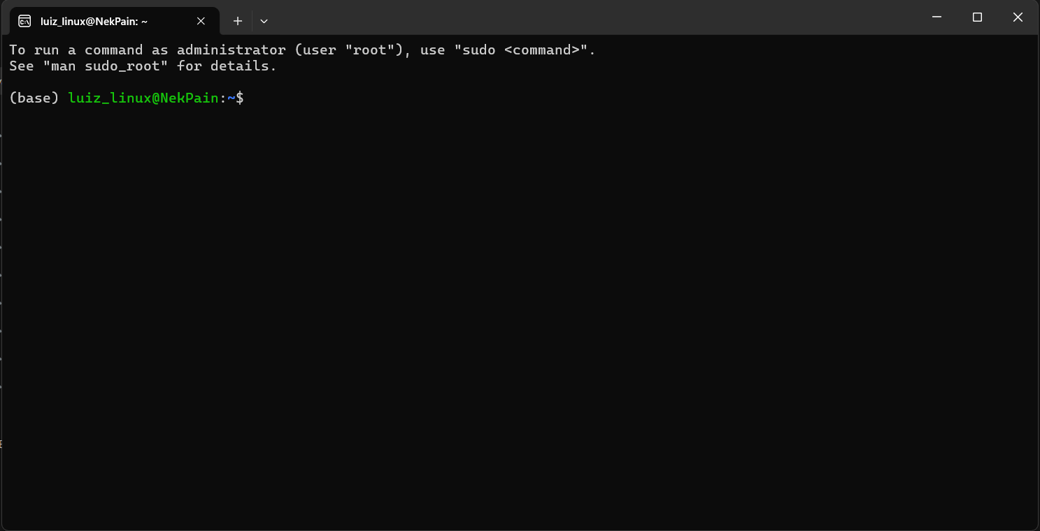
WSL
Windows Subsystem for Linux (WSL) is a feature of Windows that allows you to run a Linux environment on your Windows machine, without the need for a separate virtual machine or dual booting.

Slide 7

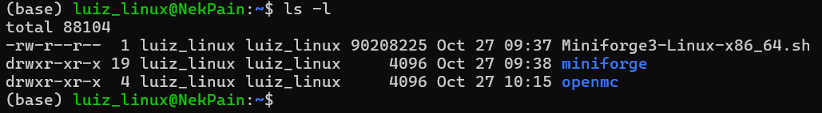
Basic terminal commands
List (ls): the ls command is used to list files and directories in Linux
ls may be followed by other options, such as:
ls -l: long format listing (show permissions, owner, size, modification time)
ls -a: shows hidden files

Slide 8

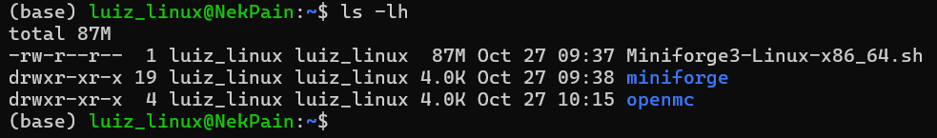
Basic terminal commands
ls -h: human-readable sizes
ls -lh: combines ls -l and ls -h for an easy-to-read format

Slide 9



Basic terminal commands
Change directory (cd): the cd command is used to navigate through directories in Linux. It allows you to move between folders within the filesystem.
cd /path/to/directory: move to a specific directory
cd: go to the home directory
cd ../: move one directory up (parent directory)

Slide 10
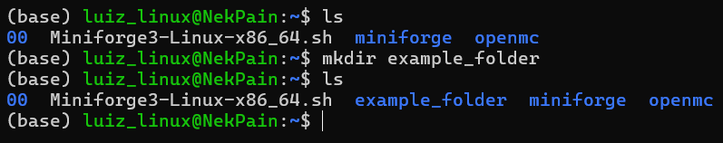
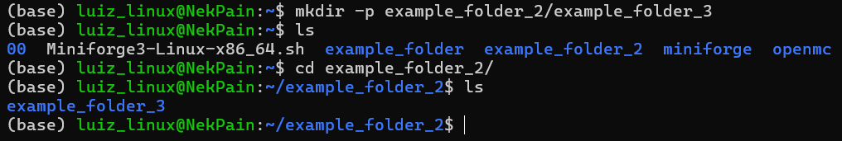
Basic terminal commands
Make directory (mkdir): the mkdir command is used to create new directories (folders) in Linux. It allows users to organize files into structured directories.
mkdir folder_name: creates a new directory
mkdir -p parent/child: create nested directories

Slide 11
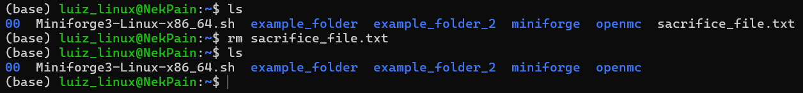
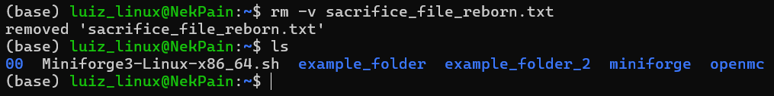
Basic terminal commands
Remove (rm): the rm command is used to delete files and directories in Linux. It is a powerful command, so be careful when using it, as deleted files cannot be easily recovered.
rm file_name: deletes a file
rm -v file_name: : deletes a file and shows verbose output

Slide 12

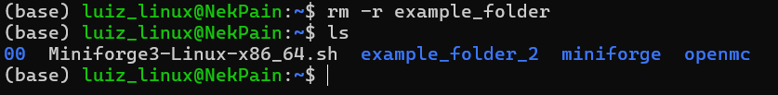
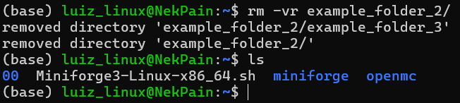
Basic terminal commands
rm cannot delete folders without extra options in the command
rm folder_name: returns an error
rm -r folder_name: : deletes a folder
rm -vr folder_name: : deletes a folder and shows verbose output

Slide 13
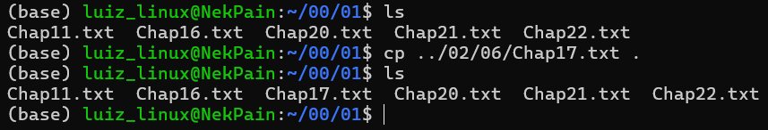
Basic terminal commands
Copy (cp): the cp command is used to copy files and directories in Linux.
cp /path/to/source/file/file_name /path/to/directory/: copy a file from one directory to another
cp -r /path/to/source/file/file_name . : copy a file from one directory to your current directory

Slide 14
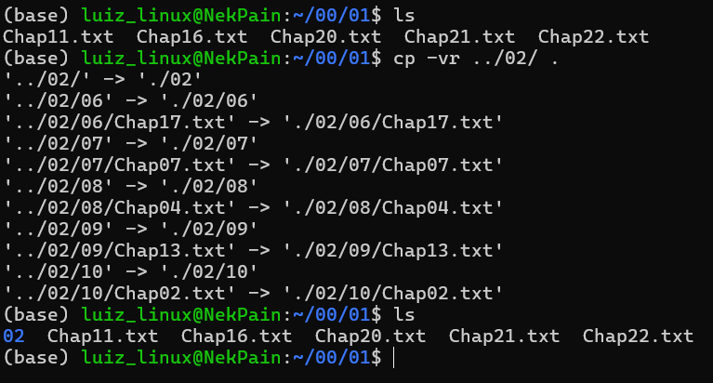
Basic terminal commands
cp -r /path/to/source/file/ /path/to/directory/: just like rm, we need to add the –r option to our command to copy folders.

Slide 15

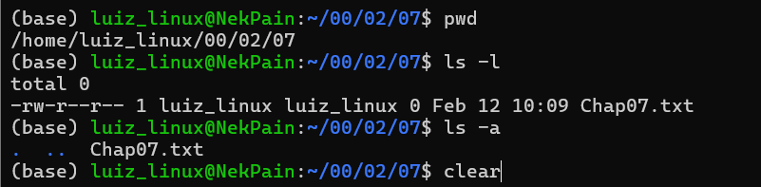
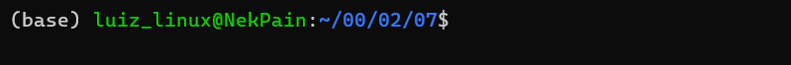
Basic terminal commands
Print working directory (pwd): the pwd command displays the absolute path of the current working directory.
Clear: the clear command is used to clear the terminal screen. It removes all previously displayed text from the terminal, providing a clean slate.

Slide 16

Basic terminal commands
Grep: the grep command is one of the most powerful tools for searching through text in files. It searches for patterns within files and displays lines that match the specified pattern.
grep -r “search_term” /path/to/directory: Recursively search through directories.

Slide 17
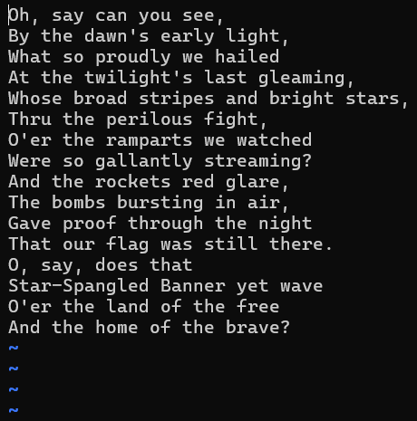
Basic terminal commands
vi: the vi command is a text editor in Unix and Linux systems, widely used for editing files.

Slide 18
Basic terminal commands
vi: the vi command is a text editor in Unix and Linux systems, widely used for editing files.
To close vi without saving use: :q!
To close vi saving any changes in the file use: :wq

Slide 19
Basic terminal commands
Exercise:
use grep to find the file inside the folder 00 that was the word “Pietro” on it
use vi to take a look into the file
use cp to copy the file to your home directory

Slide 20
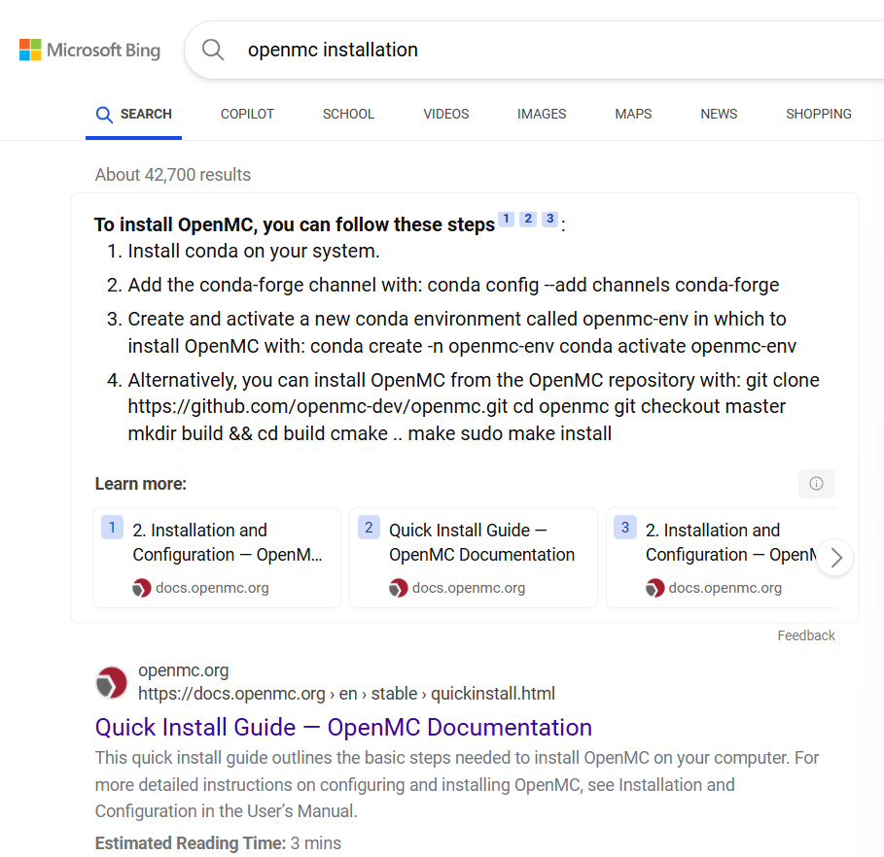
OpenMc instalation
Reference: https://docs.openmc.org/en/stable/quickinstall.html
You can google: openmc installation and follow the instruction on the quick install guide
We will help you guys going through these steps ☺
Notes:
export OPENMC_CROSS_SECTIONS=${HOME}/cross_sections/endfb-vii.1-hdf5/cross_sections.xml

