Slide 1


Luiza Souza Simões
—
Validation of remote-control use cases for construction and mining robots via 5G
—
Supervisor: Profa. Dra. Ana Isabela Araújo Cunha
Co-supervisor: M.Sc. Sarah Schmitt
10.07.2023

Slide 2
Table of Contents
1. | Introduction
2. | Objectives
3. | Contextualization
4. | Measurements Underground Mine Construction Site
5. | Conclusion
10.07.2023
© Fraunhofer IPT/WZL der RWTH Aachen

Slide 3
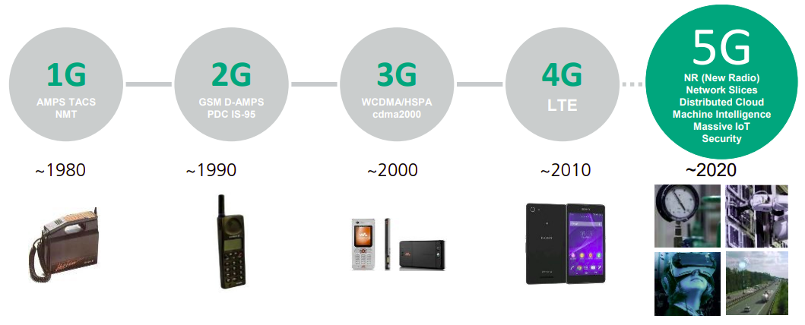

The Evolution of Wireless Connectivity
From 1G to 5G
Evolution of wireless communication [Image]. In: 5G – Capabilities and potentials. Fraunhofer IPT. Accessed on June 21, 2023.
10.07.2023

Slide 4

The Evolution of Wireless Connectivity
The 5G.NAMICO project
The 5G.NAMICO project logo [Image]. In: RWTH Aachen University. Available at: https://5g.namico.rwth-aachen.de. Accessed on June 21, 2023.
10.07.2023

Slide 5
Table of Contents
1. | Introduction
2. | Objectives
3. | Contextualization
4. | Measurements Underground Mine Construction Site
5. | Conclusion
10.07.2023
© Fraunhofer IPT/WZL der RWTH Aachen

Slide 6
Definition of the Study Problem
Key objectives
Headline, Frutiger LT Com Bd, 16 pt
Copy Frutiger LT Com Lt, 14 pt. Dolor situs cum habilitarum itum alusi causticus imanenter Status ex landum it exus rius laudanum ibis tum. Lorem et exit vulnareus plexus. Sit itum caiusticus aurum eum explindus. Status landum it exus rius laudanum ibis. Let exit vulnareus plexus causticus imanenter Status ex landum.
Headline, Frutiger LT Com Bd, 14 pt
Level 1
Level 1
Level 1
Level 2
Level 3
Level 1
1
Create and plan a setup for 5G applications in the Construction and Mining sections.
2
Set up a test plan to assess the 5G network performance and suitability, including
measurement methods description.
3
Validate the work and data extracted in different scenarios and analyze their results.

Slide 7
Table of Contents
1. | Introduction
2. | Objectives
3. | Contextualization
4. | Measurements Underground Mine Construction Site
5. | Conclusion
10.07.2023
© Fraunhofer IPT/WZL der RWTH Aachen

Slide 8
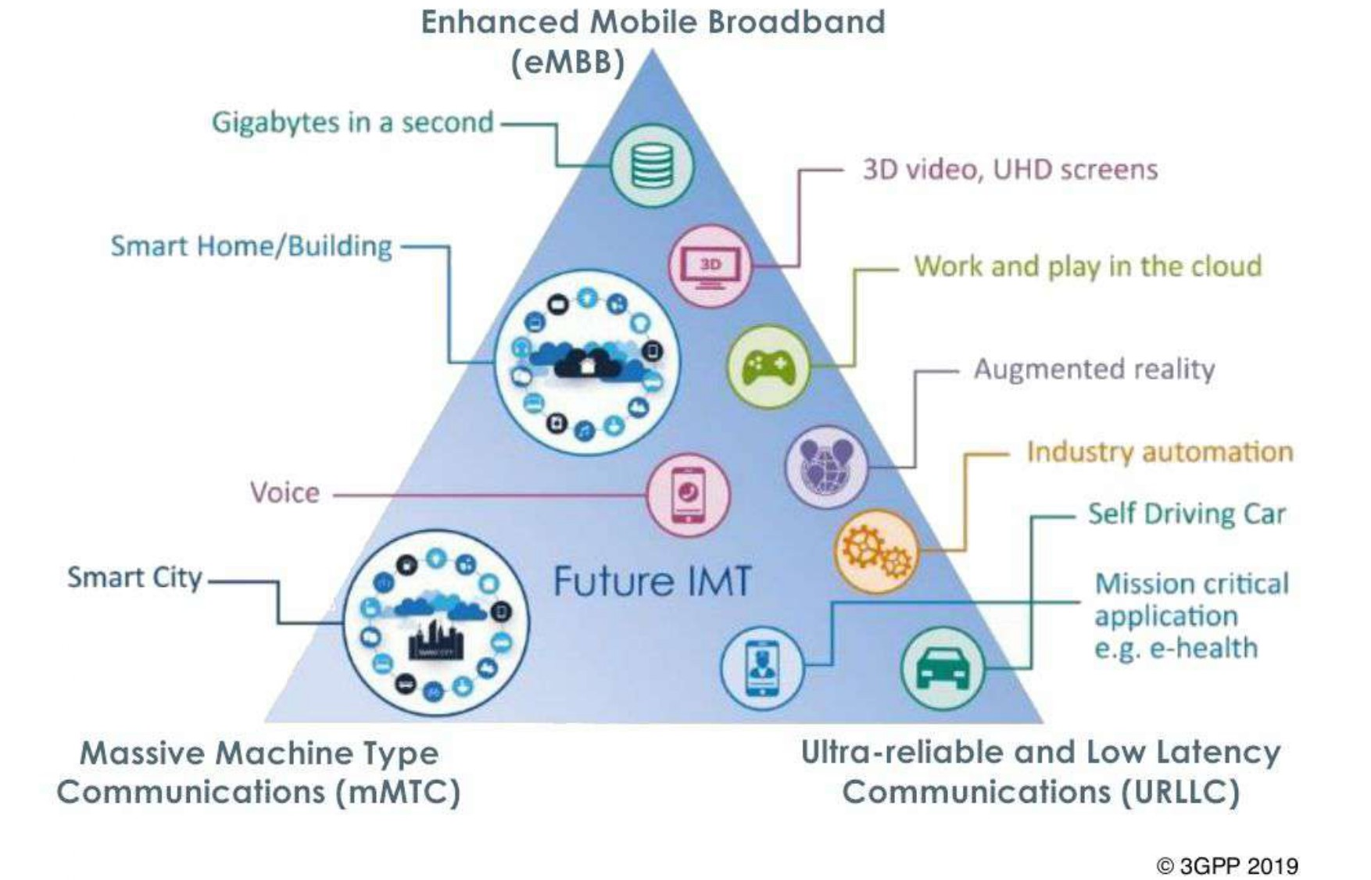
Contextualization
Important concepts
1
uRLLC
Ultra-Reliable Low Latency Communications
2
eMBB
Enhanced Mobile Broadband
3
mMTC
Massive Machine Type Communications
5G features and its applications [Image]. In: 3GPP. Available at: https://fuenf-g.de/2019/09/26/die-schrittmacher-von-5g/##. Accessed on June 22, 2023.
10.07.2023
© Fraunhofer IPT/WZL der RWTH Aachen
Notes:
Also talks about Network slicing

Slide 9
Contextualization
Use Cases
Real-time condition monitoring
Health and safety at worksites
Autonomous machinery
Collect information
Basis for decision-making
Improve efficiency
Higher productivity and sustainability
Safer work envirenments
Accident prevention
Reduce unplanned maintainance
Progress monitoring
“In 1995–2005, up to 90% of fatal mining accidents were equipment related, while maintenance is responsible for 41% of a mine’s equipment costs. […] Studies say 70% of machine-specific malfunctions could be prevented by collecting and analyzing the machine's data.”
- ERICSSON. Connected Mining: A Guide to smart mining transformation with private cellular technology. 2020
10.07.2023
© Fraunhofer IPT/WZL der RWTH Aachen

Slide 10
Table of Contents
1. | Introduction
2. | Objectives
3. | Contextualization
4. | Measurements Underground Mine Construction Site
5. | Conclusion
10.07.2023
© Fraunhofer IPT/WZL der RWTH Aachen

Slide 11
Measurements
Use Cases
Real-time condition monitoring
Health and safety at worksites
Autonomous machinery
Collect information
Basis for decision-making
Improve efficiency
Higher productivity and sustainability
Safer work envirenments
Accident prevention
Reduce unplanned maintainance
Progress monitoring
“In 1995–2005, up to 90% of fatal mining accidents were equipment related, while maintenance is responsible for 41% of a mine’s equipment costs. […] Studies say 70% of machine-specific malfunctions could be prevented by collecting and analyzing the machine's data.”
- ERICSSON. Connected Mining: A Guide to smart mining transformation with private cellular technology. 2020
10.07.2023
© Fraunhofer IPT/WZL der RWTH Aachen

Slide 12
Table of Contents
1. | Introduction
2. | Objectives
3. | Contextualization
4. | Measurements Underground Mine Construction Site
5. | Conclusion
10.07.2023
© Fraunhofer IPT/WZL der RWTH Aachen

Slide 13
Obrigada · Thank you · Danke

Slide 14
Contact information
—
Luiza Souza Simões
Tel. +49 1575 3510058
Tel. +55 71 981814845
luizassimoes@hotmail.com
Fraunhofer IPT
Steinbachstraße 17
52074 Aachen
www.fraunhofer.de

