Slide 1


Luiza Souza Simões
—
Validation of remote-control use cases for construction and mining robots via 5G
—
Supervisor: Profa. Dra. Ana Isabela Araújo Cunha
Co-supervisor: M.Sc. Sarah Schmitt
10.07.2023

Slide 2
Table of Contents
1. | Introduction
2. | Objectives
3. | Contextualization
4. | Measurements Underground Mine Construction Site
5. | Conclusion
10.07.2023
© Fraunhofer IPT/WZL der RWTH Aachen

Slide 3
Table of Contents
1. | Introduction
2. | Objectives
3. | Contextualization
4. | Measurements Underground Mine Construction Site
5. | Conclusion
10.07.2023
© Fraunhofer IPT/WZL der RWTH Aachen

Slide 4
Table of Contents
1. | Introduction
2. | Objectives
3. | Contextualization
4. | Measurements Underground Mine Construction Site
5. | Conclusion
10.07.2023
© Fraunhofer IPT/WZL der RWTH Aachen

Slide 5
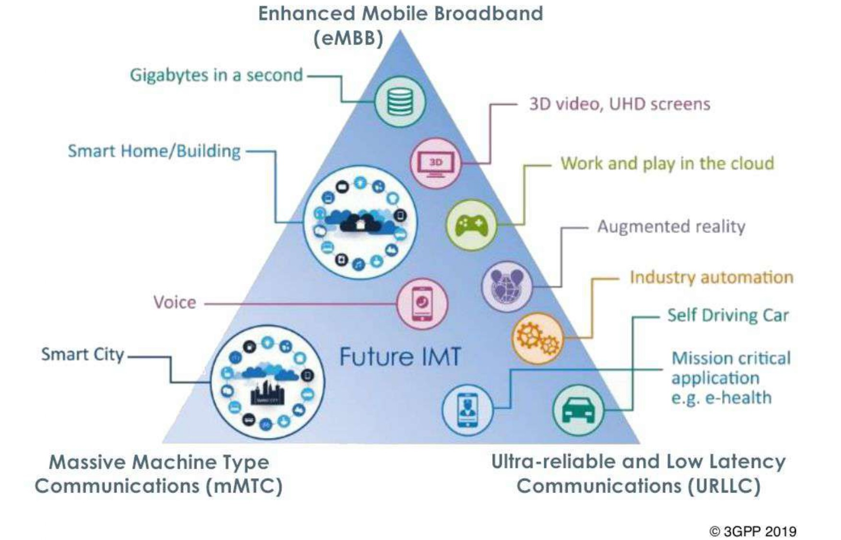
Contextualization
Important concepts
1
uRLLC
Ultra-Reliable Low Latency Communications
2
eMBB
Enhanced Mobile Broadband
3
mMTC
Massive Machine Type Communications
5G features and its applications [Image]. In: 3GPP. Available at: https://fuenf-g.de/2019/09/26/die-schrittmacher-von-5g/##. Accessed on June 22, 2023.
10.07.2023
© Fraunhofer IPT/WZL der RWTH Aachen
Notes:
Also talks about Network slicing

Slide 6
Contextualization
Use Cases
Real-time condition monitoring
Health and safety at worksites
Autonomous machinery
Collect information
Basis for decision-making
Improve efficiency
Higher productivity and sustainability
Safer work envirenments
Accident prevention
Reduce unplanned maintainance
Progress monitoring
“In 1995–2005, up to 90% of fatal mining accidents were equipment related, while maintenance is responsible for 41% of a mine’s equipment costs. […] Studies say 70% of machine-specific malfunctions could be prevented by collecting and analyzing the machine's data.”
- ERICSSON. Connected Mining: A Guide to smart mining transformation with private cellular technology. 2020
10.07.2023
© Fraunhofer IPT/WZL der RWTH Aachen

Slide 7
Table of Contents
1. | Introduction
2. | Objectives
3. | Contextualization
4. | Measurements Underground Mine Construction Site
5. | Conclusion
10.07.2023
© Fraunhofer IPT/WZL der RWTH Aachen

Slide 8
Measurements
Use Cases
Real-time condition monitoring
Health and safety at worksites
Autonomous machinery
Collect information
Basis for decision-making
Improve efficiency
Higher productivity and sustainability
Safer work envirenments
Accident prevention
Reduce unplanned maintainance
Progress monitoring
“In 1995–2005, up to 90% of fatal mining accidents were equipment related, while maintenance is responsible for 41% of a mine’s equipment costs. […] Studies say 70% of machine-specific malfunctions could be prevented by collecting and analyzing the machine's data.”
- ERICSSON. Connected Mining: A Guide to smart mining transformation with private cellular technology. 2020
10.07.2023
© Fraunhofer IPT/WZL der RWTH Aachen

Slide 9
Table of Contents
1. | Introduction
2. | Objectives
3. | Contextualization
4. | Measurements Underground Mine Construction Site
5. | Conclusion
10.07.2023
© Fraunhofer IPT/WZL der RWTH Aachen

Slide 10
Obrigada · Thank you · Danke

Slide 11
Contact information
—
Luiza Souza Simões
Tel. +49 1575 3510058
Tel. +55 71 981814845
luizassimoes@hotmail.com
Fraunhofer IPT
Steinbachstraße 17
52074 Aachen
www.fraunhofer.de

