Slide 1
Library Management
Web Application
Eduardo W. O. Bandeira de Melo
Luiz Santana

Slide 2

- Inventory Management - Reader Registration - Book Loan Tracking

Slide 3

WHAT does the System do?
Collect personal information from readers
Store book details
Chart of book availability
Book Loan Tracking

Slide 4



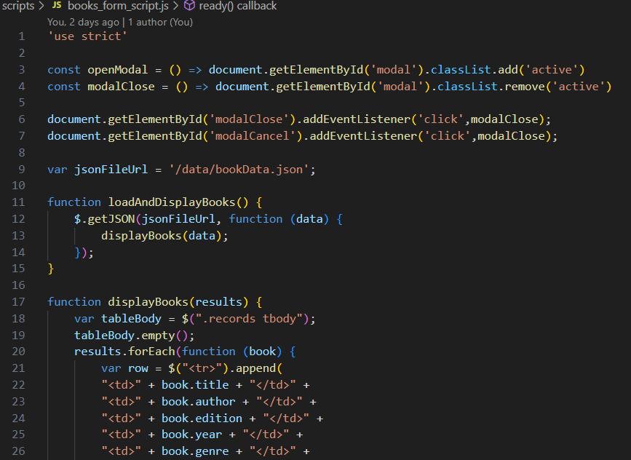
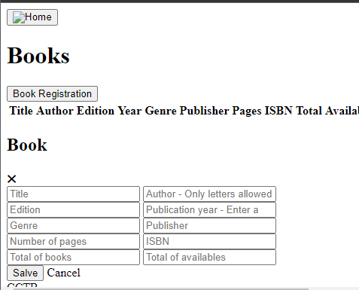
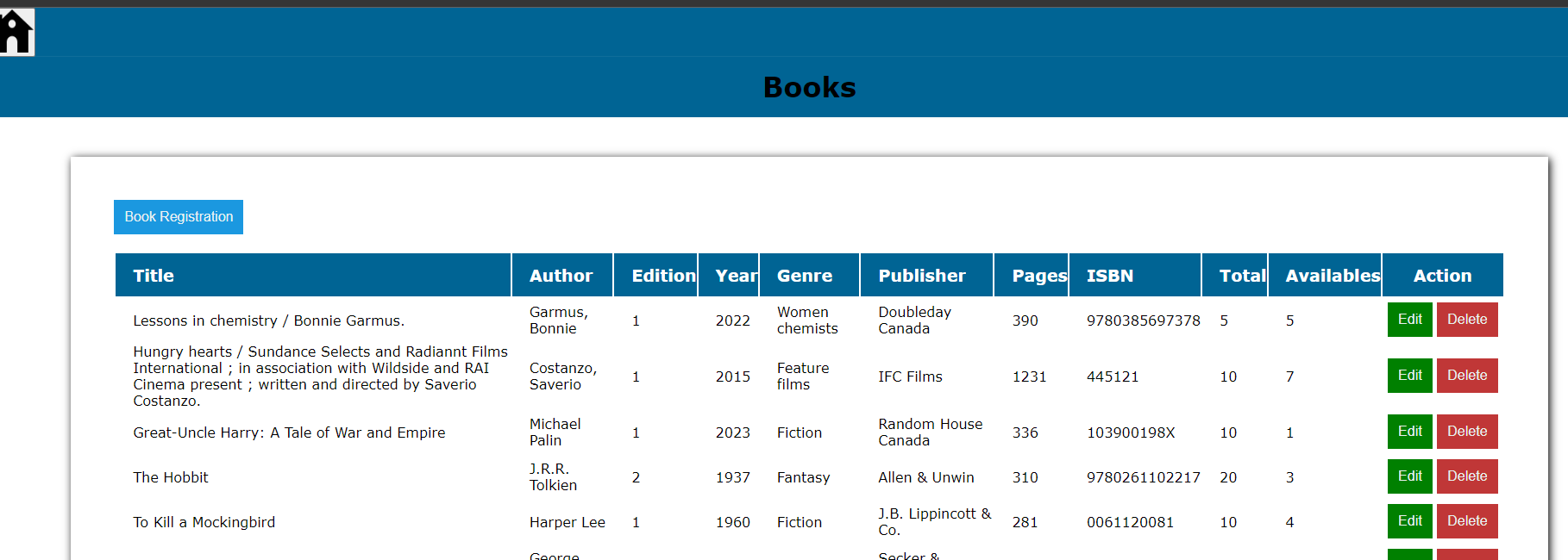
System Layers – Front-End

Slide 5


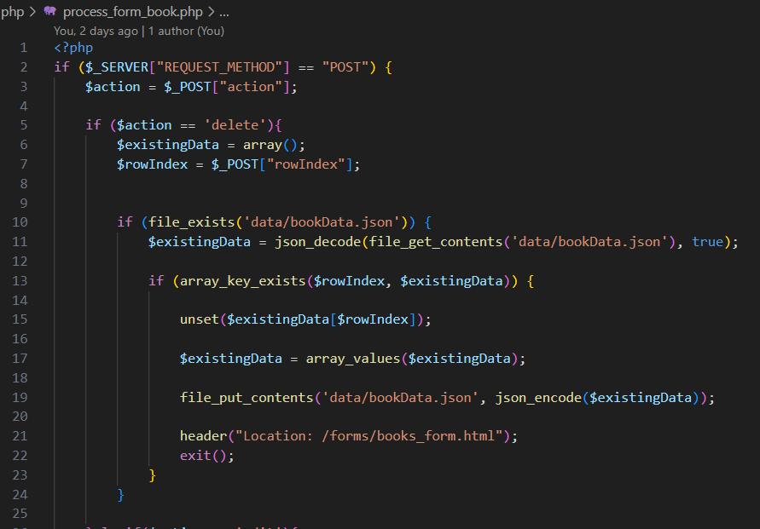
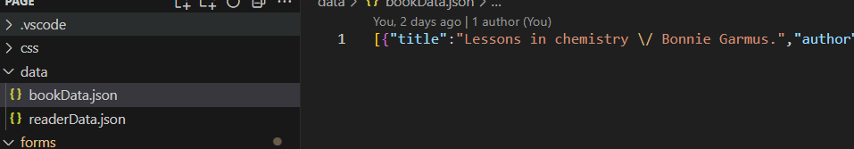
System Layers – Back-End

Slide 6
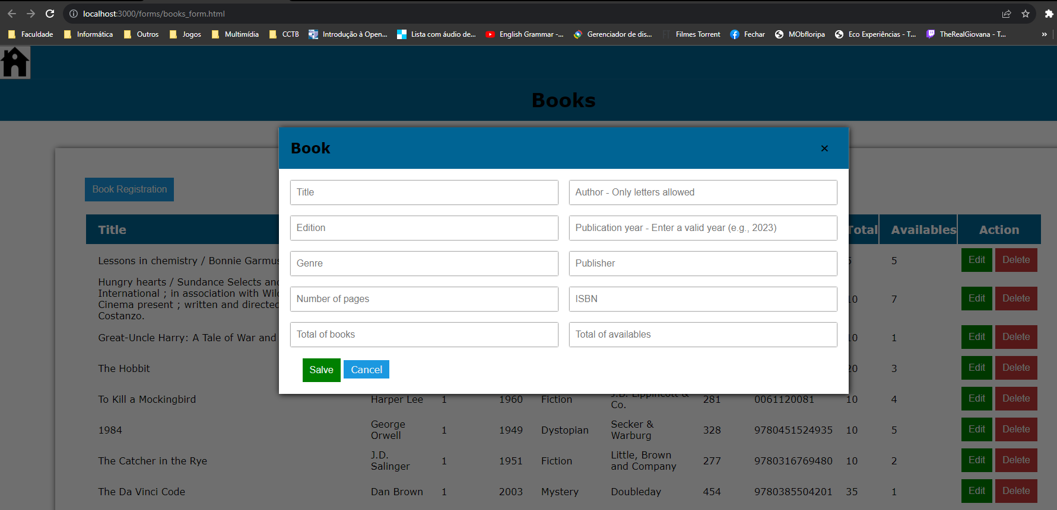
System’s Features - Design optimized
The data is displayed in tables, consistently featuring up-to-date JSON information. Notably, registering information is seamlessly facilitated without the need to navigate to a new page. This is achieved through a streamlined activation and deactivation process conveniently integrated within the same page.

Slide 7
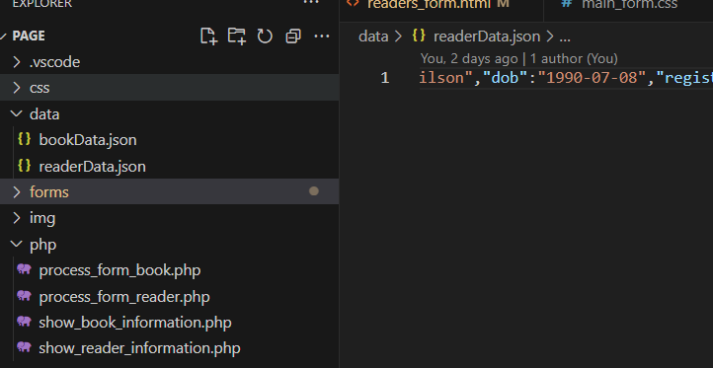
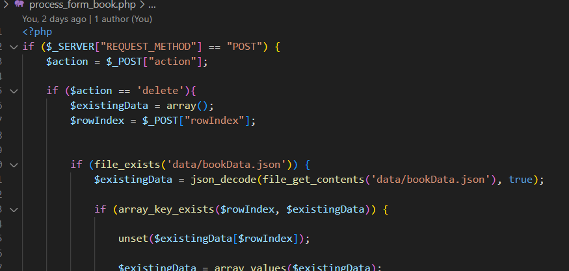
System’s Features – Json file as a database
We leverage JSON files as our database solution, thereby eliminating the requirement for a Database Management System (DBMS) and a dedicated resource for managing this technology.

Slide 8
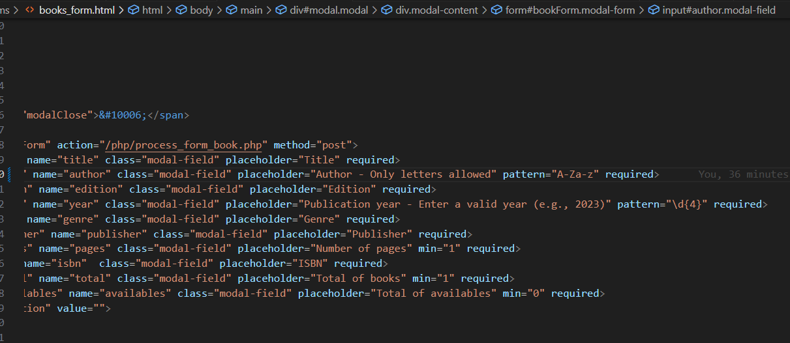
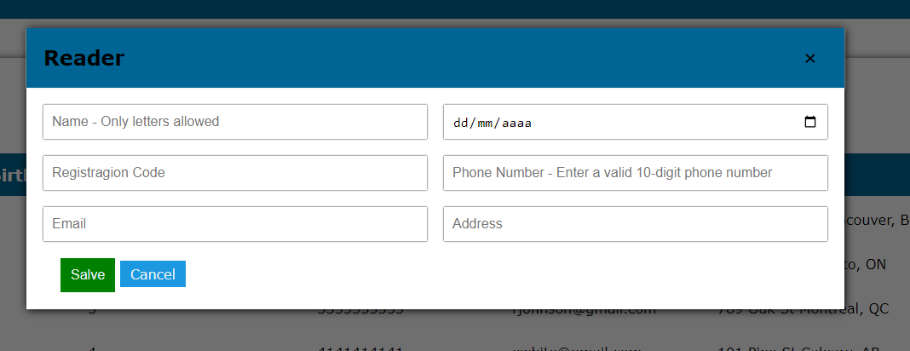
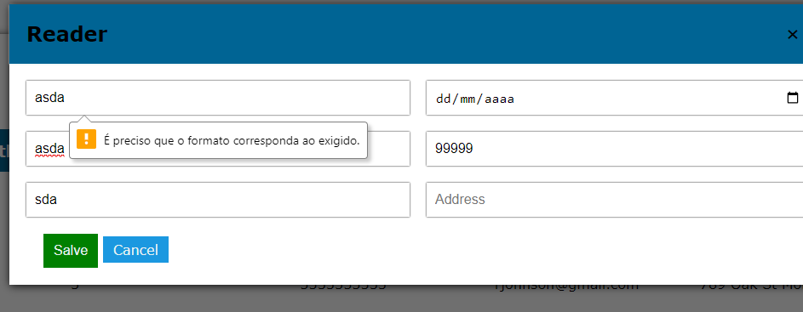
System’s Features – Data validation
We implement data validation attributes in HTML input elements, ensuring that users can only input information accepted by the system.the system accepts

Slide 9
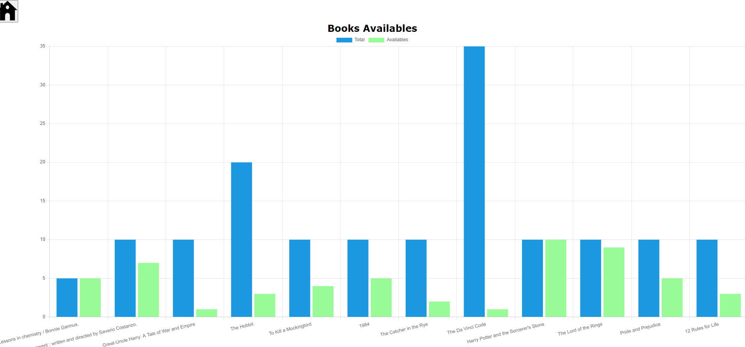
System’s Features – Chart of books available
We display a graphical representation illustrating all the books in the library along with the corresponding availability for loan, providing a visual overview of this data.

Slide 10

Future Improvements: Expand the variety of available graphics Implement book publisher control functionality Enhance site responsiveness for optimal viewing on mobile phones

Slide 11
What we learned with the project
JSON Manipulation
Manipulate JSON files with PHP
Parameter Pass
Pass parameters through different pages with JS
Modal Dialog
Use CSS 3 to create modal dialog boxes
Charts in JS
Create charts with JS
jQuery & JS
Enhance the understanding of jQuery and JS
Github
Develop the usage of GitHub

