Slide 1
MIT and Harvard Online Courses Analysis
Cindy Nguyen, Luiz Gustavo F. Malpele, and Miguel Amaral
Introduction to Data Science – Final Project
Florida Polytechnic University

Slide 2
Introduction
This project investigates the harvardMIT.csv dataset, which brings data regarding online courses of these two academical institutions.
The main objective is to examine the factors that have the most significant impact on lower completion rates and to create predictive linear models that will anticipate what will be the completion rate of courses that will further be created by Harvard and MIT.

Slide 3
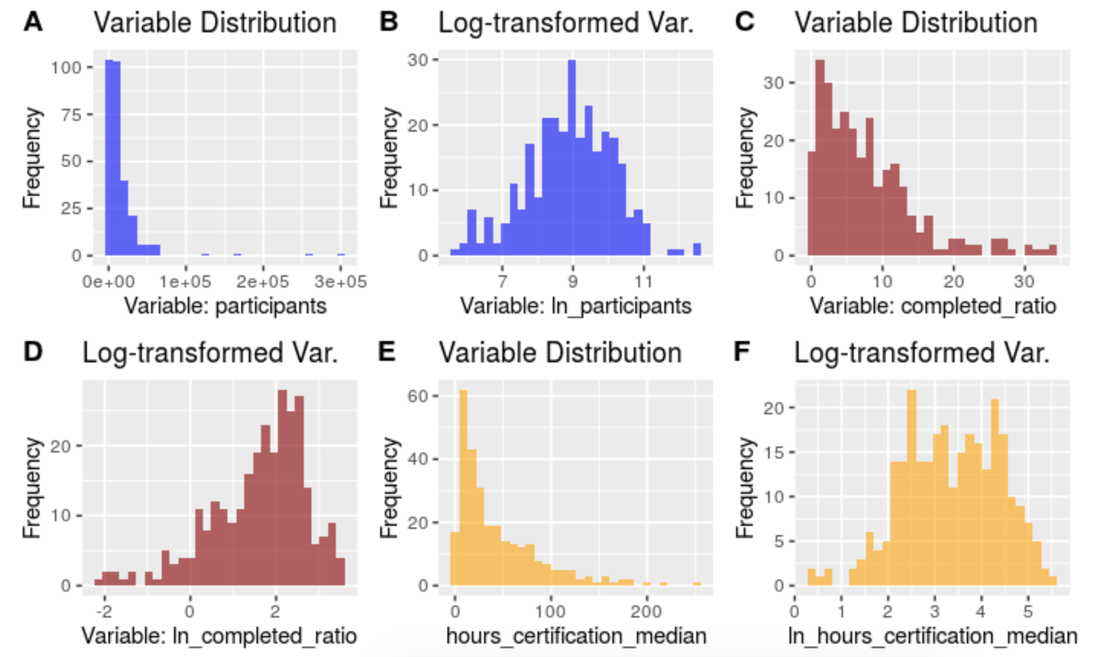
Data Wrangling for Cleansing
All variables were renamed using the delimiter separated-convention: hours_certification_median.
Natural logs of participants, completed_ratio, and hours_certification_median were taken to analyze variables that are approximately normal distributed.
Helps capturing non-linear relationships.
NA values and Inf were removed.

Slide 4
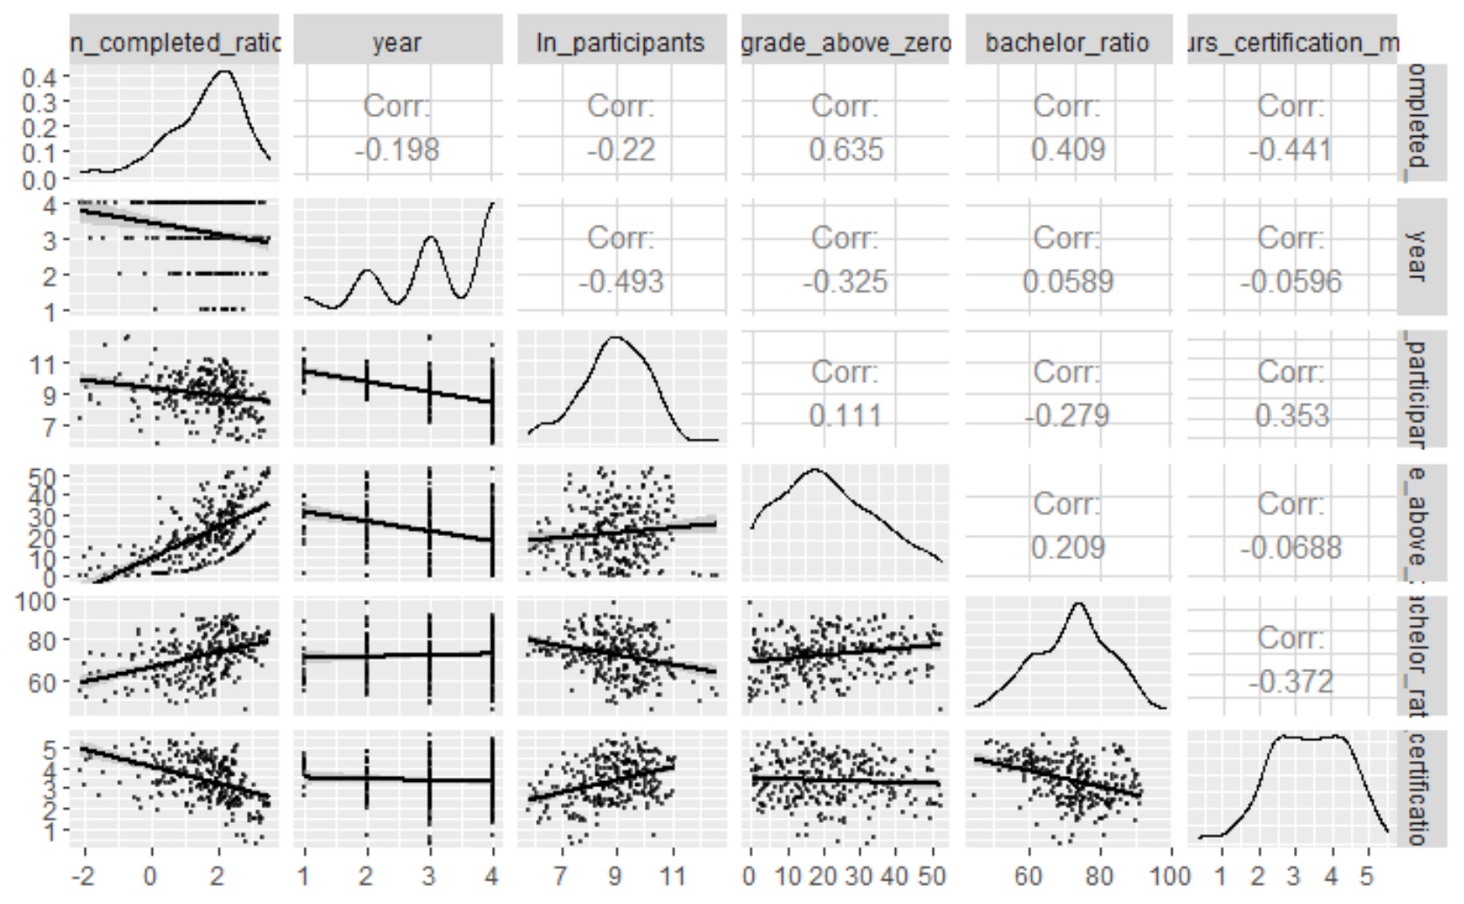
Correlation Panel
High correlation standards indicate that the variable is likely to be used for prediction:
grade_above_zero, bachelor_ratio
ln_hours_certification_median
These three continuous variables are strong candidates to be explanatory variables for the prediction of completion ratio.

Slide 5
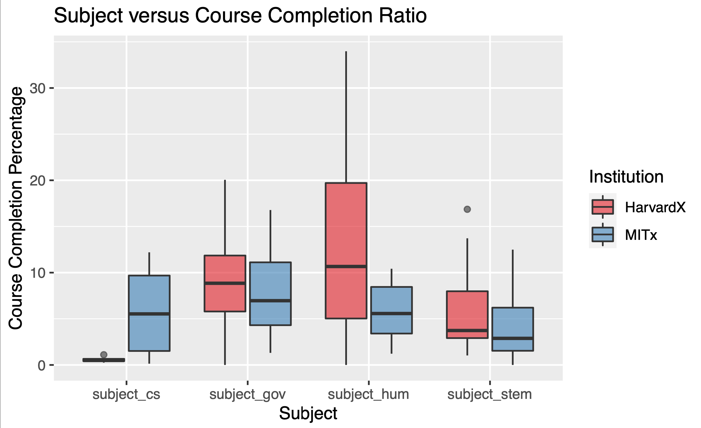
Subject vs Course Completion Ratio
MIT is known for its engineering and physical science programs and Harvard is known for their Social Sciences and has the highest median of 11 student ratio completing the course in Humanities.
It is possible that MIT has a lower median because STEM related courses can be difficult taken online or they could have smaller class sizes.

Slide 6
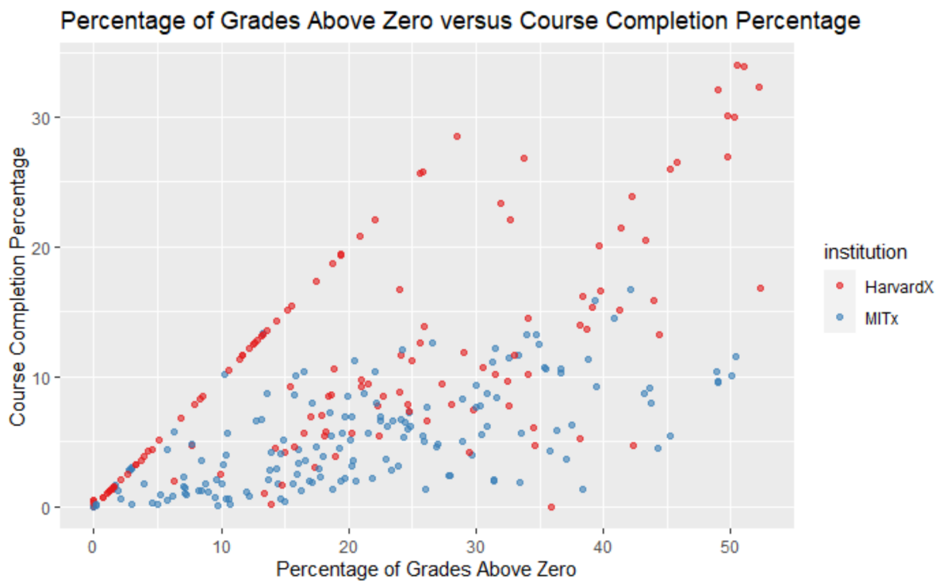
Percentage of Grades Above Zero vs Course Completion Percentage
MIT has a more gradual positive increase because there are not as many students completing the course.
Harvard has a constant linear positive increase as the class sizes could be larger.
Harvard has higher rate of students completing the course than MIT, who does have an increasing of percentage grades, but not course completion.

Slide 7
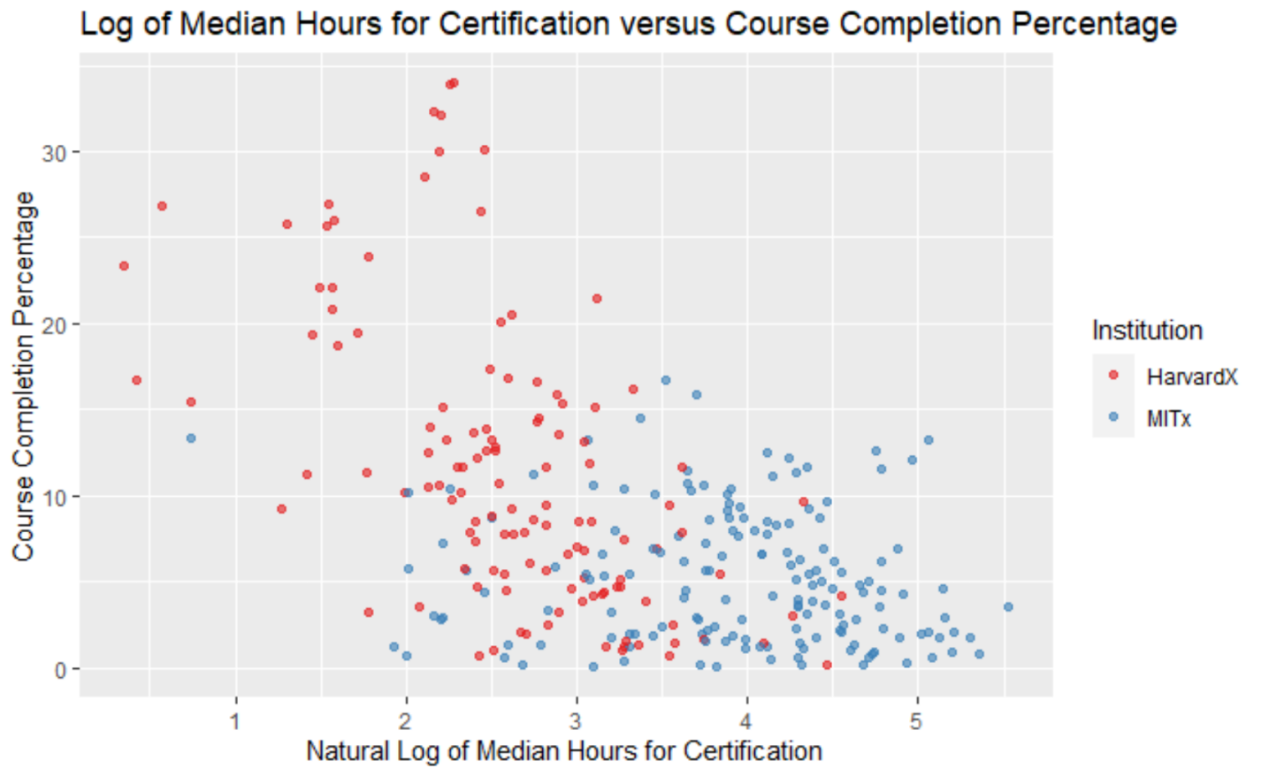
Log of Median Hours for Certification vs Course Completion Percentage
On average, Harvard's courses take about two to three median hours to complete certification and have high course completion percentage.
MIT has a lower completion rate due to possible smaller class sizes and takes more hours to receive the certification.

Slide 8
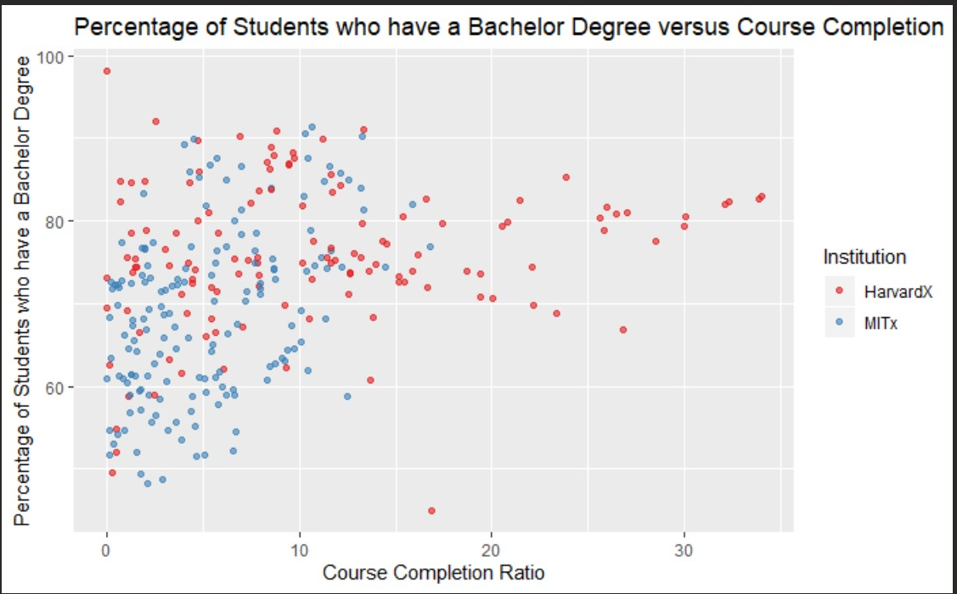
Percentage of Students who have Bachelor Degree vs Course Completion
MIT has lower averages than Harvard. This could mean that there are smaller groups of students enrolling in the online programs at MIT.
Harvard has about 80 percent of their classes, with a wide range of course completion ratios, who have a Bachelor’s Degree.

Slide 9
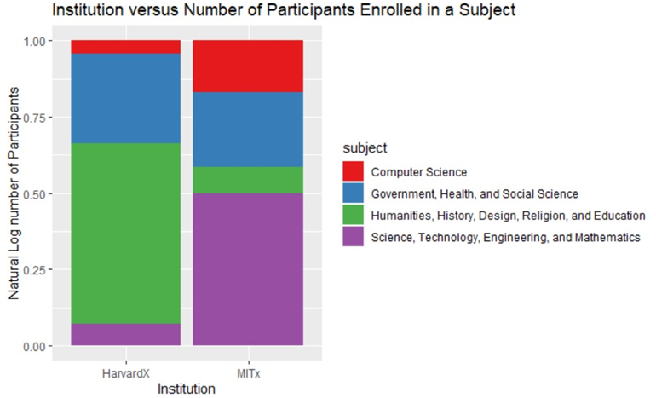
Institution vs Number of Participants Enrolled in a Subject
About 50%of students enrolled at MIT are taking STEM related courses.
The same can be said for Harvard with about 50% of students enrolled in Humanities, History, Design, Religion, and Education.
The Government, Health, and Social Science course are about the same number of participants as it is required that everyone must take a Social Science as an elective or general education course.

Slide 10
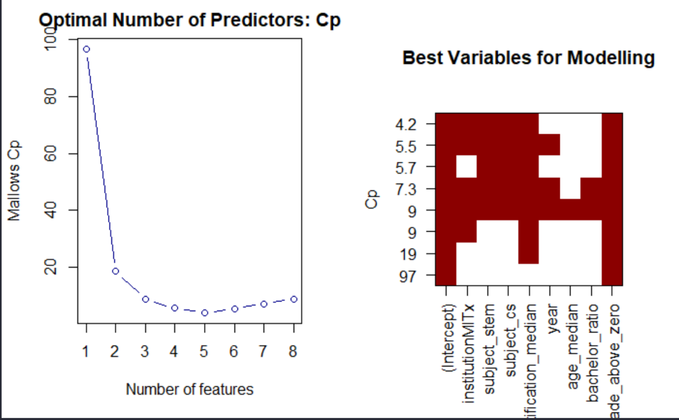
Linear Models
BIC, Mallows' CP, and the Adjusted-R^2 from the best subset selection method were the used criteria for variables selection.
The select model will account for 4 or 5 predictors, more than this will result in overfitting and these variables will be: instution, subject_cs, hours_certification_median, subject_stem, and grade_above_zero_.

Slide 11
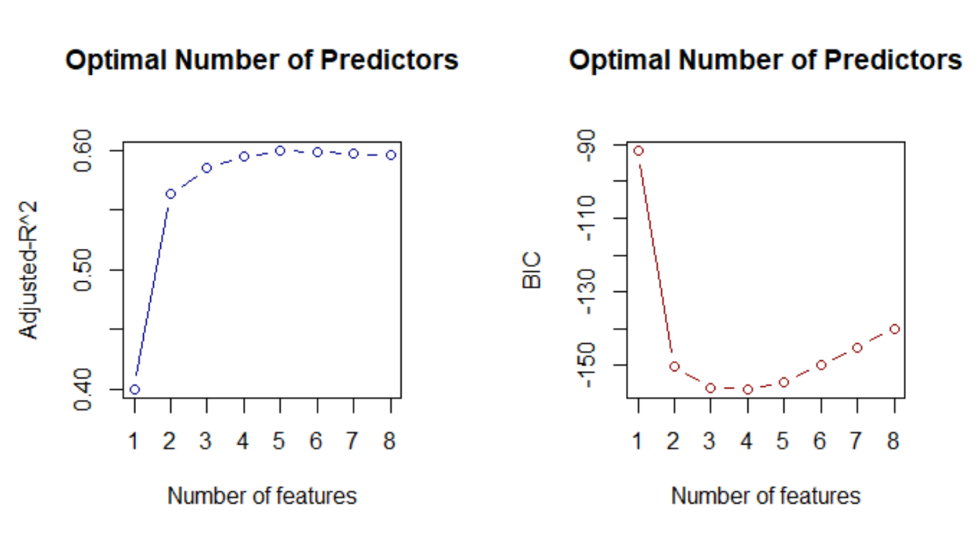
Best Subset Selection Criteria

Slide 12
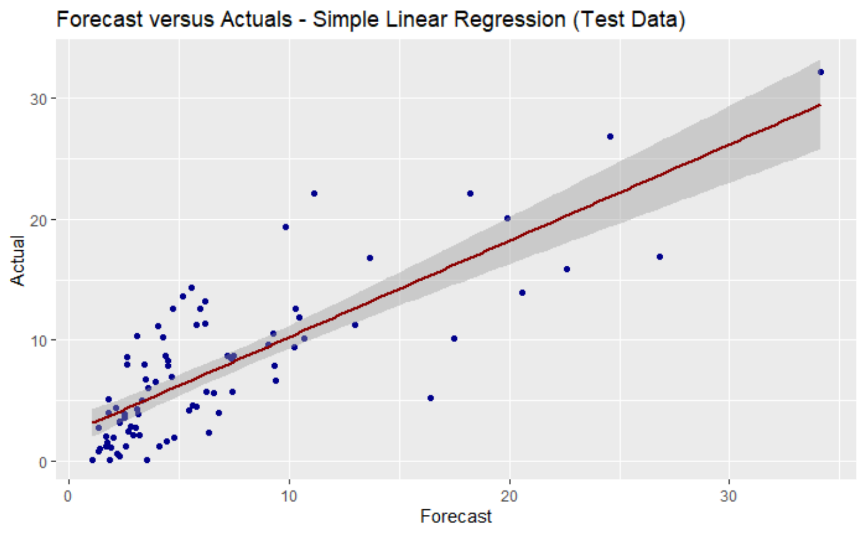
Forecast vs Actuals – Simple Linear Regression (Test Data)
Ordinary Least Squares Regression Equation:
ln_completed_ratio = 1.71 + 0.26*institutionMITx -0.54*subject_cs-0.31*suject_stem-0.25*ln_hours_certification_median + 0.049*grade_above_zero
Most of the points are concentrated around the line and that the actual value are not as different when compared to the forecast.
The line closely matches (x,y) pairs such as (10,10) and (20,20), which indicates that this model is relevant for prediction.
Harvard: +26% completion
Computer Science Course: -54% completion
STEM Related Course: -31% completion

Slide 13
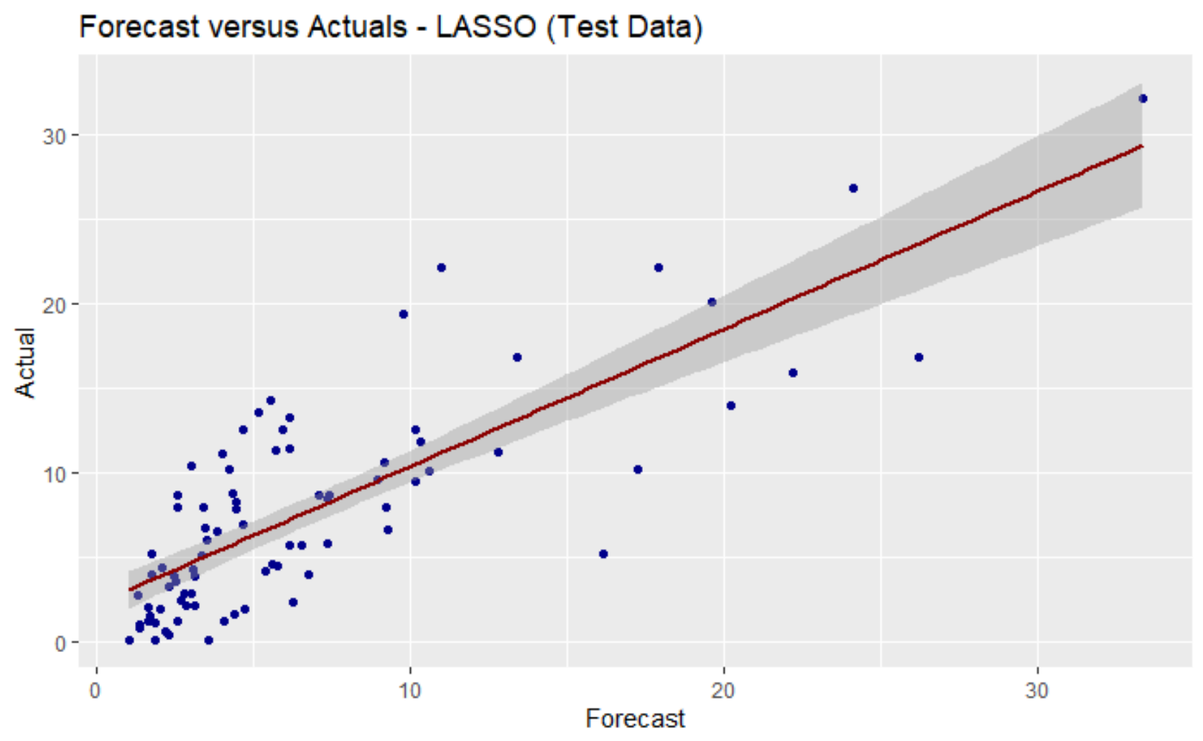
Forecast vs Actuals – LASSO (Test Data)
LASSO: Least Absolute Shrinkage and Selection Operator
When the LASSO penalization was applied to the parameter, the obtained RMSE was 0.6207. There was a small increase in bias, but the gain o explanatory power was more significant.

Slide 14
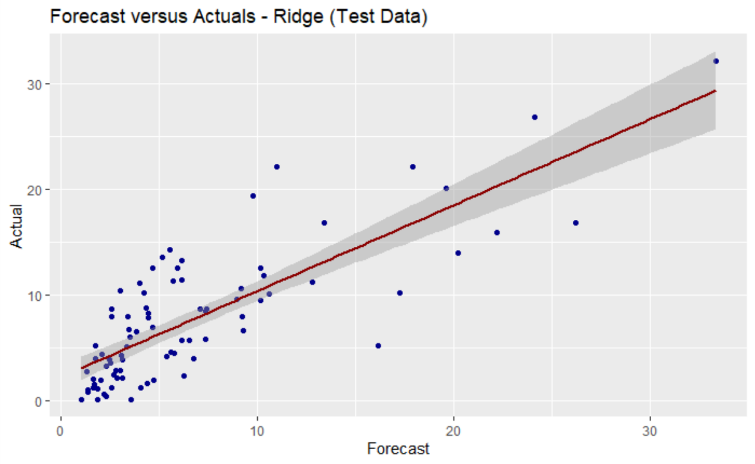
Forecast vs Actuals – Ridge (Train Data)
There not a visible difference when compared to the result obtained by the LASSO model.

Slide 15
Conclusion
There is a trend of lower completion rate related to MIT, when compared to Harvard;
A substantial difference on completion rate between computer science, STEM related subjects, and humanities related subjects:
STEM and computer science have on average lower completion rates;
Longer courses have a substantial lower completion rate;
Courses with high incidence of zeros tend to have lower completion rates.

Slide 16
Recommendations
For the creation of new online courses, especially for those on the STEM and computer science field, these need to have tools that will help the student to engage with the material on the beginning stages of the course.
It is highly recommendable avoiding a robust course work.
The predictive model that was created for evaluating percentage of people that will complete a course is an Ordinary Least Squares with the LASSO penalization and it demonstrated to be effective as noted on the Actual versus Forecast plot.

Slide 17
Questions?

Slide 18
MIT and Harvard Online Courses Analysis
Cindy Nguyen, Gustavo Malpele, and Miguel Amaral
Introduction to Data Science – Final Project
Florida Polytechnic University

