Slide 1
SWE – Project – E-Commerce
Luiz Sampaio ID 613723
Yaser Alqasem ID 614152
Abdullah Alfoqha ID 614212

Slide 2
Table of contents
Project Idea
User Stories
Use Case Diagram
Acceptance Criteria
Architecture
Class Diagram
Activity Diagram
State Machine Diagram
Future work
Demonstration

Slide 3
Project Idea
We want to create an electronic Shopping using Java SpringBoot as the back-end and React.JS as a front-end

Slide 4
User Stories
As a customer I should be able to browse shop categories, so that I can find the product I want easily.
As a customer I should be able to view the product details, so that I can see the product (Price, Details).
As a customer I should be able to add product, so that I can view the product in my shopping cart.
As a customer I should be able to view my shopping cart, so that I can see the already added products.
As a customer I should be able to update the shopping cart, so that I can add/remove products to it.
As a customer I should be able to view the total order cost, so that I can review how much I will pay.
As a customer I should be able to cancel order. (not implemented)
As a customer I should be able to checkout order. (not implemented)

Slide 5
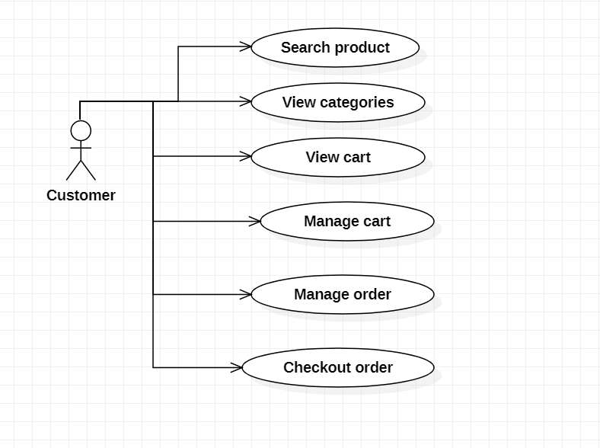
Use cases

Slide 6
Architecture & Software Developing Methodology
Layered Architecture
Front end: React JS
Back end: Java Spring Boot RESTful API
MySQL Database
GitHub as repository control
Decoupled solution

Slide 7
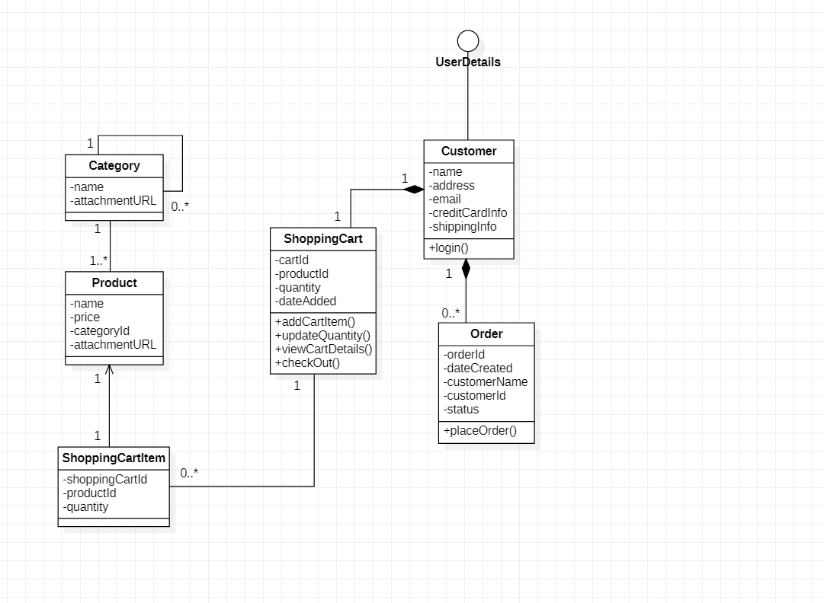
Class diagram

Slide 8
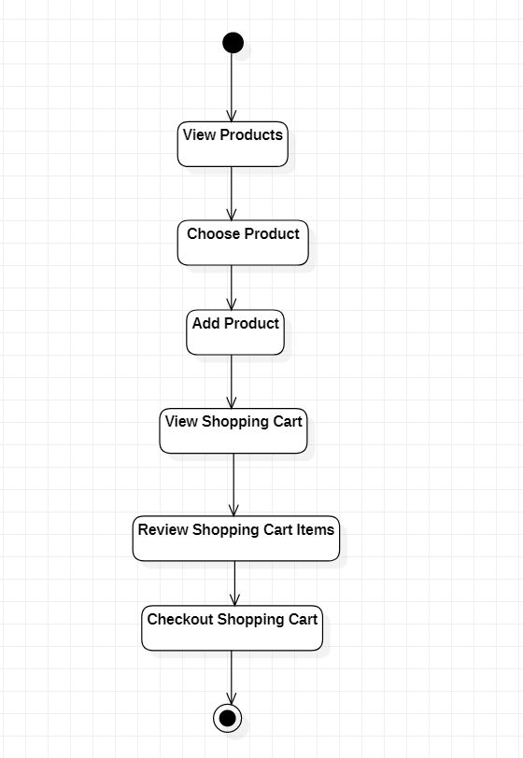
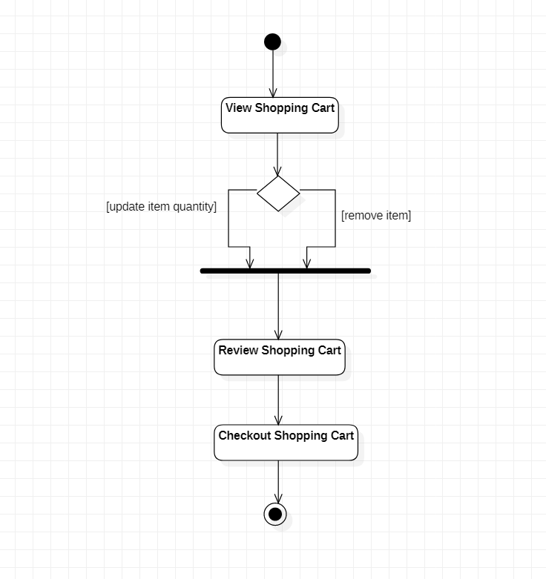
Activity Diagram

Slide 9
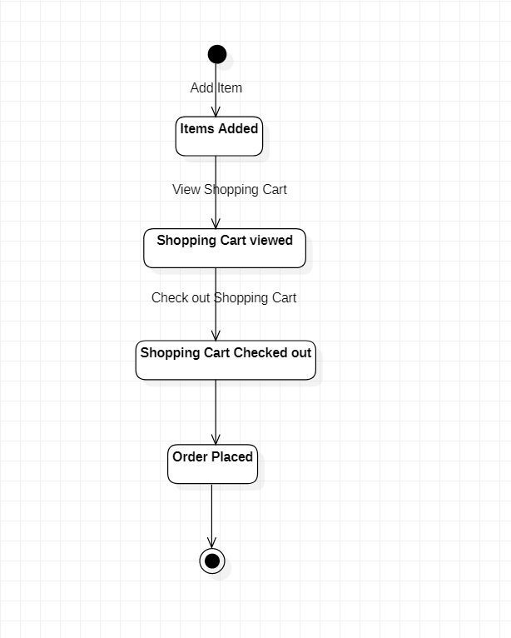
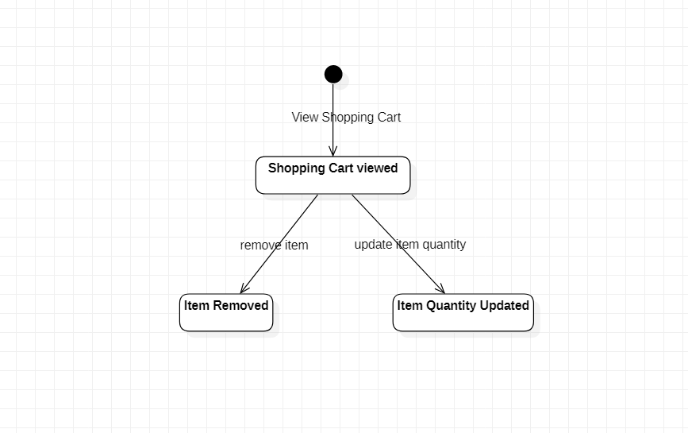
State machine Diagram

Slide 10
demonstration

Slide 11
Future work
Add payment options
Add shipping Options
Add Admin Interface to create products

