Slide 1
Sensor de Luminosidade Controle PWM de luminosidade de lâmpada LED
Sergio Takeo Kofuji
2017

Slide 2
Sensor de Luminosidade com o Raspberry Pi
Uma solução simples utilizando um LDR e um capacitor. O tempo de carga do capacitor é proporcional ao valor do LDR. Programa Python.
http://www.raspberrypi-spy.co.uk/2012/08/reading-analogue-sensors-with-one-gpio-pin/
https://www.element14.com/community/community/stem-academy/blog/2014/12/23/reading-a-photo-sensor-with-the-raspberry-pi-b
http://www.technojam.uk/wp-content/uploads/10-Input-Sensors-Light-sensor.pdf
https://pimylifeup.com/raspberry-pi-light-sensor/
Reescreva o Programa Python usando a biblioteca wiringPI
Teste manual com o comando gpio do wiringPI
http://wiringpi.com/the-gpio-utility/
Um exemplo simples usando a biblioteca “c”:
http://abyz.co.uk/rpi/pigpio/ex_LDR.html

Slide 3
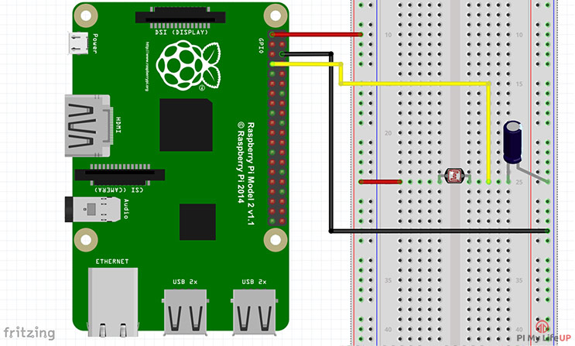

Slide 4
Controle PWM usando wiringPI
https://stackoverflow.com/questions/43870751/rpi-drive-servo-by-pwm-wiringpi-c-programming
https://www.raspberrypi.org/forums/viewtopic.php?f=63&t=151086
Teste manual com o comando gpio do wiringPI
http://wiringpi.com/the-gpio-utility/

