Slide 1


Visual Secret Sharing And Its Comparison with Caesar Cipher
Final Year Project of BSC. CSIT
Academia International College
Tribhuvan University
Institute of Science and Technology
PROJECT BY:
Sachin Maharjan (10836/73)
Sujan Raj Tuladhar (10845/73)
Nirmal Maharjan (10830/73)
Nikhil Maharjan (10829/73)

Slide 2
Agenda
Introduction of project
Problem statement and objectives
Existing Algorithms
Methodology
Implementation and Testing
Conclusion

Slide 3

Introduction of the project
Our project is about studying how visual secret sharing can be implemented in modern applications for authentication.
In addition to this we compare the Adi Shamir’s visual secret sharing with traditional Caesar Cipher Algorithm.

Slide 4
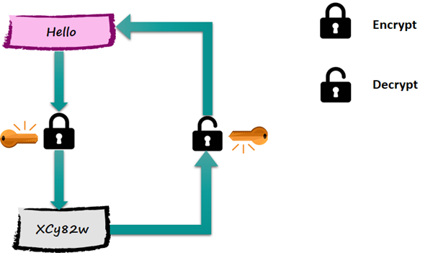
Cryptography
"Crypt" means "Hidden" and "Graphy" means "Writing".
Process of encrypting text and decrypting the encrypted text.

Slide 5
Visual Secret
Visual cryptography is a cryptographic technique.
Allows Visual information(pictures, images etc.) to be encrypted
Decryption can be performed by the human visual system.

Slide 6
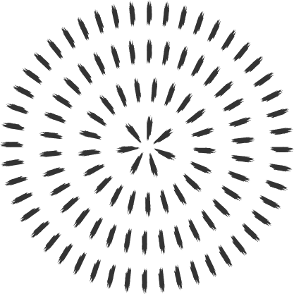
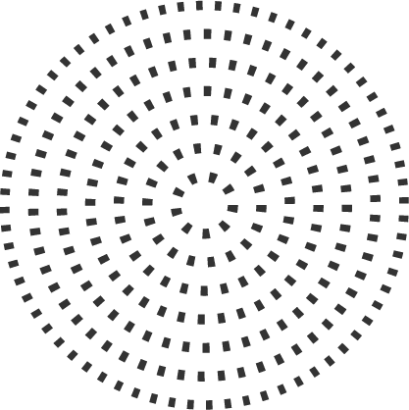
Example of VSS scheme

Slide 7
Adi Shamir's Visual Secret Sharing Scheme
Data is portioned into multiple shares.
Define minimum threshold number of shares.
When gathered from shared participants can reveal the secret.

Slide 8
Encryption
Take inputs n as total shares and k as minimum number of require threshold to recover secret.
Generate polynomial equation of degree (k-1) as q (x) = a₀+a₁x+ … +a_{k-1}x_{k1} mod p, where a0 = pixel value and a₀, a_{1,} … , a_{k-1} are coefficients < p, p is large prime.

Slide 9


Decryption
Apply Lagrange's Interpolation with minimum required threshold shares as:
Where n = total shares, fi(x) = shares value

Slide 10
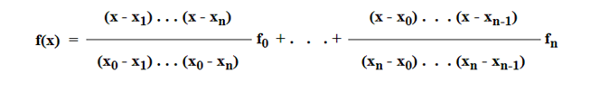
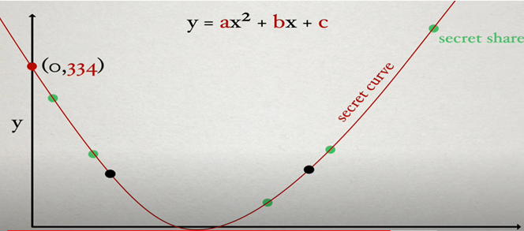
LaGrange Equation implementation on VSS

Slide 11
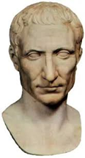
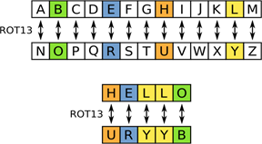
Caesar Cipher
Earliest and simplest method of encryption technique
Its' simply a type of substitution cipher
Each letter of a given text is replaced by a letter with some fixed number of position down the alphabet.

Slide 12
Existing Algorithm on Visual Secret
2 out of 2 scheme
2 by 2 block same for color image
Rotation Scheme
RGB Shuffling

Slide 13
Problem Statement
Much time consumption for encryption and decryption.
The decrypted images has low quality.
The overlapping had to be done correctly

Slide 14
Objectives of project
To understand how the share construction and secrete image reconstruction happens in the Naor Shamir's visual cryptographic scheme.
To implement the visual secret sharing scheme by using Naor Shamir's scheme and study the performances.
To compare Adi Shamir’s Visual Secret Sharing algorithm and Caeser Cipher Algorithm and provide conclusion based on result obtained.

Slide 15
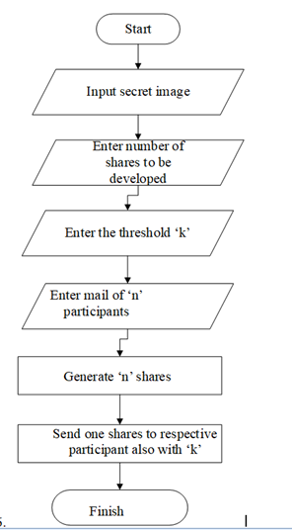
System Design
Take inputs n as total shares and k as minimum number of require threshold to recover secret.
Generate polynomial equation of degree (k-1) as q (x) = a₀+a₁x+ … +a_{k-1}x_{k-1} mod p, where a0 = pixel value and a₀, a_{1,} … , a_{k-1} are coefficients < p, p is large prime.

Slide 16
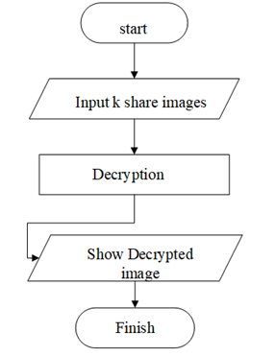
System Design (Cont...)
Apply LaGrange's interpolation with minimum required threshold shares as:
Y = q(x) = (x) mod p where l_{i} (x) = add text

Slide 17
Technology Used for Development
Python
Pillow
Numpy
Visual studio code
Jupyter Notebook
Django

Slide 18


Technology Used for Development
Any Web server that supports Django

Slide 19

Testing
Process of evaluating a system or its component(s) with the intent to find whether it satisfies the specified requirements or not.
We are testing algorithms based on NPCR and UACI.

Slide 20
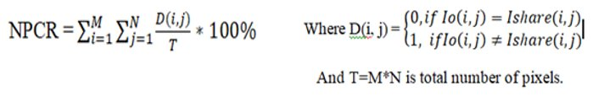
NPCR
NPCR stands for Number of Pixel Change Rate.
The NPCR measures the percentage of different pixel numbers between original images with the shares image.
Higher the NPCR, Stronger will be the algorithm.
Mathematically, NPCR is defined as:

Slide 21
NPCR TEST RESULT
S.No | (Threshold(k), Total Shares(n) and p=257) | Shares | NPCR (%)
 |  |  | Visual secret Sharing | Caesar Cipher
1 | (2,3) | 1 | 100 | 100
 |  | 2 | 100
 |  | 3 | 100
2 | (3,5) | 1 | 100
 |  | 2 | 100
 |  | 3 | 100
 |  | 4 | 99.9967
 |  | 5 | 100
3 | (4,6) | 1 | 100
 |  | 2 | 99.9943
 |  | 3 | 100
 |  | 4 | 100
 |  | 5 | 99.9943
 |  | 6 | 100
4 | (7,7) | 1 | 100
 |  | 2 | 100
 |  | 3 | 100
 |  | 4 | 100
 |  | 5 | 100
 |  | 6 | 100
 |  | 7 | 100
Average |  |  | 99.9993 | 100

Slide 22

UACI
UACI stands for Unified Average Change Intensity.
It determines the average intensity of differences between the two images.
Mathematically UACI is defined as
Where T=M*N is the total number of pixels. F is the largest supported pixel value and C is the total number of color component of image

Slide 23
UACI TEST REPORT
S.No | (Threshold(k), Total Shares(n) and p=257) | Shares | UACI (%)
 |  |  | Visual secret Sharing | Caesar Cipher
1 | (2,3) | 1 | 98.4435 | 97.66
 |  | 2 | 97.2726
 |  | 3 | 96.1089
2 | (3,5) | 1 | 96.4980
 |  | 2 | 89.4941
 |  | 3 | 78.5990
 |  | 4 | 63.8132
 |  | 5 | 45.1361
3 | (4,6) | 1 | 93.774
 |  | 2 | 67.7042
 |  | 3 | 5.0583
 |  | 4 | 88.7959
 |  | 5 | 3.50192
 |  | 6 | 31.9066
4 | (7,7) | 1 | 77.8210
 |  | 2 | 11.6731
 |  | 3 | 81.7120
 |  | 4 | 88.7959
 |  | 5 | 88.7959
 |  | 6 | 50.5836
 |  | 7 | 30.3501
Average |  |  | 65.9841 | 97.66

Slide 24
Execution Time of Adi Shamir's VSS Scheme
S.No. | (Threshold, participants) | Share generation time in microseconds | Shares reconstruction time in microseconds
1 | (2,3) | 811756 | 536379
2 | (3,5) | 390484 | 21839
3 | (4,6) | 719020 | 782960
4 | (7,7) | 862300 | 880284

Slide 25
Application of Visual Secret Sharing
Authentication
Saving and secured confidential visual data
Military (such as missile Launching)
Banking (shared accounts)

Slide 26
Conclusion
During analysis of the two algorithm, we got high NPCR and UACI rate of the Caesar cipher. Caesar cipher can be braked easily by guessing the key.
Due to low overhead the Caesar Cipher is faster than Adi Shamir's Algorithm. Encryption in Adi Shamir's VSS costs O(n3) and decryption takes (O4). In contrast the encryption and decryption using Caesar cipher takes O(n3) only.

Slide 27
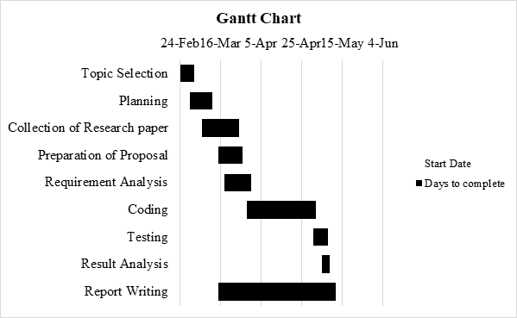
Gantt Chart

Slide 28
References
[1] A. D. B. a. A. D. Santis, "Secret Sharing and Visual cryptography schemes," Dipartimento di Informatica ed Applicazioni, Università di Salerno,, 84081 Baronissi (SA), Italy.
[2] M. N. A. Shamir, "Visual Cryptography," Department of Applied Math and Computer Science, Weizmanu Institute, Rehovot, 1995.
[3] M. Quist-Aphetsi Kester, "A cryptographic Image Encryption technique," International Journal of Advanced Research in Computer Engineering & Technology (IJARCET), Vols. Volume 2,, no. Issue 2,, ,January 2013.
[4] D. K. S. Ashish Sharma, "A Comprehensive View on Encryption Techniques of Visual," International Journal of Recent Research and Review, Vols. , Vol. VII,, no. Issue 2,, June 2014.
[5] V. V. T. R. J. Tamilarasi, "Improving Image Quality In Extended Visual," INTERNATIONAL JOURNAL OF SCIENTIFIC & TECHNOLOGY RESEARCH, Vols. VOLUME 3, , no. ISSUE 4,, APRIL 2014.
[6] M. I. G. R. A. F. I. a. G. D. C. Zhi Zhou, "Halftone Visual Cryptography," AUGUST 2006.
[7] Z.-Y. Q. a. C.-F. T. Young-Chang Hou1, "Progressive Visual Cryptography with Friendly and size invariant shares," The International Arab Journal of Information Technology, Tamkang, Tiwan, March 2018.
[8] Y.-C. Hou∗, "Visual cryptography for color images," pergamon, Jung Li, Taiwan, Received 6 June 2002; accepted 26 August 2002.
[9] S. J. H. k. a. M. y. Amir hergberg, "Proactive secreat sharing or how to cope with perpetual leakage," IBM TJ Watson Research Center, York Town Heights, New York.

Slide 29

Thank you

