Slide 1
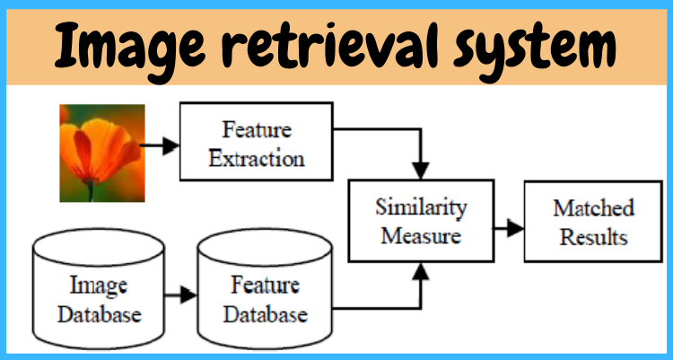
Matching in Embedding Spaces Using Deep Networks
Luke Jansen

Slide 2
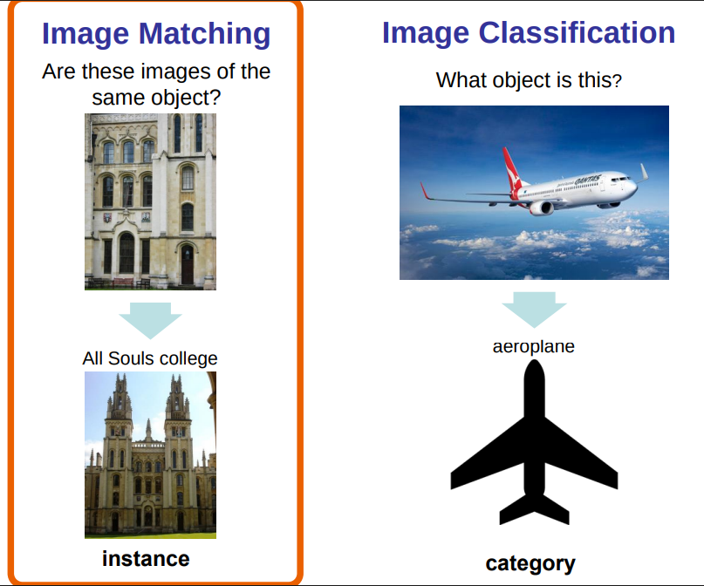
Matching vs Classification
Matching: Given an image, compute embedding and match it to the most similar image in a dataset
Classification: Given an image, pick the most likely class based on learned weights
https://www.robots.ox.ac.uk/~vgg/projects/seebibyte/events/overview_az.pdf
Notes:
Matching is more flexible than classification because with classification, the classes have to be baked into the network at training time (the final output layer has to have the same number of outputs as there are classes). Because with matching the network just computes an embedding of the image, class inference is not tied to the network and thus new classes can be added just by adding more images to the database.

Slide 3
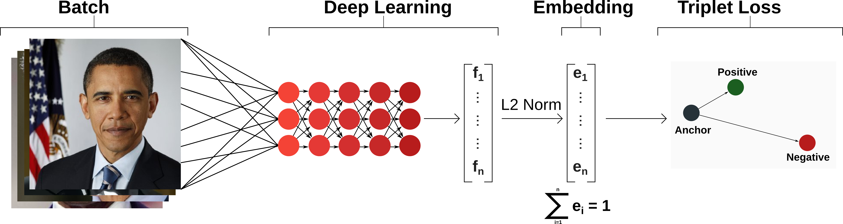
Case Study
FaceNet – Google, 2015
  Recognize input face against database of millions of faces
  Classification impossible
  128-dimensional CNN embedding, triplet loss, semi-hard negative mining
  Validates match if distance is lower than threshold
Notes:
– can’t have softmax with 1m+ outputs, plus new faces added constantly
semi-hard negative mining — picking negatives that are challenging but not so hard they destabilize training — done online within each large batch.

Slide 4
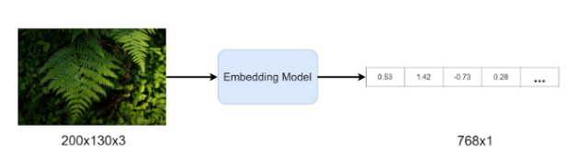
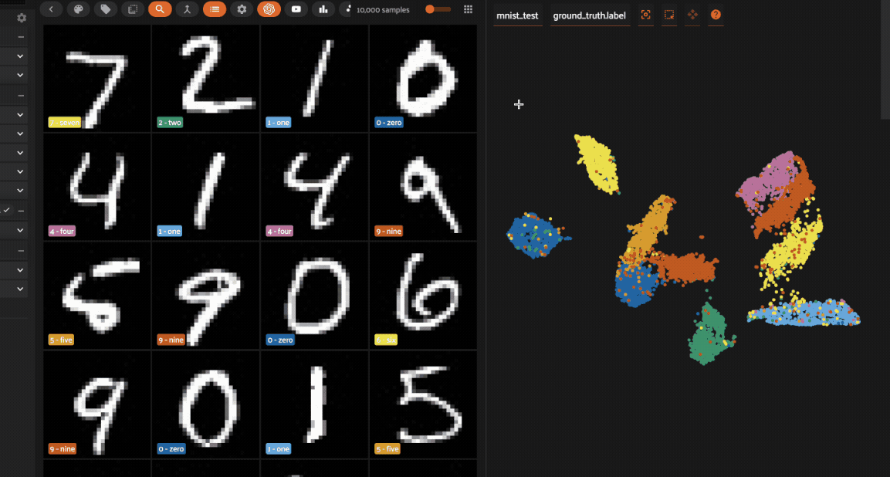
What is an Embedding?
Simplify high dimensional image data into a vector that captures only the essential features of an image.
Projects images into same space, where matching can be done
Classical and deep network approaches
https://dagshub.com/blog/image-embedding-benefits-use-cases-and-best-practices/
https://docs.voxel51.com/tutorials/image_embeddings.html
Notes:
Performing the same embedding on a set of images projects them into the same continuous space, which then you can perform matching.

Slide 5
Crafting Feature/Embedding Space
Classical: Hand pick filters, activations, run image through, output is embedding. Single pass.
Classical ML: Hand pick filters, learns output weights.
Deep Network: (usually) hand pick layer architecture, learns filter weights and output weights through back prop., output is embedding space where same-label images appear close together
Notes:
Classical ML: Haar-like features. Alvin
Haar-like features?
General purpose algorithms
Ensembles
Adaboost
Image pyramid
NMS, concept of IOU

Slide 6
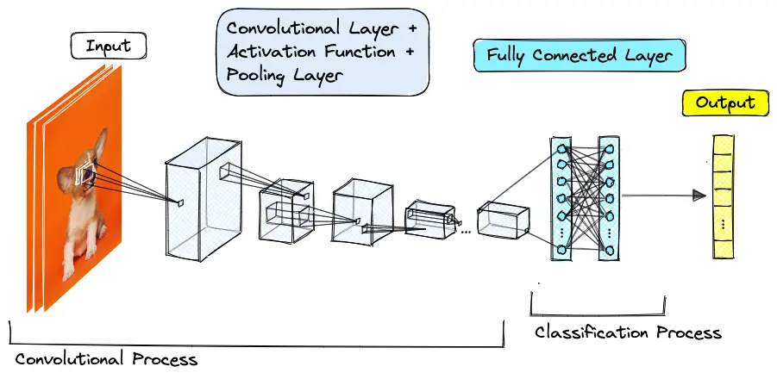
CNNs
Convolution layers learn spatial features like edges, textures, etc.
Pooling layers condense image so that increasingly higher level features can be learned
Notes:
CNNs are common choice for image matching because
Pooling + Conv layer stacks encourage more high level features, which makes network translation, orientation, lighting, independent.

Slide 7
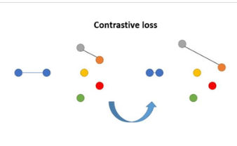
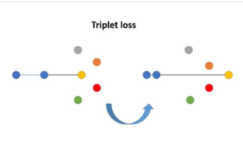
Deep Network Loss Functions
Contrastive Loss: For each image pair, pull/push away based on match
Triplet loss: More forgiving than contrastive loss. Catch: most random triplets already satisfy this, so hard negative mining is needed
https://www.researchgate.net/figure/sual-representation-of-a-gradient-descent-step-for-each-of-the-compared-losses_fig1_333418402
Notes:
Loss function – single number the training tries to minimize and directs back propagation
Cross-entropy: Used for classification. Compares the probability the network assigned to the correct class (desires a probability of 1). Makes confident wrong answers really expensive.
MSE: Used for regression and continuous values.
For embeddings, there is no output label to compare against. The loss instead looks at distances between embeddings. There are a couple different ways to look at this distance
Contrastive Loss: For each image pair, if they are same class, loss is squared distance (pull together). If different classes, loss penalizes them for being closer than a margin
Triplet loss: Take three images (anchor, positive, negative). Demand the positive be closer than the negative by a margin. More forgiving than contrastive loss. Catch: most random triplets already satisfy this, so hard negative mining is needed (deliberately picking triplets the netwrok currently gets wrong).

Slide 8
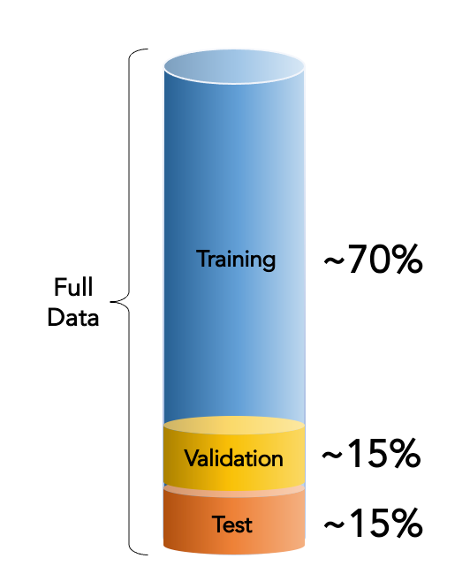

The Database & Gallery
This database concept is the same for classification problems.
Loss function changes role of the train dataset
Embedding networks have separate “Gallery” database
Notes:
Train set – teaches model filters/activations
Validation set – manages the learning process
Test set – evaluate trained model to ensure generalization
For matching, there is also a Gallery of stored embeddings, which is the collection of images where the nearest neighbor search happens. Separate from the train database used to train the model to have good/meaningful embeddings.
Gallery is made of single labeled images, train set has several images per label
e.x.: FaceNet: train set has 200m images of 8m people. Gallery just has 1 image per person
Only difference is that the loss function used on the database for an embedding network is meant to teach the model to pull/push matches together/apart rather than separate entire classes. For the embedding case, the point is to use the train data to teach the model what a good embedding is to ensure maximum separation between negative pairs, and minimum separation between positive pairs.

Slide 9
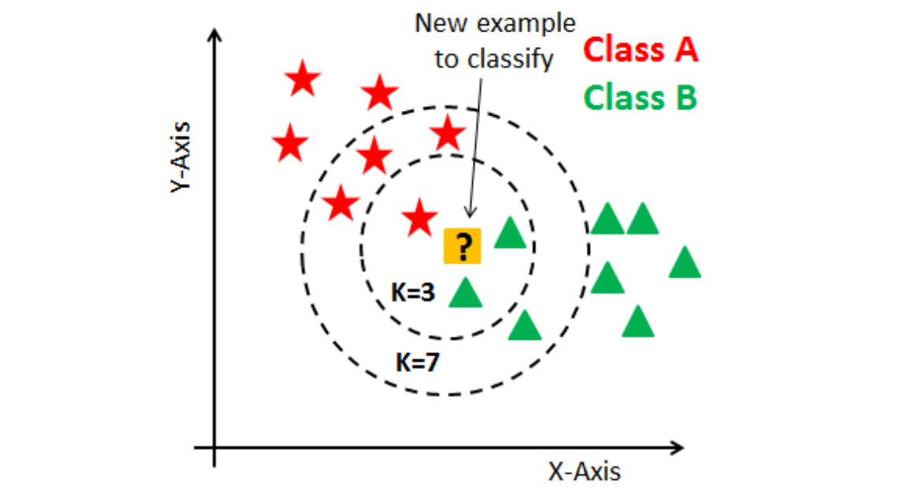
Matching
Instead of predicting a label based on a softmax over the output layer (classification), predict label by finding best match with dataset
Nearest neighbor/K-nearest neighbor
  Find the closest neighbor(s)
Nearest centroid
  Much faster (less matches to check) but loses multi-model granularity
Notes:
Nearest neighbor/K-nearest neighbor
Use some distance metric to find the closest neighbor(s) (labeled image in train dataset ) of the input
Other matching types include threshold-based verification (not really matching, just checking that a match is good enough)

Slide 10
Summary
Deep networks match by turning the problem into a geometrical one
Network first learns how to embed image with train set
Nearest neighbor search over gallery embeddings

