Slide 1
Global Placement
@luk036

Slide 2
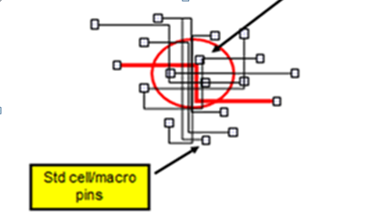
Global placement problem
About 50 years
Goal: reduce the total wire-length quickly
Important in the whole design flow
E.g. Measure of Design Space Exploration (DSE) replies on a stable P&R results
Current methods: min-sum gradient-based methods
Result: congestion problem

Slide 3
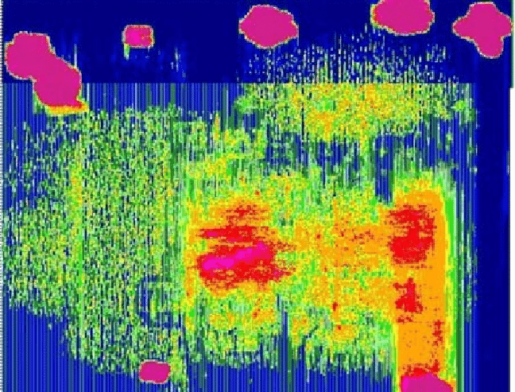
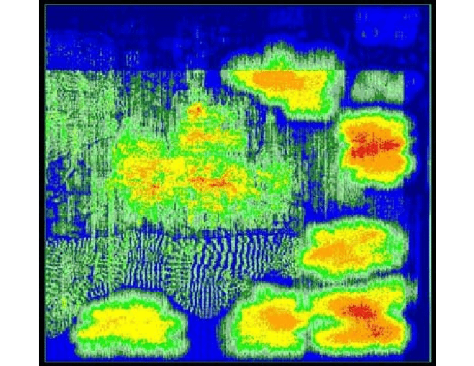
To solve the congestion problem….
Current methods: add density constraints to enforce “equality”.
Result: predictability problem (predict congestion w/o actual routing)

Slide 4
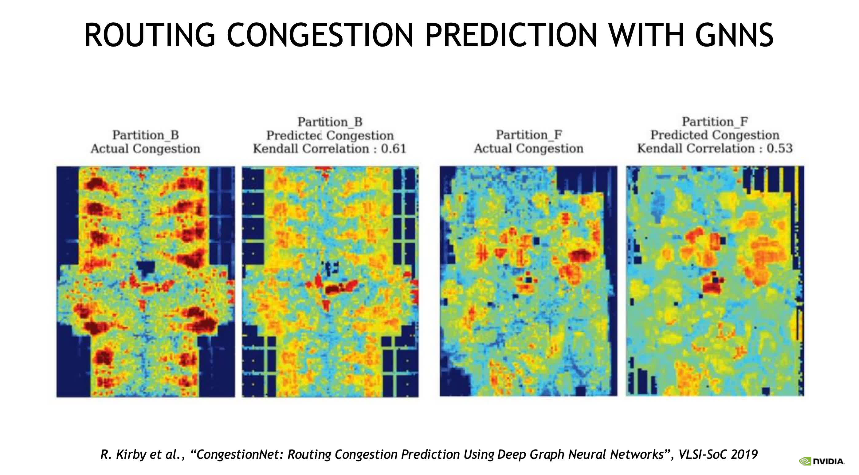
To solve the predictability problem….
Current methods: Neural network + Machine learning + GPU
Result: expensive equipment + long run time.

Slide 5
Why congestion in the first place?
Lack of routing resource? Not exactly.
不患寡而患不均:
Min-sum objective induces inequality.
Enforcing equality constraints is hard to maintain.
Proposed method:
Only enforce the min-max fairness: idea from the network service algorithm to prevent “starvation”.
“均” also mean “fairness” in ancient China.
Result (experimental) :
2000 lines of Python code + I/O placement

Slide 6

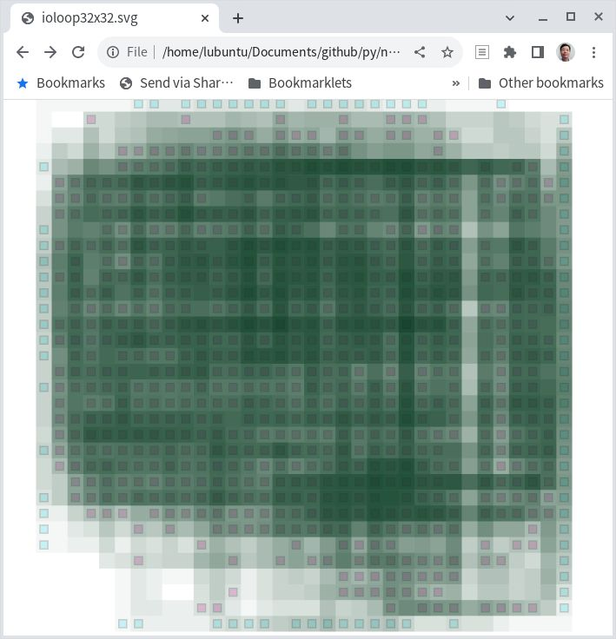
Poor man’s congestion map

Slide 7
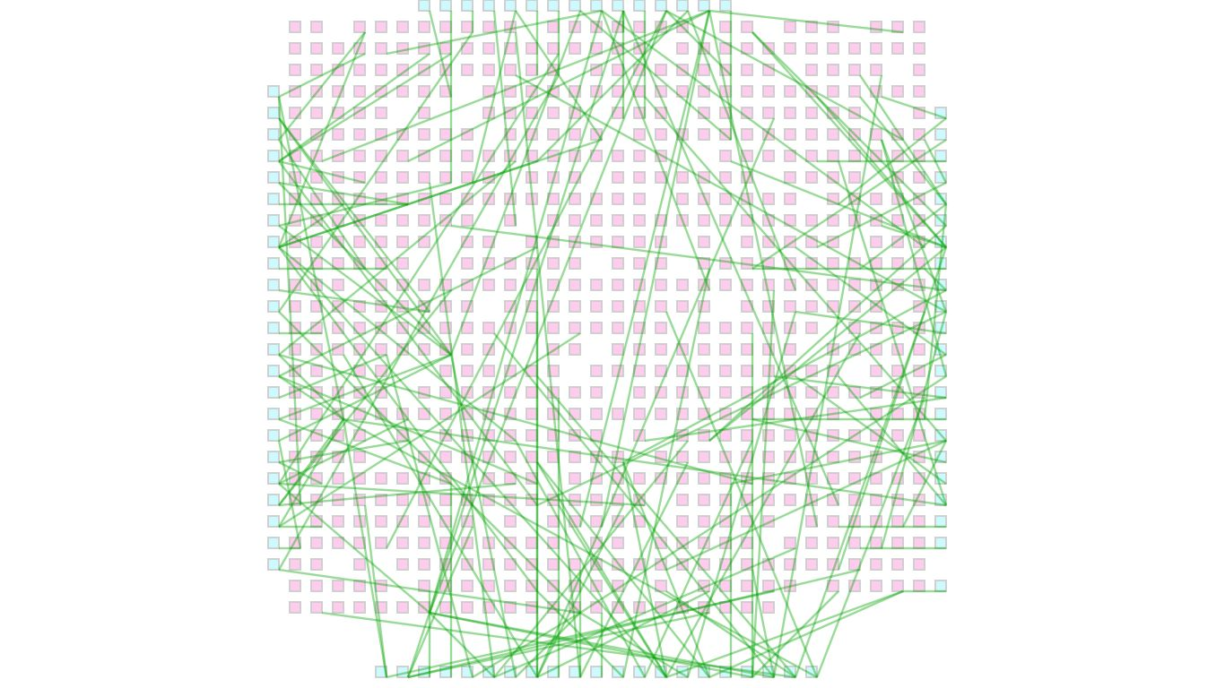
I/O assignment

Slide 8
Don’t build castles on quicksand

