Slide 1
Lubuntu 18.04 LTS
@luk036

Slide 2
Why and Why not?
Why Lubuntu?
Lightweight.
Can be run on an old PC computer.
Can be run on a USB drive.
Open source.
Less virus. No need antivirus software.
Software development.
18.04 LTS is a long-term-support version.
Why not?
Online Microsoft’s Office is not good enough.
VPN
Wi-Fi Hotspot

Slide 3
⚙️ Setup

Slide 4
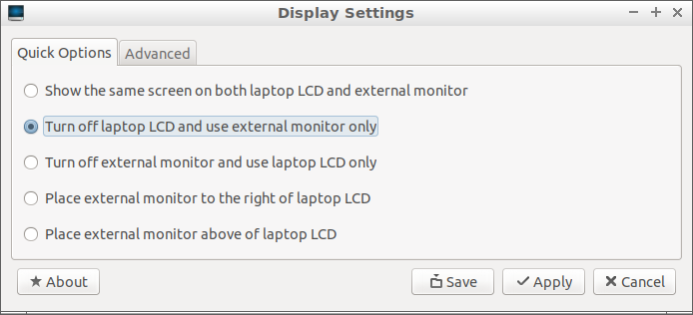
Adjust the Display Settings (optional)
In case you are using a laptop with an external monitor:
Select Preferences → Monitor Settings from main menu.
Select Turn off laptop LCD and use external monitor only.
Click Apply.
Then re-select Show the same screen on both laptop LCD and external monitor only
Click Apply and Save
image

Slide 5
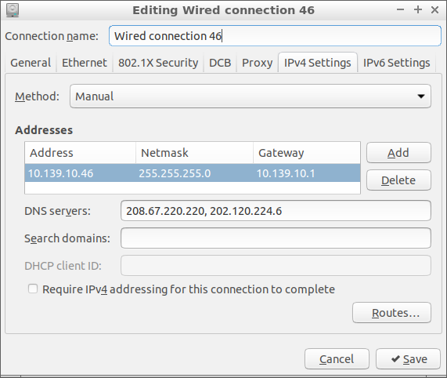
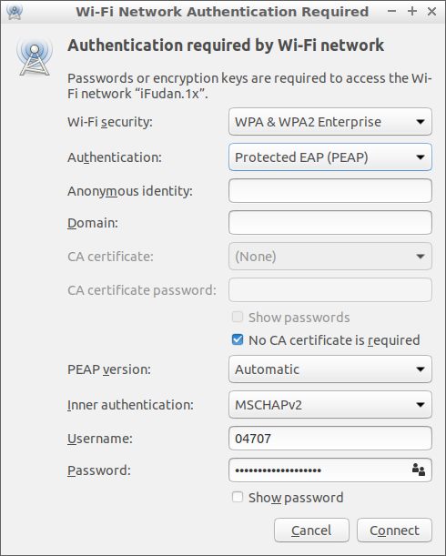
📶 Network Connections
More or less the same as in Windows.
Note that some networks may require a login from a web browser.
image
image

Slide 6
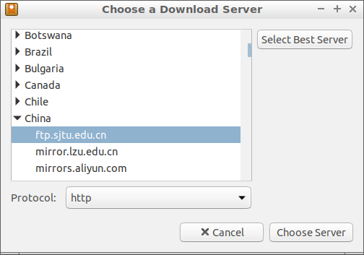
Configure Software Updates Download Server
Much faster than the main server.
Select Preferences → Software & Updates from main menu.
Select Download from: Other...
Choose a Download Server near your location.
image

Slide 7
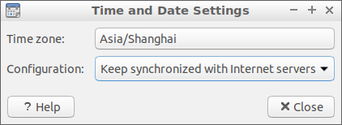
📅 Adjust Time and Date
Press Ctrl-Alt-T to open a terminal.
Type sudo apt install ntp to install a synchronization service.
Select Sytem Tools → Time and Date
Choose the Time zone of your location.
Make sure Keep synchronized with Internet servers
Wait a few seconds to make it take effective.
image

Slide 8
Install shadowsocks
sudo apt install shadowsocks
edit /etc/shadowsocks.json
exec sslocal -c /etc/shadowsocks.json
You may need Firefox Addon FoxyProxy Standard to use shadowsocks:
SOCKS5: 127.0.0.1:1080

Slide 9
Firefox Web Browser
Built-in with Lubuntu.
Sign-in to sync with other machines.
Always enabled Add-ons:
Redirector, uBlock Origin, Redirector, Vimium, 百度广告屏蔽,
Installed Add-ons: Chirpy, Evernote Web Clipper, Google Scholar Button, Grammarly for Firefox, Mendeley Importer, New Tong Wen Tang, QiuReader, Stylish, Tomato Clock, Zotero Connector

Slide 10
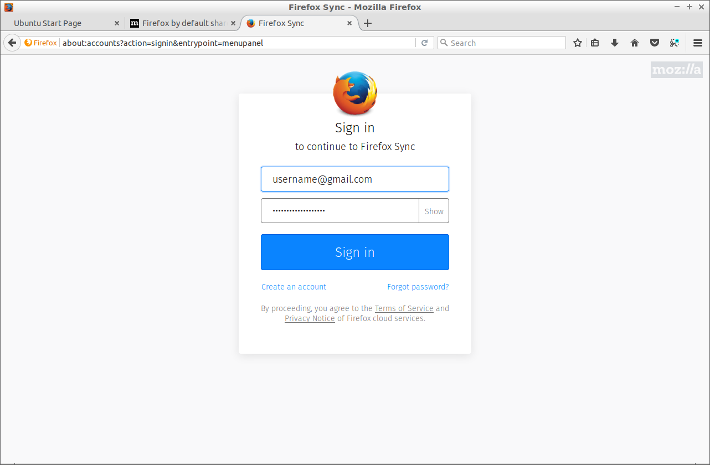
image

Slide 11
🀄 Chinese Input Methods
IBus is better than Fcitx
Press Ctrl-Alt-T to open a terminal.
Type sudo apt install ibus-pinyin to install Pinyin method.
You may want ibus-cangjie for 仓颉 or 速成。
Select Preferences → Language Support from main menu.
Ignore the warning The language support is not installed completely. Click Remind Me Later.
Choose IBus from Keyboad input method system.
Select Preferences → IBusPreferences from main menu.
Select Input Method then Add. Select Chinese and then Pinyin.
Reboot the System. Press <Super>-Space to switch the input methods.

Slide 12
Display Emoji ⌨️
sudo apt install fonts-emojione
sudo apt install fonts-noto-color-emoji
Reboot the system.

Slide 13
🔧 Tools
aria2
Chrome, Firefox (web browser)
Stacer
simplescreenrecorder
asciinema
tmux
git, gh
vscode
neovim
miniconda

Slide 14
MiniConda Installation
Assume install to a USB stick, in which the file system is mounted to $USB, and is read/write accessible.
Use Conda to install Python and Python-related C++’s libraries:
wget "http://repo.continuum.io/miniconda/Miniconda3-latest-Linux-x86_64.sh" \ -O miniconda.sh export CONDA_PREFIX=$USB/miniconda3 bash miniconda.sh -b -p $CONDA_PREFIX export PATH="$CONDA_PREFIX/bin:$PATH" # overwrite the system python export LD_LIBRARY_PATH="$CONDA_PREFIX/lib"

Slide 15
conda install
conda install cmake ninja conda install -c conda-forge boost

Slide 16
Useful Tips 💡
Share programs between Systems:
export USB=/media/lubuntu/USBDISK export CONDA_PREFIX=$USB/miniconda3 export PATH=$USB/VSCode-linux-x64/bin:$CONDA_PREFIX/bin:$PATH # optinal for advanced software development export LD_LIBRARY_PATH=$CONDA_PREFIX/lib export LDFLAGS="$LDFLAGS -lrt"
Share files between Systems:
ln -s $USB/github . ln -s $USB/loksu .

Slide 17
Useful keyboard shortcuts
Ctrl-Alt-T: open Terminal
Ctrl-Alt-Del: open Task Manager
Alt-Tab: Switch window
Win-D

Slide 18
Useful Terminal Commands
history
df
sudo apt install your-app

Slide 19
Configure ssh for GitHub check-ins
ssh-keygen -t rsa -b 4096 -C "username@example.com" eval "$(ssh-agent -s)" ssh-add ~/.ssh/id_rsa sudo apt-get install xclip xclip -sel clip < ~/.ssh/id_rsa.pub (Paste the clipboard text to the github.com ssh setting) ssh -T git@github.com # check the connection cd your-repository vim .git/config (change "https://github.com/repository" to "ssh://git@github.com/repository)

Slide 20
Common git commands
git clone ssh://git@github.com/your-repository.git
git status
git pull
git add --all
git rm your-file
git mv your-file /new/location/
git commit -m "message"
git push

Slide 21
🌐 Websites
jianguoyun.com
Dropbox.com
github.com
google.com
facebook.com

Slide 22
📚 Further Reading
Beginning Ubuntu for Windows and Mac Users (2017)
Visual Studio Code Distilled (2019)

Slide 23
Q & A 🙋

