Slide 1
Beamer Slides using Pandoc and Markdown
Wai-Shing Luk

Slide 2
Introduction

Slide 3
Why and Why not
Why Markup Language?
Separate “content” with “style”.
Why Pandoc and Beamer?
For professional presentation.
Tikz diagrams.
Cross reference

Slide 4
A simple example intro.md
--- title: Beamer Slides using Pandoc and Markdown author: Wai-Shing Luk bibliography: papers.bib ... # Introduction {#sec:intro} ## Why and Why not ### Why Markup Language? - Separate "content" with "style". ### Why Beamer? - For professional presentation. - Tikz diagrams.

Slide 5
pandoc

Slide 6
pandoc
Pandoc is a Haskell library for converting from one markup format to another¹, and a command-line tool that uses this library. It can read Markdown and write or Beamer.
To compile:
$ pandoc -s -t beamer beamer.yaml intro.md -o intro.tex
or directly to a pdf file:
$ pandoc -t beamer beamer.yaml intro.md -o intro.pdf

Slide 7
A simple header beamer.yaml
--- fontsize: 10pt classoption: - serif,onlymath institute: Fudan University date: \today link-citations: true colorlinks: true header-includes: - \usetheme{default} - \usepackage{tikz,pgf,pgfplots} - \usetikzlibrary{arrows} - \definecolor{qqqqff}{rgb}{0.,0.,1.} - \newcommand{\columnsbegin}{\begin{columns}} - \newcommand{\columnsend}{\end{columns}} - \newcommand{\col}[1]{\column{#1}} - \pgfdeclareimage[height=0.5cm]{fudan-logo}{fudan-logo.jpg} - \logo{\pgfuseimage{fudan-logo}} ...

Slide 8
Render Equations using LaTeX
Consider the following problem: $$\begin{array}{ll} \text{minimize} & f_0(x), \\ \text{subject to} & F(x) \succeq 0, \end{array}$$ {#eq:semidef} - $F(x)$: a matrix-valued function - $A \succeq 0$ denotes $A$ is positive semidefinite.

Slide 9
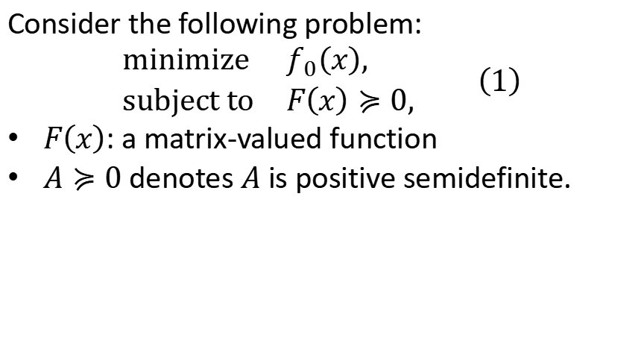
Render Equations using LaTeX (result)
Consider the following problem:
$$\begin{matrix}\text{minimize} & f_{0}\left(x\right), \\ \text{subject} \text{to} & F\left(x\right)≽0,\end{matrix} \left(1\right)$$
$F\left(x\right)$: a matrix-valued function
$A≽0$ denotes $A$ is positive semidefinite.

Slide 10
How to make a two-column slide
\columnsbegin \col{0.5\textwidth} Left-hand side \col{0.5\textwidth} Right-hand side \columnsend

Slide 11
Figures (markdown)
An image occurring by itself in a paragraph will be rendered as a figure with a caption.
![This is the caption](media/image2.jpeg){#fig:figure0}

Slide 12
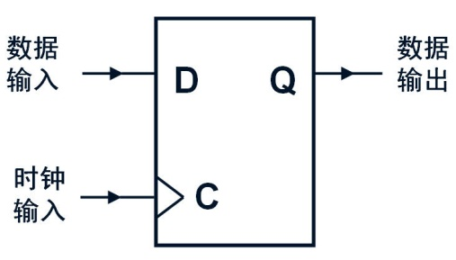
Figures (result)
This is the caption

Slide 13
Figures (cont’d)
If you just want a regular inline image, just make sure it is not the only thing in the paragraph. One way to do this is to insert a nonbreaking space after the image:
![No caption](media/image2.jpeg)\

Slide 14
Figures (result)
No caption

Slide 15
Render Diagrams using Tikz (markdown)
\begin{figure}[hp] \centering \input{pole2polar.tikz} \caption{Example of constructing the polar of a point}% \label{fig:pole2polar} \end{figure}

Slide 16
Render Diagrams using Tikz (result)

Slide 17
Table (markdown)
Simple tables can be generated using Markdown.
| Costs | 28nm | 20nm | | ------------ | --------- | ----------- | | Fab Costs | 3B | 4B - 7B | | Process R&D | 1.2B | 2.1B - 3B | | Mask Costs | 2M - 3M | 5M - 8M | | Design Costs | 50M - 90M | 120M - 500M | : Fab, process, mask, and design costs {#tbl:fab}

Slide 18
Table (result)
Costs | 28nm | 20nm
Fab Costs | 3B | 4B - 7B
Process R&D | 1.2B | 2.1B - 3B
Mask Costs | 2M - 3M | 5M - 8M
Design Costs | 50M - 90M | 120M - 500M

Slide 19
pandoc-crossref filter

Slide 20
pandoc-crossref filter
With this filter, you can cross-reference figures (see Fig. 1 and Fig. ), display equations (see Eq. 1), tables (see Table ¿tbl:fab?) and sections § 1.1, § 2.1
To compile:
$ pandoc -F pandoc-crossref -t beamer beamer.yaml \ crossref.yaml beamer.md -o intro.pdf

Slide 21
A sample crossref.yaml
--- cref: True codeBlockCaptions: True lofTitle: "## List of Figures" lotTitle: "## List of Tables" autoSectionLabels: True figureTemplate: $$t$$ tableTemplate: $$t$$ figPrefix: - "Fig." eqnPrefix: - "Eq." tblPrefix: - "Table" lstPrefix: - "Listing" secPrefix: - "§" ...

Slide 22
Code blocks
There are a couple options for code block labels. Those work only if code block id starts with lst:, e.g. {#lst:label}

Slide 23
caption attribute
caption attribute will be treated as code block caption. If code block has both id and caption attributes, it will be treated as numbered code block.
main :: IO () main = putStrLn "Hello World!"
(source)
{#lst:captionAttr .haskell caption="Listing caption A"}

Slide 24
Table-style captions
Enabled with codeBlockCaptions metadata option. If code block is immediately adjacent to paragraph, starting with Listing: or :, said paragraph will be treated as code block caption.
Listing: Listing caption B
main :: IO () main = putStrLn "Hello World!"

Slide 25
pandoc-citeproc filter

Slide 26
Bibliography
See Aalst, Weijters, and Maruster (2004), or
See (Baldi et al. 2008; Canfora and Cerulo 2005).
(source)
- See @Aalst-etal_2004, or - See [@Baldi-etal_2008;@Canfora-Cerulo_2005a].
To compile:
$ pandoc -F pandoc-crossref --citeproc -t beamer \ beamer.yaml crossref.yaml beamer.md -o intro.pdf

Slide 27
References
Aalst, W. van der, T. Weijters, and L. Maruster. 2004. “Workflow Mining: Discovering Process Models from Event Logs.” IEEE Transactions on Knowledge and Data Engineering 16 (9): 1128–42. https://doi.org/10.1109/TKDE.2004.47.
Baldi, Pierre F, Cristina V Lopes, Erik J Linstead, and Sushil K Bajracharya. 2008. “A Theory of Aspects as Latent Topics.” In ACM Sigplan Notices, 43:543–62. 10. ACM. https://doi.org/10.1145/1449955.1449807.
Canfora, G., and L. Cerulo. 2005. “Impact Analysis by Mining Software and Change Request Repositories.” In 11th IEEE International Software Metrics Symposium (METRICS’05), 29. Como, Italy: IEEE. https://doi.org/10.1109/METRICS.2005.28.

Slide 28
Notes
1. This is a footnote.

