Slide 1
Introduction

Slide 2
Common Perspective of Ellipsoid Method
It is commonly believed that it is inefficient in practice for large-scale problems.
The convergent rate is slow, even with the use of deep cuts.
Cannot exploit sparsity.
Since then, it was supplanted by interior-point methods.
Only treated as a theoretical tool for proving the polynomial-time solvability of combinatorial optimization problems.

Slide 3
But…
The ellipsoid method works very differently compared with the interior point method.
Only require a separtion oracle. Can play nicely with other techniques.
The ellipsoid method itself cannot exploit sparsity, but the oracle can.

Slide 4
Consider Ellipsoid Method When…
The number of optimization variables is moderate, e.g. ECO flow, analog circuit sizing, parametric problems
The number of constraints is large, or even infinite
Oracle can be implemented efficiently.

Slide 5
class: middle, center

Slide 6
Cutting-plane Method Revisited

Slide 7
Basic Idea
.pull-left70[
Let $𝒦⊆ℝ^{n}$ be a convex set.
Consider the feasibility problem:
Find a point $x^{∗}∈ℝ^{n}$ in $𝒦$,
or determine that $𝒦$ is empty (i.e., no feasible solution)
] .pull-right30[

Slide 8
img

Slide 9
]

Slide 10
Separation Oracle
.pull-left70[
When a separation oracle $Ω$ is queried at $x_{0}$, it either
asserts that $x_{0}∈𝒦$, or
returns a separating hyperplane between $x_{0}$ and $𝒦$:
$g^{T}(x−x_{0})+β≤0,β≥0,g≠0, ∀x∈𝒦$
] .pull-right30[

Slide 11
img

Slide 12
]

Slide 13
Separation oracle (cont’d)
$(g,β)$ is called a cutting-plane, or cut, since it eliminates the halfspace $\{x∣g^{T}(x−x_{0})+β>0\}$ from our search.
If $β=0$ ($x_{0}$ is on the boundary of halfspace that is cut), cutting-plane is called neutral cut.
If $β>0$ ($x_{0}$ lies in the interior of halfspace that is cut), cutting-plane is called deep cut.
If $β<0$ ($x_{0}$ lies in the exterior of halfspace that is cut), cutting-plane is called shallow cut.

Slide 14
Subgradient
$𝒦$ is usually given by a set of inequalities $f_{j}(x)≤0$ or $f_{j}(x)<0$ for $j=1⋯m$, where $f_{j}(x)$ is a convex function.
A vector $g≡∂f(x_{0})$ is called a subgradient of a convex function $f$ at $x_{0}$ if $f(z)≥f(x_{0})+g^{T}(z−x_{0})$.
Hence, the cut $(g,β)$ is given by $(∂f(x_{0}),f(x_{0}))$
Remarks:
If $f(x)$ is differentiable, we can simply take $∂f(x_{0})=∇f(x_{0})$

Slide 15
Key components of Cutting-plane method
Cutting plane oracle $Ω$
A search space $𝒮$ initially big enough to cover $𝒦$, e.g.
Polyhedron $𝒫$ = $\{z∣Cz≼d\}$
Interval $ℐ$ = $[l,u]$ (for one-dimensional problem)
Ellipsoid $ℰ$ = $\{z∣(z−x_{c})P^{−1}(z−x_{c})≤1\}$

Slide 16
Generic Cutting-plane method
Given initial $𝒮$ known to contain $𝒦$.
Repeat
Choose a point $x_{0}$ in $𝒮$
Query the cutting-plane oracle at $x_{0}$
If $x_{0}∈𝒦$, quit
Else, update $𝒮$ to a smaller set that covers:
$𝒮^{+}=𝒮∩\{z∣g^{T}(z−x_{0})+β≤0\}$
If $𝒮^{+}=∅$ or it is small enough, quit.

Slide 17
Corresponding Python code
def cutting_plane_feas(Omega, S, options=Options()) feasible = False status = 0 for niter in range(options.max_it): cut = Omega(S.xc) # query the oracle at S.xc if cut is None: # feasible sol'n obtained feasible = True break status, tsq = S.update(cut) # update S if status != 0: break if tsq < options.tol: status = 2 break return CInfo(feasible, niter + 1, status)

Slide 18
From Feasibility to Optimization
$$\begin{matrix}\text{minimize} & f_{0}(x), \\ \text{subject} \text{to} & x∈𝒦\end{matrix}$$
The optimization problem is treated as a feasibility problem with an additional constraint $f_{0}(x)≤t$
$f_{0}(x)$ could be a convex function or a quasiconvex function.
$t$ is also called the best-so-far value of $f_{0}(x)$.

Slide 19
Convex Optimization Problem
Consider the following general form:
$\begin{matrix}\text{minimize} & t, \\ \text{subject} \text{to} & Φ(x,t)≤0, \\ & x∈𝒦,\end{matrix}$
where $𝒦′_{t}=\{x∣Φ(x,t)≤0\}$ is the $t$-sublevel set of $\{x∣f_{0}(x)≤t\}$.
👉 Note: ${𝒦′}_{t}⊆{𝒦′}_{u}$ if and only if $t≤u$ (monotonicity)
One easy way to solve the optimization problem is to apply the binary search on $t$.

Slide 20
def bsearch(Omega, I, options=Options()): # assume monotone lower, upper = I u_orig = upper for niter in range(options.max_it): t = lower + (upper - lower) / 2 if Omega(t): # feasible sol'n obtained upper = t else: lower = t tau = (upper - lower) / 2 if tau < options.tol: break ret = CInfo(upper != u_orig, niter + 1, 0) ret.value = upper return ret

Slide 21
class bsearch_adaptor: def __init__(self, P, S, options=Options()): self.P = P self.S = S self.options = options @property def x_best(self): return self.S.xc def __call__(self, t): S = self.S.copy() self.P.update(t) ell_info = cutting_plane_feas(self.P, S, self.options) if ell_info.feasible: self.S.xc = S.xc return True return False

Slide 22
Shrinking
Another possible way is, to update the best-so-far $t$ whenever a feasible solution $x′$ is found by solving the equation:
$Φ(x′,t_{\text{new}})=0 .$
If the equation is difficuit to solve but $t$ is also convex w.r.t. $Φ$, then we may create a new varaible, say $z$ and let $z≤t$.

Slide 23
Generic Cutting-plane method (Optim)
Given initial $𝒮$ known to contain $𝒦_{t}$.
Repeat
Choose a point $x_{0}$ in $𝒮$
Query the separation oracle at $x_{0}$
If $x_{0}∈𝒦_{t}$, update $t$ such that $Φ(x_{0},t)=0$.
Update $𝒮$ to a smaller set that covers:
$𝒮^{+}=𝒮∩\{z∣g^{T}(z−x_{0})+β≤0\}$
If $𝒮^{+}=∅$ or it is small enough, quit.

Slide 24
def cutting_plane_dc(Omega, S, t, options=Options()): x_best = S.xc # this is copy t_orig = t for niter in range(options.max_it): cut, t1 = Omega(S.xc, t) if t != t1: # best t obtained t = t1 x_best = S.xc status, tsq = S.update(cut) if status != 0: break if tsq < options.tol: status = 2 break ret = CInfo(t != t_orig, niter + 1, status) ret.value = t return x_best, ret

Slide 25
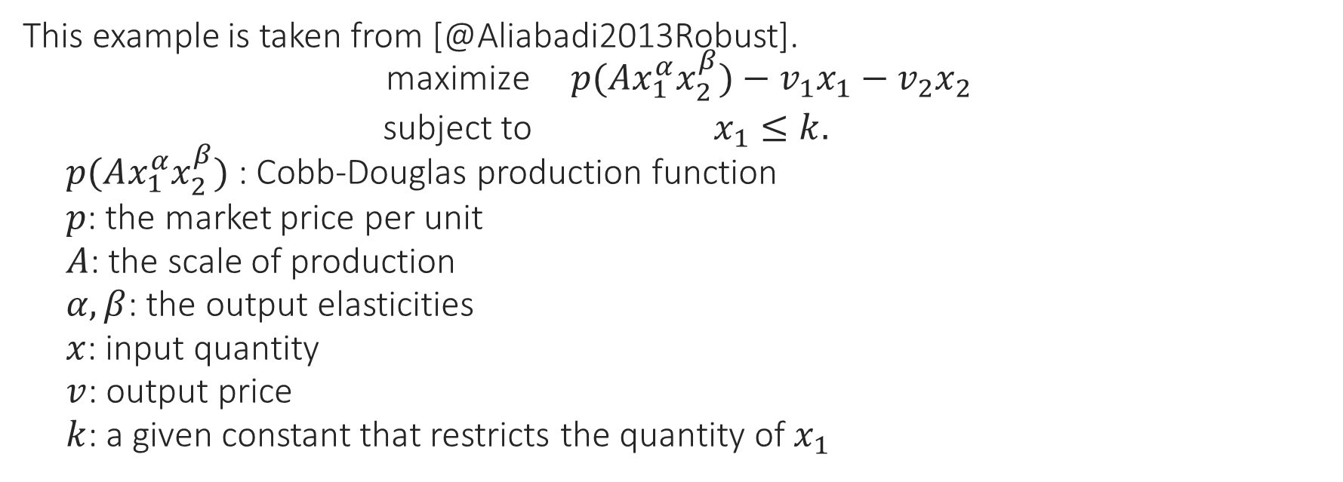
Example - Profit Maximization Problem
This example is taken from [@Aliabadi2013Robust].
$$\begin{matrix}\text{maximize} & p(Ax_{1}^{α}x_{2}^{β})−v_{1}x_{1}−v_{2}x_{2} \\ \text{subject} \text{to} & x_{1}≤k.\end{matrix}$$
$p(Ax_{1}^{α}x_{2}^{β})$ : Cobb-Douglas production function
$p$: the market price per unit
$A$: the scale of production
$α,β$: the output elasticities
$x$: input quantity
$v$: output price
$k$: a given constant that restricts the quantity of $x_{1}$

Slide 26
Example - Profit maximization (cont’d)
The formulation is not in the convex form.
Rewrite the problem in the following form:
$\begin{matrix}\text{maximize} & t \\ \text{subject} \text{to} & t+v_{1}x_{1}+v_{2}x_{2}≤pAx_{1}^{α}x_{2}^{β} \\ & x_{1}≤k.\end{matrix}$

Slide 27
Profit maximization in Convex Form
By taking the logarithm of each variable:
$y_{1}=\text{log}x_{1}$, $y_{2}=\text{log}x_{2}$.
We have the problem in a convex form:
$$\begin{matrix}\text{max} & t \\ \text{s}\text{.}\text{t}\text{.} & \text{log}(t+v_{1}e^{y_{1}}+v_{2}e^{y_{2}})−(αy_{1}+βy_{2})≤\text{log}(pA) \\ & y_{1}≤\text{log}k.\end{matrix}$$

Slide 28
class profit_oracle: def __init__(self, params, a, v): p, A, k = params self.log_pA = np.log(p * A) self.log_k = np.log(k) self.v = v self.a = a def __call__(self, y, t): fj = y[0] - self.log_k # constraint if fj > 0.: g = np.array([1., 0.]) return (g, fj), t log_Cobb = self.log_pA + self.a @ y x = np.exp(y) vx = self.v @ x te = t + vx fj = np.log(te) - log_Cobb if fj < 0.: te = np.exp(log_Cobb) t = te - vx fj = 0. g = (self.v * x) / te - self.a return (g, fj), t

Slide 29
# Main program import numpy as np from ellpy.cutting_plane import cutting_plane_dc from ellpy.ell import ell from .profit_oracle import profit_oracle p, A, k = 20., 40., 30.5 params = p, A, k alpha, beta = 0.1, 0.4 v1, v2 = 10., 35. a = np.array([alpha, beta]) v = np.array([v1, v2]) y0 = np.array([0., 0.]) # initial x0 r = np.array([100., 100.]) # initial ellipsoid (sphere) E = ell(r, y0) P = profit_oracle(params, a, v) yb1, ell_info = cutting_plane_dc(P, E, 0.) print(ell_info.value, ell_info.feasible)

Slide 30
Area of Applications
Robust convex optimization
oracle technique: affine arithmetic
Parametric network potential problem
oracle technique: negative cycle detection
Semidefinite programming
oracle technique: Cholesky or $LDL^{T}$ factorization

Slide 31
class: middle, center

Slide 32
Robust Convex Optimization

Slide 33
Robust Optimization Formulation
Consider:
$\begin{matrix}\text{minimize} & \underset{q∈ℚ}{\text{sup}}f_{0}(x,q), \\ \text{subject} \text{to} & f_{j}(x,q)≤0, ∀q∈ℚ, j=1,2,⋯,m,\end{matrix}$
where $q$ represents a set of varying parameters.
The problem can be reformulated as:
$\begin{matrix}\text{minimize} & t \\ \text{subject} \text{to} & f_{0}(x,q)<t \\ & f_{j}(x,q)≤0, ∀q∈ℚ, j=1,2,⋯,m.\end{matrix}$

Slide 34
Example - Profit Maximization Problem (convex)
$$\begin{matrix}\text{max} & t \\ \text{s}\text{.}\text{t}\text{.} & \text{log}(t+{\hat{v}}_{1}e^{y_{1}}+{\hat{v}}_{2}e^{y_{2}})−(\hat{α}y_{1}+\hat{β}y_{2})≤\text{log}(\hat{p} A) \\ & y_{1}≤\text{log}\hat{k},\end{matrix}$$
Now assume that:
$\hat{α}$ and $\hat{β}$ vary $\overset{‾}{α}±e_{1}$ and $\overset{‾}{β}±e_{2}$ respectively.
$\hat{p}$, $\hat{k}$, ${\hat{v}}_{1}$, and ${\hat{v}}_{2}$ all vary $±e_{3}$.

Slide 35
Example - Profit Maximization Problem (oracle)
By detail analysis, the worst case happens when:
$p=\overset{‾}{p}−e_{3}$, $k=\overset{‾}{k}−e_{3}$
$v_{1}={\overset{‾}{v}}_{1}+e_{3}$, $v_{2}={\overset{‾}{v}}_{2}+e_{3}$,
if $y_{1}>0$, $α=\overset{‾}{α}−e_{1}$, else $α=\overset{‾}{α}+e_{1}$
if $y_{2}>0$, $β=\overset{‾}{β}−e_{2}$, else $β=\overset{‾}{β}+e_{2}$

Slide 36
class profit_rb_oracle: def __init__(self, params, a, v, vparams): e1, e2, e3, e4, e5 = vparams self.a = a self.e = [e1, e2] p, A, k = params params_rb = p - e3, A, k - e4 self.P = profit_oracle(params_rb, a, v + e5) def __call__(self, y, t): a_rb = self.a.copy() for i in [0, 1]: a_rb[i] += self.e[i] if y[i] <= 0 else -self.e[i] self.P.a = a_rb return self.P(y, t)

Slide 37
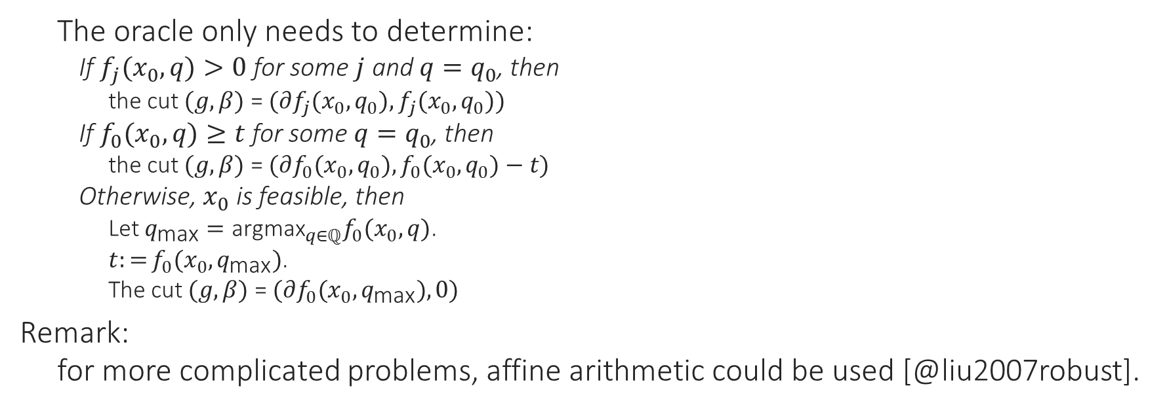
Oracle in Robust Optimization Formulation
The oracle only needs to determine:
If $f_{j}(x_{0},q)>0$ for some $j$ and $q=q_{0}$, then
the cut $(g,β)$ = $(∂f_{j}(x_{0},q_{0}),f_{j}(x_{0},q_{0}))$
If $f_{0}(x_{0},q)≥t$ for some $q=q_{0}$, then
the cut $(g,β)$ = $(∂f_{0}(x_{0},q_{0}),f_{0}(x_{0},q_{0})−t)$
Otherwise, $x_{0}$ is feasible, then
Let $q_{\text{max}}={\text{argmax}}_{q∈ℚ}f_{0}(x_{0},q)$.
$t:=f_{0}(x_{0},q_{\text{max}})$.
The cut $(g,β)$ = $(∂f_{0}(x_{0},q_{\text{max}}),0)$
Remark:
for more complicated problems, affine arithmetic could be used [@liu2007robust].

Slide 38
class: middle, center

Slide 39
Multi-parameter Network Problem

Slide 40
Parametric Network Problem
Given a network represented by a directed graph $G=(V,E)$.
Consider:
$$\begin{matrix}\text{find} & x,u \\ \text{subject} \text{to} & u_{j}−u_{i}≤h_{ij}(x), ∀(i,j)∈E,\end{matrix}$$
$h_{ij}(x)$ is the concave function of edge $(i,j)$,
Assume: network is large but the number of parameters is small.

Slide 41
Network Potential Problem (cont’d)
Given $x$, the problem has a feasible solution if and only if $G$ contains no negative cycle. Let $𝒞$ be a set of all cycles of $G$.
$$\begin{matrix}\text{find} & x \\ \text{subject} \text{to} & w_{k}(x)≥0,∀C_{k}∈𝒞,\end{matrix}$$
$C_{k}$ is a cycle of $G$
$w_{k}(x)=\sum_{(i,j)∈C_{k}}^{​}{h_{ij}}(x)$.

Slide 42
Negative Cycle Finding
There are lots of methods to detect negative cycles in a weighted graph [@cherkassky1999negative], in which Tarjan’s algorithm [@Tarjan1981negcycle] is one of the fastest algorithms in practice [@alg:dasdan_mcr; @cherkassky1999negative].

Slide 43
Oracle in Network Potential Problem
The oracle only needs to determine:
If there exists a negative cycle $C_{k}$ under $x_{0}$, then
the cut $(g,β)$ = $(−∂w_{k}(x_{0}),−w_{k}(x_{0}))$
Otherwise, the shortest path solution gives the value of $u$.

Slide 44
Python Code
class network_oracle: def __init__(self, G, dist, h): self.G = G self.dist = dist self.h = h self.S = negCycleFinder(G) def update(self, t): self.h.update(t) def __call__(self, x): def get_weight(G, e): return self.h.eval(G, e, x) C = self.S.find_neg_cycle(self.dist, get_weight) if C is None: return None f = -sum(self.h.eval(self.G, e, x) for e in C) g = -sum(self.h.grad(self.G, e, x) for e in C) return g, f

Slide 45
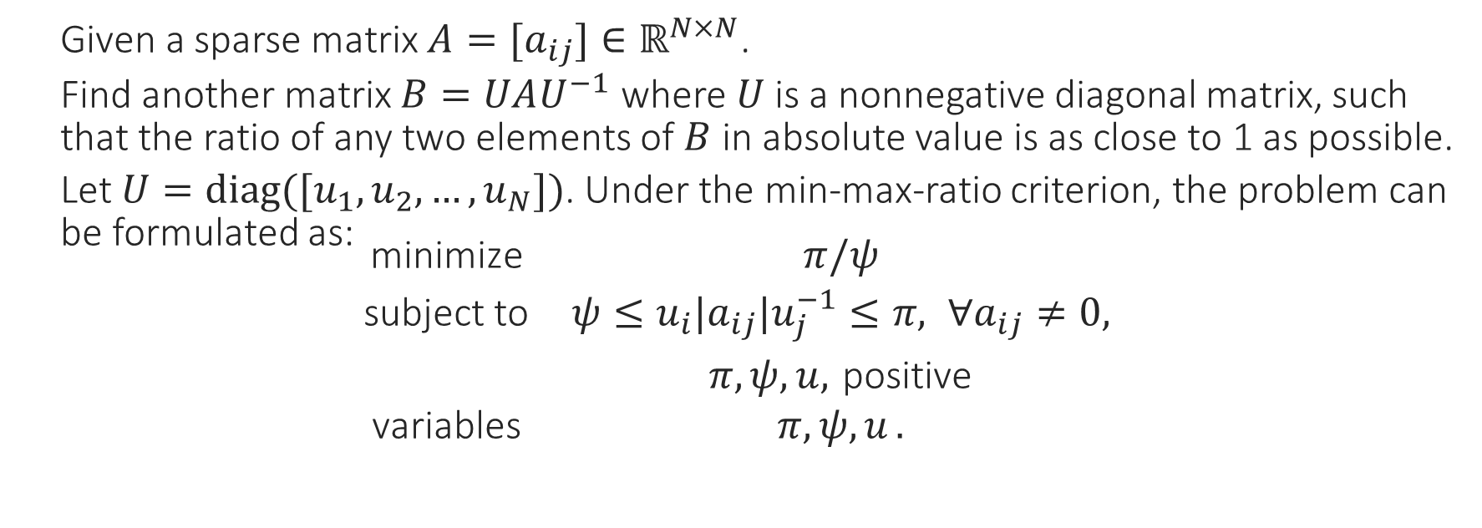
Example - Optimal Matrix Scaling [@orlin1985computing]
Given a sparse matrix $A=[a_{ij}]∈ℝ^{N×N}$.
Find another matrix $B=UAU^{−1}$ where $U$ is a nonnegative diagonal matrix, such that the ratio of any two elements of $B$ in absolute value is as close to 1 as possible.
Let $U=diag([u_{1},u_{2},…,u_{N}])$. Under the min-max-ratio criterion, the problem can be formulated as:
$$\begin{matrix}\text{minimize} & π/ψ \\ \text{subject} \text{to} & ψ≤u_{i}|a_{ij}|u_{j}^{−1}≤π, ∀a_{ij}≠0, \\ & π,ψ,u, \text{positive} \\ \text{variables} & π,ψ,u .\end{matrix}$$

Slide 46
Optimal Matrix Scaling (cont’d)
By taking the logarithms of variables, the above problem can be transformed into:
$$\begin{matrix}\text{minimize} & t \\ \text{subject} \text{to} & π′−ψ′≤t \\ & u_{i}′−u_{j}′≤π′−a_{ij}′, ∀a_{ij}≠0 , \\ & u_{j}′−u_{i}′≤a_{ij}′−ψ′, ∀a_{ij}≠0 , \\ \text{variables} & π′,ψ′,u′ .\end{matrix}$$
where $k′$ denotes $\text{log}(|k|)$ and $x=(π′,ψ′)^{T}$.

Slide 47
class optscaling_oracle: def __init__(self, G, dist): class ratio: def eval(self, G, e, x): u, v = e cost = G[u][v]['cost'] return x[0] - cost if u < v else cost - x[1] def grad(self, G, e, x): u, v = e return np.array([1., 0.] if u < v else [0., -1.]) self.network = network_oracle(G, dist, ratio()) def __call__(self, x, t): cut = self.network(x) if cut: return cut, t s = x[0] - x[1] fj = s - t if fj < 0.: t = s fj = 0. return (np.array([1., -1.]), fj), t

Slide 48
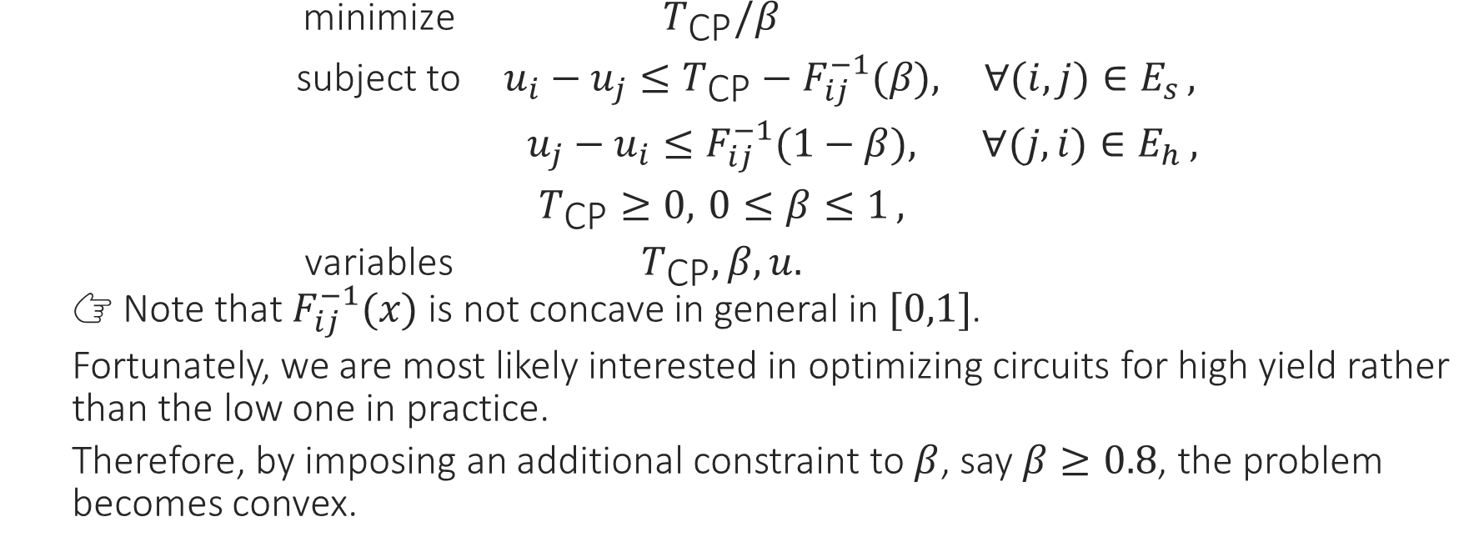
Example - clock period & yield-driven co-optimization
$$\begin{matrix}\text{minimize} & T_{\text{CP}}/β & \\ \text{subject} \text{to} & u_{i}−u_{j}≤T_{\text{CP}}−F_{ij}^{−1}(β), & ∀(i,j)∈E_{s} , \\ & u_{j}−u_{i}≤F_{ij}^{−1}(1−β), & ∀(j,i)∈E_{h} , \\ & T_{\text{CP}}≥0, 0≤β≤1 , & \\ \text{variables} & T_{\text{CP}},β,u. & \end{matrix}$$
👉 Note that $F_{ij}^{−1}(x)$ is not concave in general in $[0,1]$.
Fortunately, we are most likely interested in optimizing circuits for high yield rather than the low one in practice.
Therefore, by imposing an additional constraint to $β$, say $β≥0.8$, the problem becomes convex.

Slide 49
Example - clock period & yield-driven co-optimization
The problem can be reformulated as:
$$\begin{matrix}\text{minimize} & t & \\ \text{subject} \text{to} & T_{\text{CP}}−βt≤0 & \\ & u_{i}−u_{j}≤T_{\text{CP}}−F_{ij}^{−1}(β), & ∀(i,j)∈E_{s} , \\ & u_{j}−u_{i}≤F_{ij}^{−1}(1−β), & ∀(j,i)∈E_{h} , \\ & T_{\text{CP}}≥0, 0≤β≤1 , & \\ \text{variables} & T_{\text{CP}},β,u. & \end{matrix}$$

Slide 50
class: middle, center

Slide 51
Matrix Inequalities

Slide 52
Problems With Matrix Inequalities
Consider the following problem:
$$\begin{matrix}\text{find} & x, \\ \text{subject} \text{to} & F(x)≽0,\end{matrix}$$
$F(x)$: a matrix-valued function
$A≽0$ denotes $A$ is positive semidefinite.

Slide 53
Problems With Matrix Inequalities
Recall that a matrix $A$ is positive semidefinite if and only if $v^{T}Av≥0$ for all $v∈ℝ^{N}$.
The problem can be transformed into:
$\begin{matrix}\text{find} & x, \\ \text{subject} \text{to} & v^{T}F(x)v≥0, ∀v∈ℝ^{N}\end{matrix}$
Consider $v^{T}F(x)v$ is concave for all $v∈ℝ^{N}$ w. r. t. $x$, then the above problem is a convex programming.
Reduce to semidefinite programming if $F(x)$ is linear w.r.t. $x$, i.e., $F(x)=F_{0}+x_{1}F_{1}+⋯+x_{n}F_{n}$

Slide 54
Oracle in Matrix Inequalities
The oracle only needs to:
Perform a row-based LDLT factorization such that $F(x_{0})=LDL^{T}$.
Let $A_{:p,:p}$ denotes a submatrix $A(1:p,1:p)∈ℝ^{p×p}$.
If the process fails at row $p$,
there exists a vector $e_{p}=(0,0,⋯,0,1)^{T}∈ℝ^{p}$, such that
$v=R_{:p,:p}^{−1}e_{p}$, and
$v^{T}F_{:p,:p}(x_{0})v<0$.
The cut $(g,β)$ = $(−v^{T}∂F_{:p,:p}(x_{0})v,−v^{T}F_{:p,:p}(x_{0})v)$

Slide 55
Lazy evaluation
Don’t construct the full matrix at each iteration!
Only O($p^{3}$) per iteration, independent of $N$!

Slide 56
class lmi_oracle: ''' Oracle for LMI constraint F*x <= B ''' def __init__(self, F, B): self.F = F self.F0 = B self.Q = chol_ext(len(self.F0)) def __call__(self, x): n = len(x) * def getA(i, j): * return self.F0[i, j] - sum( * self.F[k][i, j] * x[k] for k in range(n)) * * self.Q.factor(getA) if self.Q.is_spd(): return None v, ep = self.Q.witness() g = np.array([self.Q.sym_quad(v, self.F[i]) for i in range(n)]) return g, ep

Slide 57
Google Benchmark Comparison
2: ---------------------------------------------------------- 2: Benchmark Time CPU Iterations 2: ---------------------------------------------------------- 2: BM_LMI_Lazy 131235 ns 131245 ns 4447 2: BM_LMI_old 196694 ns 196708 ns 3548 2/4 Test #2: Bench_BM_lmi ..................... Passed 2.57 sec

Slide 58
Example - Matrix Norm Minimization
Let $A(x)=A_{0}+x_{1}A_{1}+⋯+x_{n}A_{n}$
Problem ${\text{min}}_{x}∥A(x)∥$ can be reformulated as
$\begin{matrix}\text{minimize} & t, \\ \text{subject} \text{to} & \left(\begin{matrix}t I & A(x) \\ A^{T}(x) & t I\end{matrix}\right)≽0,\end{matrix}$
Binary search on $t$ can be used for this problem.

Slide 59
class qmi_oracle: t = None count = 0 def __init__(self, F, F0): self.F = F self.F0 = F0 self.Fx = np.zeros(F0.shape) self.Q = chol_ext(len(F0)) def update(self, t): self.t = t def __call__(self, x): self.count = 0; nx = len(x) def getA(i, j): if self.count < i + 1: self.count = i + 1 self.Fx[i] = self.F0[i] self.Fx[i] -= sum(self.F[k][i] * x[k] for k in range(nx)) a = -self.Fx[i].dot(self.Fx[j]) if i == j: a += self.t return a self.Q.factor(getA) if self.Q.is_spd(): return None v, ep = self.Q.witness() p = len(v) Av = v.dot(self.Fx[:p]) g = np.array([-2*v.dot(self.F[k][:p]).dot(Av) for k in range(nx)]) return (g, ep)

Slide 60
Example - Estimation of Correlation Function
$$\begin{matrix}\underset{κ,p}{\text{min}} & ∥Σ(p)+κI−Y∥ \\ \text{s}\text{. }\text{t}\text{.} & Σ(p)≽0,κ≥0 .\end{matrix}$$
Let $ρ(h)=\sum_{i}^{n}{p_{i}}Ψ_{i}(h)$, where
$p_{i}$’s are the unknown coefficients to be fitted
$Ψ_{i}$’s are a family of basis functions.
The covariance matrix $Σ(p)$ can be recast as:
$Σ(p)=p_{1}F_{1}+⋯+p_{n}F_{n}$
where $\{F_{k}\}_{i,j}=Ψ_{k}(∥s_{j}−s_{i}∥_{2})$

Slide 61
🔬 Experimental Result
img
Data Sample (kern=0.5)
img
Least Square Result

Slide 62
🔬 Experimental Result II
img
Data Sample (kern=1.0)
img
Least Square Result

Slide 63
🔬 Experimental Result III
img
Data Sample (kern=2.0)
img
Least Square Result

Slide 64
Q & A 🗣️

