Slide 1
Sampling with Halton Points on n-Sphere
Wai-Shing Luk

Slide 2
Abstract
We discuss the generation of low discrepancy sequences over n-sphere. The introduction provides an overview of the importance of low discrepancy sequences in various applications, such as numerical integration, optimization, and simulation. The paper then discusses the desirable properties of samples over n-sphere, including uniformity, determinism, and incrementality.
The proposed method for generating low discrepancy sequences over n-sphere is then presented, which is based on the Van der Corput sequence. The paper provides a detailed explanation of the algorithm and its implementation. The paper also discusses the numerical experiments conducted to evaluate the performance of the proposed method, including the comparison with randomly generated sequences and other proposed methods.

Slide 3
Motivation and Applications

Slide 4
Problem Formulation
The desirable properties of samples over n-sphere include:
being uniform,
deterministic, and
incremental.
The uniformity measures are optimized with every new point, and this is because in some applications, it is unknown how many points are needed to solve the problem in advance.

Slide 5
Motivation
The topic has been well studied for sphere in 3D, i.e. $n=2$
Yet it is still unknown how to generate for $n>2$.
Some potential applications for $n>2$ include:
Robotic Motion Planning ($S^{3}$ and SO(3)) (Yershova et al. 2010)
Spherical coding in MIMO wireless communication (Utkovski and Lindner 2006):
Cookbook for Unitary matrices
A code word = a point in $S^{n}$
Multivariate empirical mode decomposition (Rehman and Mandic 2010)
Filter bank design (Mandic et al. 2011)

Slide 6
Halton Sequence on $S^{n}$
Halton sequence on $S^{2}$ has been well studied (Cui and Freeden 1997) by using cylindrical coordinates.
Yet it is still little known for $S^{n}$ where $n>2$.
Note: The generalization of cylindrical coordinates does NOT work in higher dimensions.

Slide 7
Review of Low Discrepancy Sequence

Slide 8
Basic: Van der Corput sequence
Generate a low discrepancy sequence over $\left[0,1\right]$
Denote $vdc\left(k,b\right)$ as a Van der Corput sequence of $k$ points, where $b$ is the base of a prime number.

Slide 9
Python code
def vdc_basic(n, base=2): vdc, denom = 0.0, 1.0 while n: denom *= base n, remainder = divmod(n, base) vdc += remainder / denom return vdc def vdc(n, base=2): ''' n - number of vectors base - seeds ''' for i in range(n): yield vdc_basic(i, base)

Slide 10
Halton sequence on $\left[0,1\right]$
Halton sequence: using 2 Van der Corput sequences with different bases.
Example:
$$\left[x,y\right]=\left[vdc\left(k,2\right),vdc\left(k,3\right)\right]$$

Slide 11
Halton sequence on ${\left[0,1\right]}^{n}$
Generally we can generate Halton sequence in a unit hypercube ${\left[0,1\right]}^{n}$:
$$\left[x_{1},x_{2},…,x_{n}\right]=\left[vdc\left(k,b_{1}\right),vdc\left(k,b_{2}\right),…,vdc\left(k,b_{n}\right)\right]$$
A wide range of applications on Quasi-Monte Carlo Methods (QMC).

Slide 12
Unit Circle $S^{1}$
Can be generated by mapping the Van der Corput sequence to $\left[0,2π\right]$
$θ=2π⋅vdc\left(k,b\right)$
$\left[x,y\right]=\left[cosθ,sinθ\right]$

Slide 13
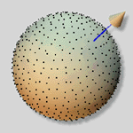
Unit Sphere $S^{2}$
Has been applied for computer graphic applications (Wong, Luk, and Heng 1997)
Use cylindrical mapping.
$\left[z,x,y\right]$ = $\left[cosθ,sinθcosφ,sinθsinφ\right]$ = $\left[z,\sqrt{1−z^{2}}cosφ,\sqrt{1−z^{2}}sinφ\right]$
$φ=2π⋅vdc\left(k,b_{1}\right)$ % map to $\left[0,2π\right]$
$z=2⋅vdc\left(k,b_{2}\right)−1$ % map to $\left[−1,1\right]$
image

Slide 14
Sphere $S^{n}$ and SO(3)
Deterministic point sets
Optimal grid point sets for $S^{3}$, SO(3) (Mitchell 2008; Yershova et al. 2010)
No Halton sequences so far to the best of our knowledge.
Note that cylindrical mapping method cannot be extended to higher dimensions.

Slide 15
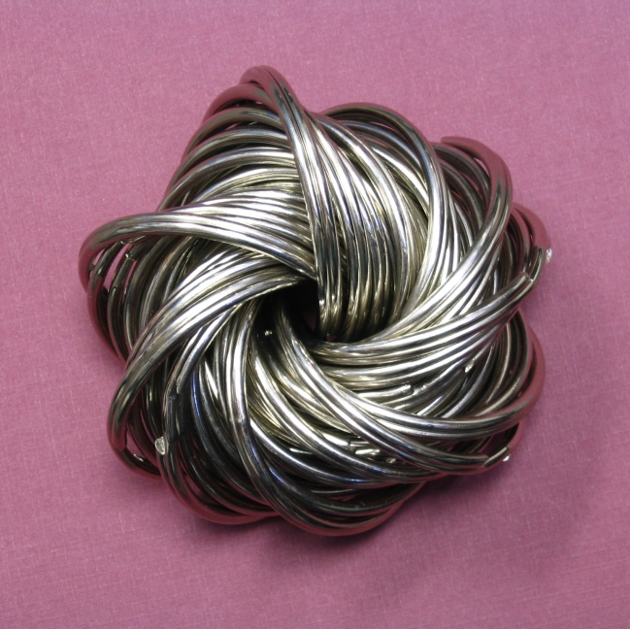
SO(3) or $S^{3}$ Hopf Coordinates
Hopf coordinates (cf. (Yershova et al. 2010))
$x_{1}=cos\left(θ/2\right)cos\left(ψ/2\right)$
$x_{2}=cos\left(θ/2\right)sin\left(ψ/2\right)$
$x_{3}=sin\left(θ/2\right)cos\left(φ+ψ/2\right)$
$x_{4}=sin\left(θ/2\right)sin\left(φ+ψ/2\right)$
$S^{3}$ is a principal circle bundle over the $S^{2}$
image

Slide 16
Hopf Coordinates for SO(3) or $S^{3}$
Similar to the Halton sequence generation on $S^{2}$, we perform the mapping:
$φ=2π⋅vdc\left(k,b_{1}\right)$ % map to $\left[0,2π\right]$
$ψ=2π⋅vdc\left(k,b_{2}\right)$ % map to $\left[0,2π\right]$ for SO(3), or
$ψ=4π⋅vdc\left(k,b_{2}\right)$ % map to $\left[0,4π\right]$ for $S^{3}$
$z=2⋅vdc\left(k,b_{3}\right)−1$ % map to $\left[−1,1\right]$
$θ=\cos^{−1}z$

Slide 17
Python Code
def sphere3_hopf(k, b): vd = zip(vdc(k, b[0]), vdc(k, b[1]), vdc(k, b[2])) for vd0, vd1, vd2 in vd: phi = 2*math.pi*vd0 # map to [0, 2*math.pi] psy = 4*math.pi*vd1 # map to [0, 4*math.pi] z = 2*vd2 - 1 # map to [-1., 1.] theta = math.acos(z) cos_eta = math.cos(theta/2) sin_eta = math.sin(theta/2) s = [cos_eta * math.cos(psy/2), cos_eta * math.sin(psy/2), sin_eta * math.cos(phi + psy/2), sin_eta * math.sin(phi + psy/2)] yield s

Slide 18
Our approach

Slide 19
3-sphere
Polar coordinates:
$x_{0}=cosθ_{3}$
$x_{1}=sinθ_{3}cosθ_{2}$
$x_{2}=sinθ_{3}sinθ_{2}cosθ_{1}$
$x_{3}=sinθ_{3}sinθ_{2}sinθ_{1}$
Spherical surface element:
$$dA=\sin^{2}\left(θ_{3}\right)sin\left(θ_{2}\right) dθ_{1} dθ_{2}dθ_{3}$$

Slide 20
n-sphere
Polar coordinates:
$x_{0}=cosθ_{n}$
$x_{1}=sinθ_{n}cosθ_{n−1}$
$x_{2}=sinθ_{n}sinθ_{n−1}cosθ_{n−2}$
$x_{3}=sinθ_{n}sinθ_{n−1}sinθ_{n−2}cosθ_{n−3}$
$⋯$
$x_{n−1}=sinθ_{n}sinθ_{n−1}sinθ_{n−2}⋯cosθ_{1}$
$x_{n}=sinθ_{n}sinθ_{n−1}sinθ_{n−2}⋯sinθ_{1}$
Spherical surface element:
$$d^{n}A=\sin^{n−2}\left(θ_{n−1}\right)\sin^{n−1}\left(θ_{n−2}\right)⋯sin\left(θ_{2}\right) dθ_{1} dθ_{2}⋯dθ_{n−1}$$

Slide 21
How to Generate the Point Set
$p_{0}=\left[cosθ_{1},sinθ_{1}\right]$ where $θ_{1}=2π⋅vdc\left(k,b_{1}\right)$
Let $f_{j}\left(θ\right)$ = $∫\sin^{j}θdθ$, where $θ∈\left(0,π\right)$.
Note 1: $f_{j}\left(θ\right)$ can be defined recursively as:
$$f_{j}\left(θ\right)=\left\{\begin{matrix}θ & \text{if }j=0, \\ −cosθ & \text{if }j=1, \\ \left(1/n\right)\left(−cosθ\sin^{j−1}θ+\left(n−1\right)∫\sin^{j−2}θdθ\right) & \text{otherwise}.\end{matrix}\right.$$
Note 2: $f_{j}\left(θ\right)$ is a monotonic increasing function in $\left(0,π\right)$
Map $vdc\left(k,b_{j}\right)$ uniformly to $f_{j}\left(θ\right)$: $t_{j}=f_{j}\left(0\right)+\left(f_{j}\left(π\right)−f_{j}\left(0\right)\right)vdc\left(k,b_{j}\right)$
Let $θ_{j}=f_{j}^{−1}\left(t_{j}\right)$
Define $p_{n}$ recursively as: $p_{n}=\left[cosθ_{n},sinθ_{n}⋅p_{n−1}\right]$

Slide 22
Numerical Experiments

Slide 23
Testing the Correctness
Compare the dispersion with the random point-set
Construct the convex hull for each point-set
Dispersion roughly measured by the difference of the maximum distance and the minimum distance between every two neighbour points:
$$\max_{a∈N\left(b\right)}\{D\left(a,b\right)\}−\min_{a∈N\left(b\right)}\{D\left(a,b\right)\}$$
where $D\left(a,b\right)=\sqrt{1−a^{T}b}$

Slide 24
Random sequences
To generate random points on $S^{n}$, spherical symmetry of the multidimensional Gaussian density function can be exploited.
Then the normalized vector ($x_{i}/∥x_{i}∥$) is uniformly distributed over the hypersphere $S^{n}$. (Fishman, G. F. (1996))

Slide 25
Convex Hull with $600$ points
Left: our, right: random
image

Slide 26
Result for $S^{3}$
Compared with Hopf coordinate method.
image

Slide 27
Result for $S^{3}$ (II)
Compared with cylindrical mapping method.
image

Slide 28
Result for $S^{4}$
Compared with cylindrical mapping method
image

Slide 29
Conclusions

Slide 30
Conclusions
Proposed method generates low-discrepancy point-set in nearly linear time
The result outperforms the corresponding random point-set, especially when the number of points is small
Python code is available at here

Slide 31
References
Cui, Jianjun, and Willi Freeden. 1997. “Equidistribution on the Sphere.” SIAM Journal on Scientific Computing 18 (2): 595–609.
Mandic, DP et al. 2011. “Filter Bank Property of Multivariate Empirical Mode Decomposition.” Signal Processing, IEEE Transactions on 59 (5): 2421–26.
Mitchell, Julie C. 2008. “Sampling Rotation Groups by Successive Orthogonal Images.” SIAM Journal on Scientific Computing 30 (1): 525–47.
Rehman, Naveed, and Danilo P Mandic. 2010. “Multivariate Empirical Mode Decomposition.” Proceedings of the Royal Society A: Mathematical, Physical and Engineering Science 466 (2117): 1291–1302.
Utkovski, Zoran, and Juergen Lindner. 2006. “On the Construction of Non-Coherent Space Time Codes from High-Dimensional Spherical Codes.” In Spread Spectrum Techniques and Applications, 2006 IEEE Ninth International Symposium on, 327–31. IEEE.
Wong, Tien-Tsin, Wai-Shing Luk, and Pheng-Ann Heng. 1997. “Sampling with Hammersley and Halton Points.” Journal of Graphics Tools 2 (2): 9–24.
Yershova, Anna, Swati Jain, Steven M LaValle, and Julie C Mitchell. 2010. “Generating Uniform Incremental Grids on SO (3) Using the Hopf Fibration.” The International Journal of Robotics Research 29 (7): 801–12.

