Slide 1
When “Network Flow” Meets “Convex Optimization”
@luk036
2021-11-10

Slide 2
当 “网络流” 遇上 “凸优化”
@luk036
2021-11-10

Slide 3
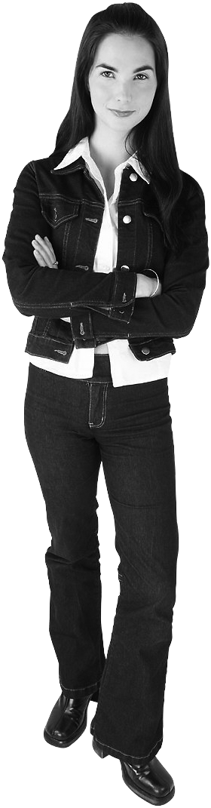
“Network Flow” says:
Ah, I can check if the problem has a feasible solution very quickly.
minimize f(x)
subject to c– ≤ x ≤ c⁺
A^{T} x = b, b(V) = 0

Slide 4

“Convex Optimization” says:
Well, maybe I can do something to it if f(x) is convex or quasi-convex.
minimize f(x)
subject to c– ≤ x ≤ c⁺
A^{T} x = b, b(V) = 0

Slide 5


Network Flow + Convex Optimization
Ok. How about we do something together?
Sure!

Slide 6
Parametric potential Problem

Slide 7
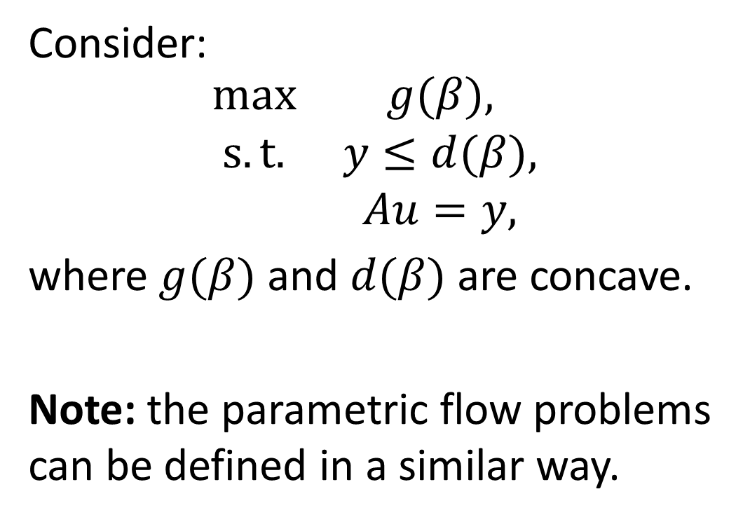
Parametric potential problems
Consider:
$$\begin{matrix}max & g(β), \\ s. t. & y≤d(β), \\ & Au=y,\end{matrix}$$
where $g(β)$ and $d(β)$ are concave.
Note: the parametric flow problems can be defined in a similar way.

Slide 8
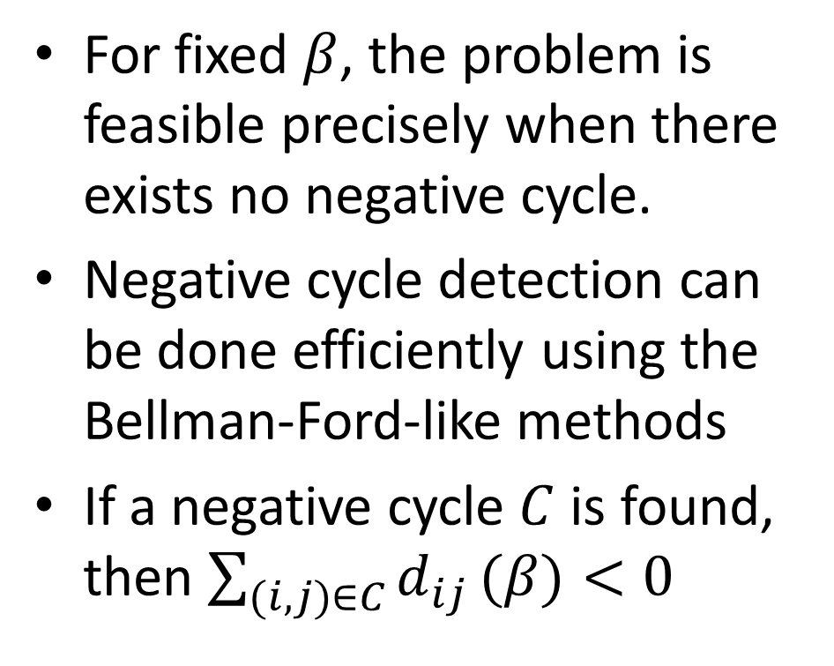
Network flow says:
For fixed $β$, the problem is feasible precisely when there exists no negative cycle.
Negative cycle detection can be done efficiently using the Bellman-Ford-like methods
If a negative cycle $C$ is found, then $\sum_{(i,j)∈C}{d_{ij}}(β)<0$

Slide 9
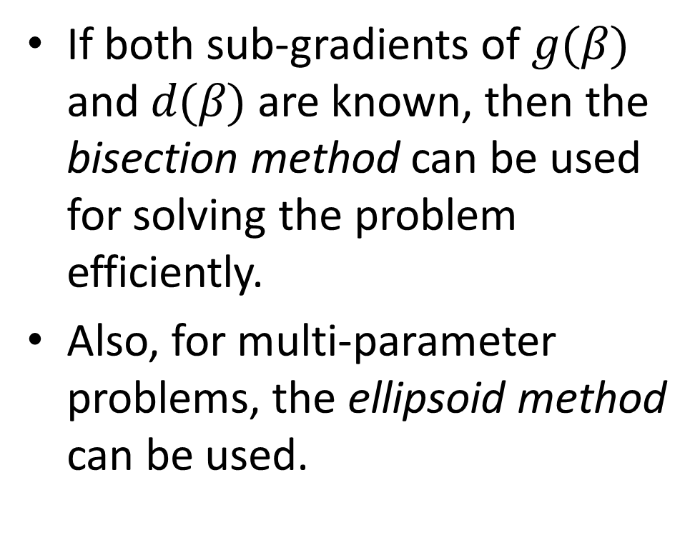
Convex Optimization says:
If both sub-gradients of $g(β)$ and $d(β)$ are known, then the bisection method can be used for solving the problem efficiently.
Also, for multi-parameter problems, the ellipsoid method can be used.

Slide 10
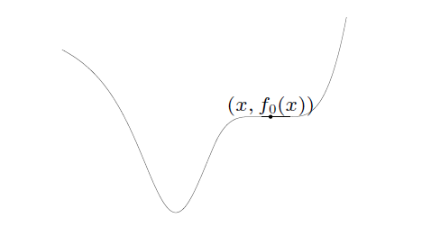
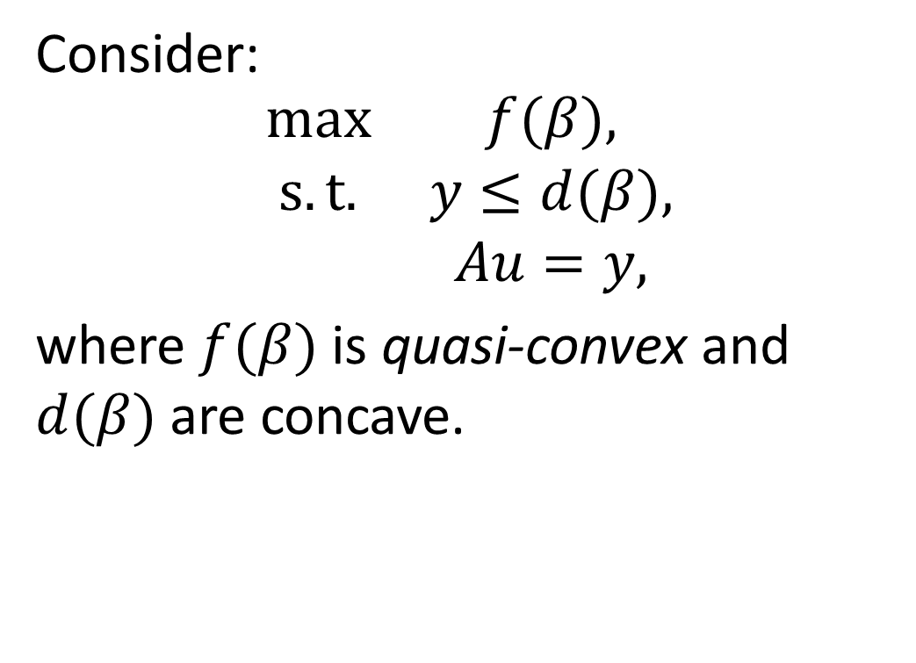
Quasi-convex Minimization
Consider:
$$\begin{matrix}max & f(β), \\ s. t. & y≤d(β), \\ & Au=y,\end{matrix}$$
where $f(β)$ is quasi-convex and $d(β)$ are concave.

Slide 11
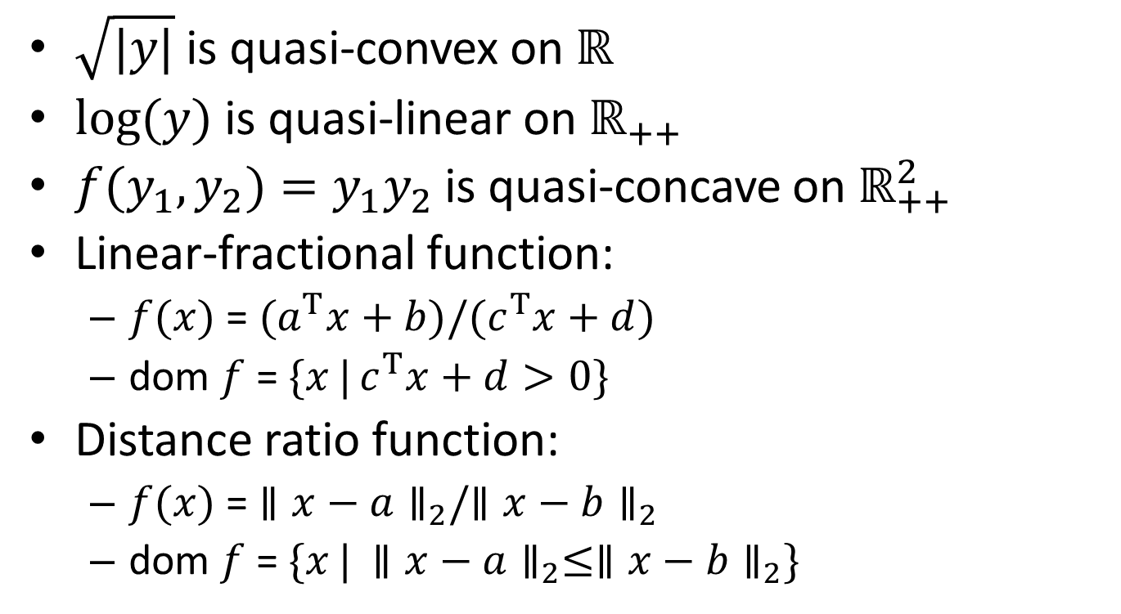
Examples of Quasi-Convex Functions
$\sqrt{|y|}$ is quasi-convex on $ℝ$
$log(y)$ is quasi-linear on $ℝ_{++}$
$f(y_{1},y_{2})=y_{1}y_{2}$ is quasi-concave on $ℝ_{++}^{2}$
Linear-fractional function:
$f(x)$ = $(a^{T}x+b)/(c^{T}x+d)$
dom $f$ = $\{x | c^{T}x+d>0\}$
Distance ratio function:
$f(x)$ = $∥x−a∥_{2}/∥x−b∥_{2}$
dom $f$ = $\{x | ∥x−a∥_{2}≤∥x−b∥_{2}\}$

Slide 12
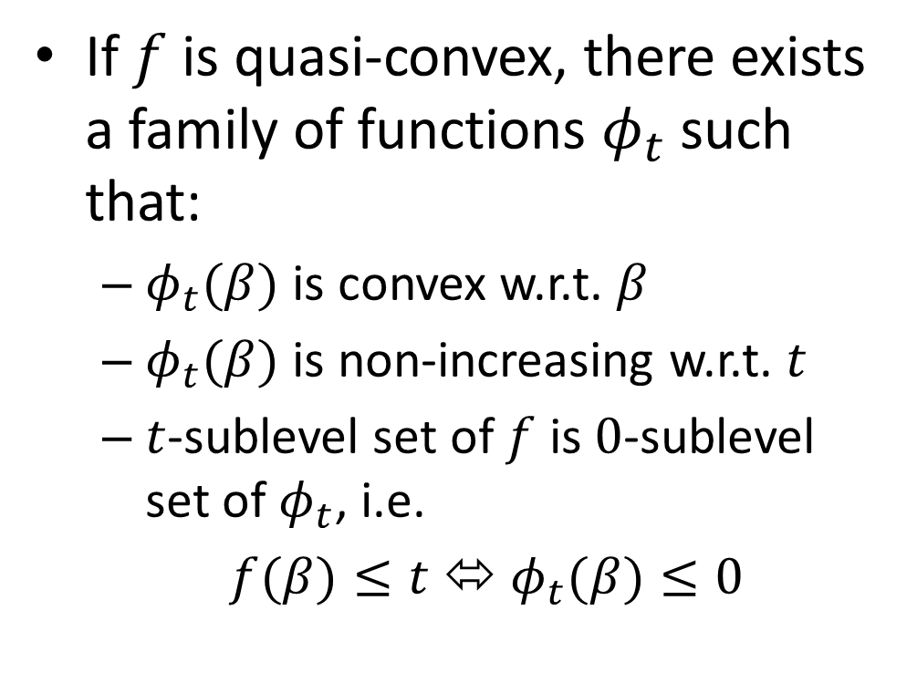
Convex Optimization says:
If $f$ is quasi-convex, there exists a family of functions $φ_{t}$ such that:
$φ_{t}(β)$ is convex w.r.t. $β$
$φ_{t}(β)$ is non-increasing w.r.t. $t$
$t$-sublevel set of $f$ is $0$-sublevel set of $φ_{t}$, i.e.
$f(β)≤t$ ⬄ $φ_{t}(β)≤0$

Slide 13
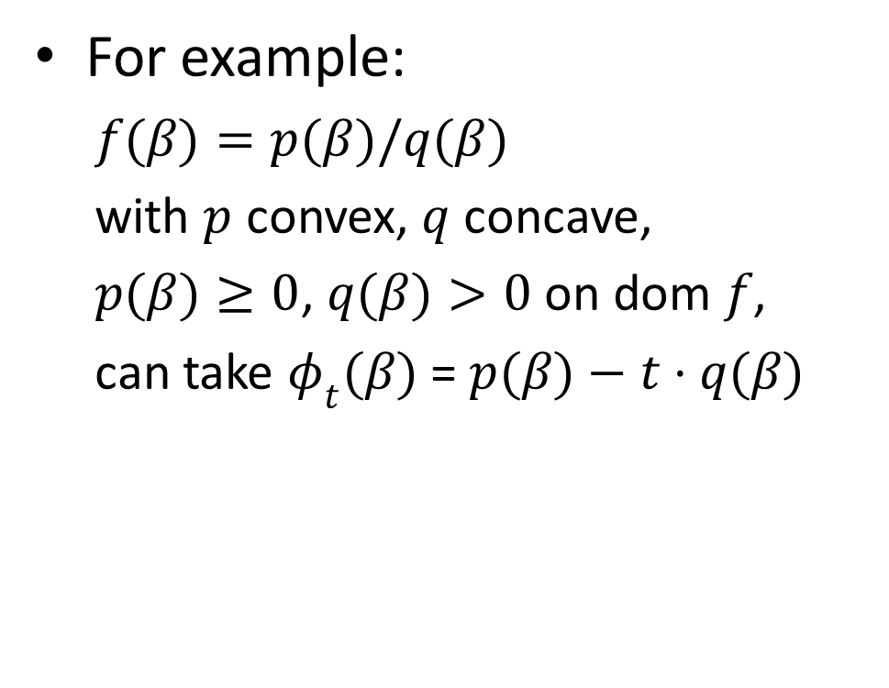
Convex Optimization says:
For example:
$f(β)=p(β)/q(β)$
with $p$ convex, $q$ concave,
$p(β)≥0$, $q(β)>0$ on dom $f$,
can take $φ_{t}(β)$ = $p(β)−t⋅q(β)$

Slide 14
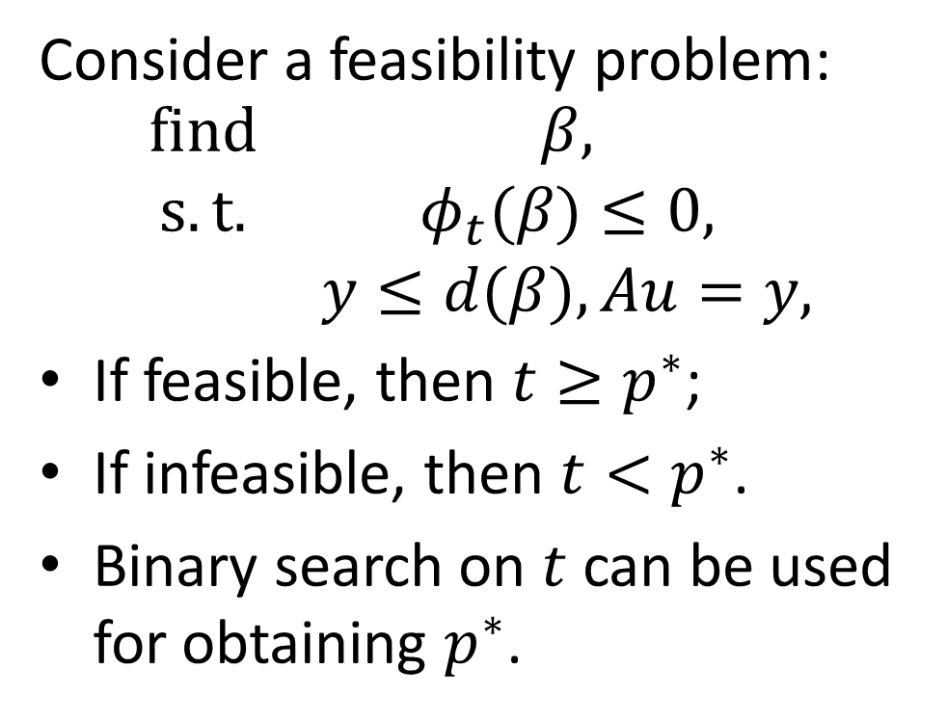
Convex Optimization says:
Consider a feasibility problem:
$$\begin{matrix}find & β, \\ s. t. & φ_{t}(β)≤0, \\ & y≤d(β),Au=y,\end{matrix}$$
If feasible, then $t≥p^{∗}$;
If infeasible, then $t<p^{∗}$.
Binary search on $t$ can be used for obtaining $p^{∗}$.

Slide 15
Quasi-convex Network Problem
Again, the feasibility problem can be solved efficiently by the bisection method or the ellipsoid method, together with the negative cycle detection technique.
Q. Any EDA’s applications ???

Slide 16
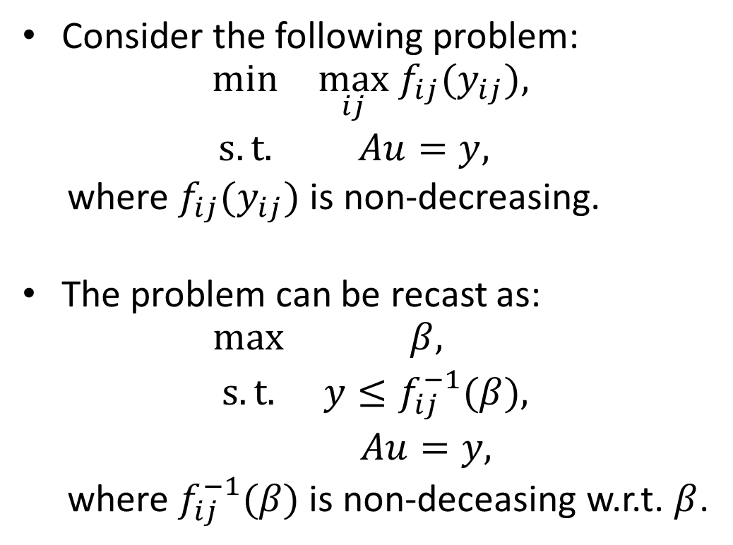
Monotonic Minimization
Consider the following problem:
$$\begin{matrix}min & \max_{ij} f_{ij}(y_{ij}), \\ s. t. & Au=y,\end{matrix}$$
where $f_{ij}(y_{ij})$ is non-decreasing.
The problem can be recast as:
$$\begin{matrix}max & β, \\ s. t. & y≤f_{ij}^{−1}(β), \\ & Au=y,\end{matrix}$$
where $f_{ij}^{−1}(β)$ is non-deceasing w.r.t. $β$.

Slide 17
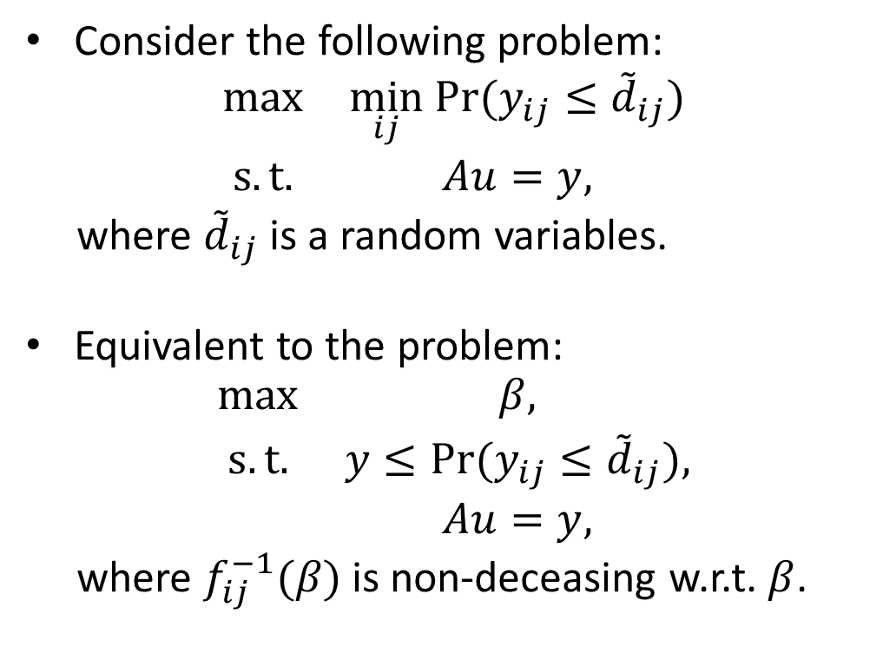
E.g. Yield-driven Optimization
Consider the following problem:
$$\begin{matrix}max & \min_{ij} Pr(y_{ij}≤{\tilde{d}}_{ij}) \\ s. t. & Au=y,\end{matrix}$$
where ${\tilde{d}}_{ij}$ is a random variables.
Equivalent to the problem:
$$\begin{matrix}max & β, \\ s. t. & y≤Pr(y_{ij}≤{\tilde{d}}_{ij}), \\ & Au=y,\end{matrix}$$
where $f_{ij}^{−1}(β)$ is non-deceasing w.r.t. $β$.

Slide 18
E.g. Yield-driven Optimization
Let F_{ij}(x) is the cdf of d_{ij}.
Then:
β ≤ Pr(y_{ij} ≤ d_{ij})
=> β ≤ 1 – F_{ij}(y_{ij})
=> y_{ij} ≤ F_{ij}⁻¹(1 – β)
The problem becomes:
maximum β
subject to y_{ij} ≤ F_{ij}⁻¹ (1 – β),
A u = y

Slide 19
E.g. Yield-driven Optimization
If d_{ij} is a Gaussian random variable with mean d_{ij} and variance s_{ij}.
Then the problem further reduces to:
maximum β
subject to y ≤ d – s β,
A u = y

Slide 20
Network flow says:
Monotonic problem can be solved efficiently using cycle-cancelling methods such as Howard’s algorithm.

Slide 21
MIN-COST flow problem

Slide 22
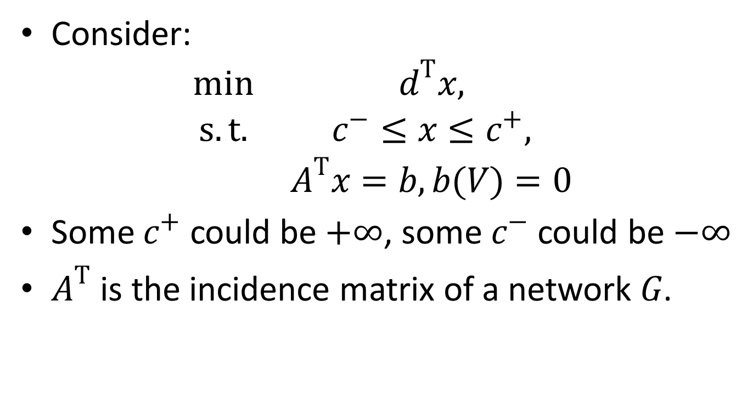
Min-Cost Flow Problem (linear)
Consider:
$$\begin{matrix}min & d^{T}x, \\ s. t. & c^{−}≤x≤c^{+}, \\ & A^{T}x=b,b(V)=0\end{matrix}$$
Some $c^{+}$ could be $+∞$, some $c^{−}$ could be $−∞$
$A^{T}$ is the incidence matrix of a network $G$.

Slide 23
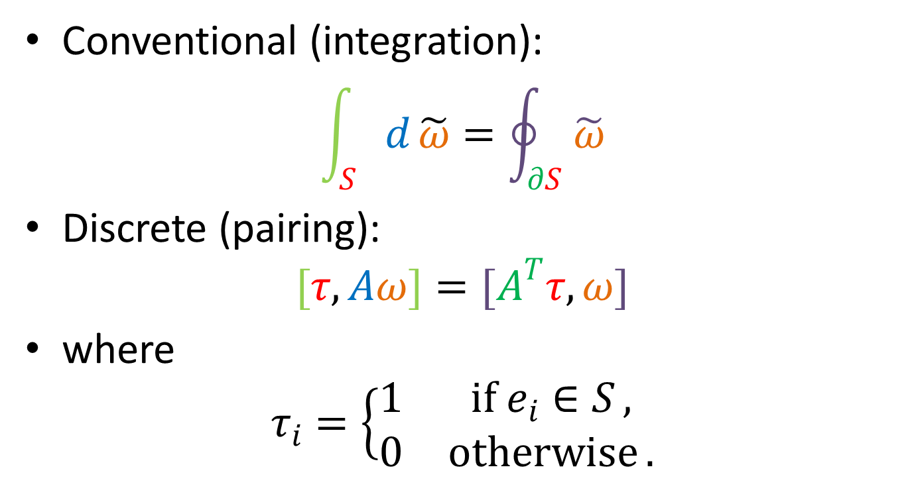
Conventional (integration):
$$\int_{S}{d}\tilde{ω}=\oint_{∂S}{\tilde{ω}}$$
Discrete (pairing):
$$[τ,Aω]=[A^{T}τ,ω]$$
where
$$τ_{i}=\left\{\begin{matrix}1 & if e_{i}∈S , \\ 0 & otherwise .\end{matrix}\right.$$

Slide 24
Conventional Algorithms
Augmented path based
Start from an infeasible solution
Inject minimal flow into the augmented path while maintaining infeasibility in each iteration
Stop when there is no flow to inject into the path
Cycle cancelling based
Start from a feasible solution x₀
find a better sol’n x₁ = x₀ + α∆x, where α is positive.

Slide 25
General Descent Method
Input: a starting x ∈ dom f
Output: x*
repeat
Determine a descent direction ∆x.
Line search. Choose a step size α > 0.
Update. x := x + α ∆x
until a stopping criterion is satisfied;

Slide 26
Some Common Descent Directions
For convex problems, the search direction must satisfy ∇f(x)^{T}∆x < 0.
Gradient descent:
∆x = –∇f(x)^{T}
Steepest descent:
∆x_{nsd} = argmin{ ∇f(x)^{T} v | ||v|| = 1}.
∆x_{sd} = ||∇f(x)||∆x_{nsd} (un-normalized)
Newton’s method:
∆x = –∇²f(x)⁻¹∇f(x)

Slide 27
Network flow says:
Here, there is a better way to choose ∆x!
Let x₁ = x₀ + α∆x, then we have:
min d^{T} x₀ + αd^{T}∆x => d^{T}∆x < 0
s. t. c––x₀ ≤ α∆x ≤ c⁺ – x₀ => residual graph G_{x}
A^{T} ∆x = 0 => ∆x is a cycle!
In other words, choose ∆x to be a negative cycle with cost d!
Simple negative cycle, or
Minimum mean cycle

Slide 28
Network flow says:
Step size is limited by the capacity constraints:
α₁ = min_{ij} {c⁺ – x₀}, for ∆x_{ij} > 0
α₂ = min_{ij} {x₀ – c–}, for ∆x_{ij} < 0
α_{lin} = min{α₁, α₂}
If α_{lin} = +∞, the problem is unbounded.

Slide 29
Network flow says:
An initial feasible solution can be obtained by a similar construction of residual graph and cost vector.
The LEMON package implements this cycle cancelling algorithm.

Slide 30
Min-Cost Flow Convex Problem
Problem Formulation:
min f(x) <----- convex
s. t. 0 ≤ x ≤ c
A^{T} x = b, b(V) = 0

Slide 31
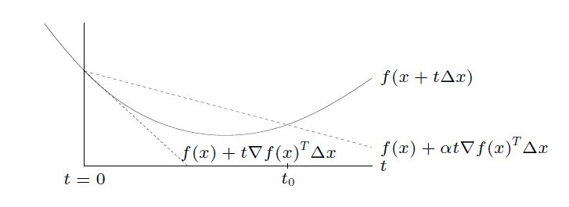
Common Line Search Types
Exact line search: t = argmin_{t>0} f(x + t∆x)
Backtracking line search (with parameters α ∈ (0,1/2), β ∈ (0,1))
starting at t = 1, repeat t := βt until
f(x + t∆x) < f(x) + αt∇f(x)^{T} ∆x
graphical interpretation: backtrack until t ≤ t₀

Slide 32
Network flow says:
The Step size is further limited by:
α_{cvx} = min{α_{lin}, t}
In each iteration, choose ∆x as a negative cycle of G_{x}, with cost ∇f(x) such that ∇f(x)^{T} ∆x < 0

Slide 33
Quasi-convex Minimization
Problem Formulation:
min f(x) <---- quasi-convex
s. t. 0 ≤ x ≤ c
A^{T} x = b, b(V) = 0
The problem can be recast as:
min t
s. t. f(x) ≤ t,
0 ≤ x ≤ c
A^{T} x = b, b(V) = 0

Slide 34
Convex Optimization says:
Consider a convex feasibility problem:
find x
s. t. φ_{t}(x) ≤ 0, (2)
0 ≤ x ≤ c
A^{T} x = b, b(V) = 0
if feasible, we can conclude that t ≥ p*;
if infeasible, t ≤ p*
Binary search on t can be used for obtaining p*.

Slide 35
Network flow says:
Choose ∆x to be a negative cycle of G_{x} with cost ∇φ_{t}(x)
If no negative cycle is found, and φ_{t}(x) > 0, we conclude that problem (2) is infeasible.
Iterate until x becomes feasible, i.e. φ_{t}(x) ≤ 0.

Slide 36
E.g. Linear-Fractional Cost
Problem Formulation:
min (e^{T}x + f) / (g^{T}x + h)
s. t. 0 ≤ x ≤ c
A^{T} x = b, b(V) = 0
The problem can be recast as:
min t
s. t. (e^{T}x + f) – t(g^{T}x + h) ≤ 0
0 ≤ x ≤ c
A^{T} x = b, b(V) = 0

Slide 37
Convex Optimization says:
Consider a convex feasibility problem:
find x
s. t. (e – t∗g)^{T}x + (f – t∗h) ≤ 0,
0 ≤ x ≤ c
A^{T} x = b, b(V) = 0
if feasible, we conclude that t ≥ p*;
if infeasible, t ≤ p*
Binary search on t can be used for obtaining p*.

Slide 38
Network flow says:
Choose ∆x to be a negative cycle of G_{x}, with cost (e – t∗g), i.e. (e – t∗g)^{T}∆x < 0
If no negative cycle is found, and (e – t∗g)^{T}x₀ + (f – t∗h) > 0, we conclude that the problem is infeasible.
Iterate until (e – t∗g)^{T}x₀ + (f – t∗h) ≤ 0.

Slide 39
E.g. Statistical Optimization
Consider the problem:
min Pr(d^{T}x > α) <--- quasi-convex
s. t. 0 ≤ x ≤ c
A^{T}x = b, b(V) = 0
d is random vector with mean d and covariance Σ.
hence, d^{T}x is a random variable with mean d^{T}x and variance x^{T}Σx.

Slide 40
Statistical Optimization
The problem can be recast as:
min t
s. t. Pr(d^{T}x > α) ≤ t
0 ≤ x ≤ c
A^{T}x = b, b(V) = 0
Note:
Pr(d^{T}x > α) ≤ t
=> d^{T}x + F⁻¹(1-t)||Σ^{½} x||₂ ≤ α
(convex quadratic constraint w.r.t x)

Slide 41

Recall that the gradient of d^{T}x + F⁻¹(1-t)||Σ^{½} x||₂ is
d + F⁻¹(1-t)(||Σ^{½} x||₂)⁻¹Σ x

Slide 42
Problem w/ additional Constraints
Problem Formulation:
min f(x)
s. t. 0 ≤ x ≤ c
A^{T} x = b, b(V) = 0
s^{T} x ≤ γ <----- added

Slide 43
E.g. Yield-driven Delay Padding
Consider the following problem:
maximum γ β – c^{T}p
subject to β ≤ Pr(y_{ij} ≤ d_{ij} + p_{ij}),
A u = y, p ≥ 0
p: delay padding
γ: weight (determined by a trade-off curve of yield and buffer cost)
d_{ij}: Gaussian random variable with mean d_{ij} and variance s_{ij}.

Slide 44
E.g. Yield-driven Delay Padding
The problem is equivalent to:
maximum γ β – c^{T}p
subject to y ≤ d – β s + p,
A u = y, p ≥ 0
or its dual:
minimize d^{T} x
subject to 0 ≤ x ≤ c
A^{T} x = 0,
s^{T} x ≤ γ

Slide 45
Considering Barrier Method
Approximation via logarithmic barrier:
min f(x) + (1/t) φ(x)
s. t. 0 ≤ x ≤ c
A^{T} x = b, b(V) = 0
where φ(x) = –log (γ – s^{T} x)
Approximation improves as t → ∞
Here, ∇φ(x) = s / (γ – s^{T} x)

Slide 46
Barrier Method
Input: a feasible x, t := t⁽⁰⁾, µ > 1, tolerance ǫ > 0
Output: x*
repeat
Centering step. Compute x*(t) by minimizing t f + φ
Update. x := x*(t).
Increase t. t := µt.
until 1/t < ǫ;
👉 Note: Centering is usually done by Newton’s method in general.

Slide 47

$$\begin{matrix}min & d^{T}x_{0}+αd^{T}p & ⇒d^{T}<0 \\ s. t. & −x_{0}≤αp≤c−x_{0} & ⇒residual graph \\ & A^{T}p=0 & ⇒p is a cycle!\end{matrix}$$

Slide 48
Network flow says:
In the centering step, instead of using the Newton descent direction, we can replace it with a negative cycle on the residual graph.

Slide 49
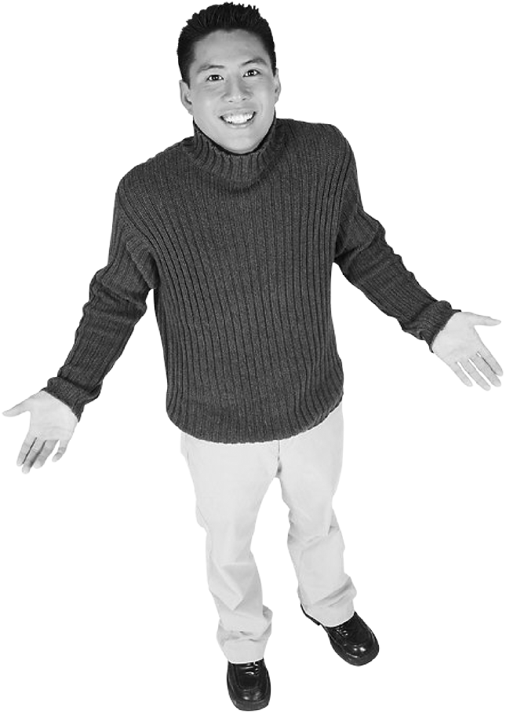
Not yet finish. Any good suggestion?

