Slide 1
Shazam Music Recognition
This is intro slide, pose a question then add history (when and how much money)

Slide 2
Context + why it’s hard
CONTEXT: Developed in 1999 when smartphones didn’t exist, searching for audio itself instead of names, used to have to dial 2580 and receive song name by SMS, then developed into an app and sold to apple in 2018 for $400 Million
WHY HARD: Brief clip, Heavy ambient noise, Reverb, Overlapping voices, Bad microphone - clipping, dropouts, EQ changes
Compare to millions of songs very quickly, & no false matches: EG waveform fails
Like identifying a person’s speech in a noisy crowd amongst millions of people.

Slide 3
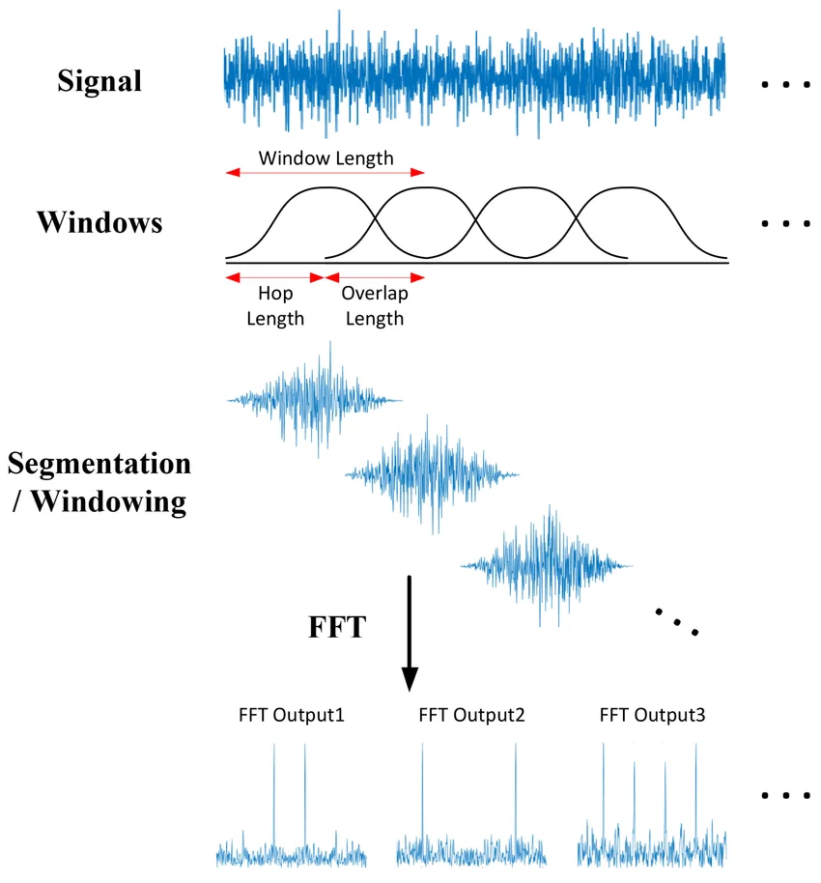


The Fourier Transform
Waveform = Air Pressure/Time
Order of Musical Frequencies
Short-
Term
Fourier Transform
Fast
Frequency
Time

Slide 4

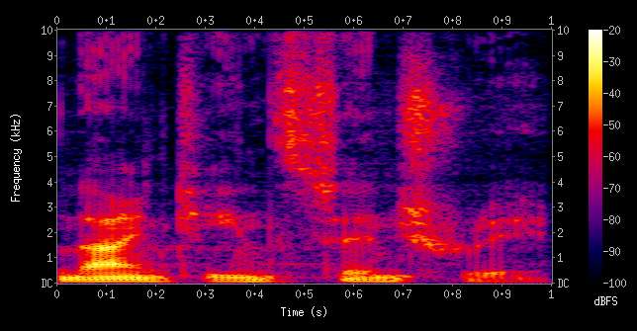
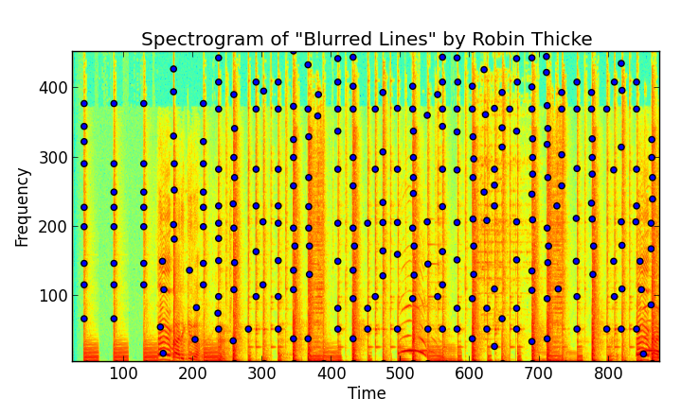
Separate Fourier Transform Results
Spectrograms & Peak Detection
Stacking the results of multiple Fourier Transforms forms a spectrogram
Isolate the strongest peaks - easier to search and can survive audio distortions
Spectrogram

Slide 5
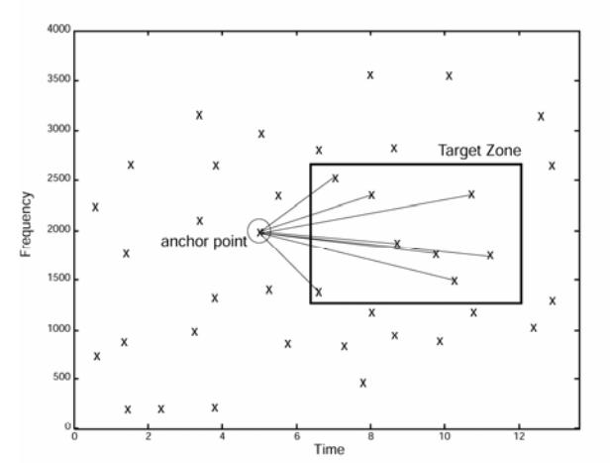
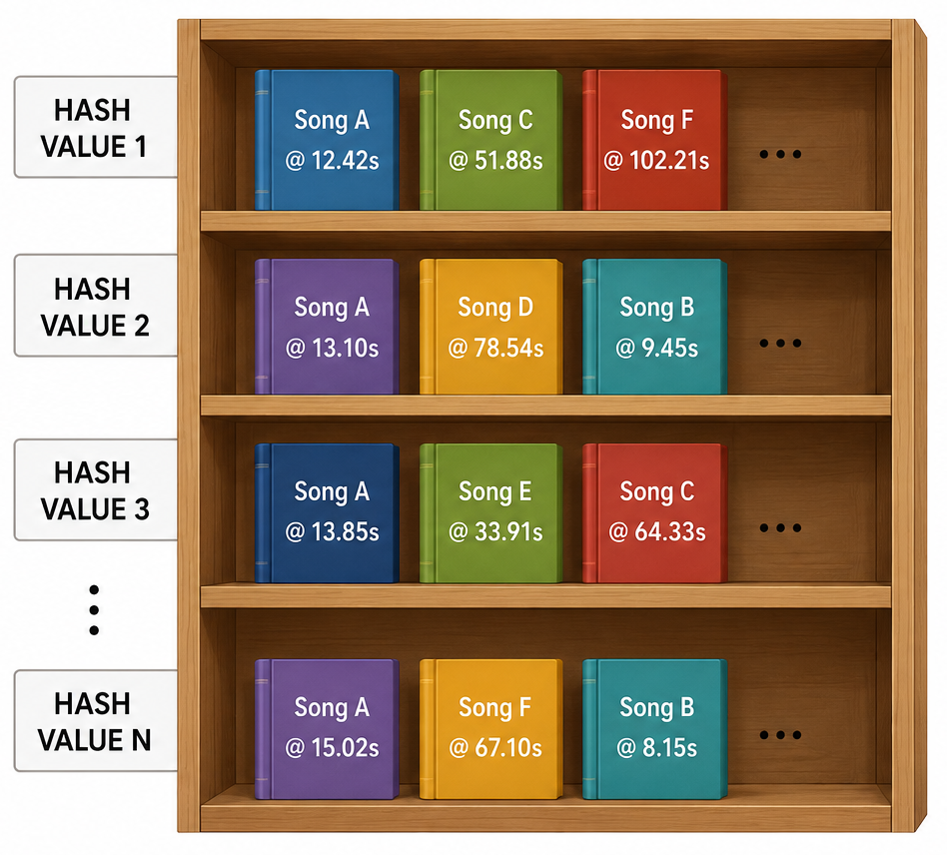
Matching the Fingerprint (Hashing + Searching)
Each peak is paired with those in a target zone shortly after:
Each peak pair records both frequencies and their time difference
This is then hashed into a 32 bit integer - easier to look up in a database
Each hash value = a shelf
Each book = song + timestamp
Offset = timestamp - time in recording
Enough votes for the same song + offset = the song
(e.g. An anchor peak at 1200 Hz paired with a peak at 2400 Hz 0.3 s later would give f₁=1200, f₂=2400, Δt=0.3)

Slide 6
Live Demo
The demo should do the teaching

Slide 7
Ai + embeddings
Everything we've seen so far is traditional computer science. Shazam searches for exact fingerprints. AI systems work differently—they learn vector embeddings that place similar items close together.

Slide 8
Vector Search

Slide 9
Conclusion

